Slide 1



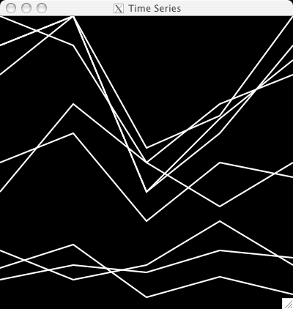

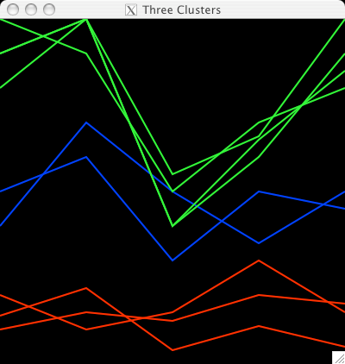

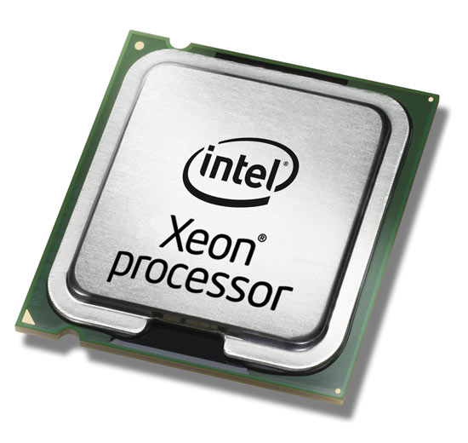
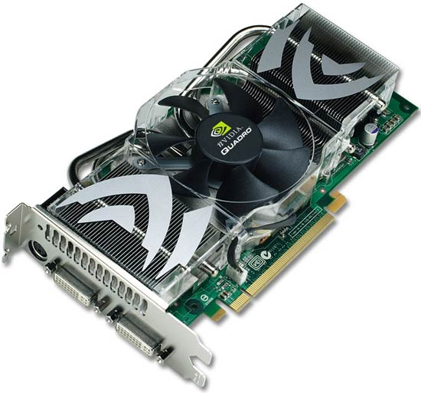
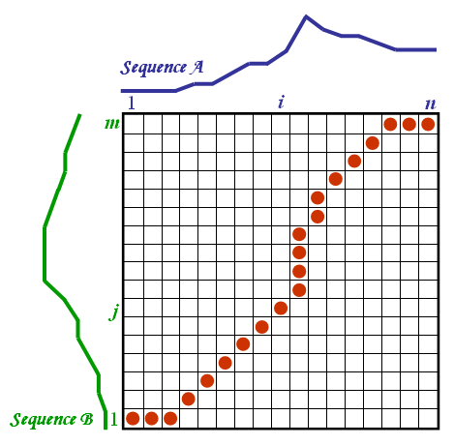

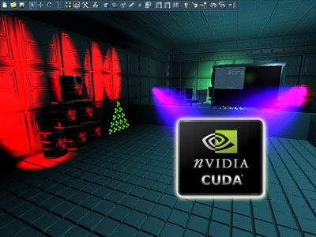
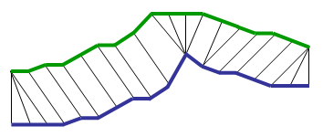
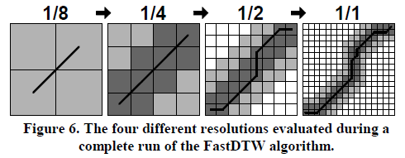
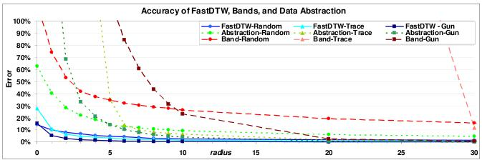
Giovani ricercatori cercansi 2010
Junge Forscher gesucht 2010
A Web-based platform for experimental design and
time series analysys
Fabiano Lever, Federico Scrinzi, Matteo Poletti, Severino Zeni
With acknowledgement to:
Cesare Furlanello and Marco Grimaldi
1. Background
Our web-platform provides a variety of machine learning and data mining tools for time series analysis.
Clustering tools:
  K-Means
  K-Medoid They are all based
Classification tools: on a similarity or distance.
  K-NN
We implement different time series similarity metrics:
Euclidean distance
Pearson linear coefficient
Dynamic Time Warping1
4. Computational cost drawback
The major drawback in adopting the standard DTW distance as similarity measure is its computational cost: given two time series of length M and N, its computational cost is O(MN). Thus, mining very large databases of time-series adopting the DTW as similarity measure may become a prohibitive task. We developed Fast DTW which helped us to reach good performance but we also decided to test recent advances in computational solution by employing technologies based on GPU Computing.
Clustering algorithm
5. GPGPU
2. Dynamic Time Warping
Dynamic time warping (DTW) is a time series alignment algorithm developed originally for speech recognition. It aims at aligning two sequences of feature vectors by warping the time axis iteratively until an optimal match (according to a suitable metrics) between the two sequences is found.
Consider two sequences of feature vectors:
The two sequences can be arranged on the sides of a grid, with one on the top and the other up the left hand side. Both sequences start on the bottom left of the grid.
Inside each cell a distance measure can be placed, comparing the corresponding elements of the two sequences. To find the distance between the time series a shortest path algorithm calculates the best route through the grid.
The power of DTW is that it is an advanced methodology for time series comparison. The DTW calculates the distance between two time series taking into account their characteristic shapes.
The major drawback of this algorithm is that it is quadratic in time samples.
We had to perform this algorithm on a huge number of time series so it required a lot of time! We looked for other similar techniques to get a similar result in a shortest span of time.
Graphics processing units (GPUs) are special processors which traditionally were used to accelerate computer graphics by offloading work from the CPU. Today, GPUs are highly parallel many-core processors which enable general-purpose computation on graphics processing units (GPGPU).
GPGPU is a new technology that consists in using GPU for mathematical calculation instead of only graphics for games. GPU offers a huge number of core and allows to parallelize computations, increasing computation power.
We based our work on Nvidia CUDA³ and two SLi Nvidia Quadro FX 3800 video cards.
CPU vs. GPU
– Intel 3.0 GHz Pentium 4
12 GFLOPs peak (MAD)
5.96 GB/s to main memory
– Nvidia Quadro FX 3800
150 GFLOPs peak (fragment engine)
51.2 GB/s to video memory
CPU → optimized for high performance on sequential codes
  – Really fast caches (great for data reuse)
  – Fine branching granularity
  – Lots of different processes/threads
  – High performance on a single thread of execution
GPU → Designed for higher arithmetic intensity for parallel nature
  – Lots of math units
  – Fast access to onboard memory
  – Run a program on each fragment/vertex
  – High throughput on parallel tasks
3. Fast DTW
Fast DTW¹ is a variation of the original DTW algorithm that sacrifices precision for speed. The end result is that this approach is almost linear with the number time samples.
approximation of DTW that has a linear time and space complexity.
FastDTW uses a multilevel approach that recursively projects a solution from a coarse resolution and refines the projected solution.
We adopt GPGPU technologies because their cost-effective computational power.
The charts indicate clearly that GPGPU offer large improvements in terms of computational time when compared to standard CPU-based solutions. Standard DTW-GPU is up to 14 times faster than DTW-CPU. Also in the case of using FAST-DTW on CPU, our GPU implementation of the standard DTW shows better performance (up to 6,5 times faster).
Furthermore, the FastDTW algorithm suffers of a somewhat decreased accuracy in the estimation of the distance between the time-series.
In the future we plan to adopt the OpenCL API, which is an open standard for GPGPU computing, not bound to the Nvidia hardware and programming language.
As it's possible to notice from the graphs, FastDTW is really efficient compared with the standard DTW. The margin of error is inconsiderable if a radius bigger than 20 it's used.
Tool
Tool
DTW
DTW
DTW
DTW
CPU
GPU
GPU
GPU
Refereces:
¹ FastDTW: Toward Accurate Dynamic Time Warping in Linear Time and Space, Stan Salvador and Philip Chan, Florida Institute of Technology
Melbourne, FL 32901
² NVIDIA CUDA (Compute Unified Device Architecture) Programming Guide, Nvidia Corporation (http://developer.download.nvidia.com/)
Results
Results
CPU computing
GPU computing

