Slide 1
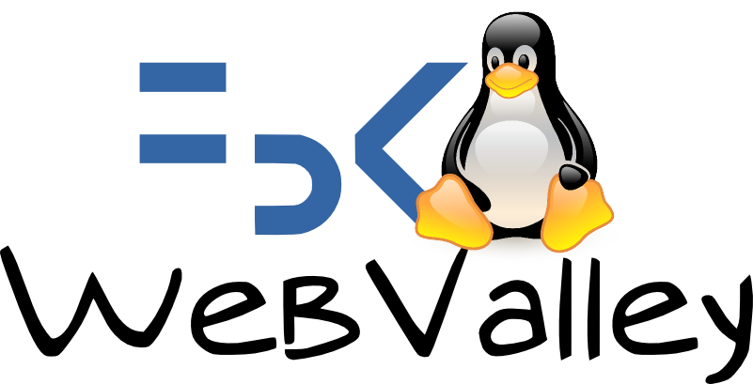


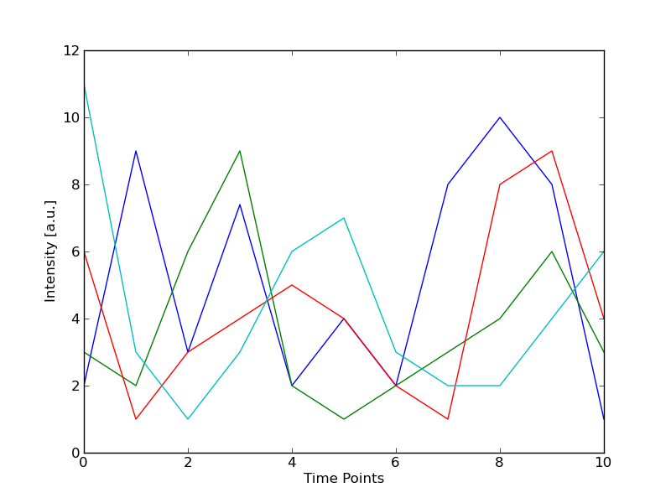
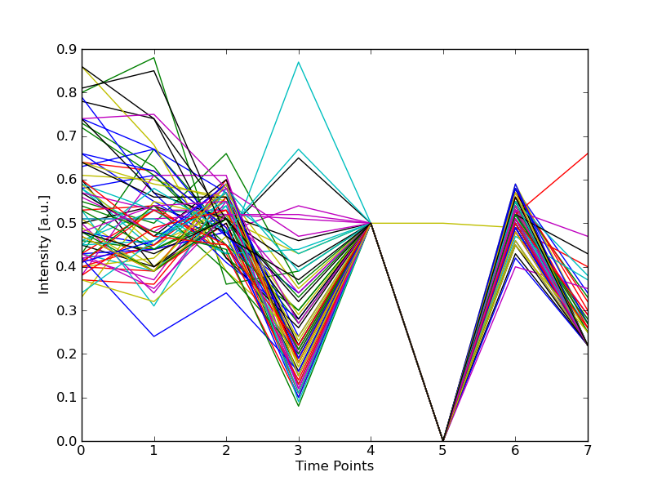
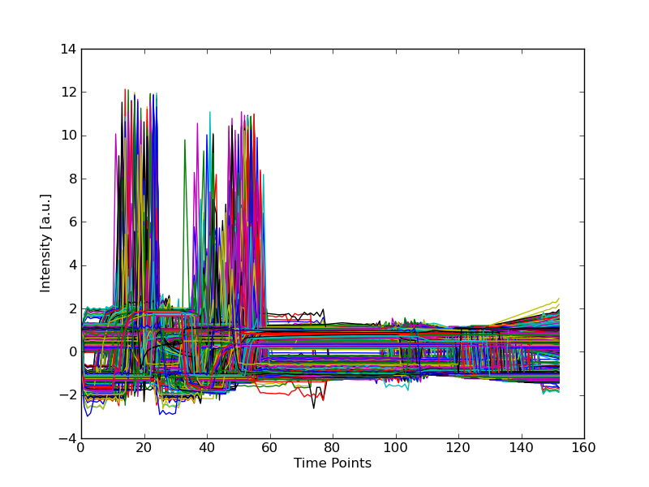

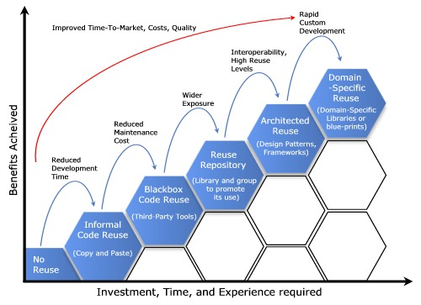

Giovani ricercatori cercansi 2010
Junge Forscher gesucht 2010
A Web-based platform for experimental design and time series analysis
Galaxy and our work
Fabiano Lever, Federico Scrinzi, Matteo Poletti, Severino Zeni
With acknowledgements to: Cesare Furlanello and Marco Grimaldi
1. Introduction
3. Galaxy
Science and research produce huge amounts of data that have to be processed using computers. One of the aims of our project is to create an easy-to-use, accessible and efficient platfrom for data mining and machine learning.
“Galaxy”¹ is a web-based framework of interactive tools for comparative genomics, targeting both experimental and computational biologists. The software is developed by the Center for Comparative Genomics and Bioinformatics of Pennsylvania State University².
“Galaxy allows you to do analyses you cannot do anywhere else without the need to install or download anything. You can analyze multiple alignemnts, compare genomic annotations, profile metagenomic samples and much much more..”.
In spite of the fact it is developed for genomic analysis, Galaxy is extremely scalable and versatile. Since
the software is released under an Open Source license and we modified it according to our needs.
We developed new time series analysis tools and integrated them into Galaxy, thus expanding the usage of the software to other research fields.
Furthermore, we wrote additional interfaces to manipulate data-sets and convert them in standard formats for easier analysis.
We had to find a possible solutions to different problems:
The amount of data to be processed is increasingly larger
Possibility of sharing
Importance of tools that allow to work from several different
places
Possibility to share computation facilities
ICT potentialities to provide research with powerful tools
Advantages:
Extremely versatile and customizable in an easy way
Designed for Research
Suports workflows and e history of operations
Supports various DBMS (SQLite, MySQL, ecc...)
It has its own web server
Cloud-computing support
Researchers
Galaxy
We chose to offer tools for data analysis of time series because they are used in nearly any research field, from finance to genomics.
We decided to implement simple algorithms for data mining and machine learning, for clustering and classification.
Disadvantages:
Offers tools only for biologists and genetists
It doesn't offer any tool for other research
fields (neither a plotting system)
Relatively young and not mature project
2. Why a Web-based platform?
Developers
A web-based interface is the perfect tool to connect users and resources remotely. In our scenario, the user is a researcher (that can also be an IT newbie) that intends to carry out some basic analysis on time-series data-sets and share the data itself, the procedures and the results with colleagues.
We aim ot creating an easy-to-use interface to the the basic tools we developed. We decided to adopt a web platform because:
It's accessible from everywhere and with very diverse appliances:
there's no need of any special program installed on local PCs in order
to use it: all it is needed is a web browser.
Computing resources are centralized and the software can be
optimized for the characteristics (hardware) of the server.
The local computer shows only an interface to the server, every job is
carried out there
It's easier to share data and information because everything is
centralized
Researcher
Researcher
Researcher
4. Reproducibility and sharing
Network
“Reproducibility is one of the main principles of the scientific method, and refers to the ability of a test or experiment to be accurately reproduced, or replicated, by someone else working independently.”
Wikipedia
“In today's environment, hoarding knowledge ultimately erodes your power. If you know something very important, the way to get power is by actually sharing it.”
Joseph Badaracco
Web interface
Computing resources
Procedures
Data
Galaxy offers by default tools useful for researchers.
Two of them are fundamental for a collaboration between scientists: history and workflows³.
History keeps record of the analysis steps: every step of your analyses
is recorded in Galaxy's history system. Users can have any number of
histories saved.
In this way reaserahcer can revise analyses done in the past.
Sharing analyses: Alice works at Penn State, while Carlo works in
Trento. Alice wants Carlo to see her analyses.
Alice clicks the “share” link and enters Carlo's e-mail address. Now
Alice’s history is visible to Carlo!
By extensive usage of workflows and histories, it is possible to facilitate communication among scientists and improve the reproducibility of their results. By sharing results, data and procedures, any researcher can reproduce someone else's work using the same input data, the same workflow and the same system.
We based the designing and developing processes of the system on the sharing principles of Open Source. In this way we have concentrate our efforts in providing powerful tools and libraries for data mining and analysis, while avoiding to invest large amount of time in debugging a brand new web interface or worrying about its security. Furthermore, by adopting an Open Source philosophy, we can share our work with others and allow further development and integration of the platform
Refereces:
¹ Giardine, B., Riemer, C., Hardison, R.C., Burhans, R., Elnitski, L., Shah, P., Zhang, Y., Blankenberg, D., Albert, I., Taylor, J., et al. (2005) Galaxy: a platform for interactive large-scale genome analysis Genome Res, . 15, 1451–1455
² http://www.bx.psu.edu/
³ Yolanda Gil, Ewa Deelman, Mark Ellisman, Thomas Fahringer, Geoffrey Fox, Dennis Gannon, Carole Goble, Miron Livny, Luc Moreau, Jim Myers. Examining the Challenges of Scientific Workflows, Computer In Computer, Vol. 40, No. 12. (2007), pp. 24-32
⁴ Three Myths about Dynamic Time Warping Data Mining, Chotirat Ann Ratanamahatana Eamonn Keogh. Department of Computer Science and Engineering, University of California, Riverside, CA
⁵ Derivative Dynamic Time Warping, Eamonn J. Keogh and Michael J. Pazzani.

Slide 2
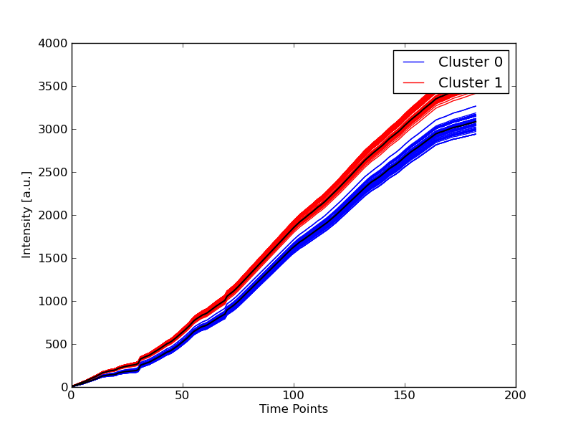


Giovani ricercatori cercansi 2010
Junge Forscher gesucht 2010
A Web-based platform for experimental design and time series analysis
Galaxy and our work
Fabiano Lever, Federico Scrinzi, Matteo Poletti, Severino Zeni
With acknowledgements to: Cesare Furlanello and Marco Grimaldi
5. Our work
We focused our work on time series analysis. A time series is a sequence of data points, measured typically at successive times, spaced at uniform time intervals (eg.: variation of temperature, stock price, etc...).
We offer some tools to process large data-sets through clustering and classification algorithms and to display them in a graphical or textual way.
Our work was modular: we tried to organize our software in a smart way in order to promote re-usage of the source code. We developed Python modules of the algorithms, then we wrote scripts to test them and finally we integrated them into Galaxy.
This kind of approach makes the libraries and the scripts an independent part which can be used in other software products from other developers.
The source code we wrote is released under the terms of the GNU General Public License v3.
Clustering
K-Medoid
K-Means
Classification
K-NN
Tools
(Python scripts)
Clustering tools
Classification tools
Display data/Plotting tools
Dataset manipulation
Libraries
(Python/C/CUDA modules)
calc_dist
dtw_cpu
dtw_gpu
iodata
kmeans
kmedoid
knn
Metrics
Euclidean distance
Dynamic Time Warping⁴
Derivative Dynamic Time
Warping⁵
Pearson's correlation
coefficient
Web-platform
6. Conclusions and future work
We created a prototype of a powerful platform for scientific analysis using different technologies and techniques.
Achievements:
Great computation power obtained with various techniques (in particular GPGPU)
It's possible to use the platform from everywhere with any gadget that provides a web browser
Easy-to-use
Easy to share information, data and procedures (using history and workflows)
Another thing we succeded in is that we worked only through the Internet and we made the most of online collaboration tools (wikis, mailing lists and version control systems).
We will continue our work in the future trying to improve performance and to develop other, more sophysticated, tools to process time series and maybe other datatypes.
Refereces:
¹ Giardine, B., Riemer, C., Hardison, R.C., Burhans, R., Elnitski, L., Shah, P., Zhang, Y., Blankenberg, D., Albert, I., Taylor, J., et al. (2005) Galaxy: a platform for interactive large-scale genome analysis Genome Res, . 15, 1451–1455
² http://www.bx.psu.edu/
³ Yolanda Gil, Ewa Deelman, Mark Ellisman, Thomas Fahringer, Geoffrey Fox, Dennis Gannon, Carole Goble, Miron Livny, Luc Moreau, Jim Myers. Examining the Challenges of Scientific Workflows, Computer In Computer, Vol. 40, No. 12. (2007), pp. 24-32
⁴ Three Myths about Dynamic Time Warping Data Mining, Chotirat Ann Ratanamahatana Eamonn Keogh. Department of Computer Science and Engineering, University of California, Riverside, CA
⁵ Derivative Dynamic Time Warping, Eamonn J. Keogh and Michael J. Pazzani.

