Slide 1


A web-based platform for experimental design and time series analysis
Samedan, 15th and 16th of April 2010
Giovani ricercatori cercansi – Junge Forscher gesucht 2010
Fabiano Lever
Federico Scrinzi
Metteo Poletti
Severino Zeni

Slide 2
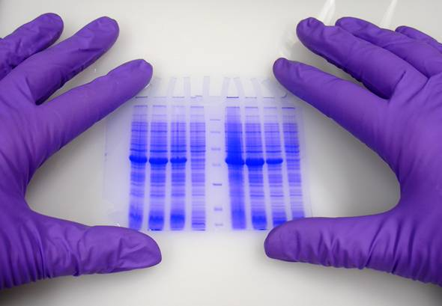
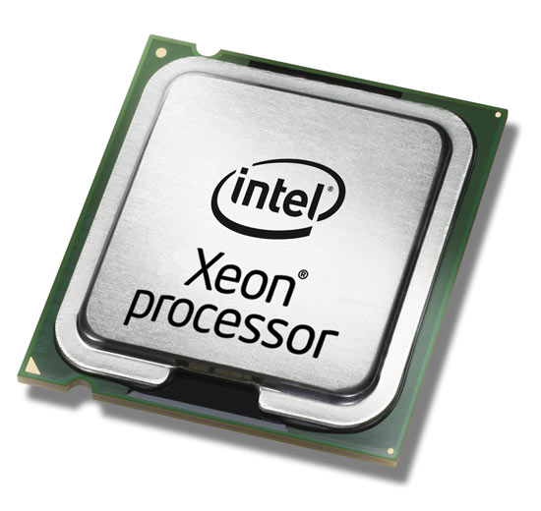
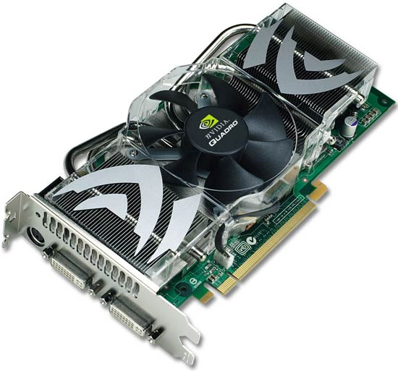

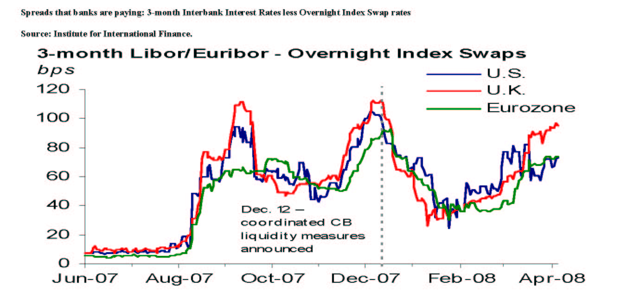

Computing
Resources
(CPU / GPU)
Research
Time series
analysis and
experimental
design tools
Produced data
(time series)
Result

Slide 3
Process and Analise Large Databases
Large amounts of data:
  difficult to process
  Hard to extract useful information
  May require specific technical
  knowledge to operate on.
Research produces
Huge amounts of data
Data/knowledge/... Sharing allows research to grow
up faster but it isn't simple
It's not simple to reproduce an
experiment made by another
researcher
Lack of a good tool to design
reproducible experiments
Large Data require large Computer facilities: really
expensive!
There is the need of dedicated appliances
to access computing resources
IT knowledge is often required to
run scientific experiments
Scientific problems
Technical problems

Slide 4

Possible solutions
Centralized computing resources
Accessible everywhere and with
any appliance (even a smartphone)
Easy-to-use
Possibility to share datasets,
experiments, procedures and results
Web-based platform
New technology which allows us
to build a powerful but cheap HPC
(High performance computing) system
GPGPU

Slide 5
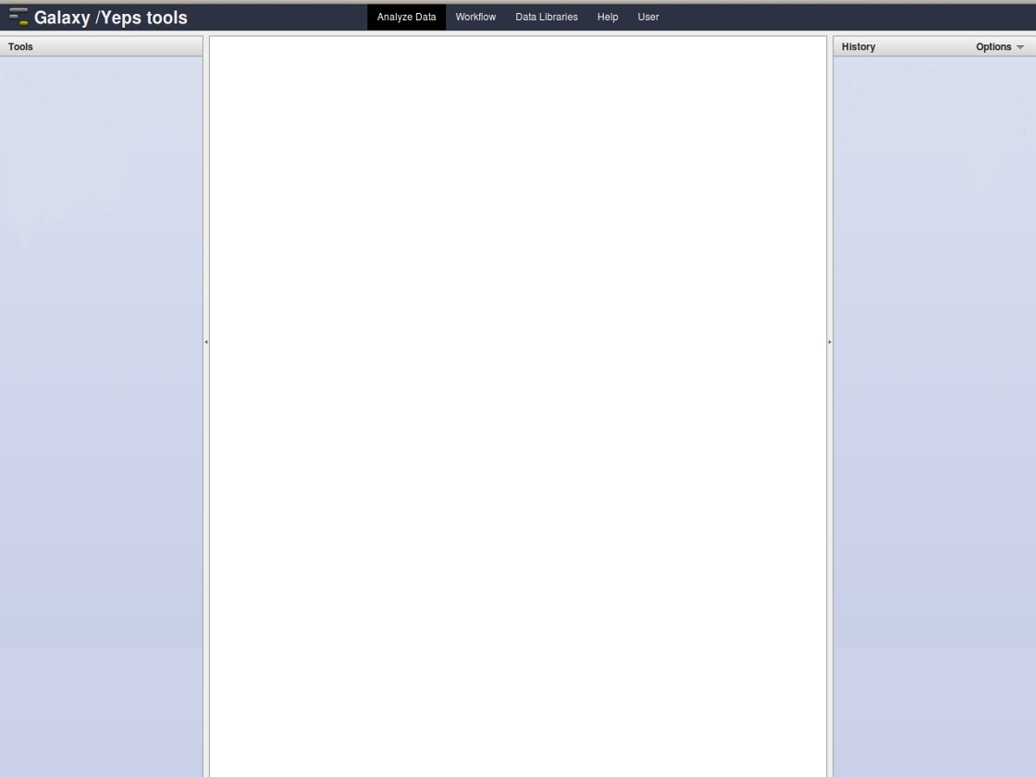
Galaxy
Easy-to-use
Easy to share
experiments and results
Centralized computing
resources
Scalable web framework
Versatile and extensible
Designed for research
Open source
Researchers
Developers
It is designed for biologists and includes a lot of tools only
for genomic analisys but not for other research fields.
We decided to:
write our own tools for time series analysis
which interests a lot of research areas
develop a plotting system to represent data
SCREENSHOT?
Meno parole

Slide 6
Time series analysis

Slide 7
Time series distance and DTW

Slide 8

GPGPU
The algorithms are computationally expensive.
GPGPU allows us to parallelize them and improve performances. GPU is probably nowadays the most powerful computational hardware taking into account the price.
Tool
Tool
DTW
DTW
DTW
DTW
CPU
GPU
GPU
GPU
Results
Results
CPU computing
GPU computing

Slide 9

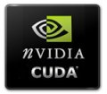




Free software and on-line collaboration
Web-platform
Plotting
Computing
Online Collaboration
Git + Wiki + Mailing List
C

Slide 10

Conclusions and future work
We set up a fully working server with our project. It is only a prototype but the development will continue in the future. It is our aim to further improve the performances of the analysis tools together with the addition of more sophisticated analysis modules.

