Slide 1

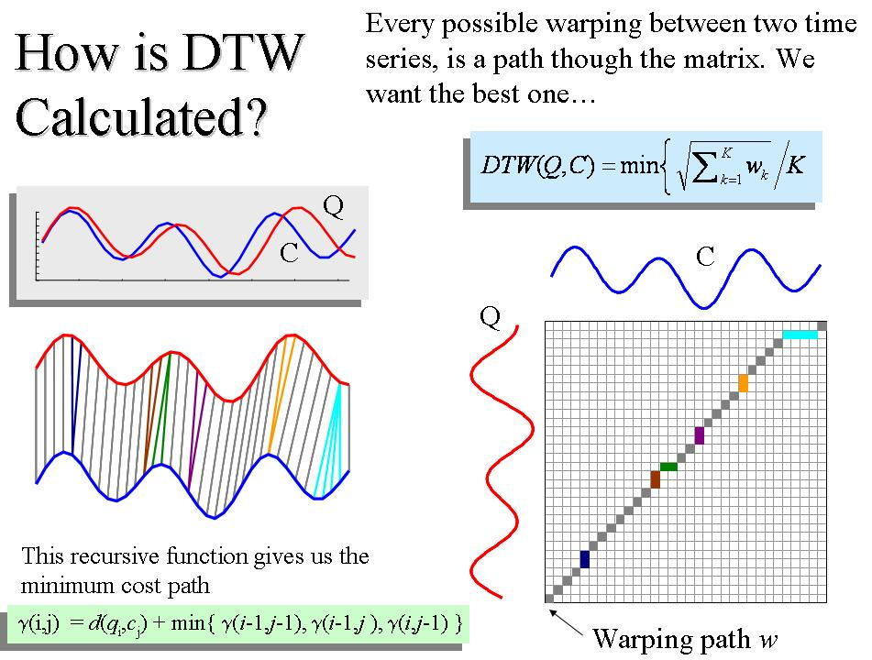
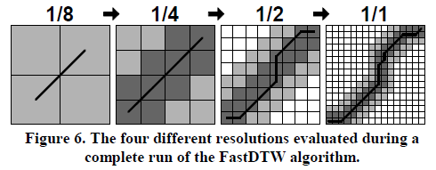
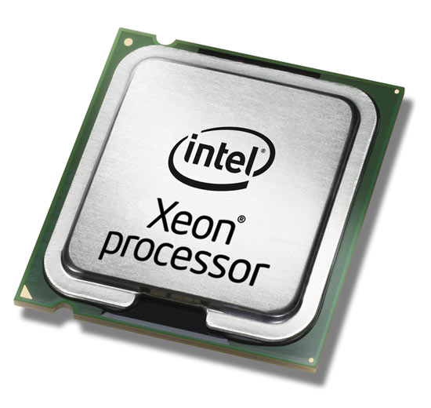

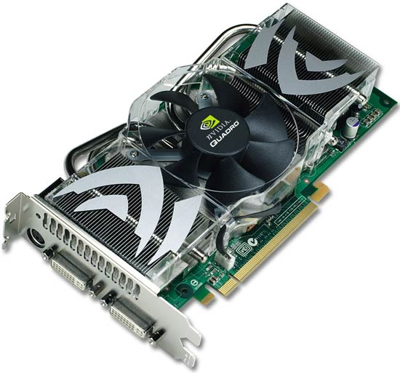
Giovani ricercatori cercansi 2010
Junge Forscher gesucht 2010
A Web-based platform for experimental design and
time series analysys
Fabiano Lever, Federico Scrinzi, Matteo Poletti, Severino Zeni
1. Background
In our web-platform we developed various tools for machine learning and data mining on time series.
Clustering tools:
  K-Means
  K-Medoid They are all based on time series similarity or distance.
Classification tools: So we needed an effective algorithm to calculate it.
  K-NN
We developed differente algoritms for that aim:
Euclidean distance
Pearson linear coefficient
Dynamic Time Warping
4. Computational cost
The major drawback in adopting the DTW distance as similarity measure is its computational cost: given two time series of length M and N, its computational cost is O(MN). Thus, mining very large databases of time-series adopting the DTW as similarity measure may become a prohibitive task. We developed Fast DTW which helped us to reach good performance but we wanted more. We looked for a new and more powerful technology.
5. GPGPU
General Purpose GPU is a new technology that consists in using GPU for mathematical calculation instead of only graphics for games. GPU offers a huge number of core and lets you parallelize computations.
We based our work on Nvidia CUDA³ and two Nvida Quadro FX 3800 video cards.
2. Dynamic Time Warping
Dynamic Time Warping (DTW) is the most reliable and advanced algorithm we developed. The calculated distance isn't affected by variation in speed or time of the time series but it's based on their characteristic shape.
We developed Derivative DTW¹ which is....
3. Fast DTW
Fast DTW² is a variation of the original DTW algorithm that sacrifices precision for speed. From the graph you can notice quite a big upscaling with operations on long series
Tool
Tool
DTW
DTW
DTW
DTW
CPU
GPU
GPU
GPU
Results
Results
Refereces:
¹Derivative Dynamic Time Warping, Eamonn J. Keogh and Michael J. Pazzani
²FastDTW: Toward Accurate Dynamic Time Warping in Linear Time and Space, Stan Salvador and Philip Chan
³NVIDIA CUDA (Compute Unified Device Architecture) Programming Guide, Nvidia Corporation
CPU computing
GPU computing

