Slide 1
A web-based platform for experimental design and time series analysis
Samedan, 15th and 16th of April 2010
Giovani ricercatori cercansi – Junge Forscher gesucht 2010
Project developed by:
Fabiano Lever
Federico Scrinzi
Metteo Poletti
Severino Zeni

Slide 2
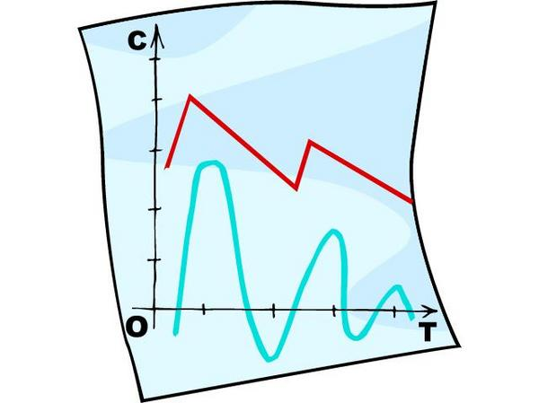
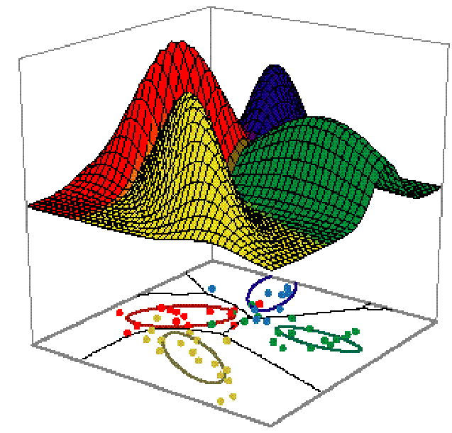
Process data produced by science
The problem is processing
that amount of data.
It's difficult to process it and extract
useful information.
Science produces a
huge amount of data
Sharing allows research to grow
up faster but it isn't simple
It's not simple to reproduce an
experiment made by another
researcher
Lack of a good tool to design
experiments
Computer clusters are really
expensive
You need dedicated appliances
to access computing resources
IT knowledge required even to
run an experiment
Scientifical problems
Technical problems

Slide 3

How to solve these problems?
Centralized computing resources
Accessible everywhere and with
any appliance (even a smartphone)
Easy-to-use
Possibility to share datasets,
experiments and results
Web-based platform
New technology which allows us
to build a powerful but cheap cluster
GPGPU

Slide 4
Galaxy
Scalable web framework
Versatile and extensible
Designed for research
Open source
Easy-to-use
Easy to share
experiments and results
Centralized computing
resources
Developers
Researchers
It is designed for biologists and includes a lot of tools only
for genomic analisys but not for other research fields.
We decided to:
write our own tools for time series analysis
which interests a lot of research areas
develop a plotting system to represent data

Slide 5
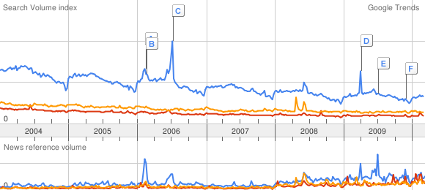
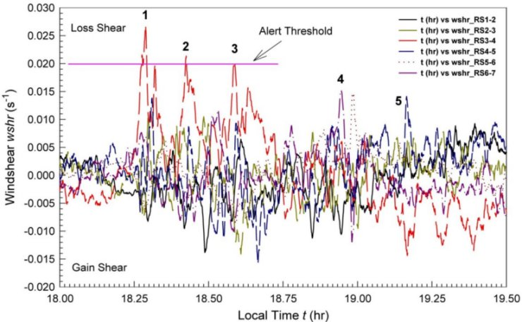
Time series analysis
We developed tools for:
Clustering
  K-Means
  K-Medoid
Classification
  k-NN
Useful to explore large amounts of data
(data-mining)
All these algorithms are
based on time series ”similarity”

Slide 6
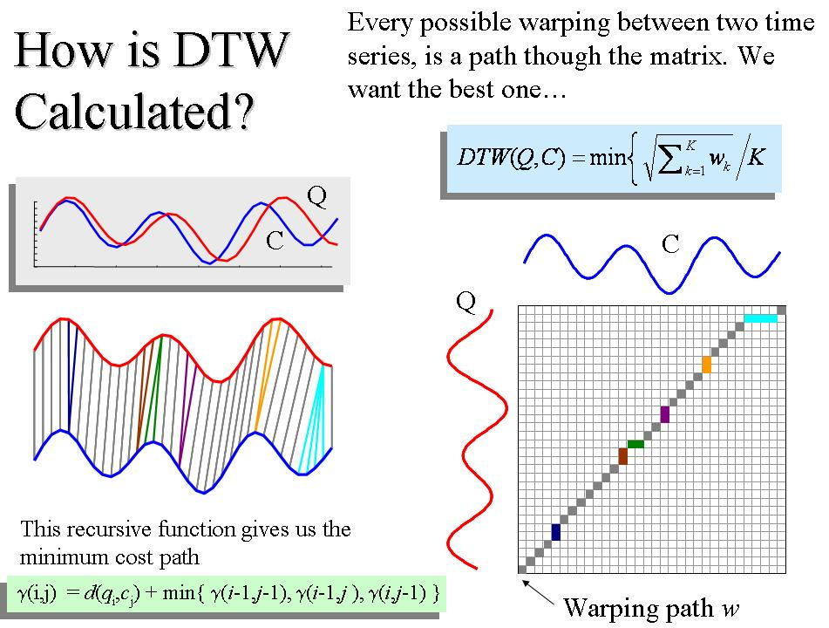
Time series distance and DTW
Dynamic Time Warping (DTW) is an algorithm that calculates similarity (distance) between time series

Slide 7
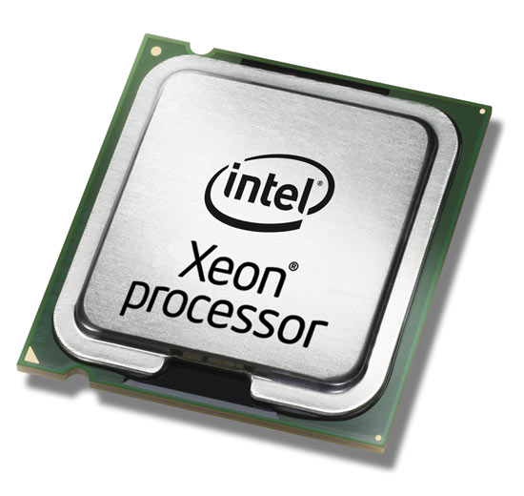

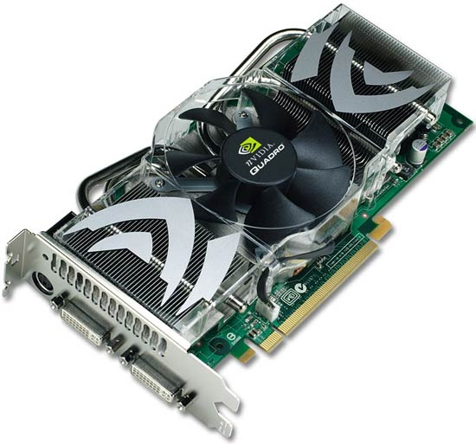
GPGPU
The algorithms we developed are computationally expensive.
GPGPU lets us parallelize them and improve performances.
GPU is probably nowadays the most powerful computational hardware taking into account the price.
Tool
Tool
DTW
DTW
DTW
DTW
CPU
GPU
GPU
GPU
Results
Results
CPU computing
GPU computing

Slide 8

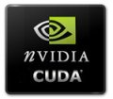




Free software and online collaboration
Web-platform
Plotting
Computing
Online Collaboration
Git + Wiki + Mailing List
C

Slide 9
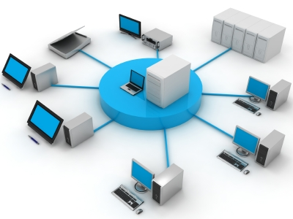
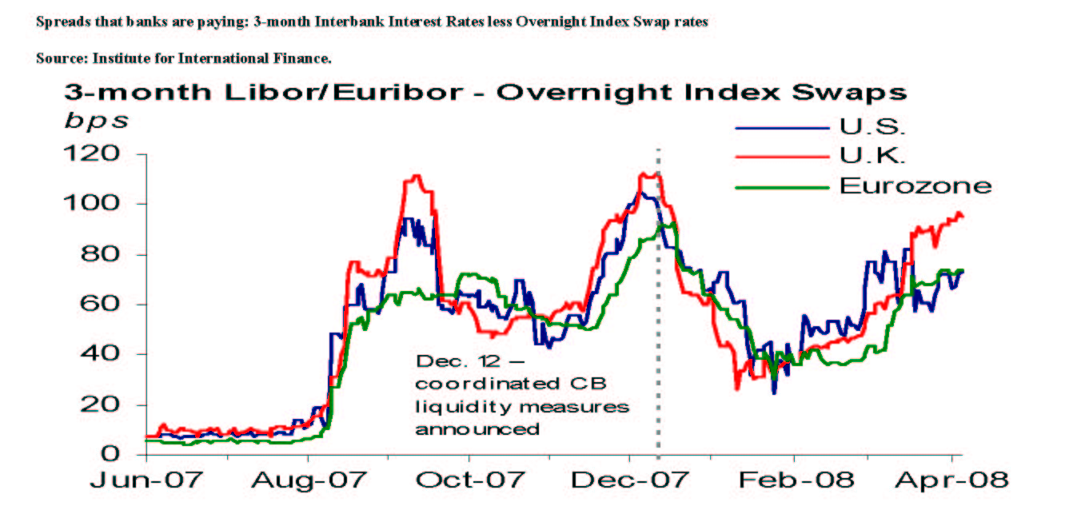
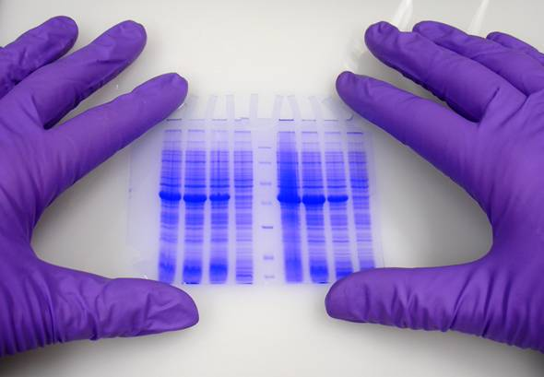

Produced data
(time series)
Web-platform
Time series analysis
tools
Computing
Resources
(CPU / GPU)
Research
Result

Slide 10
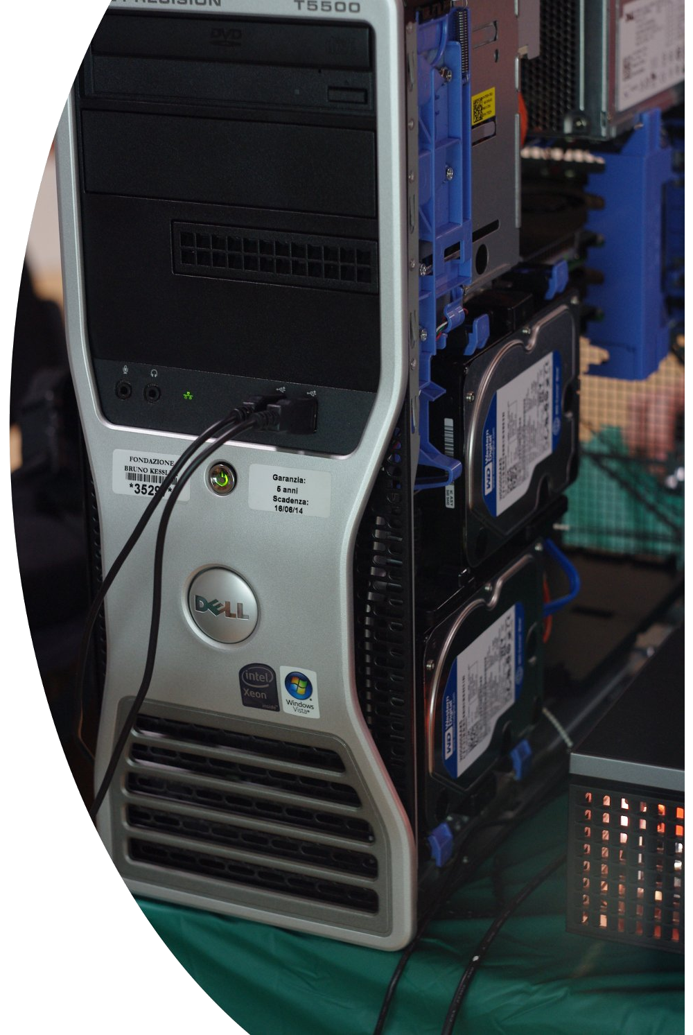
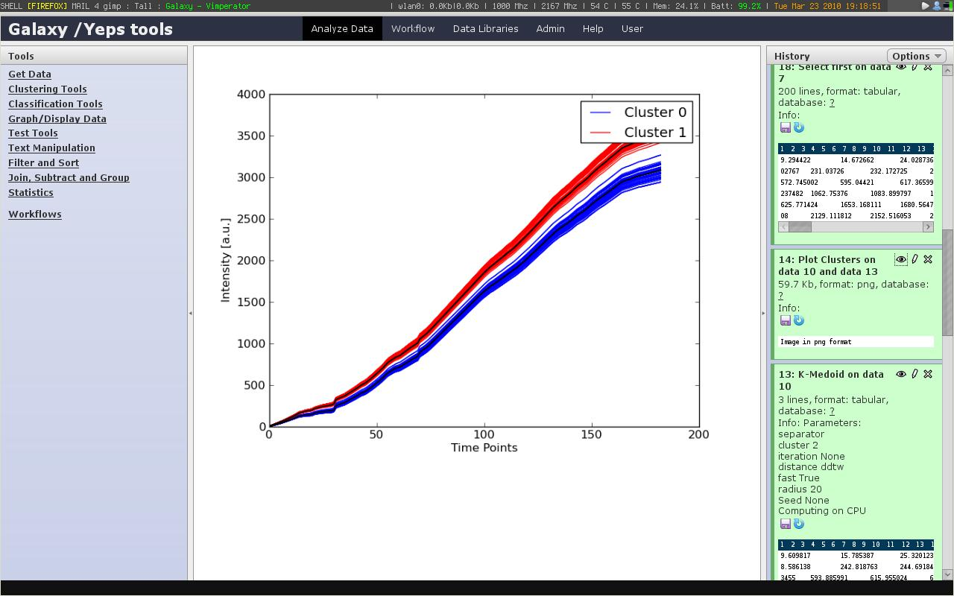
Results and future work
We reached all our objectives!
We set up a fully working server with our project. Obviously it is a prototype and the development will continue in the future. We'll try to improve performances and develop more tools.

