Slide 1
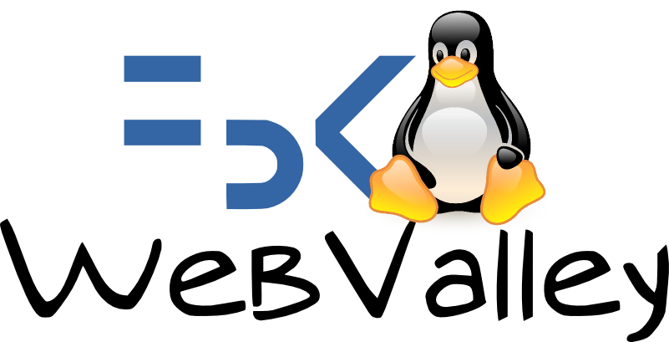


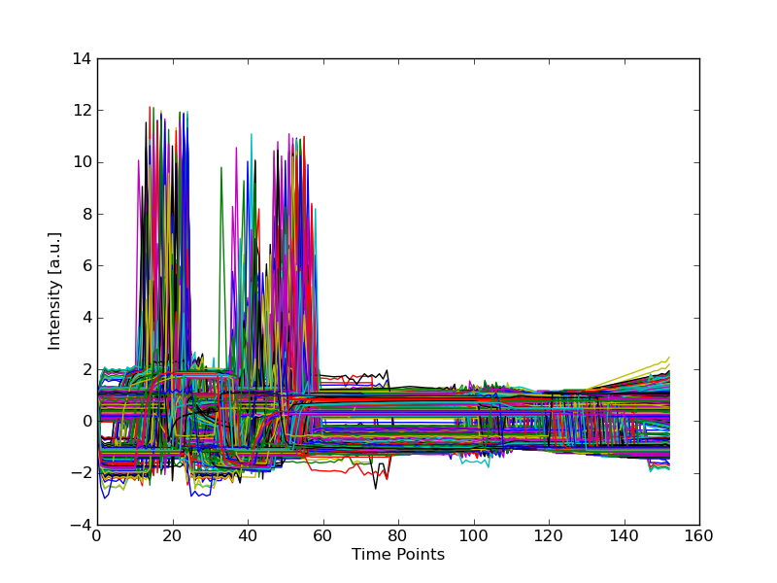

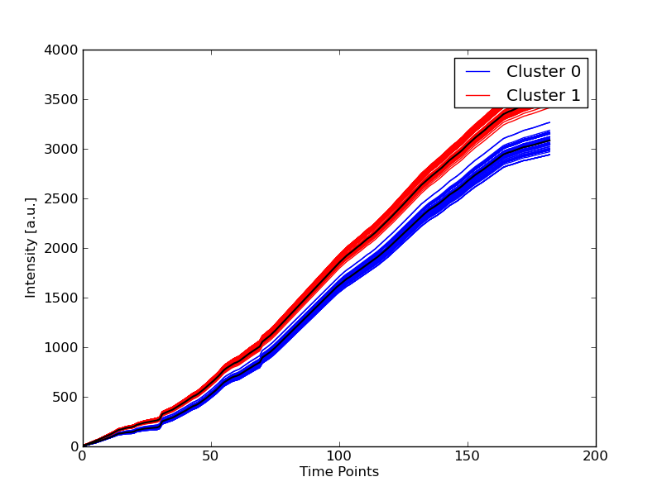



Giovani ricercatori cercansi 2010
Junge Forscher gesucht 2010
A Web-based platform for experimental design and
time series analysys
Fabiano Lever, Federico Scrinzi, Matteo Poletti, Severino Zeni
With acknowledgement to:
Cesare Furlanello and Marco Grimaldi
1. Introduction
Science and research produces an huge amount of data that have to be processed using computers. One of the aims of our project is to create an easy-to-use, accessible and efficient platfrom for data mining and machine learning.
We had to find a possible solution to some problems
problema della grande quantità di dati
possibiilità d condividere strumenti
importanza di strumenti che permettano collaboraizone a distanza
possibilità di condividere risorse di calcolo
potenzialità dell'informatica per fornire strumenti alla ricerca
For the kind of data to analyse we chose time series because they are used nearly in any research field,
from finance to genomic. We decided to implement simple algorithms for data mining and machine learning,
for clustering and classification.
4. Reproducibility and sharing
“Reproducibility is one of the main principles of the scientific method, and refers to the ability of a test or experiment to be accurately reproduced, or replicated, by someone else working independently.”
Wikipedia
“In today's environment, hoarding knowledge ultimately erodes your power. If you know something very important, the way to get power is by actually sharing it.”
Joseph Badaracco
Galaxy offers a wide variety of tools useful for researchers.
Two of them are fundamental for a collaboration among scientists: history and workflows.
History is an analysis record: Every step of your analyses is recorded in Galaxy's history system. You can have any number of histories saved.
This way you can go back to your analyses anytime.
Sharing analyses: Alice works at Penn State, while Carlo works in
Trento. Alice wants Carlo to see her analyses.
Alice clicks the “share” link and enters Carlo's e-mail address. Now
Alice’s history is visible to Carlo!
Now results are reproducible! It's possibleto share results, data and
even procedures so any researcher can reproduce your results using
the same input data, the same workflow and the same system.
2. Why a Web-based platform?
A web-based interface is a sort of a bridge that connects the user to a some kind of resources. In our case the user is a researcher who can be an IT newbie so we took into consideration the fact of creating an easy-to-use interface to the tools we developed. We decided to adopt a web platform because:
It's accessible from everywhere and with any appliance
There's not the need of any special program installed on your pc in order to use it, all you need is a web browser.
Computing resources are centralized and the program can be optimized for the server
Your computer shows only an interface to the server, every job runs there
It's easier to share data and information because everything is centralized
We thought that was useless write a brand new software, it was much more efficient to use a previous made one and adapt it to our needs. This thought was based on the sharing principle of Open Source.
In that way we could concentrate our efforts to create powerful tools and
libraries for machine learning, without spending time debugging a web
interface or worring about security. Furthermore if we could produce
good quality sources someone else could use them because we created
modules integrables in any other program.
Researcher
Researcher
Researcher
Network
5. Our work
We focused our work on time series analysis. A time series is is a sequence of data points, measured typically at successive times spaced at uniform time intervals (eg.: variation of temperature, stock price, etc...).
We offer some tools to process datasets through clustering and classification algorithms and to display them in a graphical or textual way.
Our work was most of all modular, we tried to organize our software in a smart way in order to promote recycling of source code. First of all we developed Python modules with the algorithms, then we wrote small script to test them and eventually we integrate them into Galaxy.
This kind of approach makes the libraries and the scripts an independent part which can be used in other software products from other developers. The source code we wrote is released under the terms of the GNU General Public License v3 and is free software.
All our work is coordinated through the Internet, using wikis, mailing lists and version control systems.
Web interface
Computing resources
Procedures
Data
Clustering
K-Medoid
K-Means
Classification
K-NN
3. Galaxy
We spent some time looking around on the Internet for a web-platform that could fit our needs. We took an advice from Marco Grimaldi and we read a paper¹ about a software called “Galaxy” developed by the Center for Comparative Genomics and Bioinformatics of Pennsylvania State University.
“Galaxy allows you to do analyses you cannot do anywhere else without the need to install or download anything. You can analyze multiple alignemnts, compare genomic annotations, profile metagenomic samples and much much more..”.
That platform was definitely adapt for us. In spite of the fact it is developed for genomic analysis it is extremely scalable and versatile. Of course it is released under an Open Source license and we could modify Galaxy for our needs.
We decided to develop new tools to integrate in Galaxy for time series analysis and expand this software to other research fields.
Tool integration is really simple and well documented, all you need to do is write an XML file a a program to launch.
We wrote some tools to manipulate datasets and convert them in a standard format and others for analysis.
Metrics
Euclidean distance
Dynamic Time Warping
Derivative Dynamic Time
Warping
Pearson's correlation
coefficient
Tools
(Python scripts)
Clustering tools
Classification tools
Display data/Plotting tools
Dataset manipulation
Libraries
(Python/C/CUDA modules)
calc_dist
dtw_cpu
dtw_gpu
iodata
kmeans
kmedoid
knn
Web-platform
Advantages:
Extremely versatile and customizable in an easy way
Designed for Research
Suports workflows and e history of operations
Supports various DBMS (SQLite, MySQL, ecc...)
It has its own web server
Cloud-computing support
Disadvantages:
Offers tools only for biologists and genetists
It doesn't offer any tool for other research
fields (neither a plotting system)
Relatively young and not mature project
Researchers
Developers
6. Conclusions and future work
We created a powerful platform for scientific analysis using different technologies and techniques.
Achievements:
Great computation power obtained with various techniques (in particular GPGPU)
It's possible to use the platform from everywhere with any gadget that provides a web browser
Easy-to-use
Easy to share information, data and procedures (using history and workflows)
We succeeded in another thing, we worked only through the Internet and we made the most of online collaboration tools.
We will continue our work in the future trying to improve performance and to develop other tools to process time series and maybe other datatypes.
Refereces:
¹ Giardine, B., Riemer, C., Hardison, R.C., Burhans, R., Elnitski, L., Shah, P., Zhang, Y., Blankenberg, D., Albert, I., Taylor, J., et al. (2005) Galaxy: a platform for interactive large-scale genome analysis Genome Res, . 15, 1451–1455

