Slide 1

Tri-Cities Innovation Lab
Stakeholder Briefing
August 14, 2026
[Nicholson logo]
[Builder Tech logo]
[Voltpop logo]
[Explay logo]

Slide 2

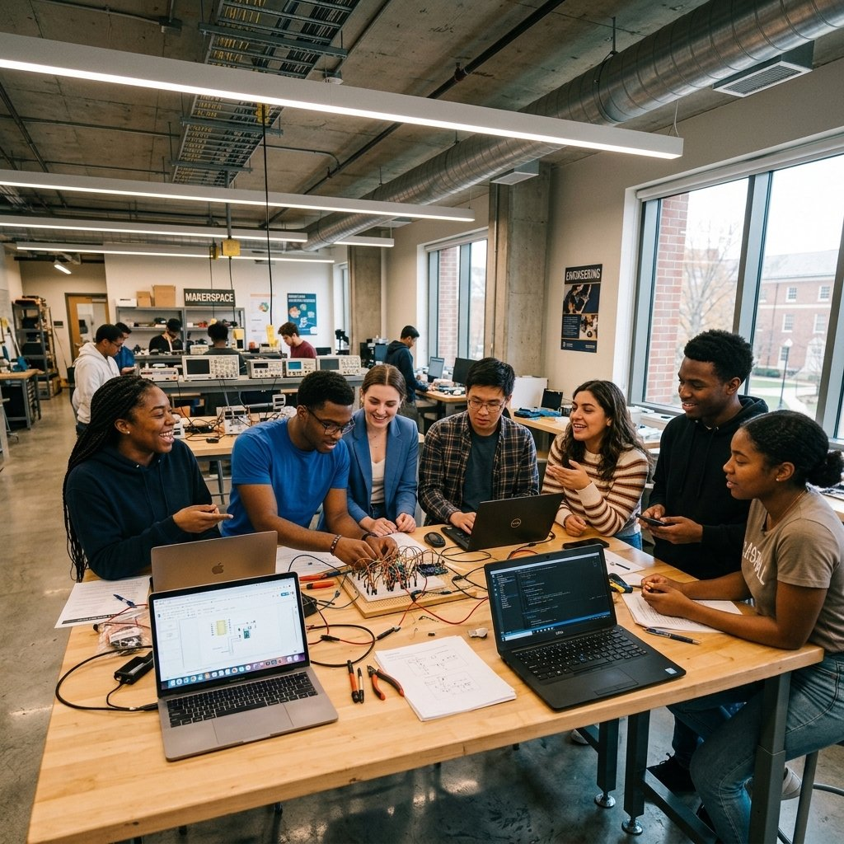
Overview
1. Who We Are
2. Purpose
3. What Is the Program
4. Inside the Program
5. The Tri-Cities Career Showcase
6. Proposed Timeline
7. The Ask
8. Contact and Next Steps

Slide 3
Who We Are
[Photo]
[Photo]
[Photo]
[Photo]
Dr. Shawn M. Nicholson
Javon Guerrier
Andrew Foulks
Emanuel Perez
Chief Executive Officer
Program Director
Curriculum Developer
Curriculum Developer & Instructor
Background running workforce development programs. [Track record figures to be confirmed]
Business and technical education specialist. Former Business Technology Solutions Analyst and UX Designer in an AI / Data Engineering practice. Educator, [Richmond / Petersburg — confirm] City Public Schools.
Hardware and software integration. Agentic AI Council member. Prior experience at NASA.
Entrepreneurial education programs, including work with Norfolk State and Unlock Alabama. Prior experience with BuildSpace.

Slide 4
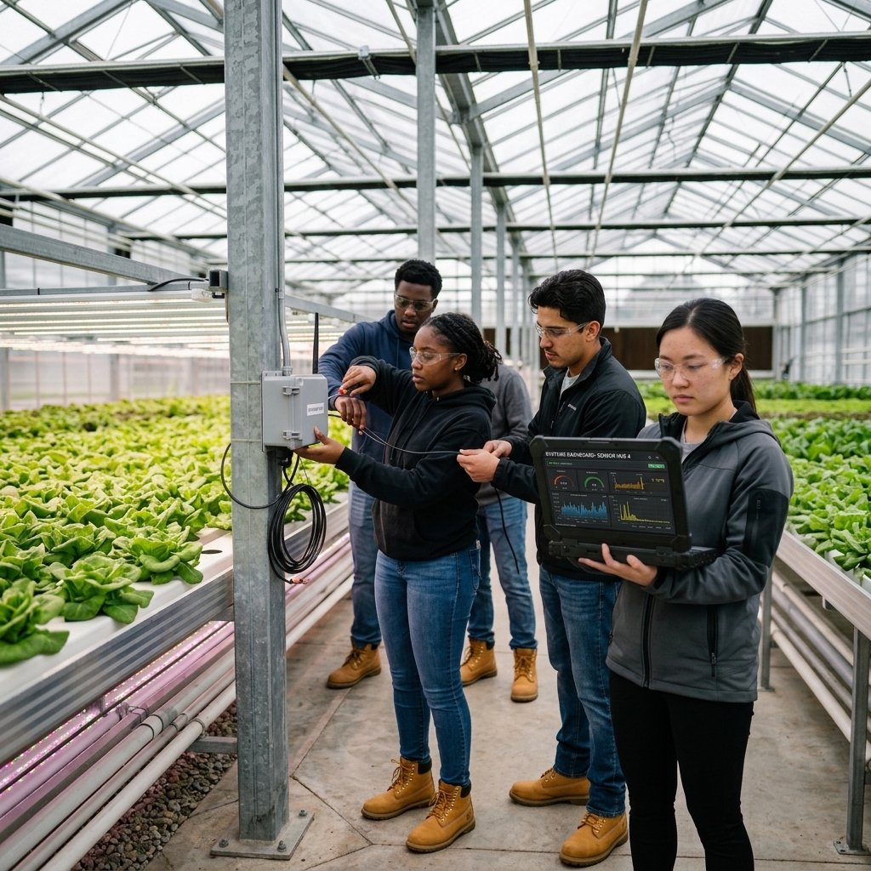


Purpose
The Tri-Cities region is producing that human capital, but some of the most talented students leave the region that helped develop them. That exit weakens the region's own capacity for economic growth.
INDUSTRIES
HOW IT WORKS
Agriculture
Manufacturing
Logistics
Energy and Utilities
Healthcare Technology
Transferable skills applied across industries
Project-based work tied directly to employers
Soft skills built alongside technical skills
Framed around Competency, Compatibility, and Commitment

Slide 5
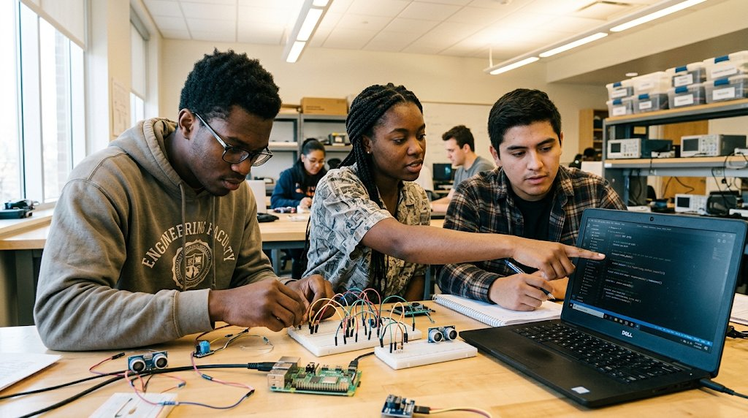


What Is the Program
A 15-week program where undergraduate teams turn a real idea into a working product. Grounded in project-based, experiential learning, students pair IoT and AI technologies with the business skills needed to bring that product to market.
DATES AND TIMES
COHORT PROFILE
Program Date: January 2027 - April 2027
Schedule: Tuesday and Thursday, 5:00 - 8:00 PM
Total Students: 60
Schools: Engineering & Technology, Business, and Agriculture
Class: Open to all (prioritize freshman and sophomore)
Dates, times, and cohort profile are tentative, pending alignment with Virginia State University.
Based at Virginia State University in Ettrick, where the Richmond metro area meets the Tri-Cities at the I-95 / I-85 junction, anchoring a footprint across Central and Southside Virginia.

Slide 6



Inside the Program
Students move through a full build cycle, from finding a real problem to launching a working product and presenting it.
ACTIVITIES
SKILLS
OUTCOMES
WHAT STUDENTS DO
WHAT STUDENTS LEARN
WHAT STUDENTS WALK AWAY WITH
Technical
Technical
Tangible Assets
Breadboard a microcontroller and wire sensors
Prompt AI tools to generate firmware and software
Build and deploy a web app with MCP servers and APIs
Run live user tests and a public launch
Prompt and context engineering
Systems thinking
Hardware, firmware, and software fundamentals
AI-assisted software development
System integration with MCP servers and APIs
Data analysis and data storytelling
A working IoT prototype (hardware)
A working software application (digital)
A business case
A resume and portfolio
Literacies
AI literacy
Data literacy
Business
Business
Interview users and define a real regional problem
Pitch and present to a live audience
Design thinking and problem definition
Business development and pitching
Experience
End-to-end product development
Cross-functional team collaboration
Stakeholder presentation and pitching
Professional
Professional
Collaborate on a team through the full build cycle
Project management and delivery
Cross-functional collaboration across engineering and business

Slide 7
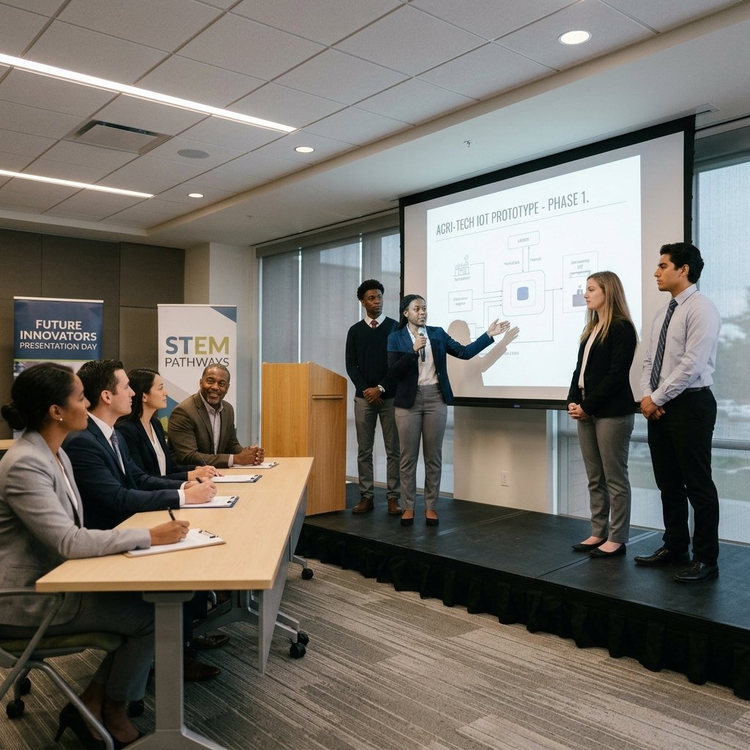


The Tri-Cities Career Showcase
The program's culminating event. Student teams present finished IoT and AI prototypes and business cases live, in front of employers, stakeholders, and the region. Held at the close of the program, April 2027.
WHAT HAPPENS
60 students across 15 teams pitch and demo working prototypes
Teams present the business case behind each product
Judges score presentations; recruiters meet students directly
Students bring resumes and portfolios for direct conversations with recruiters
WHY IT MATTERS TO EMPLOYERS
Early, direct access to a talent pipeline before hiring season starts
See how students think and solve, the same way you would in an interview
Low commitment: no internship program required to get this visibility
Most students are freshmen and sophomores, so early exposure builds a multi-year relationship before other employers start recruiting them

Slide 8


Proposed Timeline
Phase | Timing | What Happens
Proposal | August – September 2026 | Finalize partners, secure commitments, and align on scope with VSU
Setup | October – December 2026 | Recruit the student cohort, prepare curriculum and equipment, and onboard instructors
Program | January – April 2027 | Students work through the 15-week build cycle, from problem to launch (Tuesday and Thursday, 5:00 – 8:00 PM)
Outcomes and Reporting | May 2027 | Tri-Cities Career Showcase, then results and feedback shared with stakeholders
All dates are tentative, pending alignment with Virginia State University.

Slide 9

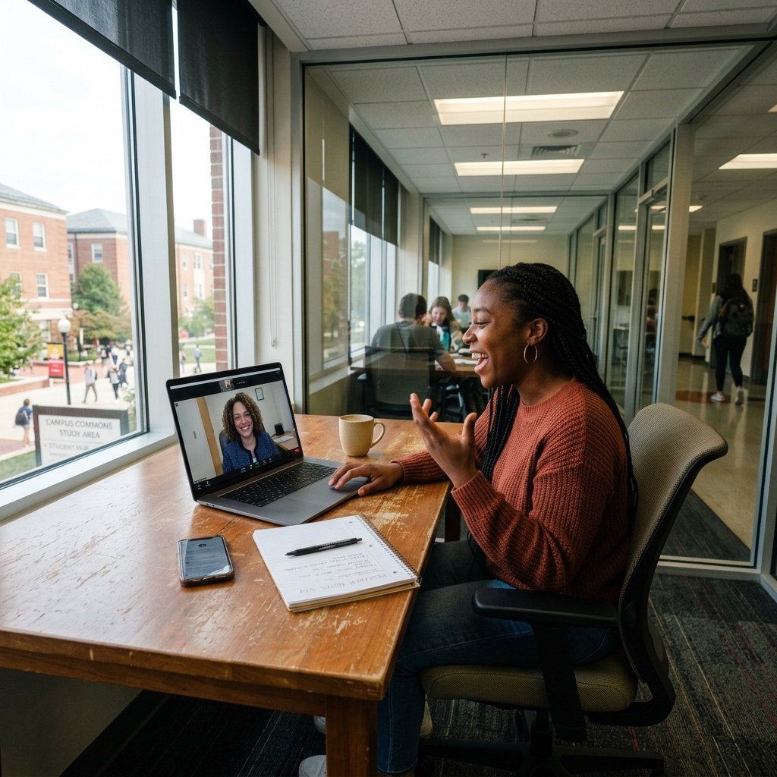

The Ask
FINANCIAL SPONSORSHIP
Direct cost coverage via a selected budget line.
IN-KIND SUPPORT
Mentorship
Judges and recruiters for the Tri-Cities Career Showcase
Equipment donation
Grant funding is being pursued separately. This ask is additive, not a substitute.

Slide 10
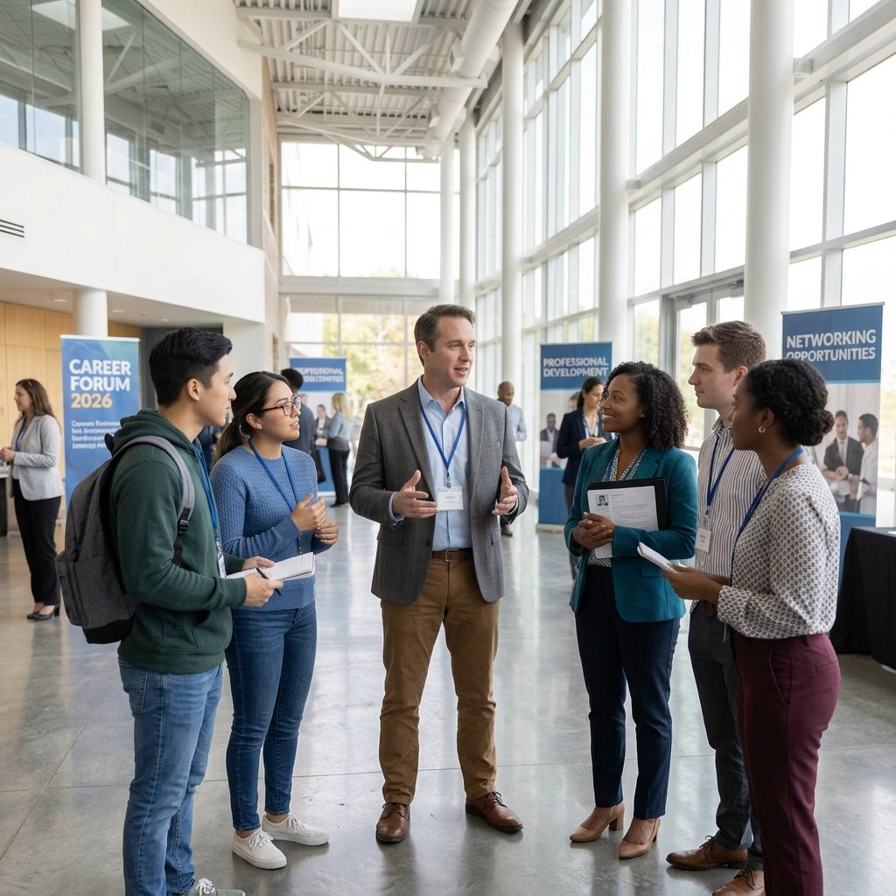
Contact and Next Steps
Next Steps
1
Confirm which form of support fits
Financial sponsorship, mentorship, serving as a judge or recruiter at the Tri-Cities Career Showcase, or an equipment donation.
2
Schedule a working session
To finalize the specific commitment, a budget line for direct cost coverage, or the scope of the in-kind contribution chosen above.
3
Join a curriculum co-development conversation
With our program design team to shape a real business challenge your organization can bring into the program as a student project.
4
Lock the commitment by [date]
Ahead of the January 2027 program launch, so we can finalize partner logistics during the Setup phase.
If no decision is made in the room, a follow-up the next day.
Contact
Dr. Shawn M. Nicholson
Chief Executive Officer
[email] | [phone]
Javon Guerrier
Program Director
[email] | [phone]

