Slide 1
GRASSMARLIN v3.2

Slide 2
Motivating Factors
Blue Teams did not conduct assessments on ICS/SCADA networks for risk of physical impact
Minimum situational awareness of devices connected to ICS/SCADA networks
Lack of GOTS or COTS solutions specifically designed for this technology space
How would you passively identify IP-based devices on your ICS/SCADA network?

Slide 3
Constraints & Limitations
Maintaining ICS/SCADA system availability is paramount
Cyber/Physical system faults/failures could result in
Loss of life
Loss of revenue
Loss of equipment
Environmental damage
Loss of service
Primary data acquisition - PASSIVE

Slide 4
Goals
Enable Blue Team capabilities on live ICS/SCADA IP networks while rigorously managing risk of harm to the network, process, or physical plant
Ability to run stand-alone, outside a Blue Team environment for other DoD customers
Facilitate the development of an ICS/SCADA Knowledge Base

Slide 5
What is GRASSMARLIN?
Passive IP Network Mapping Tool
Hardware agnostic, portable, Java based graphical tool
Used to do some initial analysis work but is not an analysis engine
Multi-platform: Supports Windows and Linux
Three views: Logical, Physical, and Sniffles
Open-Source. Can be downloaded from https://github.com/iadgov/GRASSMARLIN

Slide 6
Knowledge Base
Consists of the GeoIP database, Vendor IDs and Fingerprints
GeoIp database used to display a country’s flag
Vendor IDs identify the vendor of the Network Interface Card (NIC)
No decisions based on Vendor IDs or GeoIp

Slide 7
Fingerprints
Currently over 60 fingerprints, but continues to expand as we get more data
Fingerprints are based on the contents of an individual packet
Ability for users to create custom fingerprints
New Fingerprint Manager
GUI interface
Uses Snort like syntax

Slide 8
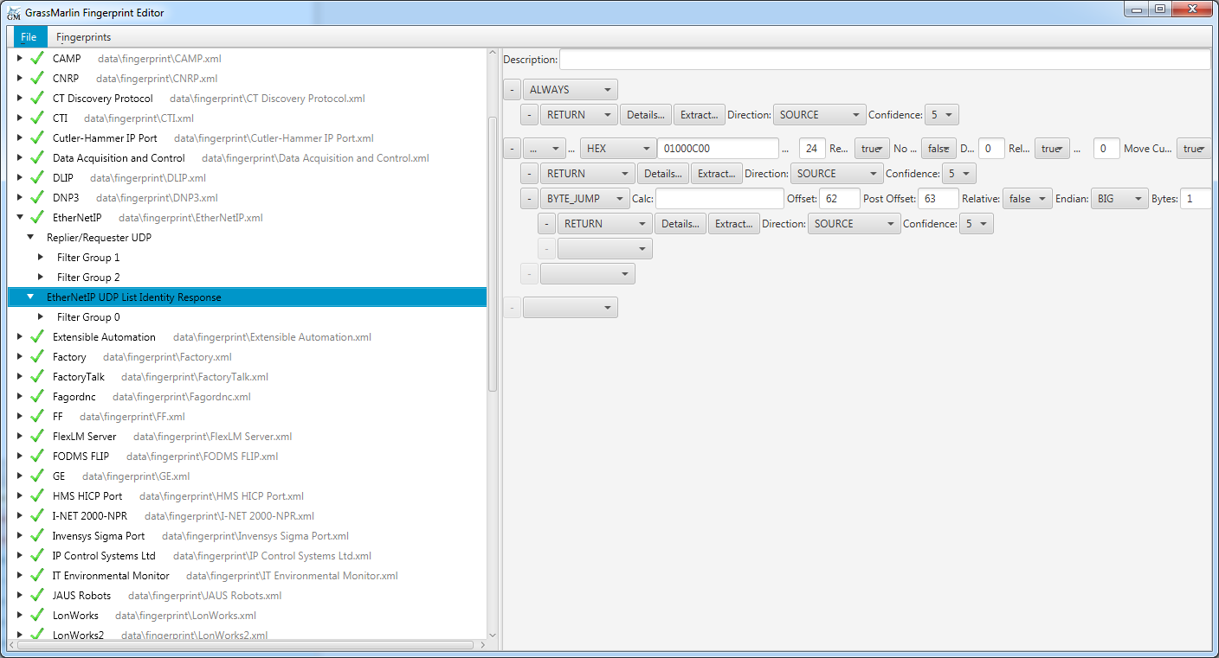
Fingerprint Manager

Slide 9
Logical View
Render IP networks from saved PCAPs, Bro Logs (CSV or JSON), or Live Capture
Draws a logical map of connections: TCP, UDP, one way, and two way connections
Ability to bring up a specific packet in Wireshark
All traffic (live or ingested) is run against the Knowledge Base

Slide 10
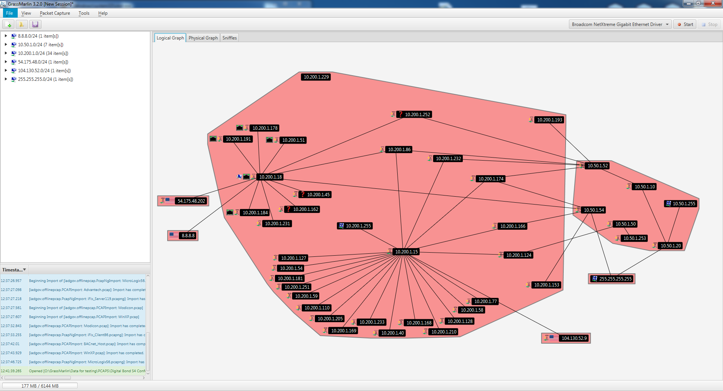
Logical View
ALL IPs USED ARE FOR DEMO PURPOSES

Slide 11
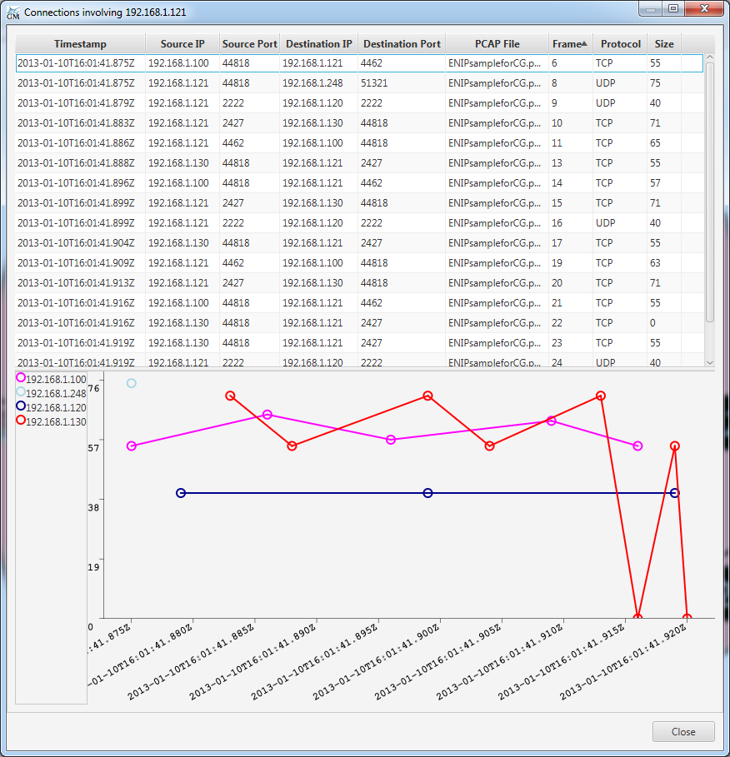
Logical View – View Frames
ALL IPs USED ARE FOR DEMO PURPOSES

Slide 12
Physical View
Renders a visual representation of the physical network
Can only be rendered through the ingest of the results of “show” commands.
Requires the result of three Cisco commands
show running-config
show ip arp *OR* show mac address-table
show interfaces
One text file per device

Slide 13
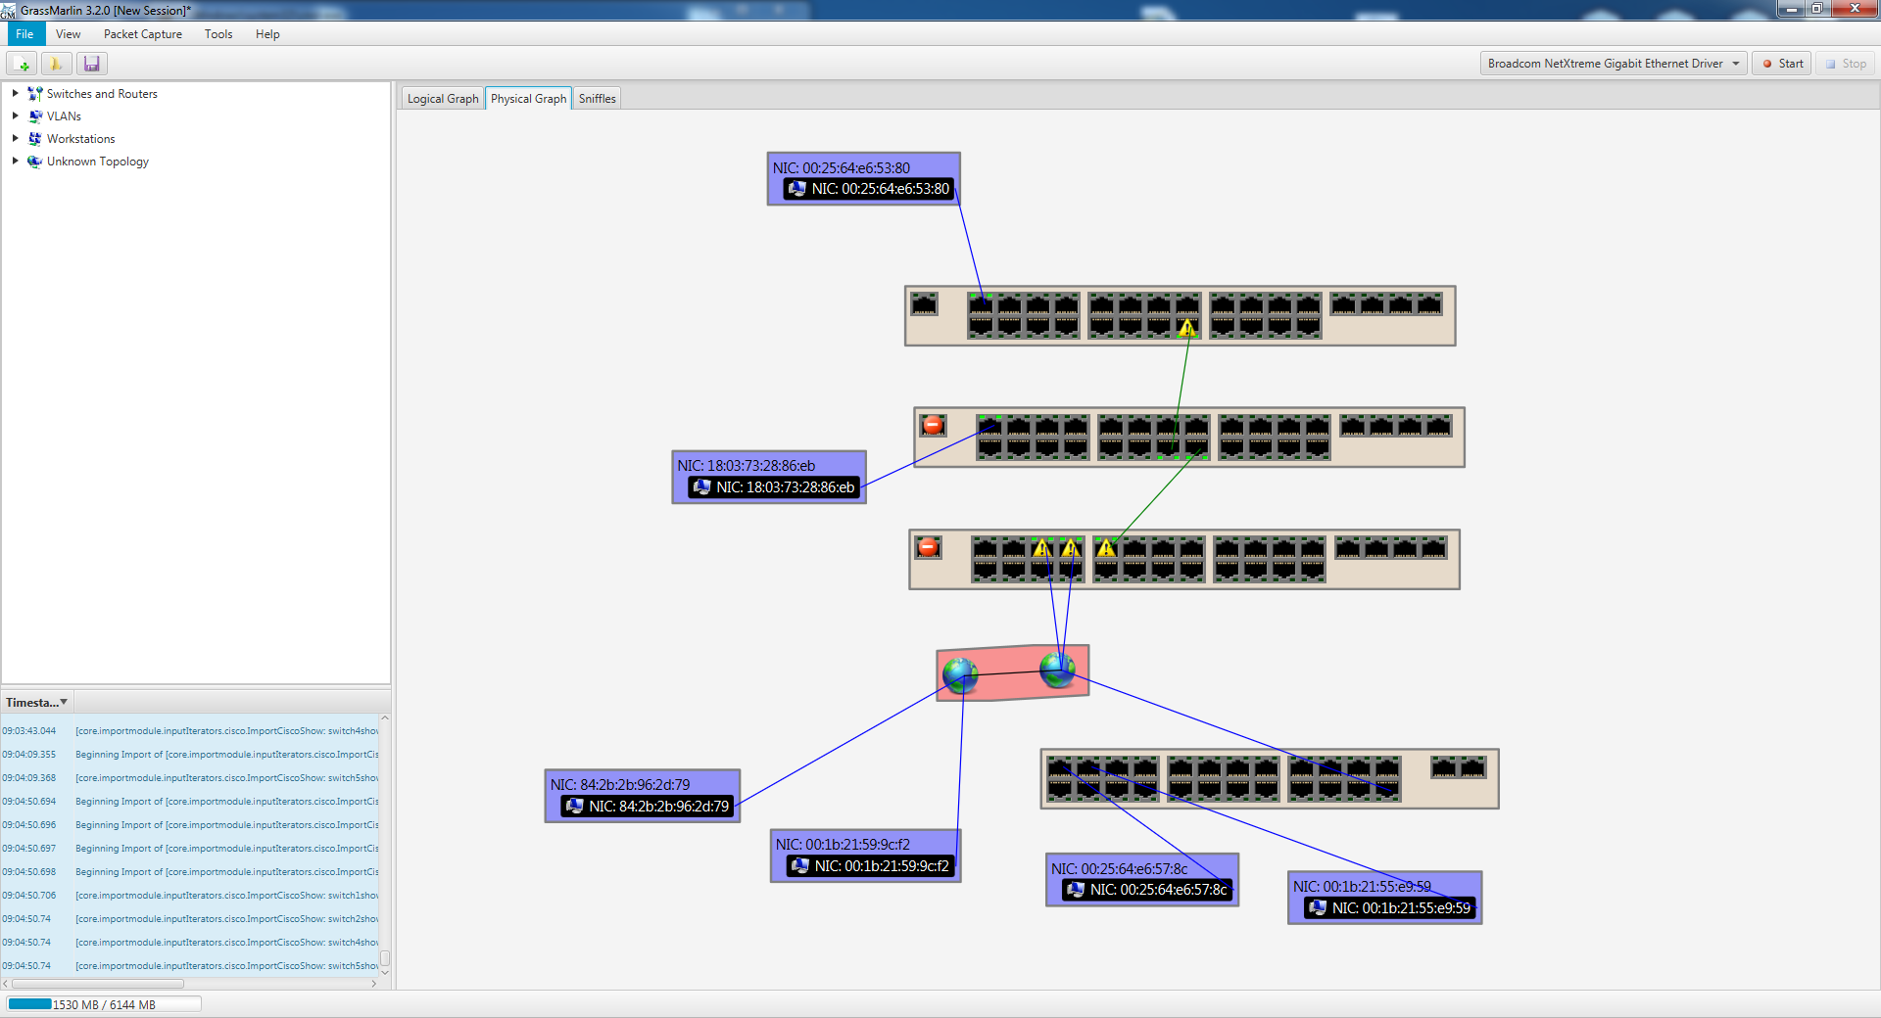
Physical View - Incomplete
ALL IPs USED ARE FOR DEMO PURPOSES

Slide 14
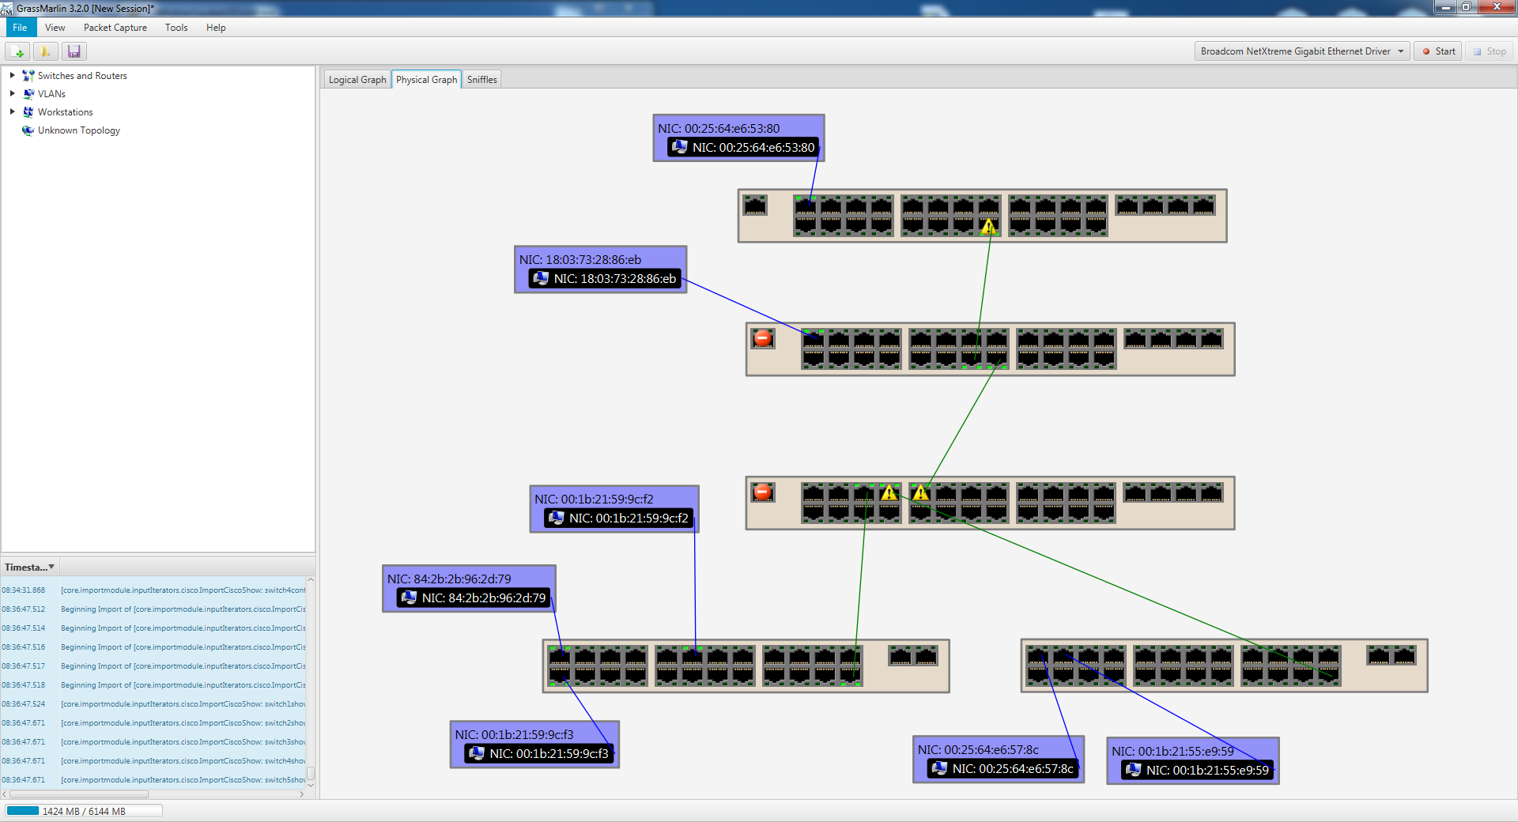
Physical View – Complete
ALL IPs USED ARE FOR DEMO PURPOSES
ALL IPs USED ARE FOR DEMO PURPOSES

Slide 15
Plug-In Support
V3.2
Support plug-ins for import and export
Written in Java
Sample plug-ins provided in code
Future
Full support for plug-ins
User developed plug-ins can be inserted at any point of the data flow

Slide 16
Sniffles

Slide 17
Common Misconceptions
Cannot ingest GB upon GB of data
Shows when hosts appear in a network but does not remove the host if the host leaves the network
Does not turn hosts red or perform intrusion detection
Can only see and map hosts based on where you are capturing data
Not an active tool
Cannot capture serial data
Support IPv4 over Ethernet only

Slide 18
Questions?

