Slide 1
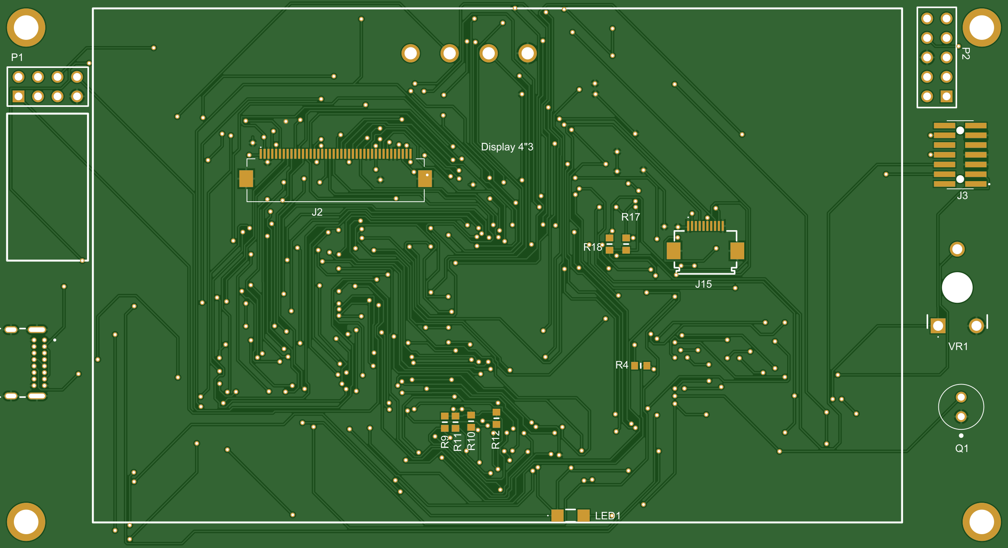
THOMAS MORE · ELECTRONICS-ICT
SMART HOME
HUB
A manufactured four-layer STM32 platform that senses the room, communicates and alarms locally.
Mahmoud Mostafa
Advanced PCB: Lab · 2025–2026
STM32F746 · RGB TFT · SCD41 · BME688 · ESP-01 · QSPI
Notes:
Opening: the goal was not a development board demo, but a complete custom PCB that combines environmental sensing, a local GUI, alarms, Wi-Fi and service interfaces. [Sources] - Project PCB Gerber render: user-authored production data.

Slide 2
DESIGN CHALLENGE
One board had to sense, warn and communicate
High-speed video and memory share the board with quiet analog sensing and two power rails.
4
2
480×272
PCB layers
I²C buses
RGB pixels
480 × 272 RGB display driven directly by LTDC
CO₂, temperature, humidity, pressure and relative gas response
Independent local flame warning and default-off buzzer
Wi-Fi telemetry through an ESP-01
Manufacturable four-layer PCB with reproducible outputs
5 V
3.3 V
16 MB
system input
logic rail
QSPI flash
Success criterion
A demonstrable working unit with traceable production data—and limitations that are measured, contained and documented.
Notes:
Explain that the challenge was the combination of interfaces, not any one sensor. The central engineering problem was maintaining power integrity and return paths while routing LTDC/FMC-density signals. [Sources] - Project requirements and measurements: user-authored technical report.

Slide 3
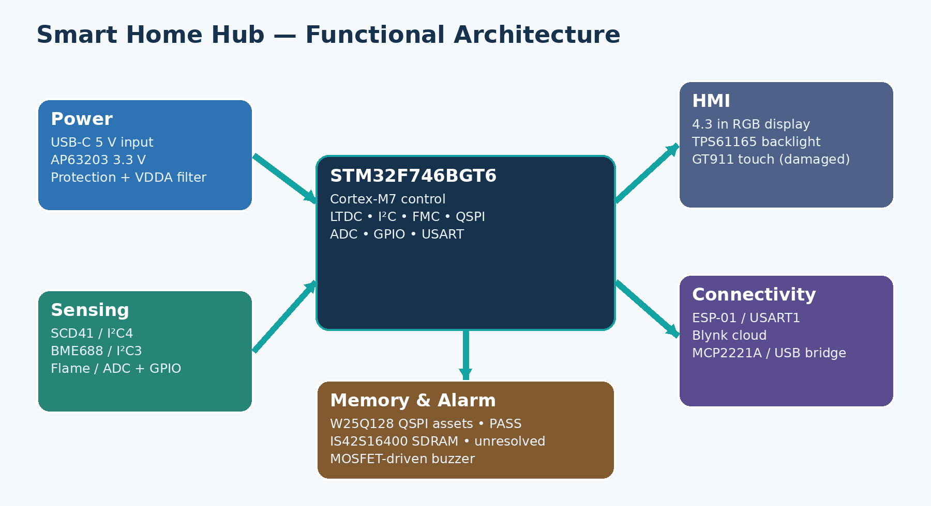
SYSTEM ARCHITECTURE
Domain separation simplified bring-up
Interface map
LTDC
RGB display
I²C4
SCD41
I²C3
BME688
ADC1 / PH2
Flame A0 / D0
USART1
ESP-01
QUADSPI
W25Q128
FMC
SDRAM
Why it matters
A failed bus or memory device does not prevent the rest of the dashboard and alarms from operating.
Notes:
Walk clockwise through the architecture. Emphasize separate I²C buses and the decision to keep the working GUI independent of SDRAM. [Sources] - Project architecture graphic: user-authored report asset. - STMicroelectronics STM32F746BG: https://www.st.com/en/microcontrollers-microprocessors/stm32f746bg.html

Slide 4
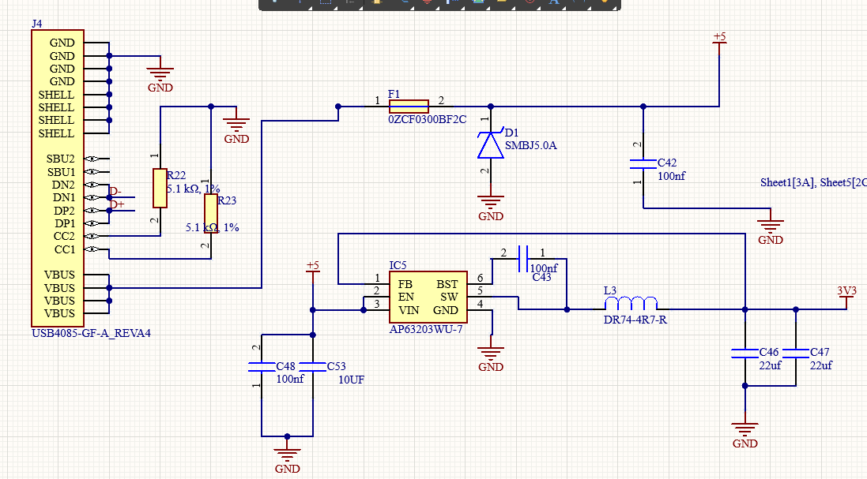
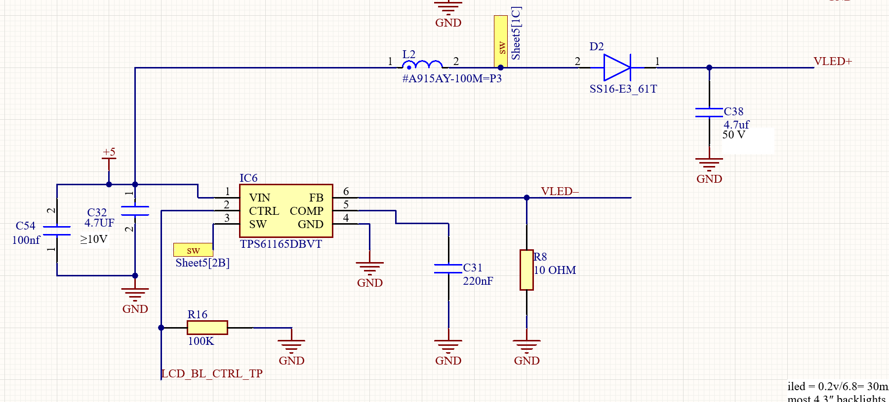
POWER AND DISPLAY
Power integrity anchors the HMI
5 V → 3.3 V power tree
TPS61165 backlight
USB-C sink: 5.1 kΩ on CC1/CC2
Fuse + TVS protection
AP63203 synchronous buck
Ferrite-isolated VDDA/VREF+
Constant-current LED-string drive
CTRL held low until MCU control
High-voltage output capacitor
Schottky polarity corrected during bring-up
Notes:
Explain the two power domains and the VDDA filter. For the backlight, the first failure was not the capacitor or inductor: the external Schottky diode was reversed. Measurements at VIN, CTRL, FB and VLED led to the correction. [Sources] - User-authored schematic captures. - Texas Instruments TPS61165: https://www.ti.com/product/TPS61165 - Diodes AP63203: https://www.diodes.com/part/view/AP63203

Slide 5
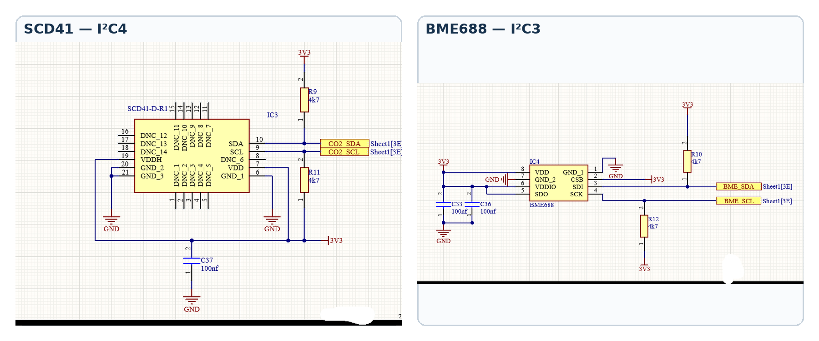
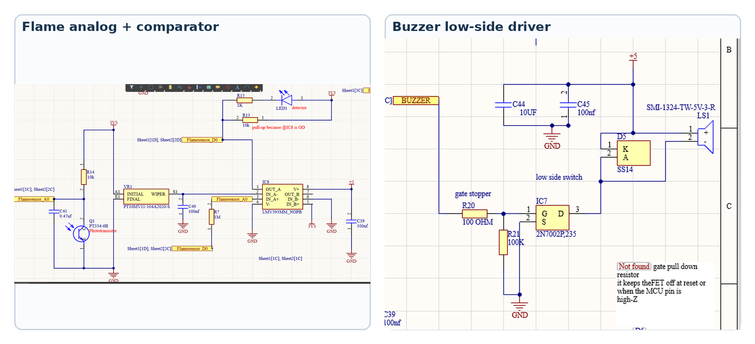
SENSING AND ALARMS
Visible comfort data, hidden safety channels
Visible environmental data
SCD41: CO₂ + T/RH on I²C4
BME688: T/RH + pressure + gas resistance on I²C3
Local pull-ups and decoupling on both buses
Background safety logic
PA1 continuously samples flame A0
PH2 reads active-low comparator D0
Gas change is judged against a learned clean-air baseline
100 kΩ gate pull-down keeps buzzer silent at reset
LOCAL ALARM DOES NOT REQUIRE WI-FI
Notes:
The normal dashboard intentionally does not show flame or gas values. They remain active in the background and take over the screen only during a fault. Gas resistance is a relative air-change indicator—not gas identification. [Sources] - User-authored schematic captures and firmware tests. - Sensirion SCD41: https://sensirion.com/products/catalog/SCD41 - Bosch BME688: https://www.bosch-sensortec.com/products/environmental-sensors/gas-sensors/bme688/

Slide 6
PCB IMPLEMENTATION
A four-layer stack protects return paths
TOP
signals + components
L1
solid GND plane
L2
3.3 V plane
BOTTOM
signals + components
Routing priorities
The autorouter established a baseline; power, constrained regions and return paths were reviewed manually.
Dense MCU–memory escape
Compact boost SW loop
Wide 5 V / 3.3 V paths
Manufacturer-aligned DRC
Notes:
Describe the L1 GND and L2 3V3 plane assignment. The PCB view is derived from the production Gerbers; final constrained and power routes were manually reviewed after autorouting. [Sources] - PCB Gerber render: user-authored production data. - Altium Designer documentation: https://www.altium.com/documentation/altium-designer

Slide 7
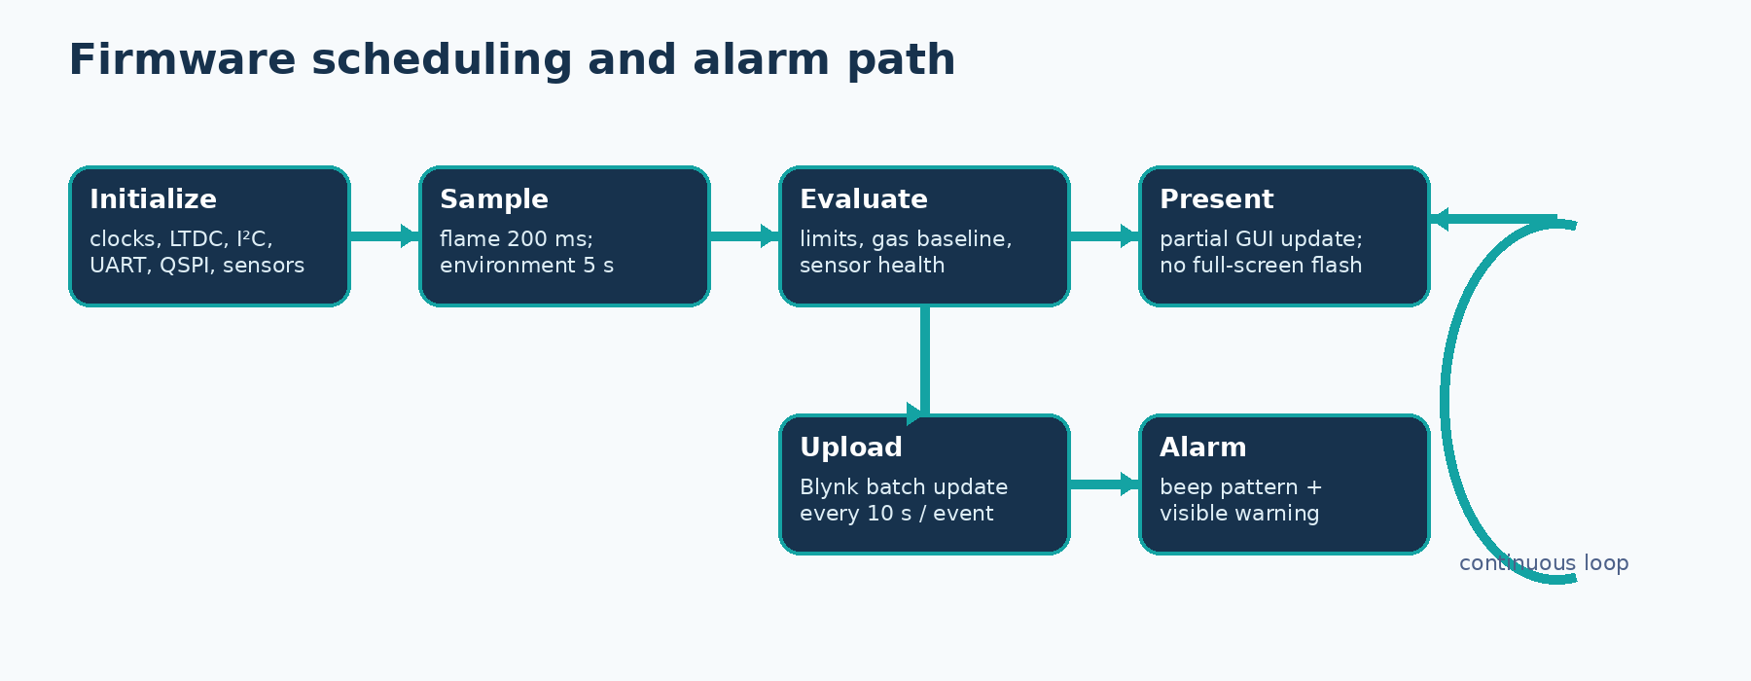
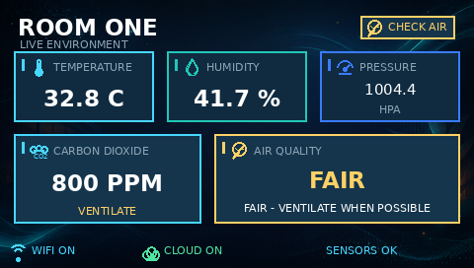
FIRMWARE AND GUI
Partial updates eliminate screen flashing
Smooth rendering
Static QSPI background remains in place
Only changed value rectangles are redrawn
D-cache cleaned before LTDC presentation when required
200 ms
5 s
500 ms
10 s
flame sample
environment
display
Blynk batch
GUI RUNS WITHOUT SDRAM
Notes:
The integrated loop is time-based rather than built around long delays. The final GUI fixes visible flashing by keeping static assets in QSPI and redrawing only dynamic fields. [Sources] - Firmware flow and GUI image: user-authored project assets.

Slide 8
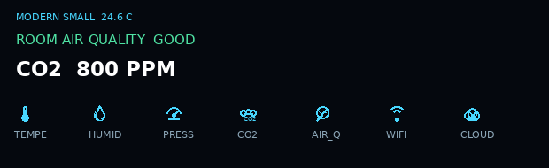
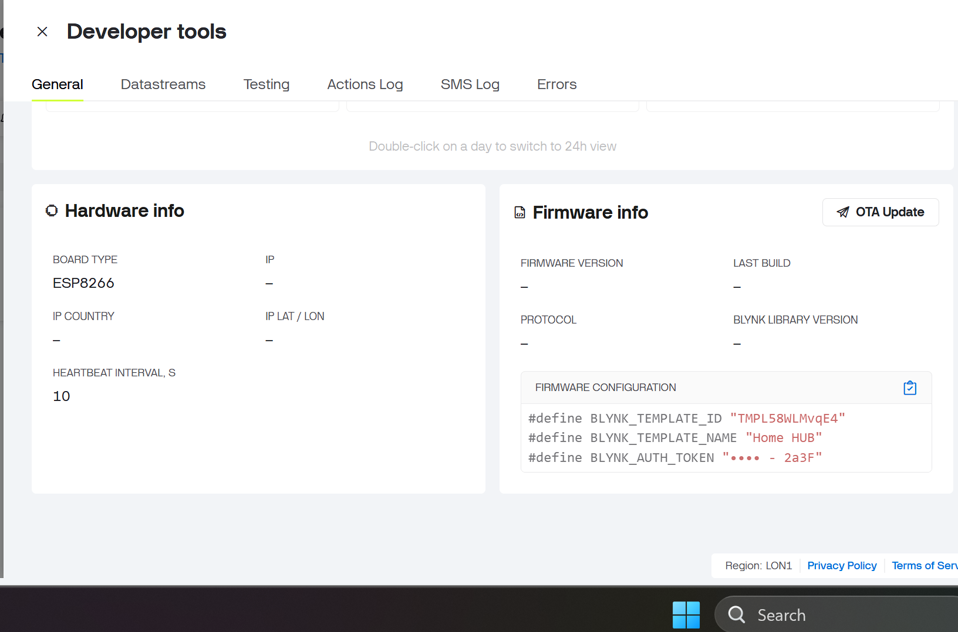
CONNECTIVITY AND STORAGE
QSPI stores visuals; ESP-01 exports data
W25Q128 QSPI
ESP-01 + Blynk
JEDEC ID EF 40 18 verified
16 MB non-volatile storage
Background and modern font/icon assets
USART1 AT command link
Wi-Fi association and TCP confirmed
Virtual-pin update passed
Lab proof uses HTTP; Rev B should use current TLS
QSPI PASS
BLYNK PASS
Notes:
QSPI is used for the background image and font/icon assets, so internal flash is not consumed by all GUI resources. The installed ESP-01 firmware could not establish a usable SSL path; HTTP was kept only for lab proof. [Sources] - User-authored QSPI GUI assets and Blynk screenshot. - Winbond W25Q128JV family: https://www.winbond.com/hq/product/code-storage-flash/qspi-nor/

Slide 9
MEASURED EVIDENCE
Live readings confirm both I²C buses
Flame response
800
30.4
54.5
3.19 V → 1.50 V
ppm CO₂
°C · SCD41
%RH · SCD41
ADC ≈3950 → ≈1730 when a lighter is presented
32.8
41.7
1004.4
Interpretation
°C · BME688
%RH · BME688
hPa pressure
These readings prove the electrical and firmware data paths. They are not calibration certificates.
SENSORS PASS
Notes:
State the readings exactly as observed. Differences between the SCD41 and BME688 temperature/humidity channels are expected from timestamps, thermal coupling, airflow and self-heating; no calibrated accuracy claim is made. [Sources] - Bench observations recorded by the user in the project report.

Slide 10
VERIFICATION MATRIX
Core functions pass; three features remain limited
SUBSYSTEM | STATUS | EVIDENCE
Power + STM32 + RGB LCD | PASS | Stable rails, boot and visible GUI
SCD41 + BME688 | PASS | Live CO₂ / T / RH / pressure
Flame + buzzer | PASS | ADC + D0 response; silent at reset
ESP-01 + Blynk | PASS | Wi-Fi, TCP and V-pin update
W25Q128 QSPI | PASS | EF 40 18 + data test
IS42S16400 SDRAM | FAIL | A5A55A5A → FF00FF00
GT911 touch | NOT TESTABLE | Flex tail torn
MCP2221A USB-UART | PARTIAL | Enumerates; UART unconfirmed
The demonstrable environmental-monitoring system remains usable because the GUI does not depend on SDRAM and the touch input is not required for sensing or alarm output.
Notes:
This is the most important honesty slide. Do not imply that every fitted feature works. Separate the working core from SDRAM FAIL, touch NOT TESTABLE and MCP2221A PARTIAL. [Sources] - User-authored bench test results and technical report.

Slide 11
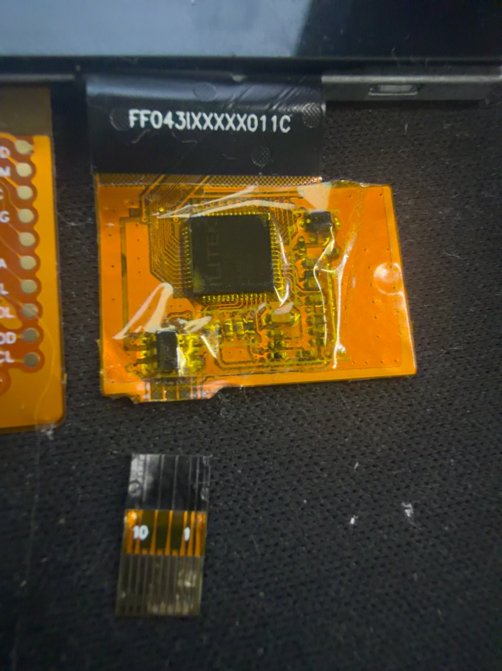
CORRECTIONS AND LESSONS
Bring-up failures became Rev-B design rules
01
Backlight off
Reversed diode → clearer polarity marking
02
Whole display flashed
Full-frame redraw → update dynamic fields only
03
SSL connection failed
Legacy AT firmware → use current TLS-capable module
04
SDRAM mismatch
Unresolved → verify FMC pins, joints and timing
Mechanical lesson
The touch failure is a torn flex—not a GT911 software problem. Replacement is the robust remedy.
Notes:
Use each failure as evidence of diagnostic method: measure first, isolate the subsystem, and prevent the same failure in the next revision. The touch flex is physically severed; it cannot be fixed in software. [Sources] - User-authored bring-up record and touch-flex photograph.

Slide 12
CONCLUSION
The architecture works—and Rev B is clear
Demonstrated now
Rev-B priorities
Custom four-layer PCB boots reliably
Environmental dashboard updates smoothly
Local flame/gas logic drives a controlled buzzer
Wi-Fi telemetry and QSPI assets work
Diagnose/redesign the FMC SDRAM path
Replace the touch assembly and add strain relief
Use modern secure Wi-Fi hardware
Add deterministic USB-UART loopback and isolation points
Final takeaway
A demonstrable and functionally useful course prototype—with verified core paths and limitations that are explicit, contained and actionable.
LIVE DEMO: power → dashboard → sensor updates → flame warning → Blynk → QSPI test
Notes:
Close by resolving the opening challenge. The board senses, explains, warns and communicates. Then run the live demonstration in the footer order. [Sources] - Synthesis of user-authored project evidence and technical report.

