Slide 1
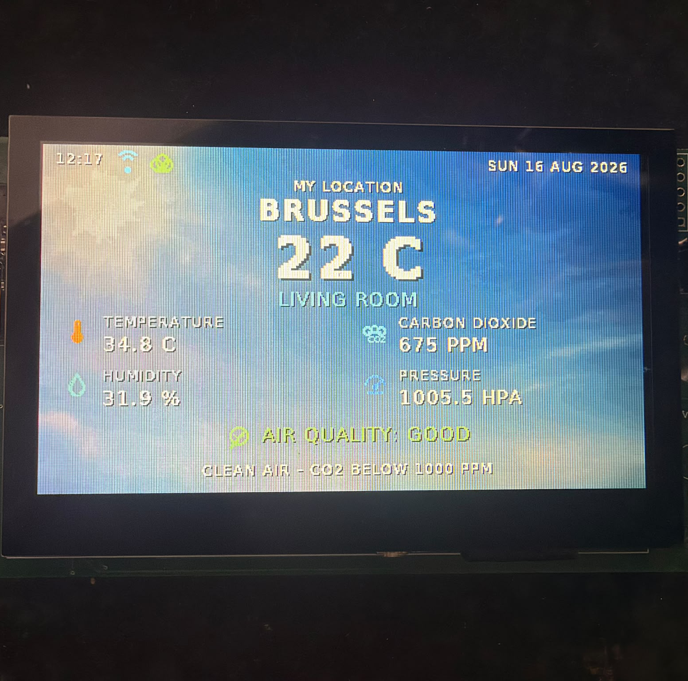
ADVANCED PCB PROJECT
Smart Home
Hub
A four-layer STM32 environmental, connected-weather and alert platform
Mahmoud Mostafa
Professional Bachelor Electronics-ICT
B-TM-YT6250 · Jurre De Weerdt · 2025–2026
MANUFACTURED · ASSEMBLED · VERIFIED
SMART HOME HUB · ADVANCED PCB
01 / 12
Notes:
This project covers the complete Advanced PCB workflow: schematic capture, a custom four-layer PCB, fabrication, assembly, embedded firmware and final verification. The finished hub measures the room, presents data locally, reports selected values remotely and raises independent local alarms.
[Sources]
- Smart_Home_Hub_Technical_Report(1).pdf, cover and pp. 2–5.
- User-supplied final-system photograph: WhatsApp Image 2026-08-16 at 1.04.45 PM.jpeg.

Slide 2
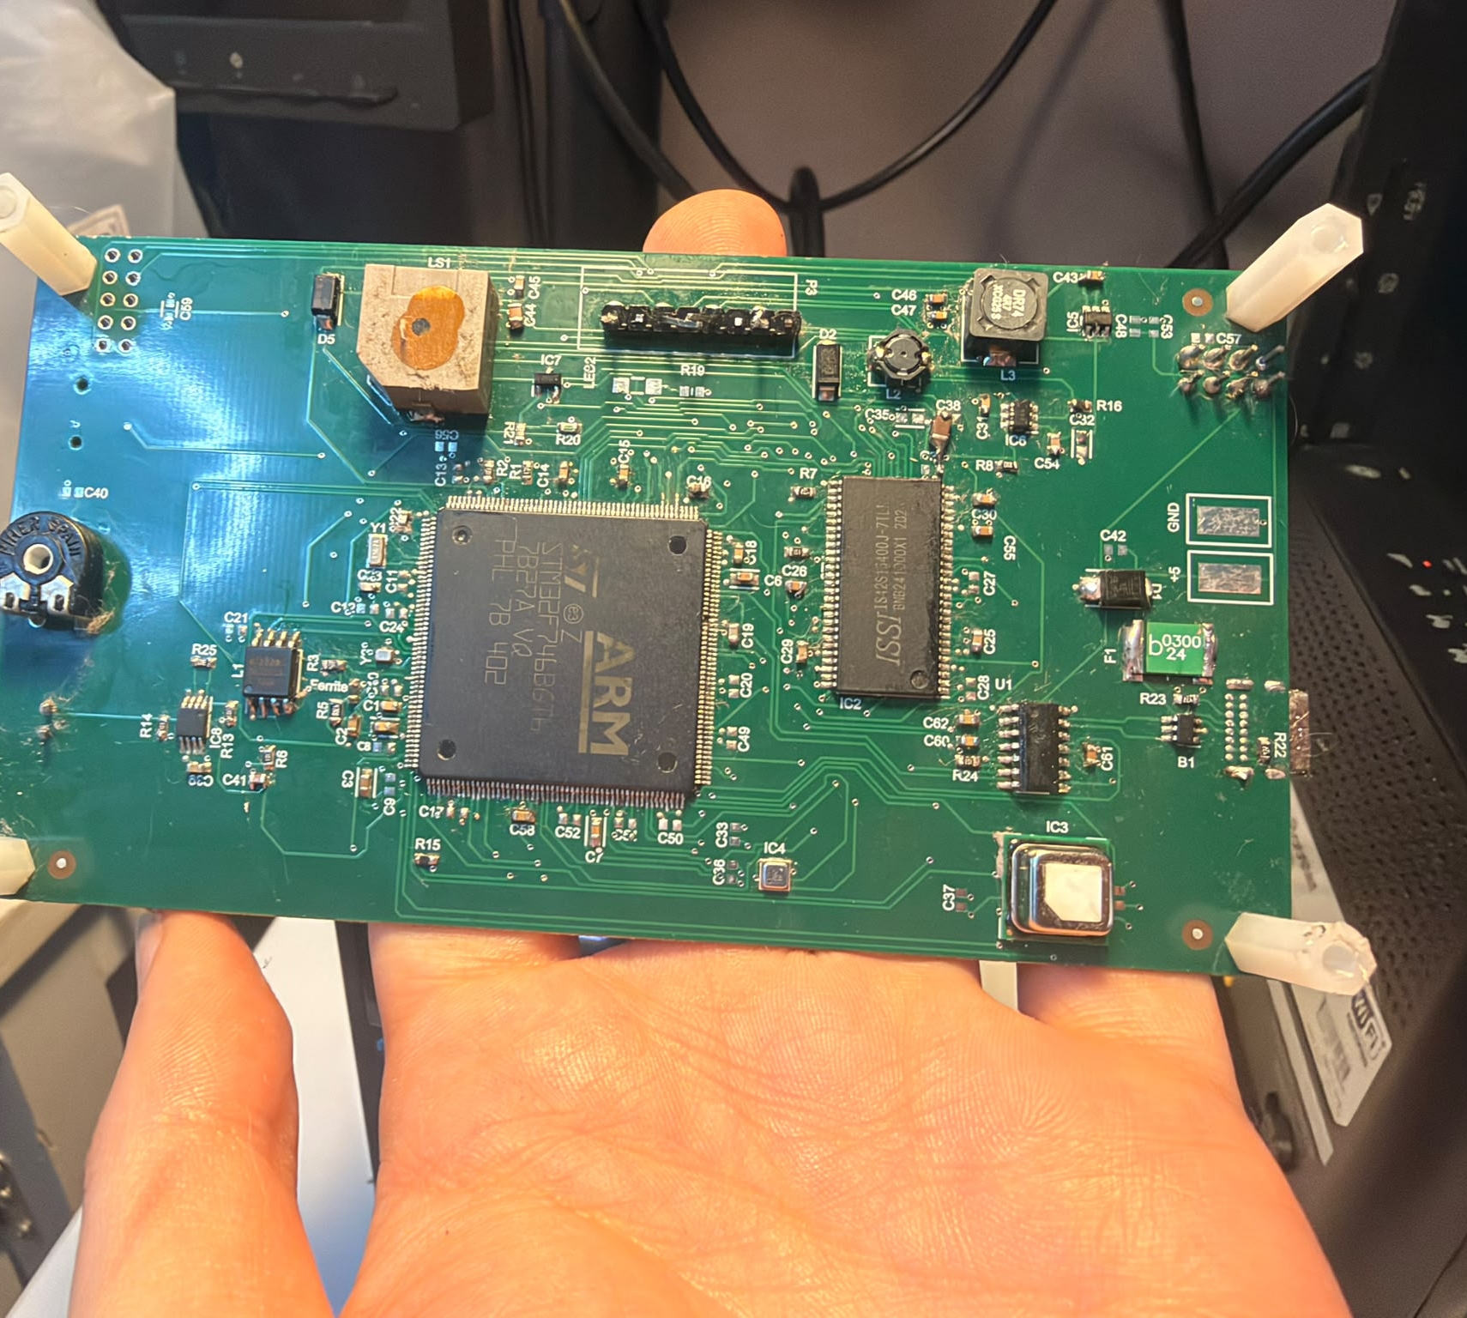
PROJECT OUTCOME
02
One PCB delivers four complete outcomes
The prototype is evaluated as an integrated system—not as isolated circuits.
LIVE
LOCAL
LOCAL ENVIRONMENTAL DASHBOARD
INDEPENDENT ALARM PATH
CLOUD
2×
WI-FI, BLYNK AND WEATHER
EXTERNAL-MEMORY TECHNOLOGIES
Core result
Senses · displays · warns · stores · communicates
SMART HOME HUB · ADVANCED PCB
02 / 12
Notes:
The project deliberately combines sensing, a high-pin-count RGB display, switch-mode power, Wi-Fi, local alarms and two external memories. The core achievement is that these functions operate together on one manufactured board.
[Sources]
- Smart_Home_Hub_Technical_Report(1).pdf, pp. 2–7.
- User-supplied component-side photograph: WhatsApp Image 2026-08-16 at 1.04.46 PM.jpeg.

Slide 3
SYSTEM ARCHITECTURE
03
STM32F746 coordinates every subsystem
ROOM SENSORS
USER OUTPUT
SCD41 · I²C4
BME688 · I²C3
STM32F746BGT6
480×272 RGB display
Backlight + buzzer
200 MHz Cortex-M7
SAFETY INPUTS
LTDC · FMC · QSPI · ADC · UART · I²C
CONNECTIVITY
Flame ADC + comparator
MOSFET buzzer output
ESP-01 / USART1
MCP2221A / USART3
EXTERNAL MEMORY
W25Q128 QSPI 16 MB · IS42S16400 SDRAM 8 MB
SMART HOME HUB · ADVANCED PCB
03 / 12
Notes:
The sensors use separate I²C peripherals, simplifying debugging and avoiding unnecessary bus interaction. LTDC and FMC handle the graphics path, USART1 serves the ESP-01, USART3 is exposed through the MCP2221A, and the local alarm path does not depend on the internet.
[Sources]
- Smart_Home_Hub_Technical_Report(1).pdf, pp. 7–13 and 17–19.

Slide 4
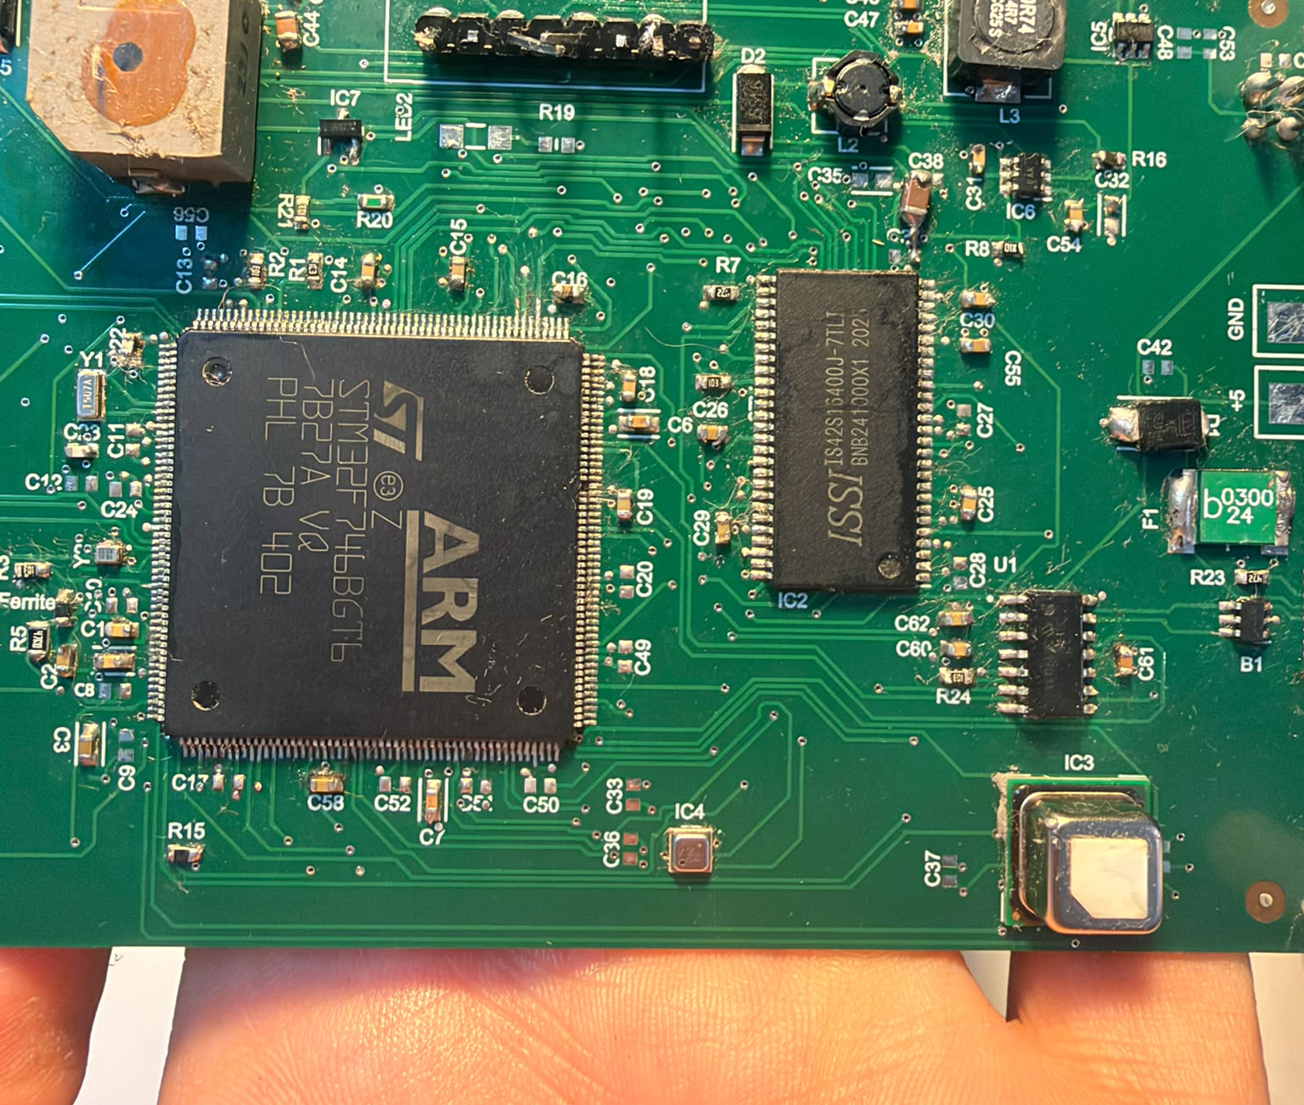
HARDWARE DESIGN
04
Power integrity and defined startup states are built in
The most important reliability choices
USB-C 5 V input with fuse and TVS protection
AP63203 3.3 V buck for MCU, sensors and logic
Ferrite-filtered VDDA / VREF+ with local decoupling
TPS61165 constant-current display backlight
Gate pull-down keeps the buzzer silent during reset
Hardware defaults remain safe before firmware starts.
SMART HOME HUB · ADVANCED PCB
04 / 12
Notes:
The board is powered from a regulated 5 V adapter. The digital rail is generated locally, the analog supply is filtered, and important control nodes have physical pull resistors so power-up cannot unintentionally activate the buzzer.
[Sources]
- Smart_Home_Hub_Technical_Report(1).pdf, pp. 8–12.
- User-supplied close-up: WhatsApp Image 2026-08-16 at 1.04.46 PM (1).jpeg.

Slide 5
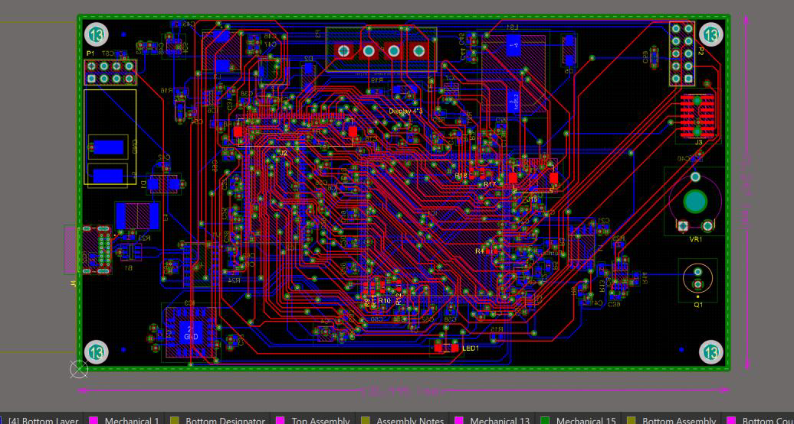
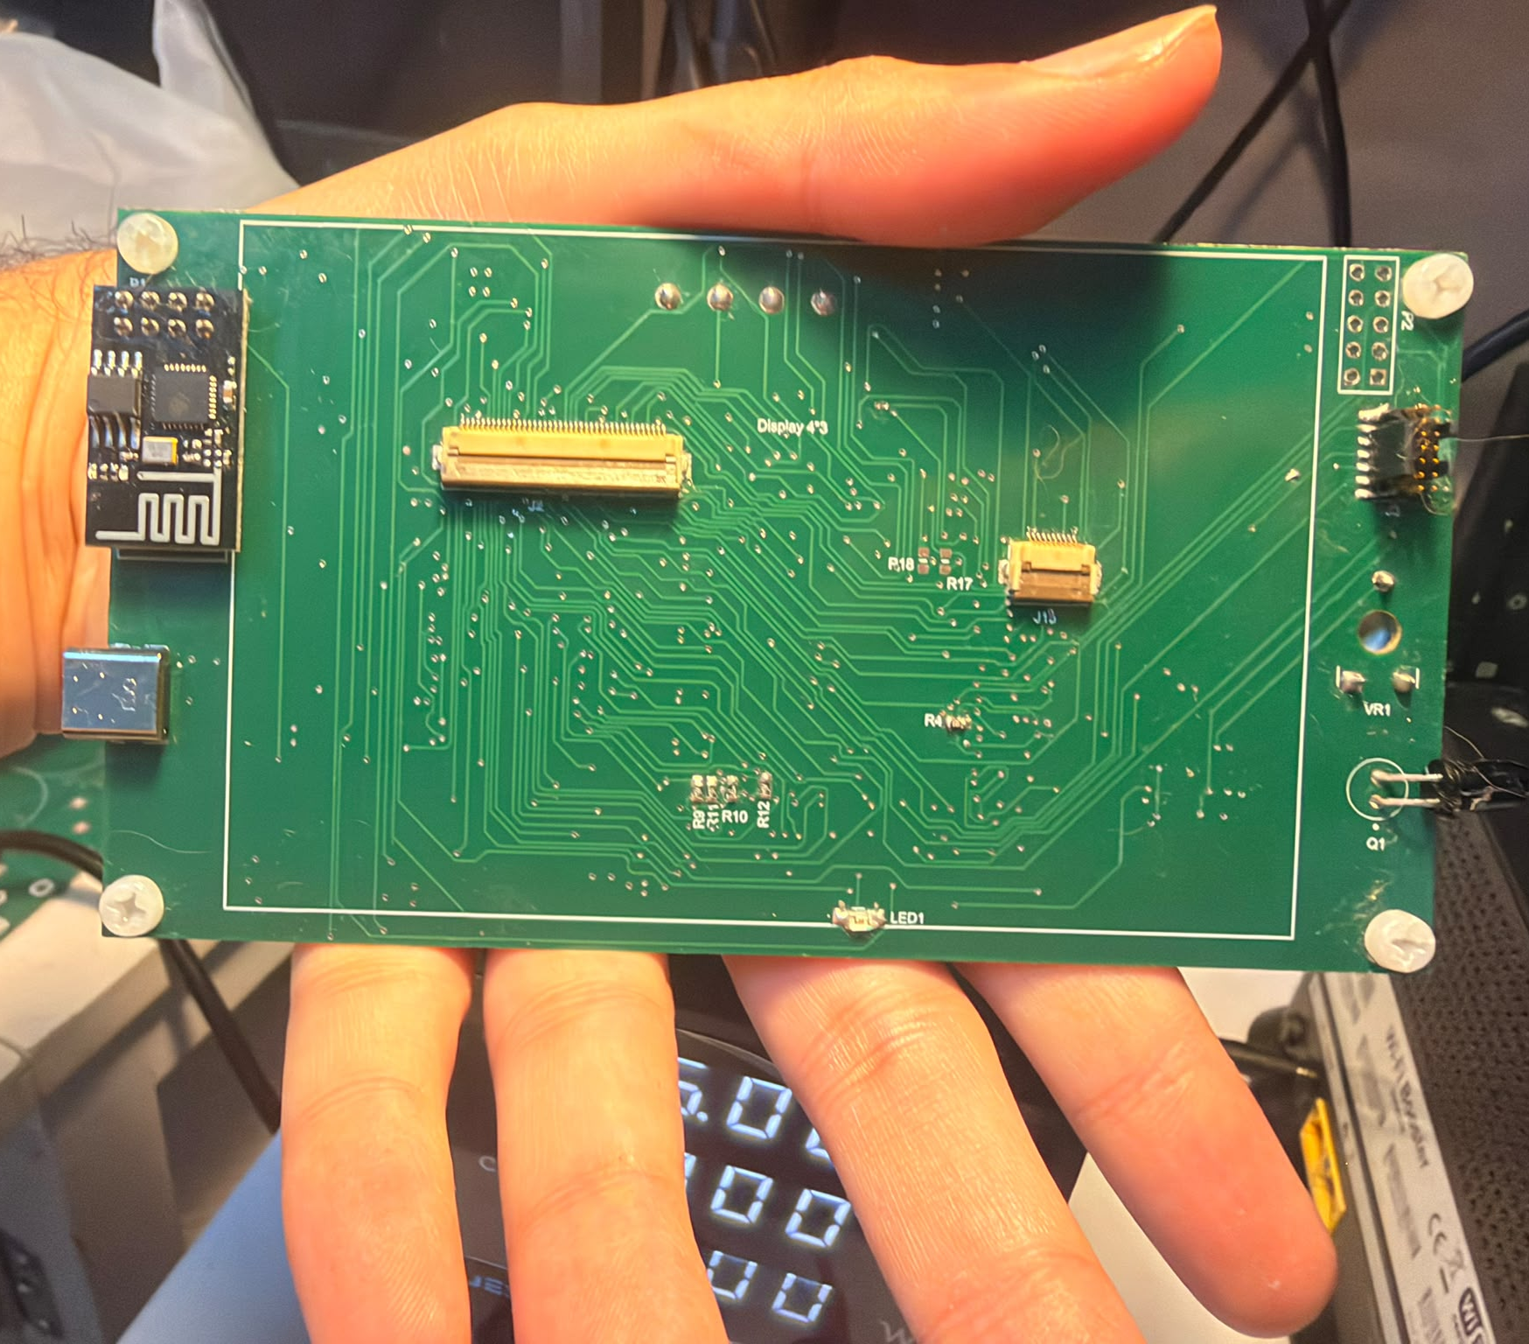
PCB IMPLEMENTATION
05
The four-layer stack provides continuous return paths
TOP
SIGNAL
L1
GND PLANE
L2
3V3 PLANE
BOTTOM
SIGNAL
Dense MCU/display escape routing stays referenced to the internal GND plane; switch-mode loops are kept away from sensor and analog sections.
SMART HOME HUB · ADVANCED PCB
05 / 12
Notes:
Layer 1 is a continuous ground reference and layer 2 distributes 3.3 V. The stack supports dense MCU, SDRAM and display escape routing while controlling current-return paths; DRC and fabricator CAM feedback were incorporated before production.
[Sources]
- Smart_Home_Hub_Technical_Report(1).pdf, pp. 14–16.
- User-supplied rear-side photograph: WhatsApp Image 2026-08-16 at 1.04.45 PM (2).jpeg.

Slide 6
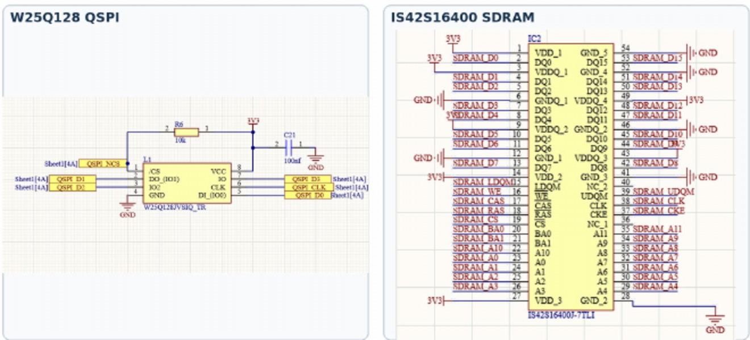
MEMORY ARCHITECTURE
06
Each memory is used for the task it performs best
16 MB
W25Q128 PERSISTENT ASSET STORE
Backgrounds · fonts · icons
8 MB
IS42S16400 WORKING AND FRAME MEMORY
Two GUI buffers · full-capacity PASS
QSPI
ASSETS
RENDER
INACTIVE
SDRAM BUFFER
LTDC
DISPLAY
JEDEC EF 40 18
0xC0000000 · ~66 MHz
SMART HOME HUB · ADVANCED PCB
06 / 12
Notes:
QSPI stores assets that must survive power loss. SDRAM supplies the capacity and bandwidth for graphics: the firmware renders into the inactive buffer, performs the required cache maintenance and swaps the LTDC address during vertical blanking to prevent full-screen flashing.
[Sources]
- Smart_Home_Hub_Technical_Report(1).pdf, pp. 13 and 17–18.

Slide 7
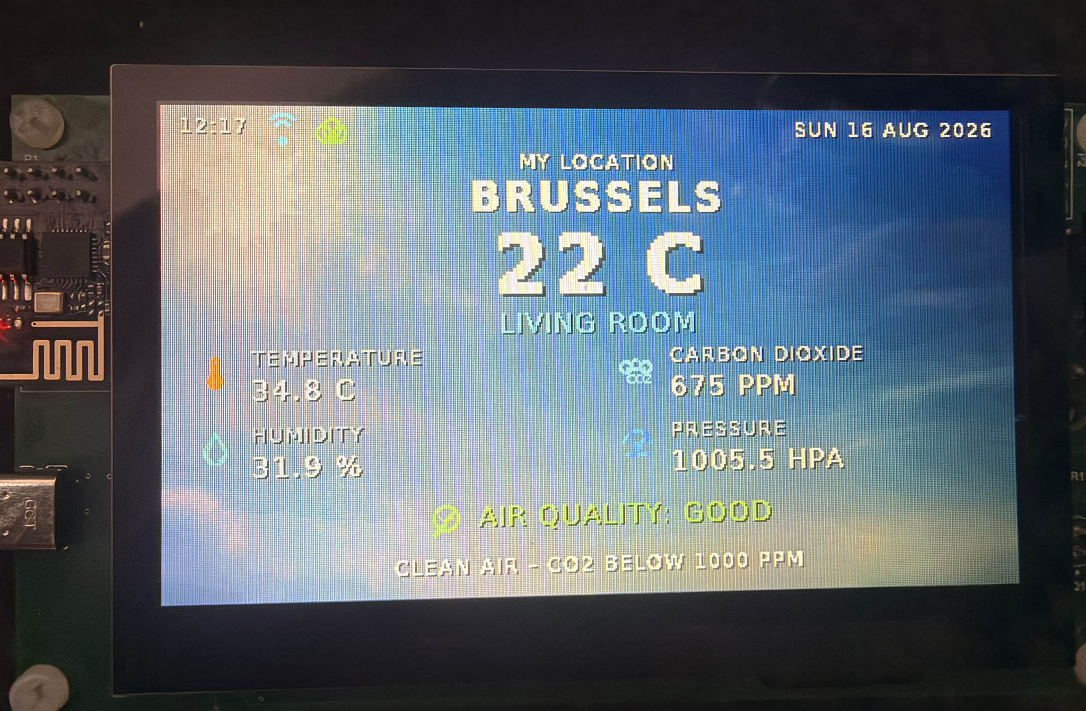
FIRMWARE AND GUI
07
The dashboard shows decisions—not raw diagnostics
Normal operation
Network time, date, location and outside temperature
Compensated SCD41 room temperature and humidity
SCD41 CO₂ and BME688 pressure
Interpreted air-quality text with status icons
Flame and gas diagnostics stay in the background until an alarm has priority.
SMART HOME HUB · ADVANCED PCB
07 / 12
Notes:
The user sees the values needed during normal operation; raw flame and gas channels remain background diagnostics. The SCD41 is the authoritative room-temperature source and uses the board-specific compensation and smoothing developed during testing; BME688 pressure remains visible while its temperature is diagnostic.
[Sources]
- Smart_Home_Hub_Technical_Report(1).pdf, pp. 17–19.
- User-supplied dashboard photograph: WhatsApp Image 2026-08-16 at 1.04.45 PM (1).jpeg.

Slide 8
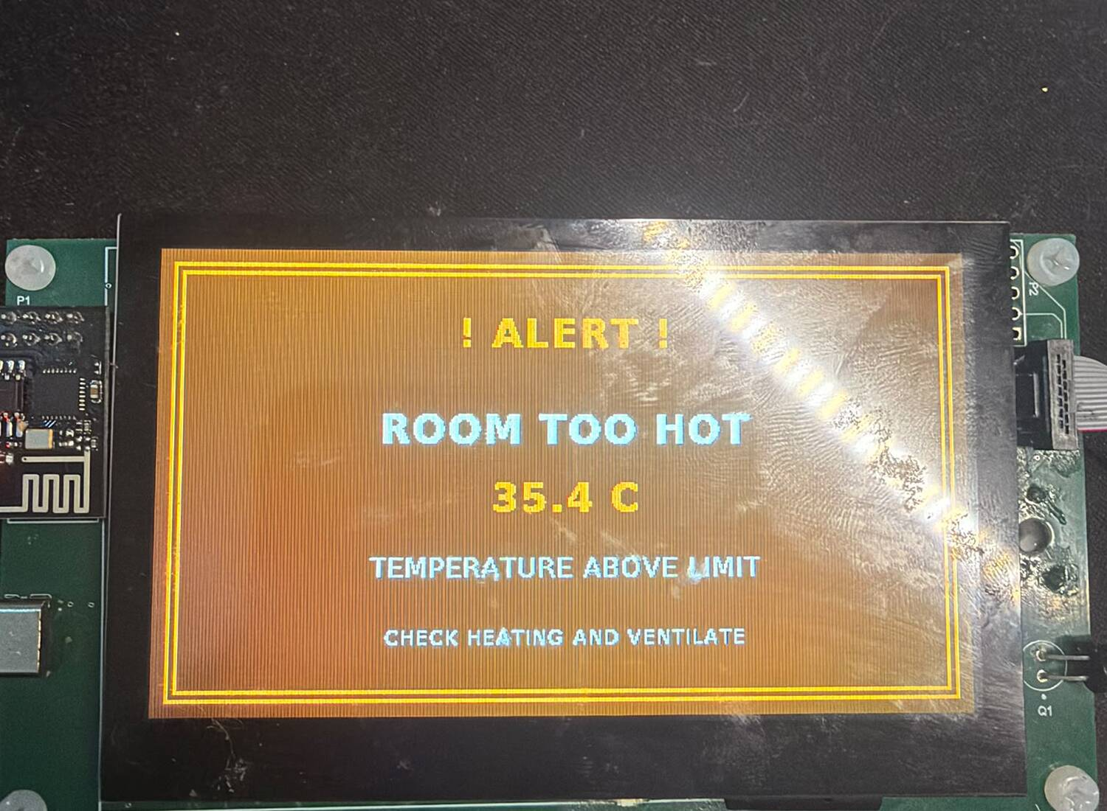
ALERT BEHAVIOUR
08
Abnormal conditions receive immediate local priority
Local path
MEASURE
Flame ADC/comparator and environmental values
CONFIRM
Persistence + hysteresis suppress chatter
WARN
Priority screen overrides the dashboard
ACT
Controlled buzzer pattern
BME688 gas resistance is an experimental relative indicator—not a certified gas-leak detector.
SMART HOME HUB · ADVANCED PCB
08 / 12
Notes:
Alarms are evaluated locally and do not depend on Blynk or internet availability. Persistence and hysteresis prevent rapid alarm chatter. The BME688 gas-resistance channel is useful for relative environmental change only and must never replace a certified gas or life-safety alarm.
[Sources]
- Smart_Home_Hub_Technical_Report(1).pdf, pp. 11 and 18–21.
- User-supplied alarm photograph: WhatsApp Image 2026-08-16 at 1.04.46 PM (2).jpeg.
- Bosch Sensortec, BME688 product page: https://www.bosch-sensortec.com/en/products/environmental-sensors/gas-sensors/bme688

Slide 9
CONNECTIVITY
09
Wireless telemetry and wired service both pass
STM32
ESP-01
BLYNK
USART1
Wi-Fi
Cloud + weather
STM32
MCP2221A
PC
USART3
USB–UART
Terminal console
✓
Wi-Fi association + Blynk updates
PASS
✓
MCP2221A + two-way USART3
PASS
✓
Weather, time and Brussels location
PASS
Root cause repaired: USBLC6-2SC6 D+ path was shorted to GND
SMART HOME HUB · ADVANCED PCB
09 / 12
Notes:
The ESP-01 provides cloud telemetry and internet data over USART1. The final MCP2221A result supersedes the earlier report status: continuity testing located a USBLC6-2SC6 D+ path short to ground, and after rework the device enumerated and USART3 communication passed in both directions.
[Sources]
- Smart_Home_Hub_Technical_Report(1).pdf, pp. 12 and 20–22 (earlier status).
- Final bench correction supplied by the user on 16 August 2026: MCP2221A PASS after USBLC6-2SC6 D+ short repair.

Slide 10
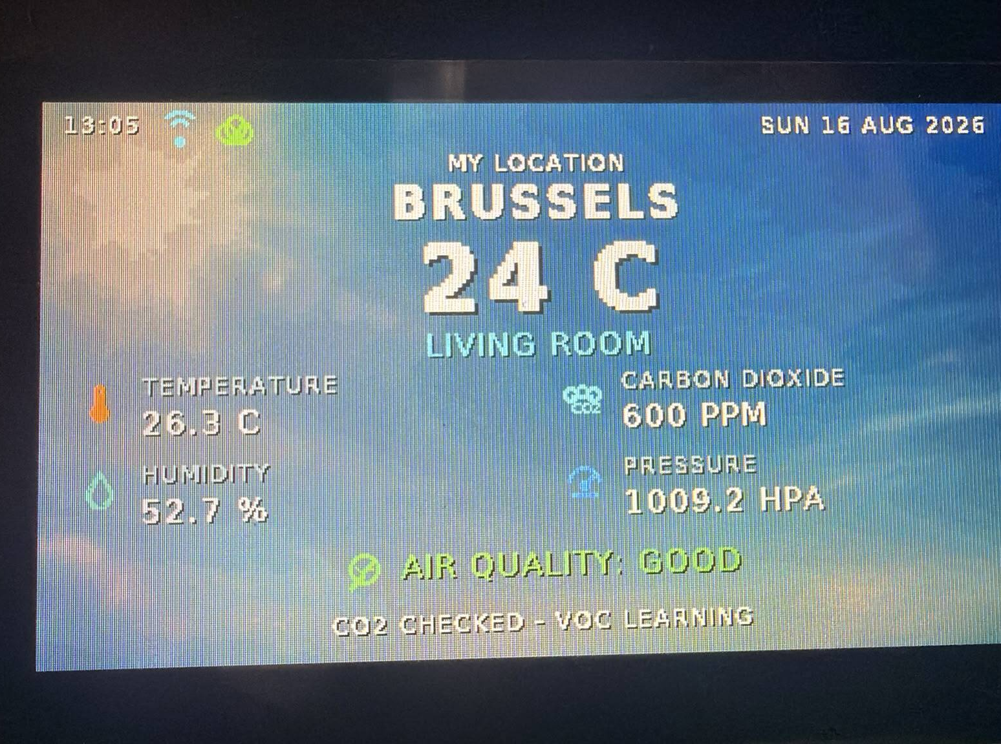
VERIFICATION
10
End-to-end tests confirm every core subsystem
✓
Power · MCU · display · backlight
PASS
✓
SCD41 · BME688 · flame · buzzer
PASS
✓
ESP-01 · Blynk · weather · USB UART
PASS
✓
QSPI EF 40 18 · full 8 MB SDRAM
PASS
!
GT911 touch — external FPC torn
NOT TESTABLE
PASS means observed end-to-end behaviour—not only device enumeration.
Touch is the only unavailable fitted feature.
Representative final snapshot
26.3 °C · 52.7 % · 600 ppm · 1009.2 hPa
SMART HOME HUB · ADVANCED PCB
10 / 12
Notes:
The displayed values are demonstration snapshots rather than calibration certificates. A PASS was assigned only when the intended end-to-end function was observed. Touch remains not testable because the external GT911 flex was mechanically torn; that is the single remaining unavailable feature.
[Sources]
- Smart_Home_Hub_Technical_Report(1).pdf, pp. 20–21.
- User-supplied verified dashboard photograph: WhatsApp Image 2026-08-16 at 1.05.11 PM.jpeg.
- Final MCP2221A status supplied by the user on 16 August 2026.

Slide 11
PROBLEMS AND CORRECTIONS
11
Measured faults became engineering improvements
BACKLIGHT
SDRAM
USB UART
TOUCH
Reversed Schottky diode
Solder/FMC configuration
D+ protection path short
External flex torn
1
2
3
4
Polarity corrected
8 MB verified
Enumeration restored
Rev-B serviceability
THE DEBUGGING METHOD
Observe the symptom → measure the node → isolate hardware from firmware → repeat the full functional test
SMART HOME HUB · ADVANCED PCB
11 / 12
Notes:
The project did not succeed because no fault occurred; it succeeded because each fault was isolated systematically. Voltage probing found the backlight polarity issue, repeatable memory patterns separated configuration from solder problems, and continuity testing located the USB D+ short.
[Sources]
- Smart_Home_Hub_Technical_Report(1).pdf, pp. 22–23.
- Final SDRAM and MCP2221A results supplied by the user on 16 August 2026.

Slide 12
LIVE DEMONSTRATION
12
Finish by proving the complete signal path
01
02
03
04
05
DASHBOARD
SAFE ALARM
CLOUD
USB UART
MEMORY
Show live room values
Use flame input or test injection
Show one fresh Blynk value
Send a console command
Show QSPI ID + SDRAM PASS
One manufactured PCB now senses, displays, warns, stores and communicates.
REV B · replaceable touch assembly · better sensor thermal isolation · authenticated TLS
SMART HOME HUB · ADVANCED PCB
12 / 12
Notes:
[Sources]
- Smart_Home_Hub_Technical_Report(1).pdf, pp. 20–25.
- Final integrated status supplied by the user on 16 August 2026.

