Slide 1
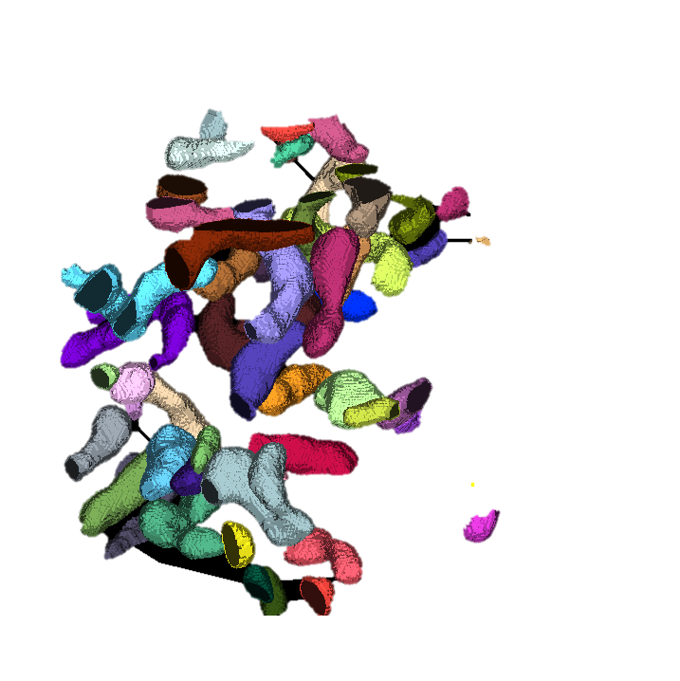
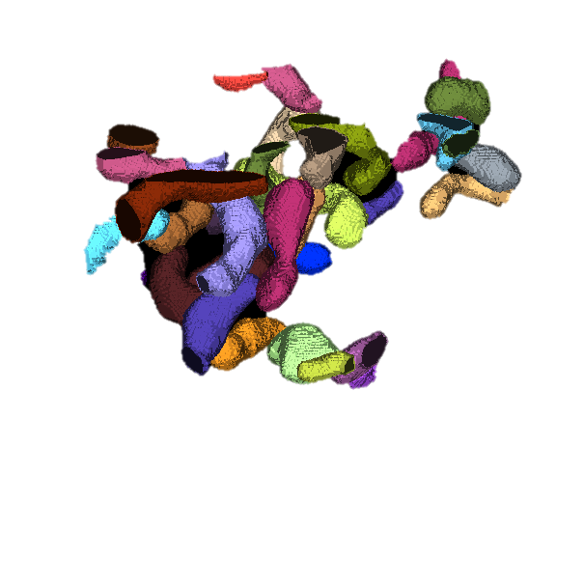
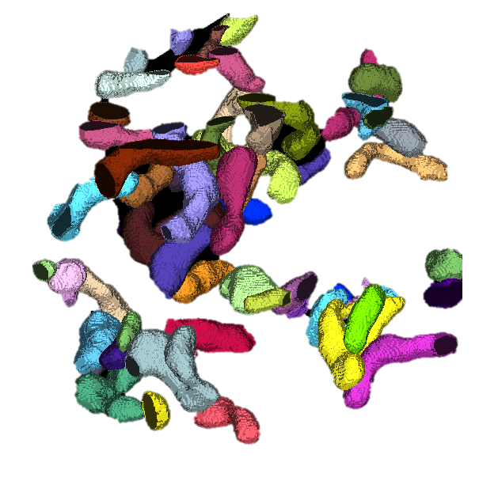

Empanada (EM Panoptic Any Dimension Annotation) is a tool for panoptic segmentation of organelles in electron microscopy (EM) images in 2D and 3D. Panoptic segmentation combines both instance and semantic segmentation enabling a holistic approach to image annotation with a single deep learning model.

Slide 2
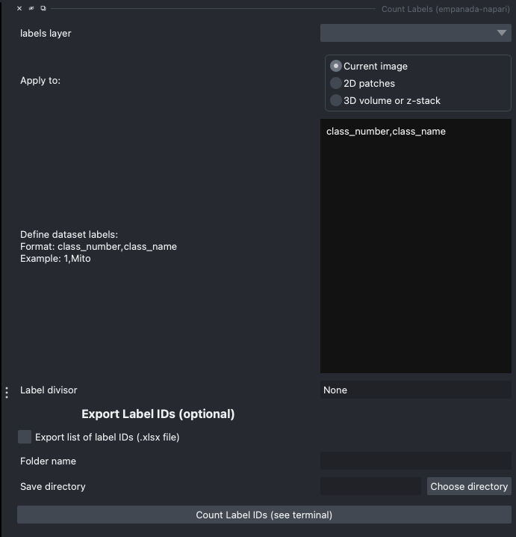
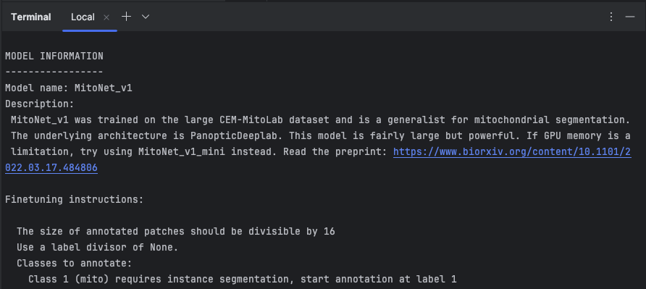
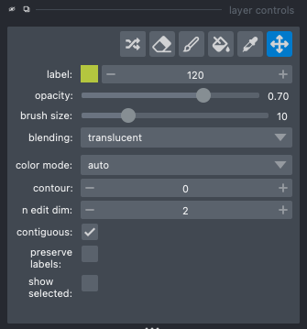
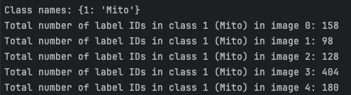
Empanada (EM Panoptic Any Dimension Annotation) is a tool for panoptic segmentation of organelles in electron microscopy (EM) images in 2D and 3D. Panoptic segmentation combines both instance and semantic segmentation enabling a holistic approach to image annotation with a single deep learning model.

Slide 3


Slide 4
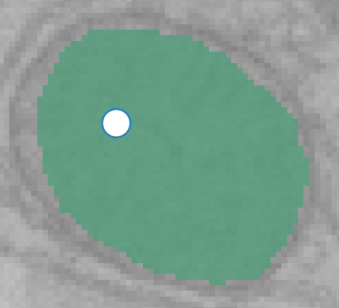
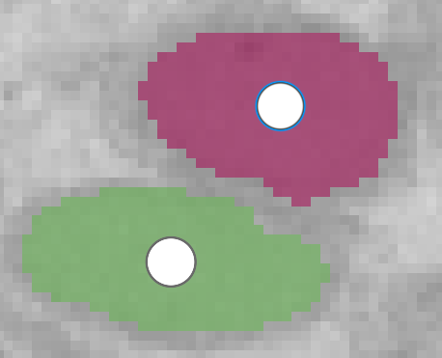

Slide 5
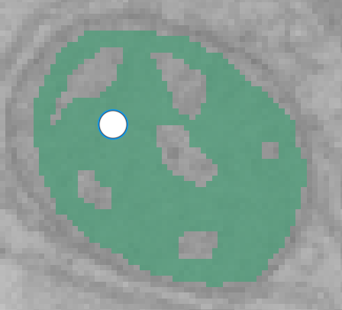

Slide 6
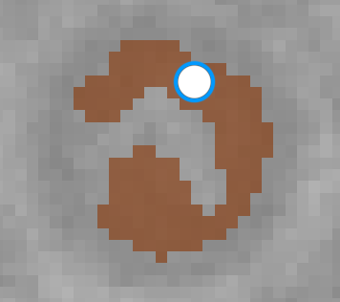
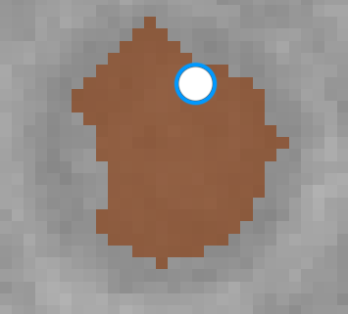

Slide 7
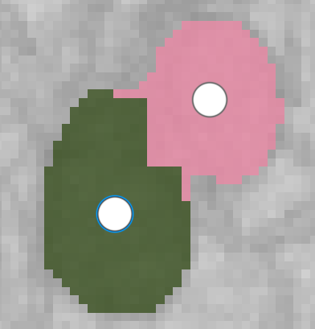
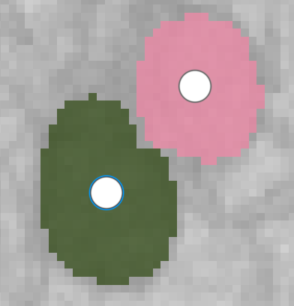

Slide 8
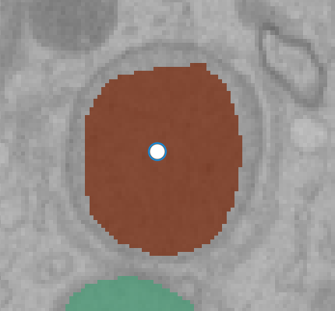
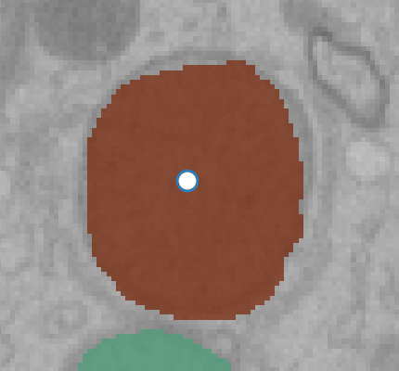
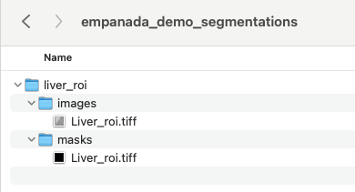

Slide 9


