Slide 1
Simulator Lab Exercises for Kongsberg TPPS and Thermodynamics
Serhat Beyenir & Sanja Boskovic
UC2026 Vancouver
26.10.2026 — 29.10.2026

Slide 2
Background

Slide 3
Boiler Plant Computer Simulation 1 & 2
Simulated thermal power plant operations
Plant start-up and shutdown procedures
Emergency operations and troubleshooting
Efficient plant operation
Three-month credit toward qualifying time for a Third Class Power Engineer certificate under the B.C. Safety Standards Act

Slide 4
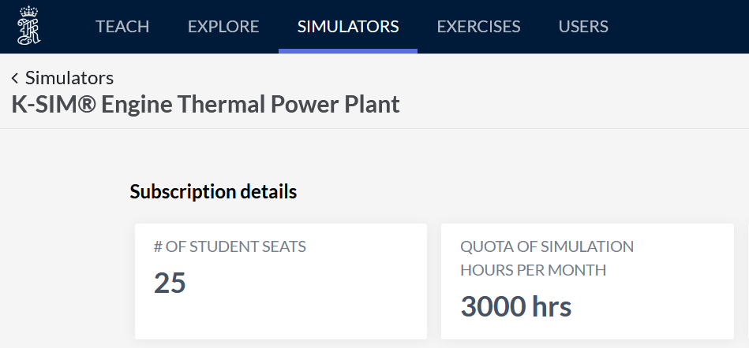
Cloud-based Setup

Slide 5
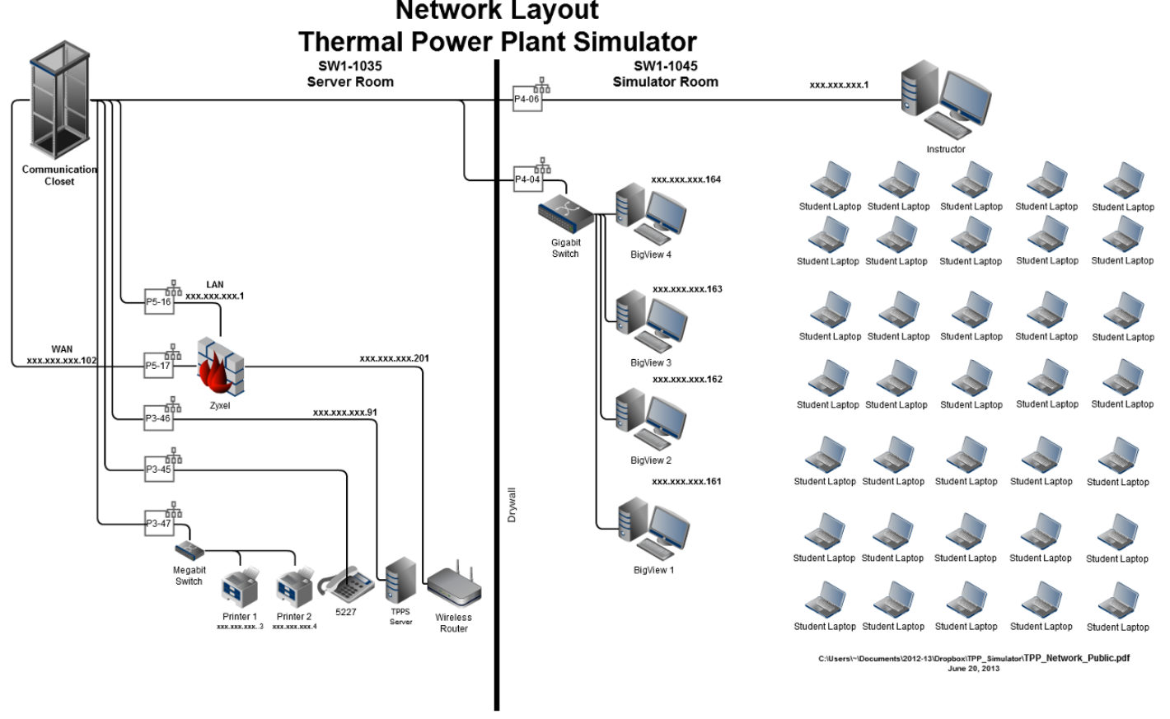
In-class Setup

Slide 6
In-class Setup
In-class system photos available at
https://study.volumen.ca/TPPS/K-Sim.html

Slide 7
Simulator Lab Exercises

Slide 8
Overview
Simulator lab exercises (SIM LABS) support Thermodynamics and Thermal Power Plant Simulator (TPPS) courses
Built on Kongsberg’s TPPS platform
This session presents a selection of SIM LABS developed for classroom and lab use

Slide 9
The Challenge
Power Engineering students often struggle with theoretical concepts
Instructors face limited instructional time to cover both theory and practice
A gap remains between classroom theory and hands on plant operation

Slide 10
How SIM LABS Help
Strengthen understanding of core ThermoFluids principles
Support application of theory in realistic operational contexts
Allow students to visualize processes and explore system behaviour
Build cause and effect connections between operating parameters and outcomes

Slide 11
Learning Benefits
Enhance conceptual comprehension
Prepare learners for hands on work with real equipment in a physical plant
Reinforce safe operational practices
Build environmental awareness within steam plant systems

Slide 12
SIM LABS
Boiler Efficiency
Turbine Efficiency
Power Plant Efficiency
NOx Emissions
Heat Exchangers
Combustion Analysis

Slide 13
SIM LABS Featured in This Session
Boiler Efficiency
Turbine Efficiency
Power Plant Efficiency

Slide 14
Boiler Efficiency

Slide 15
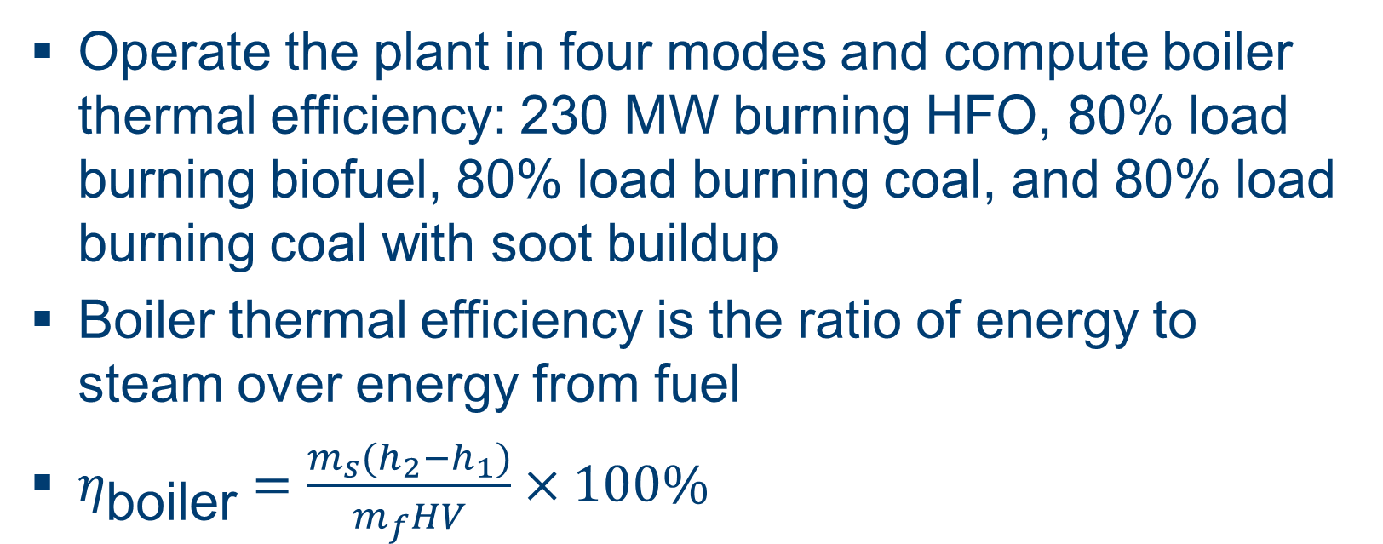
Objective and Theory
Operate the plant in four modes and compute boiler thermal efficiency: 230 MW burning HFO, 80% load burning biofuel, 80% load burning coal, and 80% load burning coal with soot buildup
Boiler thermal efficiency is the ratio of energy to steam over energy from fuel
$η_{\text{boiler}}=\frac{m_{s}(h_{2}−h_{1})}{m_{f}HV}×100\%$

Slide 16
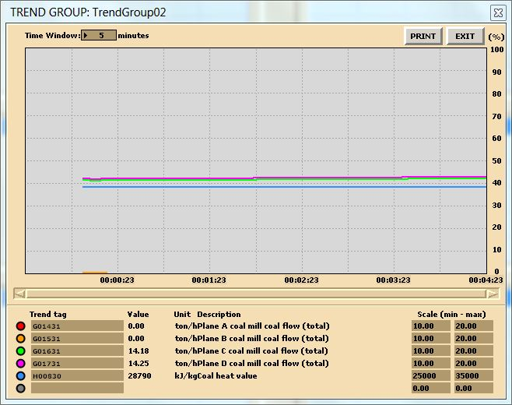
Data Collection
Use of trends.

Slide 17
Heating Values: Trend Tags to Log
Tag | Description
H00810 | HFO heating value
H00870 | Pellet heating value (biofuel)
H00830 | Coal heating value

Slide 18
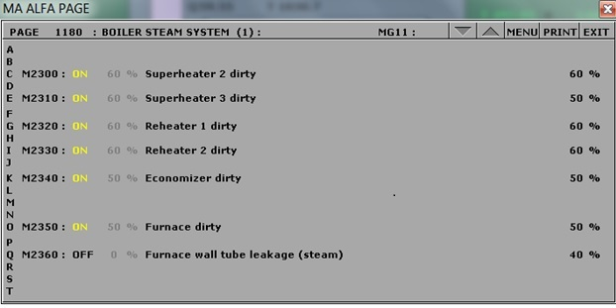
Simulating Soot Buildup
Coal operation with soot buildup.

Slide 19
Normal Operation
Tag | Description | Value | Unit
P02601 | HP line steam pressure | 144.72 | bara
T02602 | HP line steam temperature | 537.81 | °C
H02603 | HP line steam enthalpy | 3422 | kJ/kg
T02447 | Start up heat exchanger feedw outlet temp | 248.92 | °C
H02448 | Start up heat exchanger feedw outlet enthalpy | 1071.3 | kJ/kg
G02600 | HP line steam flow | 650.25 | ton/h
 | Heat Transferred: | 1528542675 | kJ/h

Slide 20
Soot Buildup
Tag | Description | Value | Unit
P02601 | HP line steam pressure | 141.72 | bara
T02602 | HP line steam temperature | 463.93 | °C
H02603 | HP line steam enthalpy | 3217.6 | kJ/kg
T02447 | Start up heat exchanger feedw outlet temp | 243.08 | °C
H02448 | Start up heat exchanger feedw outlet enthalpy | 1046.3 | kJ/kg
G02600 | HP line steam flow | 666.3 | ton/h
 | Heat Transferred: | 1446737190 | kJ/h

Slide 21
Boiler Efficiency: Lab and Deliverables
Four initial conditions: I10, I15, I14 (coal), and I14 with soot configured via MD250
Log HFO, pellet, and coal heating value tags, then use steam tables to find enthalpy values
Deliverables: trend plots for all four conditions, efficiency computations, and a conclusion comparing results

Slide 22
Turbine Efficiency

Slide 23
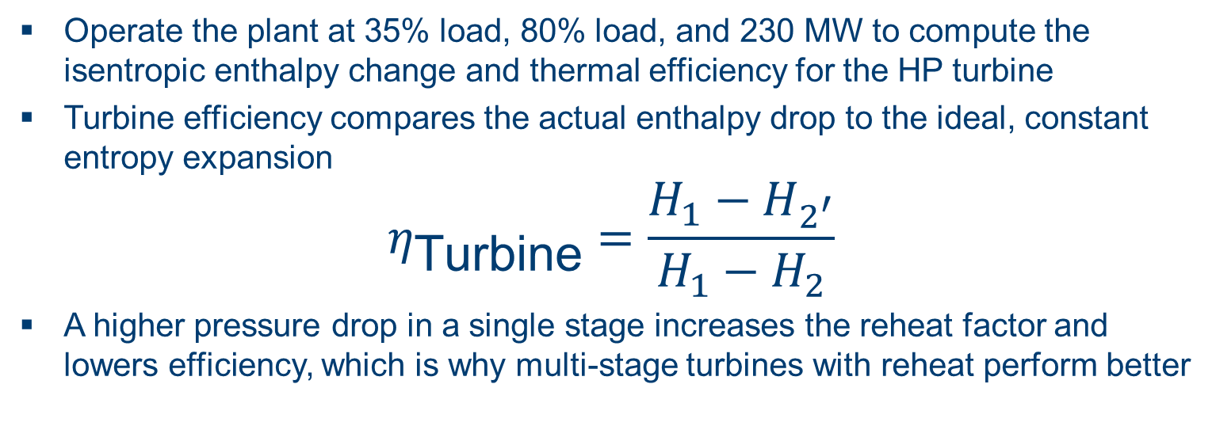
Objective and Theory
Operate the plant at 35% load, 80% load, and 230 MW to compute the isentropic enthalpy change and thermal efficiency for the HP turbine
Turbine efficiency compares the actual enthalpy drop to the ideal, constant entropy expansion
$$η_{\text{Turbine}}=\frac{H_{1}−H_{2^{′}}}{H_{1}−H_{2}}$$
A higher pressure drop in a single stage increases the reheat factor and lowers efficiency, which is why multi-stage turbines with reheat perform better

Slide 24
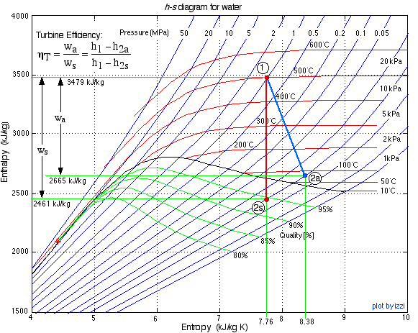
h-s Diagram
Turbine Efficiency.

Slide 25
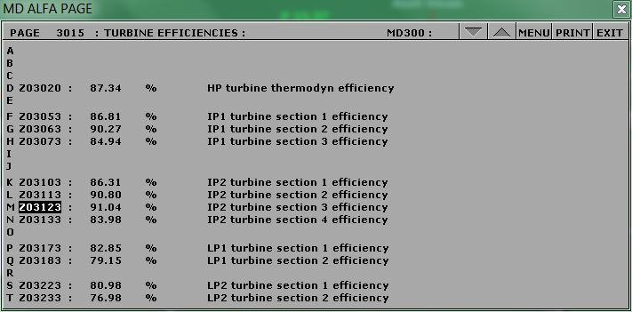
Turbine Efficiency: 101 MW Sample
I09 E23356: 101.05 MW

Slide 26
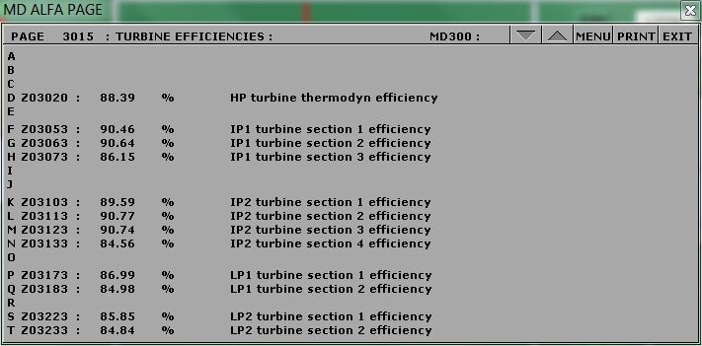
Turbine Efficiency: 250 MW Sample
I10 E23356: 249.86 MW

Slide 27
HP Turbine Efficiency (Abbreviated)
Tags | Description | Units | I13 35% Load | I14 80% Load | I10 230 MW
H03008 | HP Turbine steam enthalpy at control valve | kJ/kg | 3239.99 | 3421 | 3403.27
H03016 | HP Turbine steam enthalpy at outlet | kJ/kg | 2927.25 | 3083.99 | 3075.49
Z03020 | HP turbine thermodynamic efficiency | % | 85.95 | 88.4 | 88.39
 | Actual Change in Enthalpy | kJ/kg | 312.74 | 337.01 | 327.78
 | Isentropic Change in Enthalpy | kJ/kg | 363.86 | 381.23 | 370.83
 | Calculated ηTurbine | % | 85.95 | 88.4 | 88.39

Slide 28
Turbine Efficiency: Lab and Deliverables
Three initial conditions: I13 (35% load), I14 (80% load), and I10 (230 MW)
Compare results across conditions to determine which load yields the most favourable efficiency
Deliverables: trend plots for all three conditions, efficiency computations, and a conclusion with suggestions for further study

Slide 29
Power Plant Efficiency

Slide 30
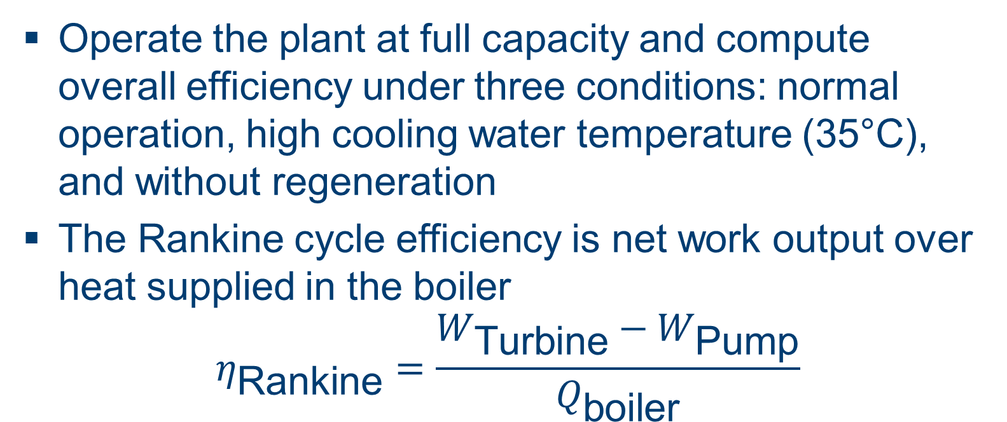
Objective and Theory
Operate the plant at full capacity and compute overall efficiency under three conditions: normal operation, high cooling water temperature (35°C), and without regeneration
The Rankine cycle efficiency is net work output over heat supplied in the boiler
$$η_{\text{Rankine}}=\frac{W_{\text{Turbine}}−W_{\text{Pump}}}{Q_{\text{boiler}}}$$

Slide 31
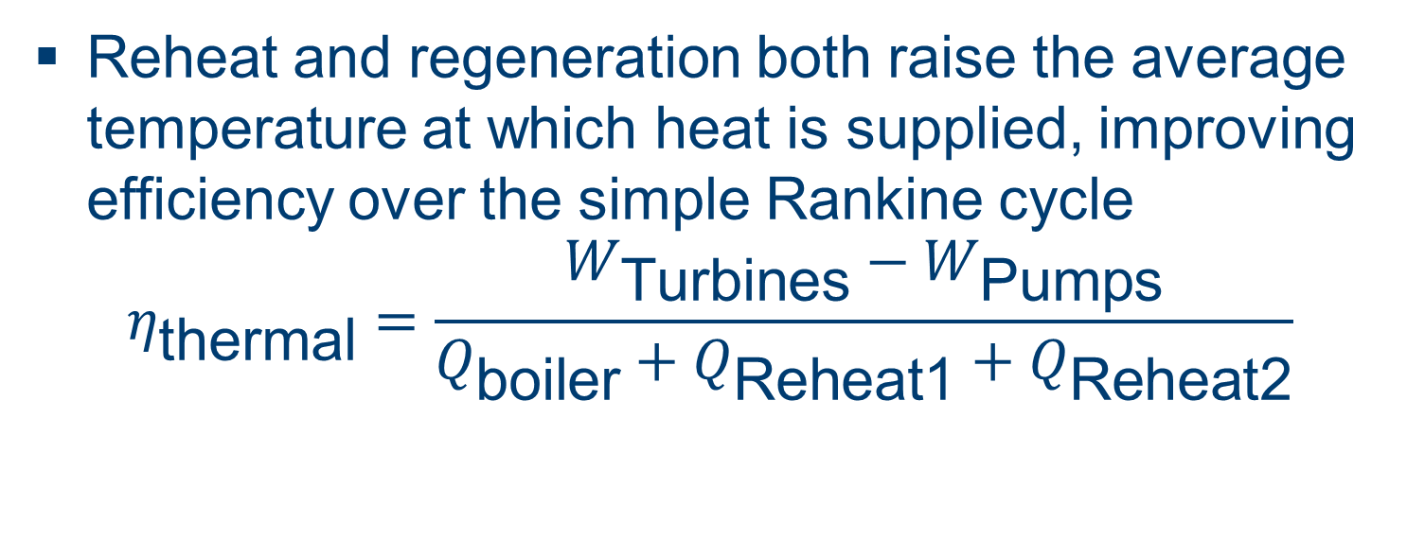
Reheat and Regeneration
Reheat and regeneration both raise the average temperature at which heat is supplied, improving efficiency over the simple Rankine cycle
$$η_{\text{thermal}}=\frac{W_{\text{Turbines}}−W_{\text{Pumps}}}{Q_{\text{boiler}}+Q_{\text{Reheat1}}+Q_{\text{Reheat2}}}$$

Slide 32
Hints & Tips: Trend Tags to Log
Tag | Description
Q02395 | Reheater 1 transferred heat
Q02375 | Reheater 2 transferred heat

Slide 33
Hints & Tips: Temperature Settings
For Boiler Feedwater Inlet Temperature, use the Startup Heat Exchanger Feedwater Outlet Temperature (tag T02447).
For the third calculation, make sure you closed all steam extraction valves and set T00305 to 10°C:

Slide 34
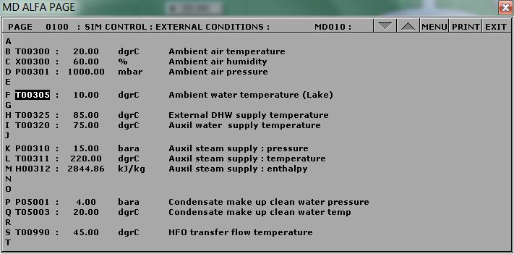
Lake Water Temperature Setting
Lake water temperature T00305

Slide 35
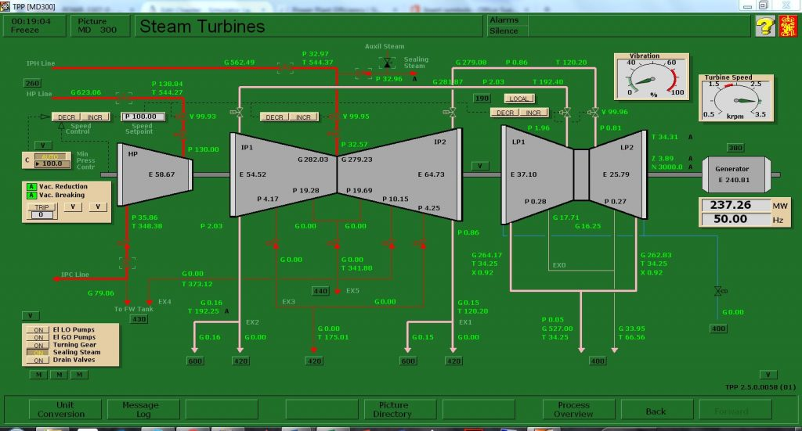
No Steam Extraction
No steam extraction MD 300

Slide 36
Power Plant Efficiency: Lab and Deliverables
Run initial condition I10 and draw a T-S diagram of the cycle including reheat and regeneration
Set cooling water temperature (tag T00305) to 35°C for the high temperature case, and to 10°C with extraction valves closed for the no regeneration case
Deliverables: T-S diagram, trend plots, efficiency computations for all three conditions, and a conclusion

Slide 37
Summary

Slide 38
Conclusion
SIM LABS bridge the gap between theory and practical plant operation
Each lab pairs a theoretical model with hands on simulator operation, reinforcing safe practice and environmental awareness
Q&A

