Slide 1
Wave Propagation by
Shishir Jagtap

Slide 2
Radio waves are affected during propagation by
Reflection and refraction waves
Atmospheric attenuation due to absorptions
Diffraction and obstruction loss
Fading (Multipath propagation)
Curvature of the Earth
Free space loss (explained in Friss space propagation)
Scattering of radio waves
Depolarization of radio waves
Sun spot cycle:(is a 11yrs cycle during which radiation varies drastically, it changes f_{c})
Magnetic storms.
Note: These are applicable to space and sky wave propagation

Slide 3
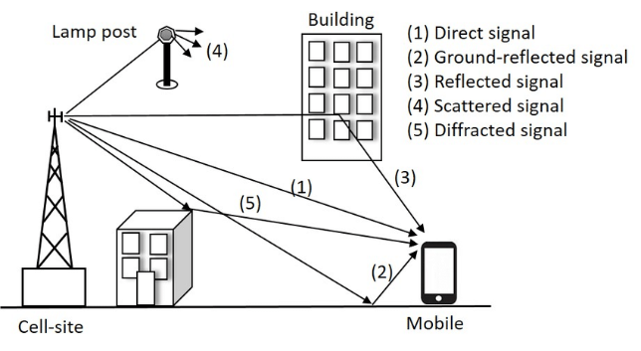
Multipath Propagation
Fading: It causes fluctuations in the received signal strength and it occurs due to multipath propagation.
Multipath propagation : Two or more signals takes different paths to reach the receiver, therefore, these signals will not reach the receiver at same time and therefore, there will be a phase difference between them.
The received signals interfere constructively and destructively, which causes fading.
Constructive/destructive interference between signals depends on phase difference.
At some time instant, when the phases of the received signals are same, constructive interference will occur and received signals will add up and at some other time instance when the received signals are out of phase, destructive interference will occur and received signals will cancel each other.

Slide 4
Reflection and Refraction of waves : Whenever waves are passing from one medium to other reflection and refraction occurs.
For both reflection and refraction, it is assumed that the surfaces involved are much larger than the wavelength; if not, diffraction will occur
Diffraction : The bending of wave around sharp edges and corners of obstacles (reduces the signal strength) appearing in their path is called as diffraction.
In the obstructed or shadow region, the received signal strength depends on position of the receiver and geometrical shape of the obstruction.
Diffraction allows the signals to propagate in regions which lie behind the obstruction.
Example : If the receiver is placed behind an obstruction such that the LOS path is completely obstructed, then due to diffraction phenomenon, the field can still have enough strength to reach the receiver.

Slide 5
Scattering: Change in direction of a signal. It occurs due to imperfect medium/structural inhomogenities .
The size of the Structural inhomogenities (obstacles) are much smaller than wavelength.
Scattering causes wave (signals) to deflect in multiple directions

Slide 6
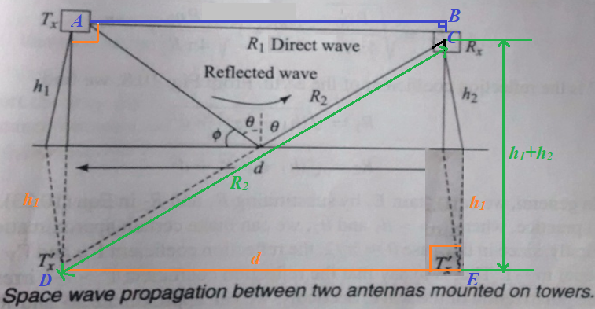
Space wave propagation over Flat Earth
Assuming flat earth and the transmitting and receiving antennas are isotropic.
In reality, d >>h1,h2.
Therefore, the angle of incidence ϴ is close to 90⁰ & the angle ϕ is close to 0⁰.
Since, the wavelength is much shorter now, the reflection seems to be a mirror like reflection.

Slide 7



Space wave propagation over Flat Earth
When seen from the receiver, the reflected wave seems to be originating from the image of the transmitter. In fact, the reflection point O is obtained by joining the image of the transmitter and receiver by a straight line.
The reflection coefficient at the earth’s surface depends upon the polarization of the wave.
Assuming that the earth has conductivity and dielectric constant . The intrinsic impedance of earth is
…..(1)
The reflection coefficient for the two polarizations can be written as
..(2) ..(3)

Slide 8




Space wave propagation over Flat Earth
Let us now assume that the transmitting antenna radiates P watts of power Isotropically. The radiated E field at a distance R then is,
…(4)
The electric field at the receiver, which is sum of the electric fields of the direct and the reflected waves can be written as
..(5) ...(6)
From Fig. 10.8, we find,
…(7) ….(8)
Since in this case , the reflection coefficient is almost equal to -1.
Now for d >> h1 and h2, …(9) …(10)

Slide 9


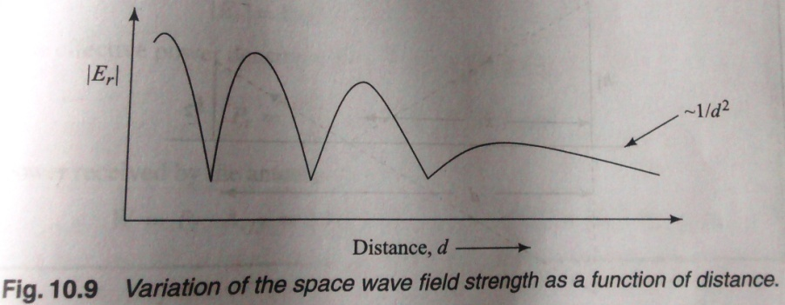
Space wave propagation over Flat Earth
Substituting equation (9) and (10) in (6), we get,
…(11)
The electric field strength of the space wave has decaying sinusoidal variation as shown in Fig.10.9.

Slide 10


Space wave propagation over Flat Earth
For short distance the field strength varies from maximum to null.
However, as the distance becomes large the field strength monotonically decreases as a function of distance.
For large d, we can approximate,
Substituting this in equation (11), we get,
At large distance, therefore, the field strength varies as and consequently decreases much rapidly compared to the 1/d variation of a wave.
The sharp decrease in the field strength is due to the reflected wave which cancels the electric field of the direct wave.
In presence of the earth, therefore, the space wave also provides a mode of transmission only over short distances.
By using directional antennas, the effect of the reflected wave can be reduced, to increase transmission range.

Slide 11
Space wave propagation over Spherical Earth
The above analysis of the space wave assumes a flat earth.
However, in reality the earth is spherical and the curvature of the earth cannot be neglected beyond a distance of few tens of km.
The curvature of the earth affects the space wave in two ways.
(i) For a given height of transmitter/receiver tower, there is an upper limit on the distance over which there is line of sight between the transmitter and the receiver.
(ii) The angle between the direct wave and the reflected waves reduces making it difficult to suppress the reflected wave using directional antennas.
Maximum distance between the transmitter and receiver is obtained when both the direct and the reflected waves become tangential to the earth’s surface.

Slide 12
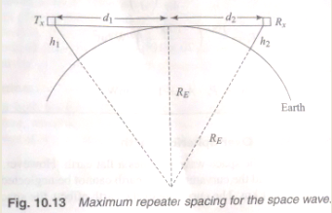


Space wave propagation over Spherical Earth
By increasing the height of transmitter and/or receiver the transmission range can be increased.

Slide 13
Ionospheric Propagation
It is also called as Sky wave propagation
Suitable for long distance communication
Suitable for frequencies of : 2 to 30 MHz
Ionosphere is the upper portion of the atmosphere (approximately between 80 km to 500km) above the earth, which is ionised by sun radiation.
Ionised gas is also called as Plasma.
Plasma is the 4th state of matter
Ionosphere is created due to ionization of earth’s atmospheric gases by sun radiation.
The atmospheric density is highest near the earth’s surface and it monotonically decreases with the altitude.

Slide 14
Ionospheric Propagation
The sun (solar) radiation on the contrary is strong at higher altitudes and its intensity decreases due to atmospheric absorption as it moves towards the earth’s surface.
At higher altitude the radiation intensity is high but there are not sufficient molecules to get ionized.
Consequently the electron density is low at higher altitudes of 1000 km or so. As the altitude decreases the molecular density increases and consequently the electron density increases.
For further decrease in the altitude, the molecular density continues to increase but the intensity of solar radiation decreases due to absorption in the upper layers.
Consequently the electron density again decreases and practically becomes zero below an altitude of 80-90 kms.
The electron density is maximum at about 500-600 Kms above the earth’s surface.

Slide 15
Ionospheric Propagation
Depending on the ion/electron density, Ionosphere is divided into 4 spherical layers
D, E F layers, F layer is divided into two layers F1 and F2
D Layer
It is the lowest layer of the ionosphere
It exist at an average height of 70km above the earth
Its thickness is about 10km
It exist only in day time
It is not useful layer for HF communication
It reflects some VLF and LF waves
Its electron density is 400 electrons/cc
Its virtual height is 60 to 80km
Critical frequency is 180KHz

Slide 16
Ionospheric Propagation
E Layer
It exist next to D layer above the earth.
Its thickness is about 100km
Its thickness is about 25 km
It exists only in day time
The ions are recombined into molecules due to absence of Sun at night.
It disappears at nights
Its electron density is 2x10⁵ electrons/cc
Its virtual height is 110km
Critical frequency is 4MHz
Its maximum single hop range is about 2340Km

Slide 17
Ionospheric Propagation
E_{s} Layer
It is a Sporadic E layer
It appears close to E layer
Its appearance is sporadic (random) in nature
If at all it exists, it exists in both day and night
It is a thin layer
It can provide good reception but it is not a reliable layer for communication
Its ionisation density is high

Slide 18
Ionospheric Propagation
F1 Layer
It exist at a height of about 180km above the earth, in day time.
Its thickness is about 20km
It combines with F2 layer during nights
Its electron density is 400 electrons/cc
Its virtual height is 180km
Critical frequency is 5MHz
Its maximum single hop range is about 3000Km

Slide 19
Ionospheric Propagation
F2 Layer
It exist at a height of about 325Km above the earth, in day time.
Its thickness is about 200km
It falls to a height of 300 km at nights as it combines with F1 layer
The height of F2 layer varies drastically
It exists at night also
It is the topmost layer of ionosphere
It is highly ionised
It offers better HF reflection and hence reception.
Its electron density is 2x10⁶ electrons/cc
Its virtual height is 300km and 350km in night.
Critical frequency is 8MHz
Its maximum single hop range is about 3800Km in day time and 4100km at night.

Slide 20
Sr. | Parameters | Ground wave Propagation | Space wave propagation | Sky wave Propagation
1 | Suitable frequencies | Low frequencies < 224KHz (2MHz) | >30MHz | 2 to 30 MHz
2 | Suitable for | Short distance communication | Large distance communication | Very large distance communication
3 | Distance of communication | Few meters to few km (<10km) | Few 10s of Km | Few 100km to few 1000km
4 | Application | AM broadcasting | TV transmission or communication between two microwave towers. | FM and long distance communication
5 | Propagation condition | Earth surface must behave as a good conductor | Transmitter and receiver must be in LOS | Ionosphere must exist with good ionization
6 | Other name | Also called as Surface wave propagation | Also called as Tropo-spheric propagation | Also called as Iono-spheric propagation
7 | Polarization | Vertical | Horizontal / Vertical | Linear/Circular
8 | Fading effect | Does not exist | Exist | Exist
9 | Diffraction | Exist | Exist | Exist
10 | Wave | Surface wave | DW / DW+GRW | Sky wave
11 | Figure

Slide 21
Measures of Ionospheric propagation
Critical frequency
Virtual height
Maximum Usable frequency
Skip distance

