Slide 1
MICROSTRIP ANTENNA (MSA),DESIGN AND APPLICATIONS
MS. HEMA D RAUT
EXTC DEPARTMENT
SIES, GRADUATE SCHOOL OF TECHNOLOGY

Slide 2
Contents
Introduction
Microstrip Antenna (MSA)
Difference between MSA and MIC
Advantages and Disadvantages of MSA
Applications of MSA
MSA–E-field distribution, current and voltage variation
MSA Feeding Techniques
MSA - Design procedure and steps
Design of Rectangular MSA
Design Examples
References

Slide 3
Introduction
In high-performance aircraft, spacecraft, satellite, and missile applications, where size, weight, cost, performance, ease of installation, and aerodynamic proﬁle are constraints, low-proﬁle antennas are required.
Microstrip antennas (MSA) are low proﬁle, conformable to planar and nonplanar surfaces, simple and inexpensive to manufacture using modern printed-circuit technology, compatible with MMIC designs, and versatile in terms of resonant frequency, polarization, pattern, and impedance.

Slide 4
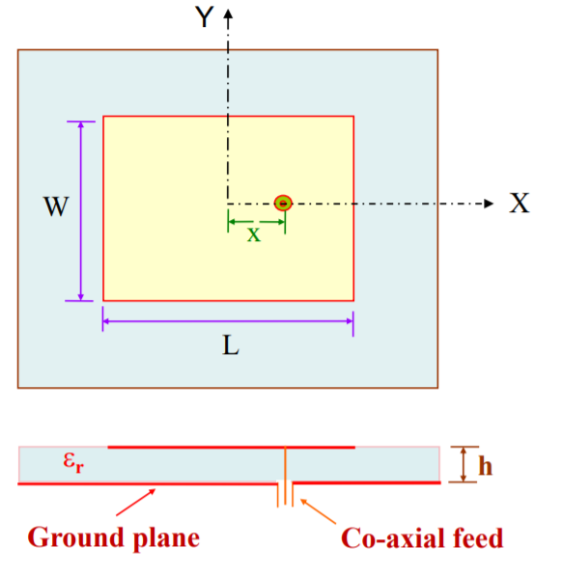
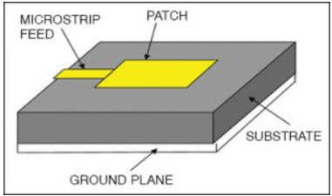
Micro-Strip Antenna (MSA)

Slide 5
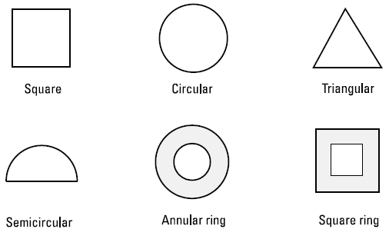
Micro-Strip Antenna (MSA)

Slide 6
Difference between MSA and MIC
Parameters | MIC | MSA
Dielectric Constant (εr) | Large | Small
Thickness (h) | Small | Large
Width (W) | Generally Small (impedance dependent) | Generally Large
Radiation | Minimum (small fringing fields) | Maximum (large fringing fields)
Examples | Filters, power dividers, couplers, amplifiers, etc. | Antennas

Slide 7
MSA-Advantages and Disadvantages
Advantages
Low weight
Small size
Ease of fabrication
Ease of integration with Microwave Integrated Circuits
They can be made conformal to the host surface.
They allow both linear polarization and CP

Slide 8
MSA-Advantages and Disadvantages
Disadvantages
Limited bandwidth (usually 1 to 5 %, but much more is possible with increased complexity
Low power handling capacity
Relatively large size at low frequency
Low gain

Slide 9
Applications of MSA
Pagers and mobile phones
Doppler and other radars
Satellite communication
Feed elements in complex antennas
Satellite navigation receiver
Biomedical radiator

Slide 10
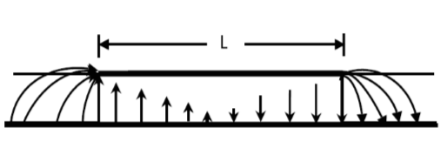
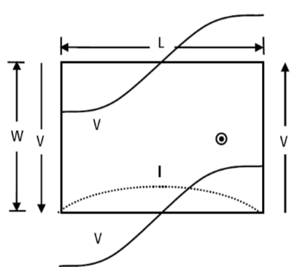
MSA - E-field distribution, current and voltage variation
Fig (a): E-field distribution
Fig (b): v/t and c/n distribution

Slide 11
MSA Feeding techniques
Two types of MSA feeding
I. Direct Feeding (Contact Feeding)
Probe feeding
Line feeding
II. In-direct Feeding (Non contact feeding)
Aperture coupled feeding
Proximity feeding

Slide 12
I. Direct feeding
Probe Feed MSA
Top View
Side view

Slide 13
I. Direct feeding
Probe Feed MSA
Advantages
Easy to fabricate & match
Low spurious radiation (around -30dB)
Disadvantages
Non-Planar antenna
Narrow BW

Slide 14
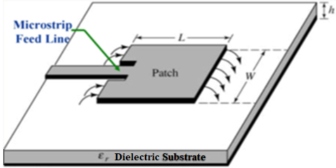
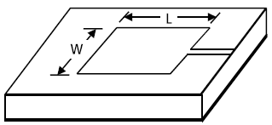
I. Direct feeding
Line Fed MSA
Dielectric Substrate
Ground plane
(a) Edge fed
(b) In-set fed MSA

Slide 15
I. Direct feeding
Line feed MSA
Advantages
Easy to fabricate & match by controlling inset feed position
Planar antenna and Low spurious radiation (around -20dB)
Disadvantages: Narrow BW ( 2 to 5%)

Slide 16
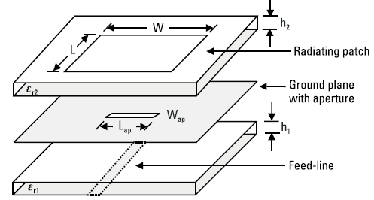
II. In-direct feeding
Aperture Coupled MSA

Slide 17
II. In-direct feeding
Aperture Coupled MSA
Advantages
Easy to model
Low cross polarization
Disadvantages
Narrow Bandwidth
Difficult to fabricate

Slide 18
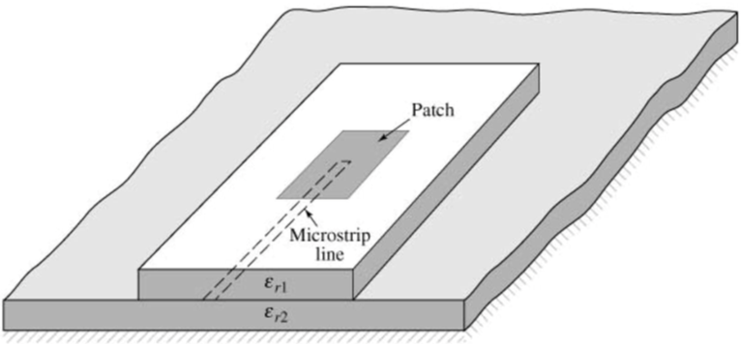
II. In-direct feeding
Proximity Coupled (Electromagnetically coupled) MSA
Ground plane

Slide 19
II. Direct feeding
Proximity Coupled MSA
Advantages
Low spurious radiations
Large BW ( up to 13%)
Easy to model
Disadvantages:
Difficult to fabricate
Cost is more

Slide 20
MSA - Design procedure and steps
The procedure assumes that the speciﬁed information includes the dielectric constant of the substrate (Є_{r}), the resonant frequency (f_{r}), and the height of the substrate h.
The procedure is as follows:
Specify: Є_{r}, f_{r} (in Hz), and h
Determine: W,L

Slide 21


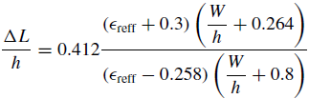

MSA - Design procedure and steps
For an efﬁcient radiator, a practical width that leads to good radiation efﬁciencies is
Determine the effective dielectric constant of the microstrip antenna using
Once W is found determine the extension of the length ΔL
The actual length of the patch can now be determined by
The ground plane dimensions G_{x} = L + 2*6*h G_{y} = W + 2*6*h
Feed position x ≈ λ/12

Slide 22
MSA - Design Numerical
Example 14.1
(Balanis: page-820)
Design a rectangular microstrip antenna using a substrate (RT/duroid 5880) with dielectric constant of 2.2, h =0.1588 cm (0.0625 inches) so as to resonate at 10 GHz.

Slide 23
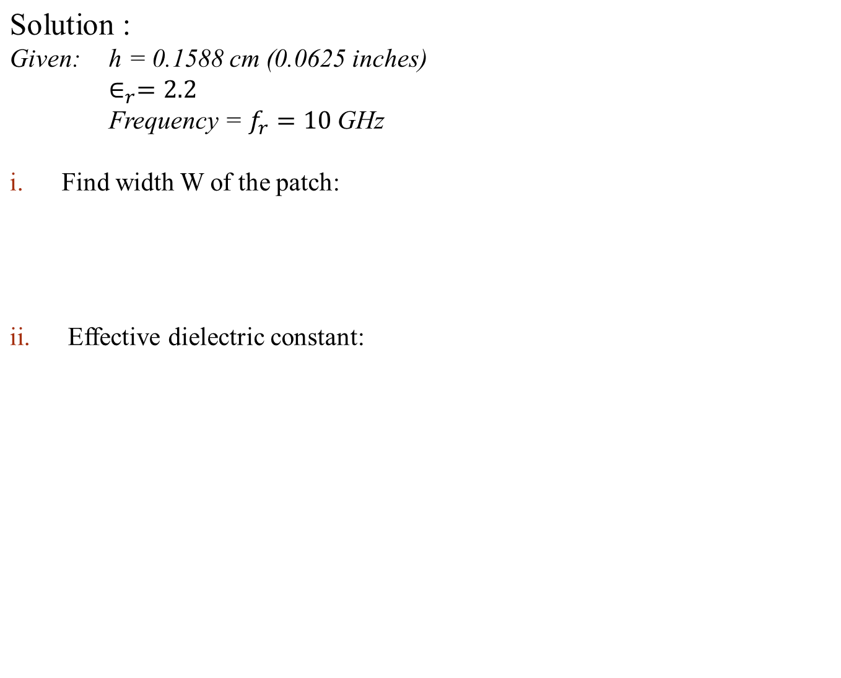
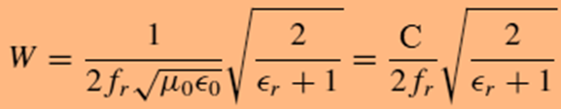



MSA - Design Numerical

Slide 24
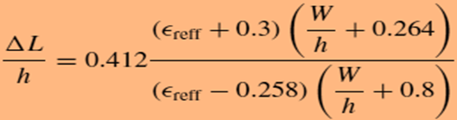




MSA - Design Numerical
Determine the extension length (ΔL):
= 0.081cm = 0.81mm
iv. Determine the actual length (L) of the patch:
= 9.06 mm
= 10.68 mm

Slide 25
Effect of operating frequency
Wireless systems are generally low powered high frequency system
The higher is the operating frequency the higher is the %BW of the antenna
Radiation is proportional to frequency, therefore, gain increases with increase in frequency.
However, wave attenuation is directly proportional to frequency.
Size of the antenna is inversely proportional to the frequency

Slide 26
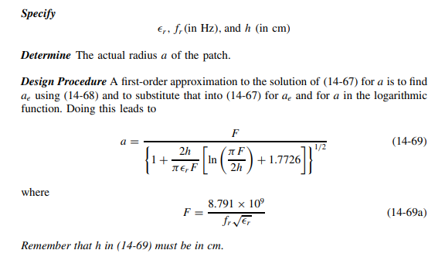
Design Steps – Circular patch

Slide 27
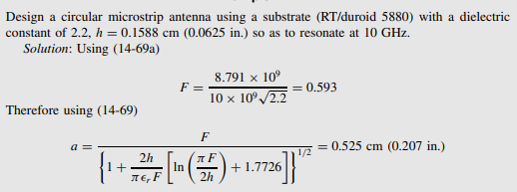
Design Steps – Circular patch

Slide 28
References
[1] G.Kumar and K. P. Ray, Broadband Microstrip Antennas, Norwood, MA Artech House, 2003.
[2] Constantine A. Balanis, Antenna Theory and Design, 3rd Edition, John Wiley and sons Inc. USA, 2005.

