Slide 1

On the Safety of IoT Device Physical (and System) Interaction Control
Omar Voltarel
Mat. VR457810
Implementation of the paper made by:
Wenbo Ding
Hongxin Hu
Computer and Communications Security (CCS’18)

Slide 2

Application field:
Manage remote
IoT devices
Home automation
has made a significant
impact on the word
economy
New security and
safety problems
Omar Voltarel
Mat. VR457810

Slide 3
New type of security problem
IoT device vulnerability
Device firmware bugs
Communication protocol vulnerabilities
Malicious third-party applications
Physical (and System) Interaction capabilities between IoT devices and their surrounding
Omar Voltarel
Mat. VR457810

Slide 4
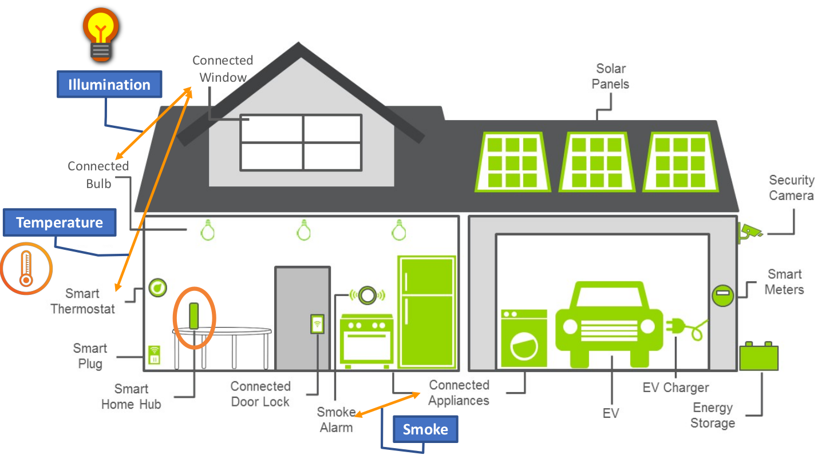
Physical (and System) interaction
Omar Voltarel
Mat. VR457810

Slide 5
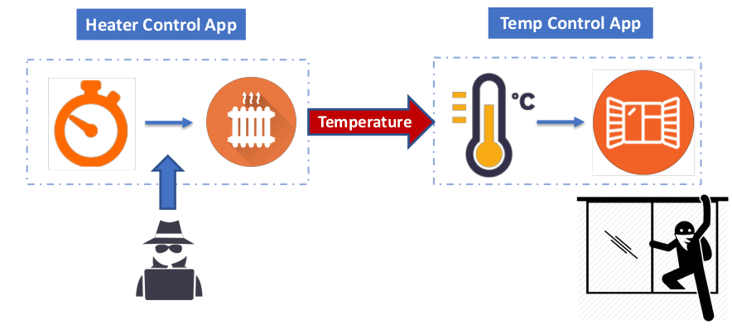
Unexpected interaction
Omar Voltarel
Mat. VR457810

Slide 6
Solution
1. Capture all potential physical interactions across applications
2. Enable safe interaction controls on IoT platforms
Framework IoTMon
Omar Voltarel
Mat. VR457810

Slide 7
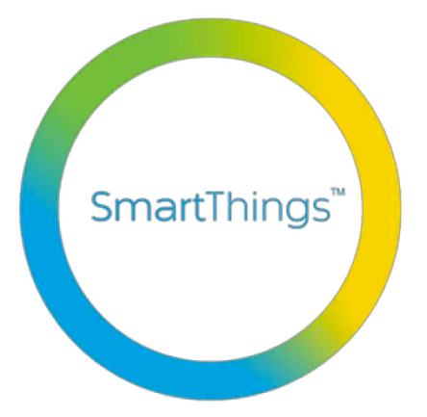
IoTMon
1. Application analysis
  I. Intra-app analysis
  II. physical channel identification
2. Interaction chain discovery
3. Risk analysis and mitigation
Omar Voltarel
Mat. VR457810

Slide 8
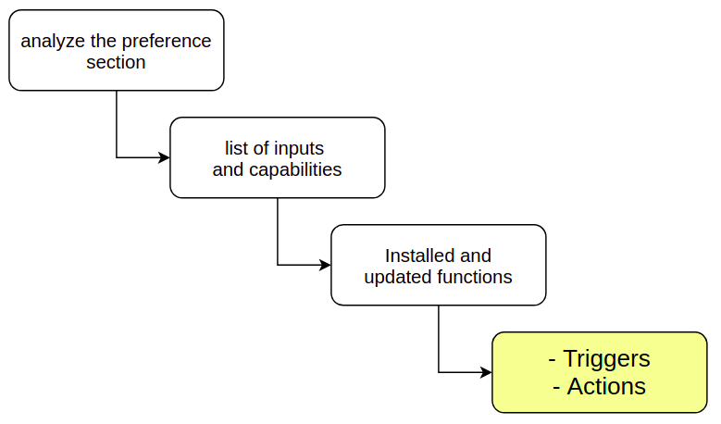

IoTMon – Intra-app analysis
Static program analysis: the Abstract Syntax Tree
Omar Voltarel
Mat. VR457810

Slide 9
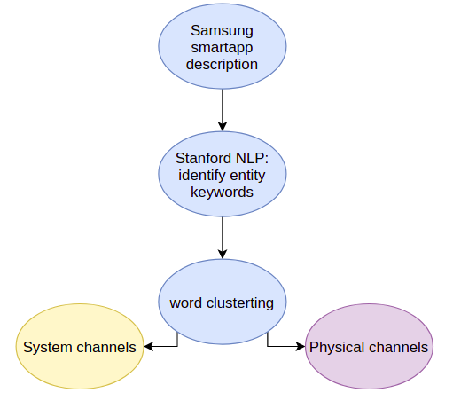


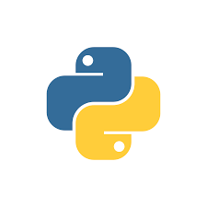
IoTMon – Physical channel identification
Omar Voltarel
Mat. VR457810

Slide 10
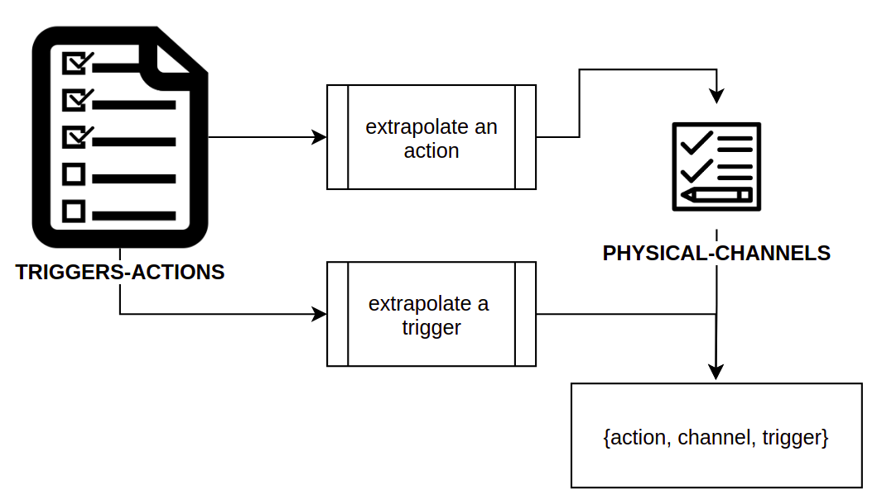
IoTMon – Interaction chain discovery
Omar Voltarel
Mat. VR457810

Slide 11
IoTMon – Risk analysis
Non so se devo farla o meno...
Omar Voltarel
Mat. VR457810

Slide 12
Omar Voltarel
Mat. VR457810

