Slide 1

Đề tài: Website nghe nhạc
Giáo viên hướng dẫn: Phan Viết Thế
Sinh viên thực hiện:
+ Võ Minh Bằng, PS07621, Team Leader
+ Lê Tuấn Kiệt, PS07753, Thành viên
+ Nguyễn Công Hiến, PS07588, Thành viên
+ Phan Lê Duy, PS07705, Thành viên

Slide 2
Nội dung
Phần I Giới thiệu đề tài
Phần II Phân tích hiện trạng
Phần III Thiết kế hệ thống
Phần IV Thực hiện dự án
Phần V Demo dự án

Slide 3
Giới thiệu
Tên đề tài
Lý do chọn đề tài?
Chức năng website
Khả năng tiếp cận khách hàng

Slide 4
Phân tích
Mô hình kinh doanh dịch vụ online
Công nghiệp 4.0 - công nghệ 4G
Tương tác online trực tiếp
Sở thích
Lợi nhuận

Slide 5
Thiết kế hệ thống
Thiết kế website làm 2 phần
- Thiết kế chức năng dành cho khách hàng
- Thiết kế chức năng dành cho quản trị

Slide 6
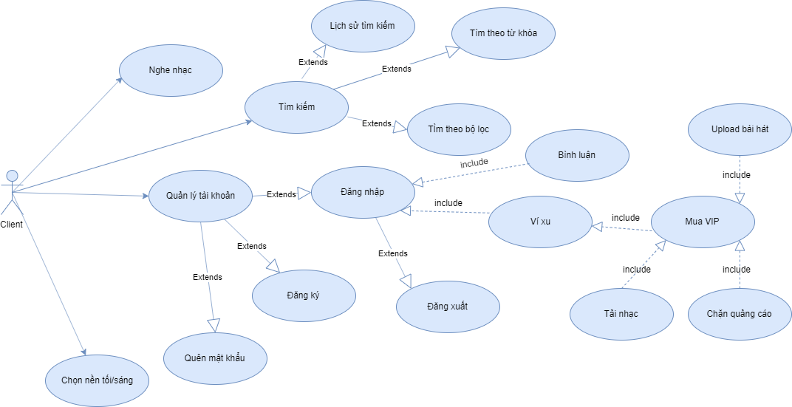
UML khách hàng

Slide 7
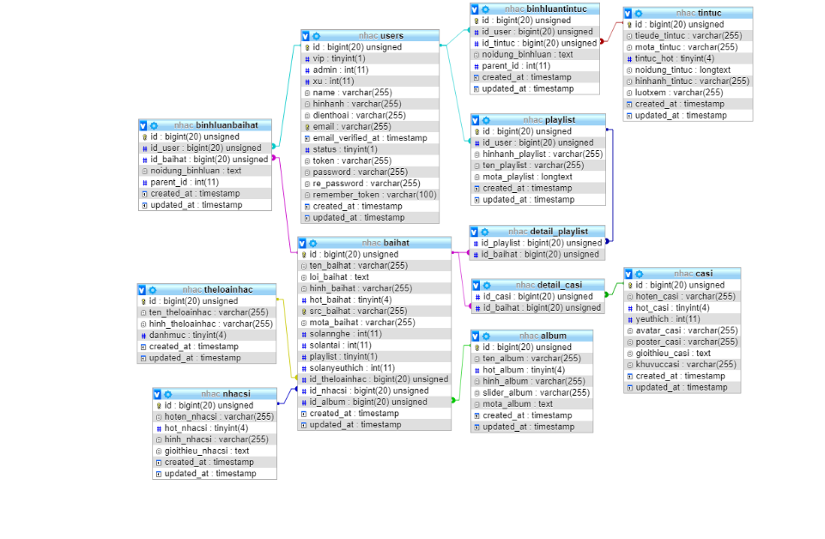
Thiết kế database

Slide 8
Thiết kế database
Tại sao phải thiết kế database?
Gắn liền với mô hình MVC
Giảm thời gian phát triển website

Slide 9
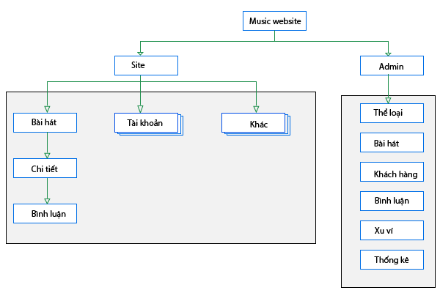
Site map

Slide 10
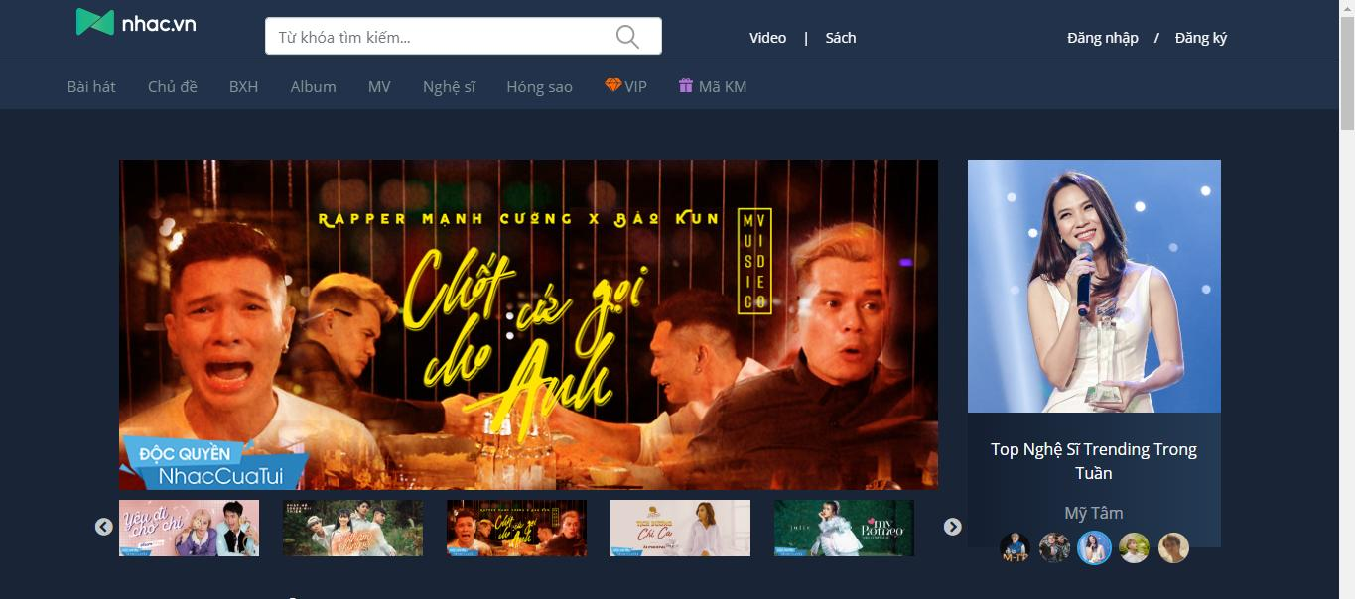
Giao diện khách hàng

Slide 11
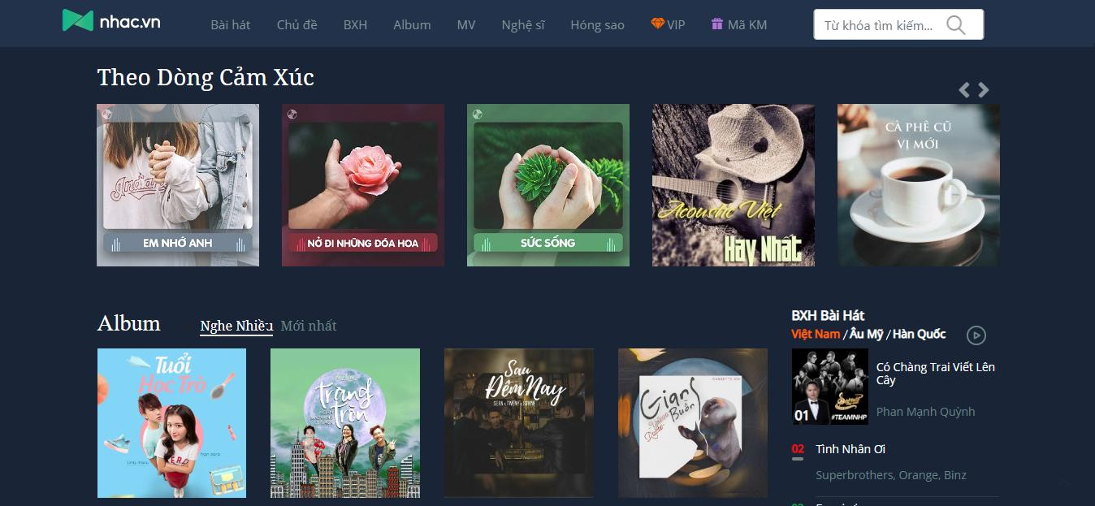

Slide 12
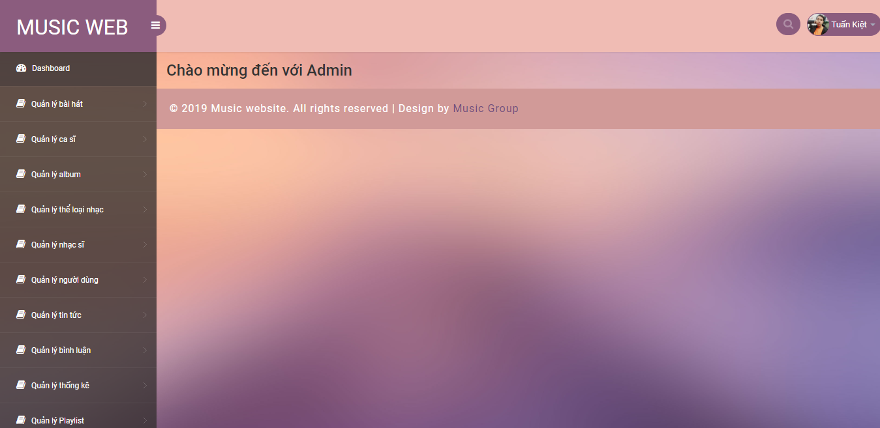
Giao diện admin

Slide 13
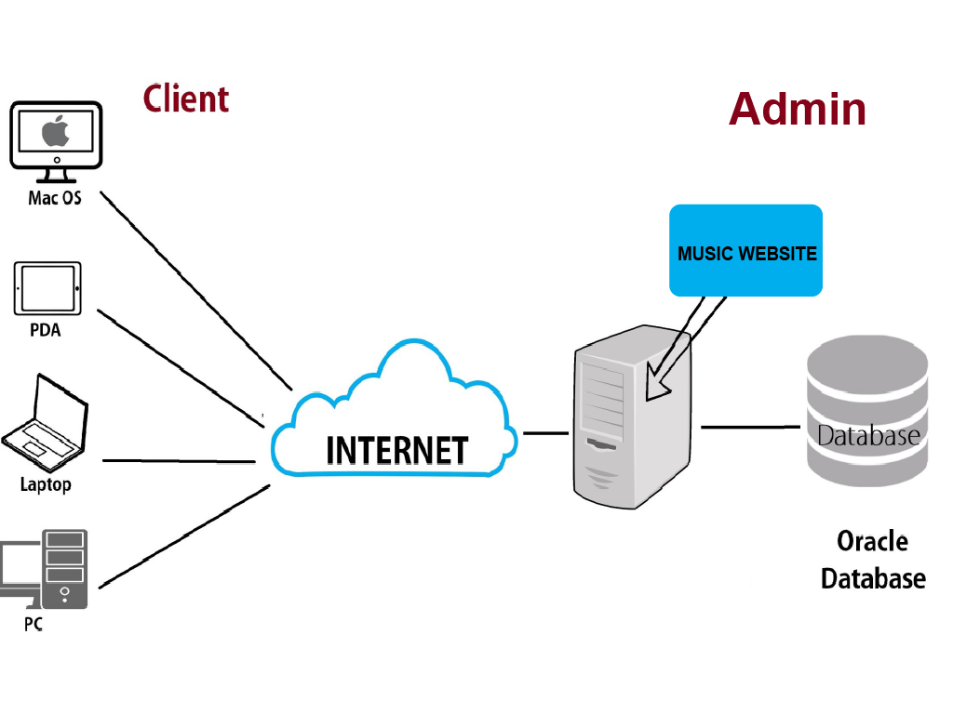
Triển khai thực hiện
Hướng triển khai website

Slide 14
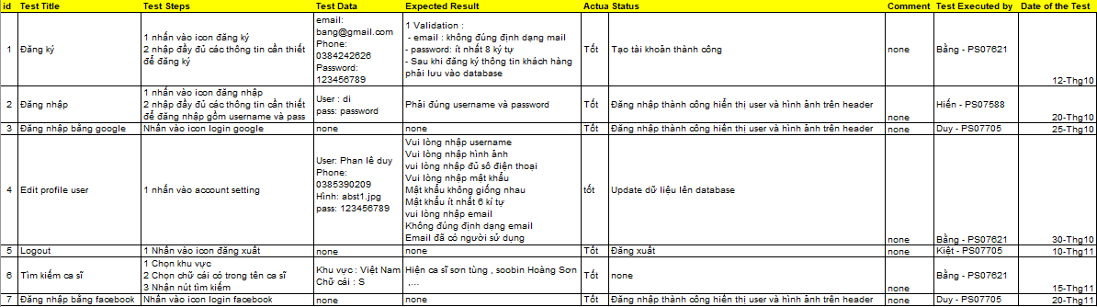
Công việc thực hiện
Bảng test case

Slide 15
Phân công thành viên

Slide 16
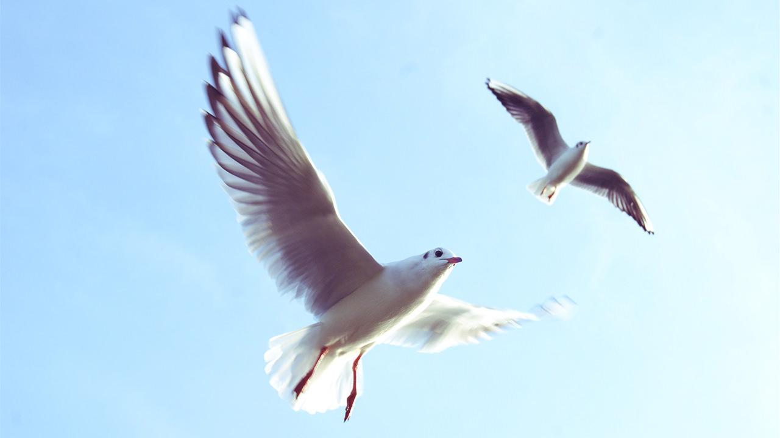
Want big impact?
Use big image.

Slide 17
89,526,124$
185,244 users
100%
That’s a lot of money
And a lot of users
Total success!

Slide 18
Our process is easy
first
second
last

Slide 19
Our sales funnel
20%
40%
60%
80%
Diagram featured by http://slidemodel.com
100%

Slide 20
Let’s review some concepts
Yellow
Is the color of gold, butter and ripe lemons. In the spectrum of visible light, yellow is found between green and orange.
Blue
Is the colour of the clear sky and the deep sea. It is located between violet and green on the optical spectrum.
Red
Is the color of blood, and because of this it has historically been associated with sacrifice, danger and courage.
Yellow
Is the color of gold, butter and ripe lemons. In the spectrum of visible light, yellow is found between green and orange.
Blue
Is the colour of the clear sky and the deep sea. It is located between violet and green on the optical spectrum.
Red
Is the color of blood, and because of this it has historically been associated with sacrifice, danger and courage.

Slide 21
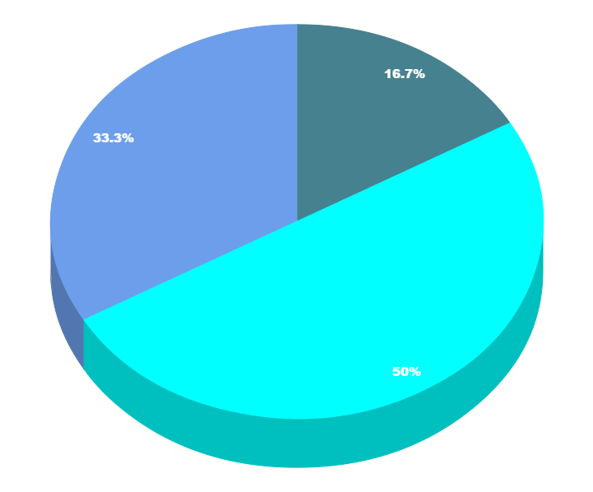
You can copy&paste graphs from Google Sheets

Slide 22
Place your screenshot here
Android project
Show and explain your web, app or software projects using these gadget templates.

Slide 23
Place your screenshot here
iPhone project
Show and explain your web, app or software projects using these gadget templates.

Slide 24
Place your screenshot here
Tablet project
Show and explain your web, app or software projects using these gadget templates.

Slide 25
Place your screenshot here
Desktop project
Show and explain your web, app or software projects using these gadget templates.

Slide 26
Thanks!
Any questions?
You can find me at:
@username
user@mail.me

Slide 27
Credits
Special thanks to all the people who made and released these awesome resources for free:
Presentation template by SlidesCarnival
Photographs by Unsplash

Slide 28
Presentation design
This presentation uses the following typographies and colors:
Titles: Nixie One
Body copy: Muli
You can download the fonts on this page:
https://www.fontsquirrel.com/fonts/nixie-one
https://www.fontsquirrel.com/fonts/muli
Aquamarina #00e1c6 / Turquoise #19bbd5 / Skyblue #2c9dde /
Light gray #c6daec / Dark blue #0e293c
You don’t need to keep this slide in your presentation. It’s only here to serve you as a design guide if you need to create new slides or download the fonts to edit the presentation in PowerPoint®

Slide 29
SlidesCarnival icons are editable shapes.
This means that you can:
Resize them without losing quality.
Change fill color and opacity.
Change line color, width and style.
Isn’t that nice? :)
Examples:

Slide 30
😉
Now you can use any emoji as an icon!
And of course it resizes without losing quality and you can change the color.
How? Follow Google instructions https://twitter.com/googledocs/status/730087240156643328
✋👆👉👍👤👦👧👨👩👪💃🏃💑❤😂😉😋😒😭👶😸🐟🍒🍔💣📌📖🔨🎃🎈🎨🏈🏰🌏🔌🔑 and many more...

