Slide 1

CSCI E-222 · Foundations of Large Language Models · Spring 2026 · Harvard Extension School
NLP for Healthcare: Medical Text Analysis
Fine-tuning & Comparing Encoder vs. Decoder LLMs on Medical NER and Question Answering
O. Mykhailovskyi · May 2026
Bio_ClinicalBERT · MedGemma-4B | MedMentions NER · MedQA USMLE
CSCI E-222 · NLP for Healthcare · O. Mykhailovskyi

Slide 2
Problem Statement
How do encoder-only (BioClinicalBERT) and decoder-based (MedGemma-4B) architectures compare when fine-tuned on two core medical NLP tasks - NER and QA - under a constrained compute budget?
Why It Matters
Task 1 - Named Entity Recognition (NER) Label each token in biomedical text with a UMLS semantic type (e.g., T038 = Biologic Function, T103 = Chemical)
• Clinical NLP enables automated chart review, coding & decision support
• Domain-specific models outperform general LLMs
Task 2 - Medical Question Answering Select the correct answer (A-D) from USMLE-style clinical questions requiring multi-step medical reasoning
Scope Constraints
• Single GPU - Google Colab Pro A100
• PEFT only (LoRA/QLoRA) for the 4B model
• Public, reproducible datasets only • Original scope (PubMedBERT + summarisation) narrowed due to compute constraints
CSCI E-222 · NLP for Healthcare · O. Mykhailovskyi
2 / 19

Slide 3
Datasets
Task 1 · NER - MedMentions MTI881
Task 2 · QA - MedQA USMLE-4-options
Split | Samples
Train | 23,399
Validation | 2,924
Test | 2,926
Split | Samples
Train | 10,200
Test | 1,270
• USMLE Step 1/2/3 clinical reasoning questions
• 4-option multiple choice (A-D)
• Random baseline: 25% · Human expert: ~90%
• Source: GBaker/MedQA-USMLE-4-options
• 4,392 PubMed abstracts, 350K+ UMLS-annotated mentions
• 105 entity classes (UMLS semantic types), BIO format
• Severe class imbalance: "O" tag = 76% of all tokens
• Source: Ben10x/MedMentions-MTI881-NER
CSCI E-222 · NLP for Healthcare · O. Mykhailovskyi
3 / 19

Slide 4
Models & Methods Overview
Bio_ClinicalBERT (Encoder)
MedGemma-4B-IT (Decoder + QLoRA)
• 110 M parameters, BERT-base architecture
• Pre-trained on MIMIC-III clinical notes (~880 M words)
• Fine-tuned with full parameter update
• NER - Token Classification head
• QA - Multiple Choice head (4 seqs - 1 logit each)
• Bidirectional attention - strong at classification
• Max sequence length: 512 tokens
• 4.3 B parameters, Gemma-3 architecture, 128 K context
• Pre-trained on medical images + text (Google Health AI)
• PEFT: QLoRA (4-bit NF4 + LoRA rank 16, alpha 16)
• Only 0.76% of parameters trainable (~33 M)
• NER - generative: "token: tag, token: tag …"
• QA - generative: outputs a single letter A / B / C / D
• 2× training speed via Unsloth optimization
Architecture: Input -> [Bio_ClinicalBERT] -> Label / Choice
33 M
4-bit
128k
Trainable params
NF4 quantization
Context window
MIT License for dataset usage.
Acceptance of Google Terms of Usage is required for model usage.
CSCI E-222 · NLP for Healthcare · O. Mykhailovskyi
4 / 19

Slide 5
Task 1 - NER: BERT
1
2
3
4
5
6
Load MedMentions
Tokenize + align labels
Compute class weights
WeightedTrainer fine-tune
seqeval F1 evaluation
Push to HF Hub
Training Configuration
Two Experiments
Model | Hyperparameter | Value
Baseline & Weighted | MAX_LENGTH | 512
Baseline & Weighted | BATCH_SIZE | 16
Baseline & Weighted | EPOCHS | 20
Baseline & Weighted | WARMUP_RATIO | 0.1
Baseline & Weighted | WEIGHT_DECAY | 0.01
Baseline | LEARNING_RATE | 2e-5
Weighted | LEARNING_RATE | 6e-5
Baseline & Weighted | LR_SCHEDULER | cosine
Notebook | What changed | Checkpoint
01-baseline | Standard fine-tuning | alexd063/bio-clinicalbert-finetuned-medmentions
02-weighted | Class weights | alexd063/bio-clinicalbert-finetuned-medmentions-v1
Class weighting was the single most impactful decision - without it the model collapses to predicting 'O' for all tokens.
CSCI E-222 · NLP for Healthcare · O. Mykhailovskyi
5 / 19

Slide 6
Task 1 - NER: MedGemma-4B with QLoRA
Generative NER Approach
Prompt Format
Unlike token classification, MedGemma generates a text sequence: "aspirin: B-T103, prescribed: O, daily: O, …" Each token is explicitly labelled in the output text.
### Instruction: Extract medical entities and label each token with its NER tag. ### Input: Patient presents with acute appendicitis and elevated CRP levels. ### Response: Patient: O, presents: O, with: O, acute: B-T047, appendicitis: I-T047, and: O, elevated: O, CRP: B-T059, …
Training Configuration
Hyperparameter | Value
MAX_SEQ_LENGTH | 512
LORA_R | 16
LORA_ALPHA | 16
LORA_DROPOUT | 0
BATCH_SIZE | 4
GRAD_ACCUM_STEPS | 4
LEARNING_RATE | 2e-4
MAX_STEPS | 300
WARMUP_STEPS | 30
WEIGHT_DECAY | 0.01
TARGET_MODULES (LORA) | q_proj, v_proj, k_proj, o_proj
LR_SCHEDULER_TYPE | cosine
Key Limitation
Generative NER is promising but requires structured output enforcement (constrained decoding or JSON mode) to be reliable.
• Checkpoint: alexd063/medgemma-finetuned-medmentions-ner
Only 300 of ~1,462 steps trained (underfitting). Parsing 'token: tag' format from free text is unreliable.
CSCI E-222 · NLP for Healthcare · O. Mykhailovskyi
6 / 19

Slide 7
Results - Task 1: Named Entity Recognition
0.65
0.27
105
76%
BioClinicalBERT Macro F1 (full test)
MedGemma F1 (10% subset)
Entity classes (UMLS types)
"O" tokens (class imbalance)
BioClinicalBERT – Per-Entity Performance
Evaluation
Top performers | F1 | Bottom performers | F1
T204 | 0.8 | T059 | 0
T103 | 0.75 | T024 | 0
T017 | 0.73 | T081 | 0
Asymmetric evaluation: BioClinicalBERT was evaluated on the full test split;
MedGemma only on a 10% subset due to slow inference. Direct F1 comparison is not completely fair.
Cause of Low Overall Scores
Performance
MedMentions has 127 UMLS semantic types; the dataset includes many with < 5 training examples, creating a fundamental underfitting errors for models.
Model | Support | Macro F1
Baseline Bio_ClinicalBERT | 11,772 | 0.65
Weighted Bio_ClinicalBERT | 11,772 | 0.65
MedGemma-4B | 1,221 | 0.27
Peers
Peer baselines: TaggerOne F1=0.453 · BERT ceiling 0.56, this project exceeds this metric. Encoder architecture is clearly better at token-level classification.
CSCI E-222 · NLP for Healthcare · O. Mykhailovskyi
7 / 19

Slide 8
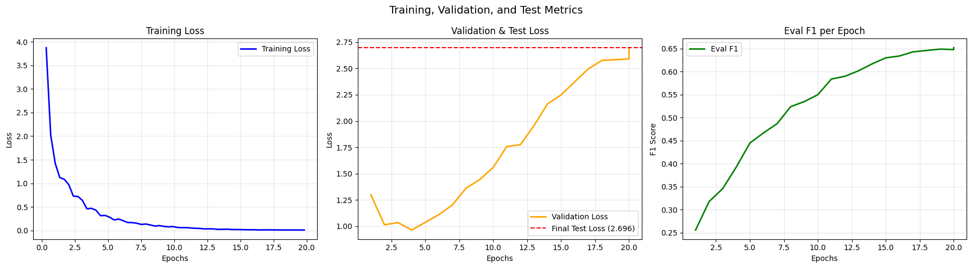
NER Training Analysis - Bio_ClinicalBERT (Weighted)
Training loss falls- validation loss rises - seqeval F1 steadily improves to 0.65 · Both variants achieve comparable F1 (0.652 baseline / 0.650 weighted)
BERT QA training: oscillating loss + flat F1 → model never learns from 512-token truncated inputs
CSCI E-222 · NLP for Healthcare · O. Mykhailovskyi
8 / 19

Slide 9
Task 2 - QA: BERT & MedGemma-4b
BioClinicalBERT Multiple-Choice
MedGemma Generative QA
[(Q: Option A), …] -> BERT -> logit ×4 -> softmax
Model sees full question + all 4 options and outputs a single letter. Instruction format: explicit EOS token appended to answer.
• 90/10 train/val split
• Checkpoint: alexd063/bio-clinicalbert-finetuned-medqa
• Checkpoint: alexd063/gemma4bit-finetuned-medqa
Training Configuration
Training Configuration
Hyperparameter | Value
MAX_LENGTH | 512
BATCH_SIZE | 4
EPOCHS | 10
WARMUP_RATIO | 0.1
WEIGHT_DECAY | 0.01
LEARNING_RATE | 4e-5
LR_SCHEDULER | cosine
Hyperparameter | Value
MAX_SEQ_LENGTH | 1024
BATCH_SIZE | 4
GRAD_ACCUM_STEPS | 4
LORA_R | 16
LORA_ALPHA | 16
LORA_DROPOUT | 0
TARGET_MODULES (LORA) | q_proj, v_proj, k_proj, o_proj, gate_proj, up_proj, down_proj
EPOCHS | 2
WARMUP_STEPS | 10
WEIGHT_DECAY | 0.01
LEARNING_RATE | 2e-4
LR_SCHEDULER | cosine
Only 2 epochs trained. Warmup = 10 steps is far too low for stable fine-tuning. No error analysis on incorrect predictions.
CSCI E-222 · NLP for Healthcare · O. Mykhailovskyi
9 / 19

Slide 10
Results - Task 2: Medical Question Answering
25%
26.2%
55%
84%
Random baseline (4-choice)
BioClinicalBERT Test Accuracy
MedGemma-4B Test Accuracy (fine-tuned)
GPT-4
Official benchmark
Why BioClinicalBERT Underperforms on QA
MedGemma-4B Fine-tuning Analysis
• Max sequence length 512 tokens - left-side truncation; long texts may lose question text
• Bidirectional encoder not designed for reasoning
• Result: 26% accuracy, while 25% is a random baseline
• 55% test accuracy - 2× random baseline (ECE not applicable; generative model)
• Official pre-trained benchmark: 64.4% on MedQA
• Fine-tuning DEGRADED performance vs. pre-trained baseline
• Possible causes: only 2 epochs, LR too high (2e-4), 10 warmup steps
• Catastrophic forgetting: fine-tuning may damage medical priors
BioClinicalBERT is architecturally not fit for QA. Published baseline: BioBERT-Large fine-tuned achieves only 36.7% on this test set (Jin et al. 2021); GPT-3.5 reaches 53.6%, GPT-4 84%. MedGemma-4B at 55% is at GPT-3.5 level for a 4B model fine-tuned for 2 epochs.
Strongly pre-trained medical model already has intrinsic medical knowledge. Fine-tuning it on the MedQA task improves its performance and achieves the levels of widely distributed models such as GPT-3.5
CSCI E-222 · NLP for Healthcare · O. Mykhailovskyi
10 / 19

Slide 11
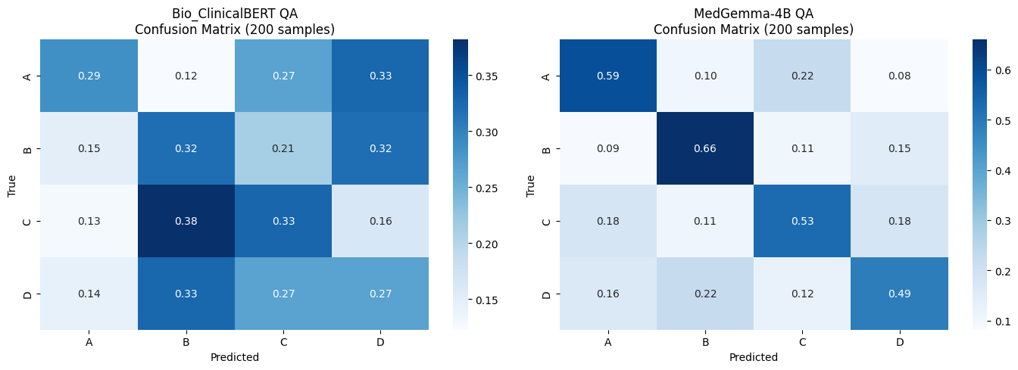
QA Confusion Matrices: BERT vs MedGemma-4B (200 samples)
BERT: near-uniform matrix (~25% each option) = guessing · MedGemma: strong diagonal = genuine medical reasoning
CSCI E-222 · NLP for Healthcare · O. Mykhailovskyi
11 / 19

Slide 12
Comparative Analysis: Encoder vs. Decoder
Dimension | Bio_ClinicalBERT (Encoder) | MedGemma-4B (Decoder)
NER Macro F1 | 0.65 (full test, token classifier) | 0.27 (subset, generative)
QA Accuracy | ~26% (≈ random) | 55.7%
GPU time / task | ~20–40 min (110 M params) | ~1.5–2.5 h (4B, QLoRA)
Trainable params | 110 M (full fine-tune) | 33 M (0.76% via LoRA)
Inference speed | Fast (single forward pass) | Slow (autoregressive)
Best suited for | Classification, token labeling, NER | Reasoning, generation, QA
Key: Use the right architecture for the task. Encoders excel at NER. Decoders excel at reasoning (QA). Neither model is universally better - task-architecture alignment is important.
Note: NER comparison is not a clean head-to-head - BERT on full 2,926-sample test split, MedGemma on 10% qualitative subset only. 200-sample QA comparative subset: BERT 30.0% accuracy / Gemma 56.5% accuracy.
CSCI E-222 · NLP for Healthcare · O. Mykhailovskyi
12 / 19

Slide 13
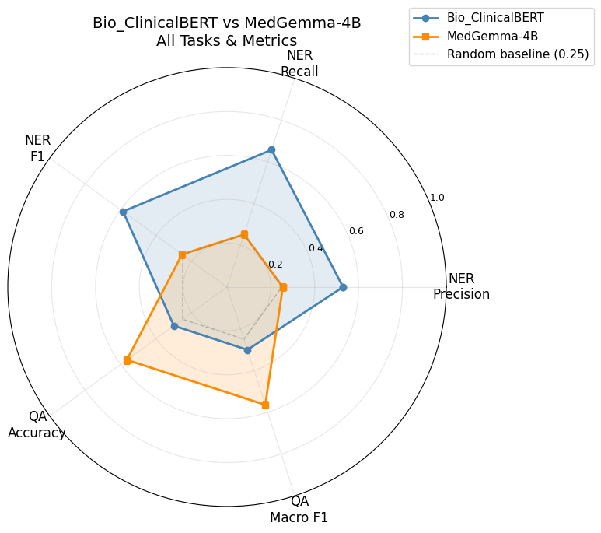
Comparative: All Tasks & Metrics
NER: Bio_ClinicalBERT wins
F1: 0.65 vs 0.27 · Bidirectional attention
QA: MedGemma-4B wins
55% vs 26.2% · 1,024-token context
Summary
No universally performant model, task-specific architectures
demonstrate better results.
CSCI E-222 · NLP for Healthcare · O. Mykhailovskyi
13 / 19

Slide 14
Compute Estimates
GPU Execution Time (Google Colab A100)
Notebook | Actual / Estimated
BERT NER baseline | ~40 min
BERT NER weighted | ~30 min
MedGemma NER (300 steps only) | ~1h
BERT QA | ~40 min
MedGemma QA (2 epochs) | ~1.5h
Comparative analysis | ~30 min
Total time | ~5 – 6 h
CSCI E-222 · NLP for Healthcare · O. Mykhailovskyi
14 / 19

Slide 15
Discussion: What Worked & What Didn't
What Worked
What Didn't Work
• Class weighting significantly improved NER on frequent entities
• QLoRA made the 4B model trainable on a single GPU
• MedGemma outperformed BERT 2:1 on QA (55% vs 26.2%)
• Custom WeightedTrainer was clean, reusable, and well-documented
• Cosine LR + early stopping stabilized training
• All models published to HuggingFace Hub for full reproducibility
• Unsloth gave 2× training speedup
• BERT QA: near-random accuracy - wrong architecture for reasoning
• MedGemma NER: 300 steps only, no quantitative metrics
• Asymmetric NER evaluation - not a clean comparison
CSCI E-222 · NLP for Healthcare · O. Mykhailovskyi
15 / 19

Slide 16
Limitations
Data & Evaluation
Model & Compute
• MedMentions: rare entity types with < 5 examples - near-zero F1 (data sparsity, not architecture)
• BERT QA: 512-token left-side truncation may discard crucial parts for long texts
• MedGemma NER – needs a full epoch training before metrics mean anything
• MedQA is US-centric (USMLE) - does not reflect global practices
• Single GPU (A100) limits scaling
• No automatic hyperparameters search
• MedGemma NER severely under-trained (300 of ~1,462 steps per epoch)
• No multiseed averaging for results
• BioClinicalBERT fine-tuned on MIMIC-III only - US bias
Data is the biggest issue - model cannot learn types it has never seen.
Fine-tuning strong pre-trained medical model is relatively more straightforward and yields better results.
CSCI E-222 · NLP for Healthcare · O. Mykhailovskyi
16 / 19

Slide 17
CSCI E-222 · Foundations of Large Language Models · Final Project
Thank You
NLP for Healthcare: Medical Text Analysis
Code & Models huggingface.co/alexd063 https://github.com/vonKleve/csci-e222-final-project/tree/master
Datasets Used Ben10x/MedMentions-MTI881-NER GBaker/MedQA-USMLE-4-options
Video Presentation URL:
https://drive.google.com/file/d/1EPFei5UW99ChOIn4ZFcI2R88i08dXfaH/view?usp=sharing
O. Mykhailovskyi · Harvard Extension School · CSCI E-222 · May 2026

