Slide 1

(1 - 1) Computer Software & Software Development
H&K Chapter 1
Instructor - Andrew S. O’Fallon
CptS 121 (August 24, 2011)
Washington State University

Slide 2
Course Collaborators
A lot of material for this course was adapted from Chris Hundhausen’s course or developed concurrently with him

Slide 3
What is Computer Science?
Computer science is the study of algorithms
  It spans theory and practice
  It requires thinking in abstract and concrete terms
  It is not just about building computers and developing programs
What is an algorithm?
  A sequence of instructions that solve a problem
Why are algorithms so important to computer science?
  If we can specify an algorithm, we can automate the solution

Slide 4
Formal Definition of Algorithm
A well ordered collection. . .
Of unambiguous and effectively computable operations. . .
That produces a result. . .
And halts in a finite amount of time.

Slide 5
Is this an Algorithm? (1)
Preheat an outdoor grill for medium heat, and lightly oil the grate.
Cook chiles on the preheated grill until the skin of the peppers has blackened and blistered, about 5 minutes. Be careful not to overcook the peppers, or the skin will not come off easily. Turn the peppers often to cook evenly.
Place the blackened peppers into a bowl, and tightly seal with plastic wrap.
Allow the peppers to steam as they cool, about 20 minutes.
Once cool, remove the skins and seeds. Chop the peppers.

Slide 6
Is this an Algorithm? (2)
Combine the chopped peppers with the pepper jack, cream cheese, garlic, salt, and pepper. Form the the mixture into a ball and place on a plate covered with wax paper.
Place the cheese ball in the freezer until very cold, about 15 minutes.

Slide 7
Is this an Algorithm? (3)
Spread the chopped pecans on a large cutting board or baking sheet.
Roll the frozen cheese ball in the pecans. Use your hand to pack any areas that are not covered by pecans, making sure the entire outside of the cheese ball is covered with a nice layer of pecans.
-- http://allrecipes.com/recipe/green-chile-cheese-ball/detail.aspx
No! Why not?
Hint: Are all operations unambiguous?

Slide 8
Is this an Algorithm? (4)
Apply small amount of shampoo to hair
Work into scalp for about 1 minute
Rinse thoroughly
Repeat
No! Why not?
Hint: Is it well ordered? Does it halt?

Slide 9
How are Algorithms Put Together?
Sequenced instructions
  do them in the order given
Conditional instructions
  do them if a condition is true
Iterative instructions
  do them while a condition is true

Slide 10
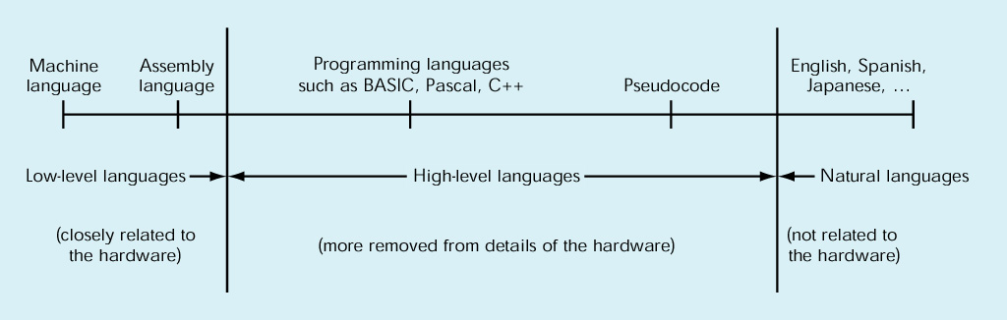
High-Level Programming Languages (1)
High-level programming languages
  The continuum of languages:
  Low-level languages were created from the perspective of the machine; working with 1’s and 0’s
  High-level languages, have natural language like elements

Slide 11
High-Level Programming Languages (2)
Problem: Computers can’t understand high-level programming languages
Solution: They must be translated
  Programmer uses a text editor to write a text-based source file in a programming language
  Compiler translates source file
    Checks to make sure that program is syntactically correct
    If so, the compiler translates the program into
    an object file with machine language instructions

Slide 12
High-Level Programming Languages (3)
Object file translated by compiler will not execute!
  High-level programs often make use of software libraries containing predefined pieces of code, including
    Math functions
    Input/output functions
  In order to execute, object file must be linked to object files containing these predefined pieces of code
  A Linker program performs this operation
  A Loader program loads the linked program into memory so that it can be executed

Slide 13
High-Level Programming Languages (4)
Executing Programs
  In this class, programs will execute in a text-based window called a console
  Input data can be entered at command-line prompts
  Output results will be displayed in the console window
  In the real world, most programs have a graphical user interface
  GUI programming is, however, beyond the scope of this course

Slide 14
High-Level Programming Languages (5)
Integrated Development Environments (IDE)
  Combine compiler, linker, and loader with a source code editor
  Provide a variety of tools to assist programmers, for example,
    Source code syntax highlighting
    Autocompletion lists ("Intellisense")
    A debugger, which allows a programmer to step through programs, one instruction at a time

Slide 15
Software Development Method
Equivalent to the “Scientific Method” in the sciences, and the “Systems Approach” in business
Six basic steps:
  Specify problem requirements
  Analyze the problem
  Design an algorithm to solve the problem
  Implement the algorithm
  Test and verify the completed program
  Maintain and update the program

Slide 16
Applying the Software Development Method (1)
Warning: Developing software is an iterative process, your first solution is generally not your best!
Example problem: Compute the volume of a cone

Slide 17
Applying the Software Development Method (2)
Data Requirements
  Problem input:
  radius (of the base), height (of the cone)
  Problem output:
  volume (of the cone)
  Relevant formula:
  volume = 1 / 3 * pi * radius² * height

Slide 18
Applying the Software Development Method (3)
Design
  Algorithm
    Get the radius and height for the cone
    Compute the volume of the cone
    Display the resultant volume of the cone
  Refined algorithm
    Get the radius and height for the cone
    Compute the volume of the cone
      volume = 1 / 3 * pi * radius² * height
    Display the resultant volume of the cone

Slide 19
Applying the Software Development Method (4)
Implementation (in C)
#include <stdio.h> /* Needed for printf (), scanf () */
#define PI 3.14159 /* Constant macro */
int main (void)
{
int height = 0, radius = 0;
double volume = 0.0;
printf ("Enter height of cone as integer: "); /* Displays prompt message */
scanf ("%d", &height); /* Gets the value from the user/keyboard */
printf ("Enter radius of base of cone as integer: ");
scanf ("%d", &radius);
/* Compute the volume of the given cone */
volume = ((double) 1 / 3) * PI * radius * radius * height;
/* Display the resultant volume of the given cone */
printf ("Volume of cone with radius %d and height %d is %lf.\n", radius, height, volume);
return 0;
}

Slide 20
Applying the Software Development Method (5)
Note: At this point, don't worry about understanding the details of C syntax! We'll get to that later
Testing
  We would compile and execute the program, trying several different input data values and observing the results
Maintenance
  It is highly unlikely that this particular program will be of general use to anyone. Most likely, we'll want to update it with new functionality…

Slide 21
Next Lecture…
We've covered the general software development method
It's time to start learning the C language!

Slide 22
References
J.R. Hanly & E.B. Koffman, Problem Solving and Program Design in C (6th Ed.), Addison-Wesley, 2010

