Slide 1

Investment Overview — Unawatuna, Sri Lanka
Prepared for Revenge Capital · Anthony Vondoom, Co-Founder & Concept Lead

Slide 2

THE INSIGHT
Every culture that ever cooked, cooked over fire.
THE GAP
Ancestral technique — treated as nostalgia, not a real kitchen practice
Long before gas lines and induction plates, hearth cooking was simply how food was made — patient, fire-fed, tied directly to what the land and sea provided that day. It is one of the few culinary techniques nearly every culture on earth shares.
Serious food-science thinking — rarely applied to hearth cuisine
Professional, HACCP/USPH-grade execution — almost never present alongside live fire
Nobody has yet combined this technique with rigorous food-science thinking, professional fine-dining execution, and HACCP / USPH-grade hygiene standards.
02
THE HEARTH

Slide 3
THE FOUNDER'S LENS
Untraditionally educated — deliberately so.
The Hearth is built by someone who reached this thesis from outside the culinary-school pipeline — as an independent researcher in cognitive archaeology, and as a chef who has worked nearly every station a kitchen and floor can offer.
Independent Researcher
15 Years in Hospitality
Hands-On Operator
Cognitive archaeology, publishing under peer review — most recently in the Journal of Egypt Heritage Association. Brings an academic, evidence-driven lens to a category usually built on instinct alone.
Every major role covered — storekeeping, dishwashing, line cook to pass at Nikki Beach Porto Cervo, a high-volume Princess Cruises pizzeria, and resort chef work in Egypt serving Italian guests food that had to taste like home.
Not a concept designed from a distance — leads menu development, kitchen build, and staff training personally through launch.
THE HEARTH
03

Slide 4

THE SOLUTION
The Hearth
BUILT TO STANDARD
"Earth, made with heart."
World-class dining execution
A live-fire fine-dining and lounge destination in Unawatuna — Sri Lankan hearth technique handled with Italian precision, hyper-local ingredients, and a day-to-night format that moves from brunch through golden-hour cocktails into hearth-fired dinner and a Sri Lankan-EDM lounge.
HACCP food-safety compliance
USPH-grade hygiene standard
EARTH
Hyper-local ingredients, hearth-fired, sourced from this land and coast.
Full CIDA / CEB / SLTDA regulatory mapping already done
Fire, gas, and electrical safety engineered into construction sequence
FIRE
Every plate is finalized with live fire — some elements are prepped ahead in the kitchen, then finished and portioned at the hearth.
HEART
Humble beginnings offered without apology — hospitality built on care.
04
THE HEARTH

Slide 5
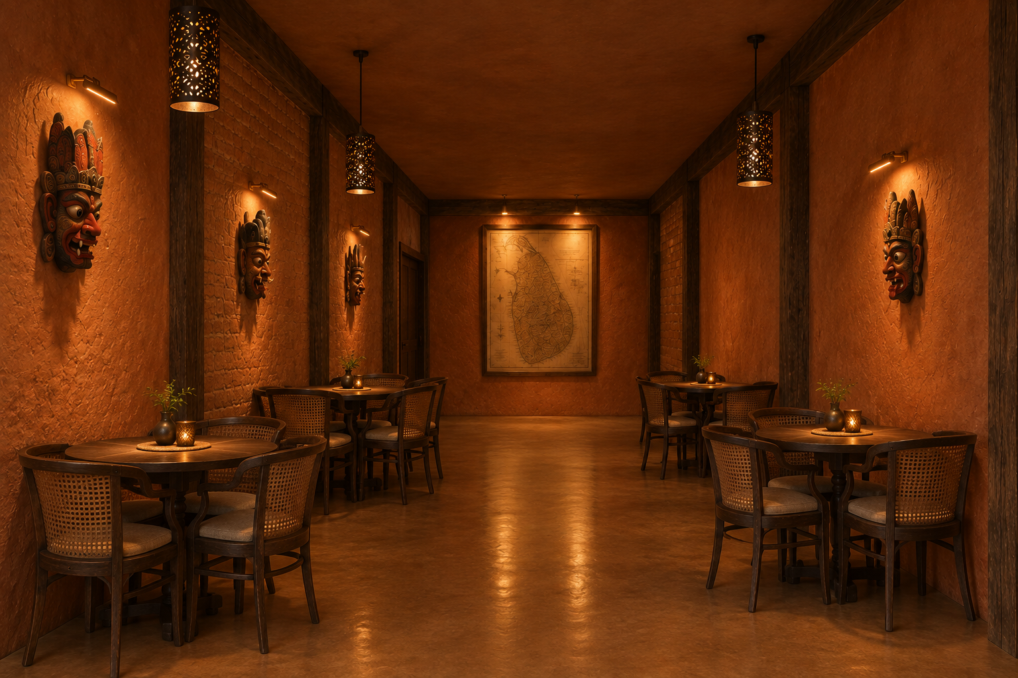
THE VISION
Concept direction for the finished space.
The Corridor
Connects the ground-floor dining areas. Traditional Sri Lankan raksha (devil) masks line the walls on both sides, leading toward a large antique-style map of Sri Lanka as the corridor's focal point. Cane-back dining chairs, perforated pendant lanterns, and warm sconce lighting throughout.
AI-generated concept render — design direction, not a finished photograph.
THE HEARTH
05

Slide 6
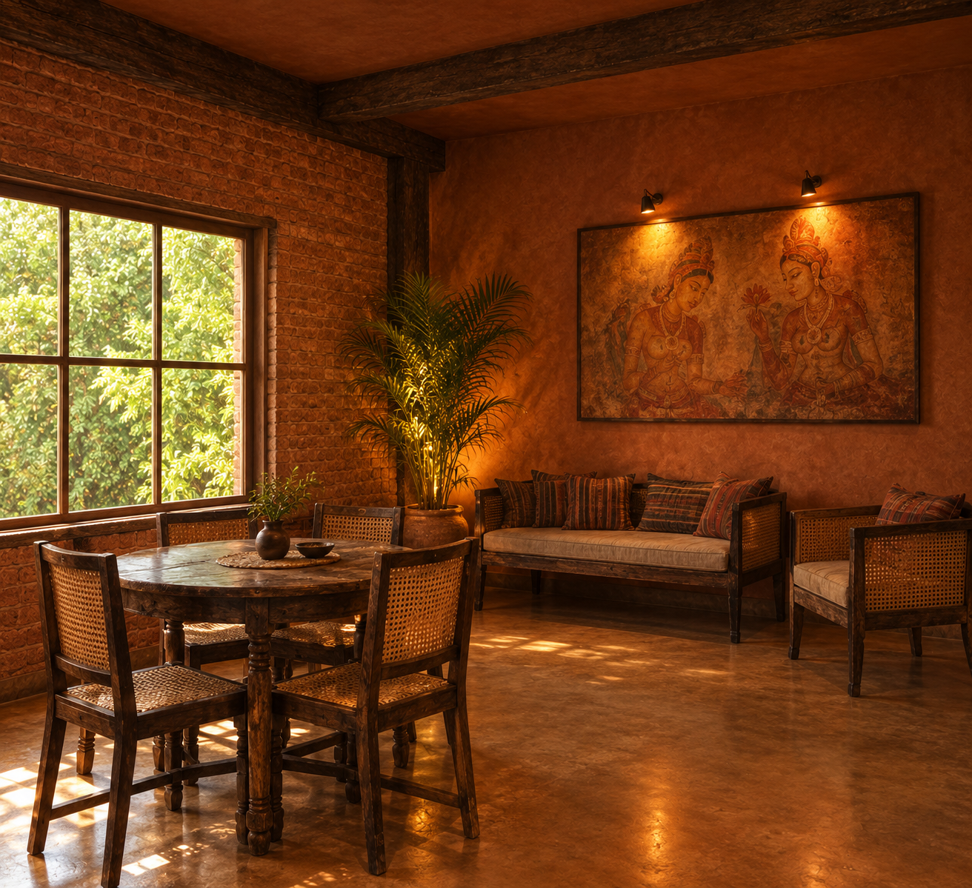
THE VISION
The Lounge Corner
A ground-floor seating nook for casual pre- or post-dinner drinks, set beneath a hand-painted reproduction of Sri Lanka's Sigiriya frescoes. Rattan sofa and armchair seating, a garden-facing window, and a potted areca palm bring natural light and greenery into the room.
AI-generated concept render — design direction, not a finished photograph.
06
THE HEARTH

Slide 7
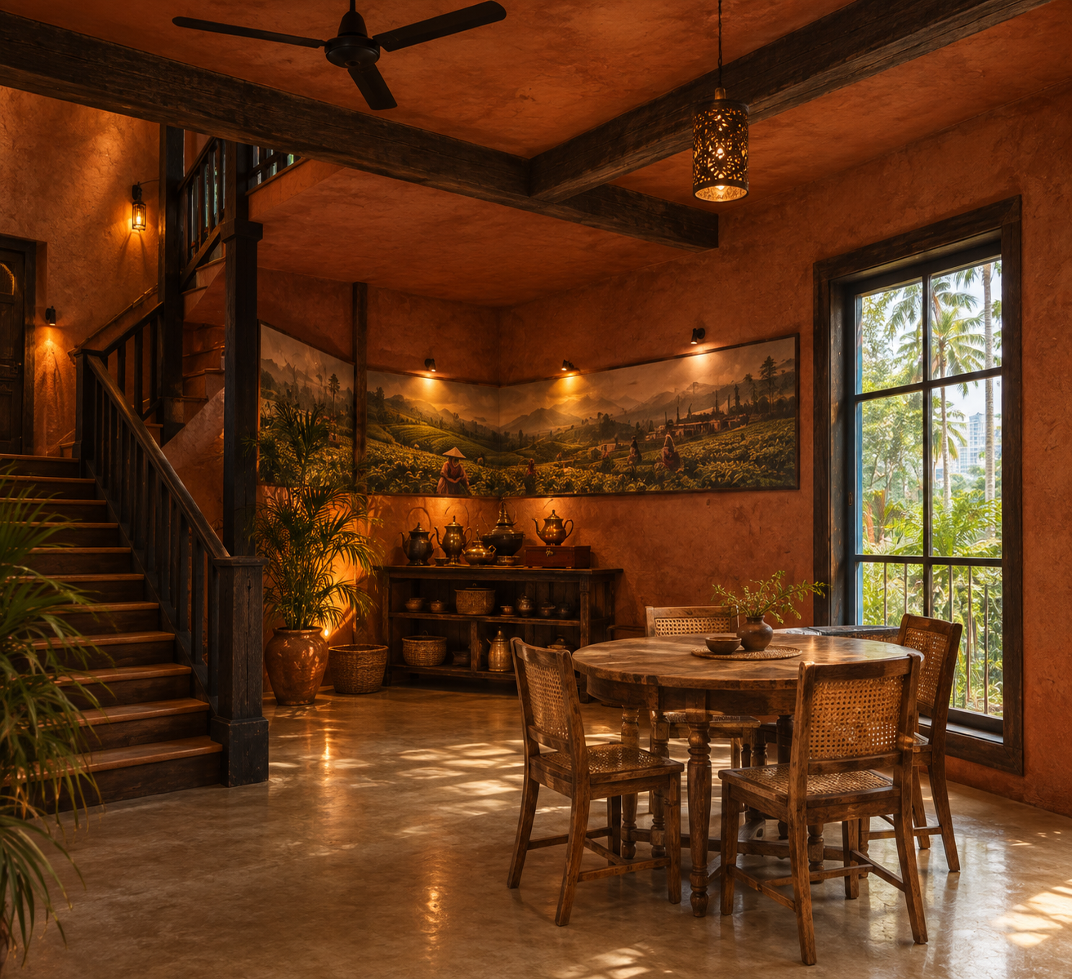
THE VISION
The Tea Heritage Corner
Set beside the staircase to the upper floor, this corner is anchored by a full-wall mural of Sri Lanka's tea highlands and a working display of antique brass teapots and kitchenware sourced locally — tying the space's heritage narrative directly into where guests sit and eat.
AI-generated concept render — design direction, not a finished photograph.
THE HEARTH
07

Slide 8
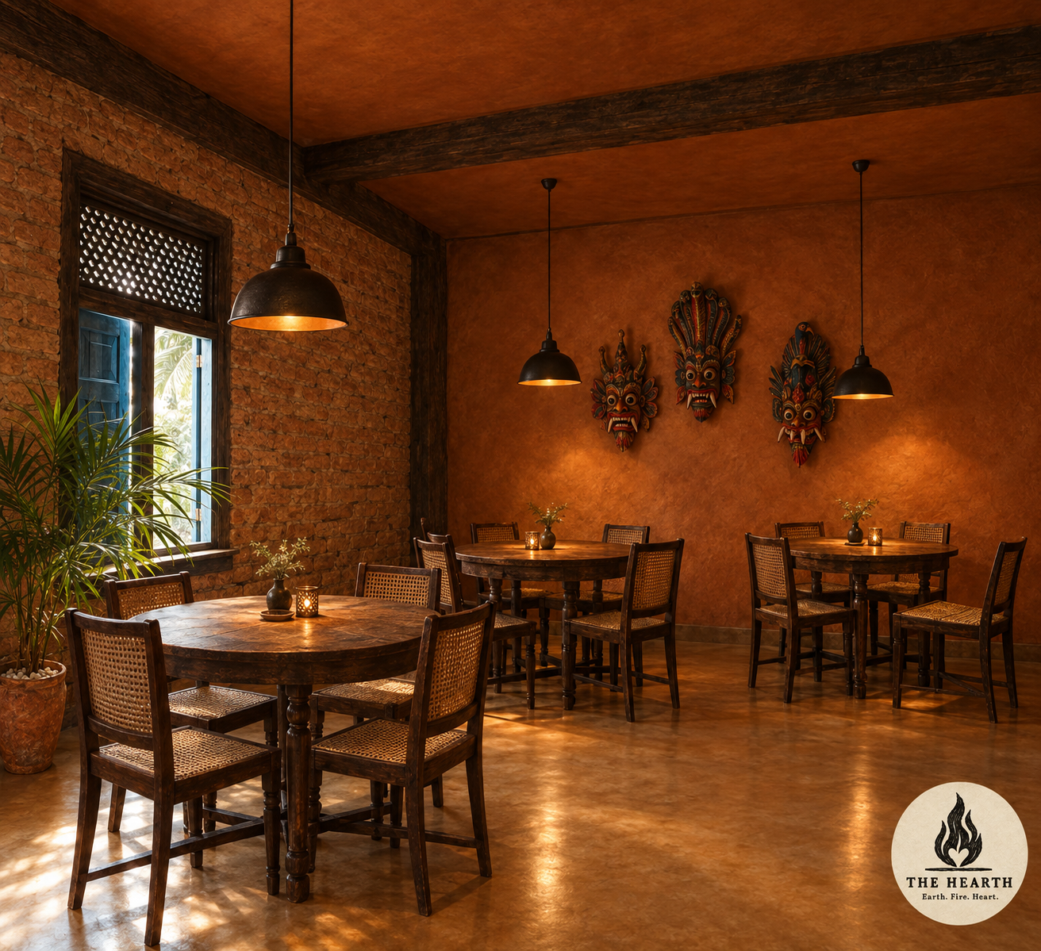
THE VISION
The Main Dining Hall
The primary seating area for dinner service, upstairs. Traditional masks mounted on red-clay walls, black pendant lighting over each table, and cane-back chairs continue the material language established throughout the ground floor.
AI-generated concept render — design direction, not a finished photograph.
08
THE HEARTH

Slide 9
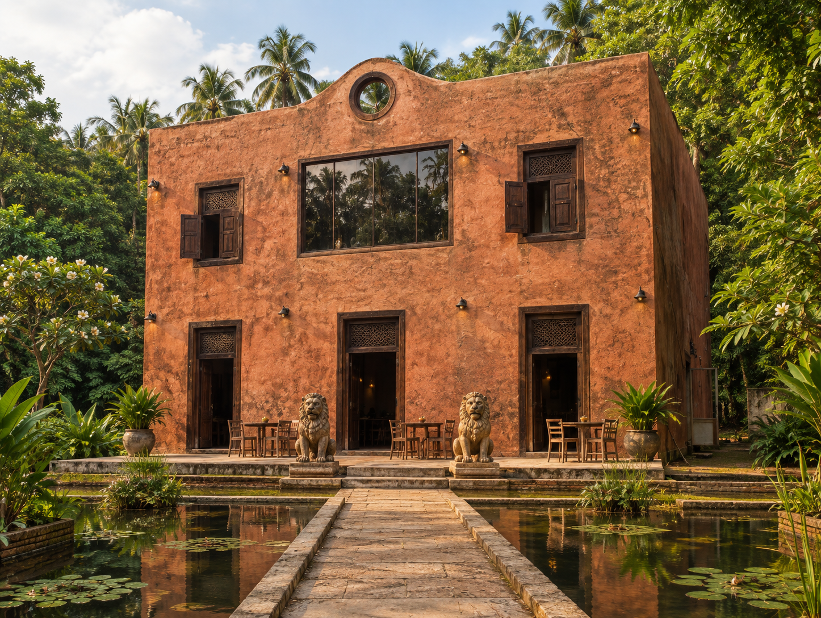
WHY SRI LANKA, WHY NOW
The pilot site is already de-risked.
Sri Lanka's tourism and food scene are booming right now, and the two hardest parts of any restaurant launch — securing a site and financing a building — are already done.
~493 m²
Site area, existing two-storey building already on it
~80%
Of required kitchen equipment already on hand
90
Covers seatable, three floors + outdoor
AI-generated concept render — the finished direction, not the site's current state.
THE HEARTH
09

Slide 10
THE TEAM
A co-founder-led launch, a local operating partner.
ANTHONY VONDOOM
RANUKA GEEGANAGAGE
Co-Founder — Concept Lead, Launch & Culinary Authority
Co-Founder — Local Operating Partner
Leads concept development, menu, kitchen build, and hands-on staff training personally through launch — the highest-risk, most execution-dependent phase. Independent researcher in cognitive archaeology with peer-reviewed publication. 15 years across every hospitality role, including Nikki Beach Porto Cervo, Princess Cruises, and resort chef work in Egypt.
After launch, continues in an active advisory and culinary-authority role while based in Europe pursuing further food research — the same inquiry this concept is built on.
Owns and provides the land and building the project is built on. Established local hospitality operator in Unawatuna, owner of Jungle Beach Cormorant and Cormorant Beach Club — an existing venue portfolio in the exact neighborhood The Hearth opens in.
Runs day-to-day operations post-launch, giving the business a permanent, on-the-ground presence backed by local market knowledge and standing relationships.
10
THE HEARTH

Slide 11
WHAT'S ALREADY DE-RISKED
This isn't a concept looking for a site.
Land & building secured
Kitchen equipment on hand
Existing two-storey structure, ~493 m² site, held by the local co-founder's family.
~80% of required equipment already available, reducing build-out capital need.
Local operator embedded
Full execution plan engineered
Co-founder already runs two venues in the same neighborhood.
Phase-by-phase construction sequence, hearth-kitchen spec, and electrical/waterproofing plan already written.
Regulatory pathway mapped
Founder-led training
Sri Lankan fire, gas, electrical, noise, and tourism-licensing requirements identified and sourced, not guessed.
Staff trained personally by the founder before opening, not delegated sight unseen.
THE HEARTH
11

Slide 12
BUSINESS MODEL & ECONOMICS
Where the capital goes, what it returns.
Pricing is a market-derived estimate — built from Sri Lanka's current premium dining landscape and 15 years of hospitality pricing experience — pending final menu costing on-site.
Investment Allocation — LKR 15.5M (~$46,100)
Revenue Scenarios — LKR Millions / month
LKR 15.5M
$8,000
~$38,100
~18–19/day
Target build-out (~$46,100)
Self-funded by Anthony & Ranuka
Remaining ask (~LKR 12.8M)
Base-case break-even covers
The single biggest open variable is hotel-to-restaurant conversion rate, not yet benchmarked against a comparable venue — treat revenue figures as a range, not a commitment. ~336 LKR/$1 used throughout.
12
THE HEARTH

Slide 13
THE SCALE STORY
Sri Lanka is the pilot. Not the ceiling.
WHERE THIS TRAVELS
South & Southeast Asia
Hearth cooking is not a Sri Lankan curiosity — it is one of the most universal cooking methods on earth. Nearly every culture with a traditional cuisine has, at some point, cooked this way. The Hearth's format — ancestral technique, modern food-science rigor, professional execution — is built to be proven once and replicated anywhere that history applies.
The Mediterranean & Middle East
Latin America
West & East Africa
That is the investment thesis: not a single restaurant's P&L, but a repeatable dining format with a defensible research foundation behind it — validated in one market before expanding into the next.
The broader Nordic and Alpine hearth tradition
THE HEARTH
13

Slide 14
ROADMAP
A sequenced build, not a guess.
1
2
3
4
PHASE 0
PHASE 1
PHASE 2
PHASE 3
Strip & Secure
Rough-In
Finishes
Fit-Out & Trial
Building cleared, salvageable heritage materials preserved.
Contractors & electricians work concurrently — all wiring and conduit placed before any finish.
Mudbrick and red-clay wall finishes applied over a completed, tested electrical layer.
Outdoor kitchens, lighting, furniture complete — followed by a full trial service run before opening.
Target opening: December 26, 2026
The water garden — the site's most distinctive feature — begins once the team is physically on-site, since its construction depends on real site grade rather than a remote spec.
14
THE HEARTH

Slide 15
THE ASK
A humble ask for the rest.
USE OF FUNDS
Construction completion
Anthony and Ranuka can self-fund roughly $8,000 of this build between them. The Hearth already has land, a building, and partial equipment — what's presented here, humbly, is the opportunity to fund the remaining ~$38,100 needed to complete construction, finish licensing, and open at the standard the concept deserves, rather than a compromised version of it.
Hearth kitchen, water garden, finishes
Licensing & compliance
Fire, LPG, electrical, noise, tourism registration
Launch execution
Staff training, trial service, soft-opening
Structure and equity are open for discussion — no fixed terms are set at this stage. Open to a conversation on what a fit looks like for Revenge Capital.
Working capital
Initial F&B stock, contingency
THE HEARTH
15

Slide 16
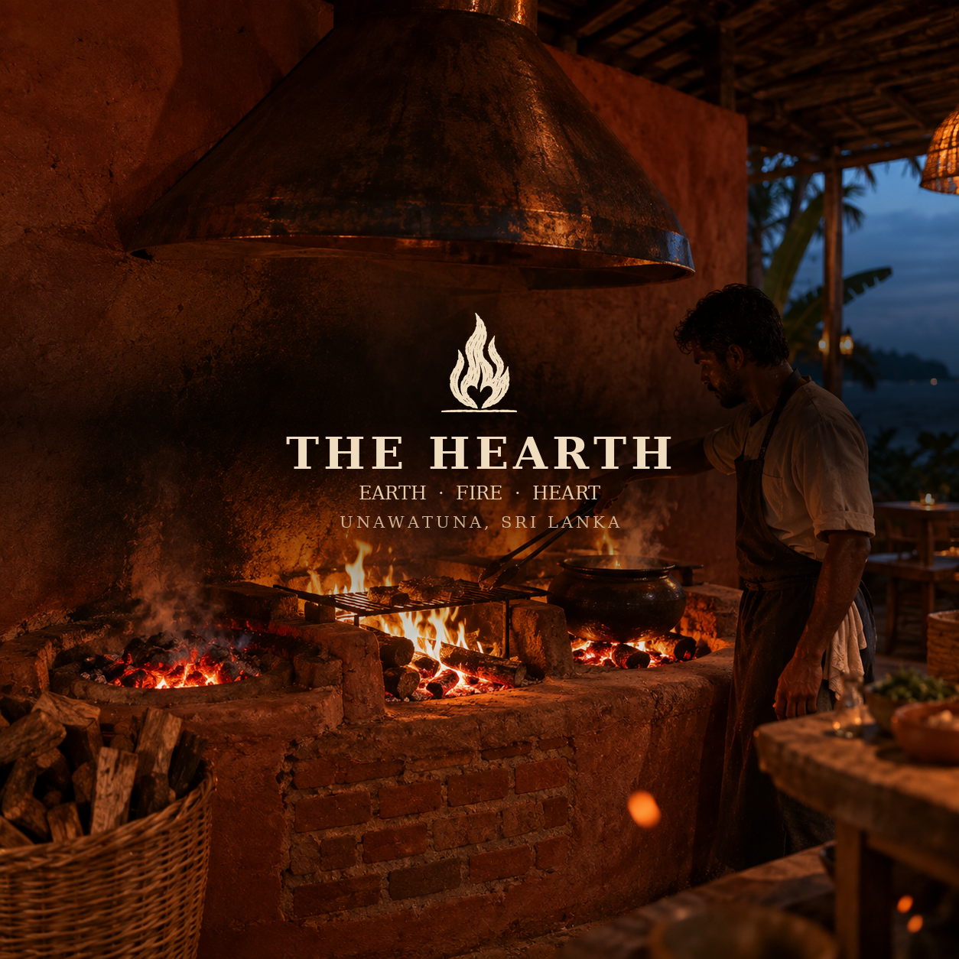
Thank you.
Anthony Vondoom · anthony.vondoom@outlook.com

