Slide 1

1. Bittorrent

Slide 2


Slide 3
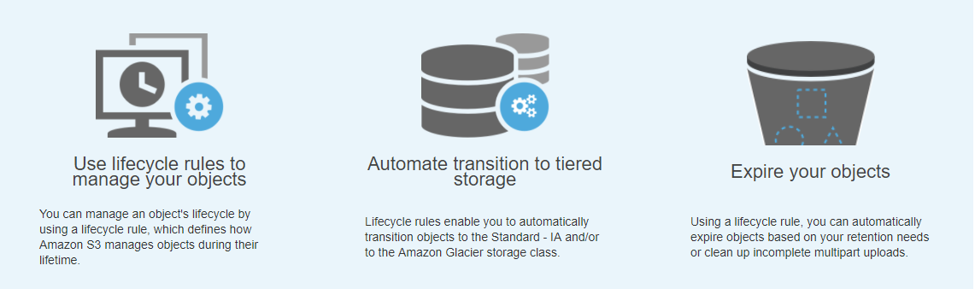
2. Object LifeCycle Management

Slide 4
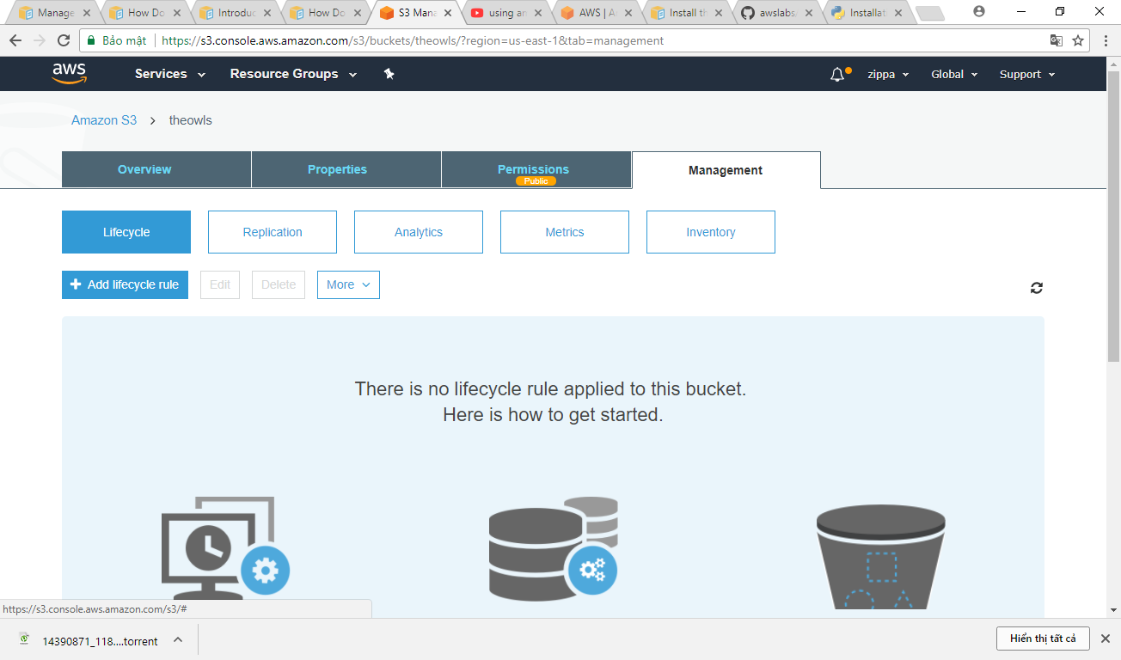

Slide 5
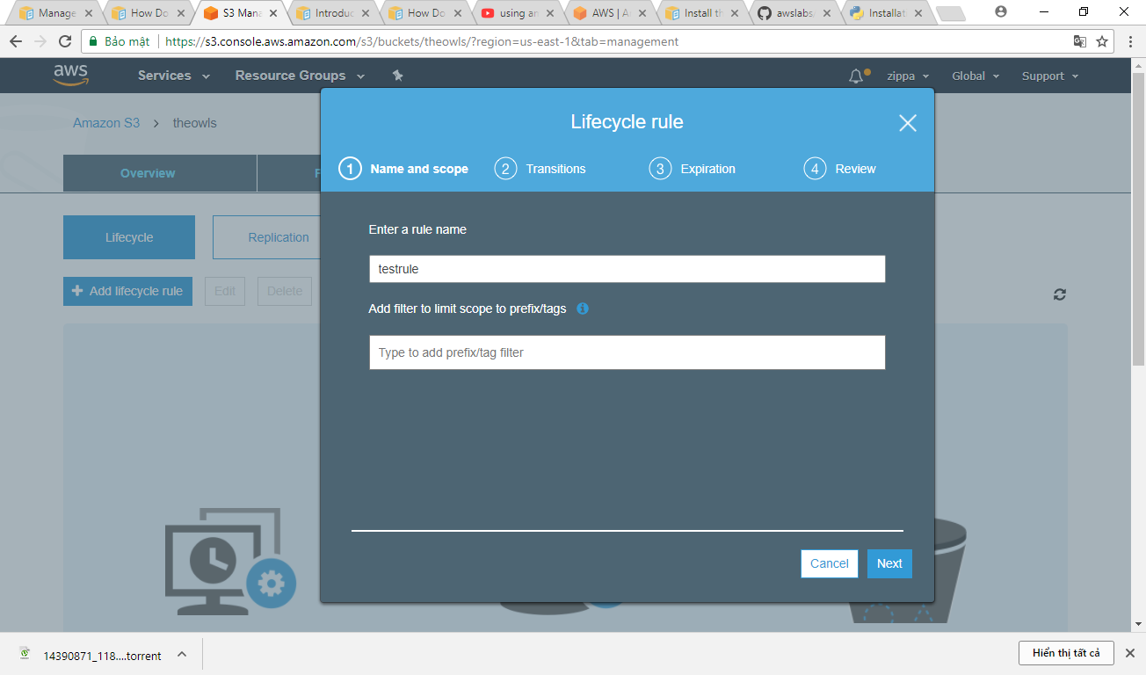

Slide 6
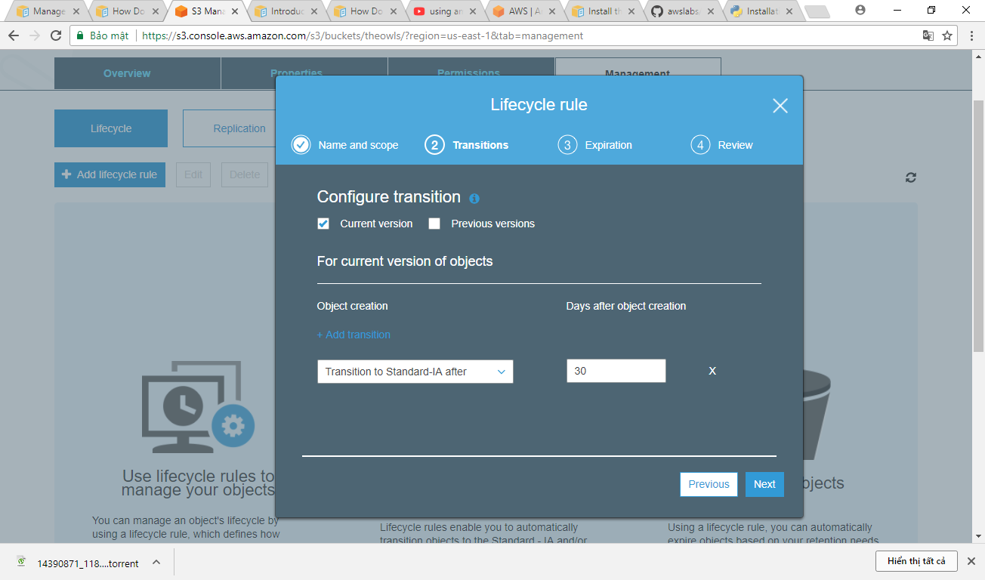

Slide 7
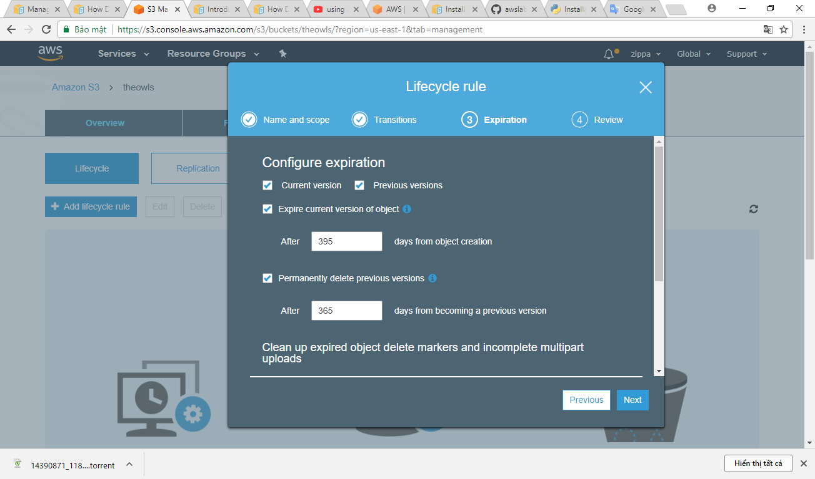

Slide 8
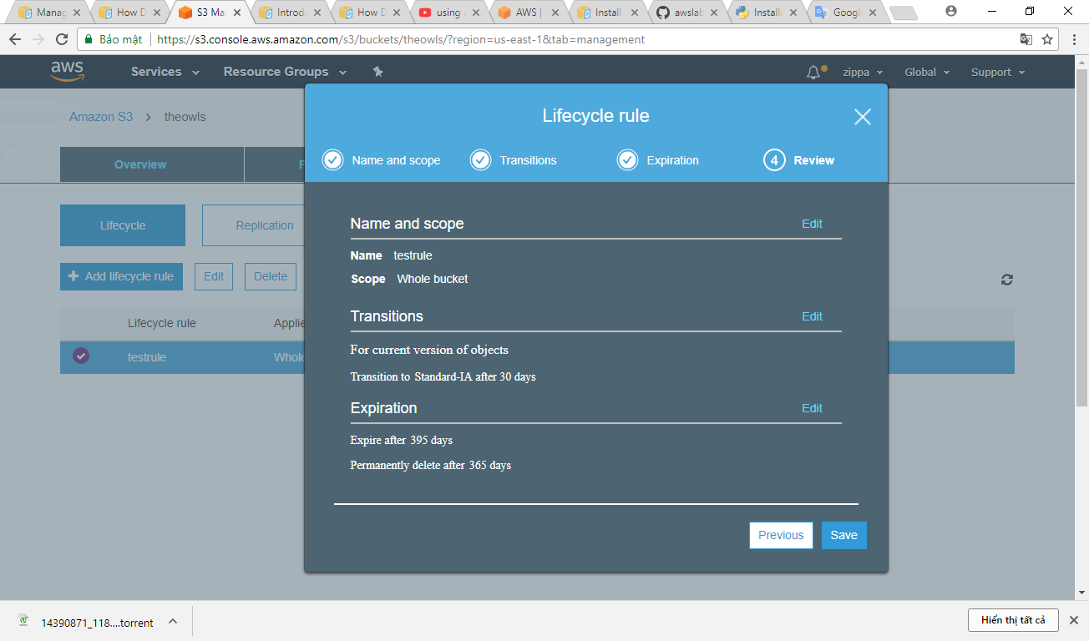
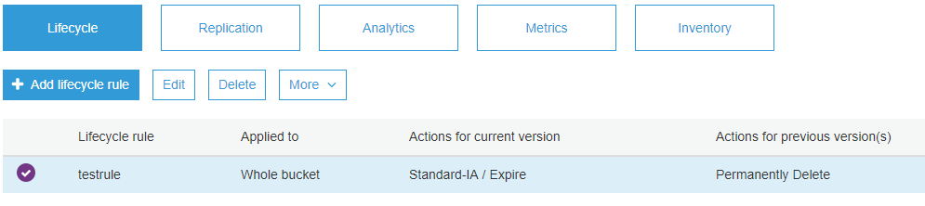

Slide 9

3. Amazon DevPay

Slide 10
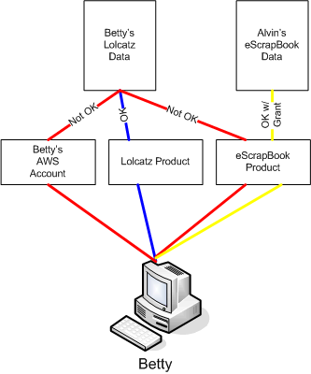
Amazon S3 Customer Data Isolation

Slide 11
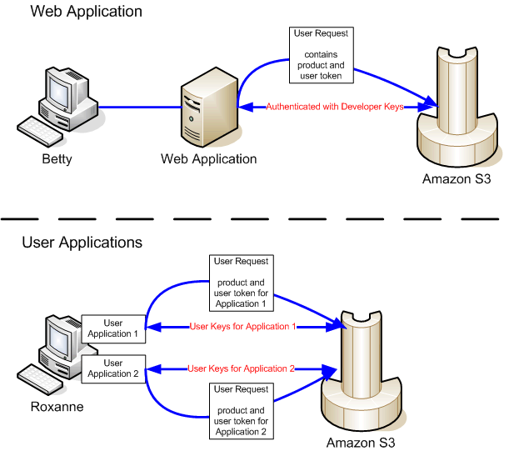
Amazon S3 and Amazon DevPay Authentication:

