Slide 1

BiG Data Technology
Professor: Mrudula Mukadam
Student: Van Vong Tran

Slide 2
Project Overview
Covid19 problem
Big Data technologies (Kafka, Spark Streamming, Spark SQL, Hbase, Plotly)

Slide 3
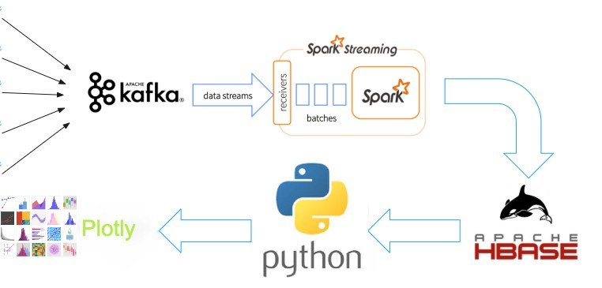
Data flow

Slide 4
Kafka - real time distributed streaming
Broker
Topic
Consumer
Partition

Slide 5
Spark Streaming - scalable, high-throughput, fault-tolerant stream processing
DStream
Transforming
Filtering

Slide 6
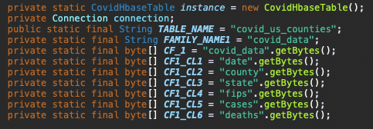
HBase – Real time DB

Slide 7
Spark SQL - DataFrame and SQL Operations
Spark Session
Spark Context

Slide 8
Visualize data
Plotly
HappyBase

Slide 9
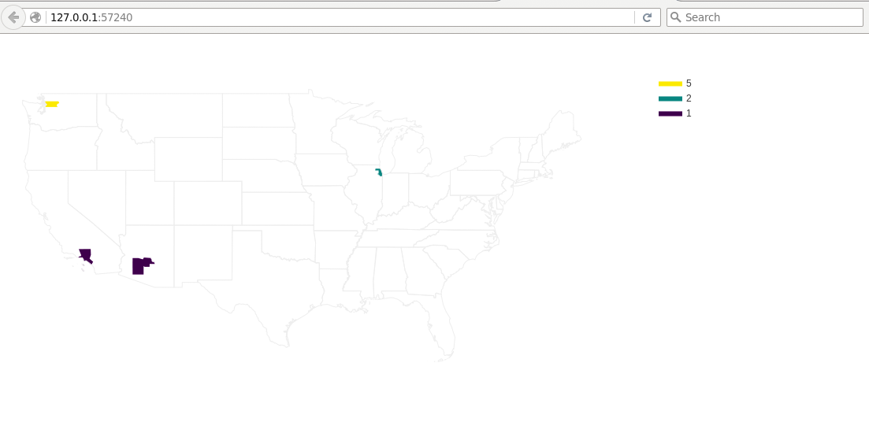
visualize

Slide 10
DEMO

Slide 11
Enhancement and future
Develop agents to collect data from multi sources
Collect other features to build a machine leaning model
Predict when will the world win Covid 19

Slide 12

Thank You!
vantran@miu.com

