Slide 1
Economics 2220 Principles Of Macroeconomics
Professor Zhigang Feng
Lecture 10:
The Aggregate Expenditure Model

Slide 2
How the inventory adjustment process moves the economy to a new equilibrium after a change in demand
Why investment spending is considered a leading indicator of the future state of the economy
To First
Active Learning

Slide 3

THE INCOME–EXPENDITURE MODEL
A more detailed look at how changes in spending get multiplied and how firms respond.
Inventories play a central role in the economy, so economists pay attention to the changes in firms’ inventories when trying to understand the direction of the economy.
Notes:
Photo Credit: Fabrizio Constantini/The New York Times/Reduax

Slide 4
THE INCOME–EXPENDITURE MODEL
The assumptions we make:
Changes in overall spending lead to changes in aggregate output.
The interest rate is fixed.
Taxes, government transfers, and government purchases are all zero.
Exports and imports are both zero.
(Future chapters loosen these assumptions.)

Slide 5
PLANNED AGGREGATE SPENDING AND REAL GDP
In our simplified economy,
GDP = C + I and
YD = GDP
and our aggregate consumption function is
C = A + MPC × YD
and we assume I_{planned} is fixed
so
AE_{Planned} = C + I_{Planned}
where planned aggregate spending = the total amount of planned spending in the economy.

Slide 6
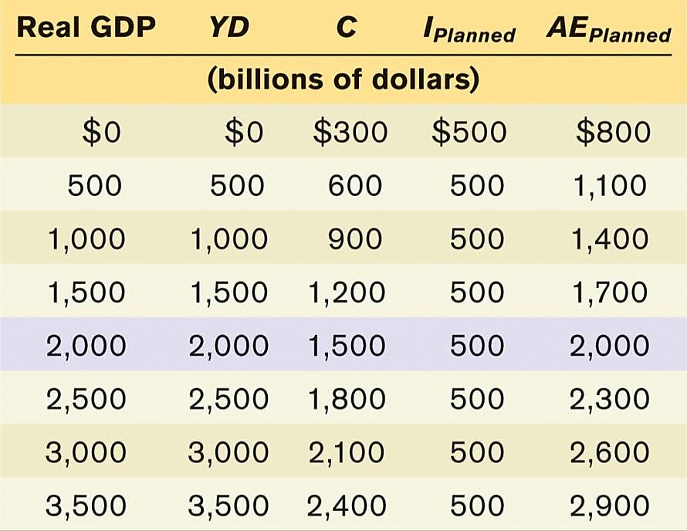
WORKING WITH THE MODEL
Example of the model in action:
Example: if C = 300 + 0.6 × YD, then

Slide 7
PLANNED AGGREGATE SPENDING AND GDP
AE_{Planned}
consumer
spending
(billions
of dollars)
$4,000
3,000
AE_{Planned}
AE_{Planned} = C + I_{Planned}
CF
2,500
2,000
Planned aggregate spending equals consumer spending plus I_{planned}, $500 billion.
C = 300 + 0.6 × YD
800
300
0
$500
1,000
1,500
2,000
2,500
3,000
3,500
4,000
Real GDP
(billions of dollars)
Notes:
7

Slide 8
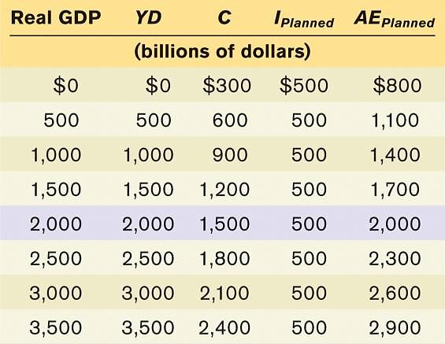
PLANNED AGGREGATE SPENDING AND GDP
$4,000
For all production levels except one, real GDP is either more or less than AE_{Planned}
AE_{Planned}
consumer
spending
(billions
of dollars)
3,000
AE
_{Planned}
2,500
2,000
800
300
$500
1,000
1,500
2,000
2,500
Real GDP
(billions of dollars)
0
3,000
3,500
4,000
Notes:
8

Slide 9
INCOME–EXPENDITURE EQUILIBRIUM
Planned aggregate spending can be different from real GDP only if there is unplanned inventory investment, I_{Unplanned}, in the economy.
If firms have overestimated sales and produced too much, there will be unintended additions to inventories (and I_{Unplanned} will be positive).
If firms have underestimated sales and produced too little, there will be unintended drops in inventories (and I_{Unplanned} will be negative).

Slide 10
Suppose the level of planned aggregate expenditure in an economy is $500 and real GDP is $600. According to the our model:
unplanned increases in inventories are occurring.
unplanned decreases in inventories are occurring.
inventories will be unaffected and will remain at the planned inventory level.
excess production will continue, since there is no mechanism to restore the level of production to the level of spending.
To Next
Active Learning

Slide 11
INCOME–EXPENDITURE EQUILIBRIUM
GDP = C + I
= C + I_{Planned} + I_{Unplanned}
= AE_{Planned} + I_{unplanned}
Whenever real GDP exceeds AE_{Planned}, I_{Unplanned} is positive.
Whenever real GDP is less than AE_{Planned}, I_{Unplanned} is negative.
(But firms will act to correct their mistakes by producing more or less accordingly.)

Slide 12

INCOME–EXPENDITURE EQUILIBRIUM
The economy is in income–expenditure equilibrium when aggregate output (real GDP) is equal to planned aggregate spending.
Income–expenditure equilibrium GDP: the level of real GDP at which real GDP equals planned aggregate spending.
Notes:
All image credits courtesy of Morgue File and/or FreeImages.com unless otherwise specified

Slide 13
INCOME–EXPENDITURE EQUILIBRIUM
Planned
aggregate
spending,
AE_{Planned}
(billions of
dollars)
$4,000
AE_{Planned} = GDP
45-degree line
I_{Unplanned} = $200
AE_{Planned}
3,000
AE_{Planned} = C + I_{Planned} =
A + MPC × GDP + I_{Planned}
2,000
E
I_{Unplanned} = –$400
1,400
The Keynesian cross is a diagram that identifies income–expenditure equilibrium as the point where a planned aggregate spending line crosses the 45-degree line.
1,000
800
0
$500
1,000
1,500
2,000
2,500
3,000
3,500
4,000
Real GDP (billions of dollars)
Y*
I_{Unplanned} is negative and GDP rises
I_{Unplanned} is positive and GDP falls
Notes:
13

Slide 14
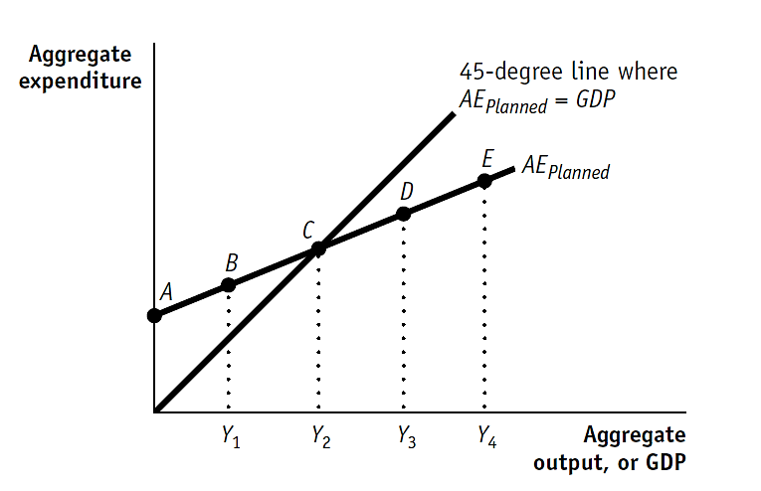
Suppose Outlandia’s economy is operating at point B.
Is this an income –expenditure equilibrium for Outlandia? Describe what is happening to inventories and production in Outlandia.
What level of GDP will this economy produce at equilibrium?
At what levels of GDP is unplanned inventory investment positive?
At what levels is planned aggregate expenditure greater than income?
To answer

Slide 15
(answers to previous slide’s questions)
No, the income–expenditure equilibrium is at point C on the graph. At point B,AE_{Planned} is greater than GDP, or income. This causes inventories to fall, and firms view this as a signal that they should increase their production from Y₁ toward Y₂, the income–expenditure equilibrium real GDP.
This economy, holding everything else constant, will produce GDP equal to Y₂ when it is in income–expenditure equilibrium.
Unplanned inventory investment is positive wherever GDP is greater than AE_{Planned}: GDP output levels Y₃ and Y₄ represent two output levels where unplanned inventory investment is positive. So at any output level greater than Y₂, unplanned inventory investment is positive.
This is true for any level of GDP less than Y₂.

Slide 16

THE MULTIPLIER PROCESS AND INVENTORY ADJUSTMENT
What happens when there’s a shift of the planned aggregate spending line?
Two possible sources of a shift:
change in interest rate
change in wealth
Notes:
Photo Credit: AP Photo/Chris O’Meara

Slide 17
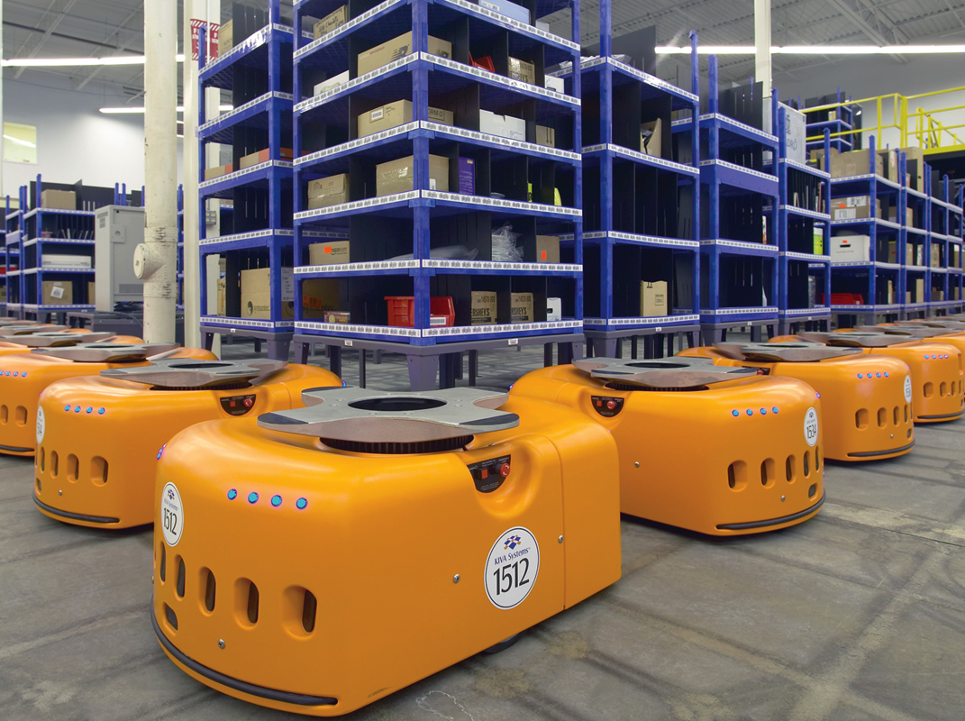
THE MULTIPLIER PROCESS AND INVENTORY ADJUSTMENT
When planned spending doesn’t equal output, it shows up in changes to inventories.
This is why changes in inventories are considered a leading indicator of future economic activity.
Notes:
All image credits courtesy of Morgue File and/or FreeImages.com unless otherwise specified

Slide 18
THE MULTIPLIER PROCESS AND INVENTORY ADJUSTMENT
A Vivid Example: Mario’s Pizzeria
Every Friday, Mario must decide how many pizzas to bake before he knows how many customers will show up.
Production (pizzas baked) = Real GDP
Actual purchases by customers = AE_{Planned}
Unsold pizzas (or emergency freezer raids) = I_{Unplanned}
What happens when Mario guesses wrong?
Notes:
All image credits courtesy of Morgue File and/or FreeImages.com unless otherwise specified

Slide 19
THE MULTIPLIER PROCESS AND INVENTORY ADJUSTMENT
Scenario 1: Mario Overestimates Demand
Mario expects a busy Friday and bakes 200 pizzas.
A big storm hits — customers only buy 150 pizzas.
50 unsold pizzas pile up in the warming racks.
I_{Unplanned} = +50 (unintended additions to inventory)
Production (200) > Spending (150)
→ Economy is above equilibrium
Next Friday, Mario will cut back production
→ Output shrinks toward equilibrium.
Notes:
All image credits courtesy of Morgue File and/or FreeImages.com unless otherwise specified

Slide 20
THE MULTIPLIER PROCESS AND INVENTORY ADJUSTMENT
Scenario 2: Mario Underestimates Demand
Mario expects a slow night and bakes only 100 pizzas.
A nearby concert lets out early — customers want 140 pizzas.
Mario sells all 100 and pulls 40 frozen pizzas from his back freezer.
I_{Unplanned} = –40 (unintended drops in inventory)
Production (100) < Spending (140)
→ Economy is below equilibrium
Next Friday, Mario will ramp up production
→ Output rises toward equilibrium.
Notes:
All image credits courtesy of Morgue File and/or FreeImages.com unless otherwise specified

Slide 21
THE MULTIPLIER PROCESS AND INVENTORY ADJUSTMENT
Scenario 3: Mario Nails His Forecast
Bakes 150 pizzas, exactly 150 sell. I_{Unplanned} = 0. Economy is in equilibrium.
 | Prod > Spending | Prod < Spending | Prod = Spending
Inventories | Pile up | Drain | Stay as planned
I(Unplanned) | Positive (+) | Negative (–) | Zero
Firms respond | Cut production | Raise production | Keep steady
Economy | Down toward eq. | Up toward eq. | At equilibrium
Notes:
All image credits courtesy of Morgue File and/or FreeImages.com unless otherwise specified

Slide 22
THE MULTIPLIER PROCESS AND INVENTORY ADJUSTMENT
Unplanned inventory changes are the signal that tells firms they’ve guessed wrong.
They are the mechanism that pushes the economy back toward equilibrium:
AE_{Planned} < GDP → I_{Unplanned} > 0 → Firms cut production → GDP falls
AE_{Planned} > GDP → I_{Unplanned} < 0 → Firms increase production → GDP rises
AE_{Planned} = GDP → I_{Unplanned} = 0 → Equilibrium!
Just like Mario adjusting how many pizzas he bakes next Friday!
Notes:
All image credits courtesy of Morgue File and/or FreeImages.com unless otherwise specified

Slide 23
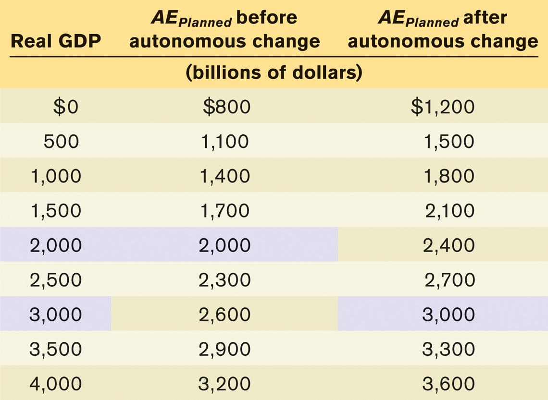
THE MULTIPLIER PROCESS AND INVENTORY ADJUSTMENT
Continuing our previous example: the effect of an autonomous increase in planned aggregate spending of $400 billion
The fact that the rise in equilibrium GDP, from $2,000 to $3,000, is much larger than the autonomous increase in aggregate spending, ($400) has a familiar explanation: the multiplier process.

Slide 24
THE MULTIPLIER
Planned
aggregate
spending,
AE_{Planned}
(billions of
dollars)
$4,000
AE_{Planned} after
autonomous change
AE_{Planned2}
E
2
AE_{Planned1}
3,000
I_{Unplanned} = –$400
X
AE_{Planned} before
autonomous change
2,400
2,000
E
1
Autonomous increase of $400 in aggregate spending
1,200
ΔY* = Multiplier × ΔAAE_{Planned} = 1 / (1 – MPC) × ΔAAE_{Planned}
800
0
$500
1,000
1,500
2,000
2,500
3,000
3,500
4,000
Real GDP (billions of dollars)
Y*₁
Y*₂
Notes:
24

Slide 25

THE PARADOX OF THRIFT
In macroeconomics, the outcome of many individual actions can generate a result that is different from and worse than the simple sum of those individual actions.
If your house loses value because the housing bubble has burst, you might adjust and spend less.
If everyone else does the same, the economy is depressed, jobs are lost, and everyone is worse off because of their virtuous individual actions.
Notes:
All image credits courtesy of Morgue File and/or FreeImages.com unless otherwise specified

Slide 26
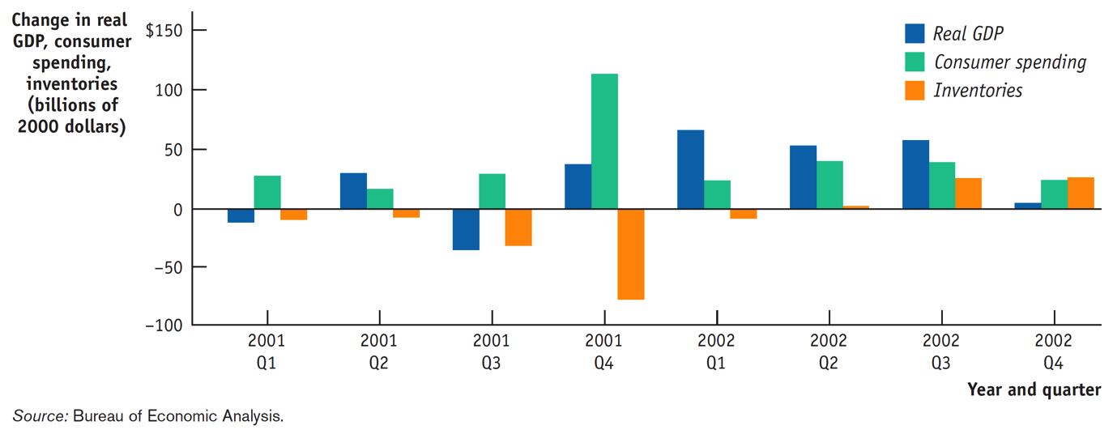
INVENTORIES AND THE END OF A RECESSION
A look at the multiplier process at the end of a recession
Notice the huge increase in consumer spending Q4 2001 that caught businesses by surprise—but by Q1 2002 businesses increased production and real GDP jumped.

Slide 27
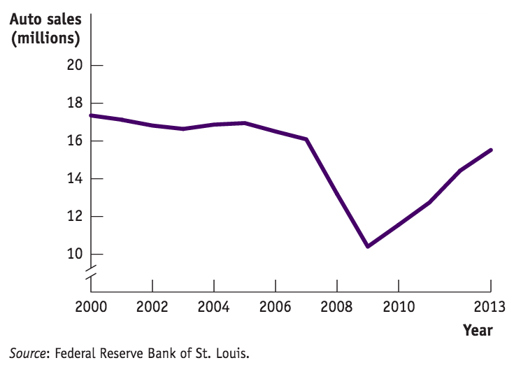
What’s Good for America is Good for GM
In 2009 the U.S. economy was in a nose-dive… and so was General Motors. The government bailed out GM and took a temporary 61% ownership.
Was GM too big to fail (would letting it fall into bankruptcy cost many more jobs?)
Were GM’s problems self-made or was it a victim of a poor economy?
Notes:
All image credits courtesy of Morgue File and/or FreeImages.com unless otherwise specified

