Slide 1
Economics 2220 Principles Of Macroeconomics
Professor Zhigang Feng
Lecture 11:
Aggregate Demand and Aggregate Supply

Slide 2
How the aggregate demand curve illustrates the relationship between the aggregate price level and the quantity of aggregate output demanded in the economy
How the aggregate supply curve illustrates the relationship between the aggregate price level and the quantity of aggregate output supplied in the economy
Why the aggregate supply curve is different in the short run from the long run
How the AD–AS model is used to analyze economic fluctuations
How monetary policy and fiscal policy can stabilize the economy
To First
Active Learning

Slide 3

SHOCKS TO THE SYSTEM
What causes recessions?
Why is inflation high in some recessions and not others?
The economy’s behavior can be explained, predicted, and potentially manipulated by looking at:
total (aggregate) demand.
total (aggregate) supply.
Notes:
Photo credit: PhotoAlto/Alamy

Slide 4
THE AGGREGATE DEMAND CURVE
Aggregate price
level (GDP deflator,
2005 = 100)
Aggregate demand curve: the relationship between the aggregate price level and the quantity of aggregate output demanded by households, businesses, the government, and the rest of the world.
1933
A movement down the AD curve leads to a lower aggregate price level and higher aggregate output.
7.9
4.2
Aggregate demand
curve, AD
0
716
1,000
Real GDP (billions of 2005 dollars)
Notes:
4

Slide 5
THE SHAPE OF THE AGGREGATE DEMAND CURVE
Recall: GDP = C + I + G + X − IM
Why does a rise in the aggregate price level reduce C, I, and X − IM?
(Why does the AD curve slope downward?)
Two reasons:
The wealth effect: A higher aggregate price level reduces the purchasing power of households’ wealth and reduces consumer spending.
The interest rate effect: A higher aggregate price level makes households hold more money and leads to a rise in interest rates (and a fall in investment spending and consumer spending).

Slide 6
THE AGGREGATE DEMAND CURVE AND THE INCOME–EXPENDITURE MODEL
Planned
aggregate
spending
We now drop the assumption that the overall price level is fixed.
45-degree line
When the aggregate price level changes, the AE_{Planned} curve shifts
AE_{Planned2}
E₂
AE_{Planned1}
AE_{Planned}
E₁
The AD curve is the application of the income–expenditure model at different prices.
AE_{Planned}
Y₁
Y₂
Real GDP
Notes:
6

Slide 7
THE AGGREGATE DEMAND CURVE AND THE INCOME–EXPENDITURE MODEL
Planned
aggregate
spending
45-degree line
If the price level drops, planned spending rises at all output levels (from the wealth and interest-rate effects).
This leads to a multiplier process that moves the income–expenditure equilibrium from E₁ to E₂ and raises real GDP from Y₁ to Y₂.
E₂
AE_{Planned2}
AE_{Planned}
E₁
AE_{Planned1}
(a) Change in Income–expenditure equilibrium
Y₁
Y₂
Real GDP
Aggregate price level
P₁
(b) Aggregate Demand
P₂
AD
Y₁
Y₂
Real GDP
Notes:
7

Slide 8
SHIFTS OF THE AGGREGATE DEMAND CURVE
What happens when something changes spending patterns at every price level?
The aggregate demand curve shifts because of changes in:
expectations.
wealth.
size of the existing stock of physical capital.
government policies.
Fiscal policy
Monetary policy

Slide 9
SHIFTS OF THE AGGREGATE DEMAND CURVE
(a) Rightward Shift
(b) Leftward Shift
Aggregate price level
Aggregate price level
Decrease in aggregate demand
Increase in aggregate demand
AD₁
AD₂
AD₂
AD₁
Real GDP
Real GDP
Notes:
9

Slide 10

CHANGES IN WEALTH: A MOVEMENT ALONG VS. A SHIFT OF THE AGGREGATE DEMAND CURVE
Q: Which is it: Does a change in wealth move us along the AD curve (wealth effect) or shift it?
A: it depends on the source of the change in wealth.
If it’s a change in price level that affects our wealth, it’s a movement along the AD.
Example: Rapid inflation shrinks our wealth.
If it’s a change in something else that affects our wealth, it’s a shift in the AD.
Example: The housing market crashes.

Slide 11
If the economy is in equilibrium and the real estate market collapses, what will likely happen?
The AD curve will shift rightward.
The AD curve will shift leftward.
The SRAS curve will shift rightward.
The SRAS curve will shift leftward.
To Next
Active Learning

Slide 12
MOVING ALONG THE AGGREGATE DEMAND CURVE, 1979-1980
Q: How do distinguish between shifts of the AD curve and movements along it?
A: Sometimes it’s hard… except in 1979
Prices rose 14.8% while consumer and investment spending dropped.
The culprit? A leftward shift in the short-run aggregate supply curve along the AD curve.

Slide 13
THE SHORT-RUN AGGREGATE SUPPLY CURVE
Aggregate price
level (GDP deflator,
2005 = 100)
A movement down
the SRAS curve leads
to deflation and lower
aggregate output.
Short-run aggregate
supply curve, SRAS
9.9
Aggregate supply curve shows the relationship between the aggregate price level and the quantity of aggregate output in the economy.
1929
7.3
1933
0
$778
1,057
Real GDP (billions of 2009 dollars)
Notes:
13

Slide 14

THE SHORT-RUN AGGREGATE SUPPLY CURVE
Why does the SRAS curve slope upward?
Because nominal wages are sticky in the short run
Nominal wage: the dollar amount of the wage paid.
Sticky wages: nominal wages that are slow to fall even in the face of high unemployment and slow to rise even in the face of labor shortages.
Notes:
All image credits courtesy of Morgue File and/or FreeImages.com unless otherwise specified

Slide 15

THE SHORT-RUN AGGREGATE SUPPLY CURVE
How do sticky wages affect SRAS?
Profit per unit= price per unit − production cost per unit.
Nominal wages are often determined by contracts that were signed some time ago.
Even when there are no formal contracts, there are often informal agreements between management and workers.
A higher aggregate price level leads to higher profits and increased aggregate output in the short run.
Notes:
All image credits courtesy of Morgue File and/or FreeImages.com unless otherwise specified

Slide 16

THE SHORT-RUN AGGREGATE SUPPLY CURVE
One more point:
Many firms are in very competitive industries, so they have no control over price.
Some aren’t—and can raise price when demand is strong.
(more support for the positive slope of the SRAS)
Notes:
All image credits courtesy of Morgue File and/or FreeImages.com unless otherwise specified

Slide 17
SHIFTS OF THE SHORT-RUN AGGREGATE SUPPLY CURVE
What happens when something changes production levels at every price level?
The SRAS curve shifts because of changes in:
Commodity prices.
Nominal wages.
Productivity.
Each of these factors changes producers’ profits and therefore shifts the SRAS.

Slide 18
SHIFTS OF THE SHORT-RUN AGGREGATE SUPPLY CURVE
(a) Leftward Shift
(b) Rightward Shift
Aggregate price level
Aggregate price level
SRAS₂
SRAS₁
SRAS₂
SRAS₁
Decrease in short-run aggregate supply
Increase in short-run aggregate supply
Real GDP
Real GDP
Notes:
18

Slide 19
SHIFTS OF THE SHORT-RUN AGGREGATE SUPPLY CURVE
(b) Rightward Shift
The SRAS curve shifts RIGHT because of a(n):
decrease in commodity prices.
decrease in nominal wages.
increase in productivity .
Each of these factors increases producers’ profits and shifts the SRAS right.
Aggregate
price
level
SRAS₁
SRAS₂
Increase in short-run aggregate supply
Real GDP
Notes:
19

Slide 20
SHIFTS OF THE SHORT-RUN AGGREGATE SUPPLY CURVE
The SRAS curve shifts LEFT because of a(n):
increase in commodity prices.
increase in nominal wages.
decline in productivity.
Each of these factors reduces producers’ profits and shifts the SRAS left.
(a) Leftward Shift
Aggregate price level
SRAS₂
SRAS₁
Decrease in short-run aggregate supply
Real GDP
Notes:
20

Slide 21
The short-run aggregate supply curve will shift to the right:
when input costs rise.
when taxes rise.
when interest rates rise.
when productivity rises.
To Next
Active Learning

Slide 22

LONG-RUN AGGREGATE SUPPLY CURVE
The long-run aggregate supply curve shows the relationship between the aggregate price level and the quantity of aggregate output supplied that would exist if all prices, including nominal wages, were fully flexible.
The long run is the time it takes for all prices (including nominal wages) to adjust.
Now there is no change to profits SIMPLY BECAUSE PRICES HAVE CHANGED.
Notes:
All image credits courtesy of Morgue File and/or FreeImages.com unless otherwise specified

Slide 23
LONG-RUN AGGREGATE SUPPLY CURVE
Long-run aggregate
supply curve, LRAS
Aggregate price
level (GDP deflator,
2005 = 100)
…leaves the quantity
of aggregate output
supplied unchanged
in the long run.
15.0
A fall in the
aggregate
price level…
Potential output is the level of real GDP the economy would produce if all prices, including nominal wages, were fully flexible.
7.5
0
Potential
output, Y_{P}
$800
Real GDP (billions of 2005 dollars)
Notes:
23

Slide 24
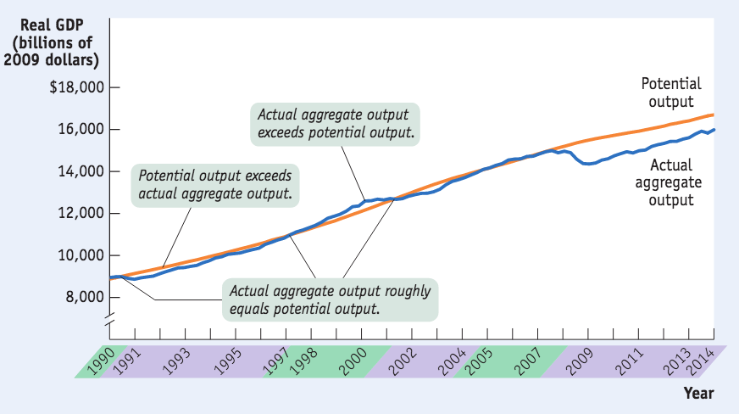
ACTUAL AND POTENTIAL OUTPUT, 1990–2014
The level of real GDP is almost always either above or below potential output because of short-run fluctuations.
Sources: Congressional Budget Office; Bureau of Economic Analysis.
Notes:
24

Slide 25
FROM THE SHORT RUN TO THE LONG RUN
Aggregate price level
LRAS
If the economy finds itself at P₁ on SRAS₁, aggregate output supplied exceeds potential output (temporarily). Eventually, low unemployment will cause nominal wages to rise, and SRAS will shift left.
SRAS₂
SRAS₁
A₁
P₁
A rise in nominal
wages shifts SRAS
leftward.
Y_{P}
Y₁
Real GDP
Notes:
25

Slide 26
FROM THE SHORT RUN TO THE LONG RUN
Aggregate price level
If the economy finds itself at P₁ on SRAS₁, aggregate output supplied falls short of potential output (temporarily). Eventually, high unemployment will cause nominal wages to fall, and SRAS will shift right.
LRAS
SRAS₁
SRAS₂
A fall in nominal
wages shifts SRAS rightward.
A₁
P₁
Y₁
Y_{P}
Real GDP
Notes:
Images courtesy of Library of Congress
26

Slide 27


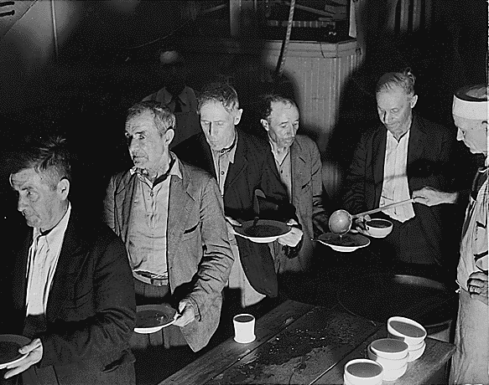
1933: 25% unemployment. Real GDP had dropped by 27%. What made it happen?

Slide 28
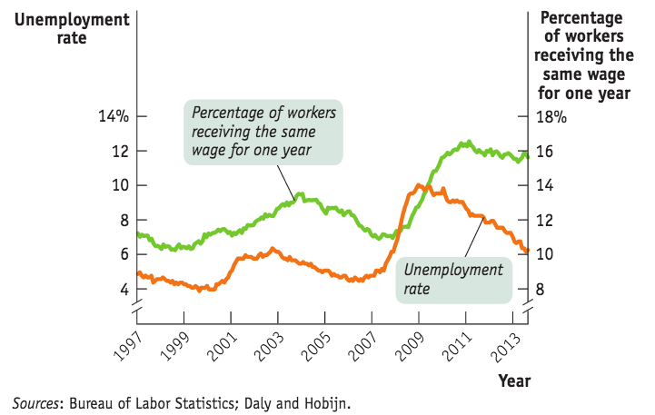
STICKY WAGES IN THE GREAT RECESSION
If the theory of sticky wages were true, we’d find evidence that wages fail to fall even during periods of high unemployment. We do.

Slide 29
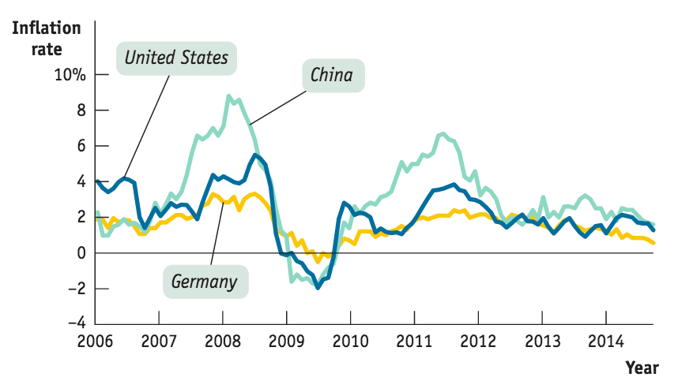
THE AD–AS MODEL
The AD-AS model uses the aggregate supply curve and the aggregate demand curve together to analyze economic fluctuations.

Slide 30
THE AD–AS MODEL
Aggregate price level
SRAS
Short-run equilibrium aggregate price level
P_{E}
E_{SR}
Short-run macroeconomic equilibrium
AD
Short-run equilibrium output
Y_{E}
Real GDP
Notes:
30

Slide 31
SHIFTS OF AGGREGATE DEMAND: SHORT-RUN EFFECTS
A negative demand shock: Total spending falls.
Aggregate price level
A negative demand shock...
SRAS
P₁
E₁
...leads to a lower aggregate price level and lower aggregate output.
P₂
E₂
AD₁
AD₂
Y₂
Y₁
Real GDP
Notes:
31

Slide 32
SHIFTS OF AGGREGATE DEMAND: SHORT-RUN EFFECTS
A positive demand shock: Total spending rises.
Aggregate price level
A positive demand shock...
SRAS
...leads to a higher
aggregate price
level and higher
aggregate output.
P₂
E₂
P₁
E₁
AD₂
AD₁
Y₁
Y₂
Real GDP
Notes:
32

Slide 33
SHIFTS OF THE SRAS CURVE
A positive supply shock: Total production increases at every price level.
Aggregate price level
A positive supply shock...
SRAS₁
SRAS₂
E₁
P₁
...leads to higher
aggregate output, lower aggregate price level.
P₂
E₂
AD
Y₁
Y₂
Real GDP
Notes:
33

Slide 34
SHIFTS OF THE SRAS CURVE
A negative supply shock: Total production falls at every price level.
Aggregate price level
A negative supply shock...
SRAS₂
SRAS₁
E₂
...leads to a lower aggregate output and a higher aggregate price level.
P₂
P₁
E₁
AD
Y₂
Y₁
Real GDP
Notes:
34

Slide 35

NEGATIVE SUPPLY SHOCKS AND STAGFLATION
Especially nasty for society is stagflation: the combination of inflation and falling aggregate output that comes with a negative supply shock.
Notes:
All image credits courtesy of Morgue File and/or FreeImages.com unless otherwise specified

Slide 36
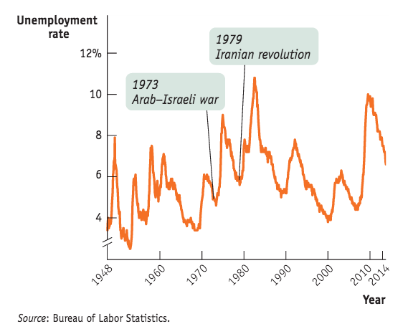
Supply Shocks vs. demand shocks in action
Which type of recession is more common? Demand shocks are the usual culprit.
Negative supply shock are rare but nasty.

Slide 37

LONG-RUN MACROECONOMIC EQUILIBRIUM
The economy is in long-run macroeconomic equilibrium when the point of short-run macroeconomic equilibrium is on the long-run aggregate supply curve.
Notes:
All image credits courtesy of Morgue File and/or FreeImages.com unless otherwise specified

Slide 38
LONG-RUN MACROECONOMIC EQUILIBRIUM
This economy is in short run AND long-run
macroeconomic equilibrium.
Aggregate price level
LRAS
SRAS
P_{E}
E_{LR}
Long-run macroeconomic equilibrium
AD
Y_{P}
Real GDP
Potential output
Notes:
38

Slide 39

WHAT HAPPENS WHEN THERE IS A SHOCK?
If a demand or supply shock hits the economy, AD or SRAS shifts and moves the economy to a new short-run equilibrium.
Notes:
All image credits courtesy of Morgue File and/or FreeImages.com unless otherwise specified

Slide 40
SHORT-RUN EFFECTS OF A NEGATIVE DEMAND SHOCK
Aggregate price level
2. …reduces the aggregate price level and aggregate output and leads to higher unemployment in the short run…
LRAS
SRAS₁
P₁
E₁
1. An initial
negative
demand shock…
P₂
E₂
AD₁
AD₂
Y₂
Y₁
Potential
output
Real GDP
Recessionary gap
Notes:
40

Slide 41
SHORT-RUN EFFECTS OF A POSITIVE DEMAND SHOCK
2. …increases the aggregate
price level and aggregate
output and leads to lower
unemployment in the short
run…
Aggregate price level
LRAS
SRAS₁
P₂
E₂
1. An initial
positive demand shock…
P₁
E₁
AD₂
AD₁
Potential
output
Y₁
Y₂
Real GDP
Inflationary gap
Notes:
41

Slide 42
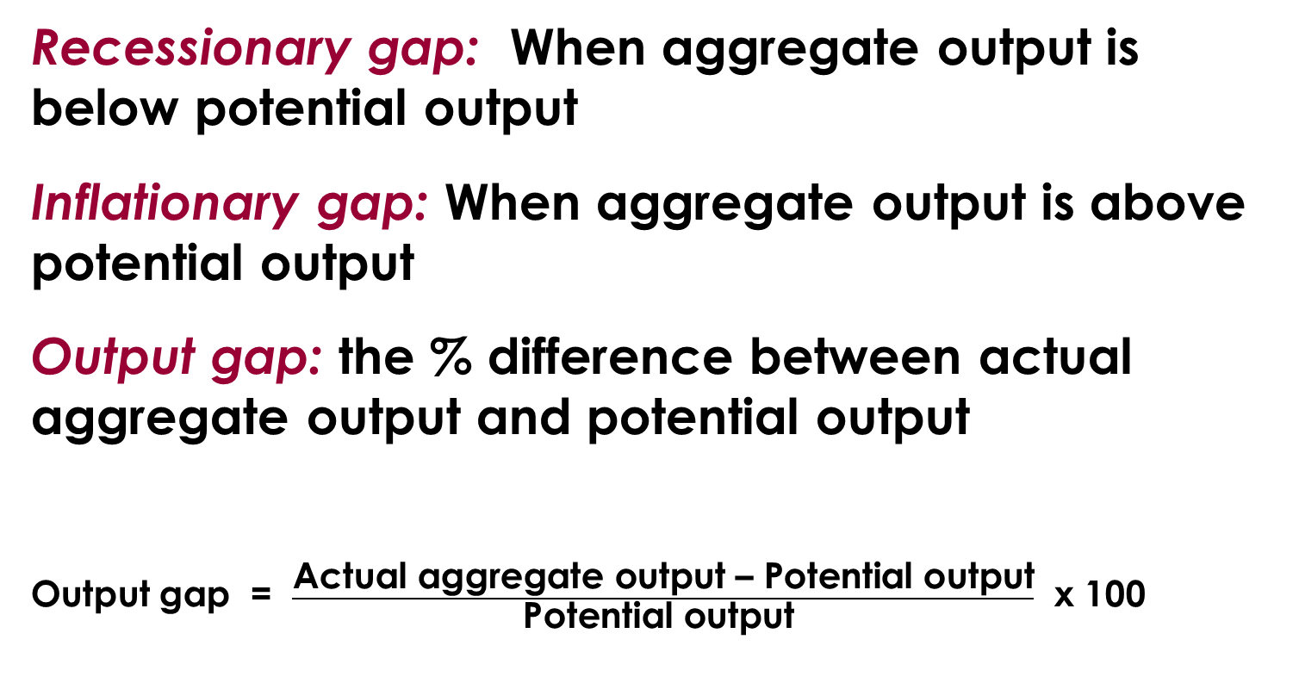
GAP RECAP
Recessionary gap: When aggregate output is below potential output
Inflationary gap: When aggregate output is above potential output
Output gap: the % difference between actual aggregate output and potential output
Output gap = $\frac{\text{Actual} \text{aggregate} \text{output}\text{ – }\text{Potential} \text{output}}{\text{Potential} \text{output} }$ x 100

Slide 43

GAP RECAP
What happens next? Are we stuck in a gap forever?
We’ll discuss how policy makers can attempt to move us back to potential output next…
But the economy may correct itself in the long run if wages and prices fully adjust.
Notes:
All photo credits unless otherwise noted from Freeimages.com (Formerly Stockxchange) or Morguefile.com

Slide 44
SHORT-RUN VERSUS LONG-RUN EFFECTS OF A POSITIVE DEMAND SHOCK
Aggregate price level
3. …until a rise in nominal wages in the long run reduces short-run aggregate supply and moves the economy back to potential output.
An initial positive
demand shock…
LRAS
SRAS₂
SRAS₁
E₃
P₃
P₂
E₂
2. …increases
aggregate price level
and aggregate output,
reduces unemployment in the short run…
E₁
P₁
AD₂
AD₁
Potential
output
Y₁
Y₂
Real GDP
Inflationary gap
Notes:
44

Slide 45
SHORT-RUN VERSUS LONG-RUN EFFECTS OF A NEGATIVE DEMAND SHOCK
2. …reduces the aggregate price level and aggregate output and leads to higher unemployment in the short run…
Aggregate price level
LRAS
SRAS₁
SRAS₂
P₁
E₁
1. An initial
negative demand shock…
3. …until a fall in nominal wages in the long run increases short-run aggregate supply and moves the economy back to potential output.
P₂
E₂
P₃
E₃
AD₁
AD₂
Y₂
Y₁
Potential
output
Real GDP
Recessionary gap
Notes:
45

Slide 46
With a partner, answer the following:
The AD–AS model is said to have a self-correcting mechanism.
Explain to each other what this means and how this self-correcting mechanism works.
Use a graph to illustrate your answer.
To Next
Active Learning

Slide 47
Suppose an economy is in short-run equilibrium; the level of real GDP is less than potential output. Which of the following statements is true?
In the long run, nominal wages will fall and the SRAS curve will shift left, restoring the economy to potential output.
In the long run, nominal wages will fall and the SRAS curve will shift right, restoring the economy to potential output.
In the long run, nominal wages will fall and the AD curve will shift left, restoring the economy to potential output.
In the long run, nominal wages will fall and the AD curve will shift right, restoring the economy to potential output.
To Next
Active Learning

Slide 48
Suppose short-run equilibrium real GDP for an economy is greater than potential output. This implies that:
nominal wages will have to adjust upward as the economy moves from the short run to the long run.
the level of unemployment is very low.
jobs are plentiful.
to reach long-run equilibrium, the SRAS curve will shift to the left, resulting in a higher aggregate price level.
Answers (a), (b), (c), and (d) are all correct.
To Next
Active Learning

Slide 49
Use a graph of the AD–AS model to illustrate long-run economic growth in an economy.
Explain your graph and how it illustrates economic growth. Assume in your answer that AD does not change over time.

Slide 50
MACROECONOMIC POLICY
It’s true that the economy is self-correcting in the long run.
Most economists think it takes a decade or longer
Stabilization policy: the use of government policy to reduce the severity of recessions and rein in excessively strong expansions.
John Maynard Keynes (1883–1946) created the modern field of macroeconomics.

Slide 51

MACROECONOMIC POLICY
“But this long run is a misleading guide to current affairs. In the long run we are all dead. Economists set themselves too easy, too useless a task if in tempestuous seasons they can only tell us that when the storm is long past the ocean is flat again.”
—J. M. Keynes
Notes:
Photo credit: Bettmann/Corbis

Slide 52
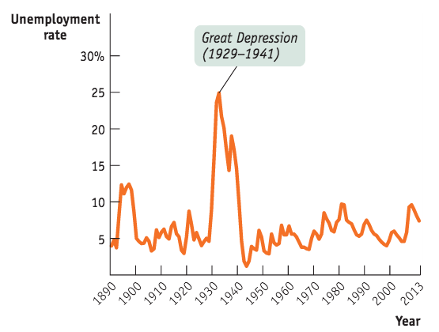
Is stabilization policy stabilizing?
Governments don’t always offset demand shocks; there are costs to intervention.
Unemployment has been more stable since WWII
Sources: Christina Romer, “Spurious Volatility in Historical Unemployment Data.”
Journal of Political Economy 94, no. 1 (1986): 1–37 (years 1890–1928); Bureau of Labor Statistics (years 1929–2014).

Slide 53

RESPONDING TO SUPPLY SHOCKS
Negative supply shocks pose a policy dilemma:
To stabilize aggregate output requires increasing aggregate demand. This will lead to inflation.
But to stabilize prices requires reducing aggregate demand. This will deepen the output slump.
Ben Bernanke’s job: was harder during the stagflation of 2008 than normal for the chair of the Federal Reserve
Notes:
All image credits courtesy of Morgue File and/or FreeImages.com unless otherwise specified

Slide 54

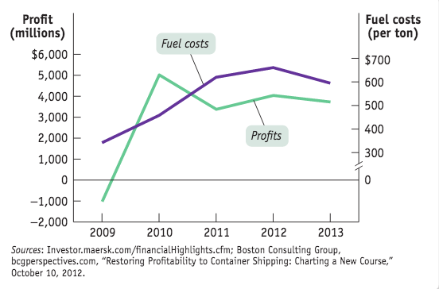
2011 saw Maersk’s profits drop 30% due to rising oil prices… many companies began “slow steaming” to 17 (from 20) knots to save fuel.
Notes:
Photo credit: Peter Titmuss/Alamy

