Slide 1
Economics 2220 Principles Of Macroeconomics
Professor Zhigang Feng
Lecture 12:
Fiscal Policy

Slide 2
What fiscal policy is and why it is an important tool in managing economic fluctuations
Which policies constitute an expansionary fiscal policy and which constitute a contractionary fiscal policy
Why fiscal policy has a multiplier effect and how this effect is influenced by automatic stabilizers
Why governments calculate the cyclically adjusted budget balance
Why a large public debt may be a cause for concern
Why implicit liabilities of the government are also a cause for concern
To First
Active Learning
To Video

Slide 3


They’re back! Keynes vs. Hayek: the fight of the century, round 2. Is fiscal policy stabilizing or destabilizing? Has the Great Recession proved either man right? Click here or below. (10:10 minutes)
Back to
Notes:
http://www.youtube.com/watch?v=GTQnarzmTOc

Slide 4
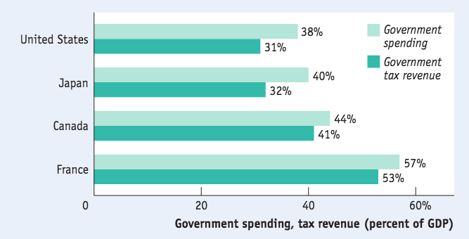
FISCAL POLICY: THE BASICS
Government spending and tax revenue for some high-income countries in 2013
Source: OECD.

Slide 5
FISCAL POLICY: THE BASICS
The government funds many programs through tax revenues.
Some important terms:
Government transfers: payments by the government to households for which no good or service is provided in return.
Social insurance programs: government programs (transfer payments) intended to protect families against economic hardship.
Social Security
Medicare
Medicaid

Slide 6
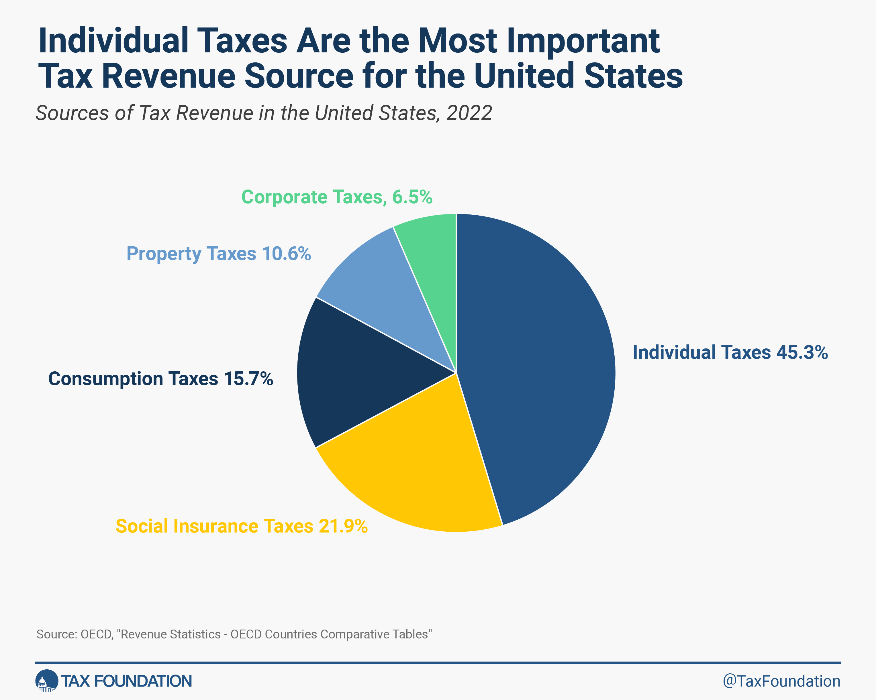
Source: Bureau of Economic Analysis

Slide 7
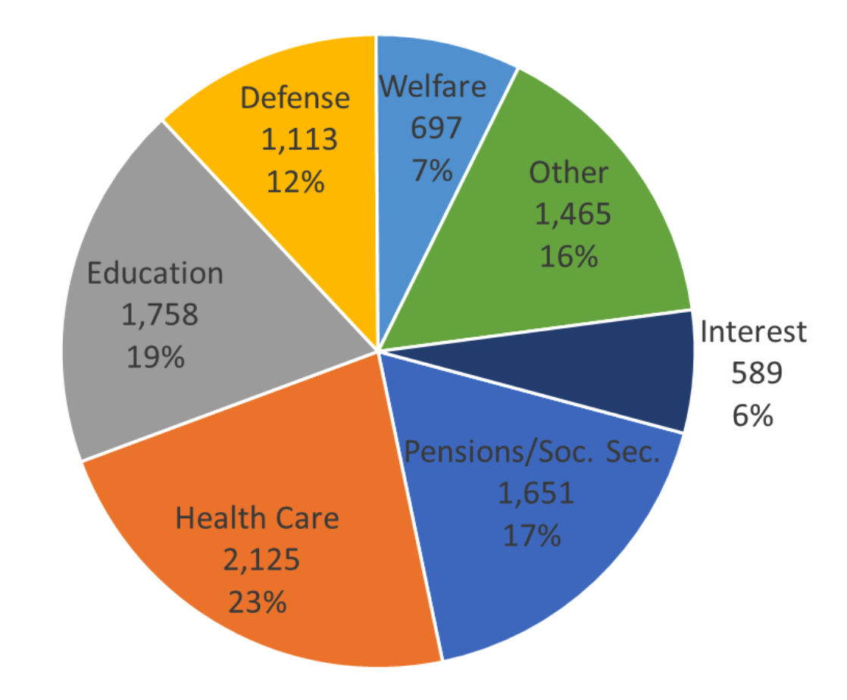
GOVERNMENT SPENDING IN THE U.S., 2023
Source: Bureau of Economic Analysis

Slide 8
Government programs that are designed to protect individuals or families from economic hardship are described as:
fiscal policy.
discretionary fiscal policy.
monetary policy.
social insurance.
To Next
Active Learning

Slide 9
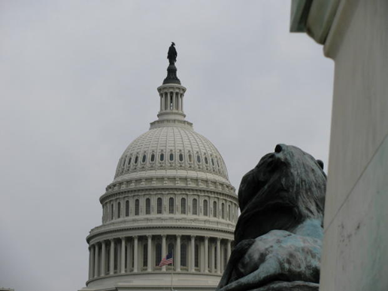
THE GOVERNMENT BUDGET AND TOTAL SPENDING
GDP = C + I + G + X – IM
The government directly controls G and indirectly affects C and I.
How?
Household incomes are affected by taxes and transfers, and business investment is affected by taxes and regulations.
So the government can shift the AD curve.
Notes:
All image credits courtesy of Morgue File and/or FreeImages.com unless otherwise specified

Slide 10
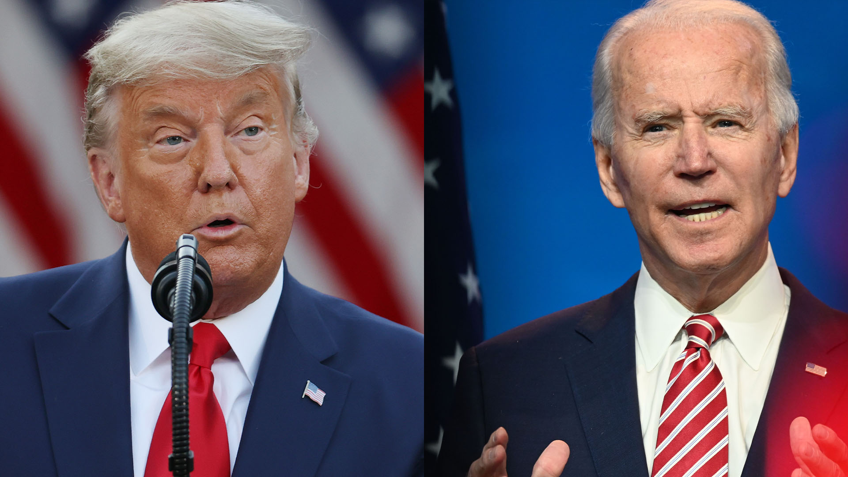
FISCAL POLICY
Fiscal policy: the use of taxes, government transfers, or government purchases of goods and services to shift the aggregate demand curve.
I tried a tax cut.
Donald, I’m gonna go in a different direction.
Notes:
All image credits courtesy of Morgue File and/or FreeImages.com unless otherwise specified

Slide 11

EXPANSIONARY AND CONTRACTIONARY FISCAL POLICY
Expansionary fiscal policy: fiscal policy that increases aggregate demand:
an increase in government purchases of goods and services
a cut in taxes
an increase in government transfers
Expansionary fiscal policy:
extra fuel for the economy
Notes:
All image credits courtesy of Morgue File and/or FreeImages.com unless otherwise specified

Slide 12
EXPANSIONARY FISCAL POLICY CAN CLOSE A RECESSIONARY GAP
Aggregate price level
LRAS
SRAS₁
Instead of waiting for the long-run correction mechanism, policy makers could choose to stimulate AD and move the economy back toward long-run equilibrium.
P₂
E₂
P₁
E₁
AD₂
AD₁
Y₁
Y_{P}
Potential
output
Real GDP
Recessionary gap
Notes:
12

Slide 13

EXPANSIONARY AND CONTRACTIONARY FISCAL POLICY
Contractionary fiscal policy: fiscal policy that decreases aggregate demand:
a reduction in government purchases of goods and services
an increase in taxes
a reduction in government transfers
Contractionary fiscal policy:
brakes for the economy

Slide 14
CONTRACTIONARY FISCAL POLICY CAN CLOSE AN INFLATIONARY GAP
Aggregate price level
LRAS
SRAS₁
Instead of waiting for the long-run correction mechanism, policy makers could choose to contract AD and move the economy back toward long-run equilibrium.
P₁
E₁
P₂
E₂
AD₁
AD₂
Potential
output
Y_{P}
Y₁
Real GDP
Inflationary gap
Notes:
14

Slide 15


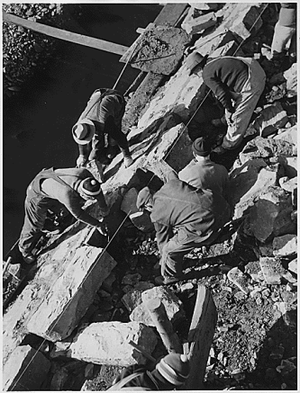
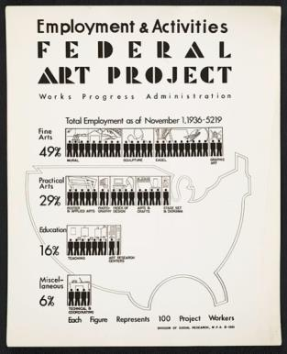

Do you think the government is right to begin massive spending programs during deep recessions?
Yes
No
To Next
Active Learning
Notes:
Images of WPA programs used during the Great Depression

Slide 16
Suppose a country wishes to produce at its potential output level. Holding everything else constant, identify which of the following policy initiatives might help it reach this goal and how these policy initiatives would help.
The government initiates policies that encourage private investment spending.
The government increases the amount of money it borrows in the loanable funds market to increase its level of government spending in the economy.
The government increases taxes on consumers and corporations.
The government authorizes new spending programs.
To answer

Slide 17
(answers to previous question)
Any policy initiative that shifts AD to the right will help the country move toward its potential output level. Items (a) and (d) will both shift AD to the right: government policies that stimulate private investment spending lead to higher levels of aggregate spending and a rightward shift in AD; and new spending by government will also lead to higher levels of aggregate spending and a rightward shift in AD. Item (b) will cause the AD to shift to the right unless the increase in government borrowing crowds out private investment to the point where private investment decreases by an amount equal to the increase in government spending. In that case item (b) would result in no shift in the AD curve. Item (c) will reduce disposable income and lead to lower levels of aggregate spending: AD may shift to the left if the decrease in spending is greater than the increase in government spending, or AD may shift to the right if the increase in government spending is greater than the decrease in spending
To Next
Active Learning

Slide 18

CAN EXPANSIONARY FISCAL POLICY ACTUALLY WORK?
There are critics who argue:
“Government spending always crowds out private spending.”
“Government borrowing always crowds out private investment spending.”
“Government budget deficits reduce private spending.”
Notes:
All image credits courtesy of Morgue File and/or FreeImages.com unless otherwise specified

Slide 19

CAN EXPANSIONARY FISCAL POLICY ACTUALLY WORK?
Claim 1: “Government spending always crowds out private spending.”
The statement is wrong because it assumes a zero-sum game in which the aggregate income earned in the economy is always a fixed sum—which isn’t true. It also assumes that resources in the economy are always fully employed—and the only way to increase government spending is at firms’ expense.
You’re squeezed only if the hot tub is full.
Notes:
All image credits courtesy of Morgue File and/or FreeImages.com unless otherwise specified

Slide 20

CAN EXPANSIONARY FISCAL POLICY ACTUALLY WORK?
Claim 2: “Government borrowing always crowds out private investment spending.”
This is true only part of the time: It depends upon whether the economy is depressed.
If it is, a fiscal expansion will lead to higher incomes, which lead to increased savings.
The CARES Act of 2020 was a case in point: despite high levels of government borrowing, U.S. interest rates stayed near historic lows.

Slide 21
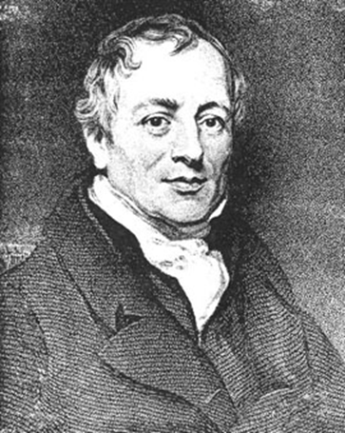
CAN EXPANSIONARY FISCAL POLICY ACTUALLY WORK?
Claim 3: “Government budget deficits reduce private spending.”
This is known as “Ricardian equivalence” (after the nineteenth-century economist David Ricardo).
It assumes that consumers, seeing the higher debt levels, will cut their spending today to save for inevitable increases in future tax rates necessary to pay down the debt.
Does this give too much credit to consumers’ foresight and budgeting discipline? Probably.
Notes:
Image credit: Wikimedia

Slide 22

A CAUTIONARY NOTE: LAGS IN FISCAL POLICY
In the case of fiscal policy, there is an important reason for caution: There are significant lags in its use.
It takes time to:
realize the recessionary or inflationary gap by collecting and analyzing economic data.
develop a plan.
implement the action plan (spending the money).
Notes:
All image credits courtesy of Morgue File and/or FreeImages.com unless otherwise specified

Slide 23
Contractionary fiscal policy:
is most helpful for restoring an economy to the potential output level of production when there is a recessionary gap.
shifts the AD curve to the right, restoring the equilibrium level of output to the potential output level for the economy.
often causes inflation or an increase in the aggregate price level.
if effective, shifts AD to the left, resulting in a reduction in the aggregate output and the aggregate price level for a given short-run aggregate supply curve (SRAS).
To Next
Active Learning

Slide 24
Which of the following statements is true? Holding everything else constant:
an economy can eliminate an inflationary gap by increasing government spending.
expansionary fiscal policy refers to an increase in taxes.
when potential output is greater than actual aggregate output, the economy faces an recessionary gap.
when SRAS intersects AD to the right of the long-run aggregate supply (LRAS) curve, the economy faces a recessionary gap.
To Next
Active Learning

Slide 25
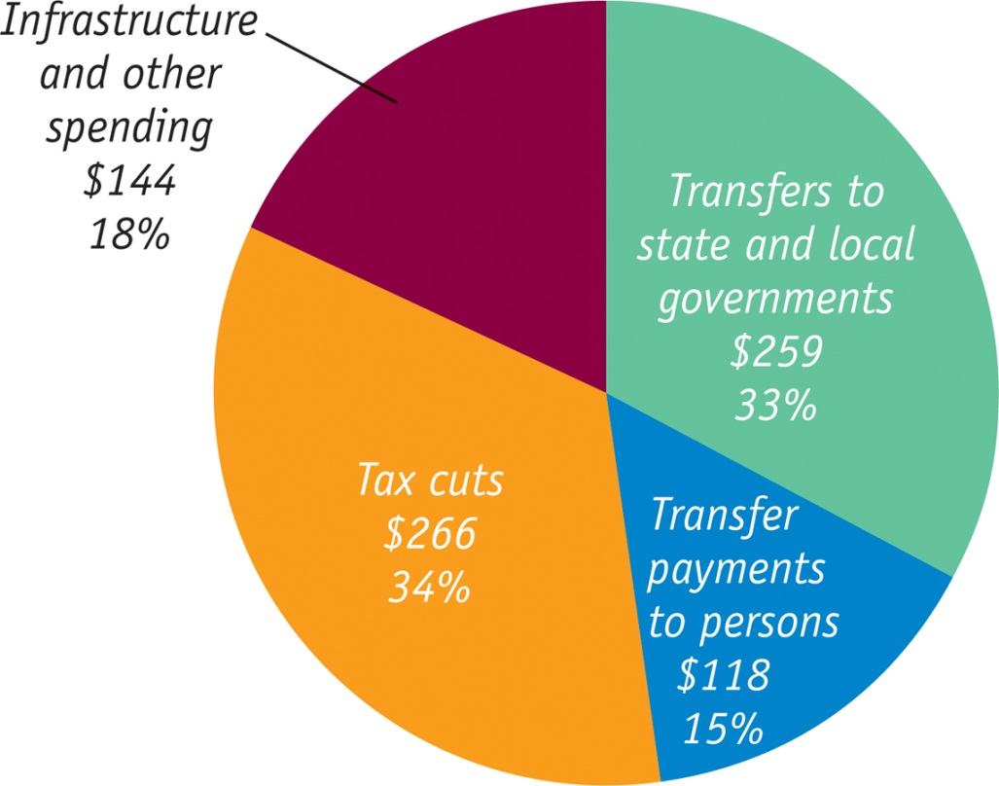
What Was in the Recovery Act?
The American Recovery and Reinvestment Act of 2009 (billions of dollars)
One effect of the recession was a sharp drop in revenues at the state and local levels, which in turn forced these lower levels of government to cut spending. Federal aid was sent to mitigate these cuts.

Slide 26
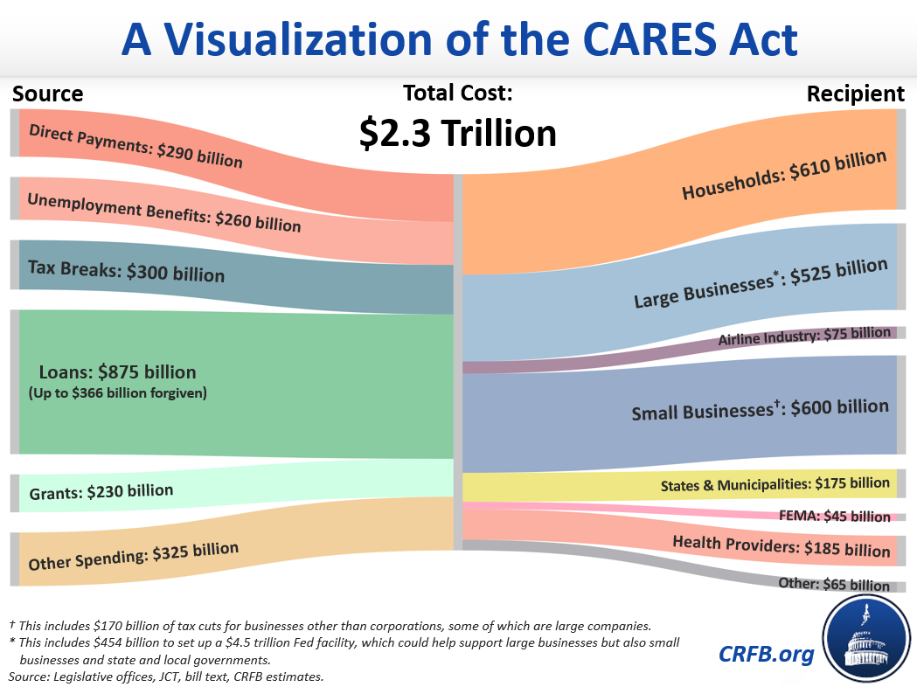

Slide 27



THE MULTIPLIER
Recall: The multiplier idea was introduced by Keynes.
The multiplier magnifies new spending into greater levels of income and output because each round of spending becomes income for someone else.
Notes:
All image credits courtesy of Morgue File and/or FreeImages.com unless otherwise specified

Slide 28
FISCAL POLICY AND THE MULTIPLIER
Multiplier effects of an increase in government purchases of goods and services:
Recall that (if we assume a simple case with no taxes or international trade),
the multiplier is 1/(1 − MPC)
Example: if MPC = 0.5, the multiplier would be 1/(1 − 0.5)= 2.
So $50 billion of new government spending would create
($50 billion) × 2 = $100 billion increase in real GDP.

Slide 29
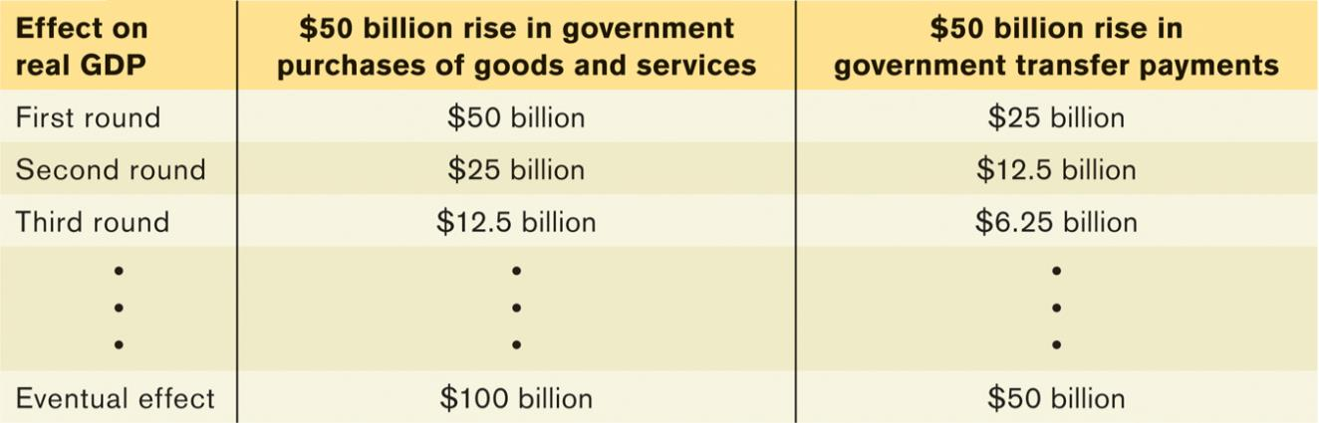
FISCAL POLICY AND THE MULTIPLIER
Multiplier effects of changes in government
transfers and taxes
Will a $50 billion tax cut (or increase in transfers) have the same effect as a $50 billion increase in government purchases?
No. Example: if the MPS=0.5, a change in tax or transfers is smaller than an equivalent change in government purchases from the outset.

Slide 30
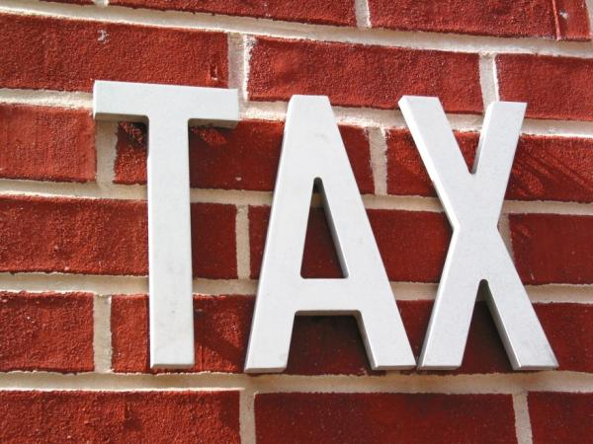
FISCAL POLICY AND THE MULTIPLIER
The size of the shift of the aggregate demand curve depends on the type of fiscal policy.
Changes in government purchases have a more powerful effect on the economy than equal-sized changes in taxes or transfers.
Notes:
All image credits courtesy of Morgue File and/or FreeImages.com unless otherwise specified

Slide 31
FISCAL POLICY AND THE MULTIPLIER
A few notes:
It’s more complicated, because (unlike most real tax policy) we use simple lump-sum taxes: taxes that don’t depend on the taxpayer’s income.
If it’s not a lump-sum tax, the tax revenue will depend on the level of real GDP (and reduce the size of the multiplier).

Slide 32
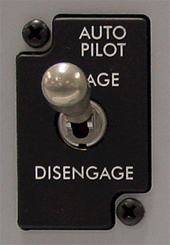
TYPES OF FISCAL POLICY
Automatic stabilizers: government spending and taxation rules that cause fiscal policy to be automatically expansionary when the economy contracts and automatically contractionary when the economy expands (unemployment insurance).
In contrast, discretionary fiscal policy arises from deliberate actions by policy makers rather than rules (the Obama stimulus).
Notes:
All image credits courtesy of Morgue File and/or FreeImages.com unless otherwise specified

Slide 33
Holding everything else constant, the multiplier effect for taxes or transfers:
is the same as the multiplier effect for changes in autonomous aggregate spending.
is smaller than the multiplier effect for changes in autonomous aggregate spending.
is larger than the multiplier effect for changes in autonomous aggregate spending.
may be smaller than, larger than, or equal to the multiplier effect for changes in autonomous aggregate spending.
To Next
Active Learning

Slide 34
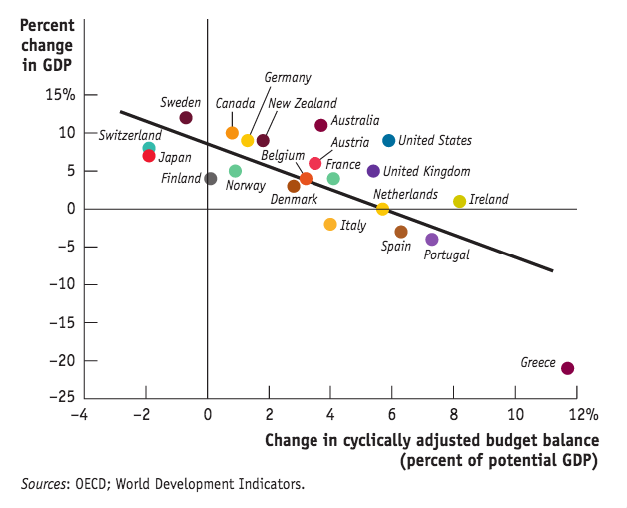
Austerity and the Multiplier
New evidence from Europe suggests that the “multiplier effect” is real…
Several nations experimented with “austerity” (sharp cuts in spending plus tax increases) because of debt concerns… but many did not.
The Fiscal Multiplier, 2009-2013

Slide 35
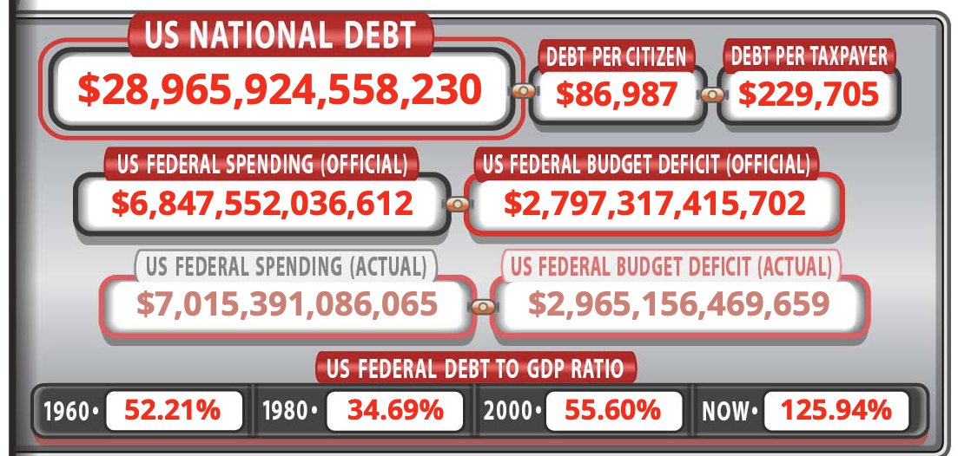
THE BUDGET BALANCE
How do surpluses and deficits fit into the analysis of fiscal policy?
Are deficits ever a good thing and surpluses a bad thing?
(And what’s the difference between deficit and debt?)
Click here for real-time debt clock

Slide 36
THE BUDGET BALANCE MEASURES FISCAL POLICY
S_{Government} = T − G − TR
Government saving (Surplus) = tax revenues (T) – government purchases (G) and transfers (TR).
A budget surplus is a positive budget balance, and a budget deficit is a negative budget balance.
Other things equal, discretionary expansionary fiscal policies reduce the budget balance for that year.
Other things equal, discretionary contractionary fiscal policies increase the budget balance for that year.

Slide 37
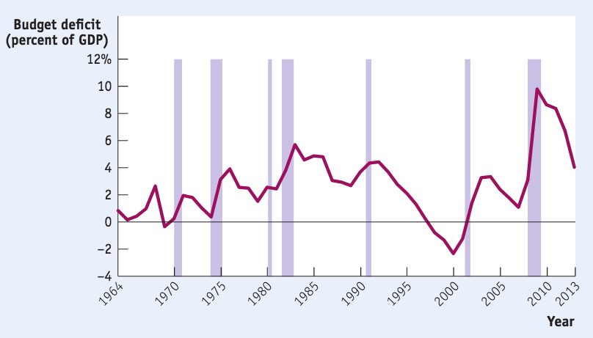
THE BUDGET BALANCE AND THE BUSINESS CYCLE
Some of the fluctuations in the budget balance are due to the effects of the business cycle.
(Shaded areas are recessions.)
Sources: Bureau of Economic Analysis; National Bureau of Economic Research.

Slide 38
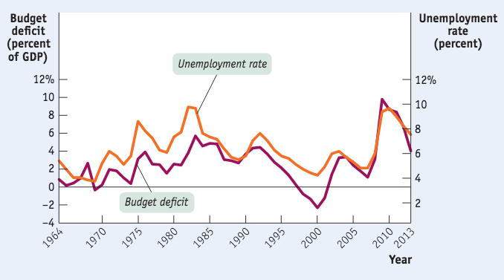
THE BUDGET BALANCE AND THE BUSINESS CYCLE
The budget deficit as a percentage of GDP moves closely with the unemployment rate.
Sources: Bureau of Economic Analysis; Bureau of Labor Statistics

Slide 39
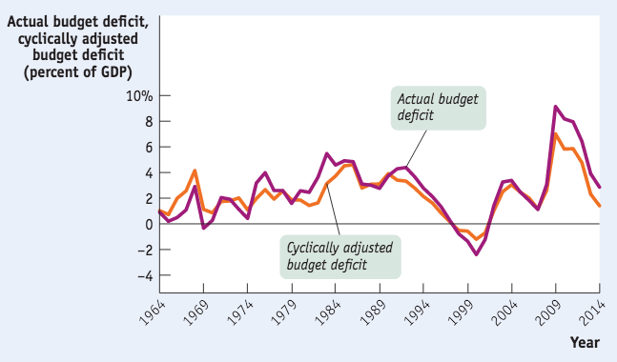
THE BUSINESS CYCLE AND THE CYCLICALLY ADJUSTED BUDGET BALANCE
To separate the effects of the business cycle from the effects of discretionary fiscal policy, governments estimate the cyclically adjusted budget balance: an estimate of the budget balance if the economy were at potential output.
Years of large budget deficits also tend to be years when the economy has a large recessionary gap.
Sources: Congressional Budget Office; Bureau of Economic Analysis.

Slide 40

WORLD WAR I WAR BOND
The U.S. deficit rises (and so does the debt) during war times.
Notes:
Image credit: Library of Congress

Slide 41
Holding everything else constant, the government’s deficit:
tends to increase during a recession.
tends to increase during an expansion.
will increase if the government pursues expansionary fiscal policy.
Answers (a) and (c) are both correct.
Answers (b) and (c) are both correct.

Slide 42

PHILOSOPHIES ON BALANCING THE BUDGET
There are various philosophies about requiring a balanced budget:
…and lose the ability to help during a recession.
Require an annually balanced budget…
Balance the budget over the business cycle on average…
…and trust the politicians to keep the long-run budget healthy?
Notes:
All image credits courtesy of Morgue File and/or FreeImages.com unless otherwise specified

Slide 43

Europe’s Search for a Fiscal Rule
1999: some European nations adopted a common currency, the euro.
Each government was required to keep its budget deficit below 3% of the country’s GDP or face penalties.
This pact limited a country’s ability to use fiscal policy.
Then, after the 2008 financial crisis, Greece, Ireland, Portugal, Spain, and Italy lost the confidence of their investors, who worried they couldn’t pay their debt.
Was it too much debt? No, only Greece had a deficit above 3% of GDP; Ireland and Spain ran surpluses.
Notes:
All image credits courtesy of Morgue File and/or FreeImages.com unless otherwise specified

Slide 44
BUDGET POLICY IN THE UNITED STATES
The United States has its own version of the original, flawed European stability pact.
The constitutions of 49 of the 50 states require a balanced budget every year.
When recession struck in 2008, most states were forced to slash spending and raise taxes in the face of a recession, exactly the wrong thing from a macroeconomic point of view.
Europe has since changed to a rule that requires a mostly balanced structural budget.

Slide 45
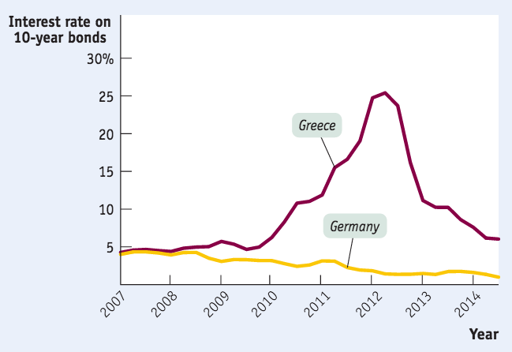
LONG-RUN IMPLICATIONS OF FISCAL POLICY
Persistent budget deficits have long-run consequences because they lead to an increase in public debt.
In 2008, the government of Greece could borrow at interest rates barely higher than those of Germany, widely considered a very safe borrower. Things changed in 2009…
Source: Federal Reserve Bank of St. Louis; OECD“Main Economic Indicators Complete Database.

Slide 46

THE SOCIAL COST OF DEBT
Greece imposed severe spending cuts to qualify for loans. Greeks angered by their government’s harsh austerity measures took to the streets in protest- and installed a new party to power.
Notes:
All image credits courtesy of Morgue File and/or FreeImages.com unless otherwise specified

Slide 47
DEFICITS VS. DEBT
A deficit is the difference between the amount of money a government spends and the amount it receives in taxes over a given period.
A debt is the sum of money a government owes at a particular time.
Deficits and debt are linked, because government debt grows when governments run deficits. But they aren’t the same thing, and they can tell different stories.
Italy found itself in debt trouble in 2011. It had a fairly small deficit by historical standards, but it had very high debt, a legacy of past policies.

Slide 48
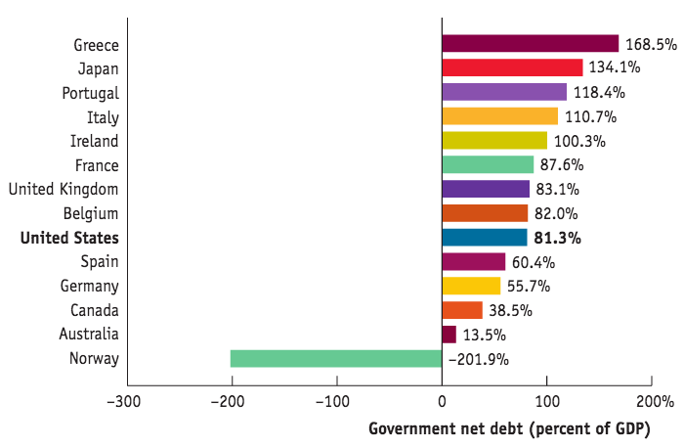
THE AMERICAN WAY OF DEBT
Source: International Monetary Fund

Slide 49
PROBLEMS POSED BY RISING GOVERNMENT DEBT
Public debt may crowd out investment spending, which reduces long-run economic growth.
And in extreme cases, rising debt may lead to government default, resulting in economic and financial turmoil.
Can’t a government that has trouble borrowing just print money to pay its bills?
Yes, it can, but this leads to another problem: inflation. More on this in a later chapter.

Slide 50
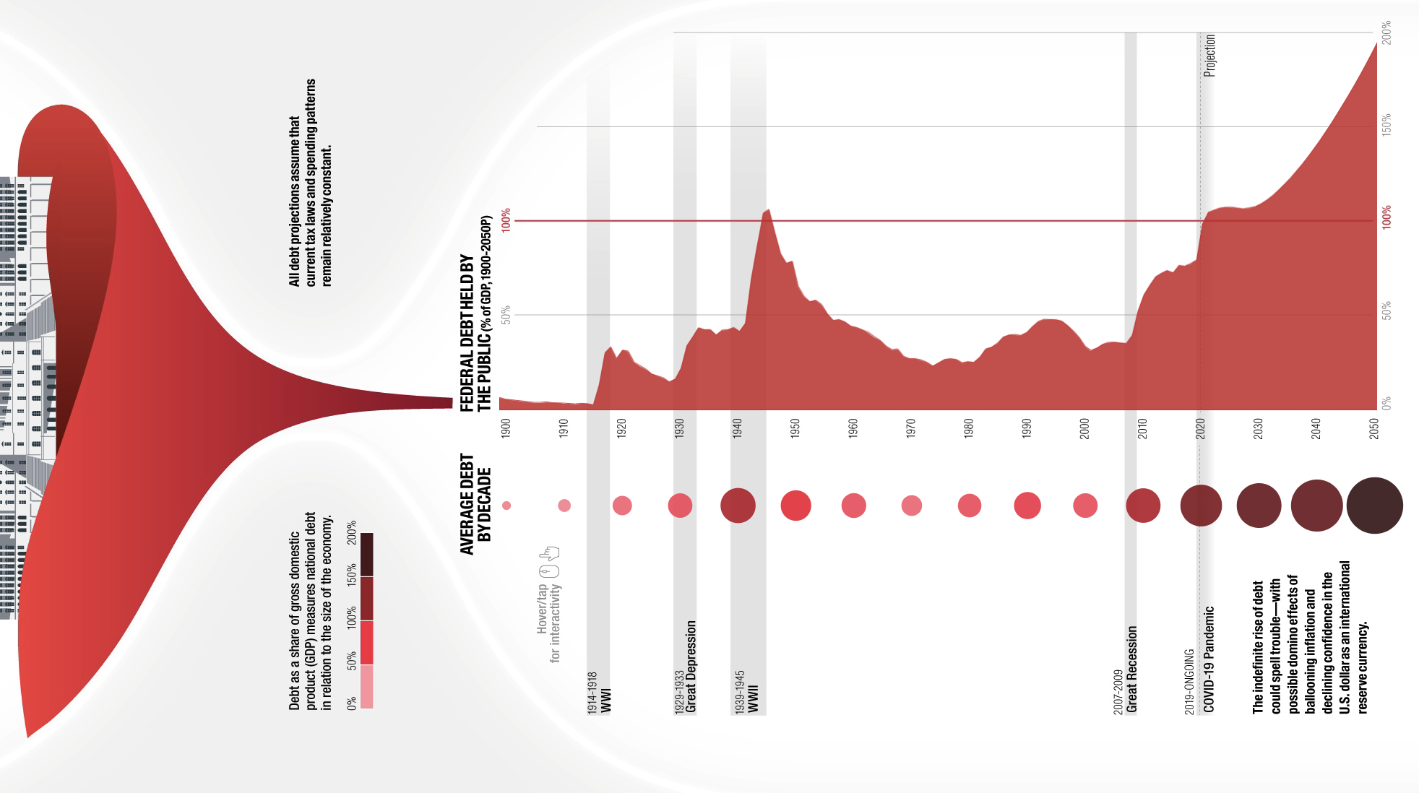
DEFICITS AND DEBT IN PRACTICE
A widely used measure of fiscal health is the debt–GDP ratio.

Slide 51
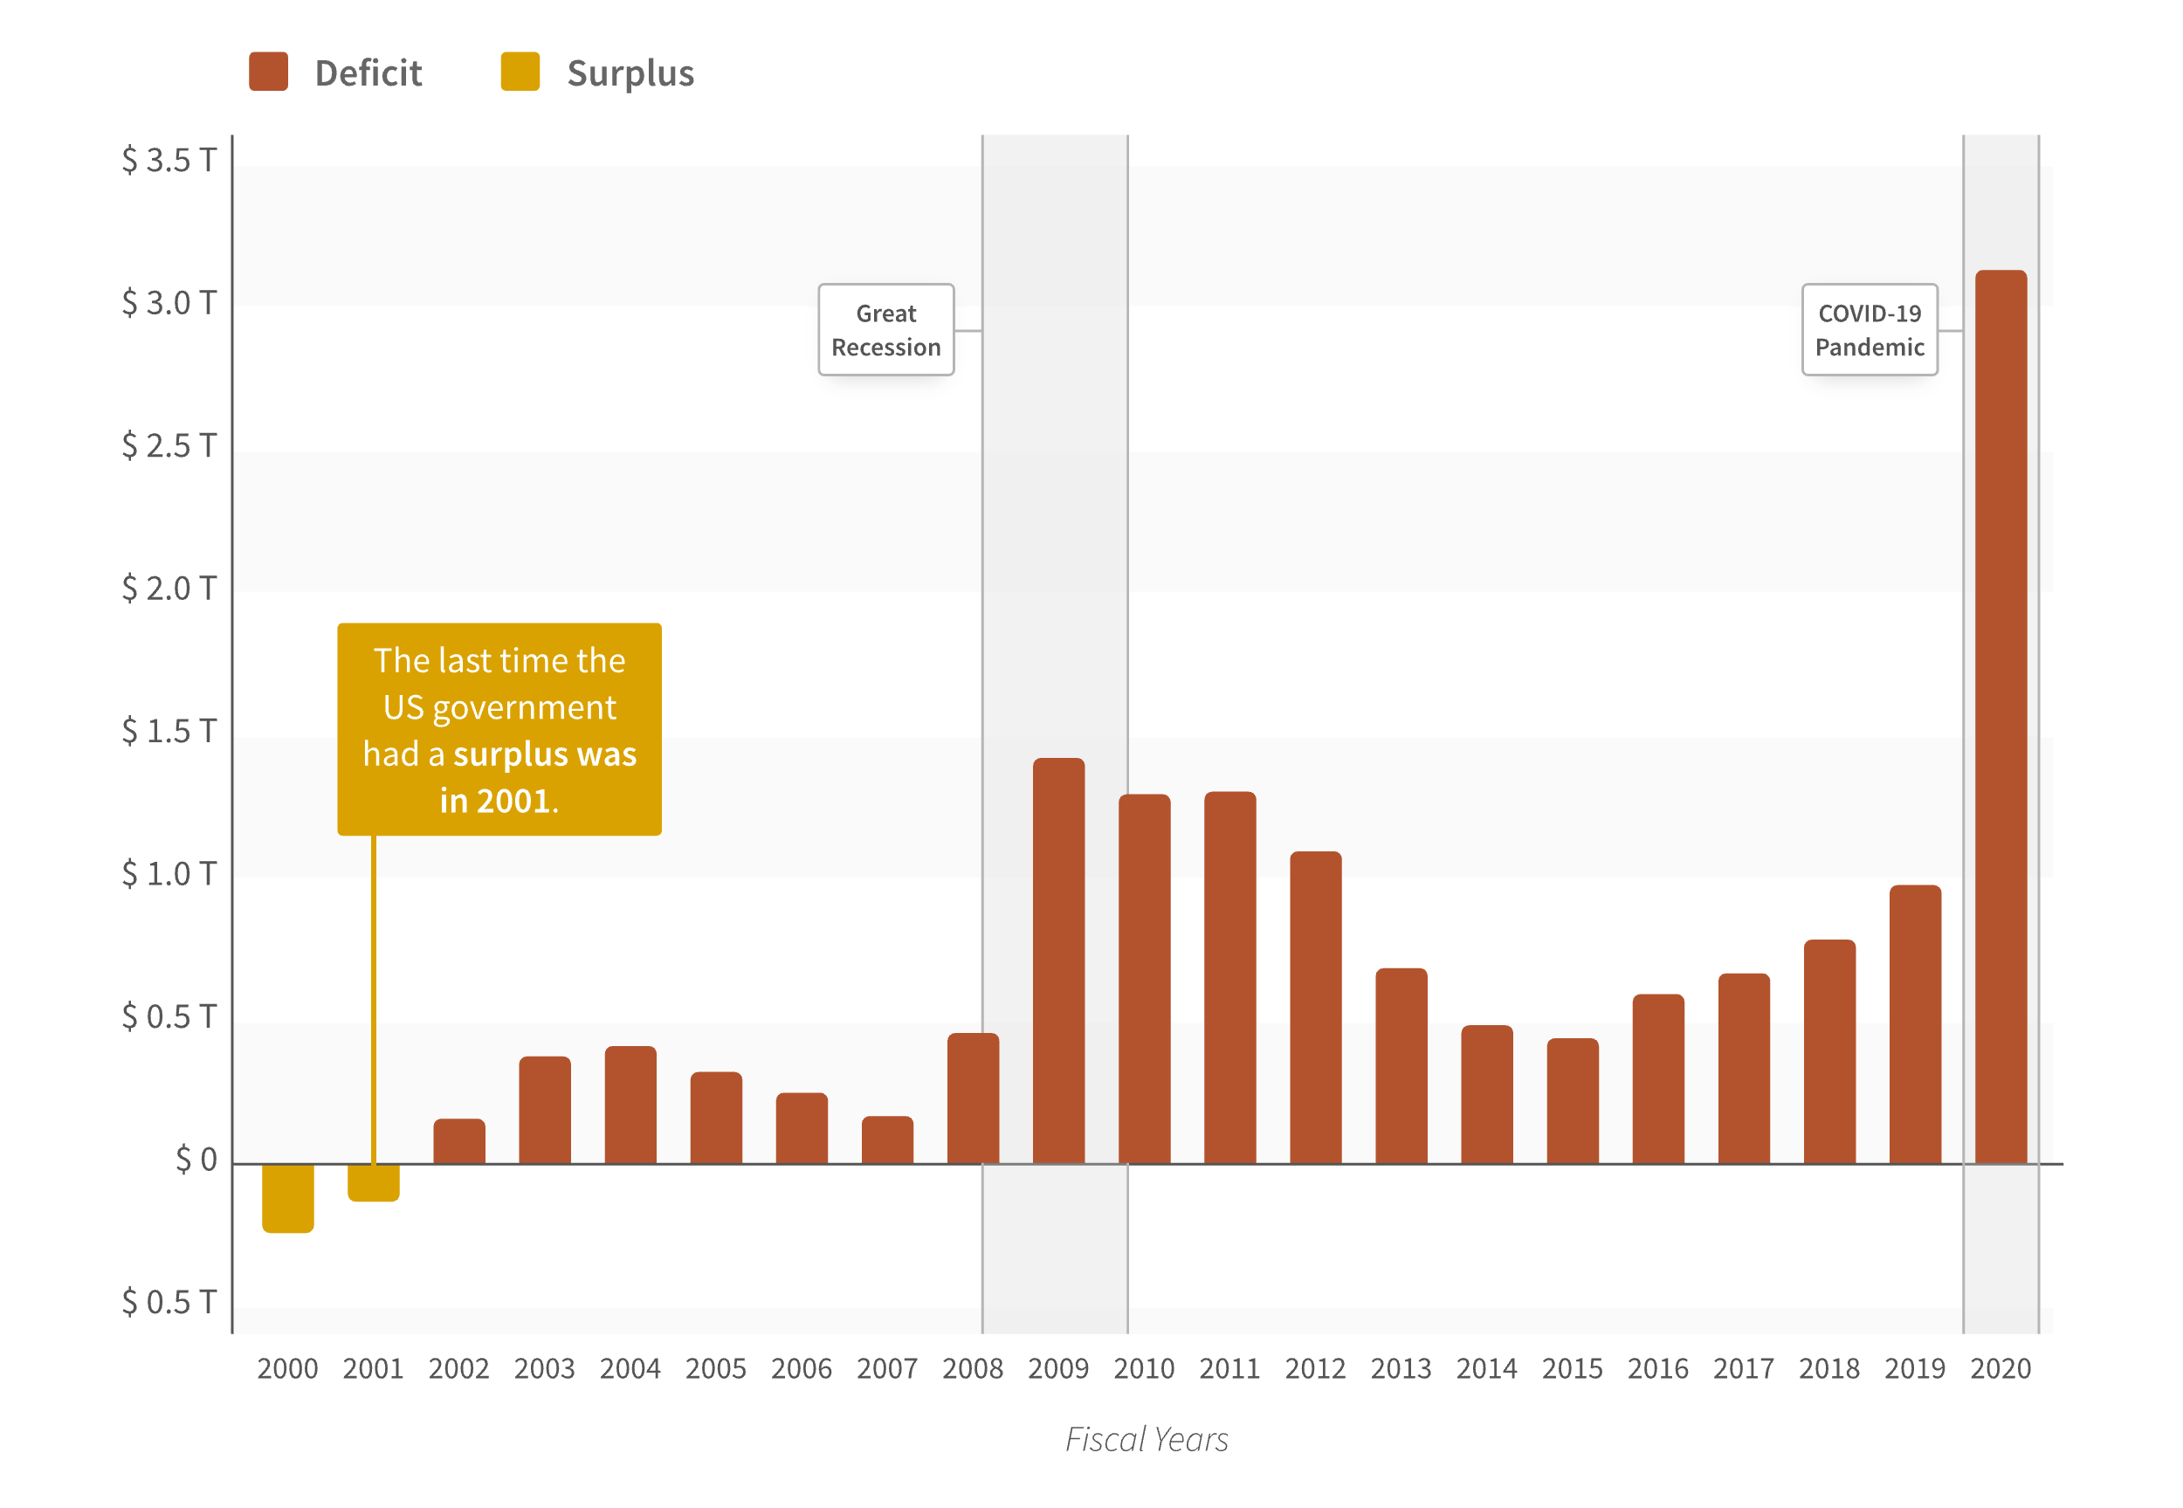
DEFICITS AND DEBT IN PRACTICE

Slide 52

IMPLICIT LIABILITIES
Experts on long-run budget issues view the situation of the United States (and other countries such as Japan and Italy) with alarm.
Implicit liabilities: spending promises made by governments that are effectively a debt despite the fact that they are not included in the usual debt statistics.
Notes:
All image credits courtesy of Morgue File and/or FreeImages.com unless otherwise specified

Slide 53
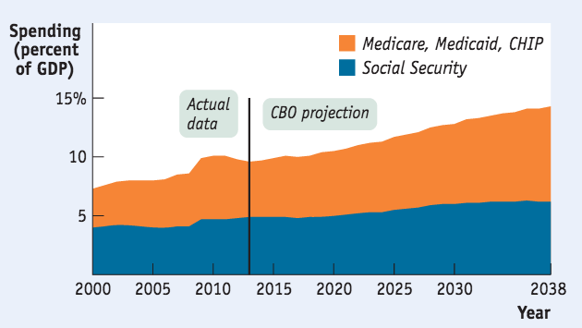
IMPLICIT LIABILITIES
Congressional Budget Office projections: The aging population plus rising health care costs will soon pose real problems for the federal budget.

Slide 54
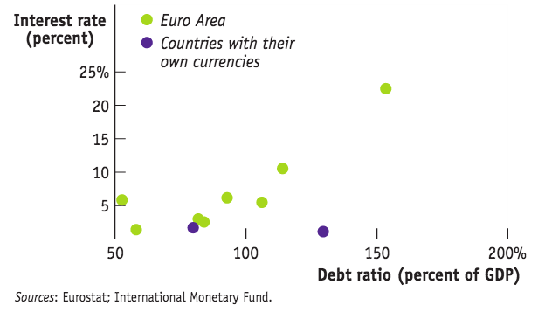
ARE WE GREECE?
Some influential people believed the U.S. was about to head into soaring interest rates and a debt crisis like Greece experienced.
Unlike the Euro area (where countries don’t have their own currency, and can’t run the printing press to pay off debt if necessary) the U.S. is less scary for lenders.

