Slide 1
Economics 2220 Principles Of Macroeconomics
Professor Zhigang Feng
Lecture 13:
Money, Banking and Monetary policy

Slide 2
The various roles money plays and the many forms it takes in the economy
How the actions of private banks and the Federal Reserve determine the money supply
How the Federal Reserve uses open-market operations to change the monetary base
To First
Active Learning
To Video

Slide 3

MONEY: THE ESSENTIAL CHANNEL BETWEEN MARKETS
Money plays unique and very important roles in modern economies.
Notes:
Photo courtesy: Anna Delaw/Alamy

Slide 4
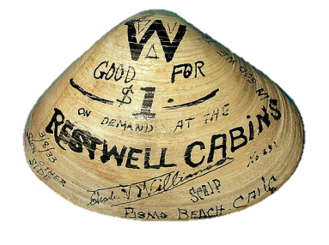
THE MEANING OF MONEY
Money: any asset that can easily be used to purchase goods and services.
In 1933, after many bank failures, some U.S. towns turned to homemade currency, like this clamshell scrip used in Pismo Beach, California.
Notes:
All image credits courtesy of Morgue File and/or FreeImages.com unless otherwise specified

Slide 5
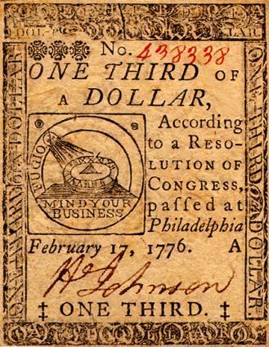
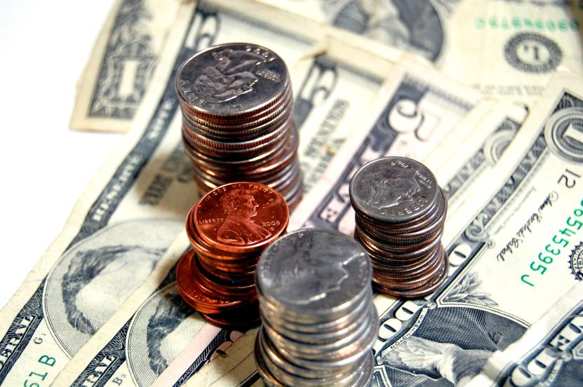
THE MEANING OF MONEY
Currency in circulation: cash held by the public.
Early U.S. currency: continental
third of a dollar
Notes:
All image credits courtesy of Morgue File and/or FreeImages.com unless otherwise specified

Slide 6
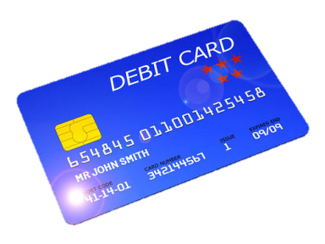
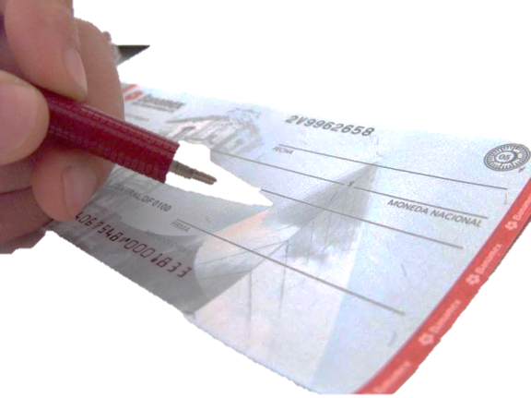
THE MEANING OF MONEY
Checkable bank deposits: bank accounts on which people can write checks.
Notes:
All image credits courtesy of Morgue File and/or FreeImages.com unless otherwise specified

Slide 7
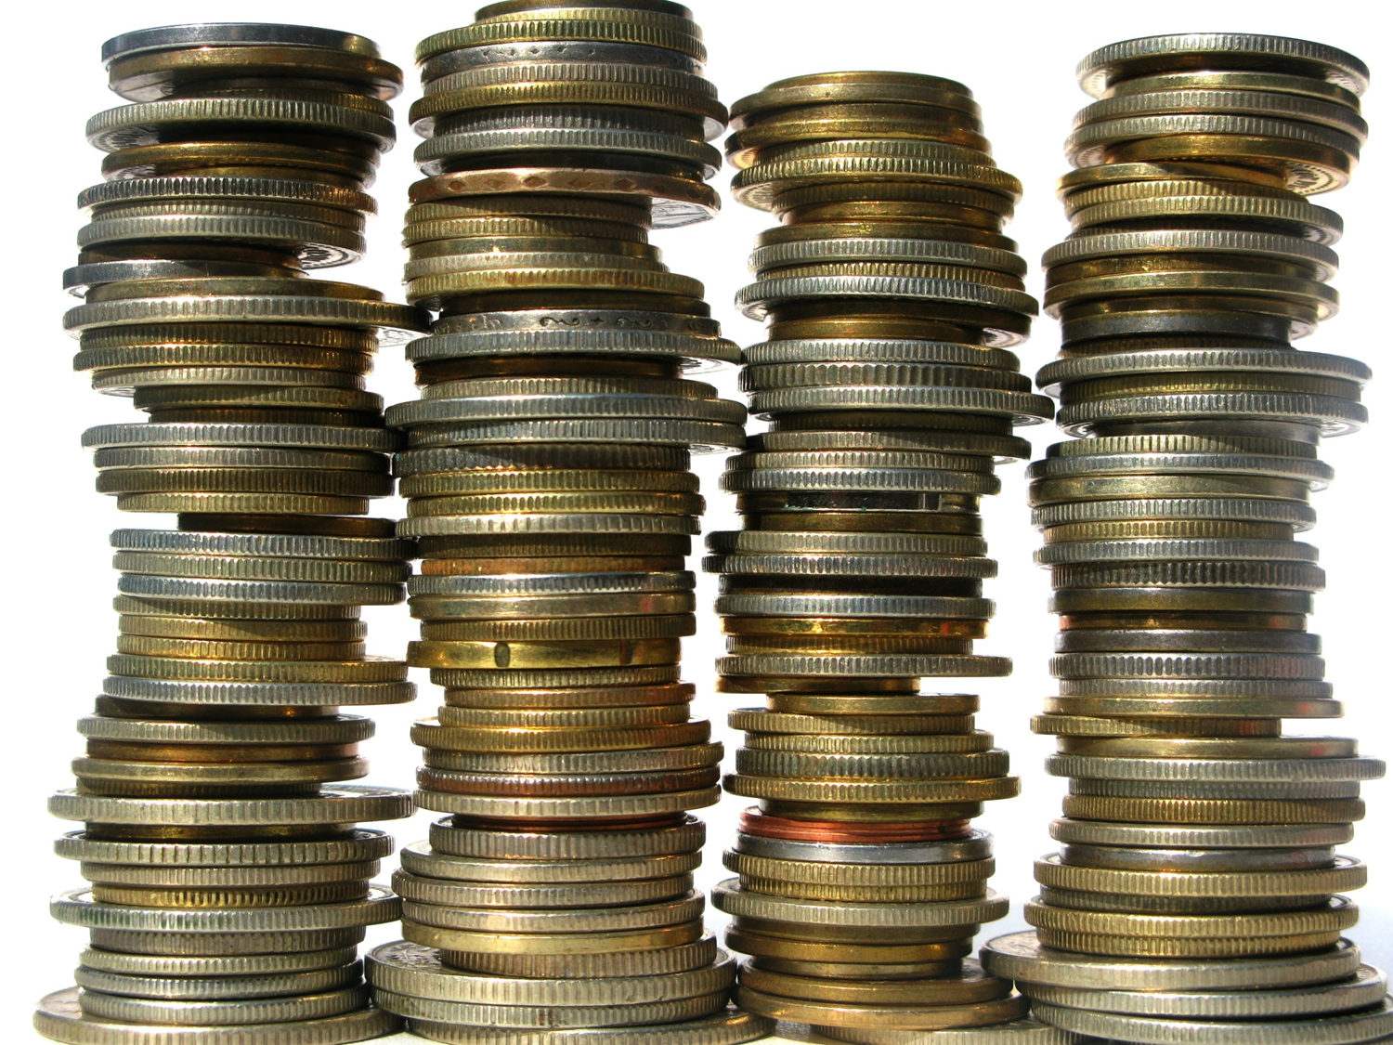
THE MEANING OF MONEY
The money supply is the total value of financial assets in the economy that are considered money.
Notes:
All image credits courtesy of Morgue File and/or FreeImages.com unless otherwise specified

Slide 8

THE ROLES OF MONEY
Money must function as:
a medium of exchange.
a store of value.
a unit of account.
Notes:
All image credits courtesy of Morgue File and/or FreeImages.com unless otherwise specified

Slide 9
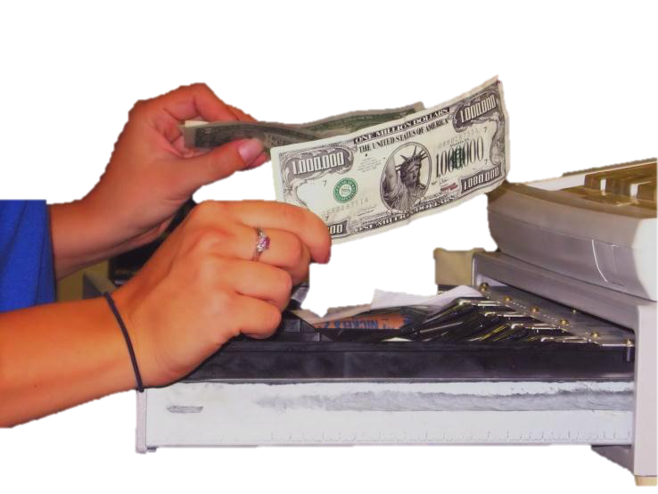
THE FUNCTIONS OF MONEY
Medium of exchange: Something people accept as payment for goods and services
(an asset that individuals acquire for the purpose of trading rather than for their own consumption).
Notes:
All image credits courtesy of Morgue File and/or FreeImages.com unless otherwise specified

Slide 10

THE FUNCTIONS OF MONEY
Store of value: Money is a means of holding purchasing power over time.
It enables people to save the money they earn today and use it to buy the goods and services they want tomorrow.
Notes:
All image credits courtesy of Morgue File and/or FreeImages.com unless otherwise specified

Slide 11
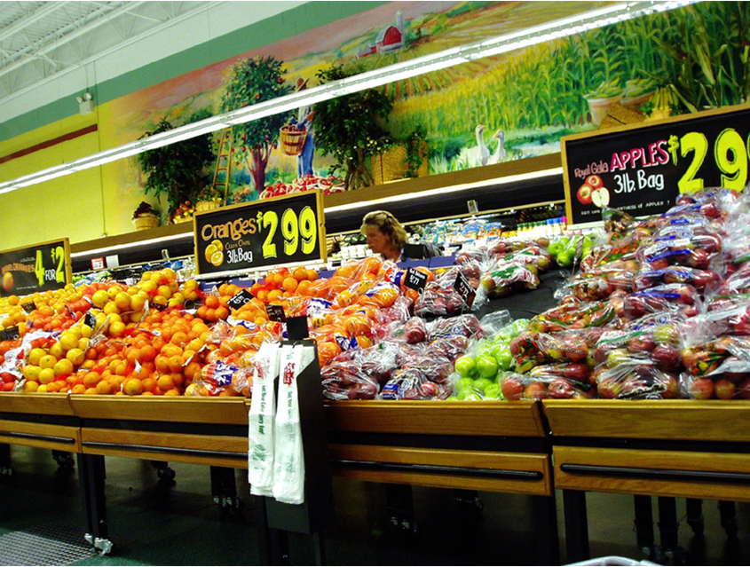
THE FUNCTIONS OF MONEY
Unit of account: Money provides a yardstick for measuring and comparing the values of a wide variety of goods and services.
Notes:
All image credits courtesy of Morgue File and/or FreeImages.com unless otherwise specified

Slide 12

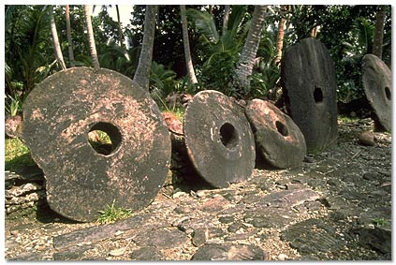
TYPES OF MONEY
For thousands of years, societies have used commodity money.
Commodity money: a good used as a medium of exchange that has intrinsic value in other uses.
Some prisons use cigarettes as currency.
The island of Yap’s currency
Notes:
All photo credits unless otherwise noted from Freeimages.com (Formerly Stockxchange) or Morguefile.com

Slide 13
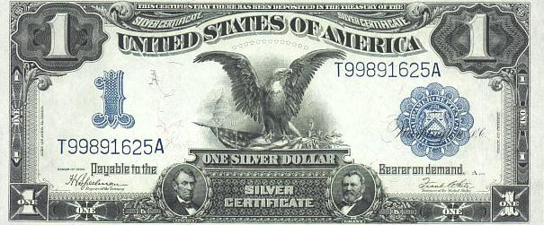
TYPES OF MONEY
To make life simpler (and safer), societies began using commodity-backed money.
Commodity-backed money: a medium of exchange with no intrinsic value whose ultimate value is guaranteed by a promise that it can be converted into valuable goods.
Notes:
Image courtesy Library of Congress

Slide 14
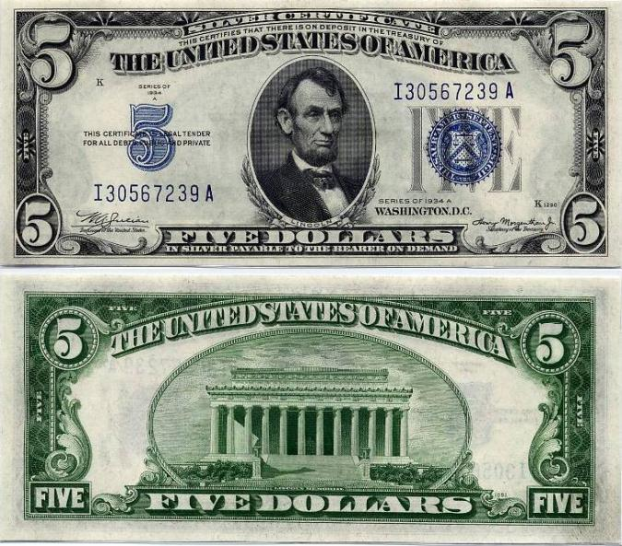
ANOTHER EXAMPLE OF COMMODITY-BACKED MONEY
Notes:
Image courtesy Library of Congress

Slide 15
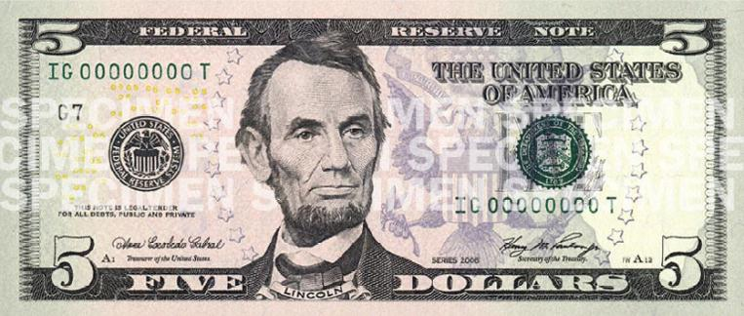
TYPES OF MONEY
Most modern economies use fiat money.
Fiat money: money whose value derives entirely from its official status as a means of payment.
Notes:
Image courtesy Library of Congress

Slide 16
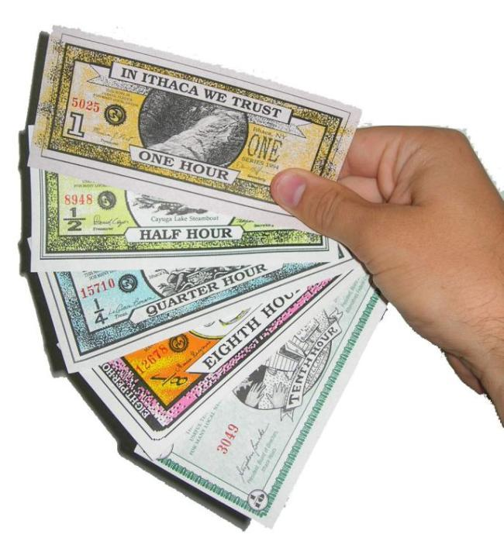
Ponder this
With a partner, discuss:
How would the economy be different if we used only local currency?
To Next
Active Learning
Notes:
All image credits courtesy of Morgue File and/or FreeImages.com unless otherwise specified

Slide 17

MEASURING THE MONEY SUPPLY
Monetary aggregate: an overall measure of the money supply.
M1 and M2: two definitions of the money supply.
Notes:
All image credits courtesy of Morgue File and/or FreeImages.com unless otherwise specified

Slide 18
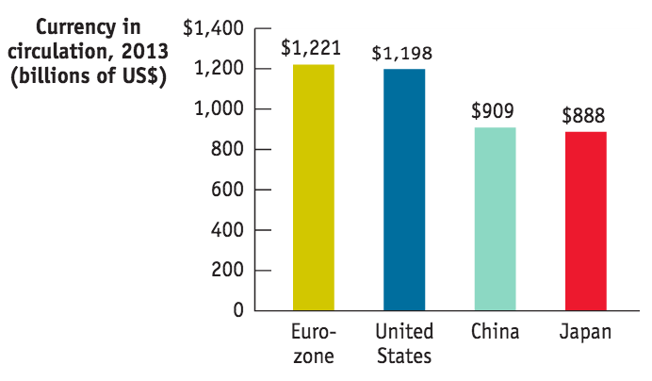
THE BIG MONEYS
The U.S. Dollar is still the currency most likely to be accepted for payment around the world… but is not the biggest money.
Sources: Federal Reserve Bank of St. Louis; European Central Bank; Bank of Japan; The People’s Bank of China.

Slide 19
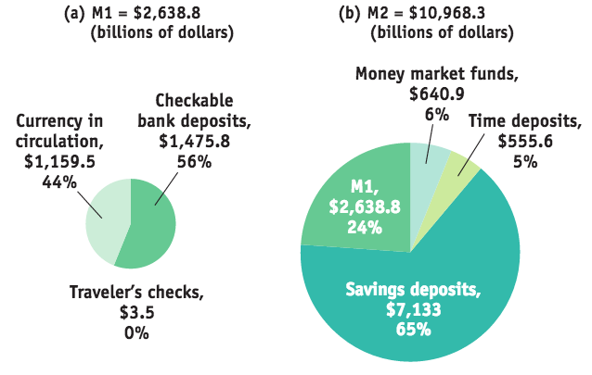
MONETARY AGGREGATES, 2013
M1 includes only the most liquid forms of money.
M2 includes near-moneys: financial assets that can’t be directly used as a medium of exchange but can readily be converted into cash or checkable bank deposits.
Source: Federal Reserve Bank of St. Louis.

Slide 20
Which of the following assets would you classify as being most liquid?
demand deposits
small-time deposits
a home
gold bullion
To Next
Active Learning

Slide 21
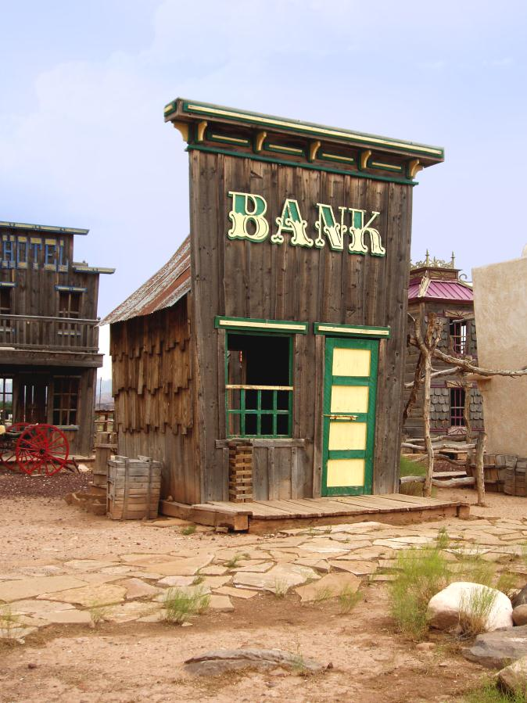
THE MONETARY ROLE OF BANKS
Q: Only half of M1 is currency; where does the rest of the money supply come from?
A: Bank deposits make up half of M1 and most of M2.
How does the banking system create money?
Notes:
All image credits courtesy of Morgue File and/or FreeImages.com unless otherwise specified

Slide 22
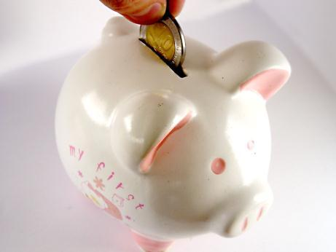

WHAT BANKS DO
Banks are financial intermediaries that use liquid assets (in the form of bank deposits) to finance the illiquid investments of borrowers.
Notes:
All image credits courtesy of Morgue File and/or FreeImages.com unless otherwise specified

Slide 23
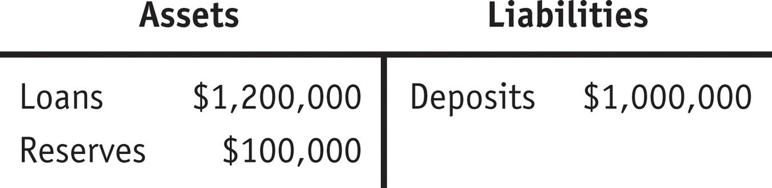
THE MONETARY ROLE OF BANKS
T-account: a tool for analyzing a business’s financial position by showing the business’s assets and liabilities.
Bank reserves: the currency that banks hold in their vaults plus their deposits at the Federal Reserve.
The reserve ratio: the fraction of bank deposits that a bank holds as reserves ($100,000/$1,000,000) = 10%.

Slide 24
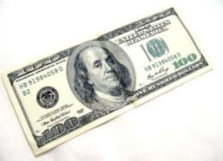



HOW BANKS CREATE MONEY
The primary purpose of financial markets and institutions is to act as a bridge between lenders and borrowers.
By accepting deposits and making loans, banks and other financial institutions are also able to create money.
Notes:
All image credits courtesy of Morgue File and/or FreeImages.com unless otherwise specified

Slide 25
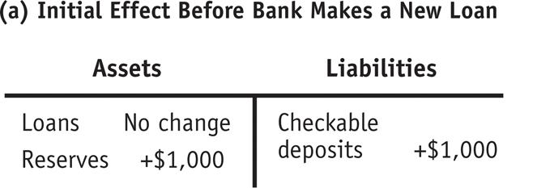
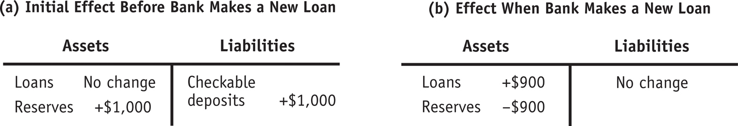
HOW BANKS CREATE MONEY
Silas keeps a shoebox full of cash under his bed. Deciding to enter the twenty-first century, he deposits this cash at the bank. What’s the effect of his $1,000?
Banks make their profit from loans, so eventually they will make new loans with 90% of Silas’s money. (The rest they must hold in reserve.)

Slide 26
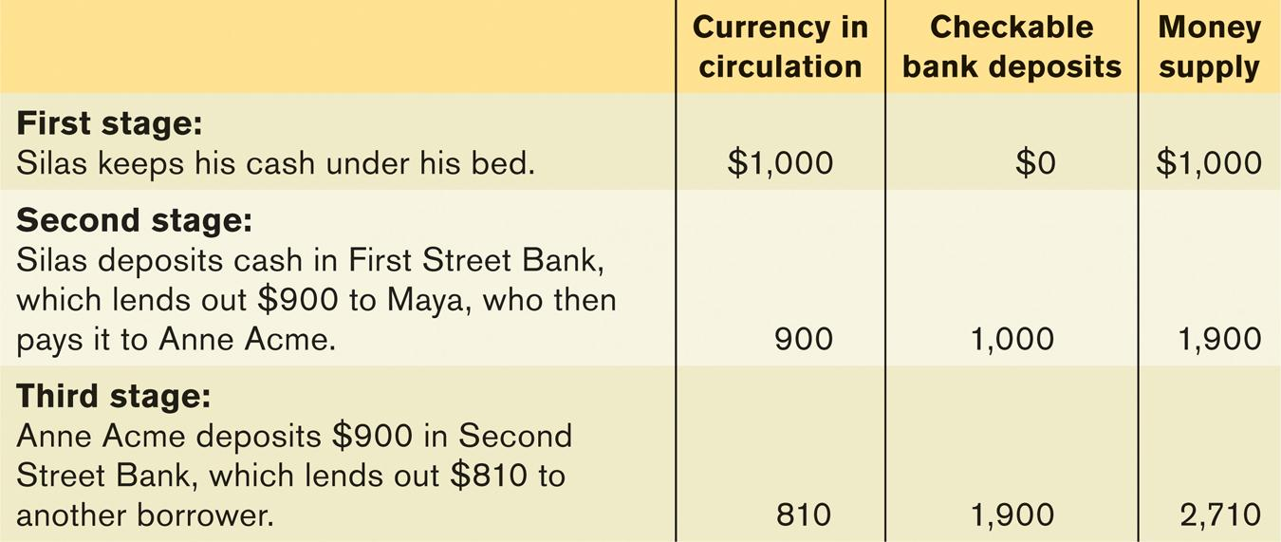
HOW BANKS CREATE MONEY
The first bank lends $900 to Maya, who pays the money to Anne, who deposits it at her bank—and the cycle starts all over. Sound familiar?

Slide 27
RESERVES, BANK DEPOSITS, AND THE MONEY MULTIPLIER
Excess reserves: a bank’s reserves over and above its required reserves.
We’ll assume banks don’t want to hold excess reserves.
Increase in bank deposits from $1,000 in excess reserves =
$1,000 + [$1,000 × (1 − rr)] + [$1,000 × (1 − rr)²] + [$1,000 × (1 − rr)³] + . . .
This can be simplified to $1,000/rr.

Slide 28
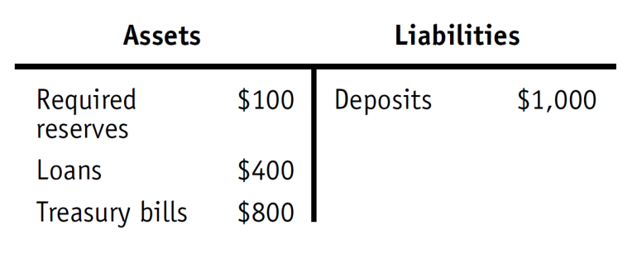
Given this T-account and assuming the bank holds no excess reserves, what is the required reserve ratio?
10%
40%
80%
1%
To Next
Active Learning

Slide 29
Suppose the required reserve ratio initially is 10% of bank deposits and is increased by the Fed to 20% of bank deposits. Holding everything else constant, this will:
reduce the size of the money multiplier.
cause the banking system to contract the level of bank deposits in the banking system.
change the value of the money multiplier from 10 to 5.
Answers (a), (b), and (c) are all correct.
To Next
Active Learning

Slide 30
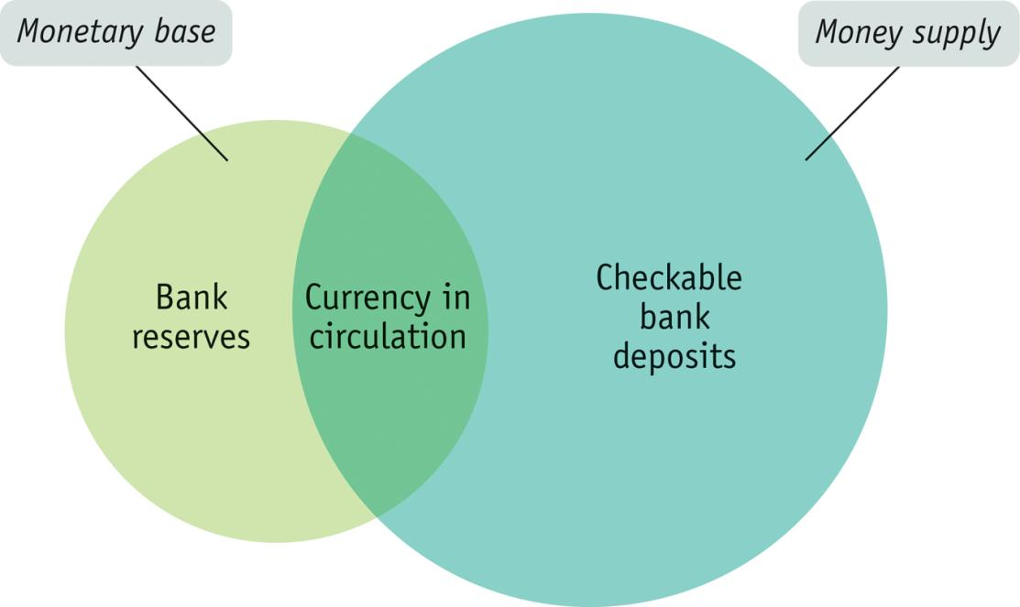
THE MONEY MULTIPLIER IN REALITY
The monetary base is the sum of currency in circulation and bank reserves.

Slide 31

THE MONEY MULTIPLIER IN REALITY
The determination of the money supply is more complicated than our simple model suggests:
It depends not only on the ratio of reserves to bank deposits but also on the fraction of the money supply that individuals choose to hold in the form of currency.
Notes:
All image credits courtesy of Morgue File and/or FreeImages.com unless otherwise specified

Slide 32
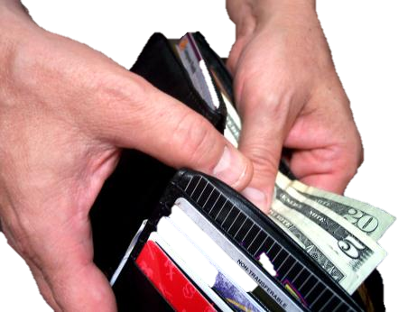
THE MONEY MULTIPLIER IN REALITY
The money multiplier is the ratio of the money supply to the monetary base.
In normal times, the U.S. money multiplier for M1 is between 1.5 and 3.0.
Why isn’t it 1/0.1 = 10?
People hold significant amounts of cash, which reduces bank deposits.
Notes:
All image credits courtesy of Morgue File and/or FreeImages.com unless otherwise specified

Slide 33
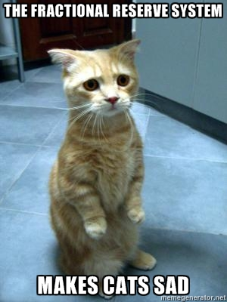
MONEY CREATION
Financial institutions operate as part of a fractional reserve banking system.
When you deposit money in a bank account, the bank is required to hold a part of it in its vault as cash
(or else in an account with the regional Federal Reserve Bank).
This system’s leverage makes some nervous.
Notes:
All image credits courtesy of Morgue File and/or FreeImages.com unless otherwise specified

Slide 34
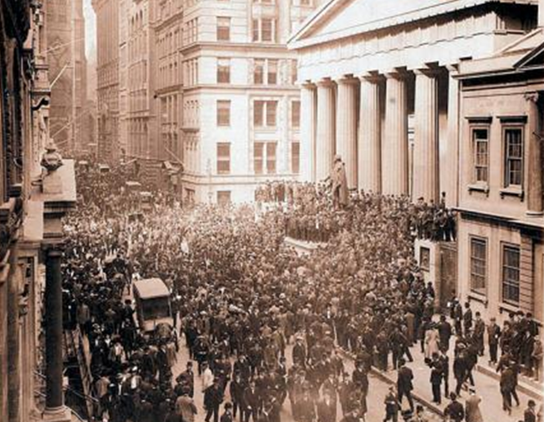
THE PROBLEM OF BANK RUNS
Banks hold only a fraction of deposits on reserve. (The rest they use to make loans.)
From time-to-time people get worried about the bank losing their money.
Bank run: a phenomenon in which many of a bank’s depositors try to withdraw their funds because they fear a bank failure.
Historically, runs have often proved contagious.
Notes:
Image courtesy Library of Congress

Slide 35
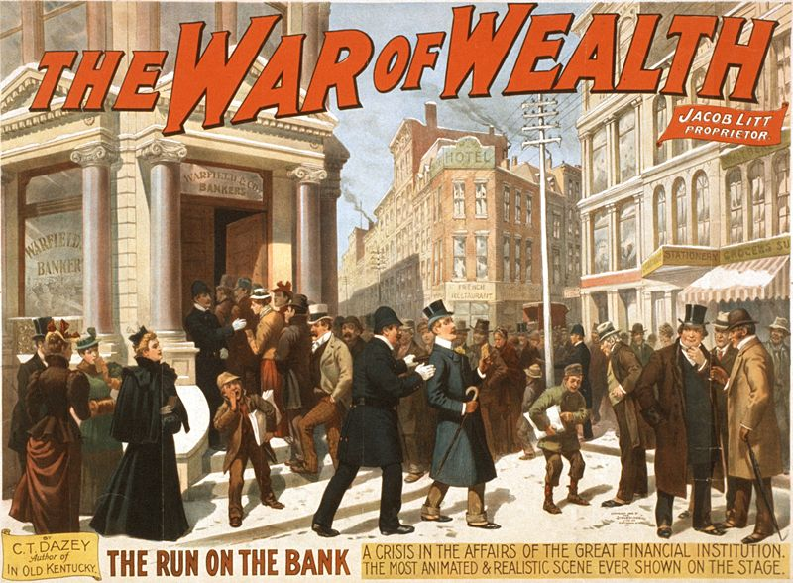
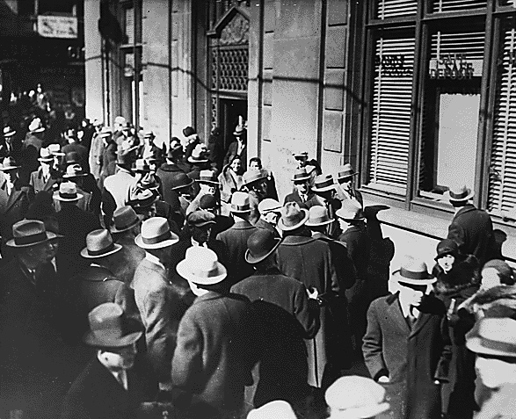
BANK PANICS
Bank run during the Great Depression in the United States, 1933.
A poster for the 1896 Broadway melodrama The War of Wealth depicts a typical 19th-century bank run in the United States.
Notes:
All image credits courtesy of Morgue File and/or FreeImages.com unless otherwise specified

Slide 36

BANK REGULATION
Deposit insurance: a guarantee that a bank’s depositors will be paid even if the bank can’t come up with the funds. (The FDIC currently guarantees the first $250,000 of each account.)

Slide 37
BANK REGULATION
Capital requirements: requirement that the owners of banks hold substantially more assets than the value of bank deposits.
Deposit insurance creates a well-known incentive problem: Banks can take more risks, since they are insured.
To help motivate safe behavior, banks’ capital is required to equal to 7% or more of their assets.

Slide 38
BANK REGULATION
Reserve requirements: rules set by the Federal Reserve that determine the minimum reserve ratio for a bank.
For example, in the United States, the minimum reserve ratio for checkable bank deposits is 10%.
The discount window: an arrangement in which the Federal Reserve stands ready to lend money to banks in trouble.

Slide 39
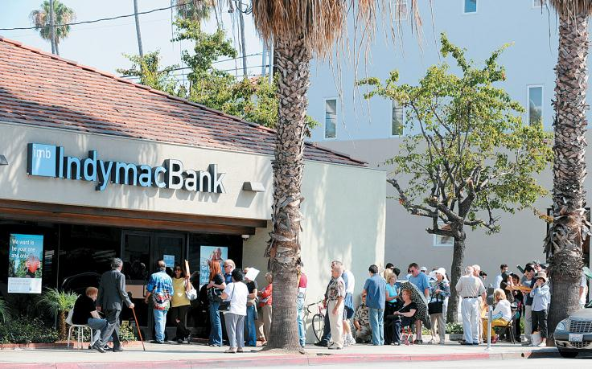

It’s a wonderful banking system
Bank runs still happen: Southern California’s IndyMac: July 2008
Silicon Vally Bank: Mar. 2023
Notes:
All image credits courtesy of Morgue File and/or FreeImages.com unless otherwise specified

Slide 40
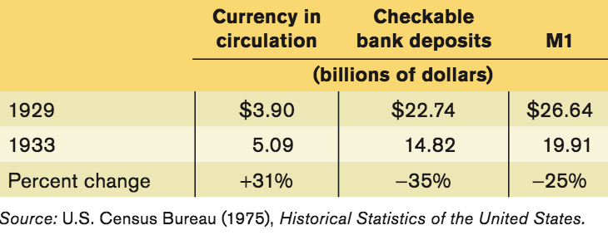
MULTIPLYING MONEY DOWN
If Silas can increase the money supply by pulling cash out from under his bed and injecting into the banking system, the reverse can happen anytime people carry cash.
Example: The Bank Runs of 1929-1933

Slide 41

THE FEDERAL RESERVE SYSTEM
The Federal Reserve is a central bank; it oversees and regulates the banking system and controls the monetary base.
Jerome Powell
16th chair of the Fed
Assumed office
Feb, 2018
Notes:
Image: public domain

Slide 42
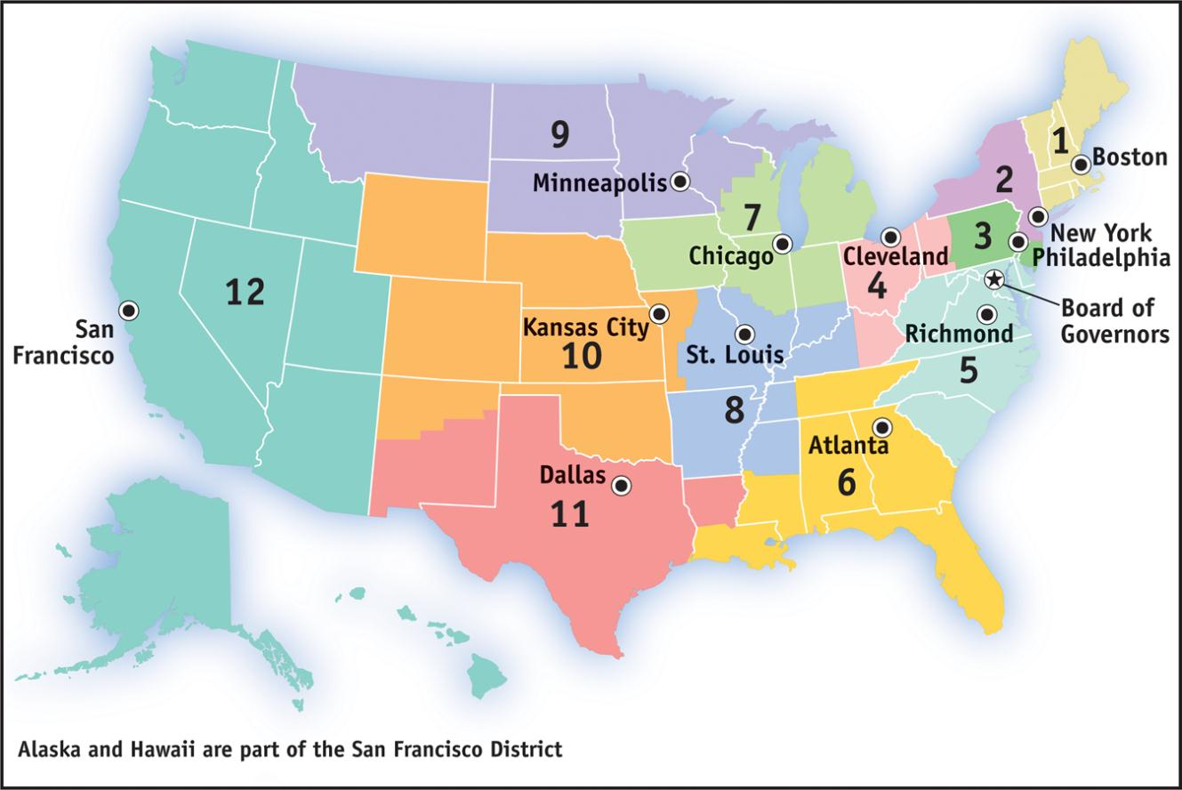
THE FEDERAL RESERVE SYSTEM
Source: Board of Governors of the Federal Reserve System

Slide 43

RESERVE REQUIREMENTS AND THE DISCOUNT RATE
What does a bank do if it can’t meet the Fed’s reserve requirement?
The federal funds market allows banks that fall short of the reserve requirement to borrow funds from banks with excess reserves.
The federal funds rate is the interest rate determined in the federal funds market.
LIBOR (London interbank offered rate) is Europe’s equivalent to the federal funds rate.

Slide 44

RESERVE REQUIREMENTS AND THE DISCOUNT RATE
The discount rate is the rate of interest the Fed charges on loans to banks.
Normally, the discount rate is set 1 percentage point above the federal funds rate in order to discourage banks from turning to the Fed when they are in need of reserves.

Slide 45
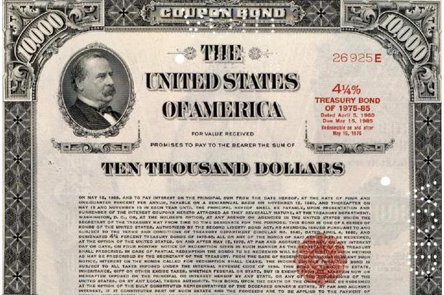
RESERVE REQUIREMENTS AND THE DISCOUNT RATE
In order to alter the money supply, the Fed can change reserve requirements, the discount rate, or both.
In reality, the Fed doesn’t use these tools much.
Why not?
It’s got a better tool: Open-Market Operations
Notes:
All image credits courtesy of Morgue File and/or FreeImages.com unless otherwise specified

Slide 46
OPEN-MARKET OPERATIONS
When the Fed buys anything (even apples), reserves increase.
Because government bonds can be stored indefinitely and are easy to buy and sell on the open market, the Fed chooses this commodity to buy and sell daily.
The Fed can buy and sell billions of dollars’ worth of government bonds in minutes.
The Fed usually buys and sells short-term bonds called Treasury bills, or T-bills

Slide 47
OPEN-MARKET OPERATIONS
The Fed does not buy bonds directly from the government.
When a central bank buys government debt directly from the government, it is lending directly to the government—in effect printing money to finance the government’s budget deficit.
The Fed’s decisions are independent of the government.

Slide 48
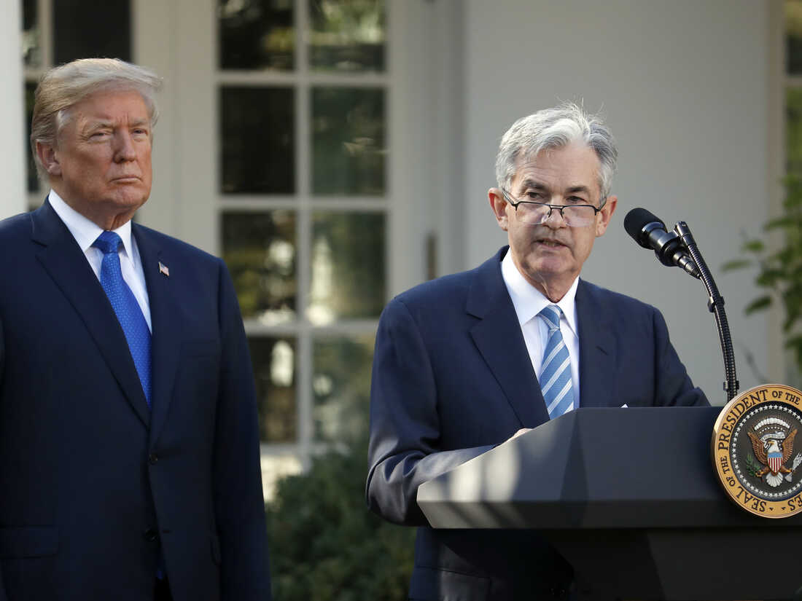
Ponder This
With a partner, discuss: If a president could pressure the chairman of the Federal Reserve to do his bidding, what would happen?
Do you think inflation be higher or lower if the Fed were not independent? Why?
To Next
Active Learning
Notes:
Image: public domain

Slide 49
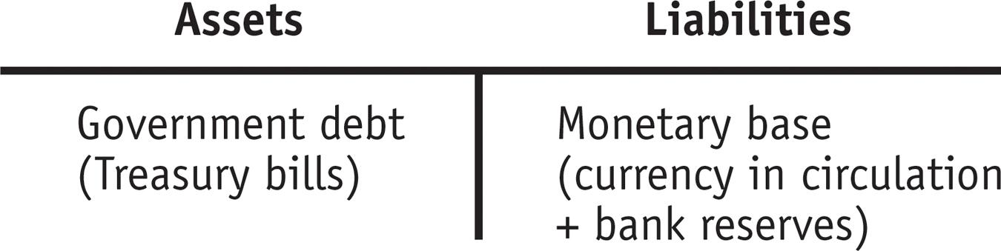
OPEN-MARKET OPERATIONS
What it looks like:
Open-market operations are the principal tool of monetary policy: the Fed can increase or reduce the monetary base by buying or selling government debt to banks.
The Federal Reserve’s Assets and Liabilities:

Slide 50

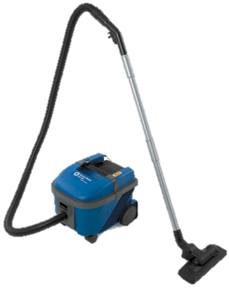
OPEN-MARKET OPERATIONS
To increase the money supply, the Fed must inject reserves into the system.
To decrease the money supply, the Fed must remove reserves from the system.
$
$
Notes:
All image credits courtesy of Morgue File and/or FreeImages.com unless otherwise specified

Slide 51
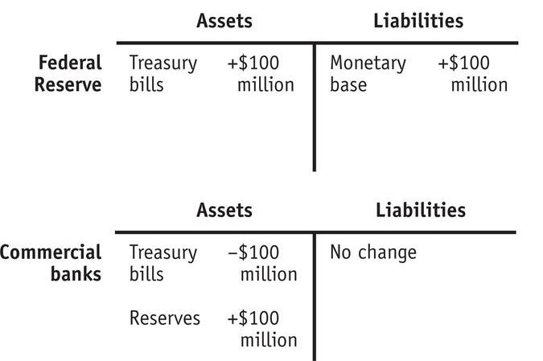
OPEN-MARKET OPERATIONS
An open-market purchase of $100 million: banks gain reserves.
Notes:
.

Slide 52
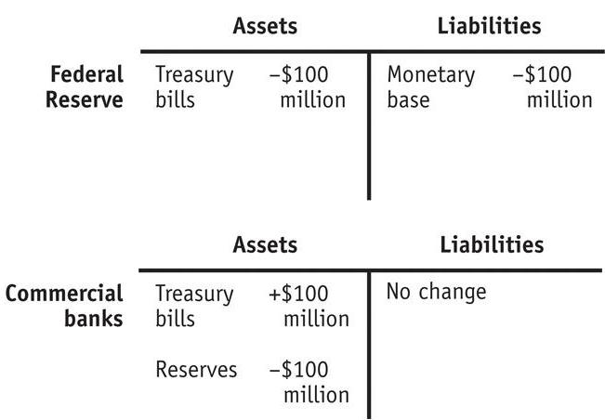
OPEN-MARKET OPERATIONS
An open-market sale of $100 million: bank reserves decline
Notes:
.

Slide 53
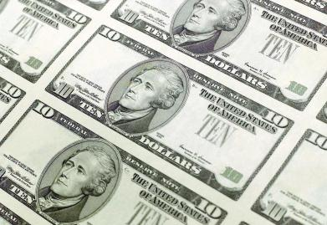
SHOW ME THE MONEY
Q: Where does the Fed gets the funds to purchase U.S. Treasury bills from banks?
A: It simply creates them with a stroke of the pen (a click of the mouse) that credits the banks’ accounts with extra reserves.
(The Fed does NOT need to print money.)

Slide 54
HOW OPEN-MARKET OPERATIONS WORK
If the Fed wants to increase the money supply, it will buy T-bills:
If the Fed wants to decrease the money supply, it will sell T-bills:
M↑ as the
money creation
process ripples
through the
economy
Fed
electronically
↑reserves of the
seller
With more
reserves, bank
↑ loans
To pay for
the T-bills
M↓ as the
money creation
process ripples
in reverse through
the economy
Fed sells
T-bills
↓reserves of the buyer
With fewer
reserves, bank
↓ loans

Slide 55
Suppose this is the only bank and all money is held in this bank. There are no excess reserves. If the Fed makes an open-market sale of $50 worth of T-bills to this bank, what will happen to the money supply after all adjustments are made?
The money supply will increase by $50.
The money supply will decrease by $50.
The money supply will increase by $500.
The money supply will decrease by $500.
To Next
Active Learning

Slide 56
How the Federal Reserve implements monetary policy, moving the interest rate to affect aggregate output?

Slide 57

THE DEMAND FOR MONEY
The Opportunity Cost of Holding Money
We all carry some cash around for the convenience.
When we do, we give up interest income we’d collect if that spending power were in an interest-bearing asset like a bond.
There is a price to be paid for the convenience of holding money.
Notes:
Image credit: Big Cheese Photos/Superstock

Slide 58
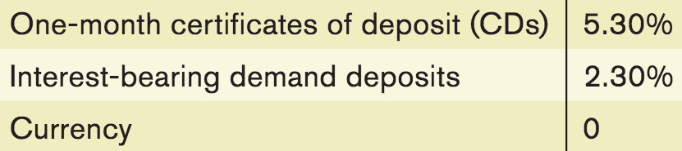
INTEREST RATES AND THE OPPORTUNITY COST OF HOLDING MONEY
Individuals and firms trade off the benefit of holding cash versus the benefit of holding interest-bearing nonmonetary assets.
Selected interest rates, 2007 (before the financial crisis)
Source: Federal Reserve Bank of St. Louis

Slide 59
INTEREST RATES AND THE OPPORTUNITY COST OF HOLDING MONEY
Short-term interest rates: the interest rates on financial assets that mature within six months or less.
Long-term interest rates: interest rates on financial assets that mature a number of years in the future.
The higher the interest rate, the higher the opportunity cost of holding money.
The lower the interest rate, the lower the opportunity cost of holding money.
Notes:
All image credits courtesy of Morgue File and/or FreeImages.com unless otherwise specified

Slide 60
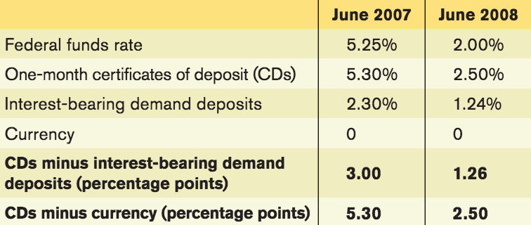
INTEREST RATES AND THE OPPORTUNITY COST OF HOLDING MONEY
Although there are many different interest rates and they don’t move exactly together, as a rule most short-term rates tend to move in the same direction.
Source: Federal Reserve Bank of St. Louis
Notes:
Source: Federal Reserve Bank of St. Louis.

Slide 61
THE MONEY DEMAND CURVE
Interest rate, r
At higher interest rates, the cost of holding money is greater, so less quantity is demanded.
The money demand curve shows the relationship between the quantity of money demanded and the interest rate.
At lower interest rates, the cost of holding money is smaller, so a higher quantity is demanded.
Money demand curve, MD
Quantity of money

Slide 62
SHIFTS OF THE REAL MONEY DEMAND CURVE
The following factors shift the money demand curve:
Changes in aggregate price level
Higher prices mean we need more money for transactions (and vice versa).
Changes in real GDP
More goods and services produced and sold means we need more money (and vice versa).
Changes in technology
The ease of credit card payments reduces the need for cash.
Changes in institutions
After 1980 banks were allowed to offer interest on checking accounts. This decreased the cost of holding money, and money demand increased.

Slide 63
EQUILIBRIUM IN THE MONEY MARKET
At r_{H}, interest rates are high. MS > MD, and a surplus of money means there is a shortage of other assets like bonds. Investors selling bonds will realize they can reduce interest rates and still find buyers.
At r_{L} , interest rates are low. MD > MS, and a shortage of money means there is a surplus of other assets like bonds. Investors selling bonds will try to make them more attractive to buyers by raising rates.
Money supply
curve, MS
Interest
rate, r
Equilibrium
H
r_{H}
E
Equilibrium interest rate
r_{E}
L
r_{L}
MD
M_{H}
M
M_{L}
Money supply
chosen by the Fed
Quantity of money
Notes:
63

Slide 64
MONETARY POLICY AND THE INTEREST RATE
By adjusting the money supply up or down, the Fed can set the interest rate.
The Fed sets a target federal funds rate and undertakes the appropriate open-market operations.
Target federal funds rate: the Federal Reserve’s desired federal funds rate.

Slide 65
MONETARY POLICY AND THE INTEREST RATE
The Effect of an Increase in the Money Supply on the Interest Rate
An increase
in the money
supply …
Interest
rate, r
MS₁
MS₂
r₁
E₁
…leads to
a fall in the
Interest rate.
E₂
r₂
MD
M₁
M₂
Quantity of money
Notes:
65

Slide 66
SETTING THE FEDERAL FUNDS RATE
The Fed uses open-market operations to
push the interest rate down to the target rate.
An open-market purchase of Treasury bills…
Interest
rate, r
MS₁
MS₂
r₁
E₁
…drives the interest rate down.
E₂
r₂
MD
M₁
M₂
Quantity of money
Notes:
66

Slide 67
SETTING THE FEDERAL FUNDS RATE
The Fed uses open-market operations to
pull the interest rate up to the target rate.
Interest
rate, r
An open-market sale of Treasury bills…
MS₂
MS₁
r₂
E₂
…drives the interest rate up.
E₁
r₁
MD
M₂
M₁
Quantity of money
Notes:
67

Slide 68


MONETARY POLICY AND AGGREGATE DEMAND
Expansionary monetary policy: monetary policy that increases aggregate demand (also called “easy money policy”).
Contractionary monetary policy: monetary policy that reduces aggregate demand (also called “tight money policy”).
Notes:
All image credits courtesy of Morgue File and/or FreeImages.com unless otherwise specified

Slide 69
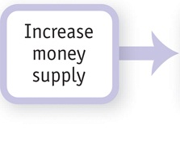
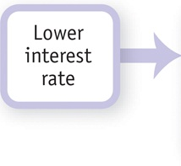
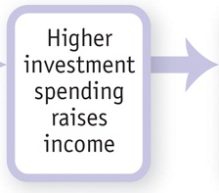
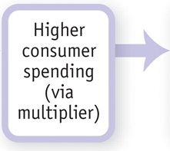
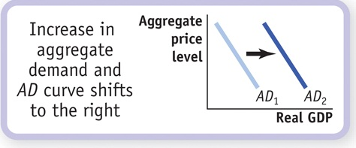
MONETARY POLICY AND AGGREGATE DEMAND
How the expansionary monetary policy
cycle works:

Slide 70
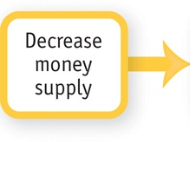
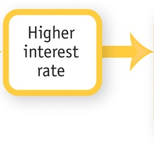
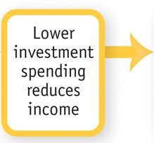
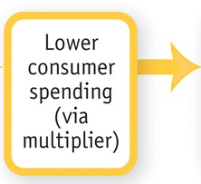

MONETARY POLICY AND AGGREGATE DEMAND
How the contractionary monetary policy
cycle works:

Slide 71
MONETARY POLICY IN PRACTICE
How does the Fed decide whether to use expansionary or contractionary monetary policy?
And how does it decide how much is enough?
Policy makers try to fight recessions, as well as to ensure price stability: low (though usually not zero) inflation.
Actual monetary policy reflects a combination of these goals.

Slide 72

THE EUROPEAN CENTRAL BANK
Created in January
1999
Located in Frankfurt, Germany
Represents a (combined) economy as large as that of the United States.
Notes:
All image credits courtesy of Morgue File and/or FreeImages.com unless otherwise specified

Slide 73

The Fed’s Balance Sheet

Slide 74

THE EVOLUTION OF THE AMERICAN BANKING SYSTEM
The crisis in American banking in the early twentieth century
The main problem afflicting the system was that the money supply was not sufficiently responsive: It was difficult to shift currency around the country to respond quickly to local economic changes.
Bank panics (bank runs) were too common.
The Panic of 1907: a foreshadowing of the financial crisis of 2008? Large losses from risky speculation destabilized the banking system.
Notes:
All image credits courtesy of Morgue File and/or FreeImages.com unless otherwise specified

Slide 75
THE EVOLUTION OF THE AMERICAN BANKING SYSTEM
Responding to banking crises: the creation of the Federal Reserve
The panic of 1907 convinced many that the time for central control of bank reserves had come.
In 1913 the Federal Reserve was created.
Now bank reserves were centralized and standardized—but not immune to bank runs.
A series of bank runs in 1930, 1931, and 1933 convinced the Fed that banks needed more regulation.

Slide 76
THE EVOLUTION OF THE AMERICAN BANKING SYSTEM
In 1932, the Reconstruction Finance Corporation (RFC) was established and given the authority to make loans to banks in order to stabilize the banking sector.
Also in 1932, the Glass-Steagall Act created federal deposit insurance and increased the ability of banks to borrow from the Federal Reserve system.

Slide 77

THE EVOLUTION OF THE AMERICAN BANKING SYSTEM
Another Glass-Steagall Act (1933) separated banks into two categories:
Commercial banks: depository banks that accepted deposits and were covered by deposit insurance.
Investment banks: banks which engaged in creating and trading financial assets (stocks and corporate bonds) but were not covered by deposit insurance because their activities were considered riskier.
Public acceptance of deposit insurance finally stopped the bank runs of the Great Depression.
Sen. Carter Glass (D-Va.) and Rep. Henry B. Steagall (D-Ala.)
Notes:
Image courtesy of Library of Congress

Slide 78
THE SAVINGS AND LOAN CRISIS OF THE 1980S
The savings and loan (thrift) crisis of the 1980s arose because Congress deregulated S&Ls, allowing them to engage in risky speculation.
The intent was to make them to offer higher rates of return, like banks, in an era of high inflation.
They incurred huge losses.
Depositors in failed S&Ls were compensated with taxpayer funds because they were covered by deposit insurance.
The crisis caused steep losses in the financial and real estate sectors, resulting in a recession in the early 1990s.

Slide 79

THE FINANCIAL CRISIS OF 2008
During the mid-1990s, the hedge fund LTCM (Long-Term Capital Management) used huge amounts of leverage to speculate in global financial markets, incurred massive losses, and collapsed.
Leverage: financing an investment with borrowed funds.
LTCM was so large that it caused balance sheet effects for firms globally, leading to the prospect of a vicious circle of deleveraging.
Balance sheet effect: the reduction in a firm’s net worth due to falling asset prices.
Vicious circle of deleveraging: asset sales to cover losses forcing creditors to call in their loans, forcing sales of more assets and causing further declines in asset prices.
As a result, credit markets around the world froze. The New York Fed coordinated a private bailout of LTCM and revived world credit markets.

Slide 80

THE FINANCIAL CRISIS OF 2008
2008—The worldwide financial system was in crisis, and banks and other financial institutions wanted to borrow more than $2 trillion. What could be done?
Notes:
Image: public domain

Slide 81
THE FINANCIAL CRISIS OF 2008
Subprime lending during the U.S. housing bubble of the mid-2000s spread through the financial system via securitization.
Subprime lending: lending to home buyers who don’t meet the usual criteria for being able to make the payments.
Securitization: a pool of loans assembled and shares of it sold to investors.
When the bubble burst, massive losses by banks and other financial institutions led to widespread collapse in the financial system.
To prevent another Great Depression, the Fed and the U.S. Treasury expanded lending to banks and other financial institutions, provided capital through the purchase of bank shares, and purchased private debt.

Slide 82

Many Americans still don't understand what happened to the economy in 2008. How did it all go so bad so quickly? Who is responsible? How effective has the response from Washington and Wall Street been? Those are the questions at the heart of FRONTLINE’s “Inside the Meltdown.” Click here. (56:23 minutes)
http://www.pbs.org/wgbh/pages/frontline/meltdown/view/
!
Notes:
http://www.pbs.org/wgbh/pages/frontline/meltdown/view/
If you can spare the time in class, this documentary really explains the mechanics of the meltdown well and introduces students to the personalities at the center of the crisis. If you can’t spare the time, require students to watch and respond as homework.

Slide 83

THE FINANCIAL CRISIS OF 2008
Because much of the crisis originated in nontraditional bank institutions, the crisis of 2008 indicated that a wider safety net and broader regulation are needed in the financial sector.
The TED spread: widely used as a measure of financial stress and perceived risk. (It’s the difference between the interest rate at which banks lend to each other and the interest rate on U.S. government debt.)

Slide 84

Regulation after the 2008 Crisis
In July 2010, President Obama signed the Dodd-Frank Act (Wall Street Reform and Consumer Protection Act).
Gives a special government committee, the Financial Stability Oversight Council, the right to designate institutions as “systemically important” and thus subject to normal bank regulation (even though they are not traditional banks).
Established new rules on the trading of derivatives: They must now be traded in exchanges so their prices and volume are more transparent.

Slide 85
Quantitative Easing
Quantitative easing (QE) is an unconventional monetary policy tool used by central banks to stimulate the economy when traditional monetary policy tools, such as lowering interest rates, become ineffective or reach their lower bounds.
Under quantitative easing, a central bank creates new money electronically and uses it to purchase financial assets, such as government bonds and other securities, from banks and other financial institutions.
By purchasing these assets, the central bank increases the demand for them, raising their prices and effectively lowering their yields (interest rates).
Lower long-term interest rates make borrowing cheaper for businesses and households, which in turn promotes investment, spending, and economic growth.
While QE can be an effective tool to stimulate economic growth, it also carries risks, such as the potential for higher inflation, asset price bubbles, and the distortion of financial markets.

Slide 86
The Federal Funds rate is the rate that banks are charged when they borrow from the Fed.
True
False

Slide 87

THE PERFECT GIFT: CASH OR A GIFT CARD?
The best-selling single item for more than 80% of top U.S. retailers? Gift cards.
Retailers know that breakage rates are high (unuse)- more than $1billion/year
Recipients will often sell these cards at a discount to get cash.
Notes:
All image credits courtesy of Morgue File and/or FreeImages.com unless otherwise specified

