Slide 1
Economics 2220 Principles Of Macroeconomics
Professor Zhigang Feng
Lecture 14:
Money, Banking and Monetary policy

Slide 2
What the money demand curve is
Why the liquidity preference model determines the interest rate in the short run
How the Federal Reserve implements monetary policy, moving the interest rate to affect aggregate output
Why monetary policy is the main tool for stabilizing the economy
How the behavior of the Federal Reserve compares to that of other central banks
Why economists believe in monetary neutrality—that monetary policy affects only the price level, not aggregate output, in the long run
To First
Active Learning

Slide 3
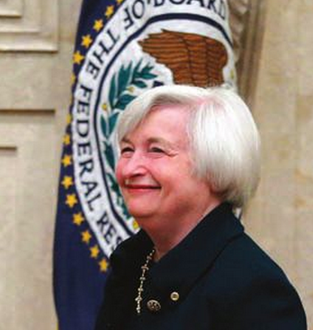
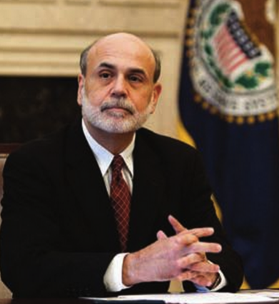
THE MOST POWERFUL PERSON IN GOVERNMENT
Janet Yellen, Current Chair
Ben Bernanke, Former Chair
The chairmanship of the Federal Reserve is arguably the most powerful position in the U.S. government
Notes:
Images courtesy of (Yellen: REUTERS/Jim Bourge/Newsroom), (Bernanke: Joshua Roberts/Bloomberg via Getty Images)

Slide 4

THE DEMAND FOR MONEY
The Opportunity Cost of Holding Money
We all carry some cash around for the convenience.
When we do, we give up interest income we’d collect if that spending power were in an interest-bearing asset like a bond.
There is a price to be paid for the convenience of holding money.
Notes:
Image credit: Big Cheese Photos/Superstock

Slide 5
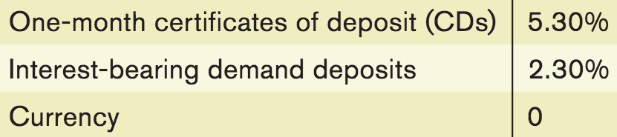
INTEREST RATES AND THE OPPORTUNITY COST OF HOLDING MONEY
Individuals and firms trade off the benefit of holding cash versus the benefit of holding interest-bearing nonmonetary assets.
Selected interest rates, 2007 (before the financial crisis)
Source: Federal Reserve Bank of St. Louis

Slide 6
INTEREST RATES AND THE OPPORTUNITY COST OF HOLDING MONEY
Short-term interest rates: the interest rates on financial assets that mature within six months or less.
Long-term interest rates: interest rates on financial assets that mature a number of years in the future.
The higher the interest rate, the higher the opportunity cost of holding money.
The lower the interest rate, the lower the opportunity cost of holding money.
Notes:
All image credits courtesy of Morgue File and/or FreeImages.com unless otherwise specified

Slide 7
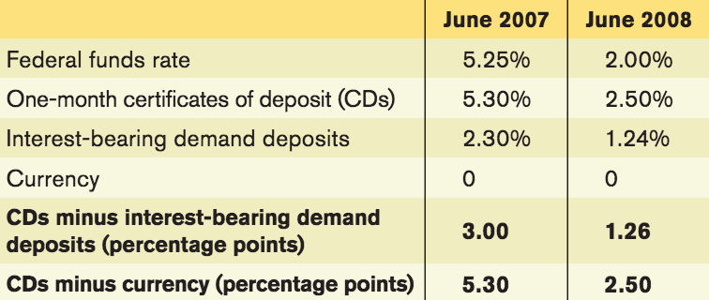
INTEREST RATES AND THE OPPORTUNITY COST OF HOLDING MONEY
Although there are many different interest rates and they don’t move exactly together, as a rule most short-term rates tend to move in the same direction.
Source: Federal Reserve Bank of St. Louis
Notes:
Source: Federal Reserve Bank of St. Louis.

Slide 8
THE MONEY DEMAND CURVE
Interest rate, r
At higher interest rates, the cost of holding money is greater, so less quantity is demanded.
The money demand curve shows the relationship between the quantity of money demanded and the interest rate.
At lower interest rates, the cost of holding money is smaller, so a higher quantity is demanded.
Money demand curve, MD
Quantity of money

Slide 9
SHIFTS OF THE REAL MONEY DEMAND CURVE
The following factors shift the money demand curve:
Changes in aggregate price level
Higher prices mean we need more money for transactions (and vice versa).
Changes in real GDP
More goods and services produced and sold means we need more money (and vice versa).
Changes in technology
The ease of credit card payments reduces the need for cash.
Changes in institutions
After 1980 banks were allowed to offer interest on checking accounts. This decreased the cost of holding money, and money demand increased.

Slide 10

A YEN FOR CASH- Japan is still a cash society.
The many small businesses haven’t invested in credit card technology.
And the short-term interest rates have been below 1% since the 1990s. Also, crime is low.
So…why not hold cash?

Slide 11
SHIFTS IN THE DEMAND FOR MONEY
Interest rate, r
A fall in money demand shifts the money demand curve to the left.
A rise in money demand shifts the money demand curve to the right.
r₁
MD₂
MD₁
MD₃
M₃
M₁
M₂
Quantity of money

Slide 12
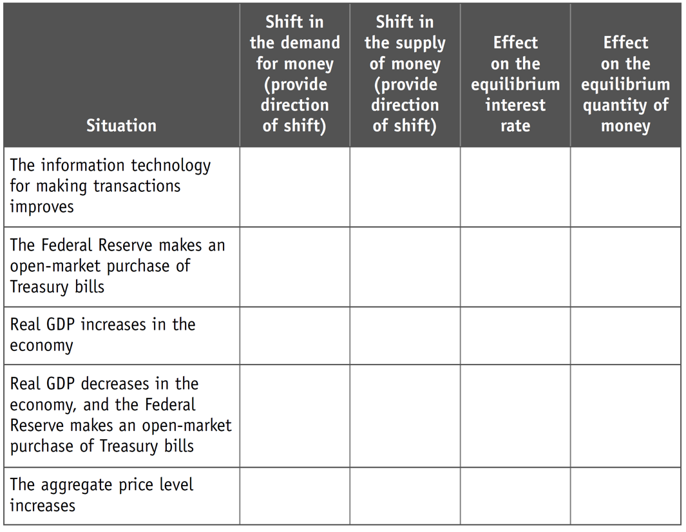
With a partner, fill in the table.
To answer

Slide 13
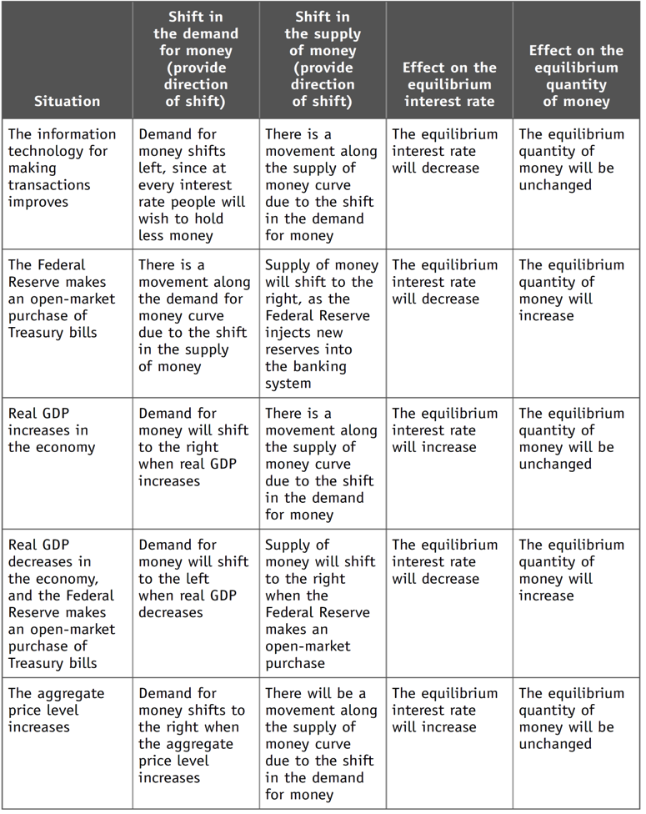
(Answers to previous slide)
To Next
Active Learning

Slide 14
MONEY AND INTEREST RATES
So how does the Fed control interest rates?
We need to understand how interest rates are set in the market.
The liquidity preference model of the interest rate asserts that the interest rate is determined by the supply and demand for money.
The money supply curve shows how the nominal quantity of money supplied varies with the interest rate.

Slide 15
EQUILIBRIUM IN THE MONEY MARKET
At r_{H}, interest rates are high. MS > MD, and a surplus of money means there is a shortage of other assets like bonds. Investors selling bonds will realize they can reduce interest rates and still find buyers.
At r_{L} , interest rates are low. MD > MS, and a shortage of money means there is a surplus of other assets like bonds. Investors selling bonds will try to make them more attractive to buyers by raising rates.
Money supply
curve, MS
Interest
rate, r
Equilibrium
H
r_{H}
E
Equilibrium interest rate
r_{E}
L
r_{L}
MD
M_{H}
M
M_{L}
Money supply
chosen by the Fed
Quantity of money
Notes:
15

Slide 16
Suppose that an economy’s aggregate output level increases. Assuming that the central bank does not engage in monetary policy, which of the following statements is true?
The interest rate will increase.
The interest rate will decrease.
The interest rate will be unaffected by this change in aggregate output.
This change in aggregate output will cause a movement along the money demand curve.
To Next
Active Learning

Slide 17
MONETARY POLICY AND THE INTEREST RATE
By adjusting the money supply up or down, the Fed can set the interest rate.
The Fed sets a target federal funds rate and undertakes the appropriate open-market operations.
Target federal funds rate: the Federal Reserve’s desired federal funds rate.

Slide 18
MONETARY POLICY AND THE INTEREST RATE
The Effect of an Increase in the Money Supply on the Interest Rate
An increase
in the money
supply …
Interest
rate, r
MS₁
MS₂
r₁
E₁
…leads to
a fall in the
Interest rate.
E₂
r₂
MD
M₁
M₂
Quantity of money
Notes:
18

Slide 19
SETTING THE FEDERAL FUNDS RATE
The Fed uses open-market operations to
push the interest rate down to the target rate.
An open-market purchase of Treasury bills…
Interest
rate, r
MS₁
MS₂
r₁
E₁
…drives the interest rate down.
E₂
r₂
MD
M₁
M₂
Quantity of money
Notes:
19

Slide 20
SETTING THE FEDERAL FUNDS RATE
The Fed uses open-market operations to
pull the interest rate up to the target rate.
Interest
rate, r
An open-market sale of Treasury bills…
MS₂
MS₁
r₂
E₂
…drives the interest rate up.
E₁
r₁
MD
M₂
M₁
Quantity of money
Notes:
20

Slide 21
THE TARGET VERSUS THE MARKET
A common mistake is to imagine that changes in the way the Federal Reserve operates alter the way the money market works.
In fact, the money market works the same way as always: The interest rate is determined by the supply and demand for money.
The only difference is that now the Fed adjusts the supply of money to achieve its target interest rate.

Slide 22
The money supply curve shifts to the left. The most likely cause for this shift is the FOMC’s open-market:
purchase of Treasury bills.
sale of Treasury bills.
To Next
Active Learning

Slide 23

LONG-TERM INTEREST RATES
Long-term interest rates don’t necessarily move with short-term interest rates.
If investors expect short-term interest rates to rise, they may buy short-term bonds.
In practice, long-term interest rates reflect the market’s average expectation for short-term rates.
Notes:
Image courtesy Flagg, James Montgomery. “I want you for US Army nearest recruiting station” 1917 Prints and Photographs Division

Slide 24
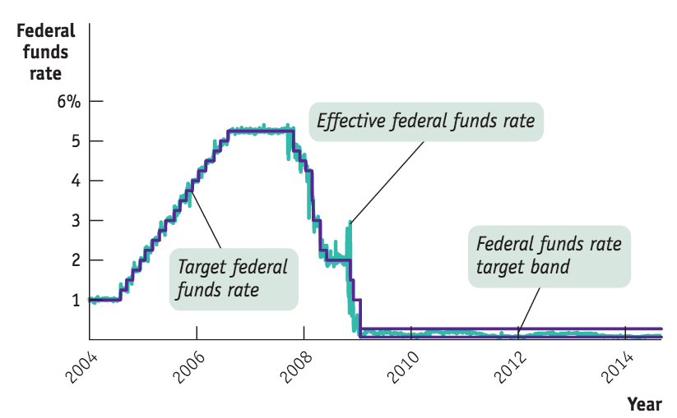
The Fed Reverses Course
Starting in September 2007, fighting the financial crisis took priority.
Source: Federal Reserve Bank of St. Louis

Slide 25


MONETARY POLICY AND AGGREGATE DEMAND
Expansionary monetary policy: monetary policy that increases aggregate demand (also called “easy money policy”).
Contractionary monetary policy: monetary policy that reduces aggregate demand (also called “tight money policy”).
Notes:
All image credits courtesy of Morgue File and/or FreeImages.com unless otherwise specified

Slide 26
When the economy is producing at a short-run level of aggregate output that is less than potential output, it is most likely that the Fed will engage in open-market:
purchases of Treasury bills.
sales of Treasury bills.
To Next
Active Learning

Slide 27
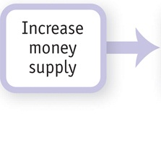
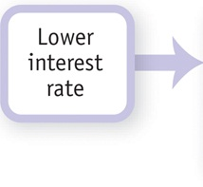
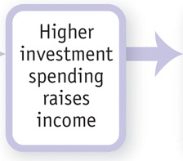
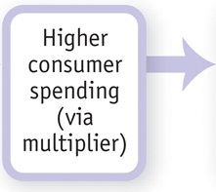
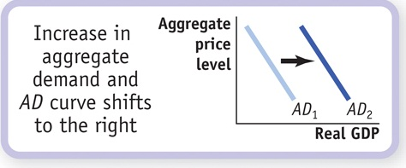
MONETARY POLICY AND AGGREGATE DEMAND
How the expansionary monetary policy
cycle works:

Slide 28
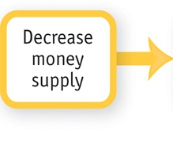
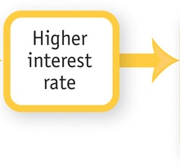
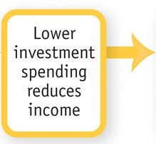
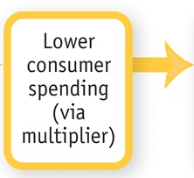
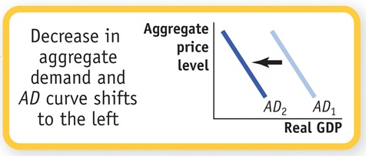
MONETARY POLICY AND AGGREGATE DEMAND
How the contractionary monetary policy
cycle works:

Slide 29
MONETARY POLICY IN PRACTICE
How does the Fed decide whether to use expansionary or contractionary monetary policy?
And how does it decide how much is enough?
Policy makers try to fight recessions, as well as to ensure price stability: low (though usually not zero) inflation.
Actual monetary policy reflects a combination of these goals.

Slide 30
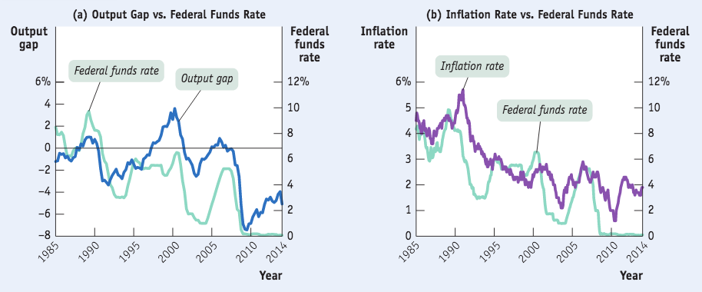
TRACKING MONETARY POLICY
The federal funds rate usually rises when the output gap is positive and falls when the output gap is negative.
The federal funds rate tends to be high when inflation is high and low when inflation is low.

Slide 31
THE TAYLOR RULE FOR MONETARY POLICY
In 1993, Stanford economist John Taylor proposed a simple rule for monetary policy.
Taylor rule for monetary policy: set the federal funds rate according to the level of the inflation rate and either the output gap or the unemployment rate.

Slide 32

THE FEDERAL FUNDS TARGET AND THE TAYLOR RULE
To address both goals:
inflation
recessions
The Fed can follow a rule:
As it turns out, between 1988 and 2008 the Fed basically did just this.
Follow the Taylor Rule
Federal funds target rate =
2.07 + 1.28 × inflation rate – 1.95 × unemployment gap.
Notes:
All image credits courtesy of Morgue File and/or FreeImages.com unless otherwise specified

Slide 33
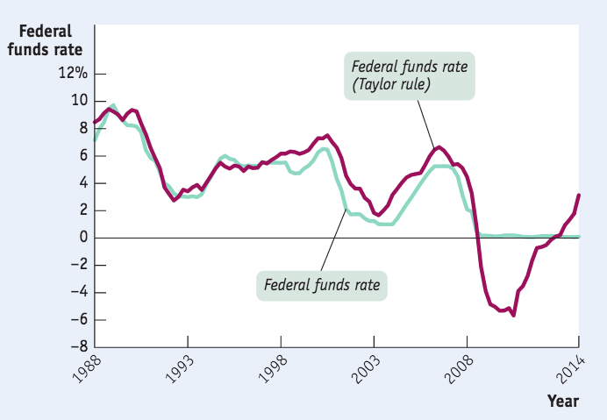
TRACKING MONETARY POLICY
The actual federal funds rate tracked the predicted rate quite closely through the end of 2008.
After that the Taylor rule called for negative interest rates, which aren’t possible.
Sources: Bureau of Labor Statistics;
Congressional Budget Office; Federal
Reserve Bank of St. Louis; Glenn D.
Rudebusch, “The Fed’s Monetary Policy
Response to the Current Crisis,” FRBSF
Economic Letter #2009-17 (May 22, 2009).

Slide 34
With a partner, draw the SRAS, AD, and LRAS curves for an economy with a recessionary gap. What monetary policy should the Fed pursue with its open market operations?
Explain what happens to interest rates. Show on a money demand–money supply graph.
Finally, show the effect of the monetary policy on the original graph.

Slide 35

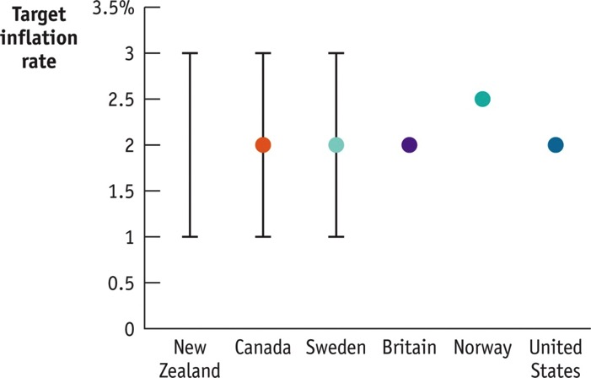
INFLATION TARGETING
Instead of using a Taylor rule, many central banks use inflation targeting.
Inflation targeting: the central bank setting an explicit target for the inflation rate and using monetary policy to hit that target.
Notes:
All image credits courtesy of Morgue File and/or FreeImages.com unless otherwise specified

Slide 36


DOES IT MATTER?
One major difference between the two methods:
Inflation targeting is forward-looking (based on a forecast of future inflation).
Taylor rule is backward-looking (adjusts monetary policy in response to past inflation).
Notes:
All image credits courtesy of Morgue File and/or FreeImages.com unless otherwise specified

Slide 37
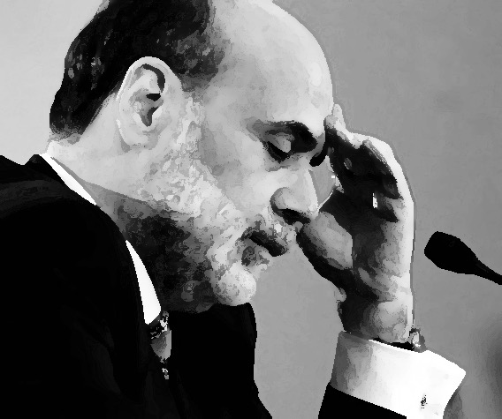
THE ZERO LOWER BOUND PROBLEM
The fact that interest rates can’t go below zero (“zero lower bound”) limits the power of monetary policy.
November 2010: Interest rates were at or near zero, but the economy was still far below potential output.
So the Fed got creative and tried “quantitative easing” (buying longer-term government bonds).
The Fed hoped this would drive down long-term interest rates and have an expansionary effect on the economy.
Notes:
Image: public domain

Slide 38
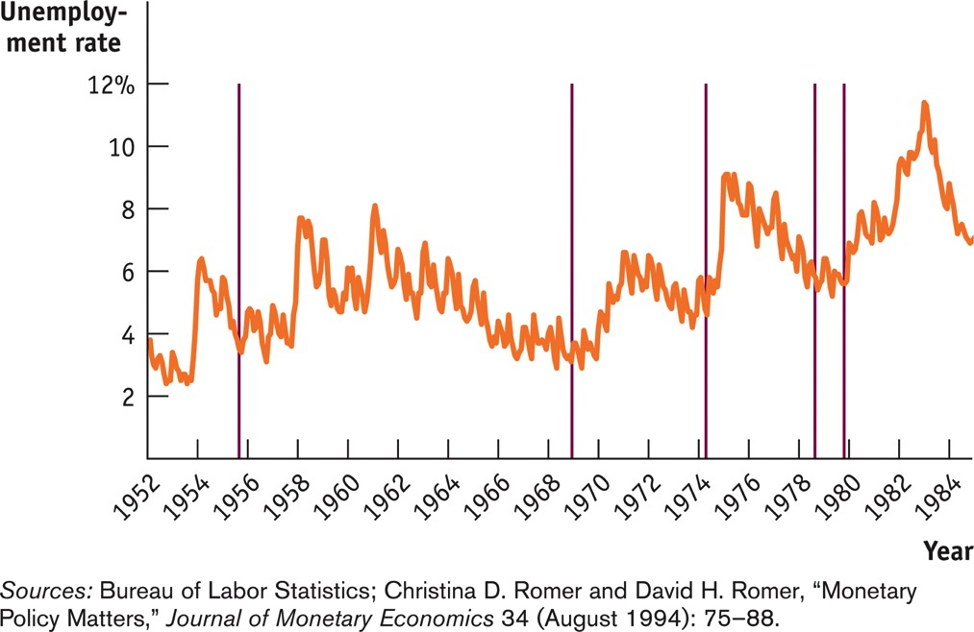
What the Fed wants, the fed gets
Causality problems make it hard to observe whether high interest rates are a result of an expansion or of the Fed. Romer and Romer focused on episodes of high interest rates when the Fed announced it would reduce inflation by increasing unemployment (red lines). In short, the Fed gets what it wants.
Notes:
Figure Caption: Figure 31-10: When the Fed Wants a Recession
This figure shows the unemployment rate from 1952 to 1984; the vertical red lines indicate occasions on which the Federal Reserve, in effect, decided that the economy needed a recession to bring inflation under control. In four of the five episodes, this decision was soon followed by a substantial rise in the unemployment rate.
Sources: Bureau of Labor Statistics; Christina D. Romer and David H. Romer, “Monetary Policy Matters,” Journal of Monetary Economics 34 (August 1994): 75–88.

Slide 39

MONEY, OUTPUT, AND PRICES IN THE LONG RUN
What about the economy’s ability to self-correct toward long-run equilibrium through flexible wages and SRAS shifts?
In short, we believe that in the long run, changes in the quantity of money affect the price level but not the output or interest rate.
Notes:
All image credits courtesy of Morgue File and/or FreeImages.com unless otherwise specified

Slide 40
MONEY, OUTPUT, AND PRICES IN THE LONG RUN
An increase in the
money supply reduces
the interest rate and
increases aggregate
demand…
Aggregate
price level
LRAS
SRAS₂
SRAS₁
E₃
P₃
…but the eventual rise in nominal wages leads to a fall in short-run aggregate supply, and aggregate output falls back to potential output.
P₂
E₂
P₁
E₁
AD₂
AD₁
Y₁
Y₂
Real GDP
Potential output

Slide 41
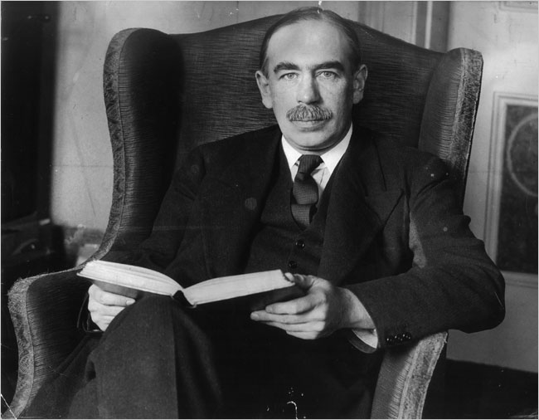
MONETARY NEUTRALITY
Monetary neutrality: Changes in the money supply have no real effect on the economy.
Don’t make me say it again:
“In the long run we are all dead.”
Notes:
Image: public domain

Slide 42
LONG-RUN CHANGES IN THE MONEY SUPPLY AND INTEREST RATE
In the long run, changes in the money supply don’t affect the interest rate.
An increase in the money supply lowers the interest rate in the short run…
Interest
rate, r
MS₁
MS₂
… but in the long run higher
prices lead to greater money demand, raising the interest rate to its original level.
E₁
E₃
r₁
E₂
r₂
MD₁
MD₂
M₁
M₂
Quantity of money

Slide 43
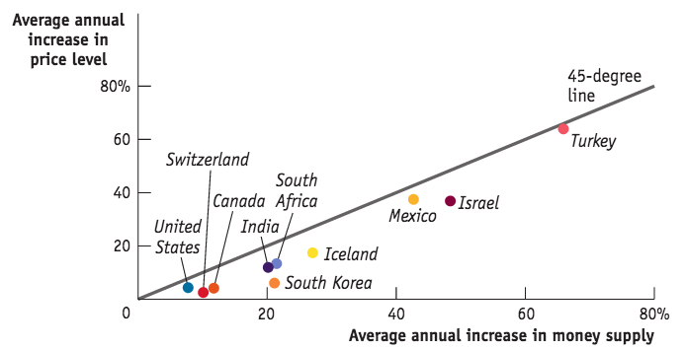
INTERNATIONAL EVIDENCE OF MONETARY NEUTRALITY
Do increases in the money supply really lead to increases in the price level? It’s not exact, but yes.
Source: Federal Reserve Bank of St. Louis

Slide 44
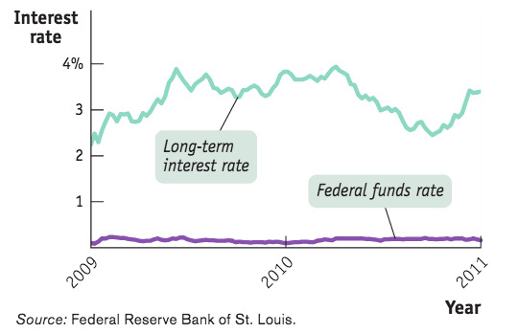
PIMCO Bets on Cheap Money
In Fall 2009, Bill Gross (then head of Pacific Investment Management Company) believed interest rates would continue to fall- and invested heavily in long-term government bonds.
Meanwhile, Morgan Stanley bet the opposite- and was wrong (until 2011)

