Slide 1
Economics 2220 Principles of Macroeconomics
Professor Zhigang Feng
Lecture 1: Introduction
Course presentation
Introduction to Macroeconomics
Recent and Current macroeconomic Events
List of topics

Slide 2
Course Presentation
Course website: Canvas.
The choice of textbook.
Homework, exams and grades.
Office hours, course materials and additional readings.

Slide 3
Who am I?
A macroeconomist studies AI and Machine Learning;
Taught at U of Illinois, U of Zurich, Purdue;
Conduct researches at Congressional Budget Office, Federal Reserve Bank;
Published at top economics journals;
Contributor to FOX 42 KPTM, KETV, Omaha World Herald;
Photographer for MNHS Swimming Team, 2021-2025

Slide 4
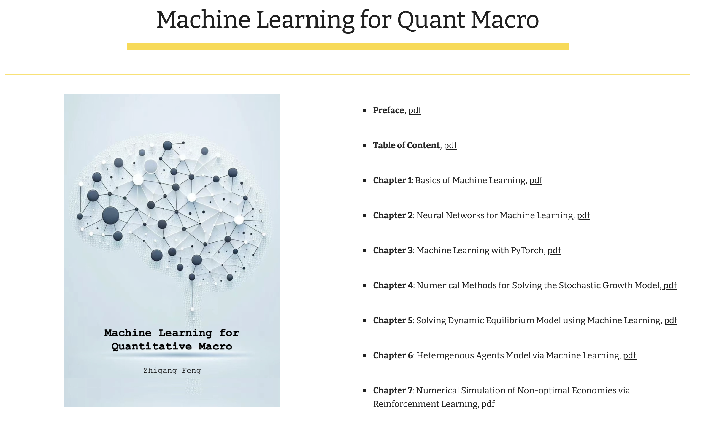

Slide 5
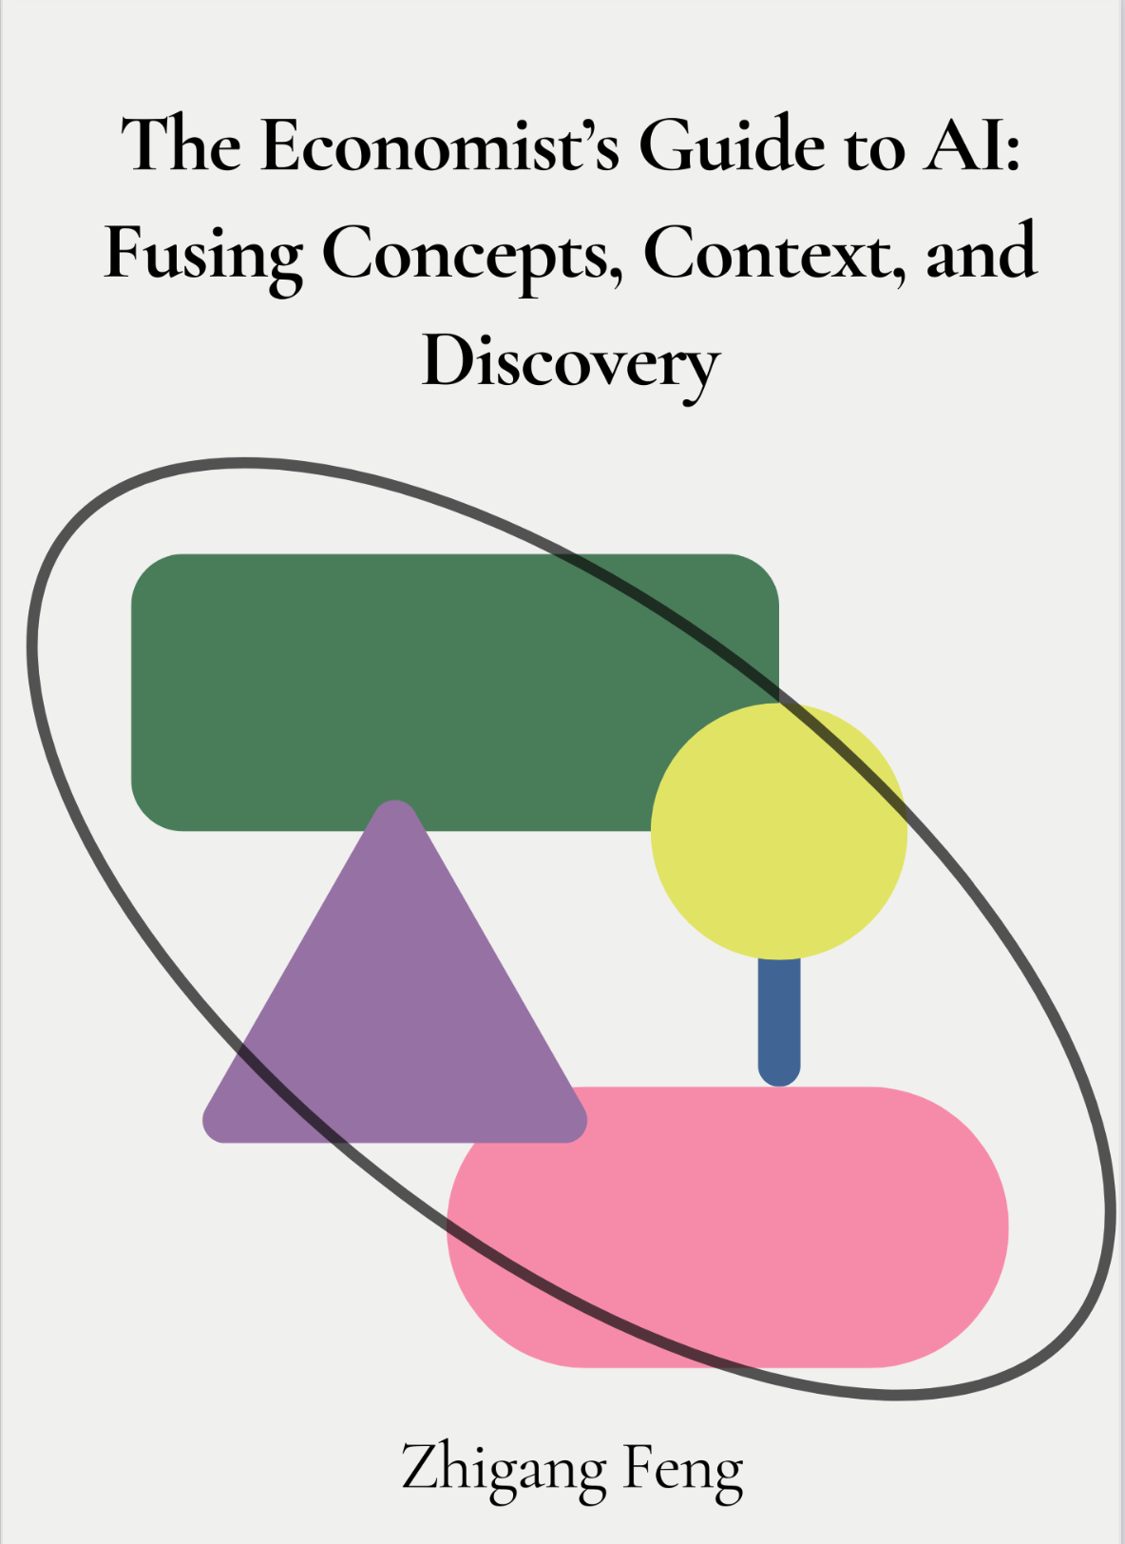
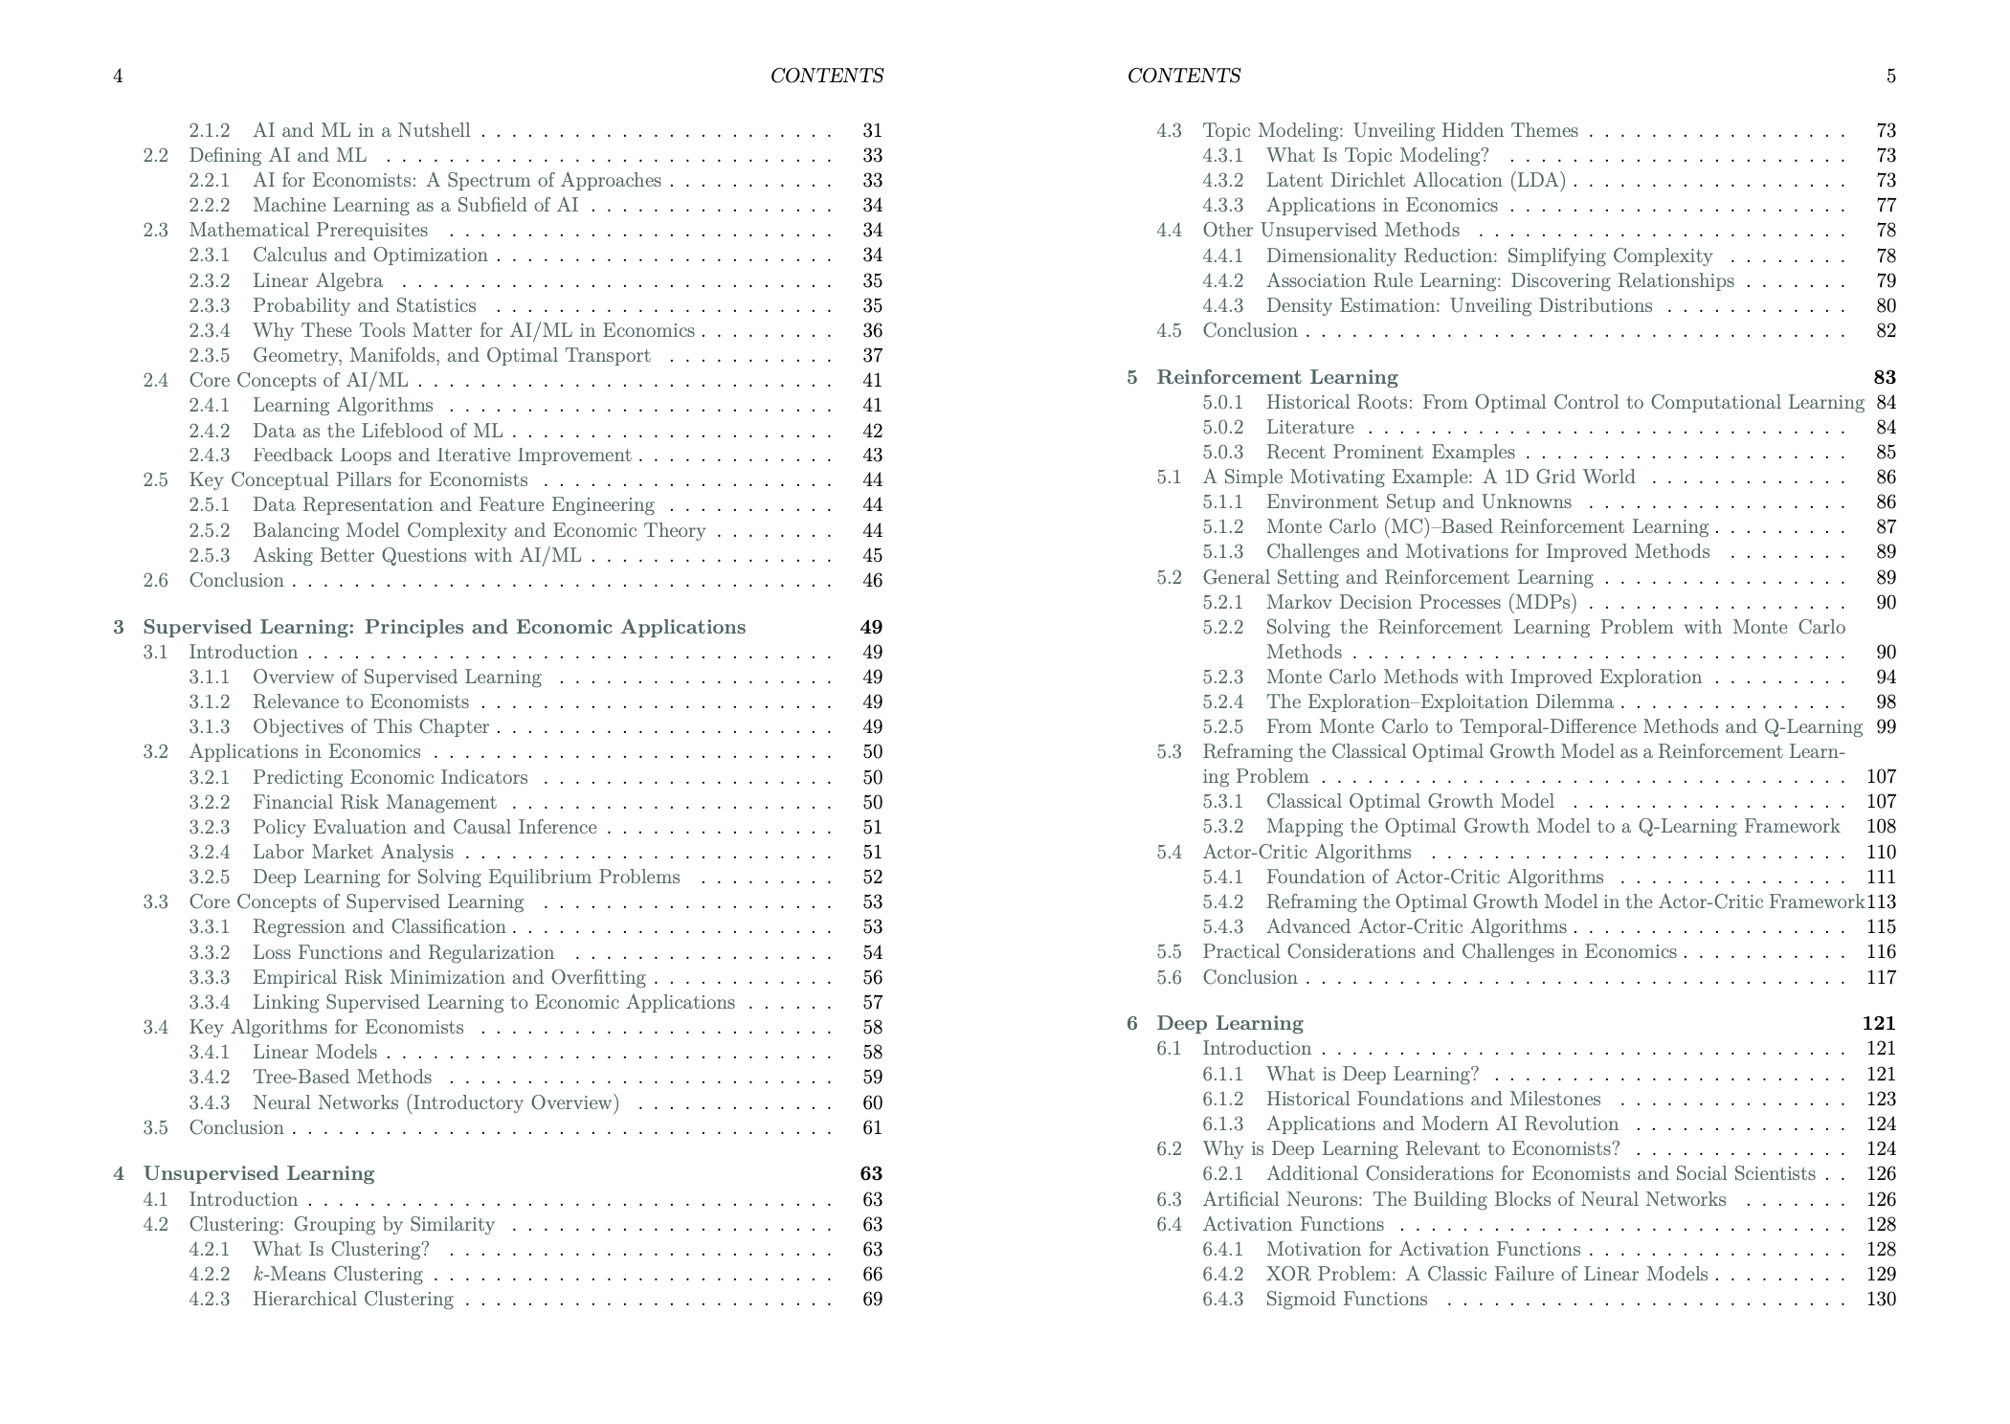

Slide 6
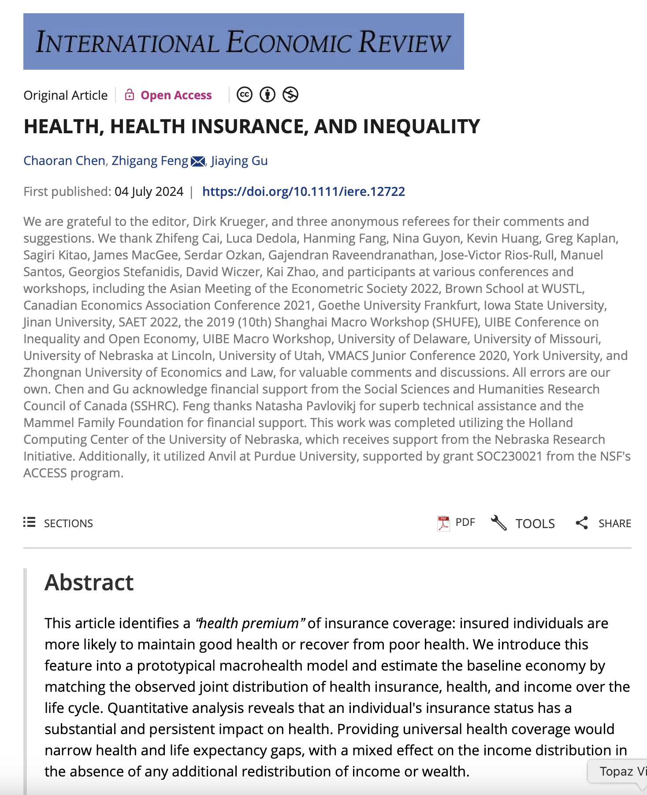

Slide 7
https://www.unomaha.edu/news/2025/10/is-ai-luring-everyone-into-a-middle-intelligence-trap.php
https://www.unomaha.edu/news/2025/08/when-hail-meets-high-finance-nebraskas-insurance-crisis-points-to-americas-climate-future.php

Slide 8
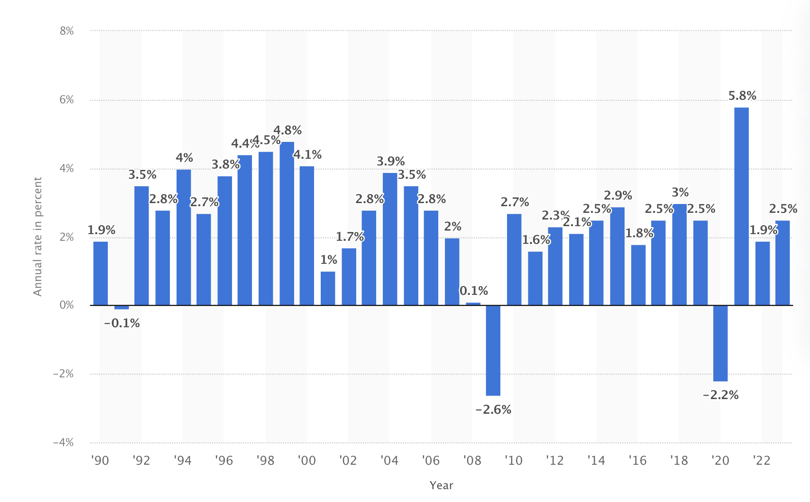
Economic Growth

Slide 9
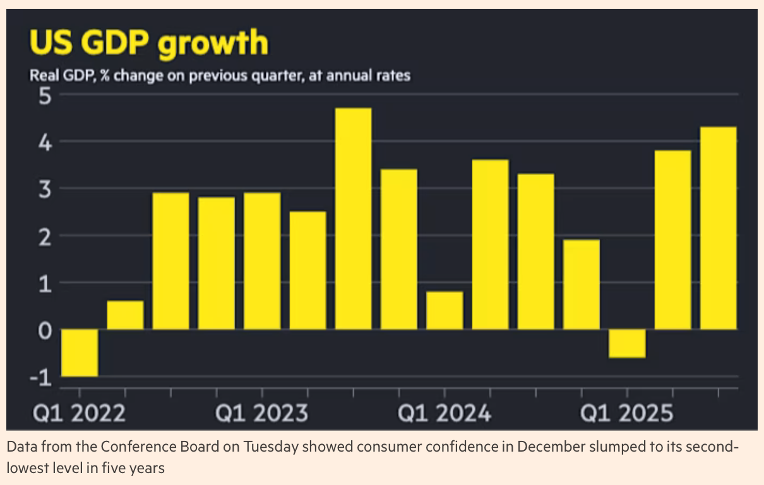

Slide 10
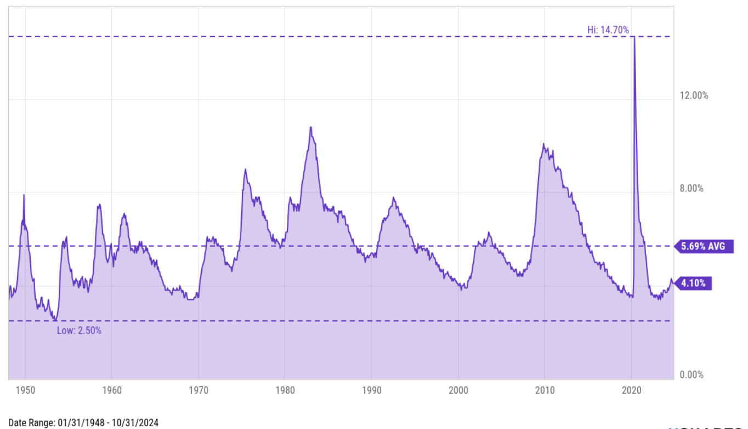
Unemployment Rate

Slide 11
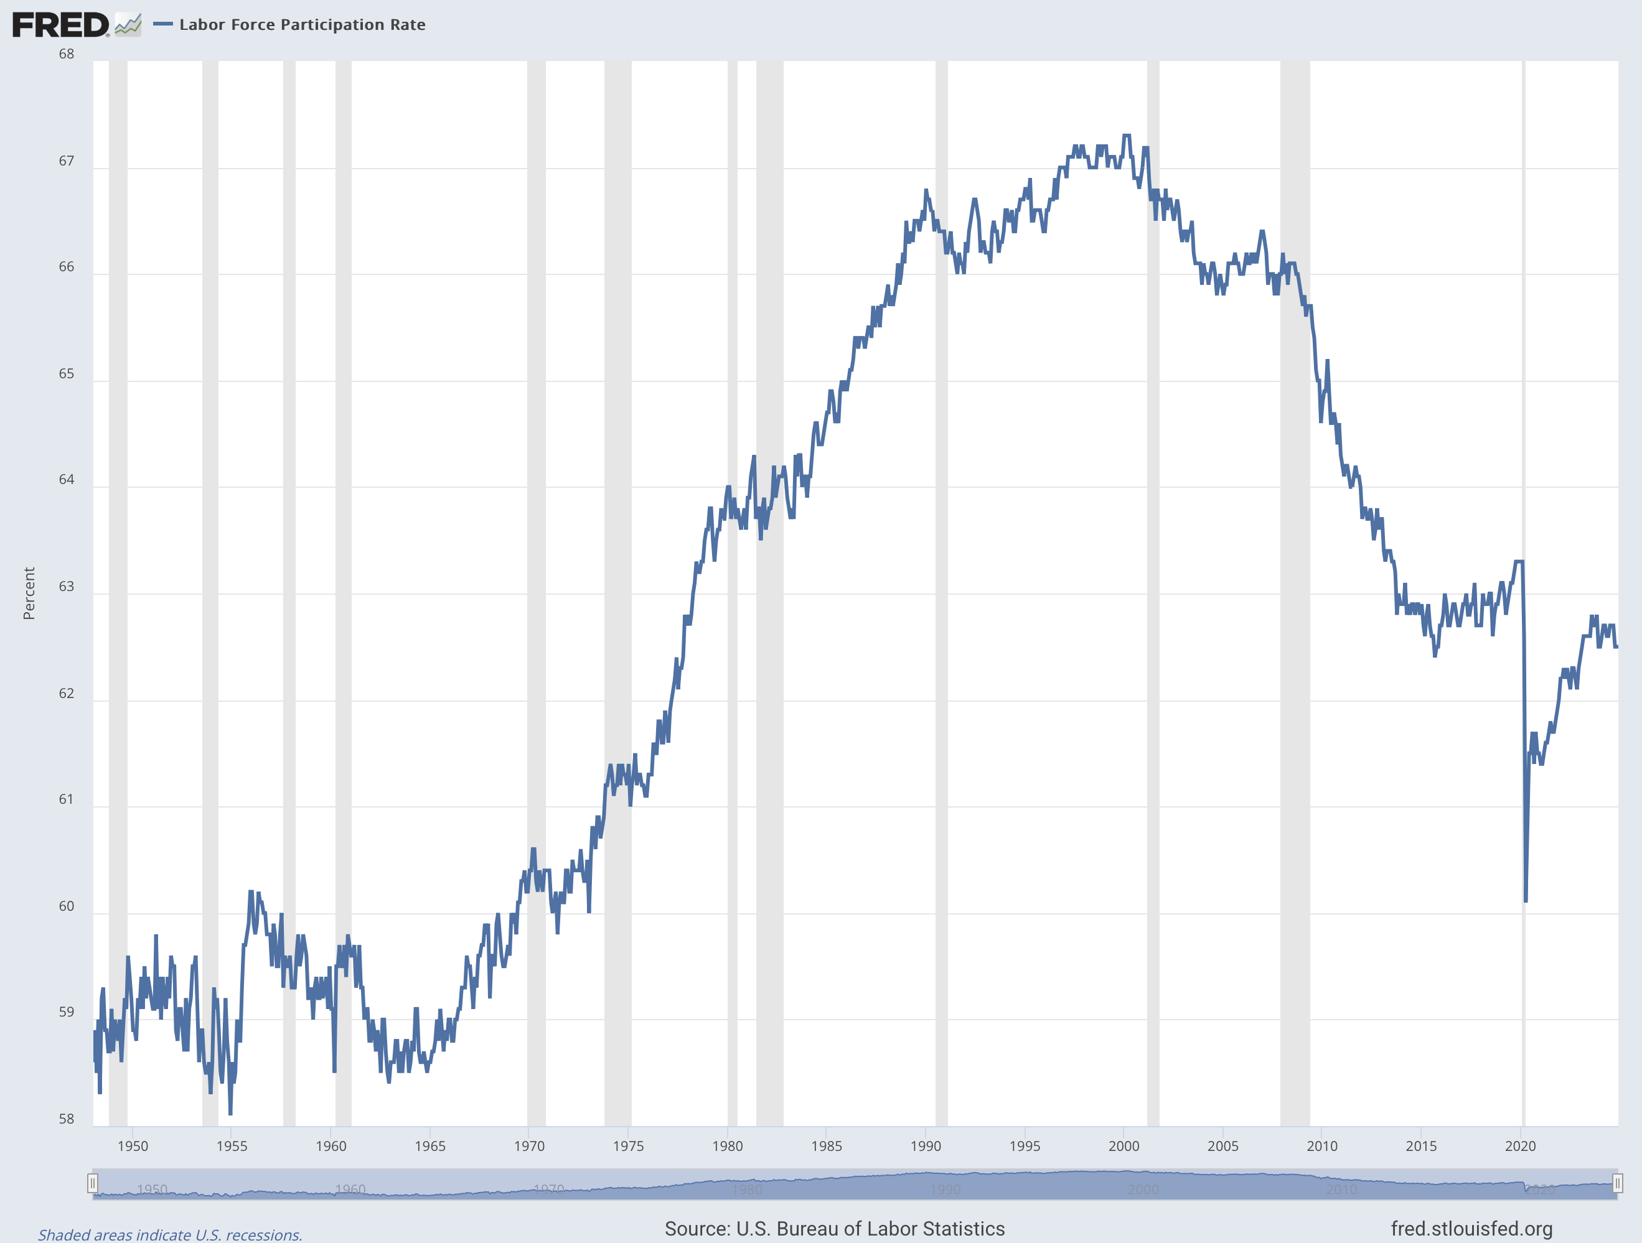
Labor Force Participation Rate

Slide 12
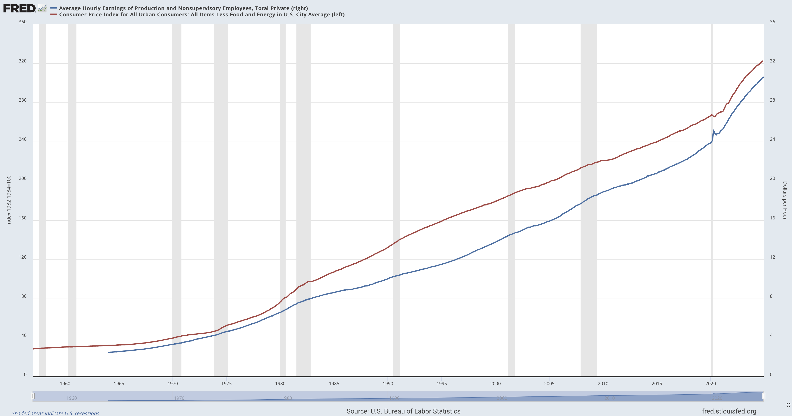
Wage Rate

Slide 13
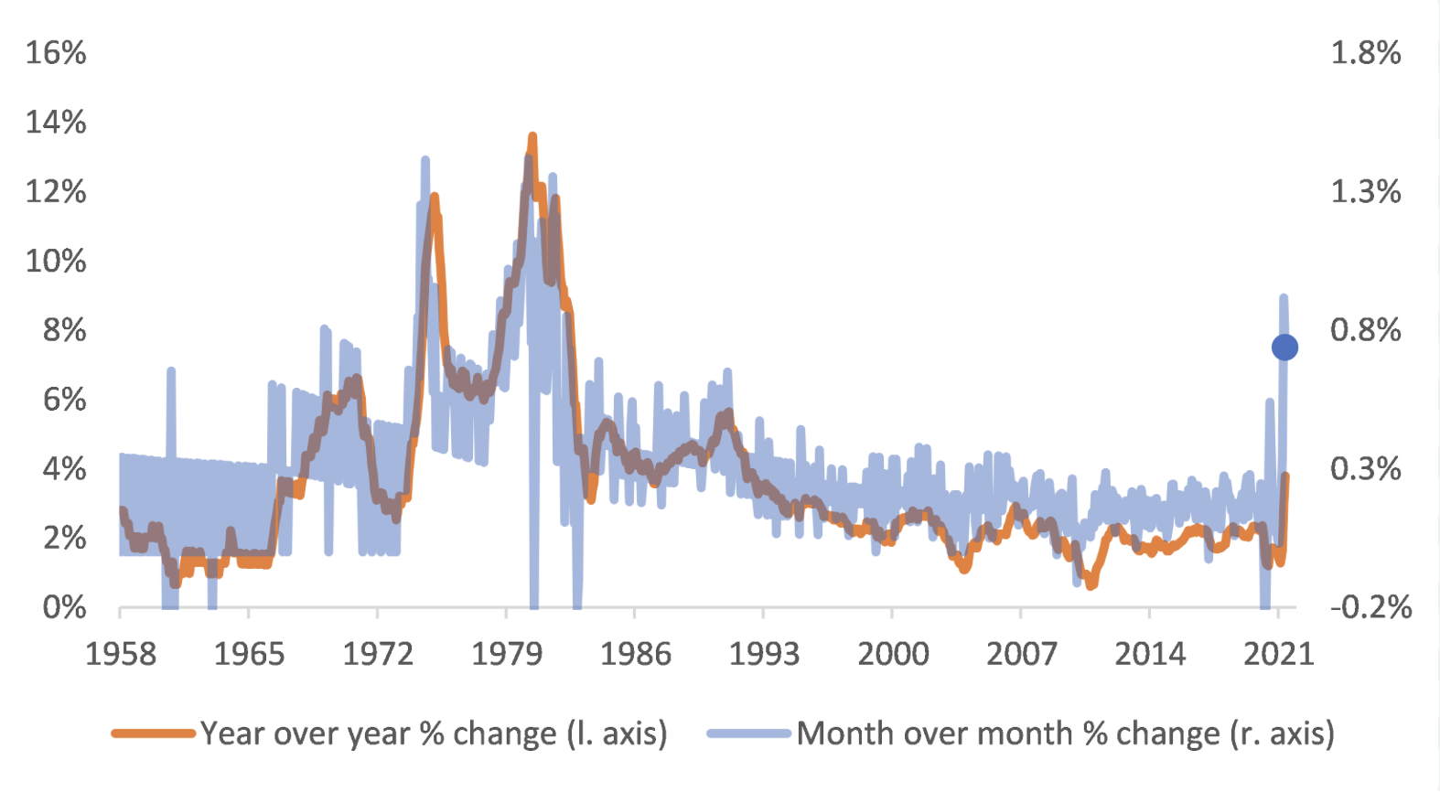
Core Inflation

Slide 14
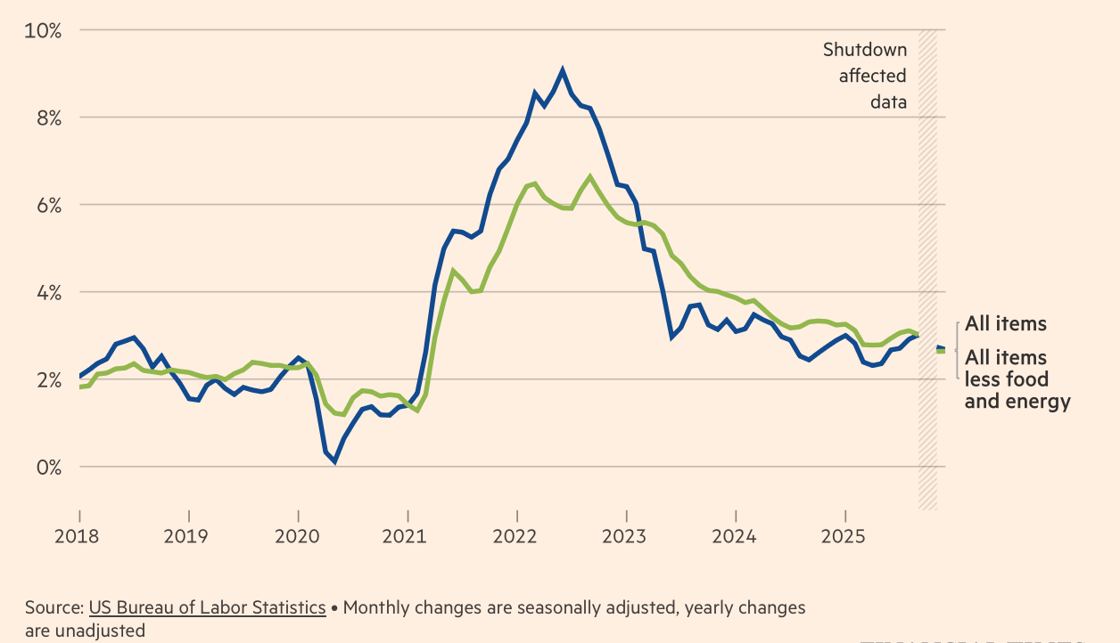

Slide 15
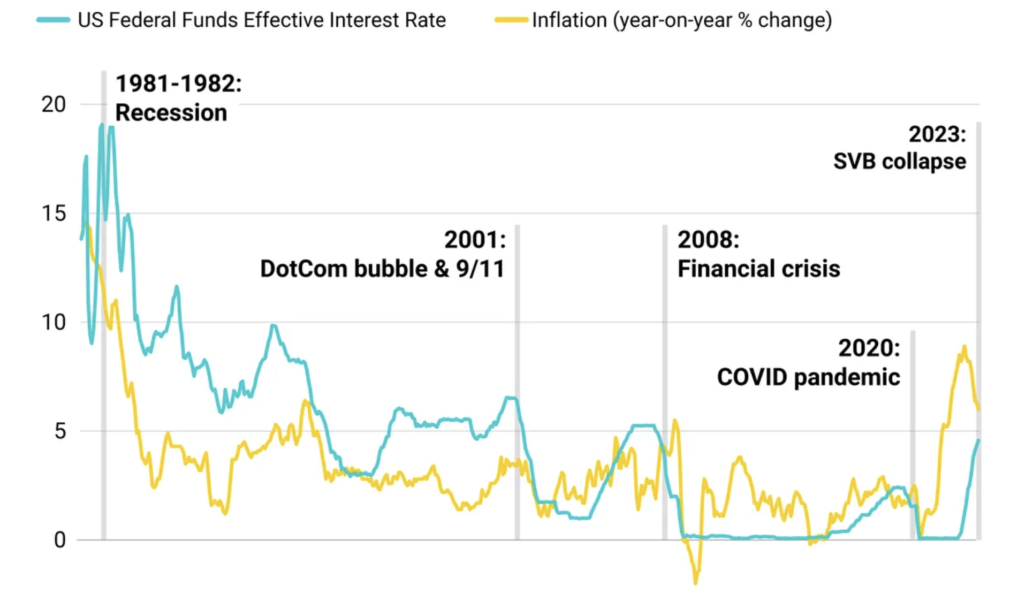
Interest Rate

Slide 16
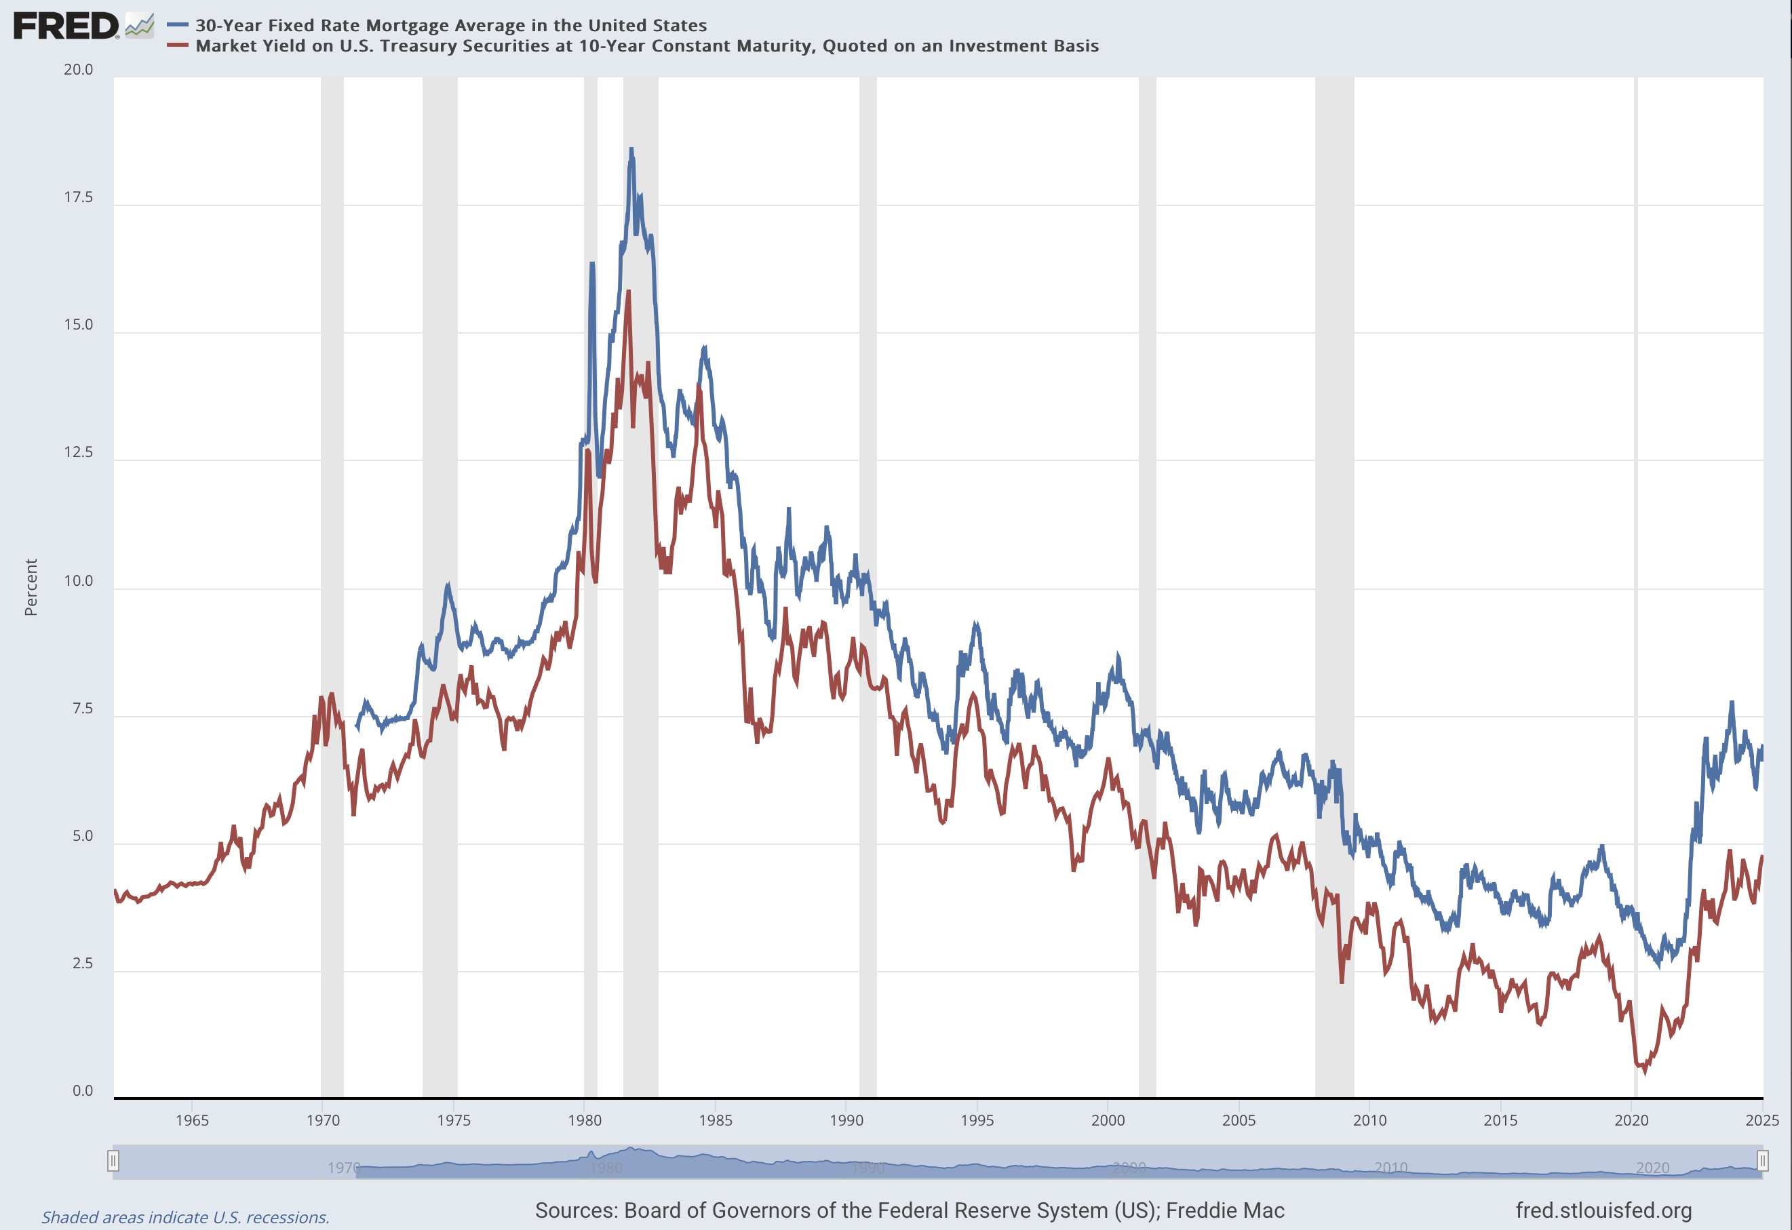
Mortgage Rate

Slide 17
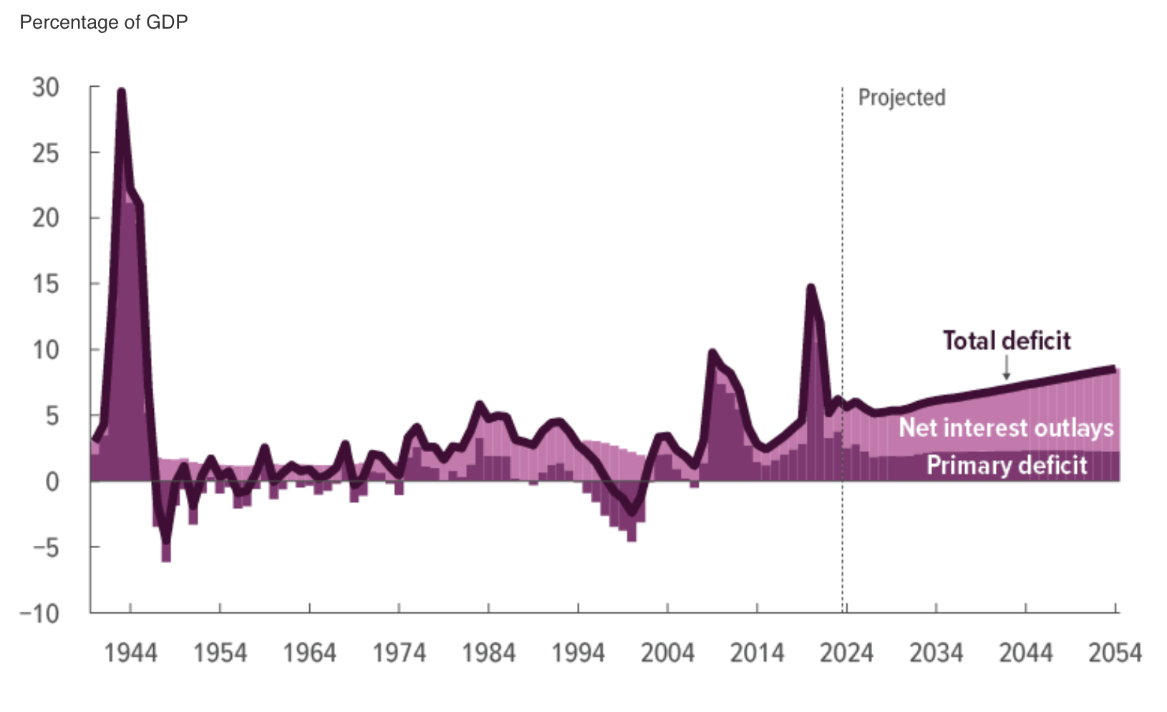
Government Deficit

Slide 18
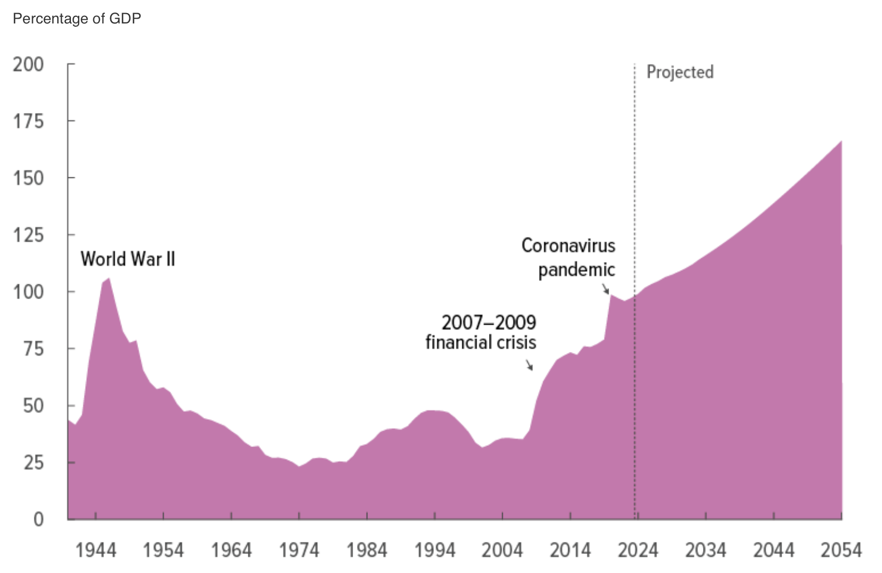
Public Debt

Slide 19
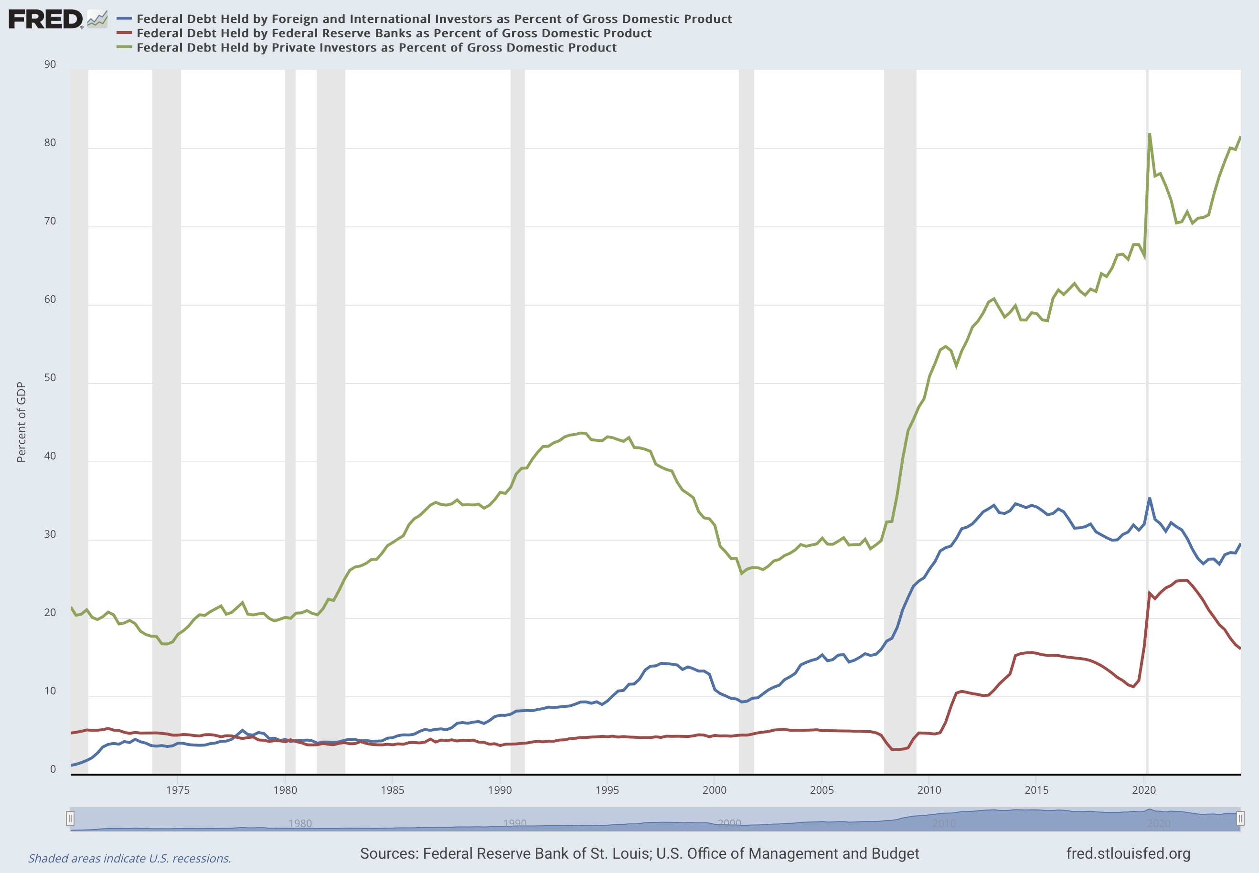
Who Own US Debt

Slide 20
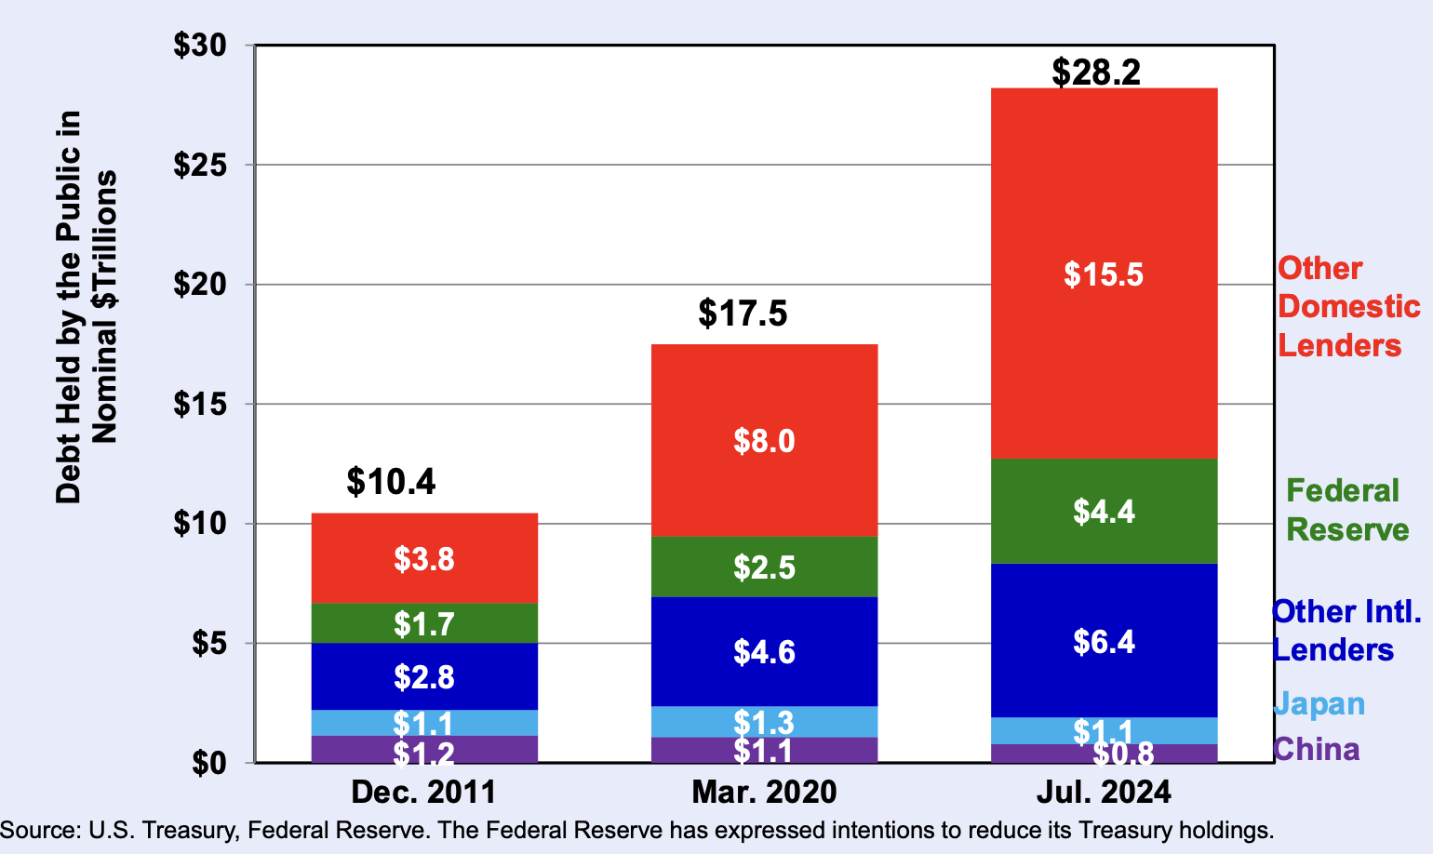
Who Own US Debt

Slide 21
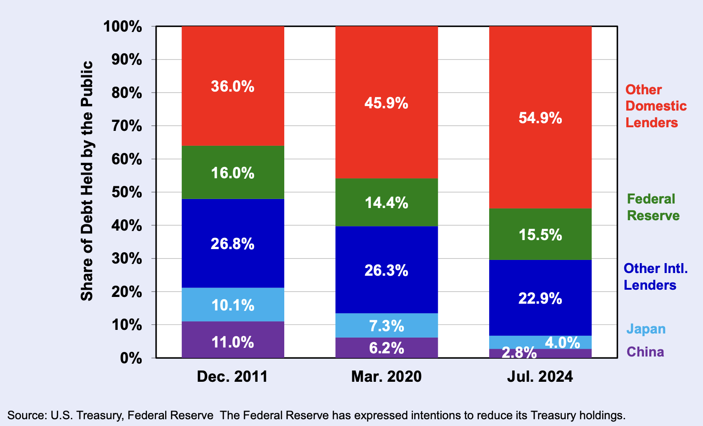
Who Own US Debt

Slide 22
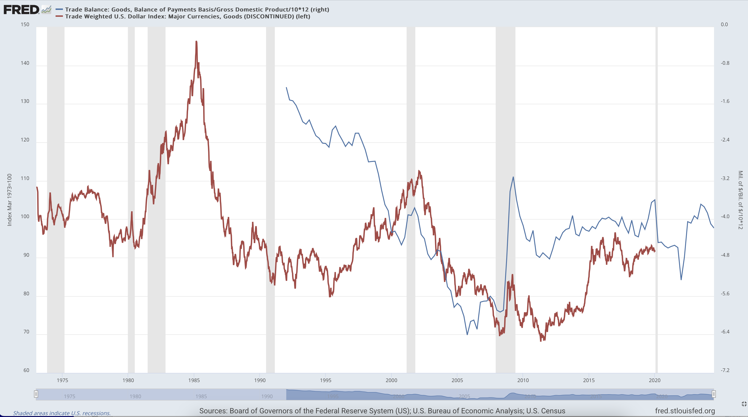
US Trade Balance

Slide 23
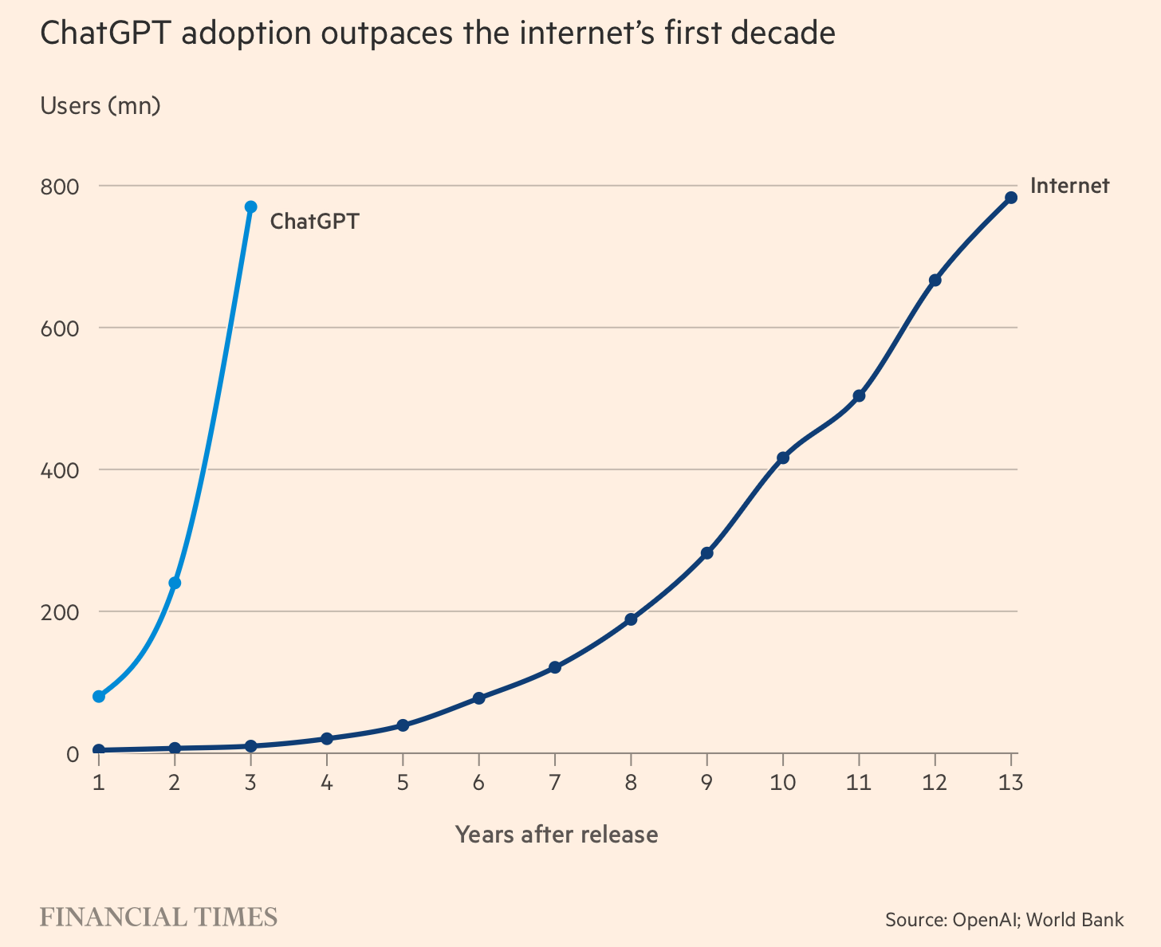

Slide 24
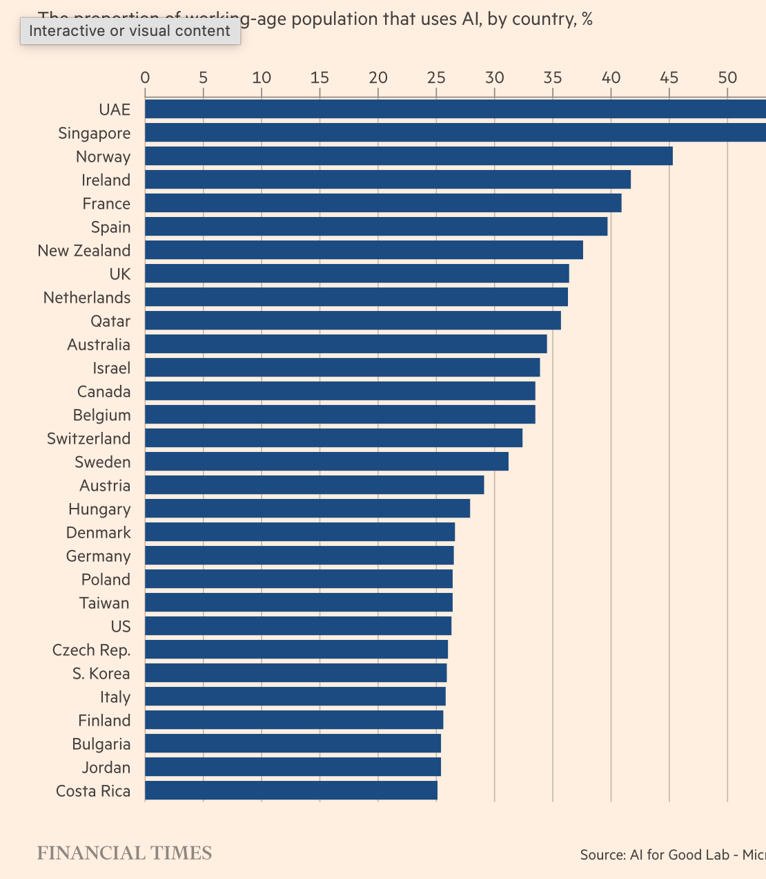

Slide 25
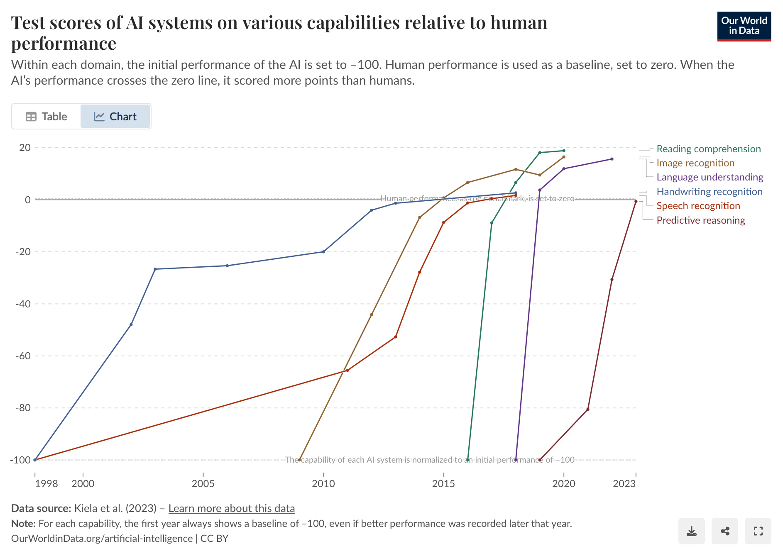

Slide 26
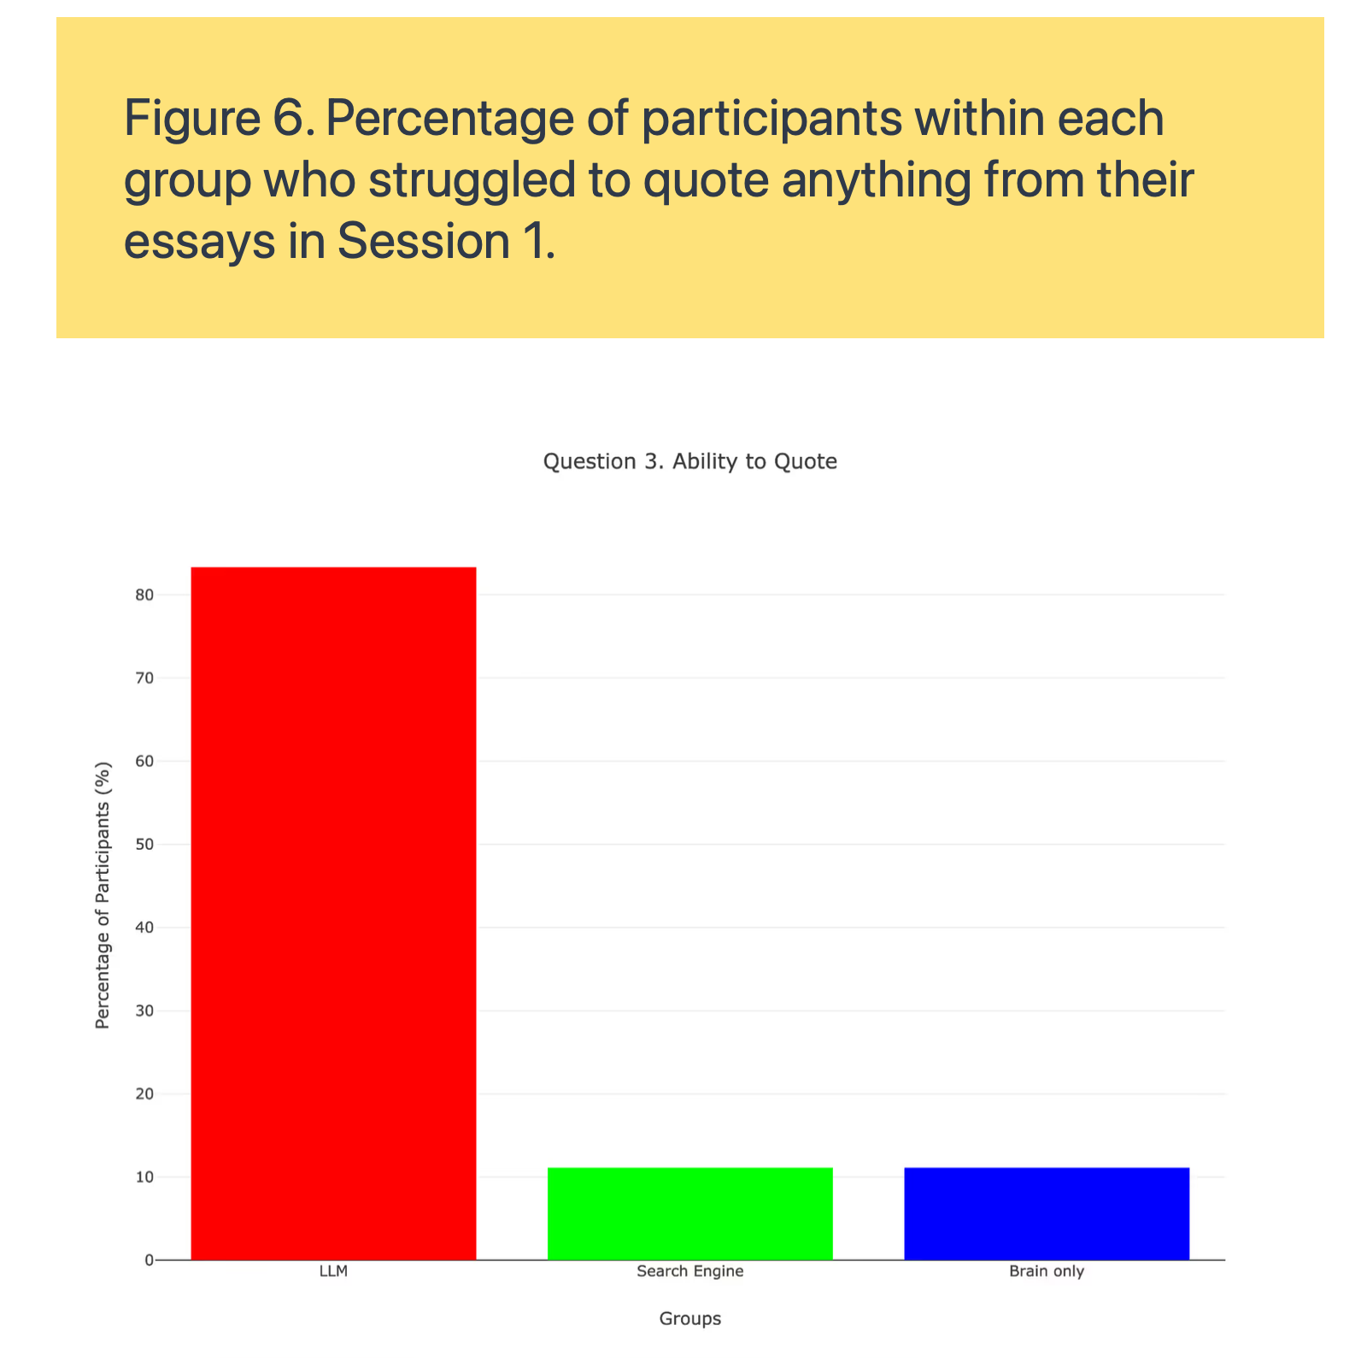

Slide 27
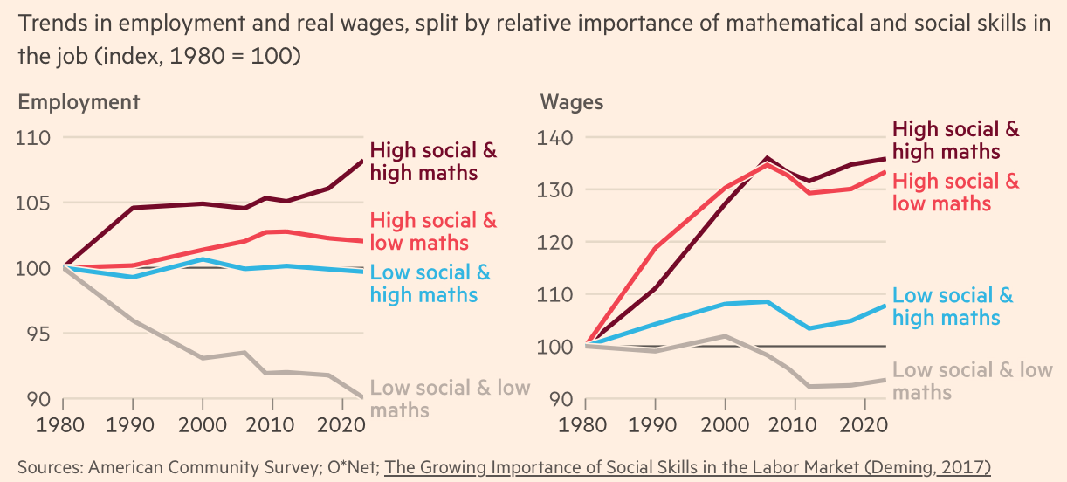

Slide 28
What is Macroeconomics
Models built to explain macroeconomic phenomena.
Examples of issues:
Why are so many countries poor?
Why are millions of people unemployed?
What makes people unequal in income and wealth?
Why are there recession? Can the government do anything to combat recession? Should it?
To summarize: long-run growth and business cycles.

Slide 29
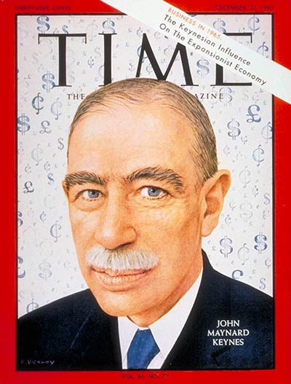
Birth of modern macroeconomics

Slide 30
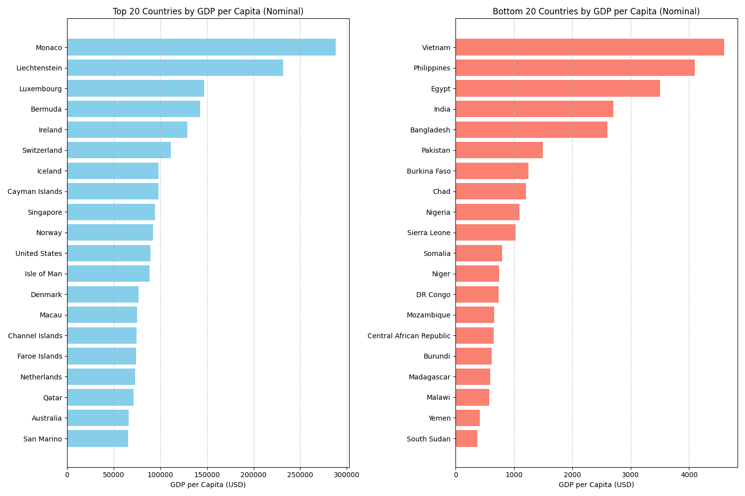
Why should we care about Macroeconomics?

Slide 31
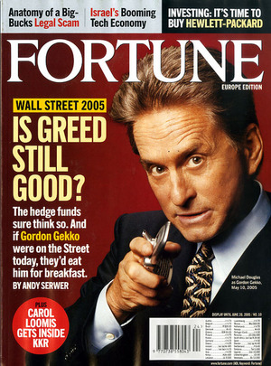
Why should we care about Macroeconomics?

Slide 32

Why should we care about Macroeconomics?

Slide 33
What do Macroeconomists do?
There are three types of macroeconomists:
Forecasters:
predict how inflation, GDP or stock markets will perform in the short run. Unfortunately economists are pretty bad at predicting the short run, even worse than meteorologists.
Analysts:
private sector: interpret current economic events and inform the decision of an investment bank to, consulting firms.
public sector: inform the government on what are the right policies, given a certain political objective that wants to be reached.
Researchers:
developing new models or validating or falsifying existing ones.

Slide 34
List of Topics
Review of Some Key Concepts From Microeconomics
National Income Accounting
Labor market
Macroeconomics: The Big Picture
Economic Growth
The Keynesian Model
Macroeconomic Equilibrium
Economic Policies

