Slide 1
Economics 2220 Principles Of Macroeconomics
Professor Zhigang Feng
Lecture 3:
Economic Basis for trade

Slide 2
Absolute advantage
Comparative advantage
Gain from trade
To First
Active Learning
To Video

Slide 3
COMPARATIVE ADVANTAGE AND GAINS FROM TRADE
Theory of Comparative Advantage:
It makes sense to produce the things you’re especially good at producing… and buy everything else from others.

Slide 4
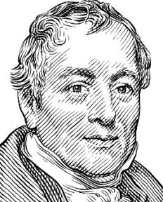
ORIGIN OF THE IDEA
David Ricardo (1772–1823)
Argued against Corn Laws in British Parliament.
Corn Laws: high tariffs on imported grain that protected British landowners.
His theory of comparative advantage is still the ideological foundation for free trade.

Slide 5
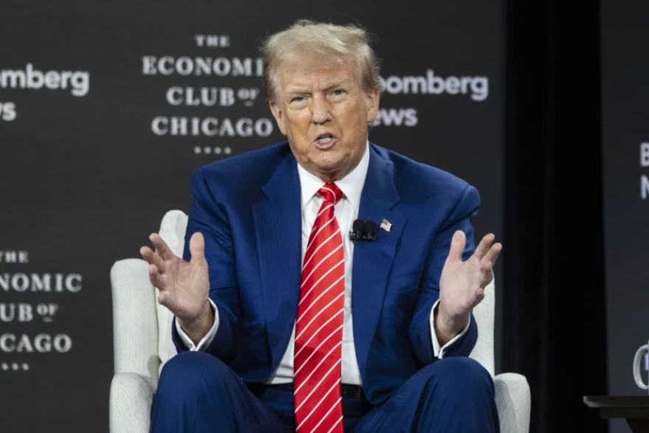
ORIGIN OF THE IDEA
Donald J Trump
To me, the most beautiful word in the dictionary is tariff. And it's my favorite word.
October 16, 2024

Slide 6



COMPARATIVE ADVANTAGE AND GAINS FROM TRADE
Suppose that there are just two goods, computers and shirts, and one input, labor.

Slide 7



COMPARATIVE ADVANTAGE AND GAINS FROM TRADE
Assume that in Mexico, it takes 12 units of labor to make one computer and 2 units of labor to produce one shirt

Slide 8



COMPARATIVE ADVANTAGE AND GAINS FROM TRADE
Suppose that Mexico has 24 units of labor. It can produce 2 computers and 0 shirts…
or 0 computers and 12 shirts

Slide 9


COMPARATIVE ADVANTAGE AND GAINS FROM TRADE
The PPF is about trade-offs.
If Mexico wants to produce more shirts, it must produce fewer computers.
Each computer “costs” 12 workers,
who could produce 6 shirts.
So a computer “costs” 6 shirts in Mexico.

Slide 10




COMPARATIVE ADVANTAGE AND GAINS FROM TRADE
AND…
Each shirt “costs” 2 workers,
who could produce one-sixth of a computer.
So a shirt “costs” one-sixth of a computer in Mexico.
1/6

Slide 11
COMPARATIVE ADVANTAGE AND GAINS FROM TRADE
Mexico’s Production Possibilities Frontier
Computers
6
Production Possibilities
Computers | Shirts
2 | 0
1 | 6
0 | 12
5
The PPF
4
3
The slope = the trade-off (“cost”) of one good for the other. (One-sixth of a computer = 1 shirt: 1 shirt “costs” 6 computers.)
2
1
2
4
6
8
10
12
Shirts

Slide 12
Erin has a choice between two activities: She can repair one transmission per hour or she can repair two fuel injectors per hour. What is the opportunity cost of repairing one fuel injector?
1 transmission
0.5 transmission
2 transmissions
To Next
Active Learning
Notes:
Correct answer is B

Slide 13
David can write either one more book this year or five more articles this year. What is the opportunity cost of writing half of a book this year, in terms of articles?
0.2 article
1 article
2.5 articles
10 articles
To Next
Active Learning
Notes:
Correct answer is C

Slide 14
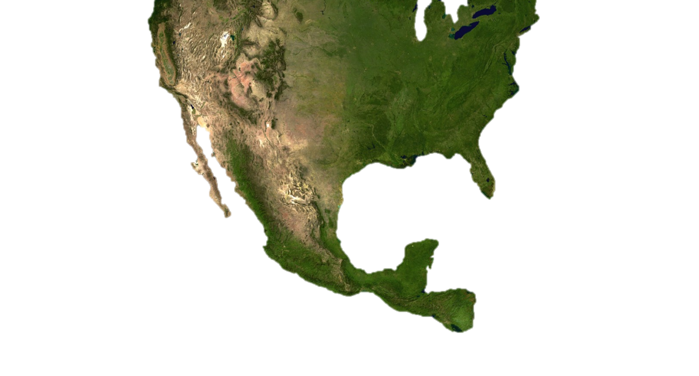



COMPARATIVE ADVANTAGE AND GAINS FROM TRADE
Enter the U.S. with its own production and cost ratios.

Slide 15





COMPARATIVE ADVANTAGE AND GAINS FROM TRADE
Assume that in the United States, there are 24 units of labor, and it takes 1 unit of labor to produce either good.

Slide 16
COMPARATIVE ADVANTAGE AND GAINS FROM TRADE
Each shirt “costs” 1 worker,
who could produce 1 computer.
So a shirt “costs” 1 computer in the United States.

Slide 17




COMPARATIVE ADVANTAGE AND GAINS FROM TRADE
Summary of costs: each country has a different opportunity cost for each good.
Take a look at the opportunity costs for computers:
Would there be a benefit to trade?
If so, who should produce what?

Slide 18
COMPARATIVE ADVANTAGE AND GAINS FROM TRADE
A country has a comparative advantage in producing goods for which it has the lowest opportunity cost.
The U.S. has the comparative advantage in (is the lower-cost producer of) computers: Each computer costs 1 shirt. (Mexico = 6 shirts.)
Mexico has the comparative advantage in (is the lower-cost producer of) shirts: Each shirt costs one-sixth of a computer. (United States = 1 computer.)

Slide 19
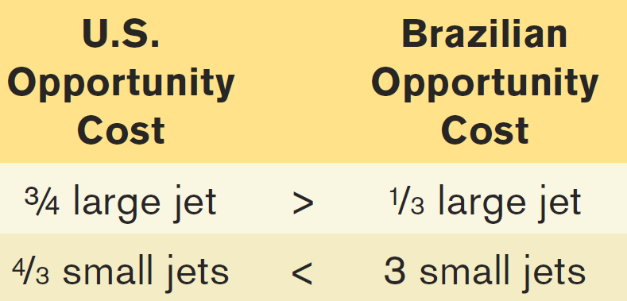
COMPARATIVE ADVANTAGE AND GAINS FROM TRADE
(a) U.S. Production Possibilities
(b) Brazilian Production Possibilities
Quantity of
large jets
Quantity of
large jets
30
U.S. consumption
without trade
18
Brazilian consumption
without trade
10
8
U.S.
PPF
Brazilian
PPF
0
16
40
0
6
30
Quantity of small jets
Quantity of small jets
Since each country has a different opportunity cost, it makes sense to specialize and trade…

Slide 20
COMPARATIVE ADVANTAGE AND GAINS FROM TRADE
(a) U.S. Production Possibilities
(b) Brazilian Production Possibilities
Quantity of
large jets
If the U.S. specializes in large jets…
Quantity of
large jets
And Brazil specializes in small jets…
30
U.S. consumption
without trade
18
Brazilian consumption
without trade
10
8
U.S.
PPF
Brazilian
PPF
0
16
40
0
6
30
Quantity of small jets
Quantity of small jets
More airplanes will be produced with the same resources (up from 26 (18 + 8) to 30 large jets and up from 22 (16+6) to 30 small jets).

Slide 21
COMPARATIVE ADVANTAGE AND GAINS FROM TRADE
Both countries gain.
(a) U.S. Production Possibilities
(b) Brazilian Production Possibilities
Then the U.S. will send some large jets to Brazil in return for small jets…
And Brazil will send some small jets to the U.S. in return for large jets…
Quantity of
large jets
Quantity of
large jets
30
U.S. consumption
without trade
U.S. consumption
with trade
20
Both are happy with 1 large jet trading for 2 small jets.
Brazilian consumption
without trade
18
10
Brazilian consumption
with trade
8
U.S.
PPF
Brazilian
PPF
0
16
20
40
0
6
10
30
Quantity of small jets
Quantity of small jets
Both countries will be happy to export their goods for any price ABOVE their cost of production and import for any price BELOW their cost of production.

Slide 22
COMPARATIVE ADVANTAGE VS. ABSOLUTE ADVANTAGE
Absolute advantage: a country can produce more output per worker than other countries.
(a) U.S. Production Possibilities
(b) Brazilian Production Possibilities
Quantity of
large jets
Quantity of
large jets
U.S. has the absolute advantage in BOTH large and small jets.
30
10
U.S.
PPF
Brazilian
PPF
0
40
0
30
Quantity of small jets
Quantity of small jets

Slide 23

Don’t confuse absolute with comparative advantage.
Just because the United States can produce more of both goods doesn’t mean we’re better off without trade.
Pay attention to opportunity costs:
If it’s cheaper for Brazil to produce small jets than it is for the United States, the United States will want to import small jets from Brazil.

Slide 24
If Texia specializes in food, it can produce 1,000 units of food and 0 units of clothing this year. If it specializes in clothing, it can produce 500 units of clothing and 0 units of food. This year Urbania can produce either 500 units of food and 0 units of clothing or 200 units of clothing and 0 units of food. (assume linear production possibility frontiers)
_______has the absolute advantage in the production of clothing and ________has the absolute advantage in the production of food.
Texia; Texia
Texia; Urbania
Urbania; Texia
Urbania; Urbania
To Next
Active Learning
Notes:
A is the correct answer.

Slide 25
If Texia specializes in food, it can produce 1,000 units of food and 0 units of clothing this year. If it specializes in clothing, it can produce 500 units of clothing and 0 units of food. This year Urbania can produce either 500 units of food and 0 units of clothing or 200 units of clothing and 0 units of food. (assume linear production possibility frontiers)
_______has the comparative advantage in the production of clothing and ________has the comparative advantage in the production of food.
Texia; Texia
Texia; Urbania
Urbania; Texia
Urbania; Urbania
To Next
Active Learning
Notes:
A is the correct answer.

Slide 26
If a country specializes according to its own comparative advantage and then trades with other nations:
it will operate at a point inside its production possibilities frontier.
it can consume at a higher level than the domestic production possibilities frontier.
its production possibilities frontier will shift or rotate inward.
it can consume at the same level as the domestic production possibilities frontier.
To Next
Active Learning
Notes:
Correct answer is B

Slide 27
Write down, then discuss with a partner:
What do you think? Would the U.S. economy be better off if we did not import so much clothing from Bangladesh?
List the groups who you think would gain and the groups who would lose if Bangladesh clothing imports were restricted.
To Next
Active Learning
Notes:
Use this as a “Think, Pair, Share” Activity.

Slide 28
Factor | Benefit of Restrictions | Cost of Restrictions
Jobs | Potential U.S. manufacturing jobs | Higher consumer prices, job losses in retail/logistics
Prices | – | Inflation in apparel (10–30% price hikes estimated)
Global Equity | – | Harm to Bangladeshi workers (avg. wage: $113/month)
Supply Chain Resilience | Reduced reliance on distant suppliers | Increased vulnerability to domestic production shocks
To Next
Active Learning
Notes:
Use this as a “Think, Pair, Share” Activity.

Slide 29
Suppose that in Australia, it takes 2 hours to harvest 10 bushels of apples and 4 hours to harvest 10 bushels of tomatoes. Suppose a worker in Brazil can harvest 10 bushels of apples in 4 hours or 10 bushels of tomatoes in 5 hours. Which of these statements is TRUE?
Brazil has a comparative advantage in producing tomatoes.
Brazil has a comparative advantage in producing apples.
Brazil has an absolute advantage in producing both goods.
In trade between these two countries, Australia would gain and Brazil would lose.
To Next
Active Learning
Notes:
This a more difficult question because it requires a two-step calculation of cost. A is correct. In Australia, the opportunity cost of harvesting 10 bushels of tomatoes is 20 bushels of apples. In Brazil, the opportunity cost of harvesting 10 bushels of tomatoes is 12.5 bushels of apples. Australia has the absolute advantage in both goods, but also exhibits the higher opportunity cost of growing tomatoes.

Slide 30

Take a look at how NAFTA works by clicking here or on the picture below. (5:54 minutes)
To Next
Active Learning
Notes:
This a more difficult question because it requires a two-step calculation of cost. A is correct. In Australia, the opportunity cost of harvesting 10 bushels of tomatoes is 20 bushels of apples. In Brazil, the opportunity cost of harvesting 10 bushels of tomatoes is 12.5 bushels of apples. Australia has the absolute advantage in both goods, but also exhibits the higher opportunity cost of growing tomatoes.

