Slide 1
Economics 2220 Principles Of Macroeconomics
Professor Zhigang Feng
Lecture 4:
Demand and Supply

Slide 2
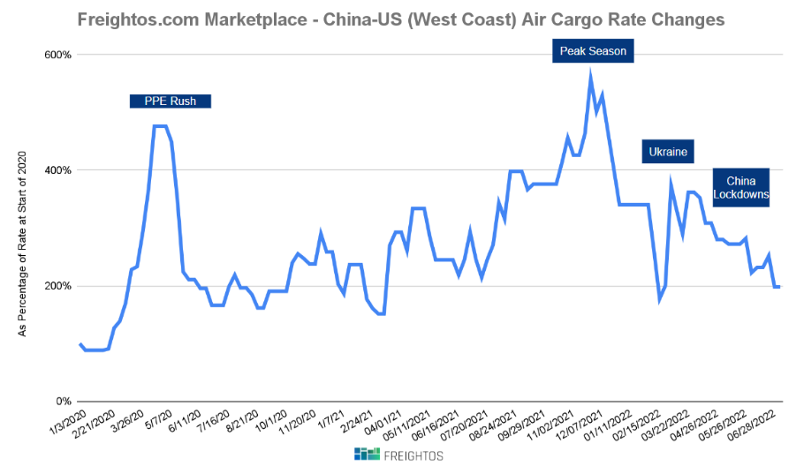

Slide 3
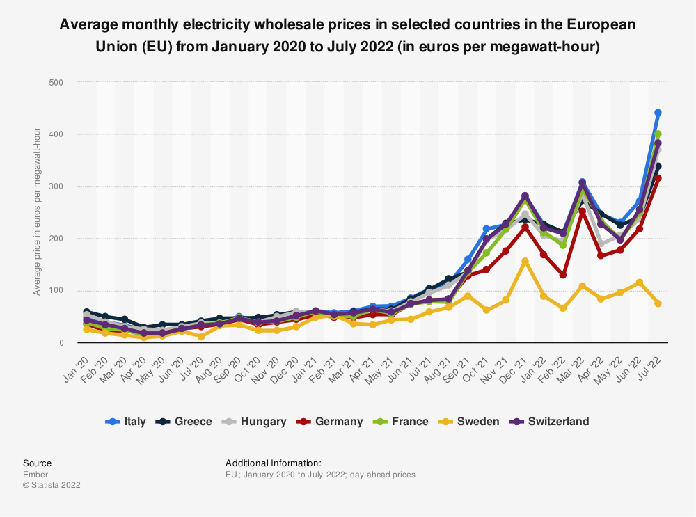

Slide 4

What is a competitive market ? How is it described by the supply and demand model?
What is a demand curve? What is a supply curve?
What’s the difference between movements along a curve and shifts of a curve?
How do supply and demand curves determine a market’s equilibrium price and equilibrium quantity?
If there’s a shortage or surplus, how does price moves the market back to equilibrium?
To First
Active Learning
To Video

Slide 5
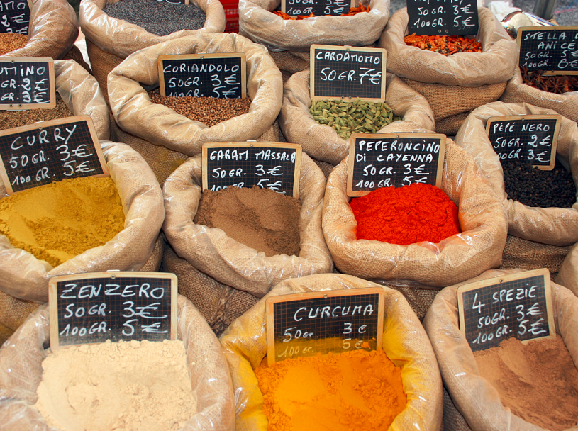
COMPETITIVE MARKETS
A competitive market has many buyers and sellers of the same good or service, none of whom can influence the price.
The supply and demand model is a model of how a competitive market behaves.
Notes:
All image credits courtesy of Morgue File and/or FreeImages.com unless otherwise specified

Slide 6


DEMAND
What made him buy it?
Demand represents the behavior of buyers.
A demand curve shows the quantity demanded at various prices.
The quantity demanded: the quantity that buyers are willing (and able) to purchase at a particular price.
Back to Table of contents
Notes:
All image credits courtesy of Morgue File and/or FreeImages.com unless otherwise specified

Slide 7
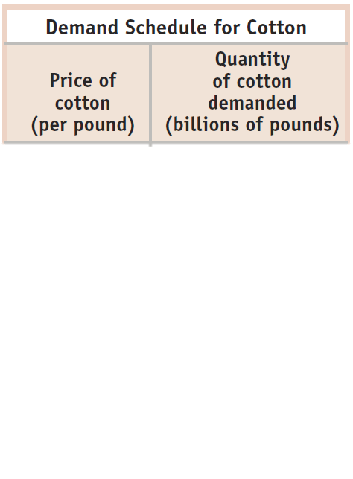














THE DEMAND SCHEDULE AND THE DEMAND CURVE
Price of cotton
(per pound)
$2.00
1.75
1.50
1.25
1.00
0.75
As price falls, the quantity demanded rises
Demand curve, D
0.50
0
7
9
11
13
15
17
Quantity of cotton
(per pound)

Slide 8

Don’t be sloppy in terminology:
a “change in demand”
a “change in quantity demanded”
Back to Table of contents

Slide 9
CHANGES IN DEMAND VS. CHANGES IN QUANTITY DEMANDED
Change in demand
Change in quantity demanded
Price
Price
$1.00
$1.00
D₂
.50
D₁
D₁
10
15
10
14.2
Quantity
Quantity
Back to Table of contents

Slide 10

THE DEMAND SCHEDULE AND THE DEMAND CURVE
The Law of demand: a higher price for a good or service leads people to demand a smaller quantity.
Notes:
All photo credits unless otherwise noted from Freeimages.com (Formerly Stockxchange) or Morguefile.com

Slide 11
SHIFTS OF THE DEMAND CURVE
A decrease in demand is a leftward shift.
Price per unit
Lower willingness to pay for the same quantity
$2
Less quantity demanded at the same price
$1
D1
D2
7
8
Quantity
Back to Table of contents

Slide 12
SHIFTS OF THE DEMAND CURVE
An increase in demand is a rightward shift.
Price per unit
Greater willingness to pay for the same quantity
$2
Greater quantity demanded at the same price
$1
D2
D1
10
15
Quantity
Back to Table of contents

Slide 13
UNDERSTANDING SHIFTS OF THE DEMAND CURVE
Important demand shifters:
Changes in the prices of related goods or services
Changes in income
Changes in tastes
Changes in expectations
Changes in the number of consumers
Back to Table of contents

Slide 14


CHANGES IN PRICE OF RELATED GOODS: SUBSTITUTES
Two goods are substitutes if a decrease in the price of one leads to a decrease in demand for the other (or vice versa).
What happens to the demand for travel in Hawaii if the (perceived) safety cost of traveling to Mexico increases?
Back to Table of contents
Notes:
All photo credits unless otherwise noted from Freeimages.com (Formerly Stockxchange) or Morguefile.com

Slide 15

CHANGES IN PRICE OF RELATED GOODS: COMPLEMENTS
Two goods are complements if a decrease in the price of one good leads to an increase in the demand for the other (or vice versa).
Consumers often have to buy goods together.
An increase in price of gasoline will decrease the demand for SUVs.
Back to Table of contents
Notes:
All photo credits unless otherwise noted from Freeimages.com (Formerly Stockxchange) or Morguefile.com

Slide 16

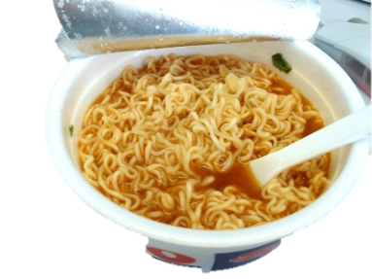
CHANGES IN INCOME
The effect of changes in income on demand depends on the nature of the good in question.
A normal good: Demand increases when income increases (and vice versa).
An inferior good: Demand decreases when income increases (and vice versa).
Back to Table of contents
Notes:
All photo credits unless otherwise noted from Freeimages.com (Formerly Stockxchange) or Morguefile.com

Slide 17

CHANGES IN TASTES
Tastes and preferences are subjective and vary among consumers.
Seasonal changes or fads have a predictable effects on demand.
What happens to demand for Face Mask in 2020?
Back to Table of contents
Notes:
All photo credits unless otherwise noted from Freeimages.com (Formerly Stockxchange) or Morguefile.com

Slide 18

CHANGES IN EXPECTATIONS
If consumers have a choice about the timing of a purchase, they buy according to expectations.
Buyers adjust current spending in anticipation of the direction of future prices in order to obtain the lowest possible price.
If prices for Xbox one are expected to drop right before Christmas, what will happen to sales during November?
Back to Table of contents
Notes:
All photo credits unless otherwise noted from Freeimages.com (Formerly Stockxchange) or Morguefile.com

Slide 19
When the price of petroleum goes up, the demand for natural gas ______, the demand for coal ______, and the demand for solar power ______. (Assume these goods are substitutes for petroleum.)
increases; increases; increases
increases; increases; decreases
decreases; decreases; increases
decreases; decreases; decreases
To Next
Active Learning
Back to Table of contents
Notes:
Correct answer is A

Slide 20
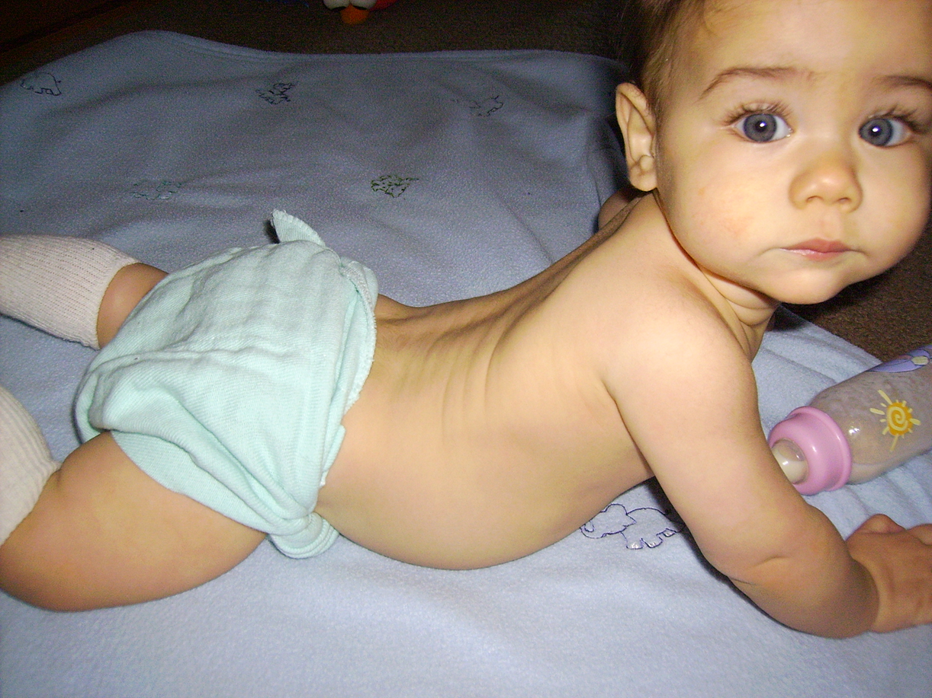
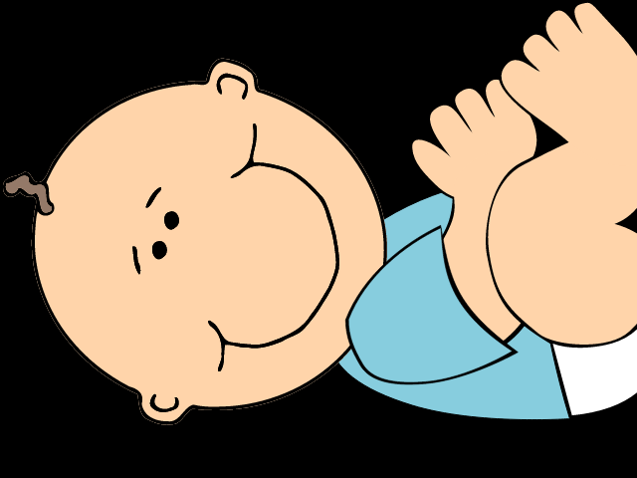
CHANGES IN THE NUMBER OF CONSUMERS
As the population of an economy changes, the number of buyers of a particular good also changes (thereby changing its demand).
What happens to the demand for diapers in Russia as birth rates drop?
Back to Table of contents
Notes:
All photo credits unless otherwise noted from Freeimages.com (Formerly Stockxchange) or Morguefile.com

Slide 21
Which of the following will cause an increase in the demand for autos?
Price of car tires increases because of a Malaysian rubber shortage.
Concrete steel reinforcing rods are replaced by aluminum along the Atlantic coast to prevent rusting.
Gasoline prices drop by 50% when OPEC nations increase production.
McDonald’s increases its hamburger production in response to consumer trends.
To Next
Active Learning
Back to Table of contents
Notes:
Correct answer is C

Slide 22
INDIVIDUAL DEMAND CURVES AND THE MARKET DEMAND CURVE
(a) Darla’s individual demand curve
(b) Dino’s individual demand curve
(c) Market demand curve
Price of blue jeans (per pair)
Price of blue jeans (per pair)
Price of blue jeans (per pair)
$2
+
$2
=
$2
D
Market
1
1
1
D
Darla
D
Dino
0
20
30
0
10
20
0
30
40
50
Quantity of blue jeans (per pair)
Quantity of blue jeans (per pair)
Quantity of blue jeans (per pair)

Slide 23

Take a look at how the market (legal AND illegal) for kidneys works by clicking here or on the picture below. (Law and Order SVU) (6:18 minutes)
Notes:
http://criticalcommons.org/Members/gdmateer/clips/the_office_moroccan_christmas_final2.m4v/view?searchterm=the%20office

Slide 24
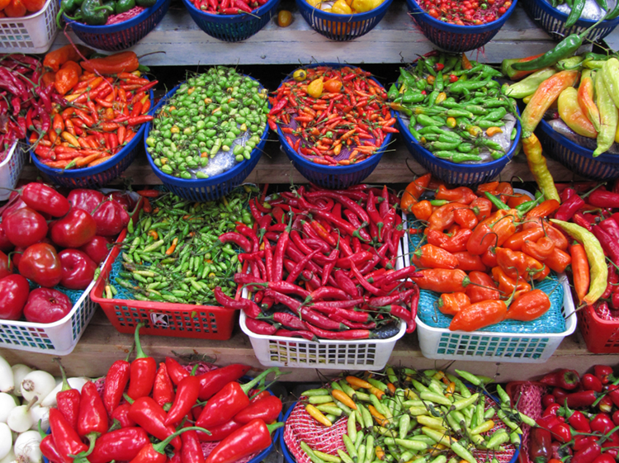
SUPPLY
Supply represents the behavior of sellers.
A supply curve shows the quantity supplied at various prices.
The quantity supplied is the quantity that producers are willing and able to sell at a particular price.
Back to Table of contents
Notes:
All photo credits unless otherwise noted from Freeimages.com (Formerly Stockxchange) or Morguefile.com

Slide 25
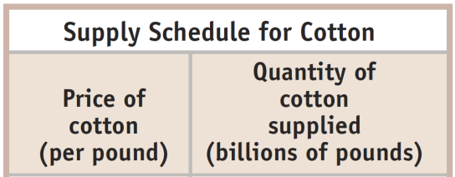

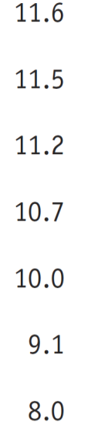
THE SUPPLY SCHEDULE AND THE SUPPLY CURVE
Price of cotton
(per pound)
Supply curve, S
$2.00
1.75
As price rises, the quantity supplied rises.
1.50
1.25
1.00
0.75
0.50
0
7
9
11
13
15
17
Quantity of cotton (per pound)

Slide 26
AN INCREASE IN SUPPLY
Price of coffee beans (per pound)
S
1
S
2
$2.00
A movement along the supply curve…
1.75
1.50
1.25
1.00
… is not the same thing as a shift of the supply curve.
0.75
0.50
0
7
9
11
13
15
17
Quantity of coffee beans (billions of pounds)

Slide 27
SHIFTS OF THE SUPPLY CURVE
An increase in supply means a rightward shift of the supply curve.
Price
S
3
S
1
S
2
Increase in supply
A decrease in supply means a leftward shift of the supply curve.
Decrease in supply
Quantity

Slide 28
UNDERSTANDING SHIFTS OF THE SUPPLY CURVE
Important supply shifters include changes in:
input prices.
the prices of related goods or services.
technology.
expectations.
the number of producers.
Back to Table of contents
Notes:
Instructor Notes:

Slide 29

CHANGES IN INPUT PRICES
A decrease in the price of an input (all else equal) increases profits and encourages more supply (and vice versa).
What will happen to the number of new businesses if the government reduces the fees and red tape associated with new business licenses? What happens if the fees rise?
Back to Table of contents
Notes:
All photo credits unless otherwise noted from Freeimages.com (Formerly Stockxchange) or Morguefile.com

Slide 30
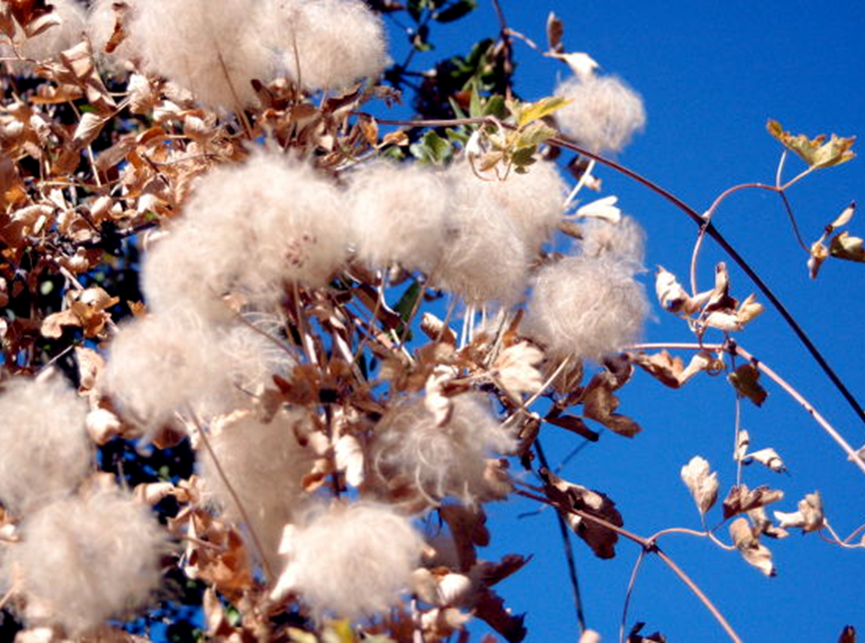
CHANGES IN INPUT PRICES
When the price of cotton drops, the supply of
blue jeans increases.
Back to Table of contents
Notes:
All photo credits unless otherwise noted from Freeimages.com (Formerly Stockxchange) or Morguefile.com

Slide 31

CHANGES IN THE PRICE OF RELATED GOODS OR SERVICES
Inputs used in production have opportunity costs. Sellers will choose to use inputs whose profit is the highest.
Sellers will supply less of a good if its profitability falls (and vice versa).
There are substitutes and complements in production processes.
Complement in pork processing? Lard.
Substitute in corn production? Cotton.
Back to Table of contents
Notes:
All photo credits unless otherwise noted from Freeimages.com (Formerly Stockxchange) or Morguefile.com

Slide 32
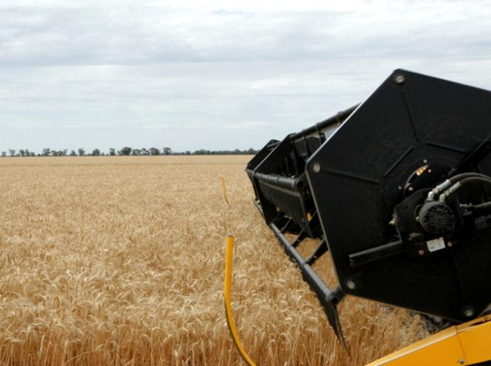
CHANGES IN TECHNOLOGY
New, better technology makes sellers willing to offer more at a given price or sell their quantity at a lower price.
A technological innovation lowers costs and increases supply.
Back to Table of contents
Notes:
All photo credits unless otherwise noted from Freeimages.com (Formerly Stockxchange) or Morguefile.com

Slide 33

CHANGES IN EXPECTATIONS
The expectation of a higher price for a good in the future decreases current supply of the good – if they can store the good (and vice versa).
Sellers will adjust their current offerings in anticipation of the direction of future prices in order to obtain the highest possible price.
Back to Table of contents
Notes:
All photo credits unless otherwise noted from Freeimages.com (Formerly Stockxchange) or Morguefile.com

Slide 34

CHANGES IN EXPECTATIONS
A change in producers’ expectations about profitability will affect supply curves.
Windmill production increases as producers expect sales and profitability to increase.
Back to Table of contents
Notes:
All photo credits unless otherwise noted from Freeimages.com (Formerly Stockxchange) or Morguefile.com

Slide 35
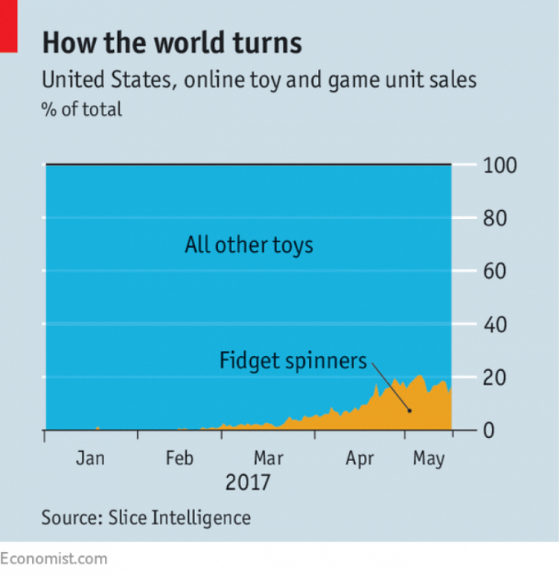

CHANGES IN EXPECTATIONS
The lessons of fidget spinners
Big retailers usually plan their inventory as much as 18 months ahead of peak seasons such as summer or Christmas.
So it was easy for big retailers to miss the eruption of fidget spinners online. (Subsequently they reacted as well as they could, ordering spinners in by air freight.)
Back to Table of contents
Notes:
All photo credits unless otherwise noted from Freeimages.com (Formerly Stockxchange) or Morguefile.com

Slide 36

CHANGES IN NUMBER OF PRODUCERS
As producers enter and exit the market, the overall supply changes.
Entry implies more sellers in the market, increasing supply.
Exit implies fewer sellers in the market, decreasing supply.
As more firms enter the solar installation market, the number of solar installations available for sale increases.
Back to Table of contents
Notes:
All image credits courtesy of Morgue File and/or FreeImages.com unless otherwise specified

Slide 37
THE INDIVIDUAL SUPPLY CURVE AND THE MARKET SUPPLY CURVE
Price of cotton (per pound)
(a) Mr. Silva’s individual supply curve
Price of cotton (per pound)
(b) Mr. Liu’s individual supply curve
Price of cotton (per pound)
(c) Market supply curve
S
S
S
Market
$2
Silva
$2
Liu
$2
+
=
1
1
1
0
1
2
3
0
1
2
0
1
2
3
4
5
Quantity of coffee beans (pounds)
Quantity of coffee beans (pounds)
Quantity of coffee beans (pounds)

Slide 38
SUPPLY, DEMAND AND MARKET EQUILIBRIUM
When Q_{s} = Q_{d} at a certain price, the market is in equilibrium.
That is, the amount consumers would purchase at this price is matched exactly by the amount producers wish to sell.
Back to Table of contents

Slide 39

Because there are middlemen who bring goods to market (and get paid for their efforts), the price that wholesale cotton farmers (sellers) receive will actually be less than the price paid by retail cotton buyers.
But have no fear: the final price paid to retail sellers will match that paid by retail buyers at equilibrium.

Slide 40
FINDING THE EQUILIBRIUM PRICE AND QUANTITY
Price of cotton (per pound)
Market equilibrium occurs at point E, where the supply curve and the demand curve intersect.
Supply
$2.00
1.75
1.50
1.25
Equilibrium price
E
Equilibrium
1.00
0.75
0.50
Demand
0
7
10
13
15
17
Equilibrium quantity
Quantity of cotton (billions of pounds)

Slide 41
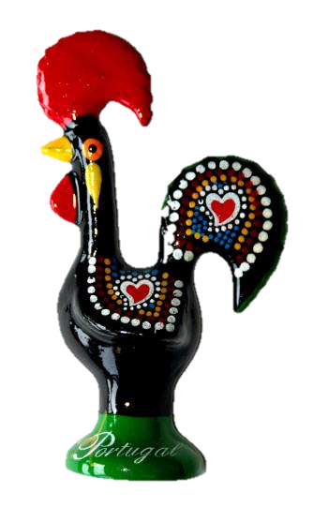
WHY DO ALL SALES AND PURCHASES IN A MARKET TAKE PLACE AT THE SAME PRICE?
Where consumers don’t have time to compare prices (like a tourist trap), different stores have different prices.
In well-established markets, there is a uniform price.
Notes:
All image credits courtesy of Morgue File and/or FreeImages.com unless otherwise specified

Slide 42
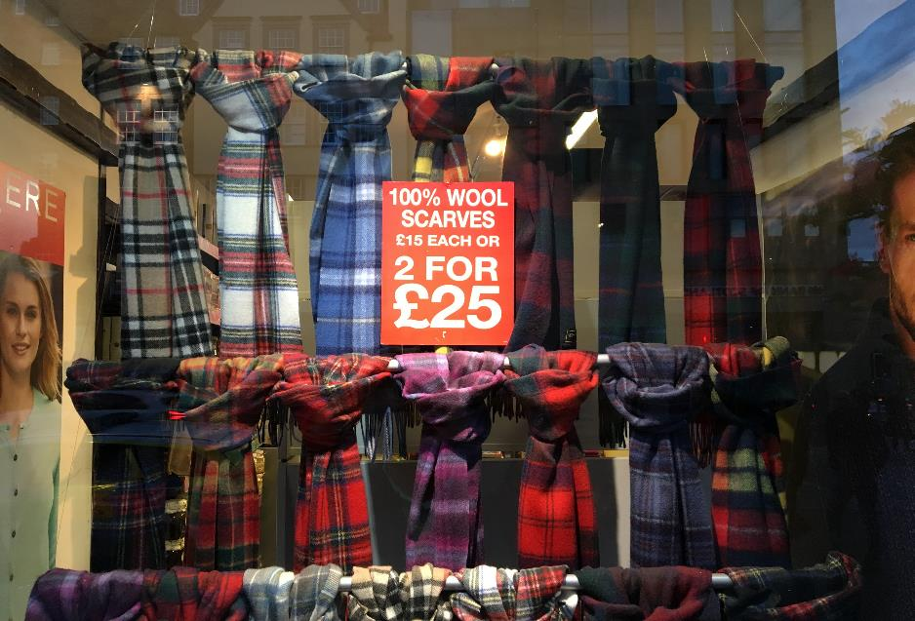
WHY DO ALL SALES AND PURCHASES IN A MARKET TAKE PLACE AT THE SAME PRICE?
Where consumers don’t have time to compare prices (like a tourist trap), different stores have different prices.
Notes:
All image credits courtesy of Morgue File and/or FreeImages.com unless otherwise specified

Slide 43
WHY DOES THE MARKET PRICE FALL IF IT IS ABOVE THE EQUILIBRIUM PRICE?
Price of cotton (per pound)
There is a surplus of a good when the quantity supplied exceeds the quantity demanded. Surpluses occur when the price is above its equilibrium level.
Supply
$2.00
1.75
Surplus
1.50
1.25
Surpluses do not last: sellers will reduce price so they can move goods off the shelves.
1.00
E
0.75
0.50
Demand
0
7
8.1
10
11.2
13
15
17
Quantity demanded
Quantity of cotton (billions of pounds)
Quantity supplied

Slide 44
WHY DOES THE MARKET PRICE RISE IF IT IS BELOW THE EQUILIBRIUM PRICE?
Price of cotton (per pound)
There is a shortage when the quantity demanded exceeds the quantity supplied. Shortages occur when the price is below its equilibrium level.
Supply
$2.00
1.75
1.50
1.25
Shortages do not last: sellers will increase price to increase revenue.
1.00
E
0.75
0.50
Shortage
Demand
0
7
9.1
10
11.5
13
15
17
Quantity supplied
Quantity demanded
Quantity of cotton (billions of pounds)

Slide 45
Price
At $5, quantity supplied is ______ and quantity demanded is ______, leading to a _______.
13; 6; surplus of 3 units
13; 6; surplus of 4 units
13; 6; surplus of 7 units
13; 6; shortage of 4 units
Supply
$7.00
6.00
5.00
4.00
3.00
E
2.00
1.00
Demand
0
4
6
10
13
18
22
27
Quantity
To Next
Active Learning
Back to Table of contents
Notes:
Correct answer is C

Slide 46
WHAT HAPPENS WHEN THE DEMAND CURVE SHIFTS
Price of cotton
An increase in demand…
Supply
… leads to a movement along the supply curve due to a higher equilibrium price and higher equilibrium quantity.
E
2
P
2
Price rises
E
1
P
1
D
2
D
1
Q
1
Q
2
Quantity of cotton
Quantity rises

Slide 47
WHAT HAPPENS WHEN THE SUPPLY CURVE SHIFTS
Price of cotton
S
2
S
A decrease in supply…
1
E
P
2
2
Price rises
… leads to a movement along the demand curve due to a higher equilibrium price and lower equilibrium quantity.
P
1
E
1
Demand
Q
Q
1
Quantity of cotton
2
Quantity falls

Slide 48

If garden gnomes regain popularity, what will happen?
Equilibrium price and quantity both fall.
Equilibrium price and quantity both rise.
Equilibrium price falls and quantity rises.
Equilibrium price rises and quantity falls.
To Next
Active Learning
Back to Table of contents
Notes:
Correct answer is B
All photo credits unless otherwise noted from Freeimages.com (Formerly Stockxchange) or Morguefile.com
48

Slide 49

If the cost of wood falls, what will happen to equilibrium price and quantity in the violin market?
Both fall.
Both rise.
Price falls and quantity rises.
Price rises and quantity falls.
To Next
Active Learning
Back to Table of contents
Notes:
Correct answer is C
All photo credits unless otherwise noted from Freeimages.com (Formerly Stockxchange) or Morguefile.com
49

Slide 50
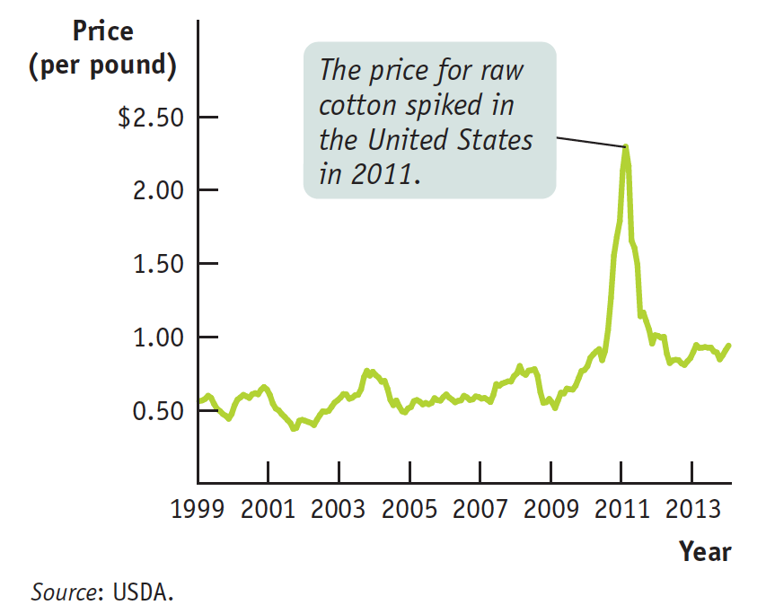
THE COTTON SPIKE AND CRASH OF 2011
What caused the price spike?
Falling supply
Rising demand
Then, in response to higher prices, manufacturers switched to polyester (and eventually supply increased also)

Slide 51

Which curve is it, anyway?
How do you know what caused a price change?
Look at the outcome: if the price and quantity move together, it was a demand change. If they move in opposite directions, a supply change.

Slide 52
SIMULTANEOUS SHIFTS OF SUPPLY AND DEMAND
(a) One possible outcome: Price rises, quantity rises.
Price of cotton
Small decrease in supply
S
2
S
1
E
Two opposing forces determining the equilibrium quantity:
2
P
2
The increase in demand dominates the decrease in supply.
E
1
P
1
D
2
D
1
Large increase in demand
Q
1
Q
2
Quantity of cotton

Slide 53
SIMULTANEOUS SHIFTS OF SUPPLY AND DEMAND
(b) Another possible outcome: price rises, quantity falls
Price of cotton
Large decrease in supply
S
2
S
1
Two opposing forces determining the equilibrium quantity:
E
2
P
2
The decrease in supply dominates the increase in demand.
E
1
Small increase in demand
P
1
D
2
D
1
Q
Q
Quantity of cotton
2
1

Slide 54
Consumers in Mayville consider houses and apartments to be substitutes. There is an increase in the price of houses in Mayville at the same time three new apartment buildings open there. In the market for apartments in Mayville:
the equilibrium price will rise.
the equilibrium price will fall.
the equilibrium quantity will rise.
the equilibrium quantity will fall.
Notes:
Correct answer is C

Slide 55

COMPETITIVE MARKETS—AND OTHERS
When markets are not competitive (as we’ll see in future chapters), things get a little more complicated.
For instance, large sellers will have to predict how their production, marketing, and pricing decisions will affect the entire market (and their own profits).
Notes:
All photo credits unless otherwise noted from Freeimages.com (Formerly Stockxchange) or Morguefile.com

