Slide 1
Economics 2220 Principles Of Macroeconomics
Professor Zhigang Feng
Lecture 5:
Macroeconomics: The Big Picture

Slide 2
What makes macroeconomics different from microeconomics
What a business cycle is and why policy makers seek to diminish the severity of business cycles
How long-run economic growth determines a country’s standard of living
The meaning of inflation and deflation and why price stability is preferred
The importance of open-economy macroeconomics and how economies interact through trade deficits and trade surpluses
To First
Active Learning
To Video

Slide 3
With a partner (and without technology), discuss and decide what you think is the (approximate) current annual inflation rate.
http://www.bls.gov/
To Next
Active Learning

Slide 4
With a partner (and without technology), discuss and decide what you think is the (approximate) current U.S. unemployment rate.
http://www.bls.gov/
To Next
Active Learning

Slide 5
THE ORIGINS OF MACROECONOMICS
Hoover’s failure to understand what caused the Great Depression (or how it could be tamed) was common at the time.
Microeconomics was well-developed; macroeconomics was not.
The effort to understand economic slumps and find ways to prevent them is at the core of macroeconomics.

Slide 6


THE ORIGINS OF MACROECONOMICS

Slide 7
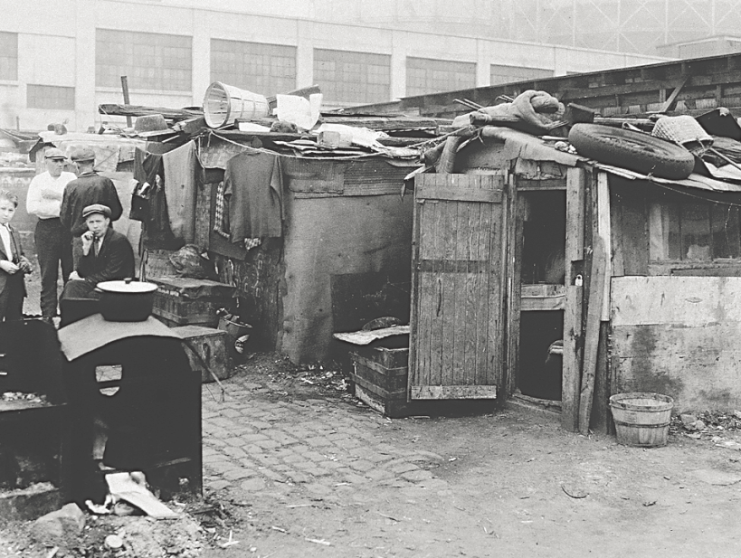
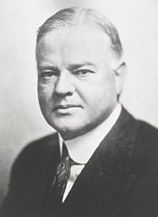
THE BUSINESS CYCLE
During the Great Depression, “Hoovervilles” sprang up across America, named after the economically clueless President Herbert Hoover.
Notes:
All image credits courtesy of Morgue File and/or FreeImages.com unless otherwise specified

Slide 8
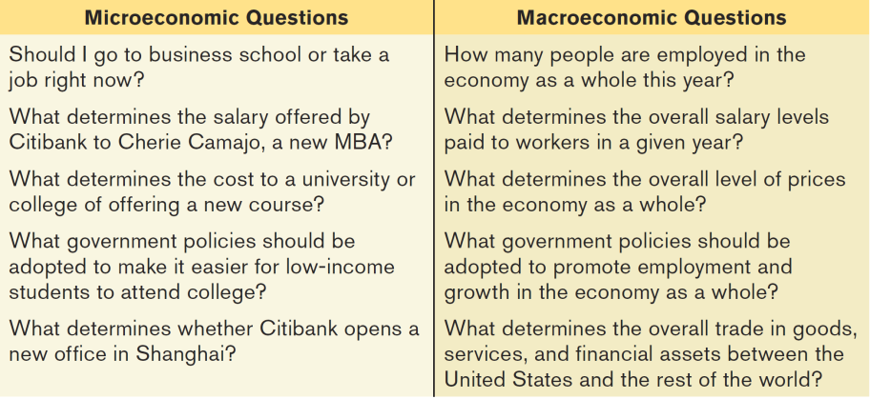
The Nature of Macroeconomics
Macroeconomic Questions

Slide 9
MACROECONOMICS: THE WHOLE IS GREATER THAN THE SUM OF ITS PARTS
An example
Paradox of thrift: When families and businesses are worried about the possibility of economic hard times, they prepare by cutting their spending. This reduction in spending depresses the economy as consumers spend less and businesses react by laying off workers. As a result, families and businesses may end up worse off than if they hadn’t tried to act responsibly by cutting their spending.

Slide 10
MACROECONOMICS: THEORY AND POLICY
Pre-1930s conventional wisdom
Self-regulating economy: Problems such as unemployment are resolved without government intervention through the working of the invisible hand.
Post-1930s conventional wisdom
Keynesian economics: Economic slumps are caused by inadequate spending, and they can be mitigated by government intervention.

Slide 11
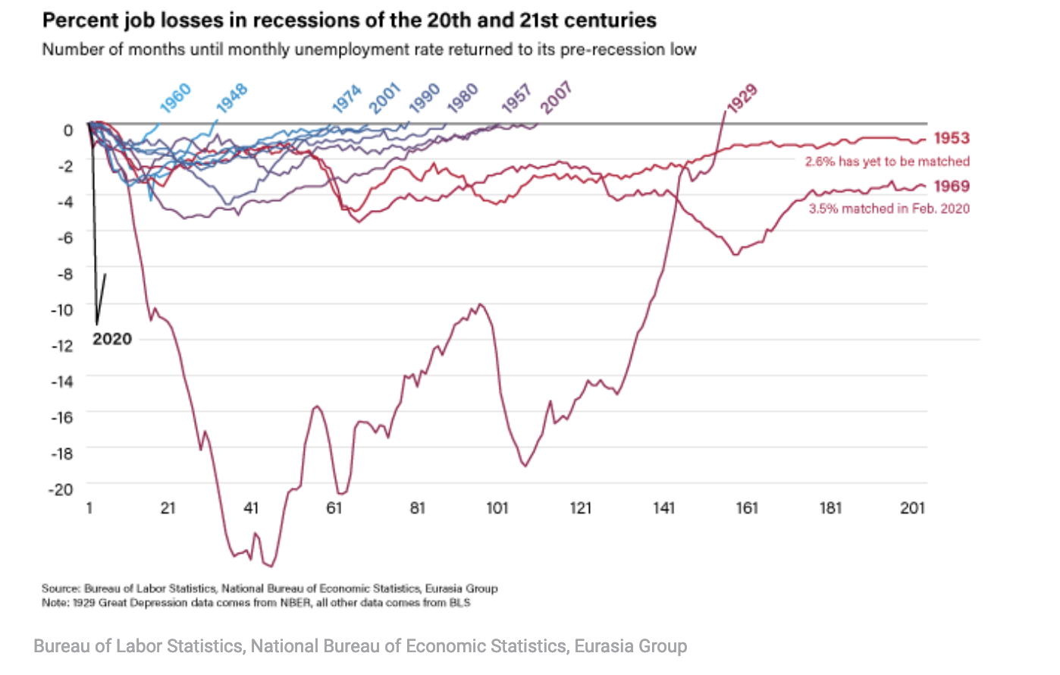
COMPARING THE GREAT RECESSION TO THE GREAT DEPRESSION
Measures of economic activity and world industrial production during the Great Depression and the Great Recession

Slide 12
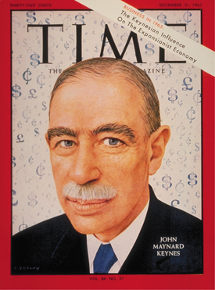
MACROECONOMICS
“The long run is a misleading guide to current affairs. In the long run we are all dead. Economists set themselves too easy, too useless a task if in tempestuous seasons they can only tell us that when the storm is past the ocean is flat again.”
-John Maynard Keynes, A Tract on Monetary Reform (1923) Ch. 3
Notes:
All image credits courtesy of Morgue File and/or FreeImages.com unless otherwise specified

Slide 13
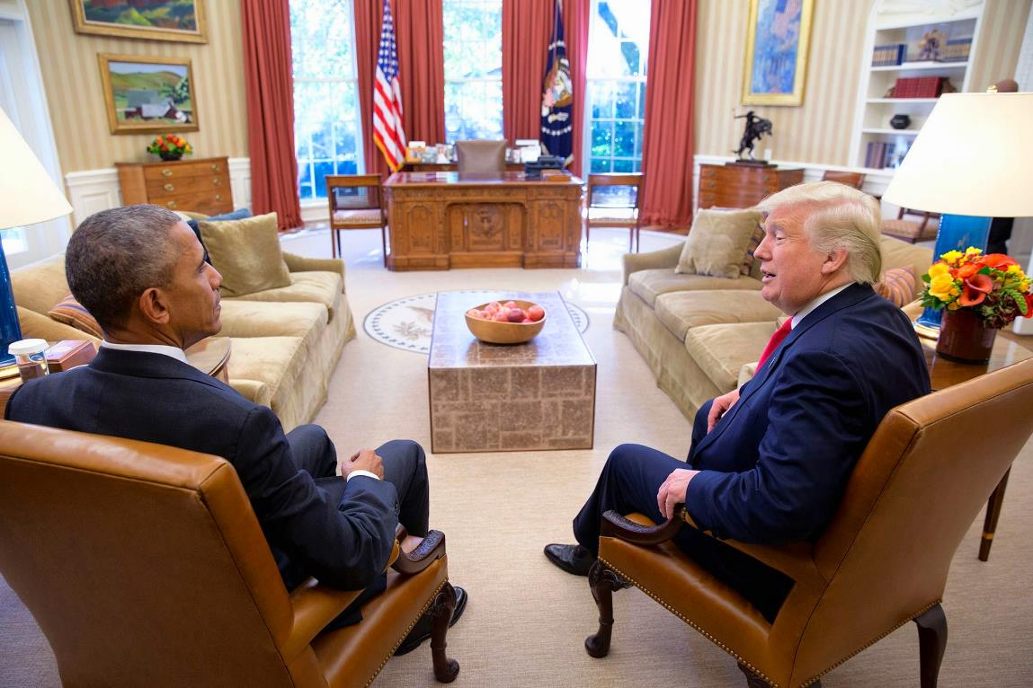
THE BUSINESS CYCLE
Since the 1930s, the U.S. (and most national governments) uses tools to improve the economy.
Monetary policy: uses changes in the quantity of money to alter interest rates and affect overall spending.
Fiscal policy: uses changes in government spending and taxes to affect overall spending.
Notes:
All image credits courtesy of Morgue File and/or FreeImages.com unless otherwise specified

Slide 14
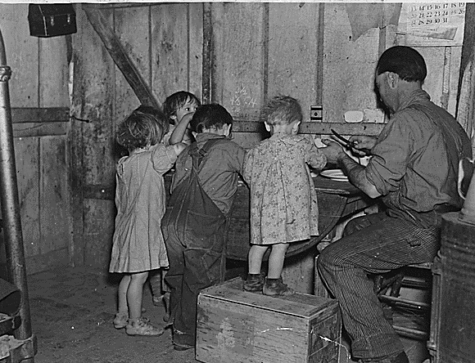
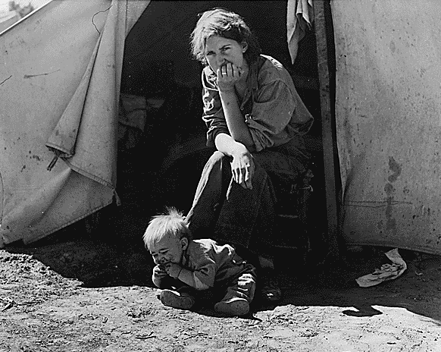
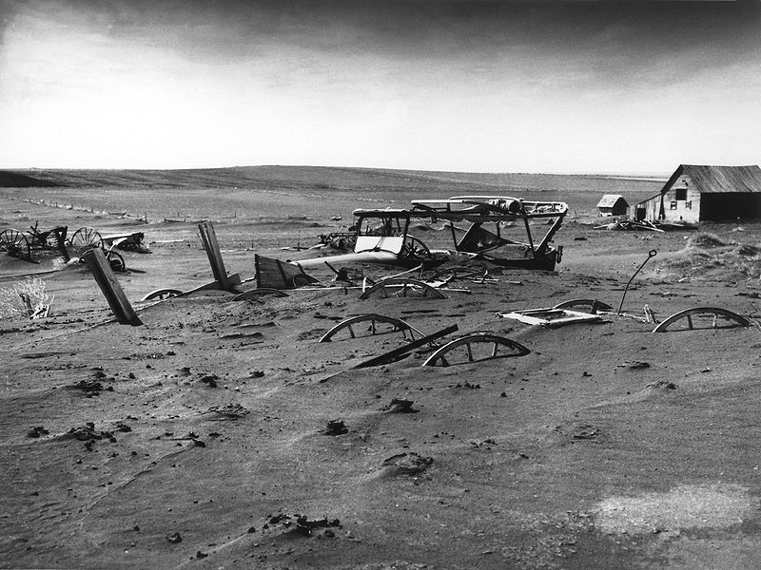
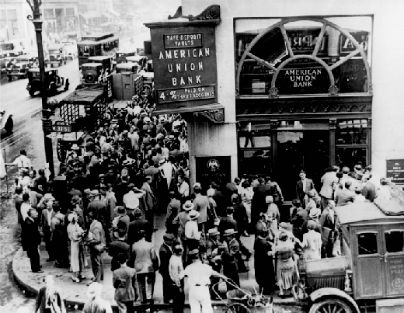
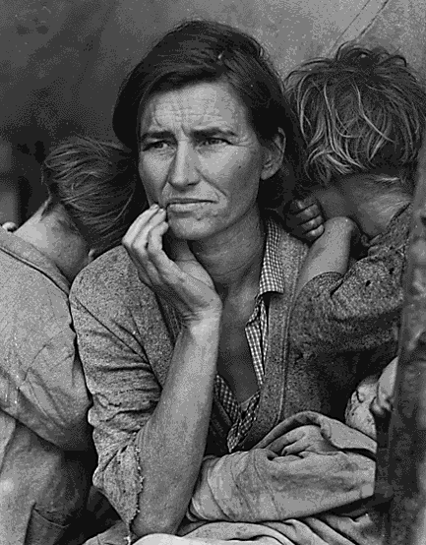
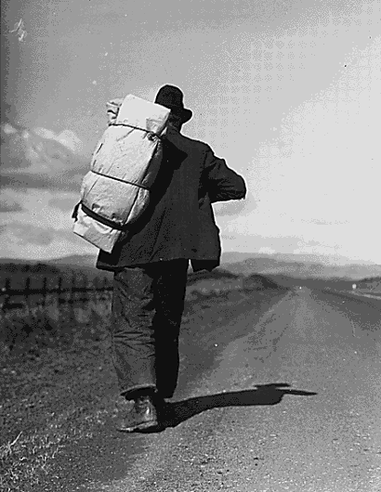
IMAGES OF THE DEPRESSION
Notes:
Image sources: Library of Congress and Wikimedia commons

Slide 15
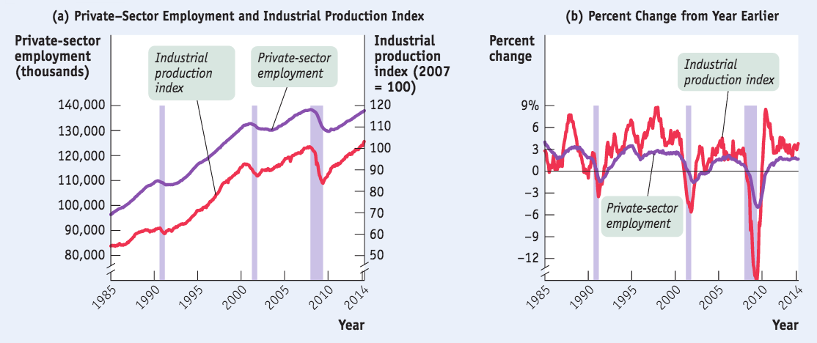
GROWTH INTERRUPTED, 1985–2014
Source: Federal Reserve Bank of St. Louis (Shaded areas are recessions)

Slide 16
CHARTING THE BUSINESS CYCLE
Recessions (contractions): periods of economic downturn, when output and employment are falling.
Expansions (recoveries): periods of economic upturn, when output and employment are rising.
Business cycle: the short-run alternation between recessions and expansions.

Slide 17
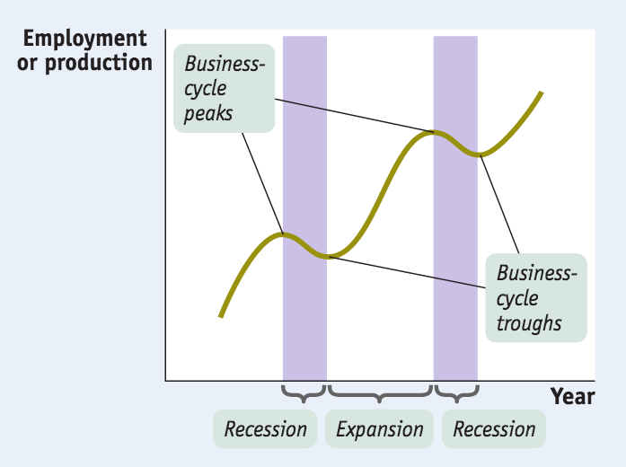
THE BUSINESS CYCLE
The point at which the economy turns from expansion to recession is a business-cycle peak.
The point at which the economy turns from recession to expansion is a business-cycle trough.

Slide 18
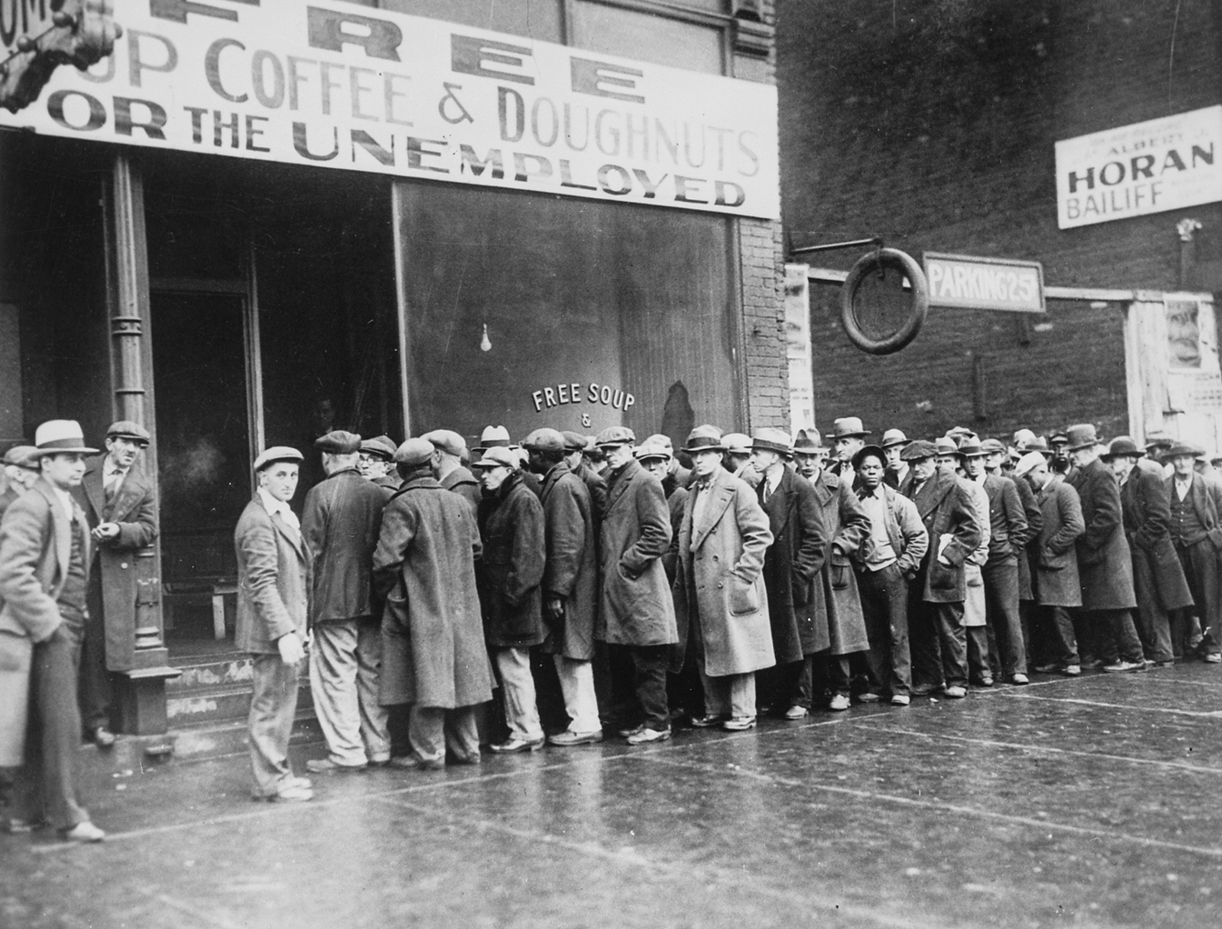
THE PAIN OF RECESSION
The most important effect of a recession is its effect on the ability of workers to find and hold jobs.
Notes:
Image source: Library of Congress and Wikimedia commons

Slide 19
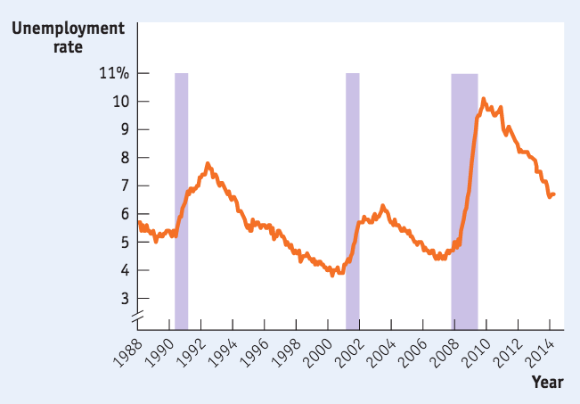
TAMING THE BUSINESS CYCLE
The business cycle is a main concern of modern policy makers: they try to smooth out the business cycle. They haven’t been completely successful.
Source: Bureau of Labor Statistics (Shaded areas are recessions)

Slide 20
The use of taxes and government spending to change the overall level of spending in an economy is called:
monetary policy.
fiscal policy.
either monetary or fiscal policy depending upon what is happening to the interest rate.
To Next
Active Learning

Slide 21
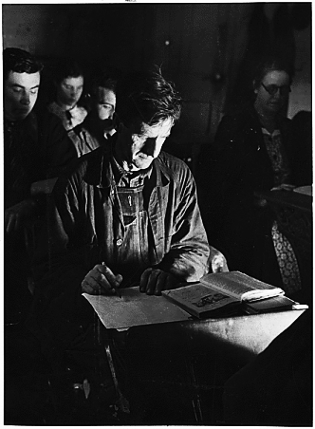

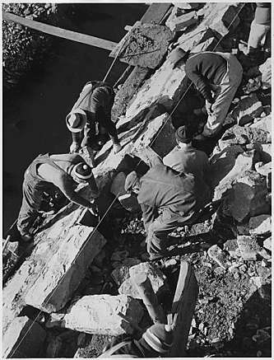
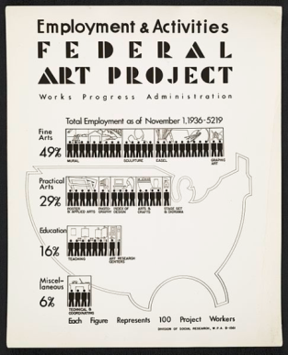
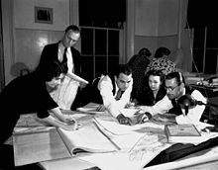
Do you think the government is right to begin massive spending programs during deep recessions?
Yes
No
To Next
Active Learning
Notes:
Images of WPA programs used during the Great Depression Image sources: Library of Congress and Wikimedia commons

Slide 22
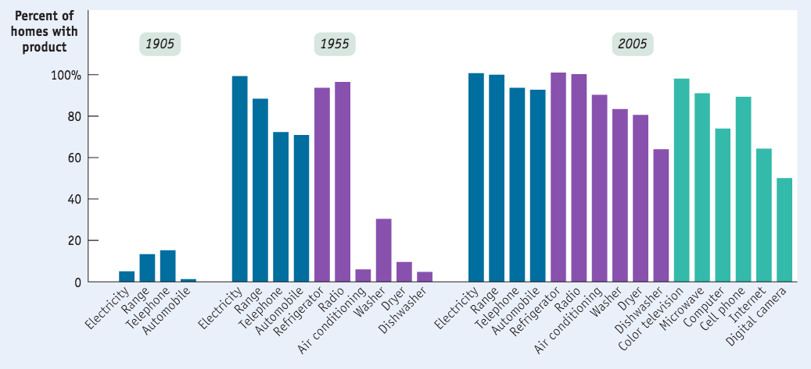
LONG-RUN ECONOMIC GROWTH
Long-run economic growth is the sustained upward trend in the economy’s output over time.
Source: W. Michael Cox and Richard Alm, “How Are We Doing?” The American (July/August 2008). http://www.american.com/ archive/2008/july-august-magazine-contents/how-are-we-doing

Slide 23
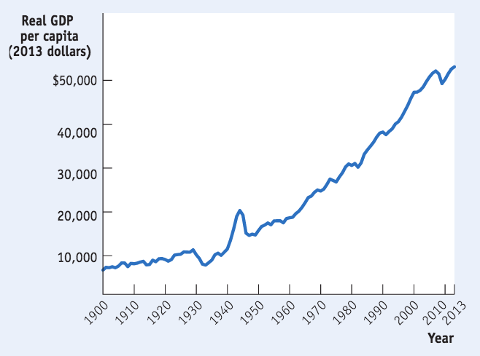
GROWTH, THE LONG VIEW
Americans have become able to afford many more material goods over time thanks to long-run economic growth.
Sources: Angus Maddison, Statisticson World Population, GDP, and Per Capita GDP, 1–2008AD,http://www.ggdc.net/MADDISON/oriindex.htm; Bureau of Economic Analysis.

Slide 24
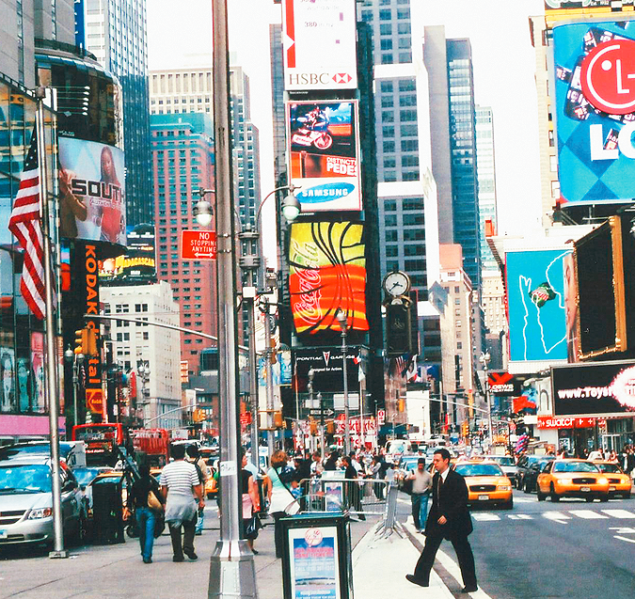
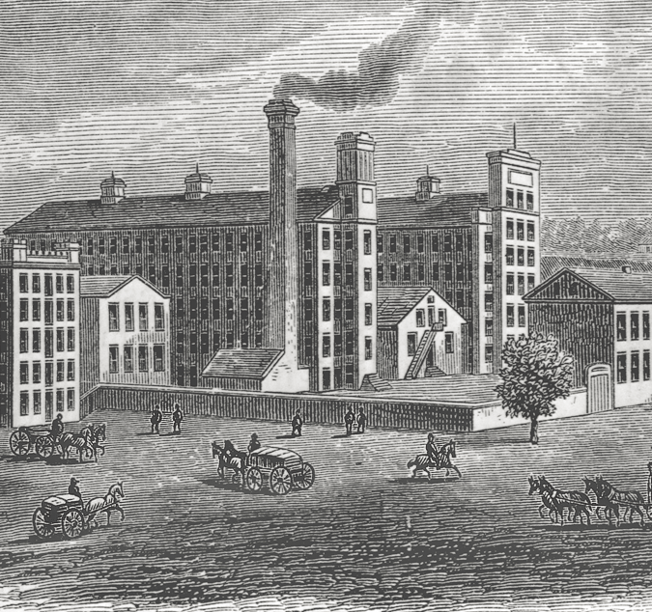
GROWTH, THE LONG VIEW
Long-run growth is a relatively modern phenomenon.
Notes:
All image credits courtesy of Morgue File and/or FreeImages.com unless otherwise specified

Slide 25


A TALE OF TWO COUNTRIES
Canada and Argentina began the 20th century looking like twins…
Political instability and high inflation slowed Argentina down.
Now Canada’s standard of living is on par with the U.S., 3x as high as Argentina
Notes:
All image credits courtesy of Morgue File and/or FreeImages.com unless otherwise specified

Slide 26
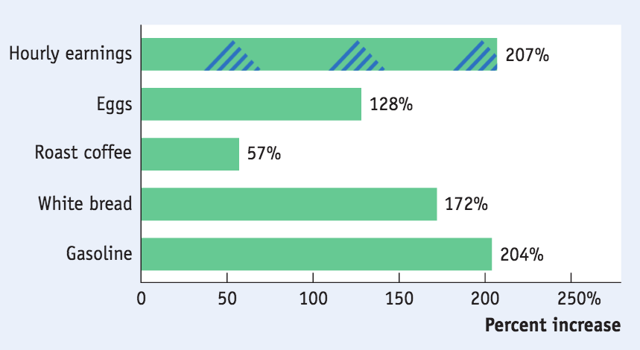
INFLATION AND DEFLATION
A rising overall level of prices is inflation.
A falling overall level of prices is deflation.
The economy has price stability when the overall level of prices changes slowly or not at all.
Rising Prices offset most of the rise in average wages.
Source: Bureau of Labor Statistics

Slide 27
THE CAUSES OF INFLATION AND DEFLATION
In the short run, movements in inflation are closely related to the business cycle.
When the economy is depressed and jobs are hard to find, inflation tends to fall; when the economy is booming, inflation tends to rise.
In the long run, the overall level of prices is mainly determined by changes in the money supply.

Slide 28
THE PAIN OF INFLATION AND DEFLATION
Both inflation and deflation are problematic.
Inflation discourages people from holding onto cash (because cash loses value if prices are rising). In extreme cases, people stop using cash altogether.
Deflation can cause the reverse problem. Since cash gains value if the price level is falling, holding on to it is more attractive than investing in new factories and other productive assets. This can deepen a recession.

Slide 29
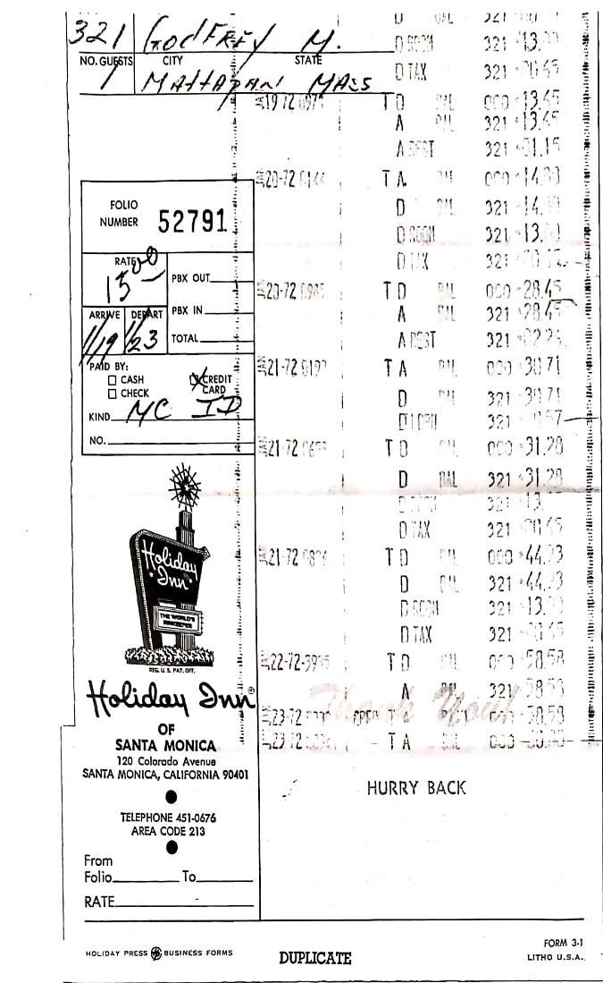
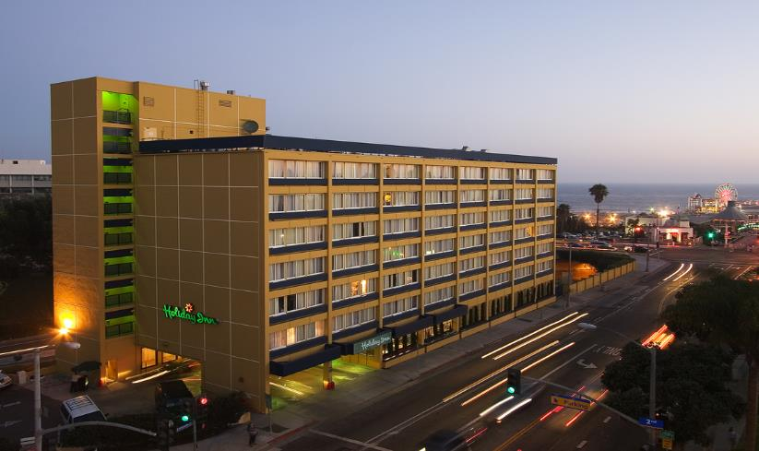
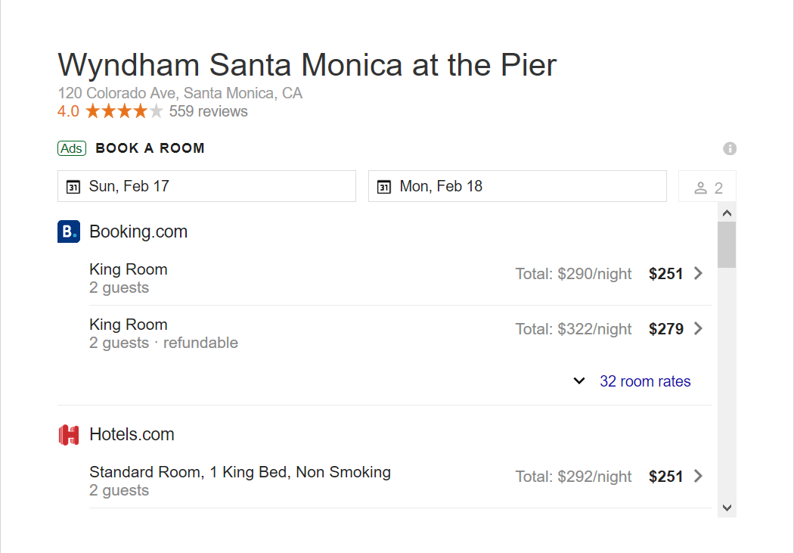

Slide 30
INTERNATIONAL IMBALANCES
The United States is an open economy: it trades goods and services with other countries.
In 2013, the United States ran a big trade deficit.
Trade deficit: the value of goods and services bought from foreigners is more than the value of goods and services sold to them.
Trade surplus: the value of goods and services bought from foreigners is less than the value of the goods and services sold to them.

Slide 31
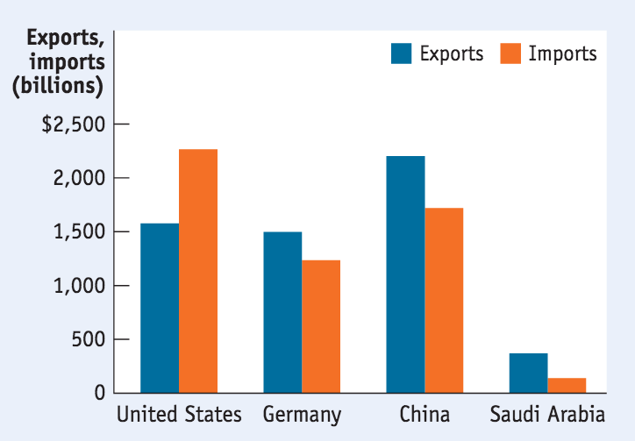
WHAT CAUSES TRADE IMBALANCES?
In a later chapter we’ll learn the surprising answer: the determinants of the overall balance between exports and imports lie in decisions about savings and investment spending. Countries with high investment spending relative to savings run trade deficits; countries with low investment spending relative to savings run trade surpluses.
Source: CIA World Factbook.

Slide 32
This year the value of a country’s imports is equal to $1.2 billion, and the value of its exports is equal to $1.3 billion. This country is running a:
trade surplus.
trade deficit.

Slide 33
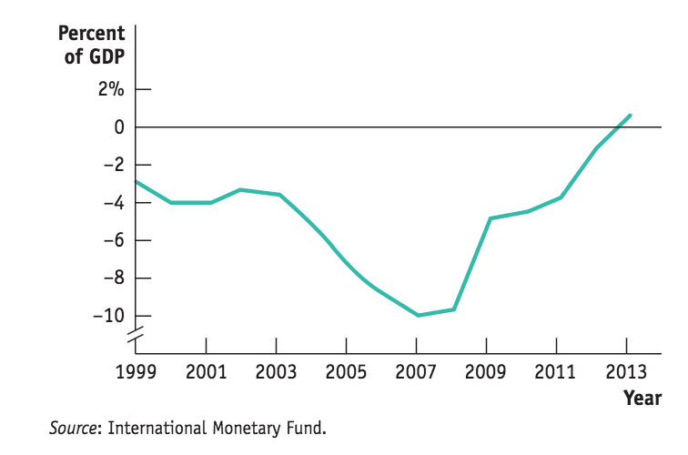
SPAIN’S COSTLY SURPLUS
Giving up the Peseta for the Euro (and closer union with Europe) in 1999 had benefits… and costs
Did the influx of foreign investment afterward lead to the housing boom (and bust) that brought down Spain?
Spain’s Current Account Balance, 1999-2013

Slide 34
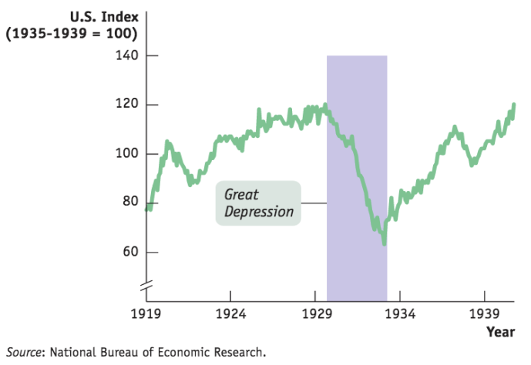
THE DECLINE OF MONTGOMERY WARD
(THE IMPORTANCE OF UNDERSTANDING THE MACROECONOMY)
1930’s: Montgomery Ward survived the Depressions by cutting costs and hoarding cash
1940’s: Expecting a similar environment post WWII, they repeated the strategy… and didn’t open a new store until 1959… far too late to stop their decline

Slide 35
https://www.wsj.com/video/series/daniela-hernandez/inflation-brain-why-you-seesaw-between-splurging-and-penny-pinching/38E64AFC-EB4E-43A1-89BB-5E524EEA5CDB

Slide 36
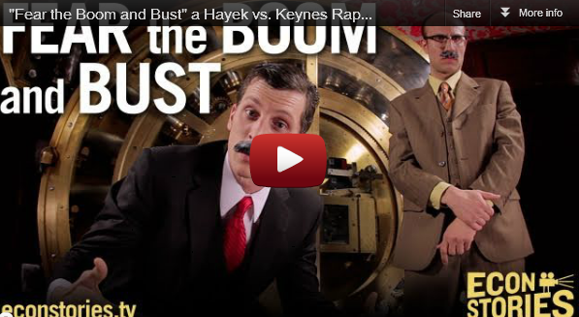
You might not understand everything mentioned in this epic economist rap battle YET…but you will enjoy it and get a taste for the philosophical debates about stabilization policy within macroeconomics. (6:28 minutes)
Notes:
https://vimeo.com/9222135

