Slide 1
Economics 2220 Principles Of Macroeconomics
Professor Zhigang Feng
Lecture 6:
National Income Accounting

Slide 2
How economists use aggregate measures to track the performance of the economy
What gross domestic product, or GDP, is and the three ways of calculating it
The difference between real GDP and nominal GDP and why real GDP is the appropriate measure of real economic activity
What a price index is and how it is used to calculate the inflation rate
To First
Active Learning
To Video

Slide 3


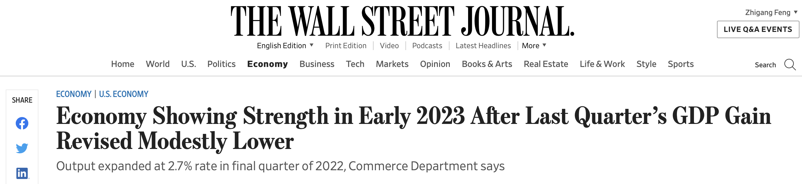
HOW DO YOU MEASURE AN ECONOMY?
How can you compare the sizes of two economies when they produce different things?
By comparing the value of their production.
GDP (gross domestic product) is the most important and common way to estimate an economy’s size.
Notes:
Image credit: Iain Masterton/Alamy

Slide 4
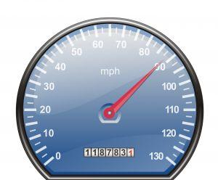
THE NATIONAL ACCOUNTS
The national income and product accounts (NIPA)
measure our nation’s economic performance
compare American income and output to that of other nations
track the economy’s condition throughout the business cycle
Notes:
All image credits courtesy of Morgue File and/or FreeImages.com unless otherwise specified

Slide 5

THE NATIONAL ACCOUNTS
Consumer spending: household spending on goods and services
Stock: a share in the ownership of a company held by a shareholder.
Bond: borrowing in the form of an IOU that pays interest.
Government transfer: payment by the government to individuals for which no good or service is provided in return.
Disposable income: income plus government transfers minus taxes; available to spend on consumption and to save.

Slide 6




AN EXPANDED CIRCULAR-FLOW DIAGRAM
Government purchases of goods and services
Government borrowing
Taxes
Government transfers
Consumer spending
Private savings
Markets for goods and services
Wages, profit,
interest, rent
Factor markets
Financial markets
Wages, profit, interest, rent
Borrowing and stock issues by firms
GDP
Investment spending
Foreign borrowing and sales of stock
Exports
Imports
Foreign lending and purchases of stock

Slide 7
THE NATIONAL ACCOUNTS
Households don’t spend all of their disposable income. Some of it is saved in the financial markets.
Private savings: disposable income minus consumer spending.
Financial markets: the banking, stock, and bond markets, which channel private savings and foreign lending into investment spending, government borrowing, and foreign borrowing.

Slide 8
THE NATIONAL ACCOUNTS
The government spends and borrows for various reasons.
Government borrowing: the total amount of funds borrowed by federal, state, and local governments in the financial markets.
Government purchases of goods and services: total expenditures on goods and services by federal, state, and local governments.

Slide 9

THE NATIONAL ACCOUNTS
The government spends and borrows for various reasons.
Government borrowing: the total amount of funds borrowed by federal, state, and local governments in the financial markets.
Government purchases of goods and services: total expenditures on goods and services by federal, state, and local governments.
Notes:
All image credits courtesy of Morgue File and/or FreeImages.com unless otherwise specified

Slide 10

THE NATIONAL ACCOUNTS
Exports: goods and services sold to other countries.
Imports: goods and services purchased from other countries.
Notes:
All image credits courtesy of Morgue File and/or FreeImages.com unless otherwise specified

Slide 11

THE NATIONAL ACCOUNTS
Inventories: stocks of goods and raw materials held to facilitate business operations.
Investment spending: spending on productive physical capital, such as machinery and construction of structures, and on changes to inventories.
Notes:
All image credits courtesy of Morgue File and/or FreeImages.com unless otherwise specified

Slide 12
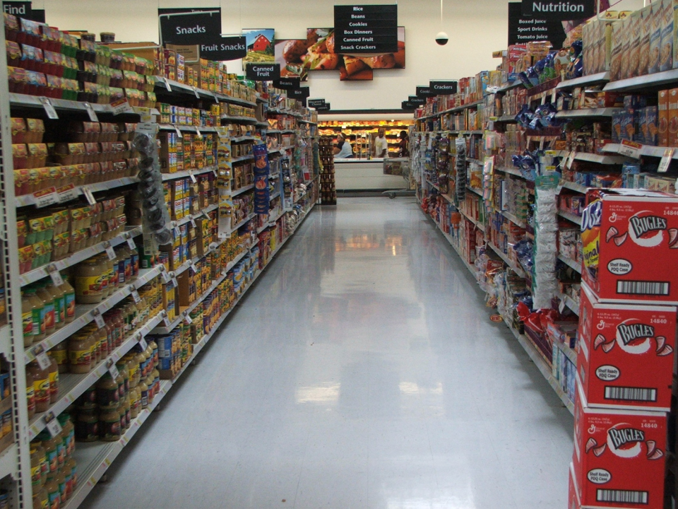
WHAT IS GDP?
Gross domestic
product (GDP):
the market value
of all final
goods and services
produced
within a country
in a year.
Notes:
All image credits courtesy of Morgue File and/or FreeImages.com unless otherwise specified

Slide 13
CALCULATING GROSS DOMESTIC PRODUCT
GDP can be calculated three ways:
Add up the total value of all final goods and services produced
Add up all spending on domestically produced final goods and services.
Add up the total factor income earned by households from firms in the economy

Slide 14

SPENDING = INCOME
It doesn’t matter HOW we measure the production, since one person’s spending is another’s income.
$10 for a shave? Barber’s income of $10 = customer’s spending of $10.
Notes:
All image credits courtesy of Morgue File and/or FreeImages.com unless otherwise specified

Slide 15

WHAT IS GDP?
…Produced…
GDP measures production.
Sale of used goods: NOT included.
The sale of financial assets, such as stocks and bonds, are not included.
This building’s value was counted when it was built.
Notes:
All image credits courtesy of Morgue File and/or FreeImages.com unless otherwise specified

Slide 16
WHAT IS GDP?
…Within a Country…
Only production that takes place within the borders of a country is included in GDP.
Examples:
Cars produced in Mexico by American firms: NOT included in the U.S. GDP.
Cars produced in the U.S. by Japanese firms ARE included in the U.S. GDP.

Slide 17
Are the following included in U.S. GDP? (1) The price paid by a German tourist when staying at a New York hotel. (2) The price paid by an American tourist when staying at a Berlin hotel.
Both are included in U.S. GDP.
Neither is included in U.S. GDP.
Only the price paid by a German tourist when staying at a New York hotel is included in U.S. GDP.
Only the price paid by an American tourist when staying at a Berlin hotel is included U.S. GDP.
To Next
Active Learning

Slide 18

WHAT IS GDP?
…in a year.
GDP is like annual income:
it measures a rate of production during a given period.
For the current quarter’s GDP data, visit the U.S. Bureau of Economic Analysis here.
Notes:
www.bea.gov

Slide 19
GDP: WHAT’S IN AND WHAT’S OUT
Included
Domestically produced final goods and services, including capital goods, new construction of structures, and changes to inventories
Not Included
Intermediate goods and services
Inputs
Used goods
Financial assets, such as stocks and bonds
Goods and services produced outside this country

Slide 20

OUR IMPUTED LIVES
Problem: GDP does not count the value of services family members provide to each other… except for the estimated value of housing “services” for those that own their home (instead of renting)
Notes:
Photo credit: Shutterstock

Slide 21


METHOD 1: VALUE ADDED
Value added of a producer is the value of its sales minus the value of its purchases of intermediate goods and services.
value
added
Notes:
All image credits courtesy of Morgue File and/or FreeImages.com unless otherwise specified

Slide 22

METHOD 2: SPENDING
Final goods and services: goods and services sold to the final, or end, user.
Intermediate goods and services: goods and services (bought from one firm by another firm) that are inputs for production of final goods and services.
Notes:
All image credits courtesy of Morgue File and/or FreeImages.com unless otherwise specified

Slide 23
METHOD 2: SPENDING
Add up all spending on domestically produced final goods and services.
This results in the equation GDP = C + I + G + X – IM where
C = consumer spending,
I = investment spending,
G = government purchases of goods and services,
X = sales to foreigners, and
IM = imports (purchases here of foreign goods… or income that has leaked across national borders).

Slide 24
VALUE ADDED VS. SPENDING METHOD
$20,000
$15,000
10,000
5,000
0
-5,000
Components of GDP (billions of dollars)
Value added by government
= 12.1%
Government purchases of goods and services
= 18.6%
Value added by households
= 12.4%
Investment spending
= 15.9%
C + I + G
= $16,800
Value added by business
= 75.5%
Consumer spending
= 68.4%
Value added by sector
Net exports X – IM = (–3.0%)
Net exports: the difference between the value of exports and the value of imports.

Slide 25
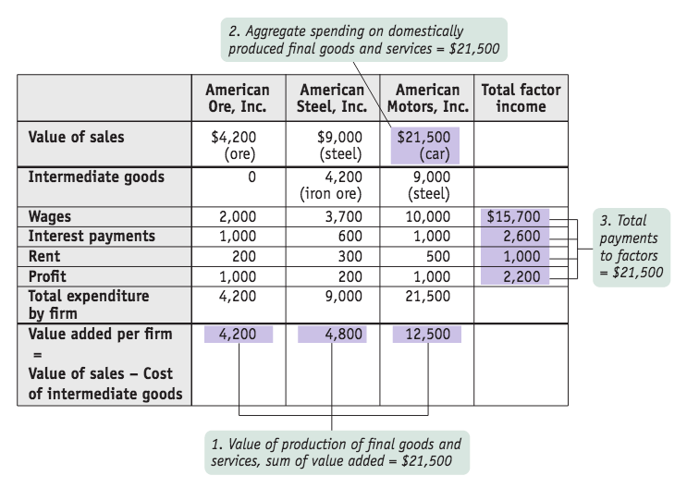
CALCULATING GROSS DOMESTIC PRODUCT
Notes:
.

Slide 26
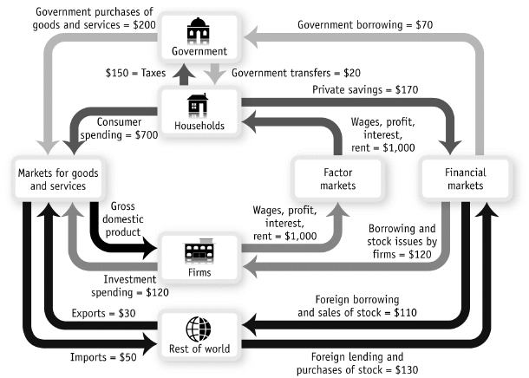
Notes:
.

Slide 27
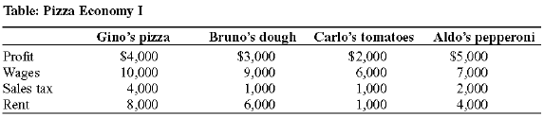

Slide 28
Suppose country A sells $100 million worth of goods and services to country B. Country B sells $50 million worth of goods and services to country A. These are the only two countries in macro world. Net exports in country:
B equal −$50 million.
A equal $150 million.
A equal -$150 million.
B equal $50 million.
To Next
Active Learning

Slide 29
Income spent on imported goods:
represents income that has leaked across national borders.
must be subtracted from spending data to calculate an accurate value for domestic production.
is income that is not spent on domestically produced goods and services.
Answers (a), (b), and (c) are all correct.
To Next
Active Learning

Slide 30
WHO CREATED THE NATIONAL ACCOUNTS (AND WHY)?
The national accounts owe their creation to the Great Depression. The only data available were scattered statistics (railroad data, etc.)
Simon Kuznets (a young Russian-born economist) developed a set of national income accounts. The first version was presented to Congress in 1937.
The push to complete the national accounts came during World War II, when policy makers were in even more need of comprehensive measures of the economy’s performance.
The federal government began issuing estimates of gross domestic product and gross national product in 1942.

Slide 31
REAL GDP: A MEASURE OF AGGREGATE OUTPUT
We need to be able track the quantity of total output over time.
Real GDP: the total value of the final goods and services produced in the economy during a given year, calculated using the prices of a selected base year.
Nominal GDP: the value of all final goods and services produced in the economy during a given year, calculated using the prices current in the year in which the output is produced.

Slide 32
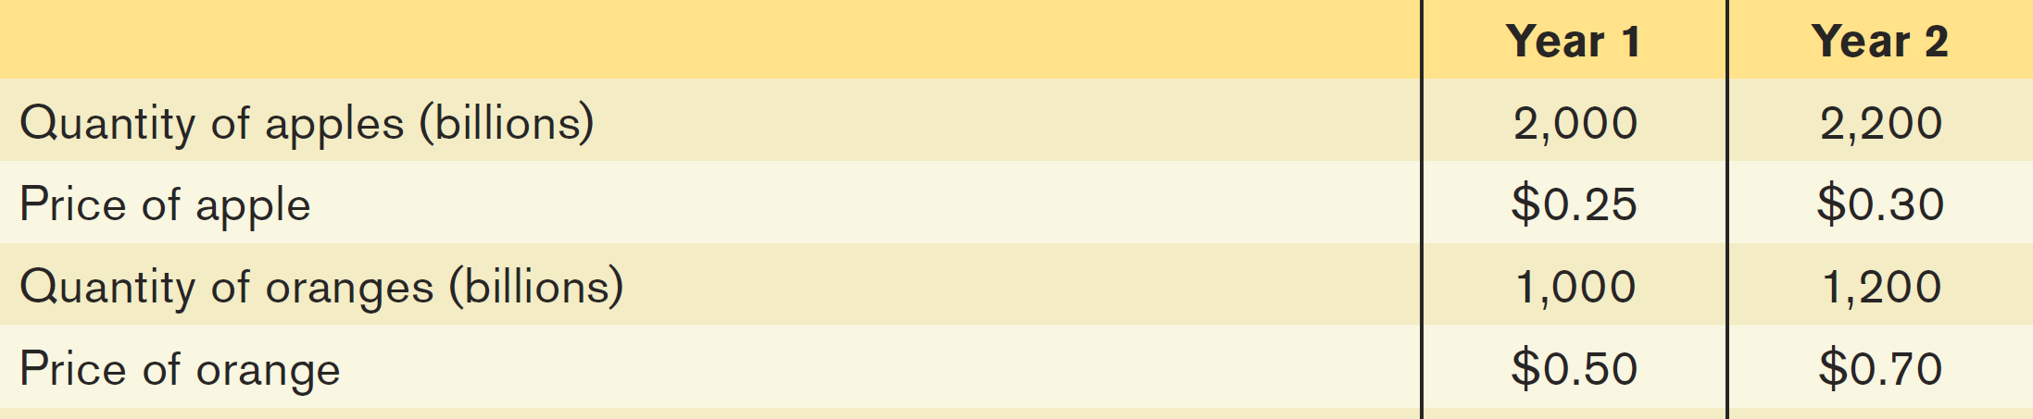
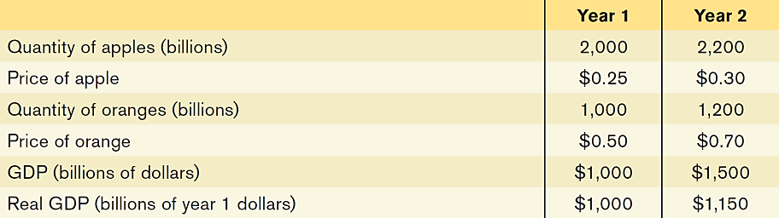
REAL VS. NOMINAL GDP
Calculating GDP and real GDP in a simple economy:
how much would GDP have gone up if prices had not changed? To answer this question, we need to find the value of output in year 2 expressed in year 1 prices.

Slide 33
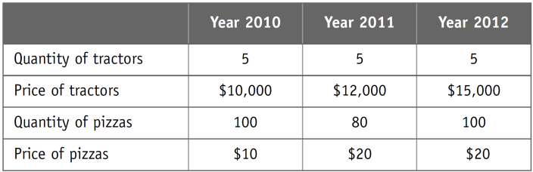
Nominal GDP in 2011:
is greater than nominal GDP in 2010.
is less than nominal GDP in 2012.
cannot be calculated until a base year is specified.
Answers (a) and (b) are both correct.
To Next
Active Learning
Notes:
Answer d. To answer this question, it is helpful to calculate the nominal GDP for each
of these years. Nominal GDP in 2010 equals the sum of the product of the prices of the
goods produced times the quantity of the goods produced or ($10,000/tractor)(5 tractors)
+ ($10/pizza)(100 pizzas), or $51,000. Using the same process, nominal GDP in
2011 equals $61,600 and nominal GDP in 2012 equals $77,000. Thus, nominal GDP in
2011 is greater than nominal GDP in 2010 and less than nominal GDP in 2012.

Slide 34
Suppose the base year is 2010. Real GDP in 2011 using 2010 as the base year:
is greater than nominal GDP in 2011.
is less than nominal GDP in 2011.
is equal to nominal GDP in 2011.
may be greater than, less than, or equal to nominal GDP in 2011.
To Next
Active Learning
Notes:
To answer this question, first calculate real GDP in 2011 using 2010 as the
base year. Real GDP in 2011 equals the sum of the product of the quantities produced in
2011 times the price of the product in the base year. Thus, real GDP in 2011 using 2010
as the base year equals ($10,000/tractor)(5 tractors) + ($10/pizza)(80 pizzas), or
$50,800. Nominal GDP in 2011 equals $61,600 (see previous question), so real GDP in
2011 using 2010 as the base year is less than nominal GDP in 2011.

Slide 35
Using 2011 as the base year, real GDP is greatest in:
2010.
2011.
2012.
2010 and 2012, since real GDP using 2011 as the base year is the same for these two years.
To Next
Active Learning
Notes:
Answer d. To answer this question, first compute real GDP for each year using 2011 as the
base year. Real GDP in 2011 will equal nominal GDP in 2011 since 2011 has been designated
the base year. Thus, real GDP in 2011 equals $61,600. Real GDP in 2010 using 2011
as the base year equals ($12,000/tractor)(5 tractors) + ($20/pizza)(100 pizzas), or
$62,000. Real GDP in 2012 using 2011 as the base year equals ($12,000/tractor)(5 tractors)
+ ($20/pizza)(100 pizzas), or $62,000.

Slide 36
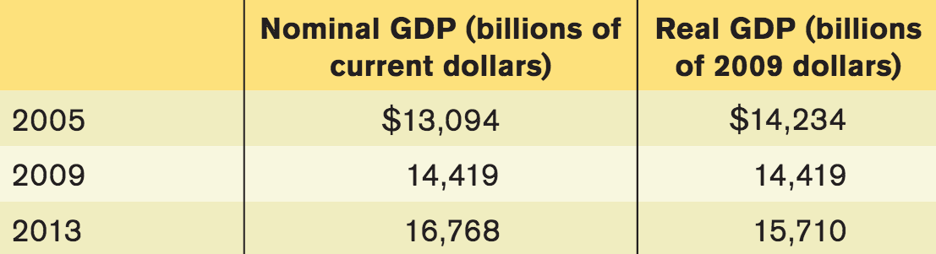
REAL-LIFE REAL GDP
Nominal versus real GDP in 2005, 2009 and 2013

Slide 37
REAL VS. NOMINAL GDP
Except in the base year, real GDP is not the same as nominal GDP: output valued at current prices.
Chained dollars: the method of calculating changes in real GDP using the average between the growth rate calculated on an early base year and the growth rate calculated on a late base year.
GDP per capita: average GDP per person; not by itself an appropriate policy goal.

Slide 38
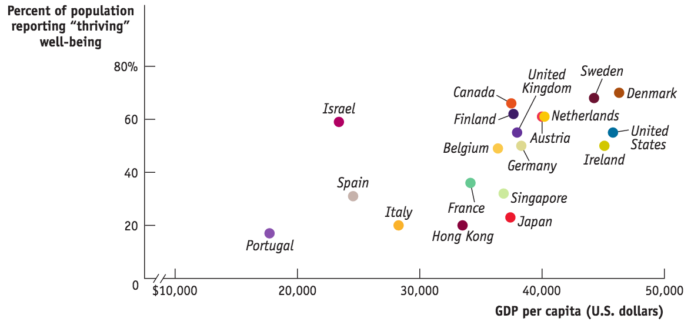
GDP AND THE MEANING OF LIFE
Rich is better.
Money matters less as you grow richer.
Money isn’t everything.
Source: Gallup; World Bank.

Slide 39
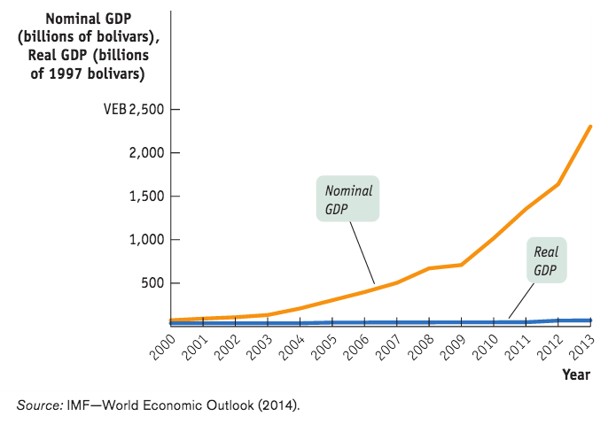
Miracle in Venezuela?
No, it’s just suffering from unusually high inflation.

Slide 40
PRICE INDEXES AND THE AGGREGATE PRICE LEVEL
Aggregate price level: a measure of the overall level of prices in the economy.
To measure the aggregate price level, economists calculate the cost of purchasing a market basket.
Market basket: a hypothetical set of consumer purchases of goods and services.

Slide 41
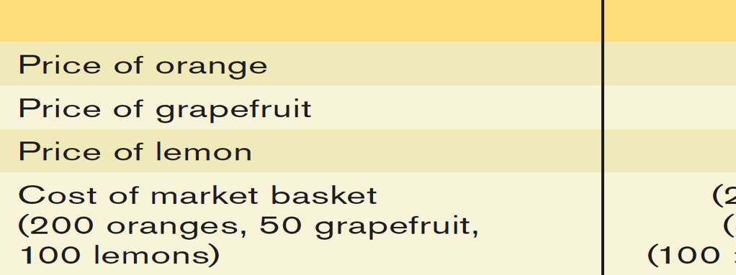
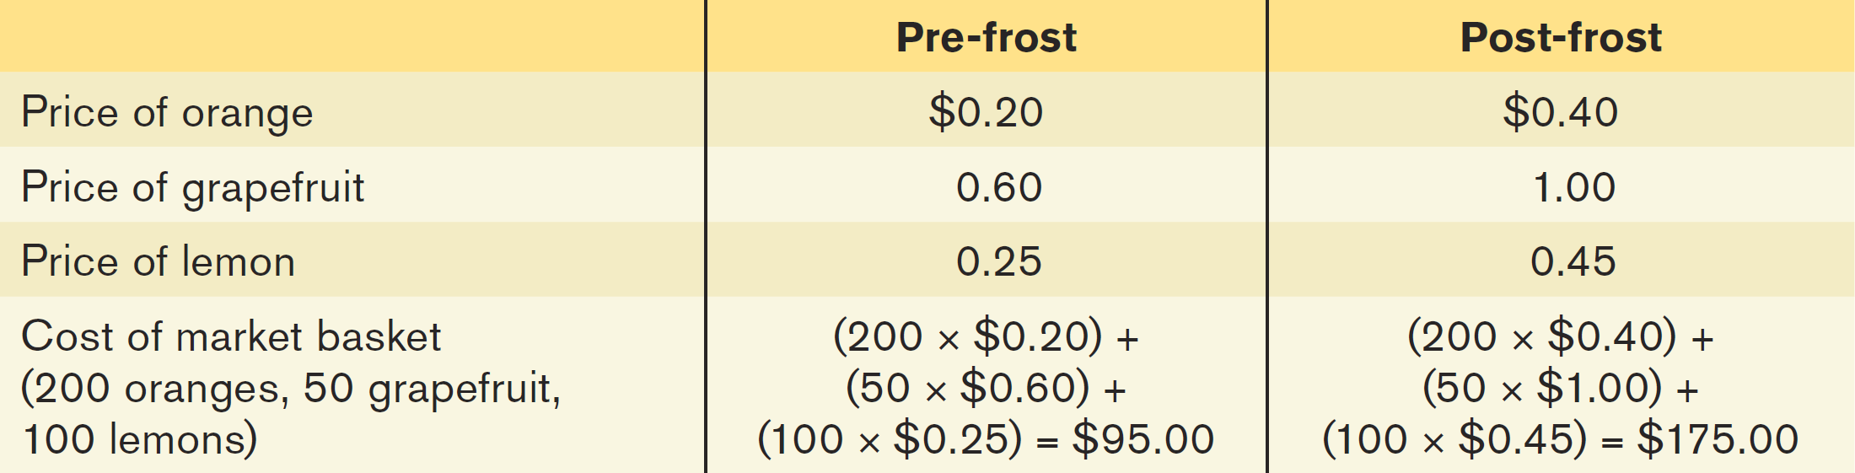
MARKET BASKETS AND PRICE INDEXES
Calculating the cost of a market basket

Slide 42

PRICE INDEXES
Price Index: the cost of purchasing a given market basket in a given year, where that cost is normalized so that it is equal to 100 in the selected base year
Price index in a given year
= $\frac{\text{Cost} \text{of} \text{market} \text{basket} \text{in} \text{a} \text{given} \text{year}}{\text{Cost} \text{of} \text{market} \text{basket} \text{in} \text{base} \text{year}}\text{x}\text{ 100}$

Slide 43
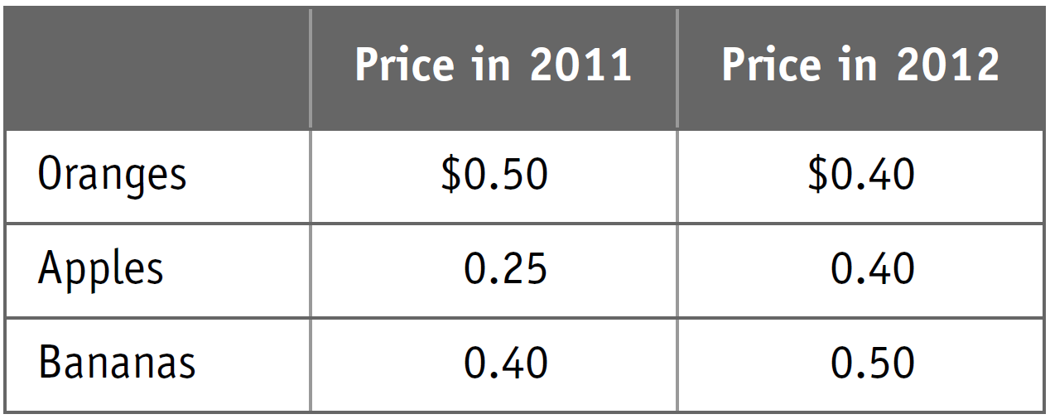
Suppose 2011 is the base year and the market basket for purposes of constructing a price index consists of 200 oranges, 100 apples, and 100 bananas.
What is the value of the price index in 2011?
1.15
100
165
190
To Next
Active Learning

Slide 44
What is the value of the price index in 2012, using 2011 as the base year?
0.97
1
100
103
To Next
Active Learning

Slide 45
INFLATION RATE, CPI, AND OTHER INDEXES
The Inflation rate: the yearly percentage change in a price index, typically based upon consumer price index, or CPI, the most common measure of the aggregate price level.
The consumer price index, or CPI, measures the cost of the market basket of a typical urban American family
Inflation rate = Price index in year 2 – Price index in year 1 x 100
Price index in year 1

Slide 46
What is the rate of inflation between 2011 and 2012 in this economy?
0%
3%
103%
67%, since two of the three prices increased between 2011 and 2012

Slide 47
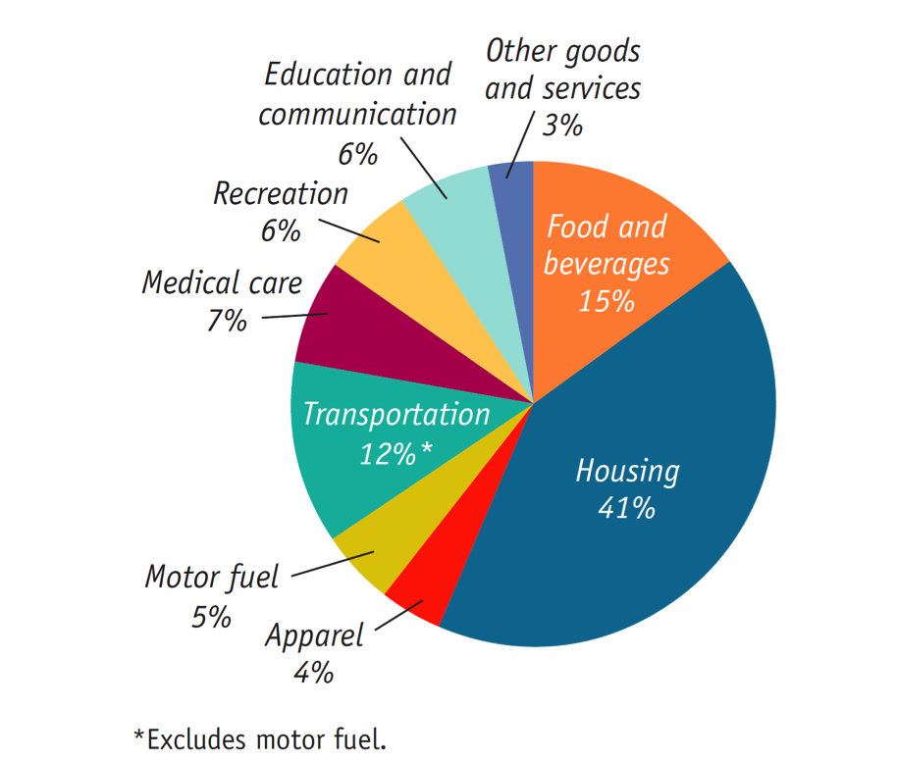
THE CONSUMER PRICE INDEX
The makeup of the consumer price index in 2010
Source: Bureau of Labor Statistics.

Slide 48
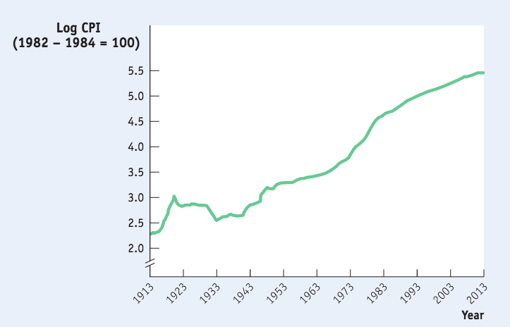
CONSUMER PRICE INDEX
The annual percentage increases in recent years have been much smaller than those of the 1970s and early 1980s.
Source: Bureau of Labor Statistics.

Slide 49
OTHER PRICE MEASURES
Producer price index (PPI): similar to the CPI but measures changes in the prices of goods purchased by producers.
Economists also use the GDP deflator, which measures the price level by calculating the ratio of nominal to real GDP.
The GDP deflator for a given year is 100 times the ratio of nominal GDP to real GDP in that year.

Slide 50
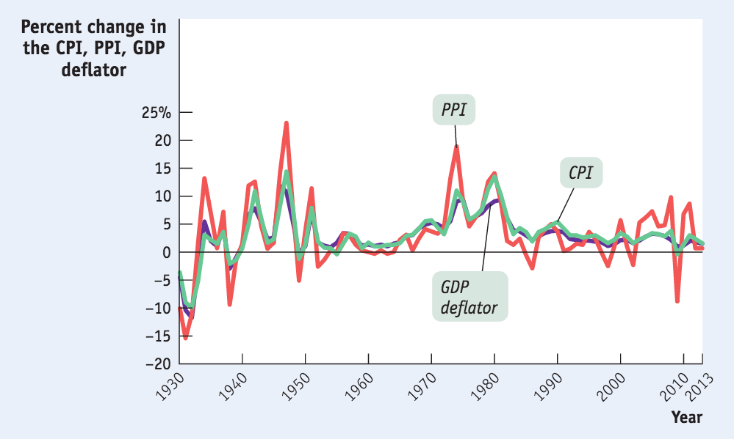
THE CPI, THE PPI, AND THE GDP DEFLATOR
The three measures usually move closely together.
Source: Bureau of Labor Statistics.

Slide 51



INDEXING TO THE CPI
Many payments like Social Security are tied (“indexed”) to the CPI
This practice goes back to the Revolutionary war: to keep soldiers’ pay in line with rising prices, wages were indexed to the cost of:
68 4/7 lbs beef, 10 lbs of wool and 16 lbs of leather
Notes:
All photo credits unless otherwise noted from Freeimages.com (Formerly Stockxchange) or Morguefile.com

Slide 52

TAKE A LOOK…
Does money buy happiness? Can well-being be measured? Does growth equal progress? These may sound like esoteric questions, but they are at the heart of efforts to move beyond GDP to develop more accurate ways of measuring human development touched on in this video. (3:19 minutes)
Notes:
http://www.youtube.com/watch?v=Ep4DWx1--sY

Slide 53
GETTING A JUMP ON GDP
Many businesses are eager for macroeconomic data and can’t wait for the government’s quarterly data
Two organizations supply monthly GDP estimates:
Macroeconomic Advisors (based on raw government data)
Institute for Supply Management (based on its own surveys of business orders)

