Slide 1
Economics 2220 Principles Of Macroeconomics
Professor Zhigang Feng
Lecture 7:
Economic Growth

Slide 2
Why long-run economic growth is measured as the increase in real GDP per capita, how real GDP per capita has changed over time, and how it varies across countries
Why productivity is the key to long-run economic growth and how productivity is driven by physical capital, human capital, and technological progress
The factors that explain why long run growth rates differ so much among countries
How growth has varied among several important regions of the world and why the convergence hypothesis applies to economically advanced countries
The question of sustainability and the challenges to growth posed by scarcity of natural resources and environmental degradation
To First
Active Learning
To Video

Slide 3
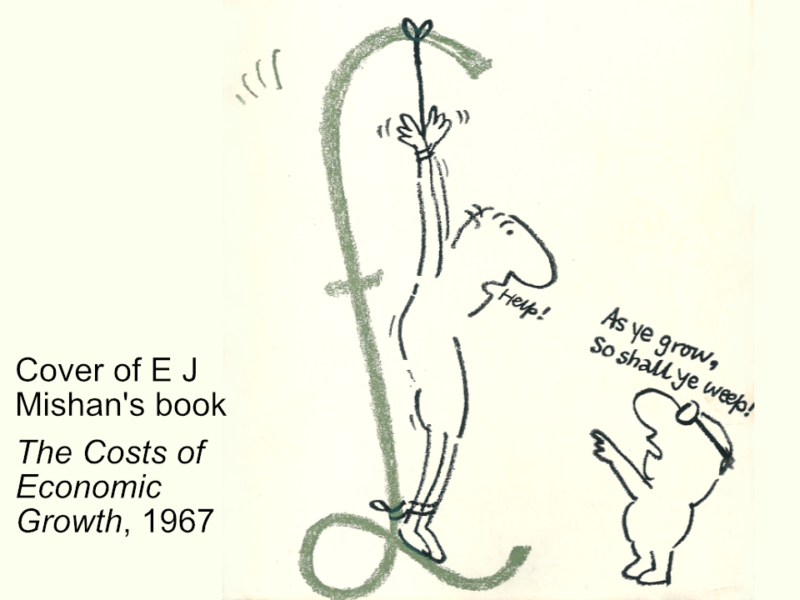

Slide 4

At TEDIndia, TED favorite Hans Rosling gives another lively and humorous talk here and graphs global economic growth since 1858. He also predicts the exact date that India and China will outstrip the United States. (15:50 minutes)
Notes:
http://www.ted.com/talks/hans_rosling_asia_s_rise_how_and_when.html

Slide 5
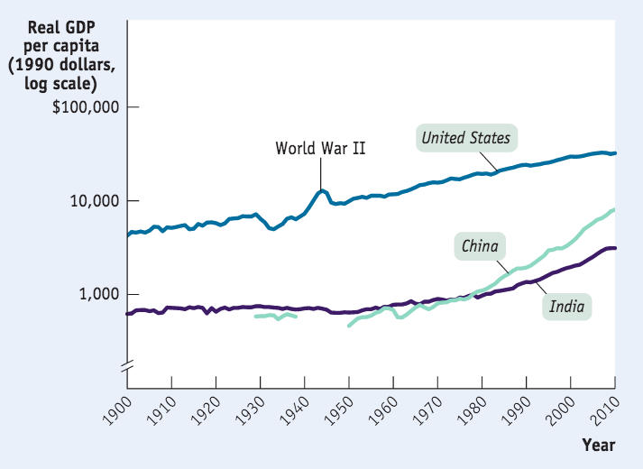
COMPARING ECONOMIES ACROSS TIME AND SPACE
Real GDP per capita (real GDP divided by the population size) is the key statistic.
Sources: Angus Maddison, Statistics on World Population, GDP, and Per Capita GDP, 1–2008AD, http://www.ggdc.net/maddison; International Monetary Fund.

Slide 6
Suppose real GDP for Macronesia is $200 million in 2010. Furthermore, suppose population in Macronesia is 100,000 in 2010. If population increases to 105,000 in 2011 while GDP increases by 5%, then it must be true that real GDP per capita in Macronesia in 2011:
increased.
decreased.
stayed constant.
may have increased, decreased, or remained constant.
To Next
Active Learning

Slide 7
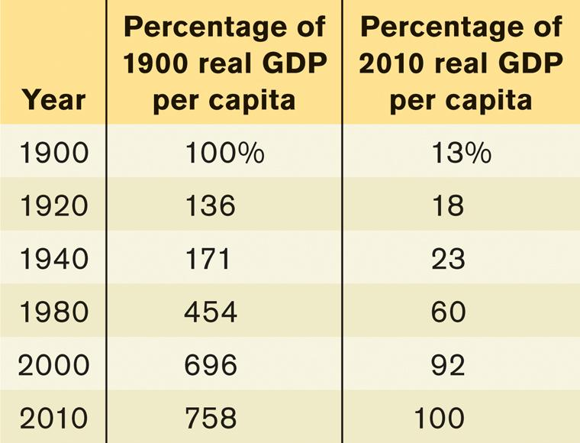
U.S. REAL GDP PER CAPITA
The U.S. economy produces more than seven times as much per person as in 1900.
Sources: Angus Maddison, Statistics on World Population, GDP, and Per Capita GDP, 1–2008AD, http://www.ggdc.net/maddison; Bureau of Economic Analysis.

Slide 8
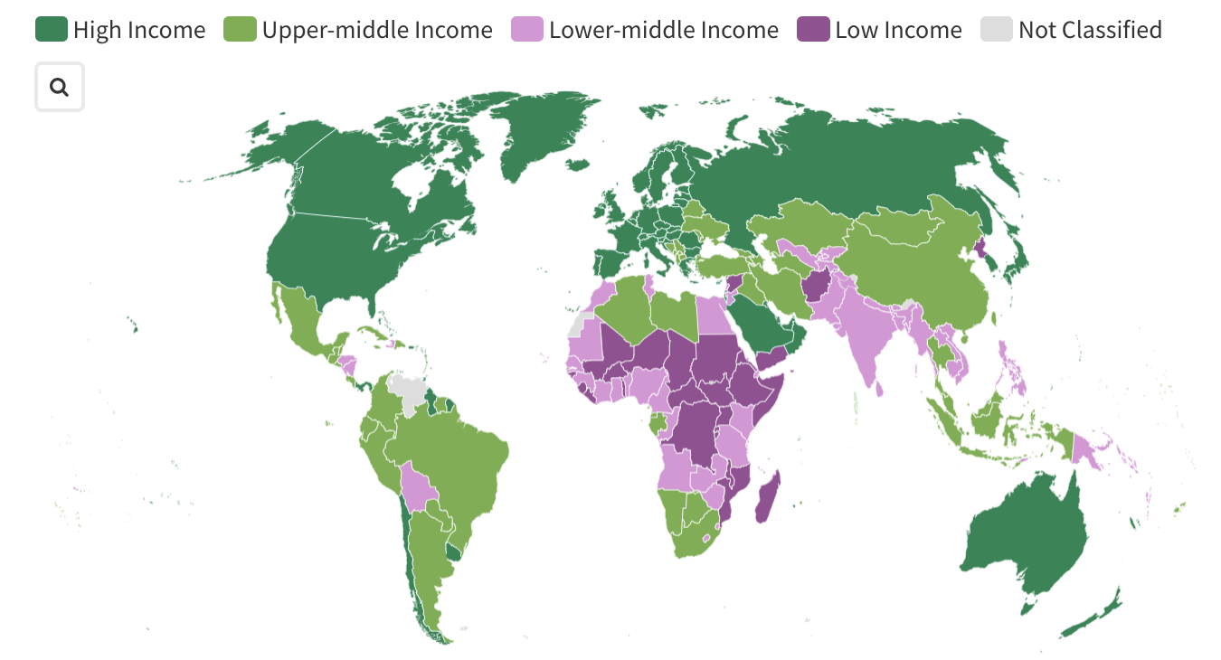
INCOMES AROUND THE WORLD, 2023
The United States has grown quickly, while some nations have stalled.
50% of the world’s population lives in countries whose standard of living is lower than the United States’ in 1900.
Source: International Monetary Fund

Slide 9
THE RULE OF 70: THE MAGIC OF COMPOUNDING
Even small differences in growth rates get magnified over time.
The rule of 70:
Example: If real GDP per capita is growing at an annual growth rate of 3.5%, it will double in:
The moral? Small improvements in growth add up fast (the power of compounding).

Slide 10
Suppose that real GDP per capita grows at 2% per year. How many years will it take for real GDP per capita to approximately double? It will take:
70 years because of the rule of 70.
140 years, because the rule of 70 states that a variable will double in 70 years if the variable has an annual growth rate of 1%; therefore, a variable growing at 2% will take twice as long to double.
35 years, because 70/2 = 35
50 years, since at 2% per year it takes 50 years to reach 100% more than the initial real GDP per capita.
To Next
Active Learning

Slide 11
Let's figure out how long it will take for the average Indian to be as wealthy as the average Western European is today. Note that all numbers are adjusted for inflation. India's GDP per capita is $3,000, and let’s assume real output per person grows at 5% per year. Using the rule of 70, how many years will it take for India to reach Italy's current level of GDP per capita, about $24,000 per year?
42 years
14 years
28 years
12 years
To Next
Active Learning

Slide 12
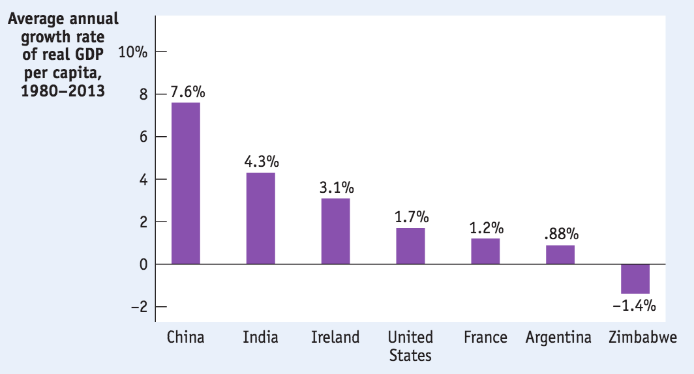
COMPARING RECENT GROWTH RATES
China, India and Ireland saw impressive growth. Zimbabwe, once the breadbasket of Africa, collapsed.

Slide 13

India’s high rate of economic growth since 1980 has raised living standards and led to the emergence of a rapidly growing middle class. Will lack of education and infrastructure hold back future growth?
Notes:
Photo credit: Sipra Das/The India Today Group/Getty images

Slide 14

THE SOURCES OF LONG-RUN GROWTH
The crucial importance of productivity
Labor productivity (often referred to simply as productivity): output per worker

Slide 15
EXPLAINING GROWTH IN PRODUCTIVITY
Increase in physical capital
Physical capital: human-made resources, such as buildings and machines

Slide 16
EXPLAINING GROWTH IN PRODUCTIVITY
Increase in human capital
Human capital: the improvement in labor created by the education and knowledge embodied in the workforce.

Slide 17

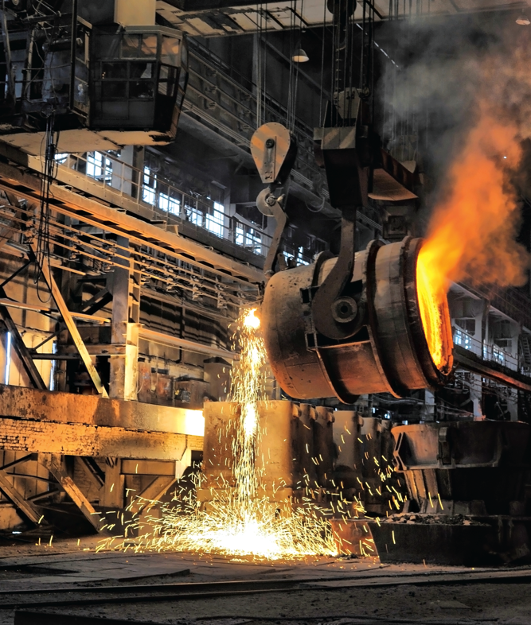
EXPLAINING GROWTH IN PRODUCTIVITY
Technological progress: an advance in the technical means of production in goods & services.
Notes:
Photo credits: Prisma/UIG via Getty Images (left picture) Kaband/Shutterstock (right picture)

Slide 18
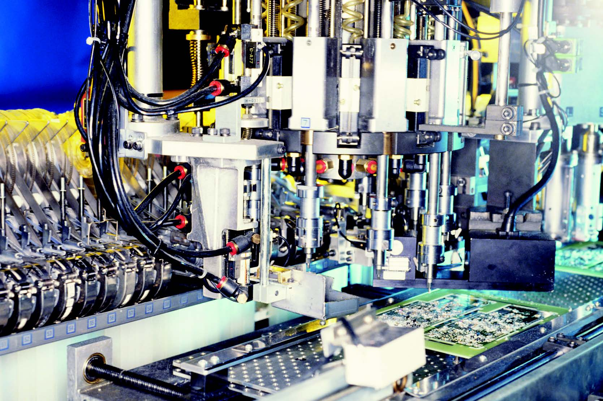
THE AGGREGATE PRODUCTION FUNCTION
How much does output change when we change inputs?
Aggregate production function: a hypothetical function that shows how productivity (real GDP per worker) depends on the quantities of physical capital per worker and human capital per worker as well as the state of technology.
Notes:
All photo credits unless otherwise noted from Freeimages.com (Formerly Stockxchange) or Morguefile.com

Slide 19
ACCOUNTING FOR GROWTH: THE AGGREGATE PRODUCTION FUNCTION
But can we be more specific? How much does output change when we change inputs?
For instance, China and India may have a production function like this (Brookings Institution estimates):
GDP per worker = T × (physical capital per worker)^{0.4} × (human capital per worker)^{0.6}
If China had more physical capital than India, that would explain its quicker growth.

Slide 20

THE AGGREGATE PRODUCTION FUNCTION
There are some well-known patterns.
Diminishing returns to physical capital: holding the amount of human capital per worker and the state of technology fixed, each successive increase in the amount of physical capital per worker leads to a smaller increase in productivity.
A second computer improves his productivity, but not by as much as the first computer did.
Notes:
All photo credits unless otherwise noted from Freeimages.com (Formerly Stockxchange) or Morguefile.com

Slide 21
ACCOUNTING FOR GROWTH: THE AGGREGATE PRODUCTION FUNCTION
Real GDP per worker
$60,000
50,000
30,000
0
1. The increase in real GDP per worker becomes smaller . . .
C
B
A
$20,000 50,000 80,000
Physical capital per worker (2000 dollars)
2. as physical capital per worker rises…

Slide 22

TECHNOLOGY AND PRODUCTIVITY
So additional amounts of physical capital are less productive when the amount of human capital per worker and the technology are held fixed.
But this assumes all other things equal.
Diminishing returns may disappear if we increase the amount of human capital per worker or improve the technology or both as the amount of physical capital per worker is increased.
Notes:
All photo credits unless otherwise noted from Freeimages.com (Formerly Stockxchange) or Morguefile.com

Slide 23
TOTAL FACTOR PRODUCTIVITY
Real GDP per worker
(constant dollars)
$120,000
D
Rising total factor productivity shifts curve up
60,000
50,000
30,000
0
C
B
A
$20,000 50,000 80,000
Physical capital per worker
(constant dollars)

Slide 24
GROWTH ACCOUNTING
How do we tell what caused the growth (and help develop future policy)?
Growth accounting: estimates of the contribution of each major factor in the aggregate production function to economic growth.
Total factor productivity: the amount of output that can be produced with a given amount of factor inputs.
(When total factor productivity increases, the economy can produce more output with the same quantity of physical capital, human capital, and labor.)

Slide 25
TECHNOLOGY AND PRODUCTIVITY
Increases in total factor productivity are crucial for growth.
And increases in total factor productivity likely measure the economic effects of technological progress.
So technological change is crucial to economic growth.

Slide 26

WHAT ABOUT NATURAL RESOURCES?
In the modern world, human or physical capital matter more than natural resources for the great majority of countries.

Slide 27
Is the end of economic growth in sight?
Economist Robert Gordon argues that new information technologies won’t create as much growth as the five big innovations:
Electricity
The internal combustion engine
Running water and central heating
Modern chemistry
Mass communication, movies, and telephones
Is it too soon to tell?

Slide 28
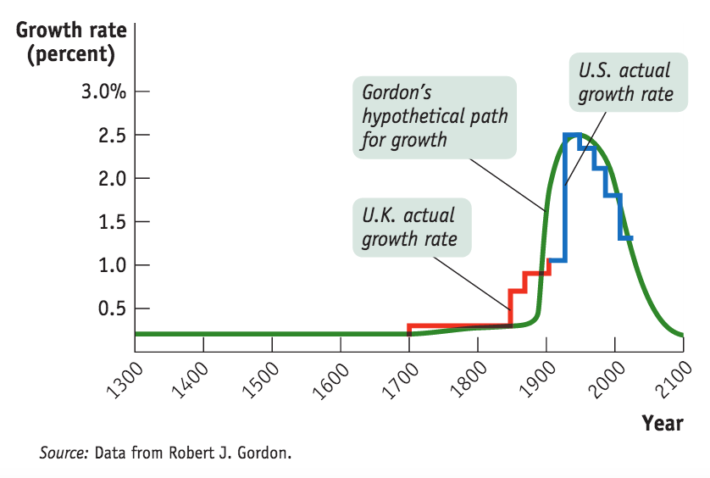
Is the end of economic growth in sight?
Robert Gordon’s predictions vs. data

Slide 29

What economic growth looks like at night
Notes:
All photo credits unless otherwise noted from Freeimages.com (Formerly Stockxchange) or Morguefile.com

Slide 30


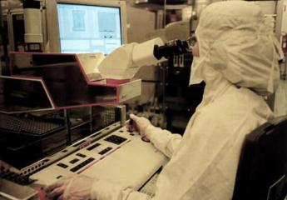
WHY GROWTH RATES DIFFER
Savings and investment spending
Education
Research and development

Slide 31
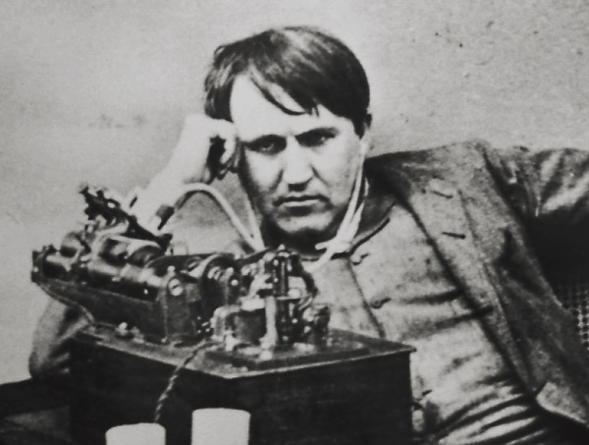
RESEARCH AND DEVELOPMENT
Research and development (R&D): spending to create and implement new technologies
Thomas Edison: inventor of light bulb…. And research and development.

Slide 32
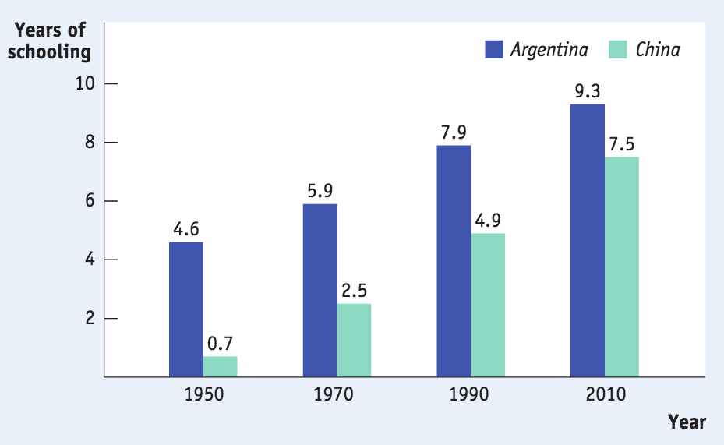
CHINA’S STUDENTS ARE CATCHING UP
China’s success at adding human capital is one key to its spectacular long-run growth.
Source: Robert Barro and Jong-Wha Lee, “A New Data Set of Educational Attainment in the World, 1950– 2010,” NBER Working Paper No. 15902 (April 2010).

Slide 33
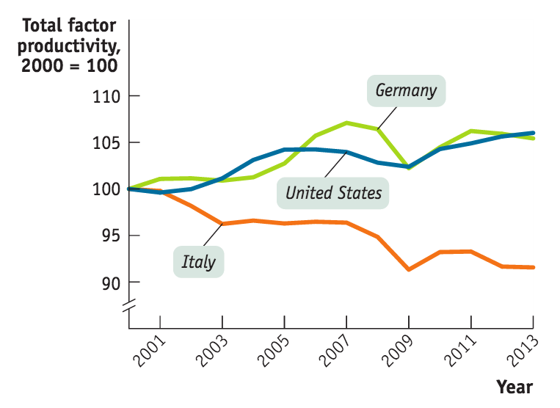
What’s the matter with italy?
Is Italy’s productivity slump due to rigid labor markets, political weakness or slow information technology infrastructure?
Source: The Conference Board Total Economy Database, January 2014

Slide 34
THE ROLE OF GOVERNMENT IN PROMOTING ECONOMIC GROWTH
Government policies
GOVERNMENT SUBSIDIES TO INFRASTRUCTURE
Infrastructure: roads, power lines, ports, information networks, and other underpinnings for economic activity.
GOVERNMENT SUBSIDIES TO EDUCATION
GOVERNMENT SUBSIDIES TO R&D
MAINTAINING A WELL-FUNCTIONING FINANCIAL SYSTEM
Protection of property rights
Political stability and good governance

Slide 35
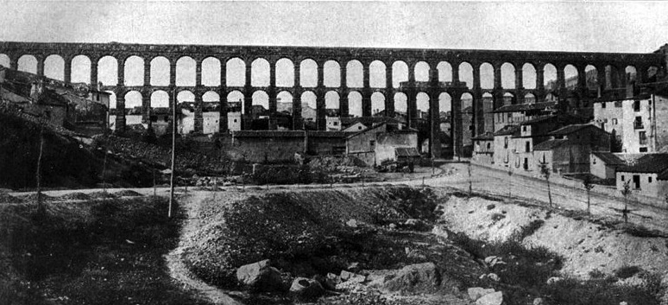
INFRASTRUCTURE
Roman aqueducts: ushering in an era of economic growth.
Aqueducts were sophisticated feats of engineering that enabled population and industry to thrive.
Roman Aqueduct in Segovia, Spain, built in second century A.D./C.E.

Slide 36

Why did britain fall behind?
There are many theories- but it’s clear Britain fell behind the United States and Germany largely due to barriers to education.

Slide 37

WHAT CAUSED EAST ASIA’S MIRACLE?
Very high savings rates that allow business to borrow and add more physical capital per worker.
Very good basic education has permitted a rapid improvement in human capital.
Substantial technological progress.
Notes:
SEOUL plaza
All photo credits unless otherwise noted from Freeimages.com (Formerly Stockxchange) or Morguefile.com

Slide 38
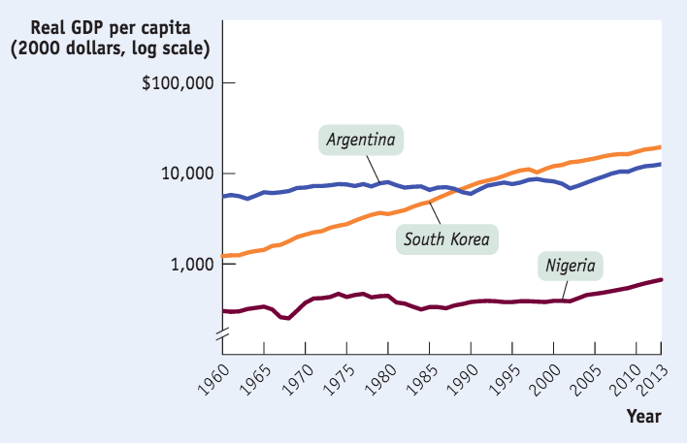

SUCCESS, DISAPPOINTMENT AND FAILURE
What’s holding Argentina (and other Latin American nations) back?
Irresponsible government action that eroded savings through high inflation
Lack of emphasis on education
Political instability
Source: World Bank.

Slide 39

AFRICA’S TROUBLES AND PROMISE
What’s holding much of Africa back?
Government corruption
Civil wars & political instability
Unfavorable geography
A big question: Is Africa poor because its politics are unstable? Or vice versa?
Good news: Growth rates are up in
sub-Saharan African nations since 2011.

Slide 40
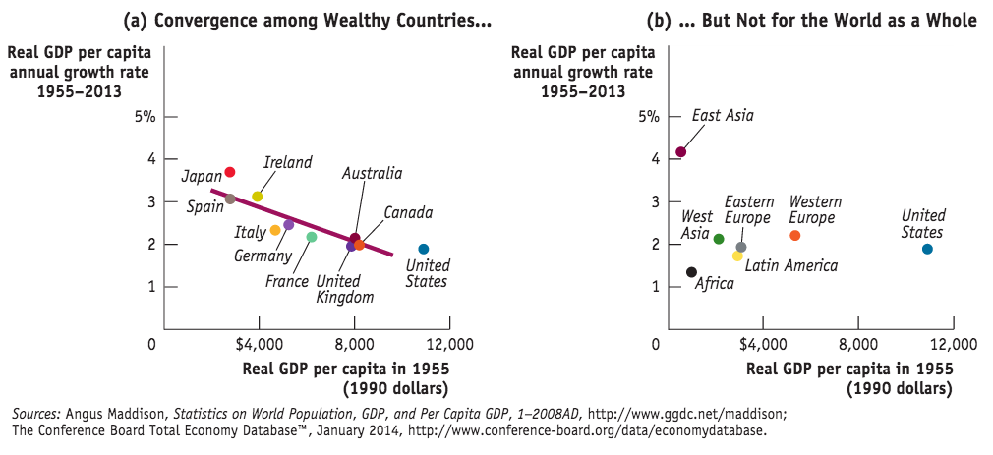
CONVERGENCE HYPOTHESIS
Convergence hypothesis: international differences in real GDP per capita tend to narrow over time.

Slide 41
Economic growth can be especially fast:
for countries playing catch-up with countries that already have high real GDP per capita.
for relatively poor countries if the convergence hypothesis holds true.
if the country is able to benefit from adopting the technological advances already used in advanced countries.
Answers (a), (b), and (c) are all true.

Slide 42
At TEDIndia, TED favorite Hans Rosling gives another lively and humorous talk here and graphs global economic growth since 1858. He also predicts the exact date that India and China will outstrip the United States. (15:50 minutes)
Notes:
http://www.ted.com/talks/hans_rosling_asia_s_rise_how_and_when.html

Slide 43
IS WORLD GROWTH SUSTAINABLE?
Sustainable long-run economic growth: long-run growth that can continue in the face of the limited supply of natural resources and the impact of growth on the environment.
What is the impact of limited natural resources on long-run economic growth? Three important questions:
How large are the supplies of key natural resources?
How effective will technology be at finding alternatives to natural resources?
Can long-run economic growth continue in the face of resource scarcity?

Slide 44
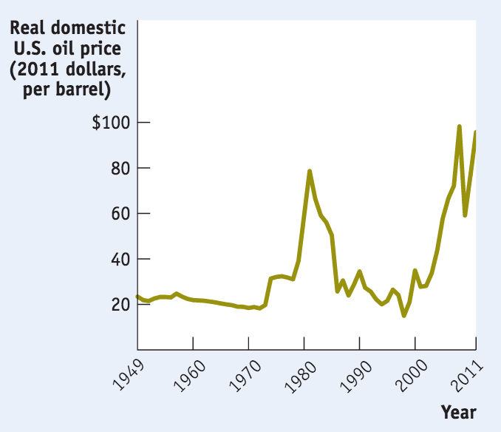
NATURAL RESOURCES AND GROWTH, REVISITED
How large are the supplies of key natural resources?
Geologists are figuring it out.
Source: Energy Information Administration.

Slide 45
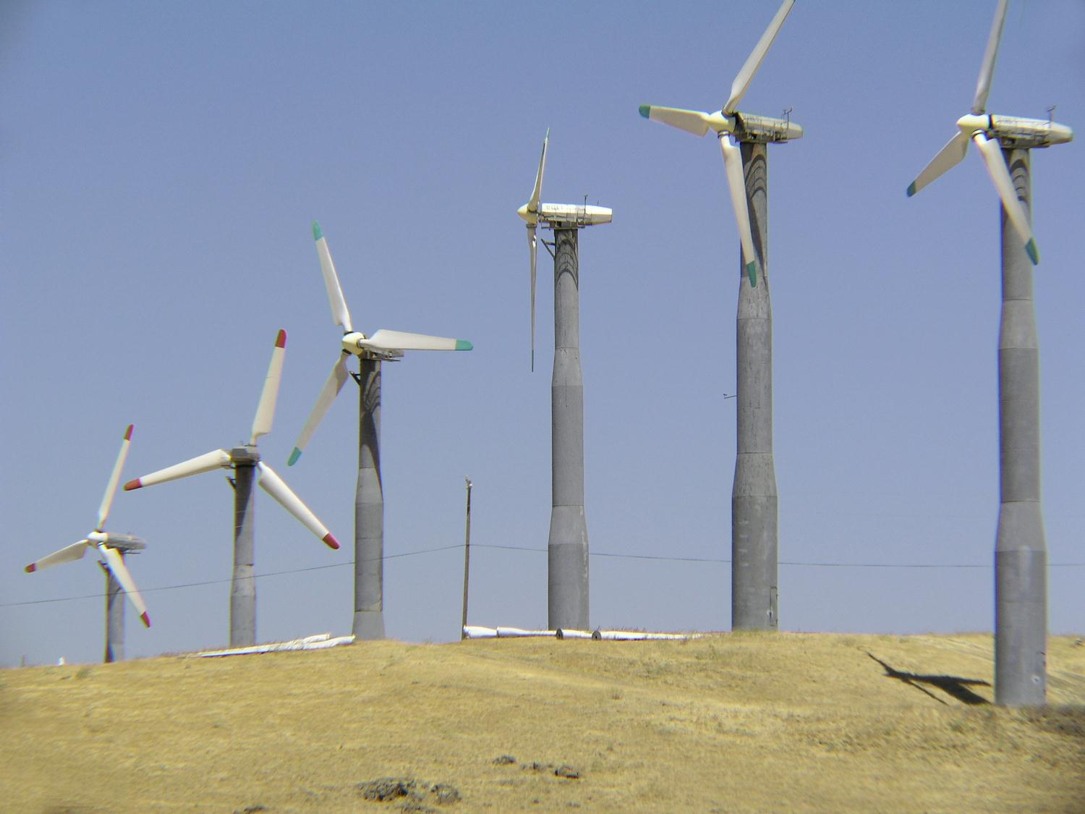
NATURAL RESOURCES AND GROWTH, REVISITED
How effective will technology be at finding alternatives to natural resources?
Engineers are figuring it out.

Slide 46
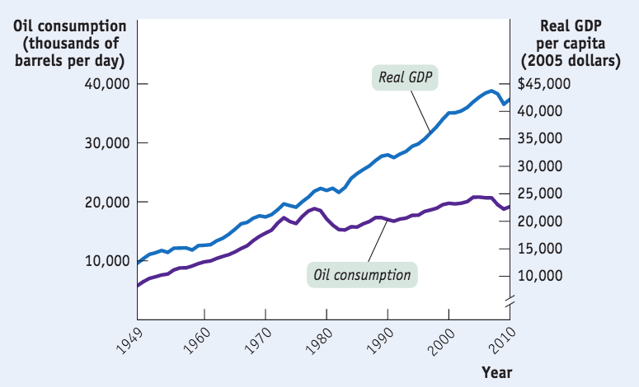
NATURAL RESOURCES AND GROWTH, REVISITED
Can long-run economic growth continue in the face of resource scarcity?
A question for economists. Resource scarcity and higher prices don’t necessarily cost growth.
Sources: Energy Information Administration; FRED; Bureau of Economic Analysis.

Slide 47
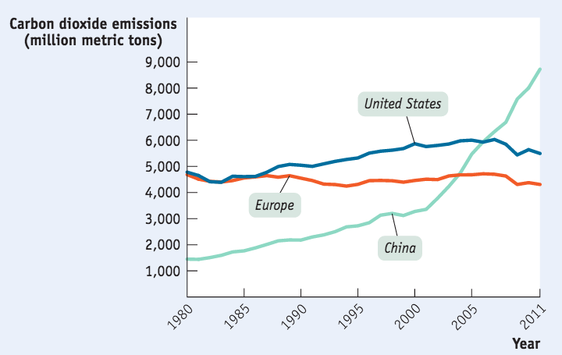
ECONOMIC GROWTH AND THE ENVIRONMENT
Economic growth tends to increase the human impact on the environment.
Sources: Energy Information Administration; Bureau of Economic Analysis.
Unlike resource scarcity, environmental problems don’t automatically provide incentives for changed behavior.

Slide 48
ECONOMIC GROWTH AND THE ENVIRONMENT
There is consensus in economics that government action is needed to deal with climate change.
Economists prefer market-based incentives, in the form of:
Carbon tax (a tax per unit of carbon emitted) or
Cap and trade system in which the total amount of emissions is capped and producers must buy licenses to emit greenhouse gases.
How much action is appropriate? We are uncertain about how fast climate change is happening and what impact the solutions will have.

Slide 49

THE COST OF CLIMATE PROTECTION
Numerous studies find the cost of carbon reduction is smaller than expected.
2014: The U.N. International Panel on Climate Change (IPCC) estimated that global measures limiting the rise in temperatures to 2 degrees centigrade would be small—around 0.06 percentage points reduction in growth each year.

