Slide 1
Economics 2220 Principles Of Macroeconomics
Professor Zhigang Feng
Lecture 8:
Business cycle,
Unemployment and Inflation

Slide 2
How unemployment is measured and how the unemployment rate is calculated
The significance of the unemployment rate for the economy
The relationship between the unemployment rate and economic growth
The factors that determine the natural rate of unemployment
The economic costs of inflation
How inflation and deflation create winners and losers
Why policy makers try to maintain a stable rate of inflation
To First
Active Learning
To Video

Slide 3
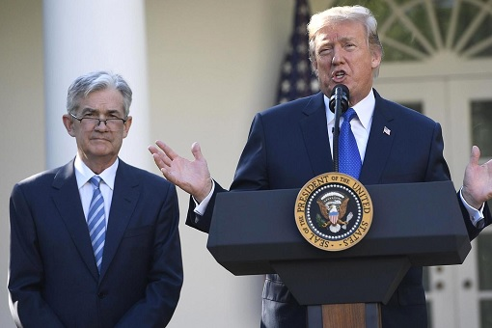
HITTING THE “BRAKING” POINT
The chair of the Federal Reserve (Jerome Powell) must balance the needs of workers against the need for price stability
Notes:
Photo credit: Bradley Boner/Bloomberg via Getty Images

Slide 4
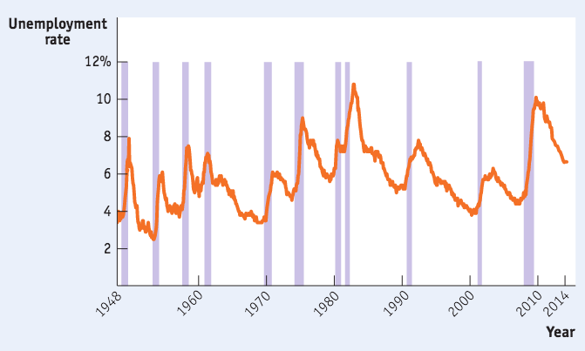
THE U.S. UNEMPLOYMENT RATE, 1948–2014
Unemployment always rises during recessions and usually (but not always) falls during periods of economic expansion.
Sources: Bureau of Labor Statistics; National Bureau of Economic Research.

Slide 5
DEFINING UNEMPLOYMENT
Unemployment rate: the percent of the total number of people in the labor force who are unemployed.
Labor force: all workers, employed or unemployed.
Labor force participation rate: the percentage of adults (people 16 and over) in the labor force.

Slide 6
DEFINING UNEMPLOYMENT
Measuring the labor force participation rate: The % of the adult (16+) noninstitutionalized civilian population who are working or actively looking for work.
Measuring unemployment: The unemployment rate is the % of the labor force without a job

Slide 7
In your country, there are 24 million people in the labor force. 21.5 million people are employed. What is the unemployment rate in your country?
10.4%
2.5%
89.6%
21.5%
To Next
Active Learning

Slide 8
THE SIGNIFICANCE OF THE UNEMPLOYMENT RATE
The unemployment rate is a good indicator of how easy or difficult it is to find a job given the current state of the economy.
It can overstate the true level of unemployment.
Even if the labor market is healthy, it takes time to find the right job. (Meanwhile, you’re “unemployed.”)
It can understate the true level of unemployment.
You are not “unemployed” if you have given up looking for a job because there are no jobs available.

Slide 9
PROBLEMS WITH UNEMPLOYMENT STATISTICS
Discouraged workers: nonworking people who have given up looking for work for the time being. Not considered unemployed.
The deeper the recession, the more discouraged workers there are.
Marginally attached workers: those who were available and actively looked for work recently but are not currently looking (in the past 12 months but NOT in the past 4 weeks)
Underemployed workers: people who work part time because they cannot find full-time jobs.
Notes:
All photo credits unless otherwise noted from Freeimages.com (Formerly Stockxchange) or Morguefile.com

Slide 10
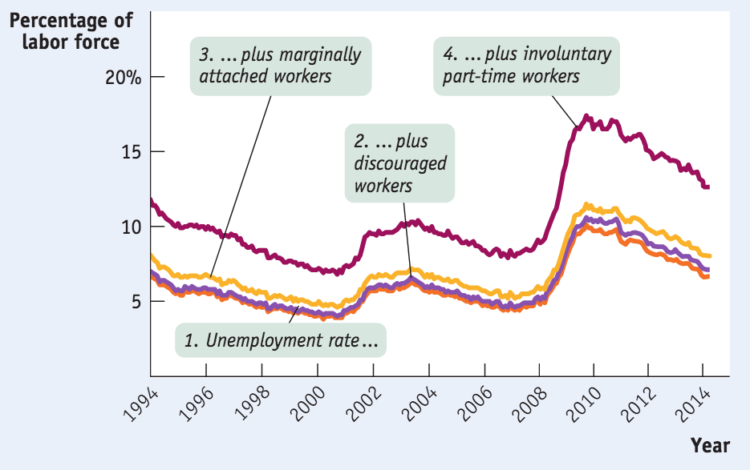
ALTERNATIVE MEASURES OF UNEMPLOYMENT, 1994–2014
Source: Bureau of Labor Statistics

Slide 11
Adult population | 200 million
Labor force | 150 million
Employed persons | 138.75 million
Discouraged workers | 10.5 million
According to the table, the unemployment rate is _________ and the labor force participation rate is __________.
7%; 60.4%
0.7%; 99.3%
5.6%; 69.4%
7.5%; 75%
To Next
Active Learning

Slide 12
Which of the following individuals can be counted as unemployed?
Darren, a 10-year-old child
Nazma, a stay-at-home mom
Moesha, a full-time college student
Carl, who works part time at the Olive Garden but would prefer more hours
None of the answers is correct.
To Next
Active Learning

Slide 13
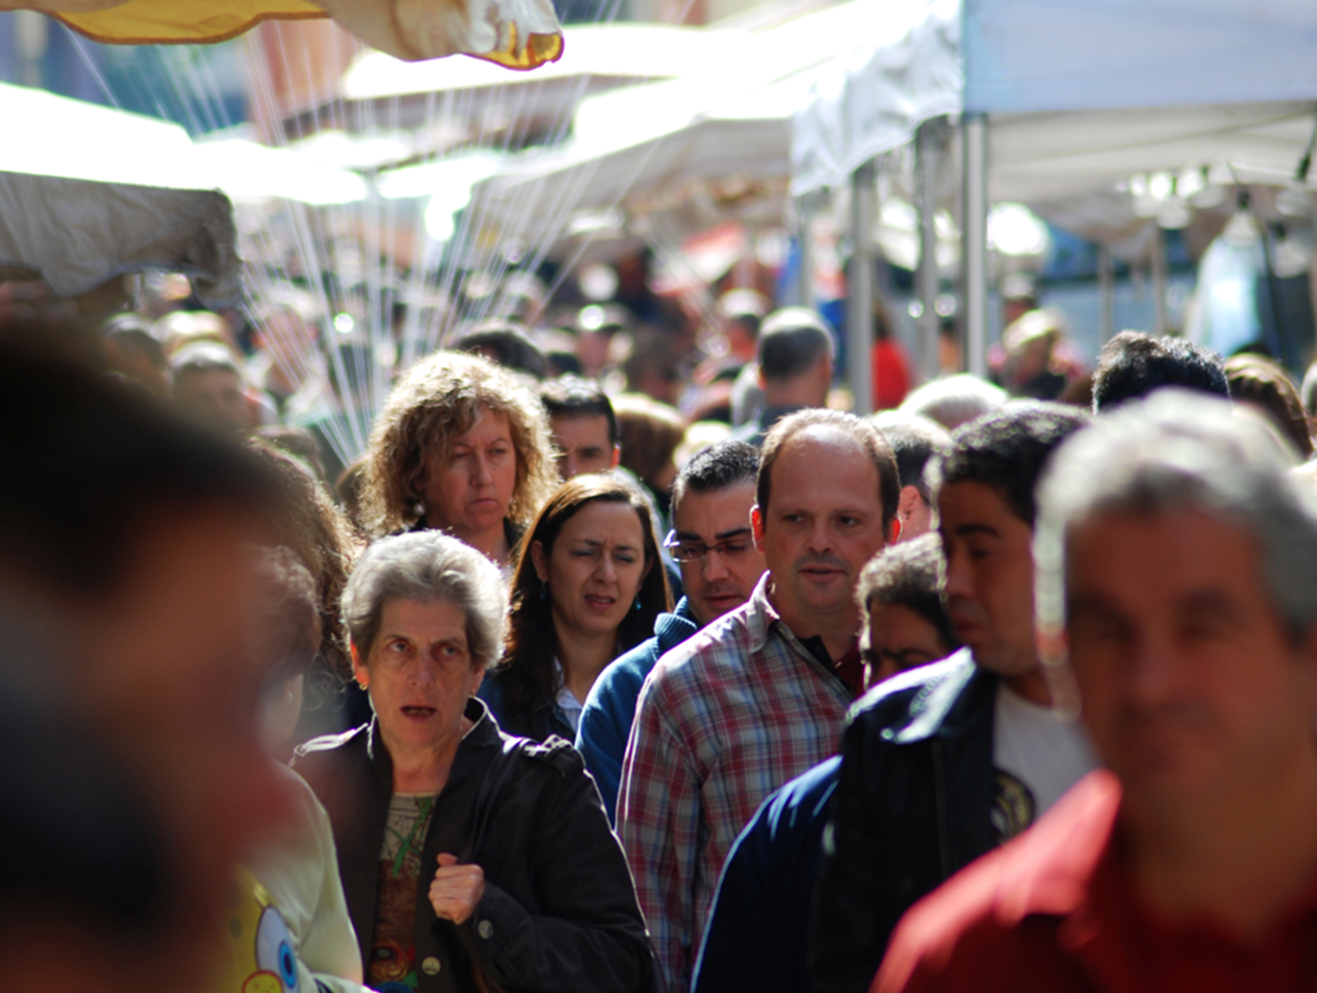
DEFINING UNEMPLOYMENT
So how good an indicator is the unemployment rate?
It isn’t perfect.
It doesn’t measure the quality of jobs or how well people are matched to their jobs.
Economists also look at other indicators:
Labor force participation rate
Number of full-time jobs
Average wages
Notes:
All photo credits unless otherwise noted from Freeimages.com (Formerly Stockxchange) or Morguefile.com

Slide 14
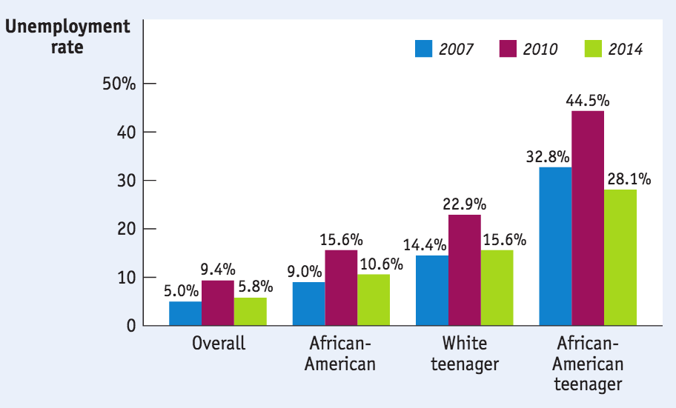
UNEMPLOYMENT RATES AND DEMOGRAPHICS
Data show that unemployment rates vary greatly between groups.
Source: Bureau of Labor Statistics

Slide 15
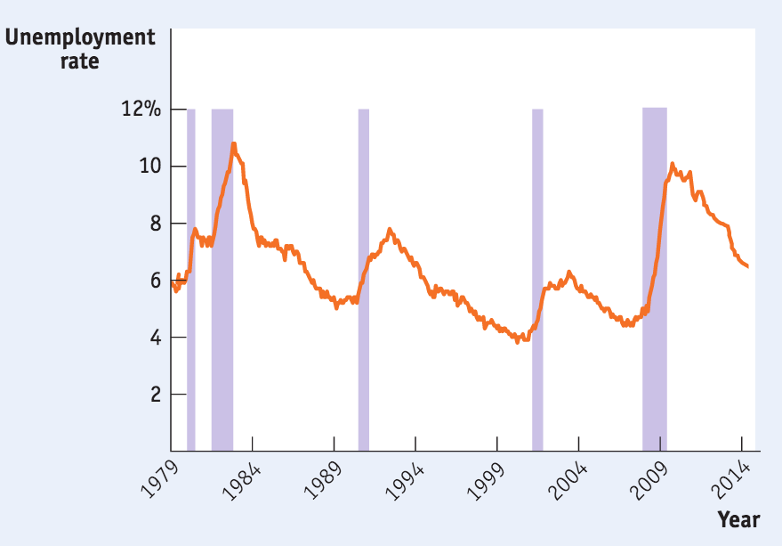
GROWTH AND UNEMPLOYMENT
Unemployment and Recessions,
1978–2014 (Shaded areas are recessions.)
Sources: Bureau of Labor Statistics; National Bureau of Economic Research.
A jobless recovery is a period in which the real GDP growth rate is positive but the unemployment rate is still rising.

Slide 16
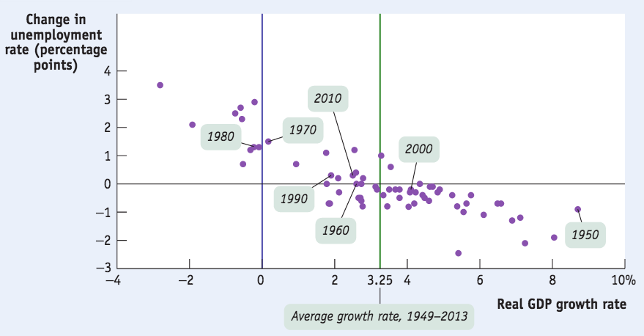
GROWTH AND CHANGES IN UNEMPLOYMENT, 1949–2013
Generally there is a negative relationship between economic growth and the unemployment rate.
Sources: Bureau of Labor Statistics; Bureau of Economic Analysis.

Slide 17
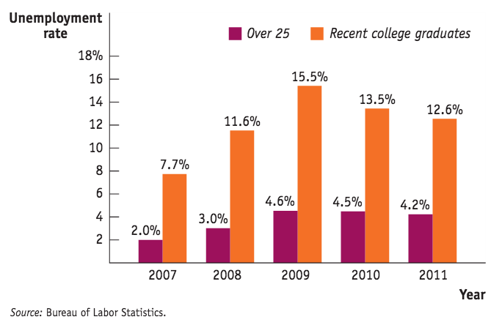
Failure to Launch
Times of high unemployment are especially hard on new graduates.

Slide 18
THE NATURAL RATE OF UNEMPLOYMENT
Some unemployment is natural.
Over the past 50 years, the national unemployment rate has never dropped below 2.9%.
There are three types of unemployment:
frictional
structural
cyclical

Slide 19
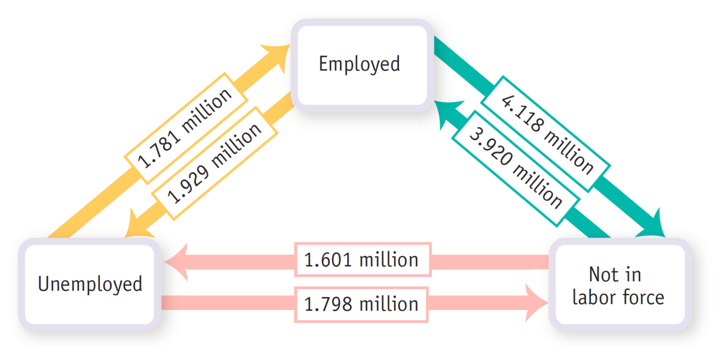
LABOR MARKET FLOWS IN AN AVERAGE MONTH IN 2007
In a healthy year (like 2007) many workers move into and out of both employment and unemployment each month.

Slide 20






FRICTIONAL UNEMPLOYMENT
Frictional unemployment: unemployment due to the time workers spend in job search.
Scarcity of information creates frictional unemployment.
Matching people to jobs takes time.
Notes:
All photo credits unless otherwise noted from Freeimages.com (Formerly Stockxchange) or Morguefile.com

Slide 21
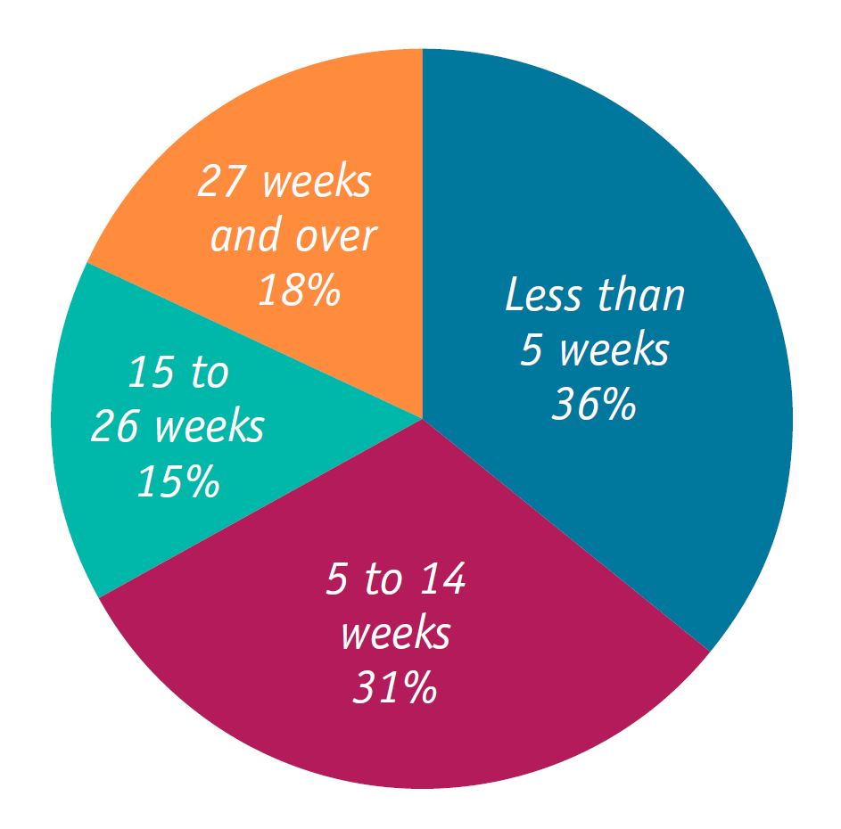
DURATION OF UNEMPLOYMENT, 2007
The short duration of unemployment for most workers suggests that most unemployment in 2007 was frictional.
Source: Bureau of Labor Statistics.

Slide 22
STRUCTURAL UNEMPLOYMENT
Structural unemployment: more people are seeking jobs in a particular labor market than there are jobs available at the current wage rate, even when the economy is at the peak of the business cycle.
Some causes:
Labor unions
Efficiency wages
Efficiency wages: wages that employers set above the equilibrium rate as an incentive for better employee performance.
Side effects of government policies
Mismatches between employees and employers

Slide 23

STRUCTURAL UNEMPLOYMENT
Union: an association of workers that bargains collectively with employers over wages, benefits, and working conditions.
Unions take many forms: some act to increase wages simply by restricting entry into a profession with licensing requirements.
Notes:
All photo credits unless otherwise noted from Freeimages.com (Formerly Stockxchange) or Morguefile.com

Slide 24
STRUCTURAL UNEMPLOYMENT
The traditional argument: minimum wage creates low-skilled unemployment: the higher the wage, the more structural unemployment.
Wage rate
Structural
unemployment
Labor supply
Minimum
wage
Minimum
wage
Equilibrium
wage
Labor demand
Q_{D}
Q_{E}
Q_{S}
Quantity of labor

Slide 25
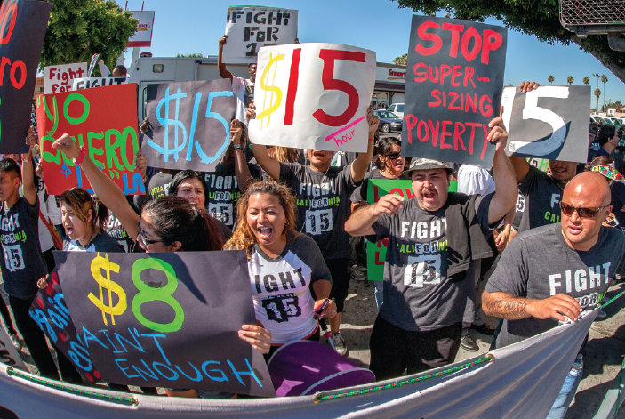
MINIMUM WAGE AND UNEMPLOYMENT
Other research suggests the opposite effect… at any rate, minimum wage in the U.S. is relatively low.
Notes:
Photo credit: Marmaduke/St John Alamy

Slide 26
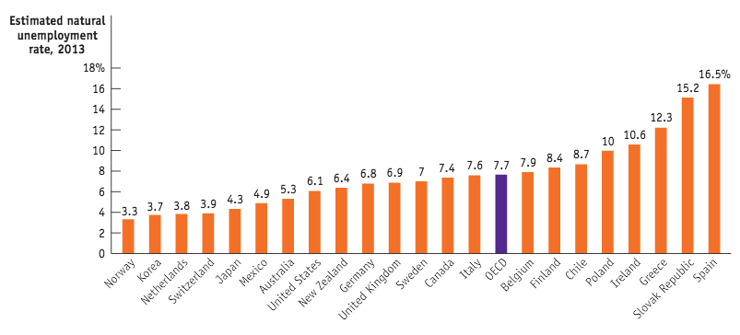
NATURAL UNEMPLOYMENT AROUND THE OECD
Are persistently high European unemployment rates the result of government policies like high minimum wages and generous unemployment benefits?
Source: OECD.

Slide 27
Jasmine has recently moved to Florida because she loves the warm climate there. Being new to the area, she will need to spend a few weeks looking for a new job. This is an example of:
frictional unemployment.
cyclical unemployment.
structural unemployment.
underemployment.
To Next
Active Learning

Slide 28
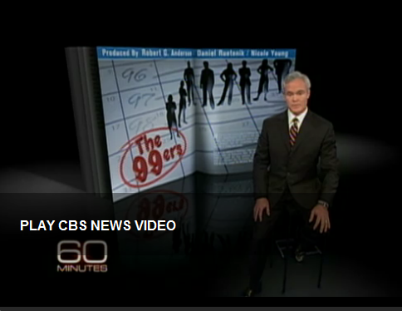
Take a look…
Even after an extension of unemployment benefits to 99 weeks, many of those about to go off the program are in a quandary. 60 Minutes talks to some of them in Silicon Valley in this clip. (13:05 minutes)
Notes:
https://www.youtube.com/watch?v=CwpdGyIY2fQ

Slide 29
THE NATURAL RATE OF UNEMPLOYMENT
Frictional and structural unemployment are always present; they are “natural.”
Natural unemployment = frictional unemployment + structural unemployment.
Actual unemployment = natural unemployment + cyclical unemployment.

Slide 30
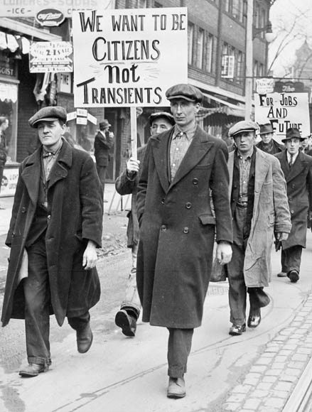
CYCLICAL UNEMPLOYMENT
Cyclical unemployment: unemployment correlated with the business cycle—the deviation from the natural rate.
Lower growth is usually correlated with higher unemployment for two reasons:
When GDP falls, firms lay off workers.
Idle labor and capital → economic growth not being maximized → ↓ ability of the economy to create more jobs.
Fighting for jobs in the Great Depression
Notes:
All photo credits unless otherwise noted from Freeimages.com (Formerly Stockxchange) or Morguefile.com

Slide 31
CHANGES IN THE NATURAL RATE OF UNEMPLOYMENT
We need estimates of the natural rate of unemployment both to make forecasts and to conduct policy analyses.
What causes it to change?
Changes in characteristics of the labor force
Changing demographics
Changes in labor market institutions
Unions, temp agencies, and new technology
Changes in government policies
Job training programs

Slide 32
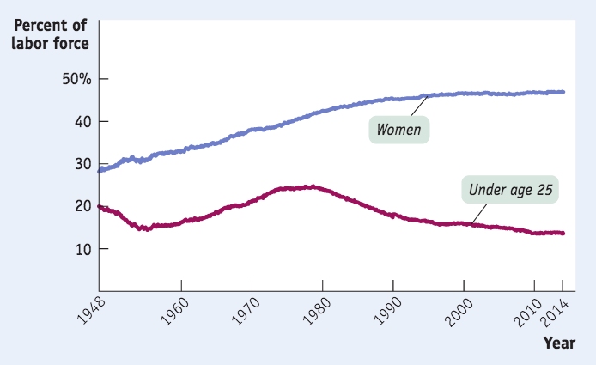
THE CHANGING MAKEUP OF THE U.S. LABOR FORCE, 1948–2014
1970s: Women and baby boomers join the labor force in droves.
Source: Bureau of Labor Statistics

Slide 33
Which of the following statements is true?
The natural rate of unemployment equals a country’s unemployment rate during a recession.
The natural rate of unemployment equals a country’s unemployment rate during an expansion.
The natural rate of unemployment is the sum of frictional and structural unemployment.
The natural rate of unemployment is the sum of frictional and cyclical unemployment.
To Next
Active Learning

Slide 34
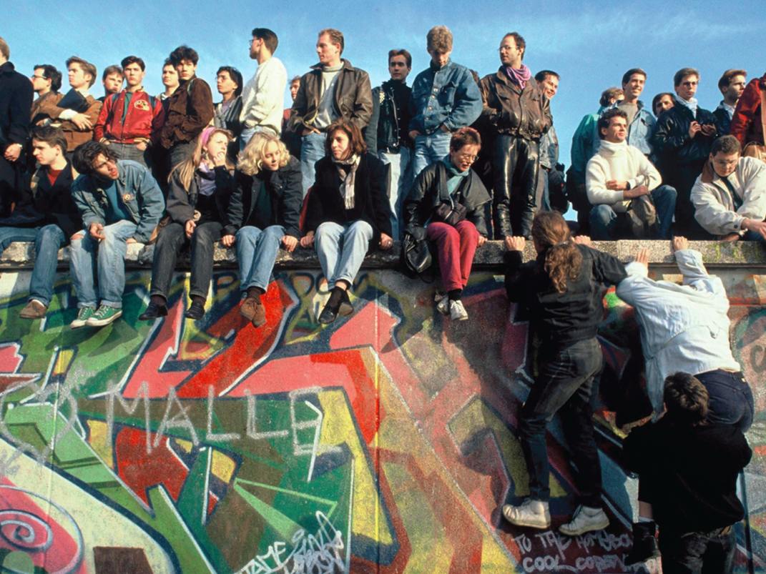
STRUCTURAL UNEMPLOYMENT IN EAST GERMANY
Since reunification in 1989, East Germany’s economy has remained depressed, with productivity low and structural unemployment high.
Notes:
Photo Credit: Robert Wallis/Corbis

Slide 35
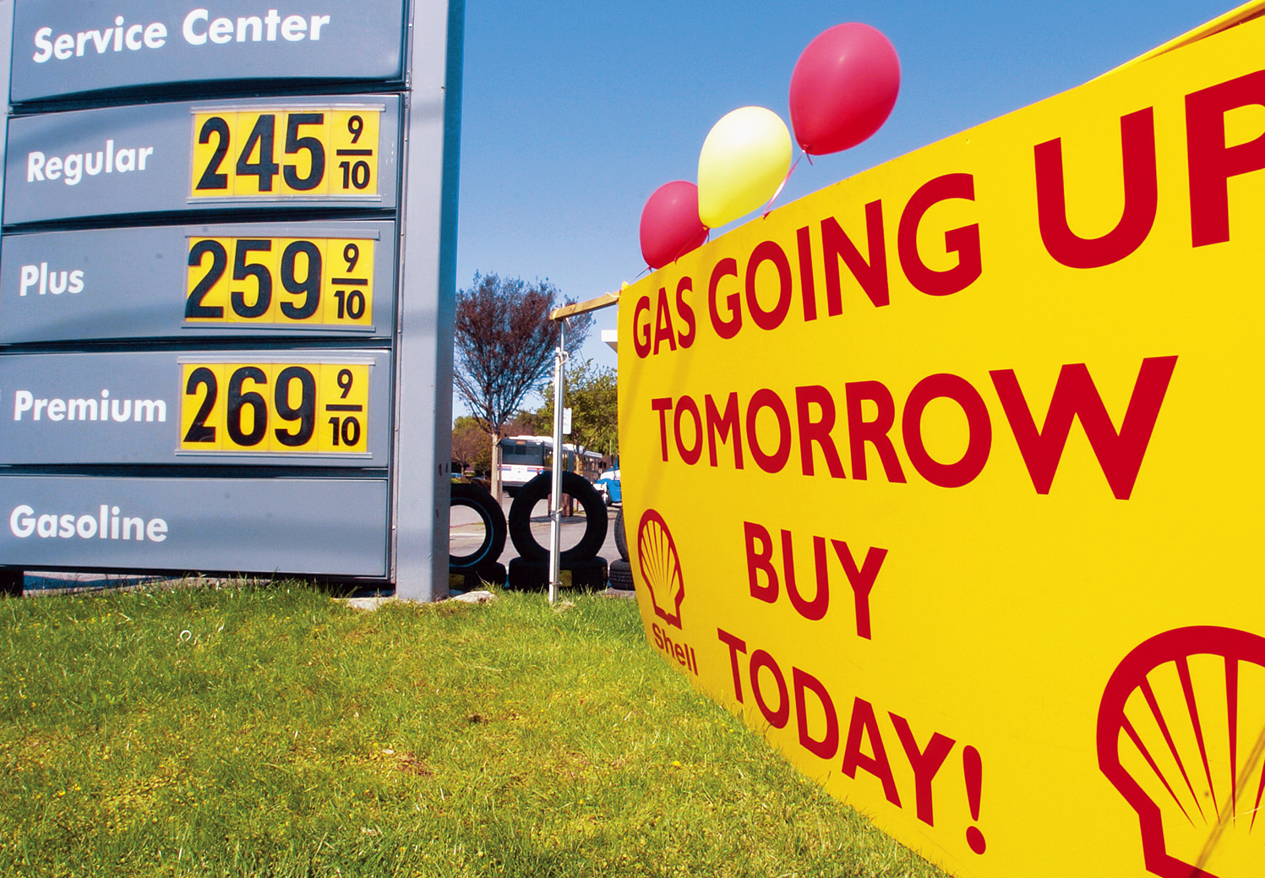
INFLATION AND DEFLATION
Inflation hurts the economy, but most people misunderstand how.
Notes:
Photo credie: AP Photo/Paul Sakuma

Slide 36
THE LEVEL OF PRICES DOESN’T MATTER
Inflation does not make everyone poorer because incomes often rise with prices.
A better measure? Real wages.
Real wage is the wage rate divided by the price level.
Real income is income divided by the price level.

Slide 37
THE RATE OF CHANGE DOES MATTER
It’s crucial to distinguish between the level of prices and the inflation rate
Inflation rate = Price level in year 2 – Price level in year 1 X 100
Price level in year 1
Example: if the CPI increases from 120 to 135 over a year, what is the inflation rate?
Answer: inflation rate = 135-120 x 100 = 12.5%
120

Slide 38
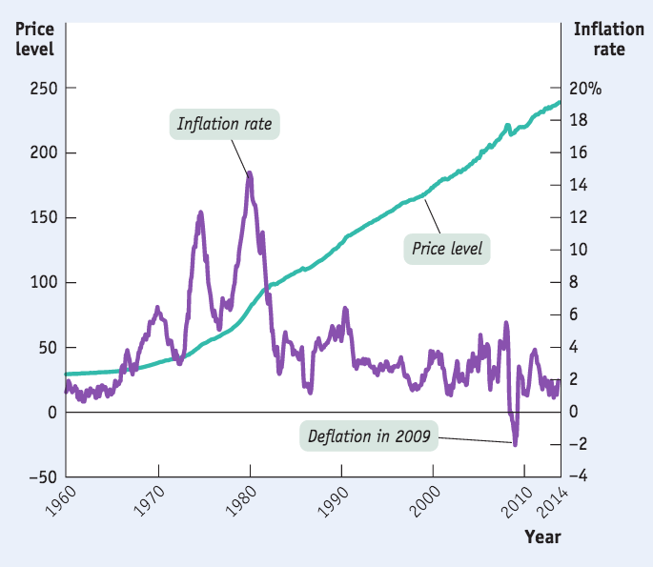
THE PRICE LEVEL VS. THE INFLATION RATE, 1960–2014
The consumer price index has continuously increased,
but the inflation rate fluctuates.
Source: Bureau of Labor Statistics.

Slide 39
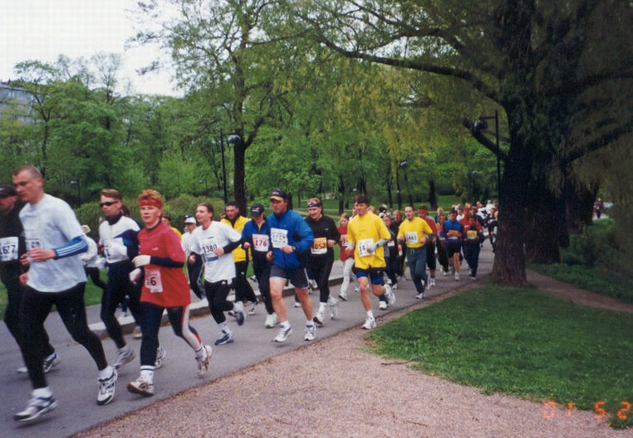
WHAT HIGH INFLATION COSTS
Shoe-leather costs: the increased costs of transactions caused by inflation.
Since cash loses its value quickly during high inflation, people waste more time running around to spend it as fast as they can
Notes:
All photo credits unless otherwise noted from Freeimages.com (Formerly Stockxchange) or Morguefile.com

Slide 40
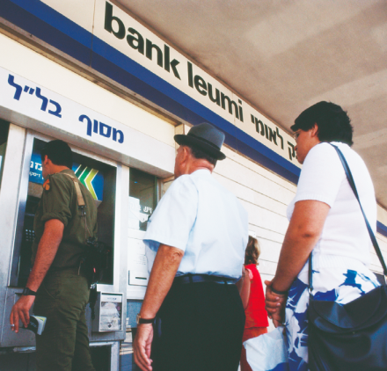
Israel’s experience with inflation
The shoe-leather costs of inflation in Israel: When the inflation rate hit 500% in 1985, people spent a lot of time in line at banks.
Notes:
All photo credits unless otherwise noted from Freeimages.com (Formerly Stockxchange) or Morguefile.com

Slide 41

WHAT INFLATION COSTS
Menu cost: the real cost of changing a listed price.
Notes:
All photo credits unless otherwise noted from Freeimages.com (Formerly Stockxchange) or Morguefile.com

Slide 42
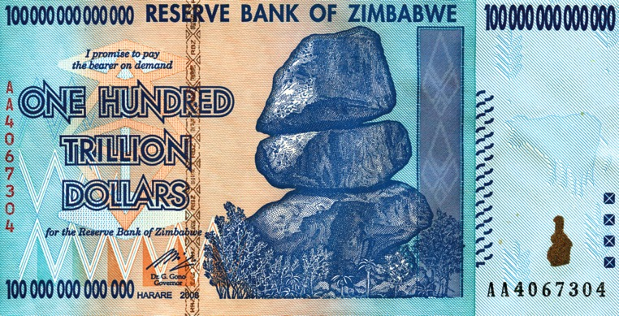
WHAT INFLATION COSTS
Unit-of-account costs: costs arising from the way inflation makes money a less reliable unit of measurement.
Calculations are hard when inflation is high.

Slide 43
WINNERS AND LOSERS FROM INFLATION
If inflation is different from predictions, some will lose and some will benefit.
Interest rate: the price (calculated as a percentage of the amount borrowed) that a lender charges for the use of his or her savings for one year.
Nominal interest rate: the interest rate expressed in dollar terms.
Real interest rate: the nominal interest rate minus the rate of inflation.

Slide 44
Mary expects the inflation rate to be 5%, and she is willing to pay a real interest rate of 3%. Joe expects the inflation rate to be 5%, and he is willing to lend money if he receives a real interest rate of 3%. If the actual inflation rate is 6% and the loan contract specifies a nominal interest rate of 8%, then:
Joe is glad he lent out funds even though his real interest rate has fallen.
Joe is sorry he lent out funds, since his real interest rate is now 9%.
Mary is glad she borrowed the funds because her real interest rate has fallen.
Mary is sorry she borrowed funds, since her real interest rate is now 9%.
To Next
Active Learning

Slide 45
Sarah works for a firm that automatically adjusts her wages to the annual rate of inflation.
Bob works for a firm that grants its employees a 5% annual income increase.
Milt is retired and receives two payments: a pension payment that is fixed at $2,000 per month and a Social Security payment of $1,000 per month. The Social Security payment is indexed to the inflation rate in the community.
Suppose the rate of inflation is 8% this year. Describe the effect of this inflation rate on Sarah, Bob, and Milt. Who is left in worse shape with this inflation? Does anyone end up better off despite this inflation rate? Explain your answer.
Suppose the rate of inflation is 20% this year. Describe the effect of this inflation rate on Sarah, Bob, and Milt.
Explanation here
To Next
Active Learning

Slide 46
(Answers to previous question) With an inflation rate of 8% for the year, Sarah finds that her income is automatically adjusted upward by that 8%: Sarah’s real income has not changed, since prices rose by 8%, as did her income. Bob’s income will rise by 5% even though the inflation rate was 8%: Bob is worse off, since his nominal income rose by an amount smaller than he needed to stay even with the inflation rate. Bob has less purchasing power than he did initially. Milt’s situation is complicated: his pension from his former employer does not adjust with the inflation rate: this implies that Milt will now have less purchasing power from his fixed pension of $2,000 per month than he did initially. Milt’s government-provided retirement payment maintains its real value, since it is adjusted with changes in the rate of inflation. Overall, Milt has less purchasing power than he did initially. No one in this example ends up better off despite this inflation rate.
Again, Sarah’s purchasing power is not affected, since her nominal income is adjusted each year based upon the rate of inflation. Bob is much worse off this year, since the overall price level rose 20% while his nominal income only rose 5%. Milt’s fixed pension sees an even bigger erosion in its purchasing power than in part (a), while his government-provided retirement payment maintains its real value.
To Next
Active Learning

Slide 47


WINNERS AND LOSERS FROM INFLATION
Americans who took out mortgages in the early 1970s quickly found their real payments reduced by higher-than-expected inflation.
(By 1983, the purchasing power of a dollar was only 45% of what it had been in 1973.)
Notes:
All photo credits unless otherwise noted from Freeimages.com (Formerly Stockxchange) or Morguefile.com

Slide 48
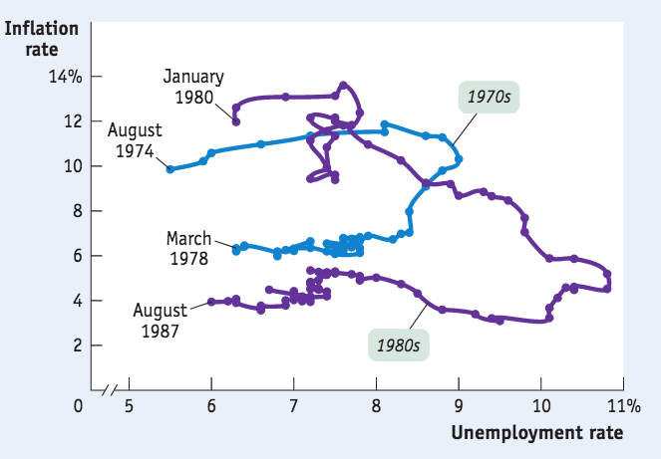
INFLATION IS EASY; DISINFLATION IS HARD
The policies needed to slow prices usually cause unemployment.
Disinflation is the process of bringing the inflation rate down.
In the 1970s and early 1980s, bringing inflation down required a temporary but very large increase in the unemployment rate.
Source: Bureau of Labor Statistics

Slide 49
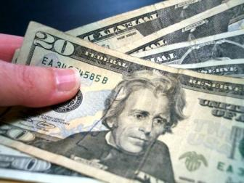
You have just been awarded a cost-of-living increase tied to the CPI. The CPI has gone from 110 to 112. If your salary is $30,000 per year before the increase, what will it be after the CPI increase is factored in?
$29,464
$30,545
$30,600
$33,600
Notes:
All photo credits unless otherwise noted from Freeimages.com (Formerly Stockxchange) or Morguefile.com

