Slide 1
Economics 2220 Principles Of Macroeconomics
Professor Zhigang Feng
Lecture 9:
Macroeconomic Relation

Slide 2
The nature of the multiplier, which shows how initial changes in spending lead to further changes
The meaning of the aggregate consumption function, which shows how current disposable income affects consumer spending
How expected future income and aggregate wealth affect consumer spending
The determinants of investment spending and the distinction between planned investment spending and unplanned inventory investment
To First
Active Learning

Slide 3
THE MULTIPLIER: AN INFORMAL INTRODUCTION
Since households and firms are mutually interdependent (recall the circular flow), booms and busts involve chain reactions.
The multiplier helps us understand the extent of the chain reactions.
Basically, we want to understand how much extra income and spending are created from an initial change in spending.
Example: if UNMC is building a new $1 billion hospital, how much does this affect the economy?

Slide 4
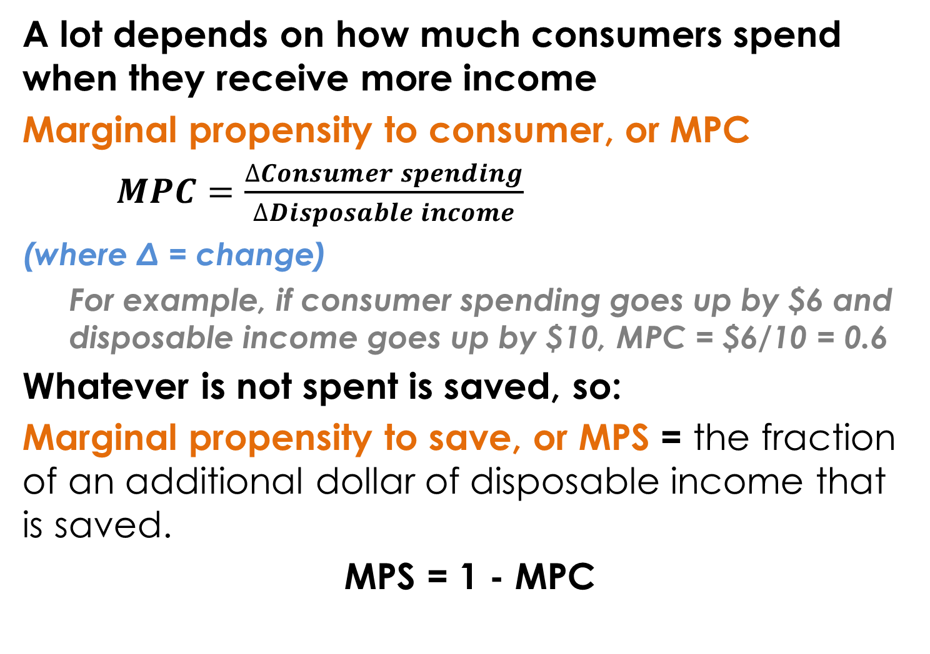
THE MPC
A lot depends on how much consumers spend when they receive more income
Marginal propensity to consumer, or MPC
$MPC=\frac{∆Consumer spending}{∆Disposable income}$
(where Δ = change)
For example, if consumer spending goes up by $6 and disposable income goes up by $10, MPC = $6/10 = 0.6
Whatever is not spent is saved, so:
Marginal propensity to save, or MPS = the fraction of an additional dollar of disposable income that is saved.
MPS = 1 - MPC

Slide 5
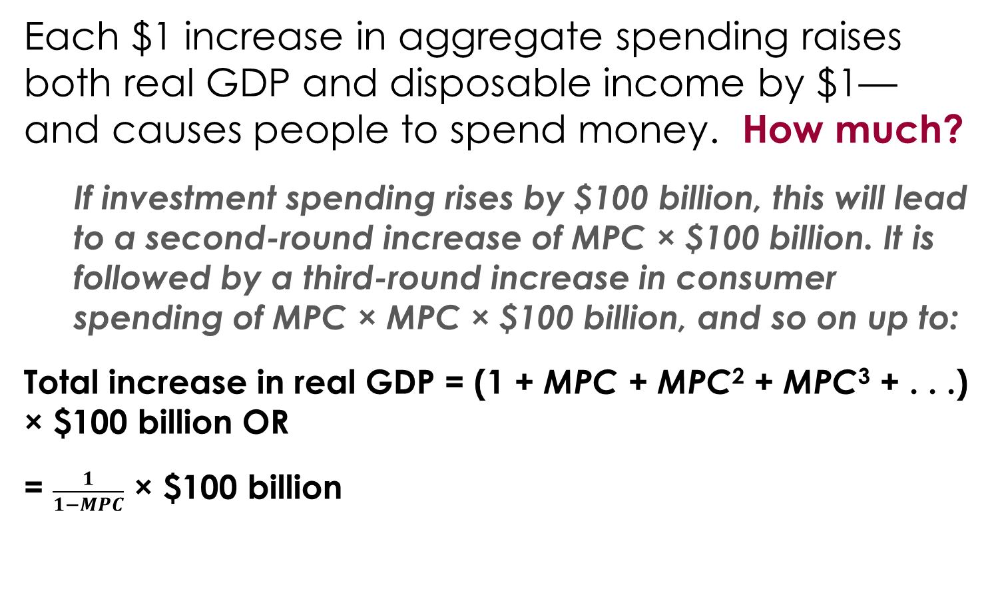
THE MULTIPLIER EFFECT
Each $1 increase in aggregate spending raises both real GDP and disposable income by $1—and causes people to spend money. How much?
If investment spending rises by $100 billion, this will lead to a second-round increase of MPC × $100 billion. It is followed by a third-round increase in consumer spending of MPC × MPC × $100 billion, and so on up to:
Total increase in real GDP = (1 + MPC + MPC² + MPC³ + . . .) × $100 billion OR
= $\frac{1}{1−MPC}$ × $100 billion

Slide 6
With a partner, answer the following:
Suppose that the marginal propensity to save in an economy is equal to 0.2. Suppose that the level of investment spending increases by $200 this year.
Trace out the total increase in real GDP, showing the increase in consumer spending for at least the second, third, and fourth round of spending and the overall increase in real GDP.
(Assume that in this economy there is no government sector, no taxes, and no transfers and that the aggregate price level and the interest rate are fixed.)
To answer

Slide 7
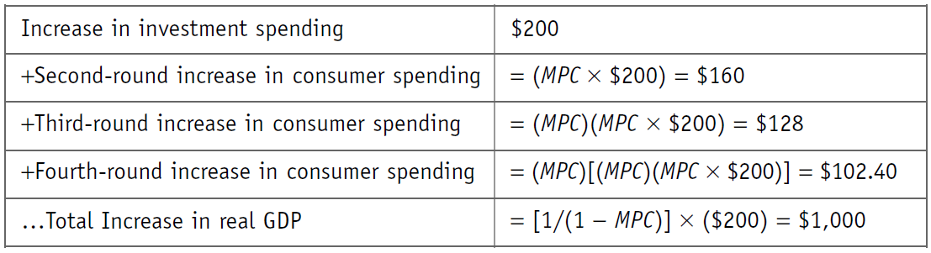
(Answer to question on previous slide)
Since MPS = 0.2, we know that MPC = 0.8.
To Next
Active Learning

Slide 8
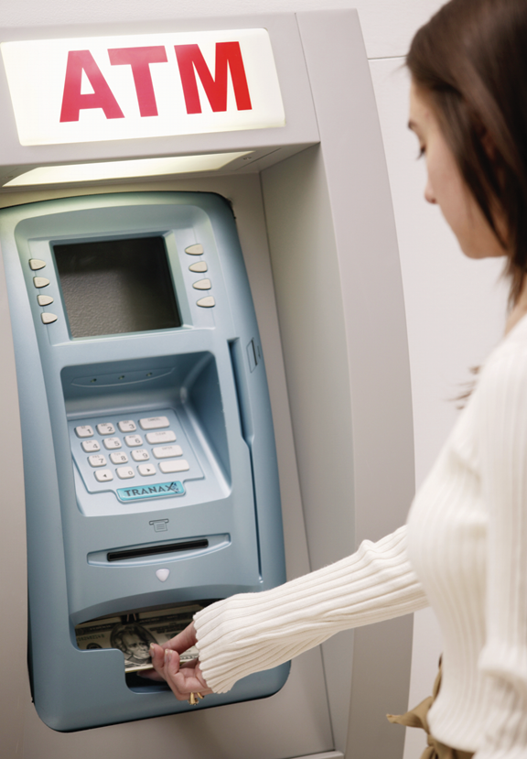
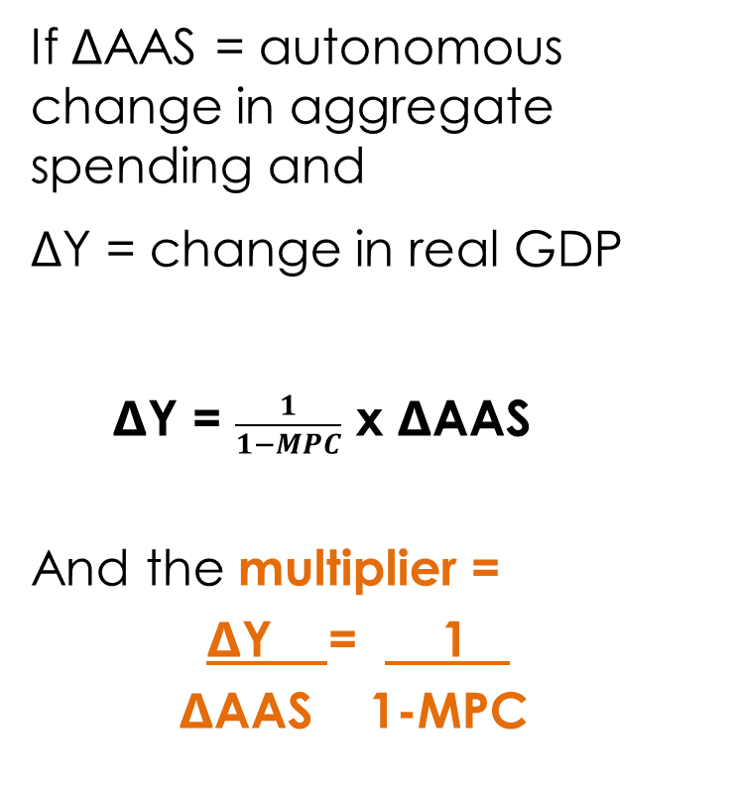
THE MULTIPLIER
If ΔAAS = autonomous change in aggregate spending and
ΔY = change in real GDP
ΔY = $\frac{1}{1−MPC}$ x ΔAAS
And the multiplier =
ΔY = 1 .
ΔAAS 1-MPC
Notes:
All image credits courtesy of Morgue File and/or FreeImages.com unless otherwise specified

Slide 9
Holding everything else constant in an economy, the larger the MPS, the:
smaller the value of the multiplier.
larger the value of the multiplier.
To Next
Active Learning

Slide 10
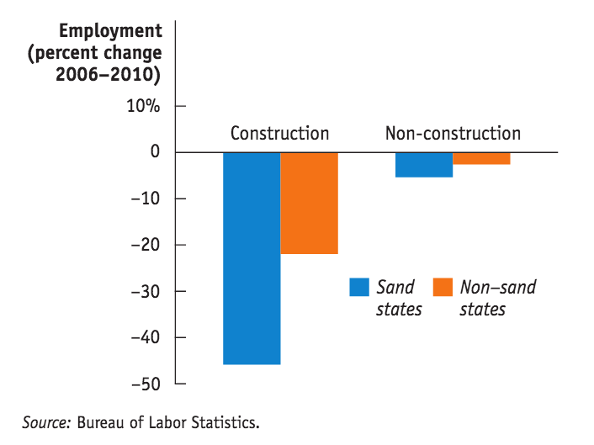
SAND STATE SLUMP
Florida, Arizona, California and Nevada were hit harder by the housing bust because the (especially deep) construction slump spread throughout the economy- and incomes fell everywhere.

Slide 11

CONSUMER SPENDING
Households are constantly confronted with choices—not just about what to consume but also about how much to spend. And that depends mostly on income.
Notes:
Photo credit: AP Photo/Paula Sakuma

Slide 12
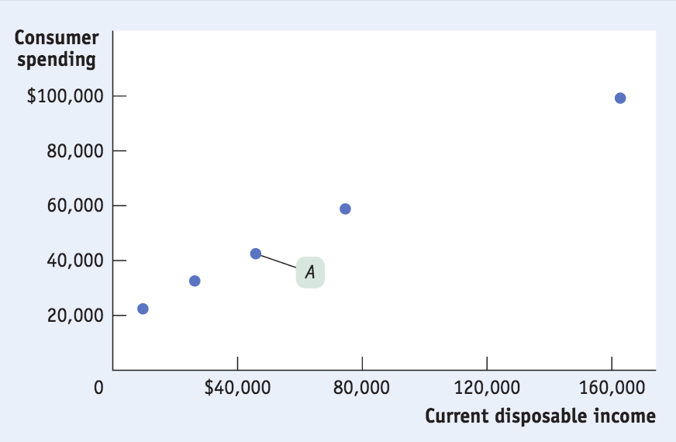
CURRENT DISPOSABLE INCOME AND CONSUMER SPENDING
Current disposable income: income after taxes are paid and government transfers are received. 2013: average household disposable income = $45,826 and average household consumer spending = $42,495

Slide 13
THE CONSUMPTION FUNCTION
Consumption function: an equation showing how an individual household’s consumer spending varies with the household’s disposable income.
c = a + MPC × yd
Where
c = a household’s consumer spending
yd = household disposable income
MPC = marginal propensity to consume
a = a constant, autonomous consumer spending—what a family would spend even with zero income

Slide 14
THE CONSUMPTION FUNCTION
Recall,
MPC = Δc/Δyd
Multiplying both sides of the equation by Δyd, we get:
MPC × Δyd = Δc
In other words, when yd goes up by $1, c goes up by MPC × $1.

Slide 15
Suppose when Sue’s disposable income is $10,000, she spends $8,000, and when her disposable income is $20,000, she spends $14,000. Sue’s autonomous consumer spending is equal to __________ and her MPS is equal to __________.
$0; 0.2
$2,000; 0.2
$0; 0.4
$2,000; 0.4
To Next
Active Learning

Slide 16
THE CONSUMPTION FUNCTION
Household consumer
spending, c
C = a + MPC x yd
Consumption function, cf
Slope = MPC
∆c = MPC × ∆yd
∆yd
0
Household disposable income, yd
Notes:
16

Slide 17
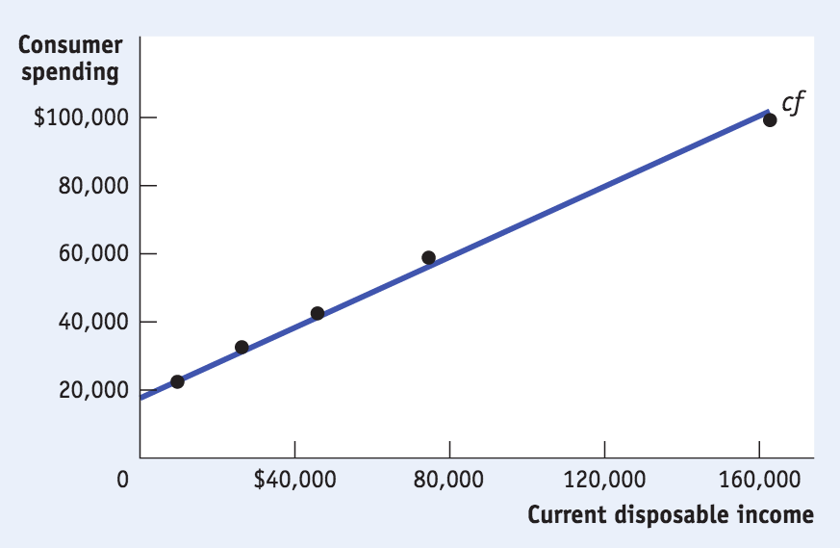
HOW WELL DO THE DATA FIT THE THEORY?
Pretty well. Here’s 2013. Autonomous spending is around $19,343 and MPC = 0.50.

Slide 18
AGGREGATE CONSUMPTION FUNCTION
Aggregate consumption function: the relationship for the economy as a whole between aggregate disposable income and aggregate consumer spending.
C = A + MPC × YD
Same form as consumption function, just aggregate.

Slide 19
Assume aggregate consumer spending equals $5,000 when aggregate disposable income is zero, and when disposable income increases from $300 to $400, consumer spending increases by $70. What is the equation for the aggregate consumption function?
C = 5,000 + 70YD
C = 500 + 0.7YD
C = 5,000 + 0.7YD
C = 5,000 + 7YD
To Next
Active Learning

Slide 20
SHIFTS IN THE AGGREGATE CONSUMPTION FUNCTION
An upward shift of the
aggregate consumption function
Consumer
spending, C
Aggregate
consumption
function, CF₂
Aggregate
consumption
function, CF₁
If consumers expect higher aggregate income or wealth? Consumption increases at all income levels now.
0
Disposable income, YD
Notes:
20

Slide 21
SHIFTS IN THE AGGREGATE CONSUMPTION FUNCTION
A Downward shift of the
aggregate consumption function
Consumer
spending, C
If consumers expect lower aggregate income or wealth? Consumption decreases at all income levels now.
Aggregate
consumption
function, CF₁
Aggregate
consumption
function, CF₂
0
Disposable income, YD
Notes:
21

Slide 22
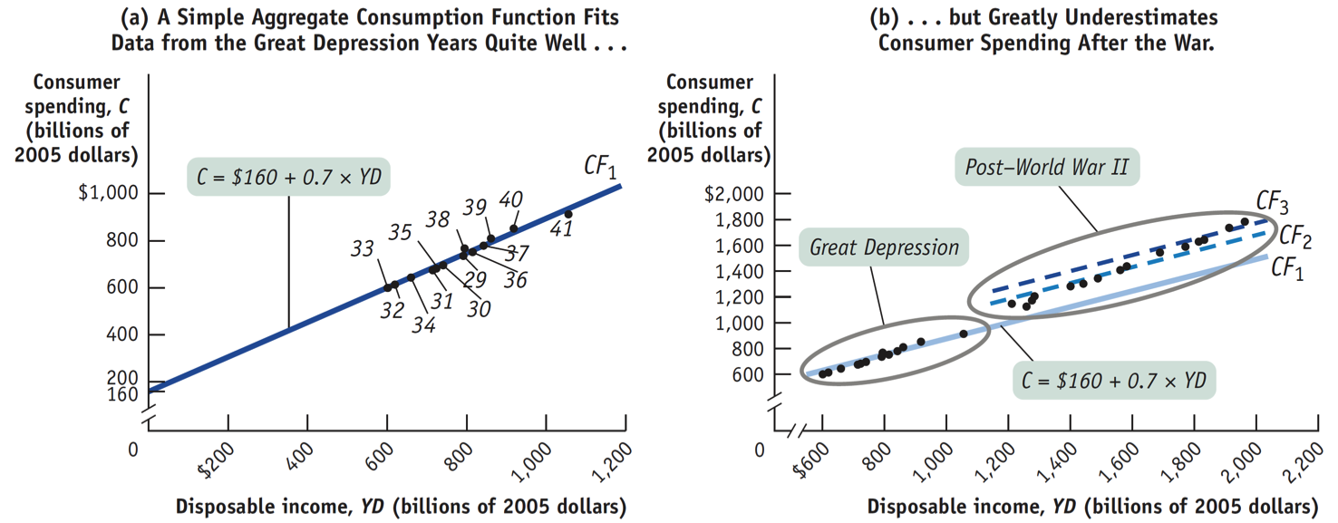
SHIFTS OF THE AGGREGATE CONSUMPTION FUNCTION
What causes shifts?
changes in expected future disposable income
changes in aggregate wealth
Did the aggregate consumption function shift after WWII? It looks that way.
Source: Bureau of Economic Analysis

Slide 23
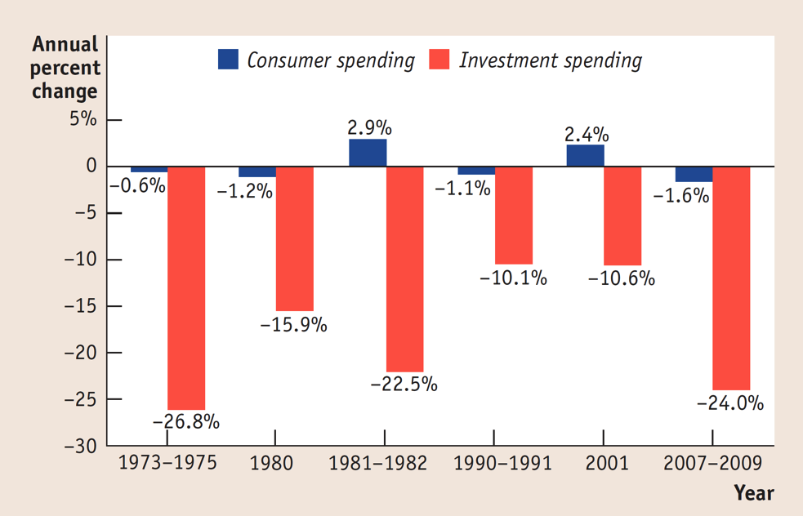
INVESTMENT SPENDING
Small yet powerful: Although much smaller than consumer spending, investment spending tends to drive the booms and busts in the business cycle. Shown here: 6 recent recessions
Here are six recent recessions:

Slide 24

WHAT DRIVES (PLANNED) INVESTMENT SPENDING?
Planned investment spending: the investment spending that businesses intend to undertake during a given period.
The interest rate
Expected future real GDP
Current level of production capacity
Notes:
All image credits courtesy of Morgue File and/or FreeImages.com unless otherwise specified

Slide 25
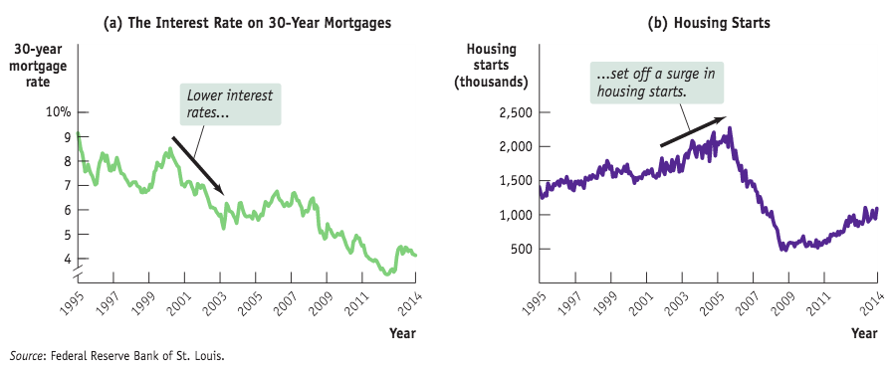
THE INTEREST RATE AND INVESTMENT SPENDING
Interest rates are often the cost of investment projects.
When interest rates are low, more loans are undertaken and investment rises (other things equal).

Slide 26
EXPECTED FUTURE REAL GDP, PRODUCTION CAPACITY, AND INVESTMENT SPENDING
If your firm has extra capacity and doesn’t expect sales to increase, its investment will be lower.
According to the accelerator principle:
A higher rate of growth in real GDP leads to higher planned investment spending.
A lower growth rate of real GDP leads to lower planned investment spending.

Slide 27
INVENTORIES AND UNPLANNED INVESTMENT SPENDING
Inventories: stocks of goods held to satisfy future sales.
Inventory investment: the value of the change in total inventories held in the economy during a given period.
Unplanned inventory investment: unplanned changes in inventories occurring when actual sales are more or less than businesses expected.
Actual investment spending: the sum of planned investment spending and unplanned inventory investment.
So in any period: I = I_{Unplanned} + I_{Planned}

