Slide 1
Economic Theory: Macroeconomics
Introduction

Slide 2
Topics of today’s class
Course Presentation
Chapter 1
  Introduction to Macroeconomics
  Recent and Current macroeconomic Events
1-<number>

Slide 3
Who am I?
A macroeconomist studies public policy and economic theory;
Taught at U of Illinois, U of Zurich, Purdue;
Conduct researches at Congressional Budget Office, Federal Reserve Bank;
Published at top economics journals;
Contributor to FOX 42 KPTM, KETV, Omaha World Herald;
ECON CLUB Advisor.

Slide 4

Course Presentation
Course website: canvas
The choice of textbook
Homework, exams and grades
Office hours, course materials and additional readings
  The Economist, WSJ, NY Times, etc
1-<number>

Slide 5
Gross Domestic Product, Economic Growth, and Business Cycles
Gross Domestic Product (GDP): the quantity of goods and services produced within a country’s borders over a particular period of time.
The time series of GDP can be separated into trend and business cycle components.
Notes:
Our fist step is to look at some basic data. A key concept in macro is Gross Domestic Product, which is the quantity of goods and services produced within a particular country over a particular period of time. This is our basic measure of aggregate economic activity. In order to study the two phenomena were are interested in, it helps to separate GDP into trend and business cycle components.

Slide 6
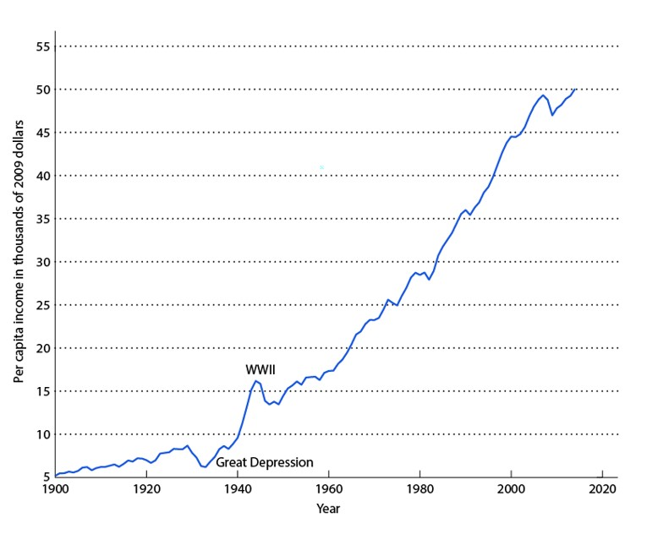
Figure 1.1
Per Capita Real GDP (in 2009 dollars) for the United States, 1900–2020
Notes:
The slide shows GDP per capita for the United States since 1900. This is GDP adjusted for inflation (the general increase in prices over time) and for population growth. GDP per capita in the chart is a measure of income per person in the United States, in 2009 dollars. The chart shows a trend increase in GDP per capita over the sample period.

Slide 7
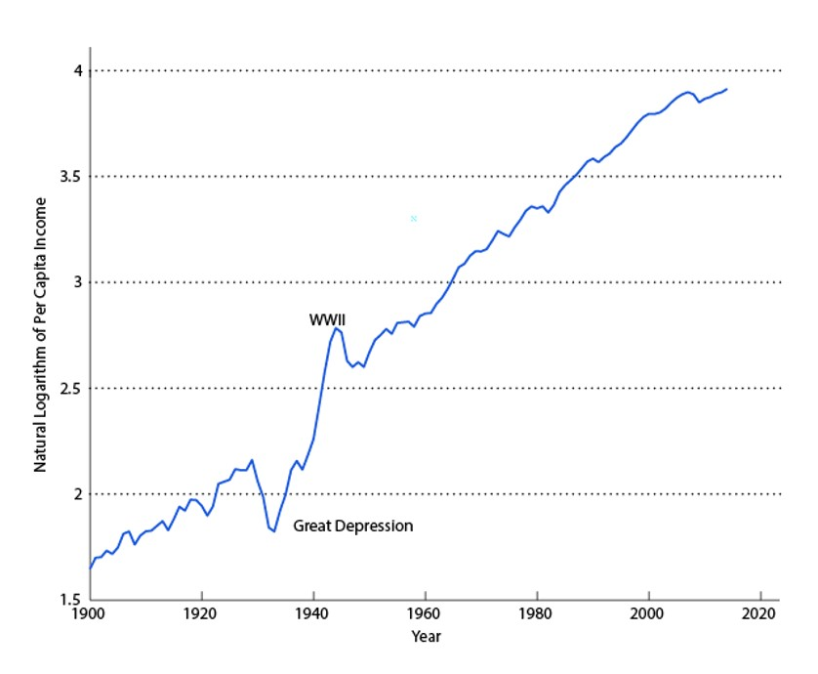
Figure 1.2
Natural Logarithm of Per Capita Real GDP
Notes:
A helpful approach is to take the natural logarithm of the time series. This is useful for most (but not all) economic time series. The transformation is useful as then the slope of the graph is close to the growth rate. Then, it’s easy to eyeball the chart and see changes in the growth rate over time.

Slide 8
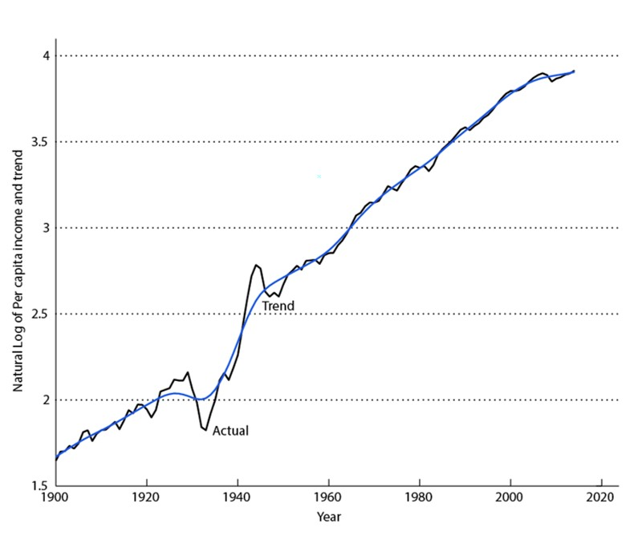
Figure 1.3
Natural Logarithm of Per Capita Real GDP and Trend
Notes:
The chart shows a time-varying trend fit to the data. The trend is called a “Hodrick-Prescott filter.” In principle, this does a better job than just fitting a straight line to the data to uncover the trend.

Slide 9
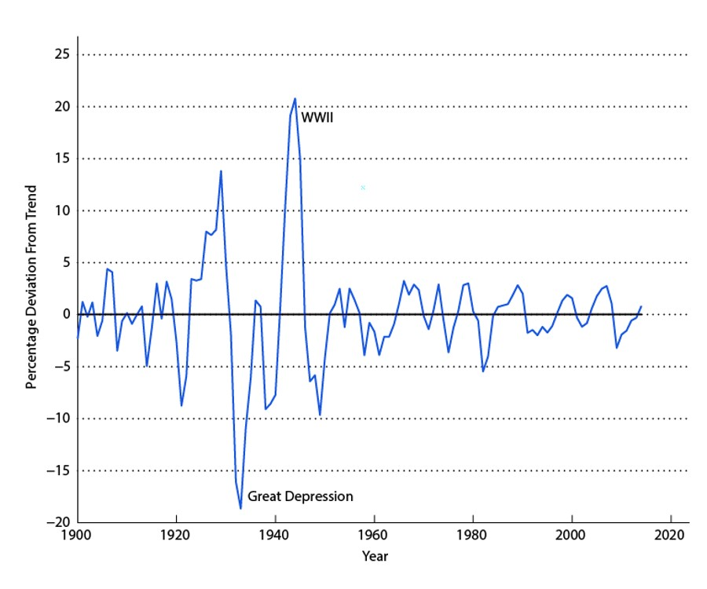
Figure 1.4
Percentage Deviations from Trend in
Per Capita Real GDP
Notes:
The chart shows what we get if we look at just the deviations from trend from Figure 1.3. This then is a measure of the business cycle component of real GDP per capita. Note the very large deviations from trend during the Great Depression and World War II – two key events in the 20th century.

Slide 10
What is Macroeconomics?
Models built to explain macroeconomic phenomena.
Examples of issues:
  Why are so many countries poor?
  Why are millions of people unemployed?
  What makes people unequal in income and wealth?
  Why are there recession? Can the government do anything to combat recession? Should it?
To summarize: long-run growth and business cycles.
Our approach is to build up macroeconomic analysis from microeconomic principles.
1-<number>

Slide 11
How Does Macroeconomics Work?
Build (simple) model to match key facts
Include relevant Agents
  Consumers
  Firms
Agents make decisions based on an objective function and resource constraints
1-<number>

Slide 12
How Does Macroeconomics Work?
An economic model allows us to use exogenous variables to explain endogenous variables.
  Endogenous variables are ones we want to explain.
  Exogenous variables are ones that are fixed and have some influence on the endogenous variable that we want to explain.
EXOGENOUS VARIABLES:
Oil reserve, Weather, etc.
ECONOMIC MODEL
ENDOGENOUS VARIABLES:
Stock market.
1-<number>

Slide 13
History of Thought
1776 (Smith – Wealth of Nation) to 1920s
  Classical economics
  Prices adjust to clear markets (supply=demand)
1920s to 1970s
  Keynesian economics
  Prices adjust slowly
Now: Neo-classical vs New-Keynesian
  Both use Quantitative Models
  Micro-founded reasons for price frictions
1-<number>

Slide 14
List of Topics
Measurement
  Measuring GDP and Prices
A Simple Macroeconomic Model
  Work-Leisure Decision, Impact of Taxes on Work Decision
Economic Growth
  What are the sources of Income differences across countries? Can growth be sustained?
Consumption and Savings
  Life Cycle Decisions, Fiscal Policy & Ricardian Equivalence, Credit Market Imperfections & Financial Crisis, Social Security
Business Cycles
  Stylized Facts, Monetary Policy, Fiscal Policy
Unemployment and Labor Market
1-<number>

Slide 15
What Do We Learn From Macroeconomic Analysis? Part I
What is produced and consumed in the economy is determined jointly by the economy’s productive capacity and the preferences of consumers.
In free market economies, strong forces tend to produce socially efficient economic outcomes.
Unemployment is painful for individuals, but it is a necessary evil in modern economies.
Improvements in a country’s standard of living are brought about in the long run by technological progress.
Notes:
The next 4 slides give a preview of 12 key ideas that will be explored in the text. It helps to see these ideas now, and to come back to them later, as the course unfolds.

Slide 16
What Do We Learn From Macroeconomic Analysis? Part II
A tax cut is not a free lunch.
Credit markets, banks play key roles in the macroeconomy.
What consumers and firms anticipate for the future has an important bearing on current macroeconomic events.

Slide 17
What Do We Learn From Macroeconomic Analysis? Part III
Money takes many forms, and society is much better off with it than without it. Once we have it, however, changing its quantity ultimately does not matter.
Business cycles are similar, but they can have many causes.

Slide 18
What Do We Learn From Macroeconomic Analysis? Part IV
Countries gain from trading goods and assets with each other, but trade is also a source of shocks to the domestic economy.
In the long run, inflation is caused by growth in the money supply.
If there is a short-run tradeoff between output and inflation, that has very different implications relative to the relationship between nominal interest rates and inflation.

Slide 19
Understanding Recent and Current Macroeconomics Events
Aggregate Productivity
Unemployment and Vacancies
Taxes, Government Spending, and the Government Deficit
Inflation
Interest Rates
Business Cycles in the United States
Credit Markets and the Financial Crisis
The Current Account Surplus
Notes:
The text has two goals. The first is to give general frameworks that can be used to understand macroeconomic (and also microeconomic) problems. The second is to illustrate how these frameworks are applied. The next slides show eight aspects of model applications, with current and past data in mind.

Slide 20
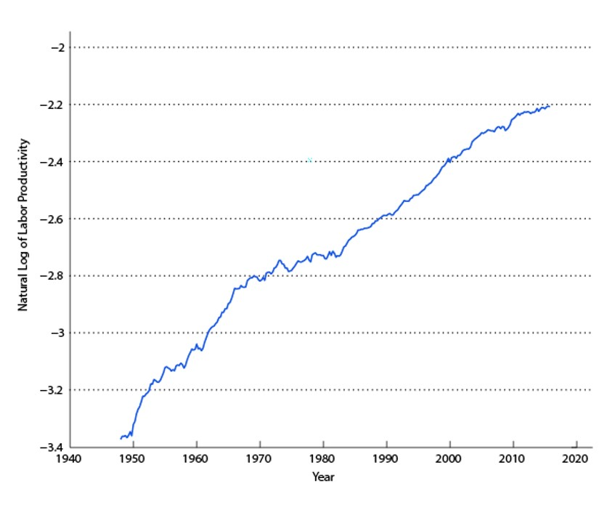
Figure 1.5
Natural Logarithm of Average Labor Productivity
Notes:
Average labor productivity is one measure of productivity for the economy. It’s measured as total real GDP divided by total employment. The chart shows high productivity growth in the 1950s and 1960s, and low productivity growth in the 1970s and after the 2008-2009 recession. Productivity proves to be important, both in explaining business cycles, and in explaining long run growth in standards of living.

Slide 21
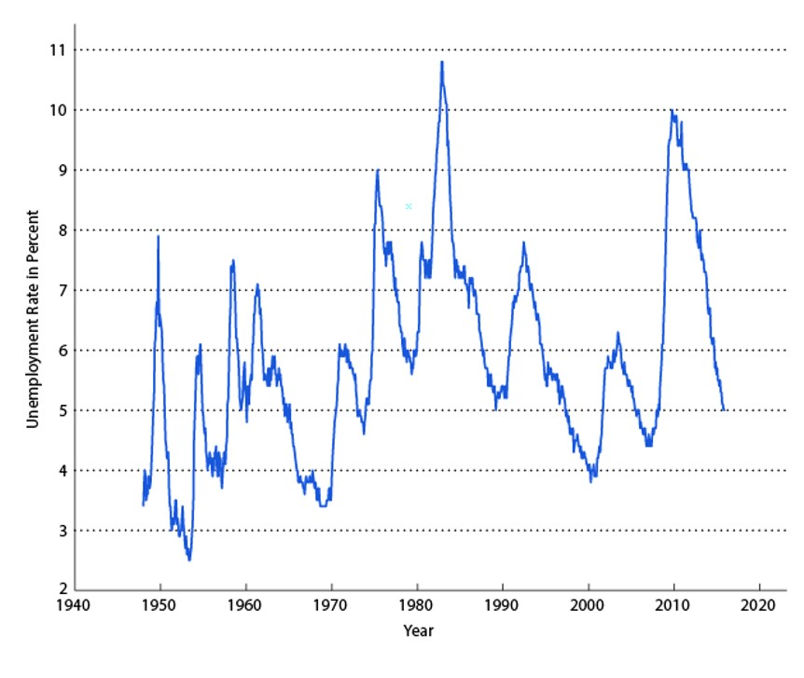
Figure 1.6
The Unemployment Rate for the United States
Notes:
The unemployment rate is measured as the number of people actively searching for work, as a percentage of the labor force. In the chart, the unemployment rate clearly has a lot of cyclical variation, and it increases on trend until about 1990, and then declines on trend. Chapter 6 is devoted to understanding the behavior of the unemployment rate, using two search models of the labor market. In general, the patterns we see in the chart can be explained by demographics, the generosity of unemployment insurance programs, and shocks to the economy that cause business cycles.

Slide 22
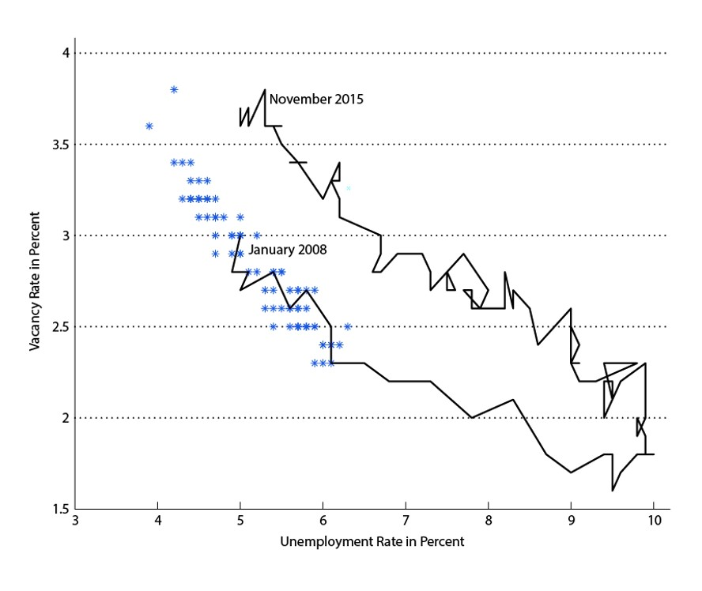
Figure 1.7
The Beveridge Curve
Notes:
The Beveridge curve is a negative relationship between the vacancy rate – job postings by firms divided by total employment plus vacancies – and the unemployment rate. In Chapter 6, a two-sided model of labor search, in which firms with vacancies are matched with workers seeking jobs, is used to understand the Beveridge curve. Basically, the number of vacancies relative to unemployment is a measure of labor market tightness, and tightness tends to increase in economic booms and decrease in recessions. But, the Beveridge curve has shifted out since the beginning of the 2008-2009 recession. This is sometimes ascribed to long-run changes in the labor market – an increase in the mismatch between the skills needed by firms, and the skills unemployed workers possess.

Slide 23
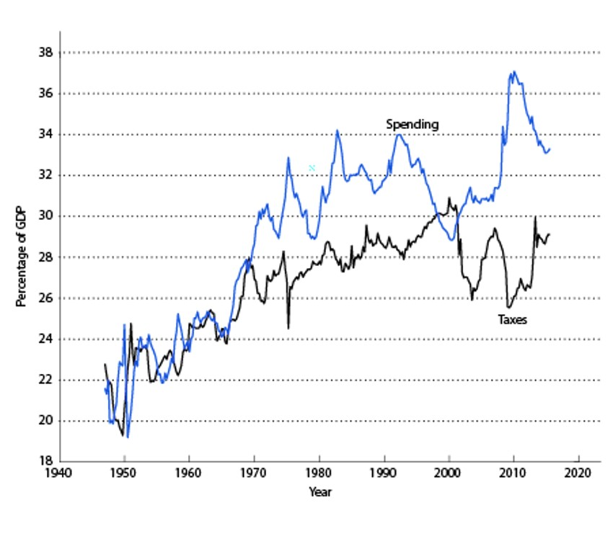
Figure 1.8
Total Taxes and Total Government Spending
Notes:
The chart shows the two sides of the government’s budget – total spending and total taxes, as percentages of GDP. This is total government spending and taxes, including federal, state, and local governments. Note the increases in spending and declines in taxes that occur during recessions, particularly the 2008-2009 recession.

Slide 24
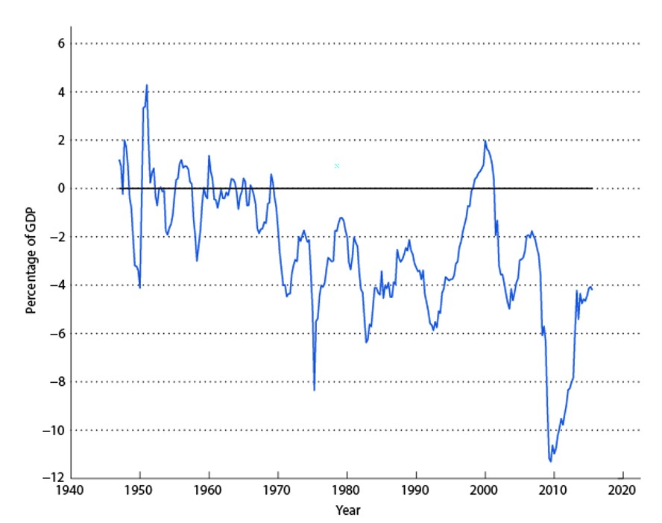
Figure 1.9
Total Government Surplus
Notes:
The chart shows the total government surplus – the difference between spending and taxes in Figure 1.9, expressed as a percentage of GDP. Note the large decline in the surplus in the 2008-2009 recession. In the whole post-World War II period, the government deficit (minus the government surplus) was at its highest point during the last recession. This was in part due to the large drop in GDP, but also due to the drop in tax revenue and the 2009 federal government stimulus program.

Slide 25
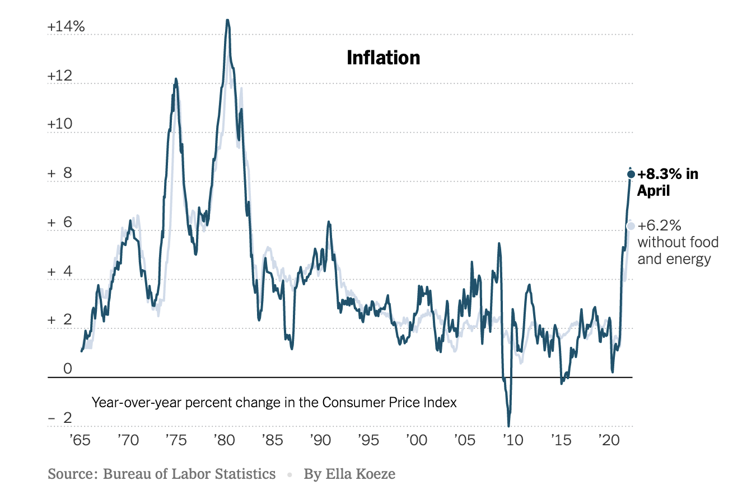
Figure 1.10
The Inflation Rate
Notes:
The United States has never experienced a hyperinflation on the scale of what happened in some European countries in the 1920s. The worst recent inflation experience in the United States was in the 1970s, when inflation peaked at about 14%. Since then, monetary policy in the United States has been aimed at keeping inflation low – the current inflation target of the Fed is 2%. Currently, in much of the world, inflation is deemed to be too low – a problem not envisioned in the 1970s.

Slide 26
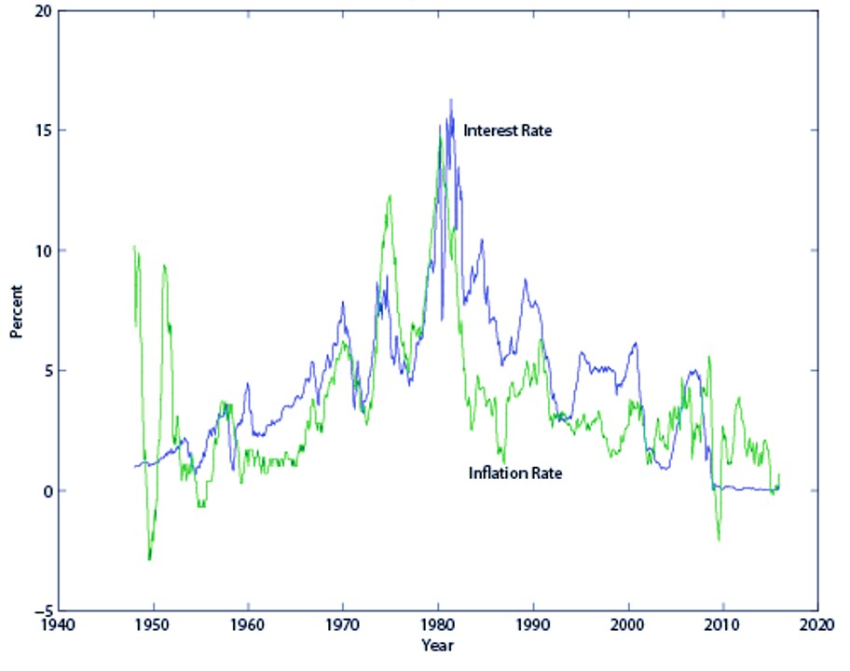
Figure 1.11
The Nominal Interest Rate and the Inflation Rate
Notes:
Over the long run, the Fisher effect comes into play. The Fisher effect is a positive relationship between the nominal interest rate and the inflation rate. This effect can be readily discerned in the chart, which shows the nominal interest rate and inflation rising through the 1970s and then falling. Recently, the nominal interest rate has been close to zero for a considerable time, and inflation has been low.

Slide 27
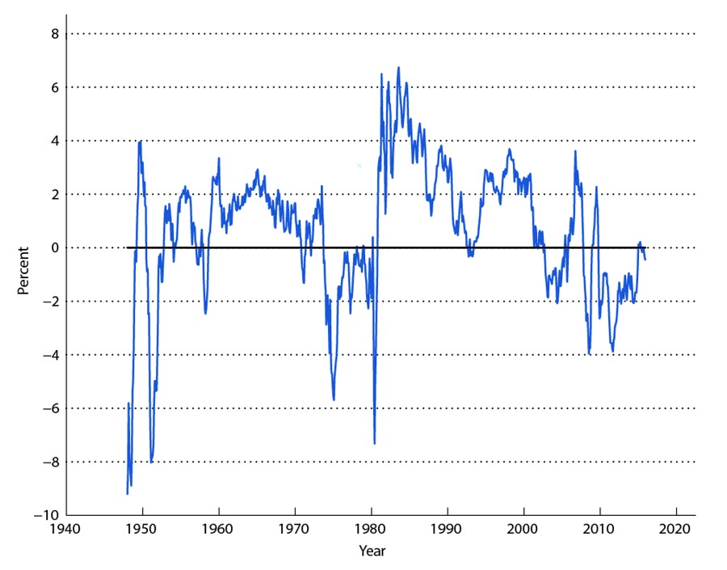
Figure 1.12
Real Interest Rate
Notes:
The chart shows a measure of the real interest rate – the difference between the nominal interest rate and observed inflation over a 12-month period. The real interest rate has been quite variable, and has been persistently high and persistently low. A key observation in the chart, which holds for many countries in the world, is that the real rate of interest has declined substantially since about 1980. The low real interest rate can create a problem for monetary policy, which we address in Chapters 14 and 15.

Slide 28
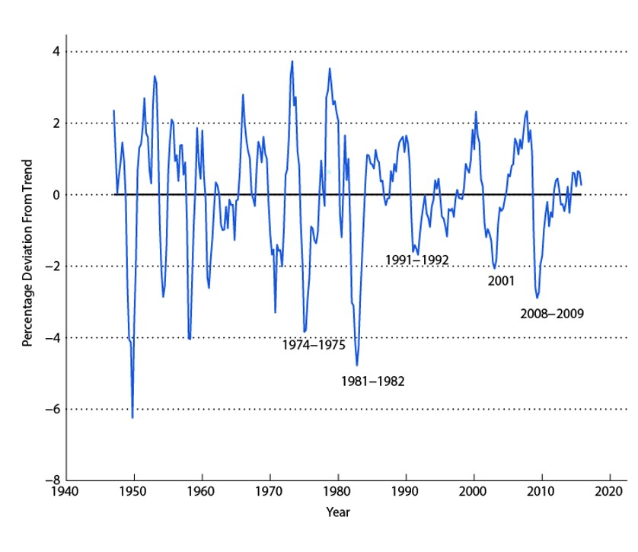
Figure 1.13
Percentage Deviation From Trend in Real GDP
Notes:
In this chart, we show quarterly real GDP, after taking out the Hodrick-Prescott trend. This allows us to pick out booms and recessions. The chart shows the last five major recessions, which correspond closely to the dating provided by the National Bureau of Economic Research, which uses a different approach to determining what is a major business cycle event. As can be seen in the chart, the 2008-2009 recession was relatively severe, but not as severe as the 1981-1982 recession. Different recessions can have different causes, and we want to look at different business cycle models to help us understand these alternative contributing factors.

Slide 29
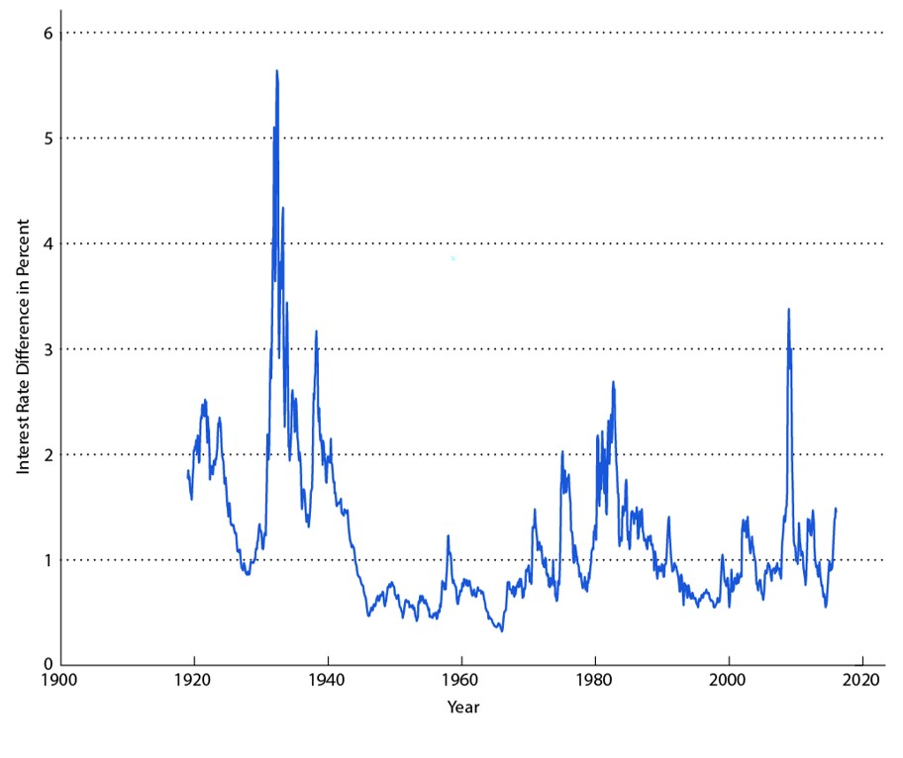
Figure 1.14
Interest Rate Spread
Notes:
The financial crisis which coincided with the 2008-2009 recession caused macroeconomists to focus more on financial factors as a cause of business cycles. Financial market friction can be reflected in interest rate spreads – the difference between interest rates on risky assets and safe assets. During a time of financial stress, such spreads increase, as can be seen in the chart. The largest spread observed was during the Great Depression. The second largest was during the Great Recession – what the 2008-2009 recession is often called.

Slide 30
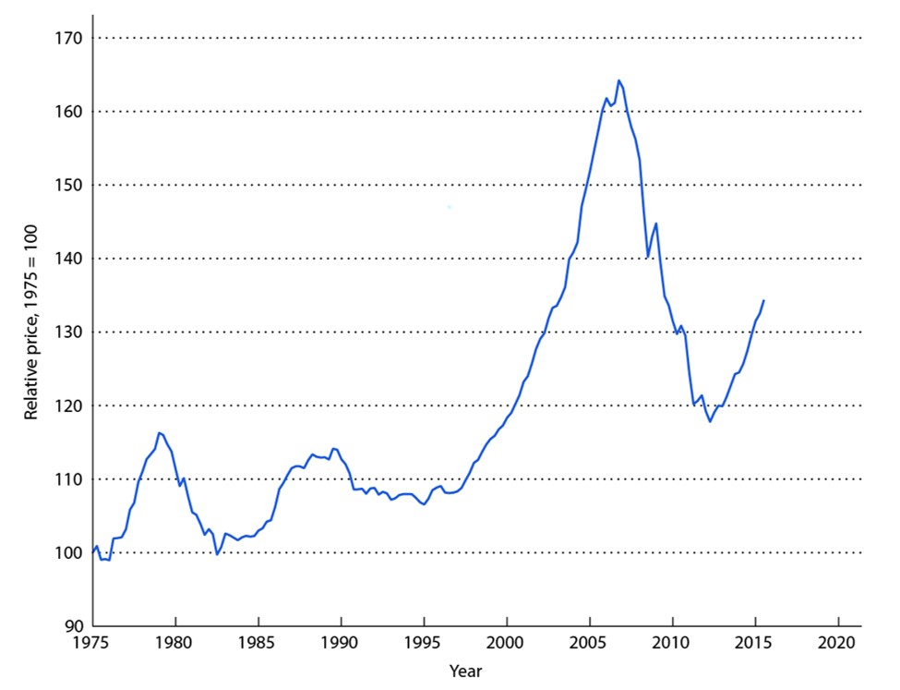
Figure 1.15
Relative Price of Housing
Notes:
Another feature of the financial crisis was the large drop in asset prices, particularly the price of housing, that acted to propel a wave of mortgage foreclosures, along with severe disruption in the upper levels of the financial system. Housing – and real estate generally – plays a key role as collateral. In a mortgage contract the house is the collateral – it can be seized if the borrower defaults. In Chapter 10 we explore the role of collateral in the credit market.

Slide 31
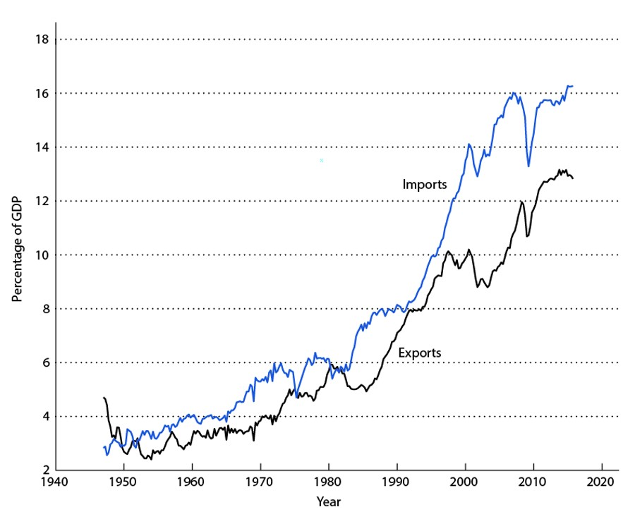
Figure 1.16
Exports and Imports of Goods and Services
Notes:
The world has become more open to trade in goods and assets over time. In this chart, we can see this in terms of exports and imports (as percentages of GDP) for the United States. The U.S. economy was much more open in 2015 than it was in 1947, as can be observed in the volume of trade.

Slide 32
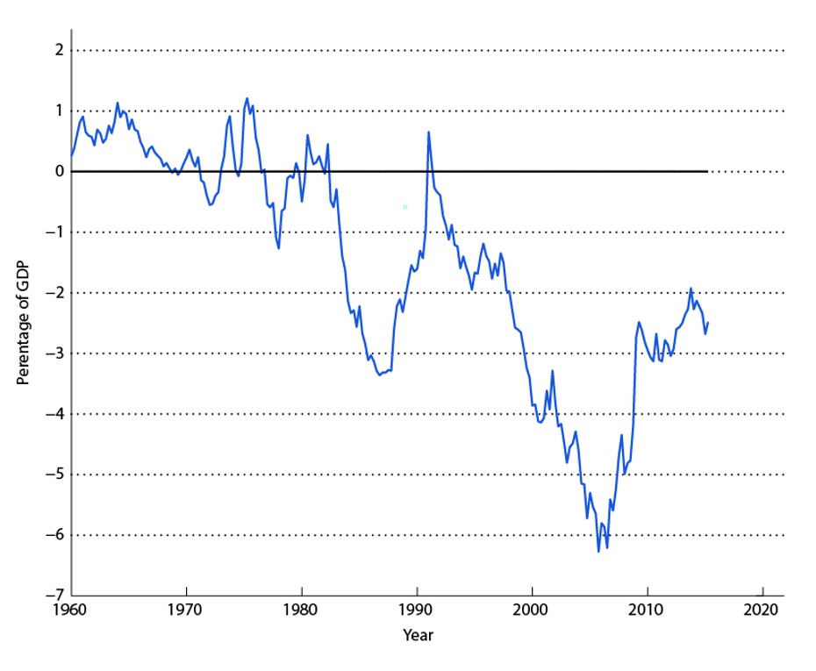
Figure 1.17
The Current Account Surplus
Notes:
When a country runs a negative current account surplus, it is importing more than it is exporting, and it pays for these net imports by borrowing from the rest of the world. Since 1990, the current account surplus in the United States has been negative, so the U.S. has been accumulating debts to the rest of the world. This need not be a bad thing, as a current account deficit (the deficit is the negative of the surplus) allows a country to smooth its consumption relative to its income (much like an individual), and can permit investment in plant and equipment that can be used to produce more in the future.

