Slide 1
Chapter 10
Credit Market Imperfections: Credit Frictions, Financial Crises, and Social Security

Slide 2
Chapter 10 Topics
Credit Market Imperfections and Consumption.
Asymmetric Information and the Financial Crisis.
Limited Commitment and the Financial Crisis.
9-<number>

Slide 3
Credit Market Imperfections
Credit market Imperfections:
  different interest rate for lenders and borrowers
  borrowing limits
There exists many reasons for the existence of Credit Market Imperfections. We focus on 2
  asymmetric information: one party has more information about his characteristic than the party it is trading with
  limited commitment: impossible to commit to pay off his debt in the future
Both played a key role during the 2008-2009 crisis
9-<number>

Slide 4
Credit Market Imperfections
r1: lending interest rate
r2: borrowing interest rate
r2 > r1
lenders can lend at a lower interest rate than the one faced by borrowers
9-<number>

Slide 5
Asymmetric Information
Definition
one party has more information than the other party it is trading with
Example
For example, a used car salesman knows the quality of a particular car, but the buyer doesn’t.
Example
I know how hard I worked today, but my boss doesn’t.
9-<number>

Slide 6
Asymmetric Information
Akerlof (1972) - The Market for Lemons
“Nature” chooses how good a car will be: good or bad with equal probability
The buyer offers a price, and then the seller accepts or rejects
A good car is worth $35,00 to the buyer, but a bad one only $28,000
How much might the buyer offer? Which cars are sold?
9-<number>

Slide 7
Asymmetric Information
The buyer offers $31,000 (the average quality)
Sellers of good cars won’t sell: their car is worth $35,000
Sellers of bad cars sell - their car is worth $28,000
The buyer knows this, and thus offers only $28,000: No good cars are sold in equilibrium!
9-<number>

Slide 8
Asymmetric Information and Financial Crisis
Financial Intermediary: Lending carried out through banks
  deposit rate at banks is r1
  loan rate is r2
Fraction a of borrowers never defaults, fraction 1 − a always defaults
Asymmetric Information:
  bank cannot tell the good borrowers from the bad ones
  All good borrowers identical, borrow L
  Bad borrowers mimic the good ones
9-<number>

Slide 9


Asymmetric Information and Financial Crisis
Average profit of the bank:
In Equilibrium, profits are equal to 0:
9-<number>

Slide 10
Asymmetric Information and Financial Crisis
If a = 1, r2 = r1
Otherwise r2 > r1
9-<number>

Slide 11


Lifetime Budget Constraint
Lenders:
Borrowers:
9-<number>

Slide 12
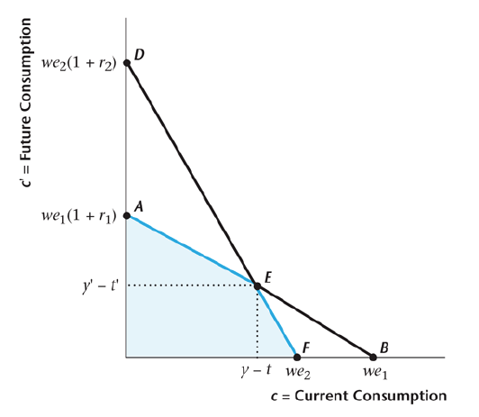
Lifetime Budget Constraint
9-<number>

Slide 13
Effect of a Decrease in the Fraction of Creditworthy Borrowers
Default premium increases – even good borrowers face higher loan rates.
Budget constraint shifts in.
Consumption falls for all borrowers.
  Substitution Effect: c: relative price of current consumption increased
  Wealth Effect: c Borrower is poorer: higher interest on his debt
9-<number>

Slide 14
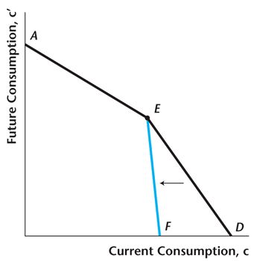
Effect of a Decrease in the Fraction of Creditworthy Borrowers
9-<number>

Slide 15
Government
The government borrows and lends at the interest rate that lenders face
  treasury securities (US government debt) are backed by full faith and credit of the US Treasury
  they are considered as risk free
This implies that Ricardian equivalence does not hold, in general
9-<number>

Slide 16
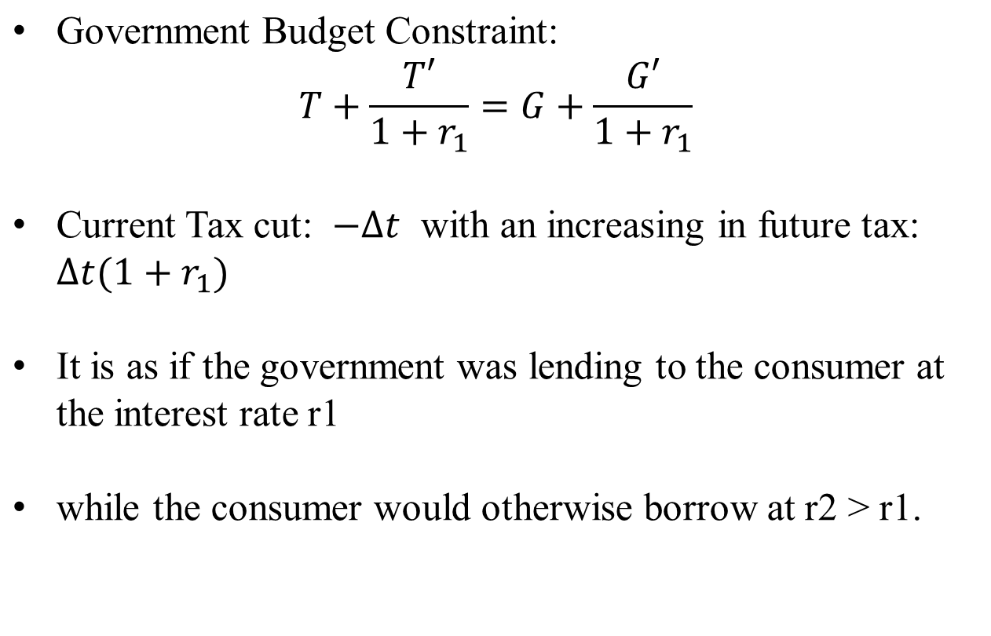
Effect of a Tax Cut
9-<number>

Slide 17
Effect of a Tax Cut
Suppose a consumer initially is credit constrained – that is he or she saves zero.
For such a consumer, the entire tax cut will be spent on current consumption.
This is very different from the case with no credit market imperfections, where the consumer will save the entire tax cut to pay higher future taxes.
9-<number>

Slide 18
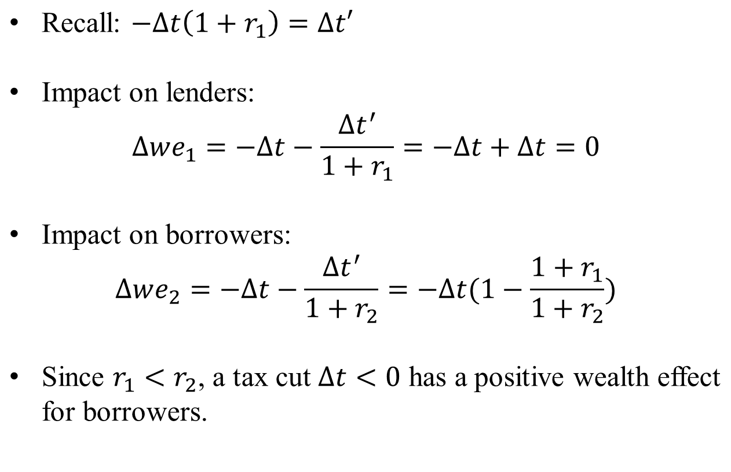
Effect of a Tax Cut
9-<number>

Slide 19
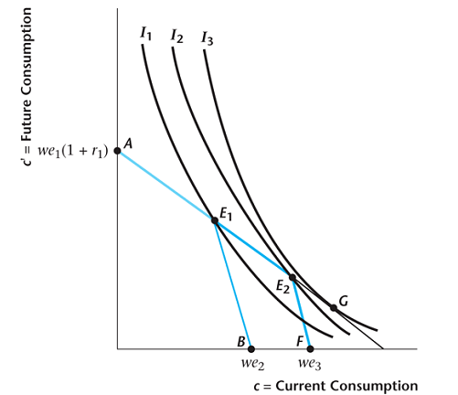
Effect of a Tax Cut
9-<number>

Slide 20
Limited Commitment
Impossibility for a borrower to commit to pay off his debt
Borrowers need incentives not to default on their debts
Incentive device: collateral requirement
Definition
  A collateral is an asset owned by the borrower that the lender has a right to seize if the borrower defaults
Example
  House is collateral for a mortgage loan
9-<number>

Slide 21
Financial crisis 2008 - 2009
burst of the housing bubble
  in cities like Phoenix, Las Vegas, Miami: prices have fallen by up to 50% from their peak
amount of collateral of household declined
9-<number>

Slide 22
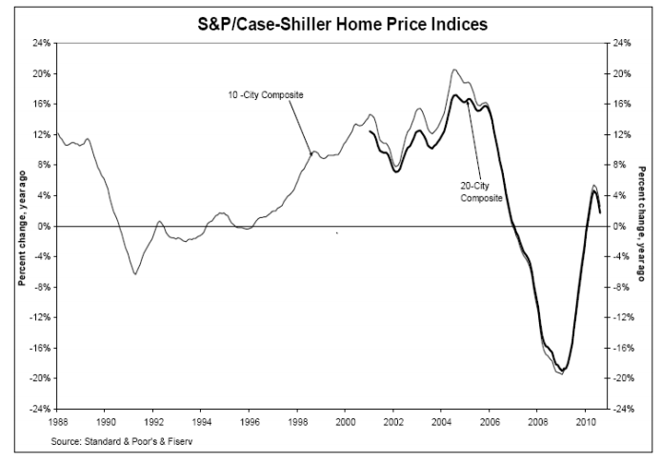
Financial crisis 2008 - 2009
9-<number>

Slide 23
Limited Commitment
Falling housing prices hurts consumption through 2 channels:
1, amount of collateral of household declined
  homeowners have less collateral
  limit homeowners ability to borrow
  They reduce their consumption of durable goods
2, negative Housing wealth effect
  Lower House prices make people poorer: reduce the amount they have to spend over their lifetimes
  they distribute some of it in the present because of consumption smoothing
Empirically, 1 is more important than 2
9-<number>

Slide 24
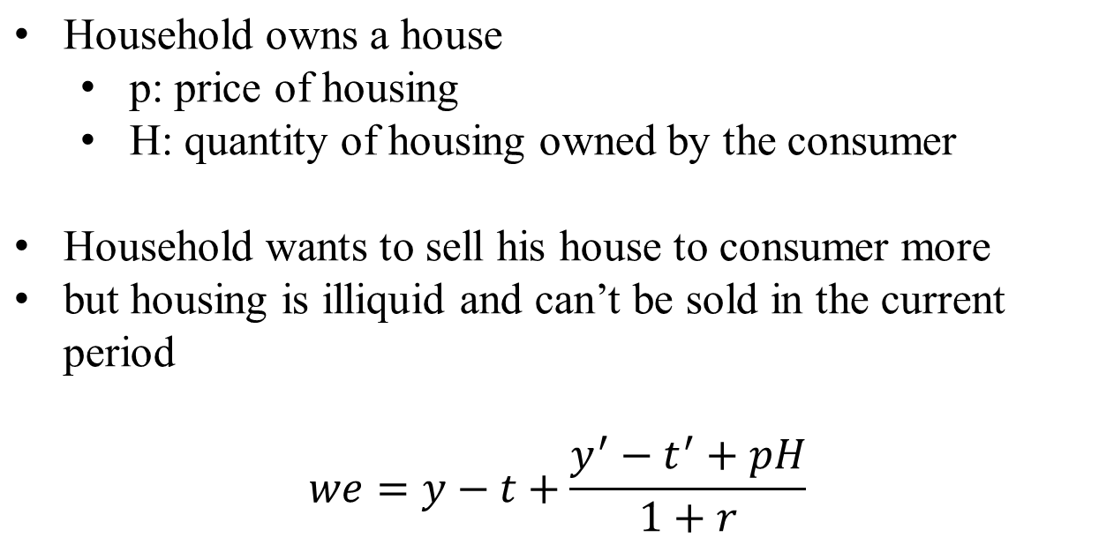
Saving with Assets
9-<number>

Slide 25
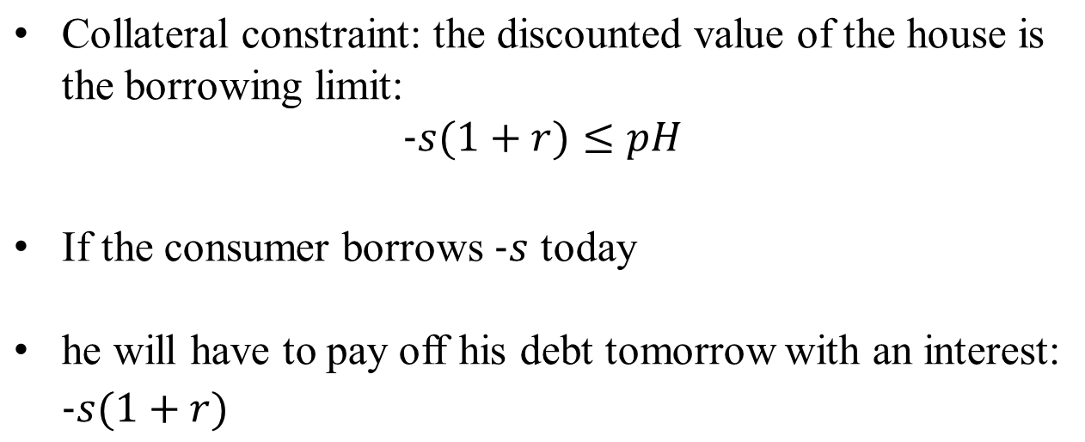
Collateral Constraint
9-<number>

Slide 26
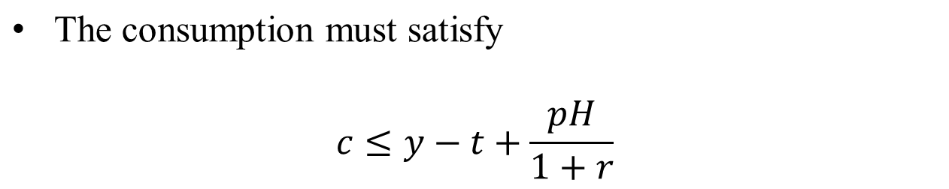
Collateral Constraint
9-<number>

Slide 27
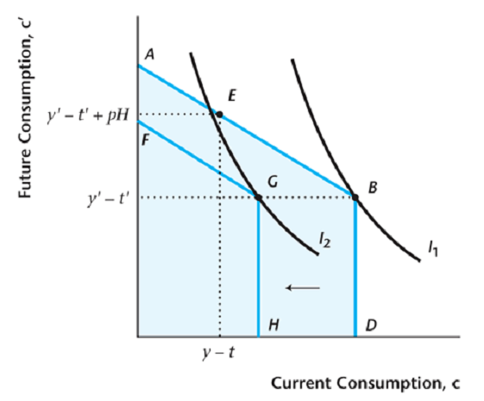
Collateral Constraint
9-<number>

Slide 28
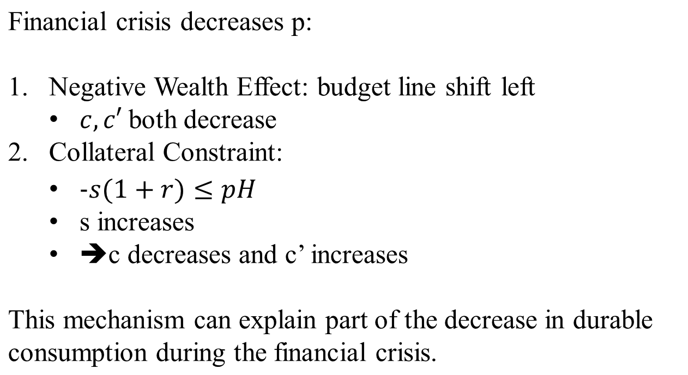
Saving with Asset
9-<number>

Slide 29
Pay-as-you-go Social Security
Taxes on the working population pay for social security transfers to the retired each period.
Suppose two generations alive at each date, young and old.
The young pay social security taxes t, the old receive social security benefits b.
Notes:
We next want to examine how social security systems work. First, we look at pay-as-you-go systems, in which benefits for the old are financed by taxes on the young.

Slide 30
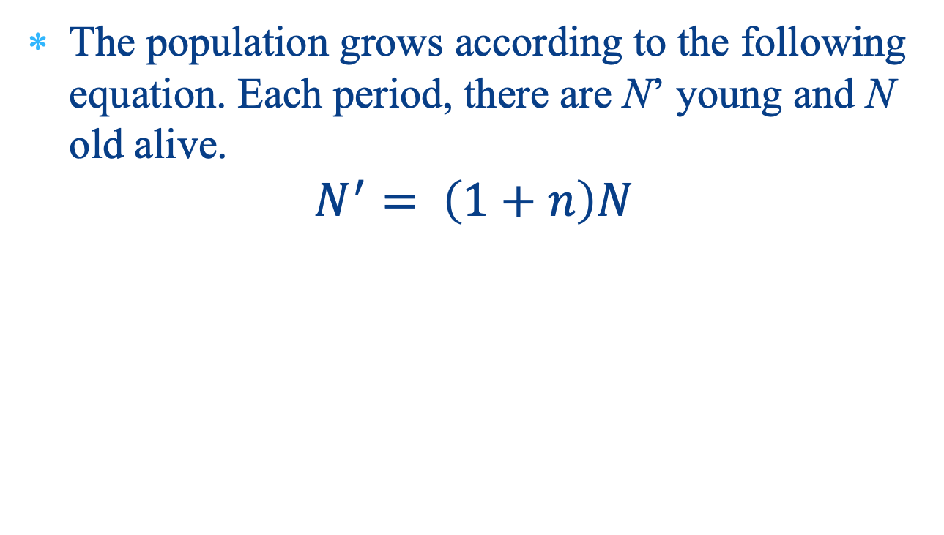
Population Growth
Notes:
Assume that the population is growing at rate n.

Slide 31
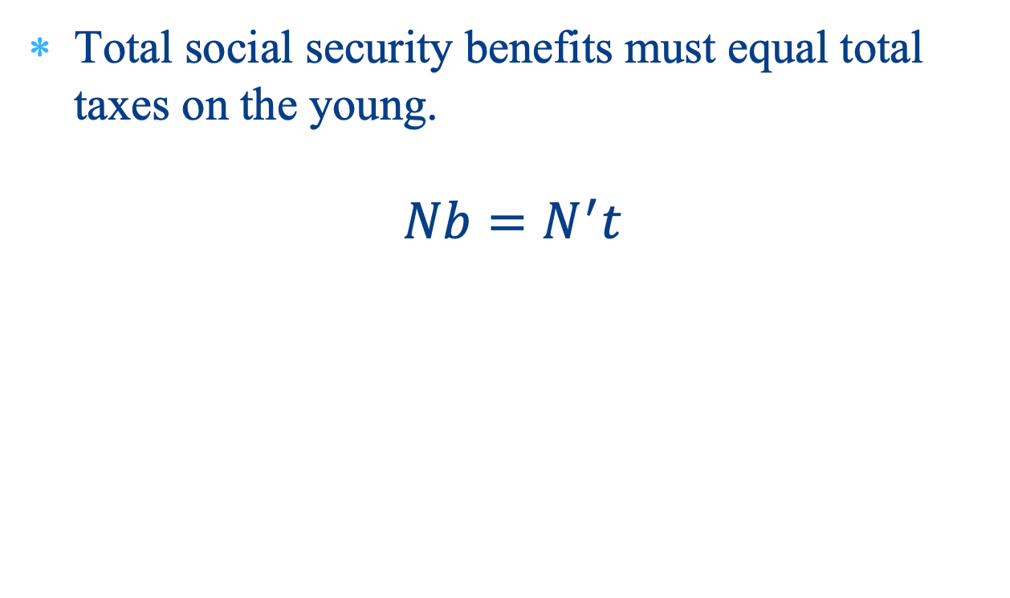
The Government Balances Its Budget
Notes:
Also, assume in the pay-as-you-go system that total benefits to the old are just equal to total taxes on the young. There is simply an income transfer from young to old.

Slide 32

Relationship Between Taxes for the Old and Benefits for the Young
Notes:
Simplifying, this tells us how the tax per young person depends on the population growth rate and the benefit per old person.

Slide 33
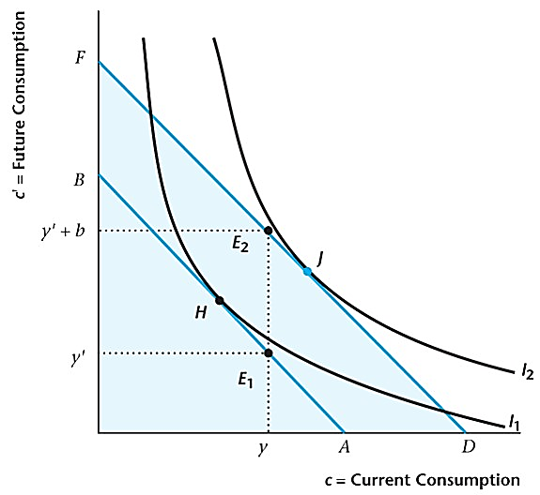
Figure 10.8 Pay-As-You-Go Social Security for Consumers Who Are Old in Period T
Notes:
When social security is introduced, it clearly benefits the initial old people, who did not have to pay the tax when young, but get social security benefits. Their lifetime wealth increases.

Slide 34
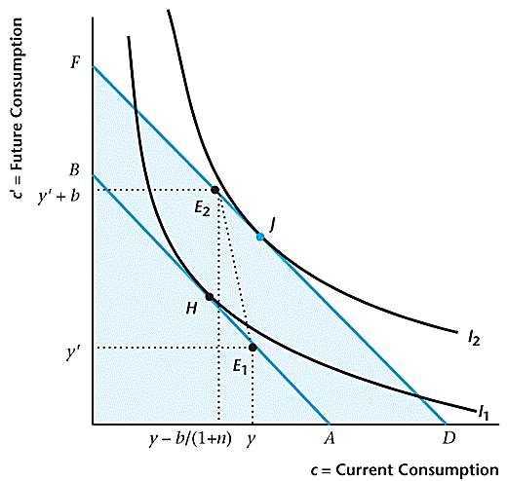
Figure 10.9 Pay-As-You-Go Social Security for Consumers Born in Period T and Later
Notes:
For succeeding generations, welfare will go up if lifetime wealth goes up. For this to happen depends on the interest rate and the population growth rate.

Slide 35
Pay-as-you-go Social Security
Pay-as-you-go is beneficial only if the population growth rate exceeds the real interest rate.
The interpretation is that the population growth rate is the implied rate of return for an individual from the social security system, so social security is only worthwhile if the return exceeds what could be obtained in private credit markets.
Notes:
Pay-as-you-go is only welfare improving if the population is growing sufficiently rapidly – if the population growth rate is greater than the real interest rate. But, if this holds, then this is one of the few examples of a free lunch in economics. Intergenerational transfers forever makes everyone better off.

Slide 36
Fully-Funded Social Security
Essentially a mandated savings program where assets are acquired by the young, with these assets sold in retirement.
Notes:
Fully funded social security is essentially a program of forced savings. While working, people are required to save in some specified assets, so that they have savings accumulated at the time of retirement.

Slide 37
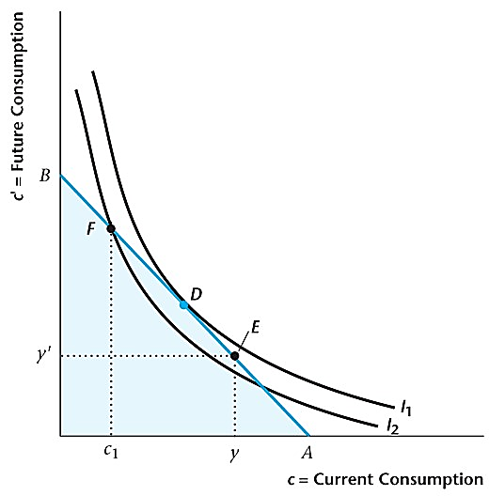
Figure 10.10 Fully Funded Social Security When Mandated Retirement Saving Is Binding
Notes:
In a perfect world, forced savings can never make consumers better off. They are always choosing different quantities of savings than what they would choose if they optimized. Fully funded social security could be justified by a commitment argument. Everyone knows that the government cannot bear to let senior citizens go destitute, so people don’t save, expecting the government to bail them out in old age. Forcing them to save actually improves social welfare in this case.

