Slide 1
Chapter 11
A Real Intertemporal Model with Investment

Slide 2
Chapter 11 Topics
Construct a real intertemporal model.
Understand the investment decision of the firm.
Show how macroeconomic shocks affect the economy.
10-<number>

Slide 3
Real Intertemporal Model
Current and future periods.
Representative Consumer
  consumption/savings decision
Representative Firm
  hires labor and invests in current period, hires labor in future
Government
  spends and taxes in present and future and borrows on the credit market.
10-<number>

Slide 4
Real Intertemporal Model
Determination of Equilibrium in the Labor Market
10-<number>

Slide 5
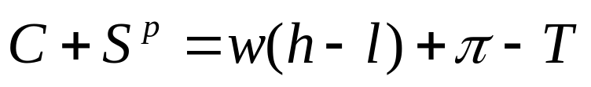
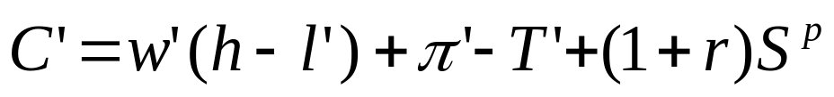
Representative Consumer’s Budget Constraints
Consumer’s current-period budget constraint:
Consumer’s future-period budget constraint:
10-<number>

Slide 6
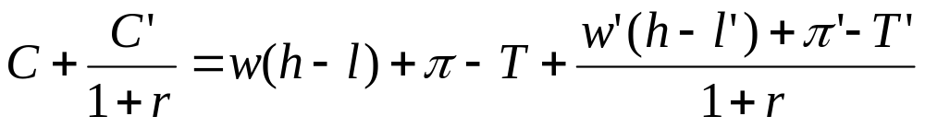
Consumer’s Lifetime Budget Constraint
10-<number>

Slide 7
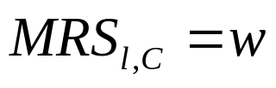
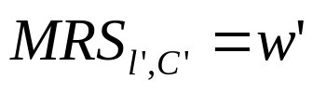

Marginal Conditions for the Consumer
Current period:
Future period:
Intertemporal Choice:
10-<number>

Slide 8
Consumer’s Current Labor Supply Behavior
Current labor supplied increases with the real wage (substitution effects are assumed to dominate income effects).
Labor supply increases with an increase in the real interest rate, through an intertemporal substitution effect.
An increase in lifetime wealth (e.g. taxes fall) reduces labor supply.
10-<number>

Slide 9
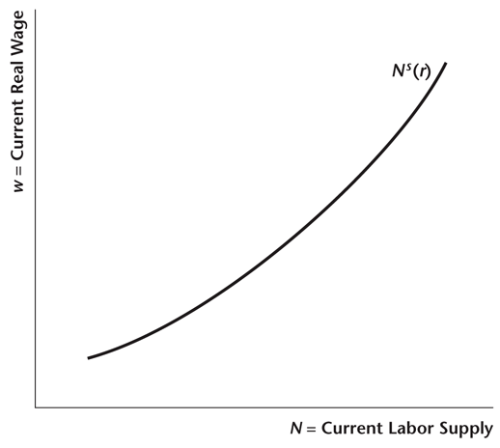
Figure 10.1
The Representative Consumer’s
Current Labor Supply Curve
10-<number>

Slide 10
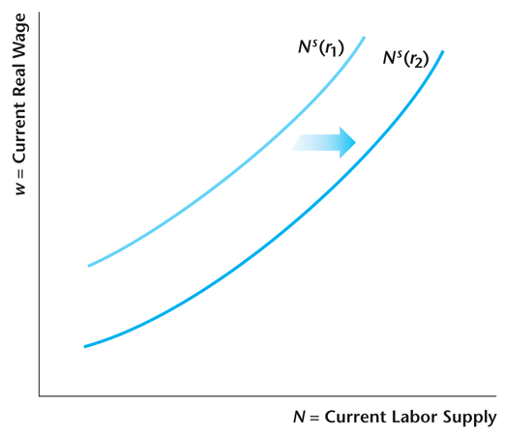
Figure 10.2
An Increase in the Real Interest Rate Shifts the Current Labor Supply Curve to the Right
10-<number>

Slide 11
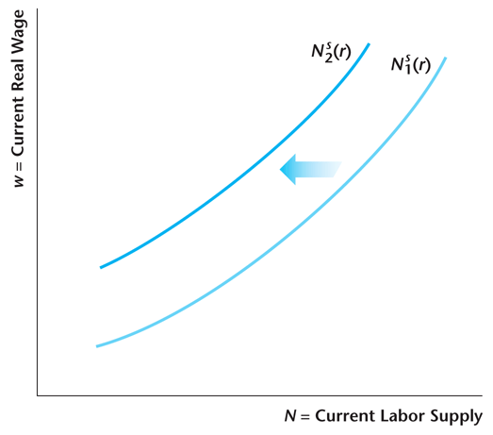
Figure 10.3
Effects of an Increase in Lifetime Wealth
10-<number>

Slide 12
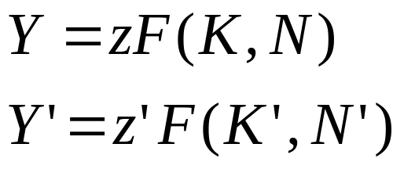
Firm’s Current and Future Production Technology
3-<number>

Slide 13
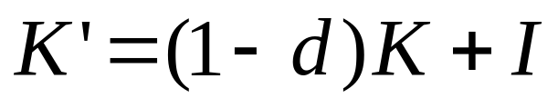
Evolution of the Firm’s Capital Stock
3-<number>

Slide 14
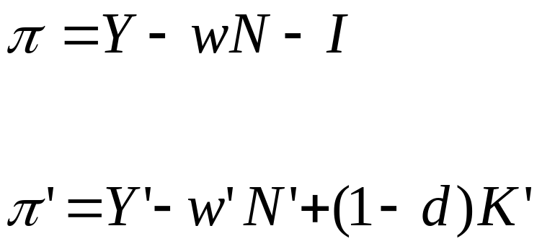
Firm’s Current and Future Profits
3-<number>

Slide 15
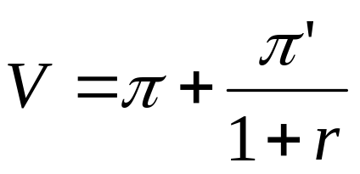
The Firm Maximizes the Present Value of Profits
3-<number>

Slide 16
The Firm’s Labor Demand
As in Chapter 4, the firm’s labor demand schedule is the marginal product of labor for the firm, which is downward sloping.
3-<number>

Slide 17
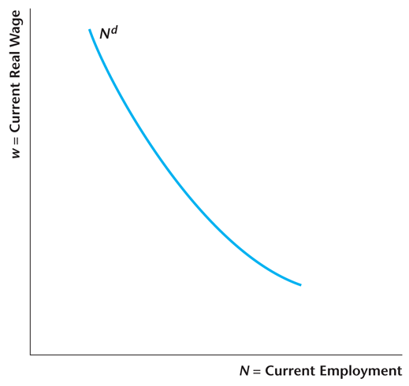
Figure 10.7
The Demand Curve for Current Labor Is the Representative Firm’s MP of Labor Schedule
10-<number>

Slide 18
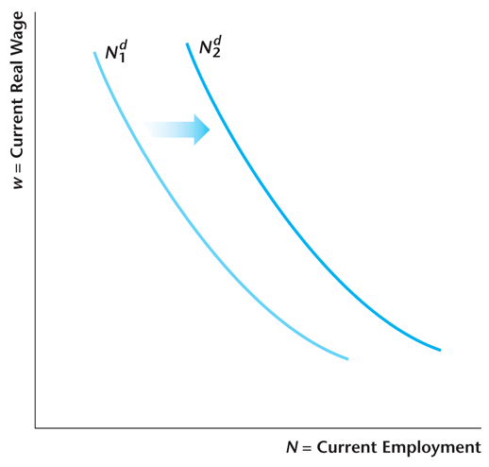
Figure 10.8
The Current Demand Curve for Labor Shifts Due to Changes in Current TFP z and in the Current K
10-<number>

Slide 19
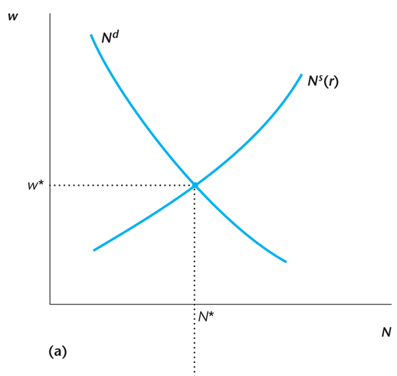
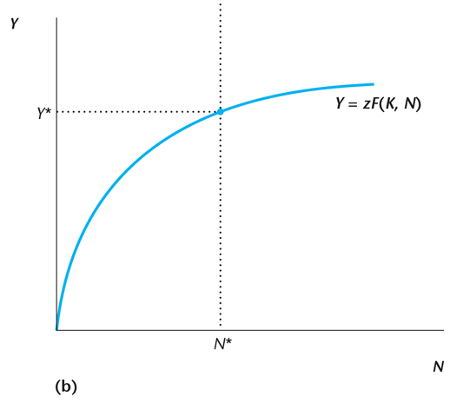
Figure 10.14
Determination of Equilibrium in the Labor Market Given the Real Interest Rate r
10-<number>

Slide 20
Real Intertemporal Model
Determination of Equilibrium in good Market
3-<number>

Slide 21
The Current Demand for Consumption Goods
MPC = marginal propensity to consume – the increase in demand for consumption goods induced by a one-unit increase in current real income.
Intertemporal substitution: the demand for consumption goods decreases with an increase in the real interest rate (Chapter 8)
An increase in lifetime wealth (e.g. taxes fall) increases the demand for consumption goods.
3-<number>

Slide 22
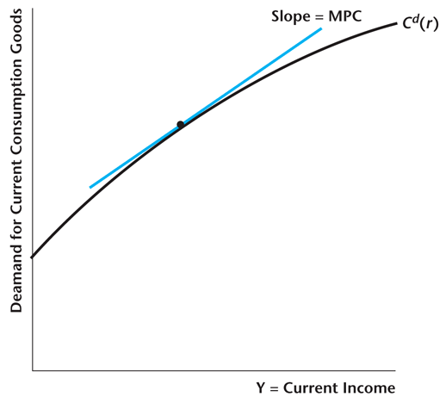
Figure 10.4
The Representative Consumer’s Current Demand for Consumption Goods Increases with Income
10-<number>

Slide 23


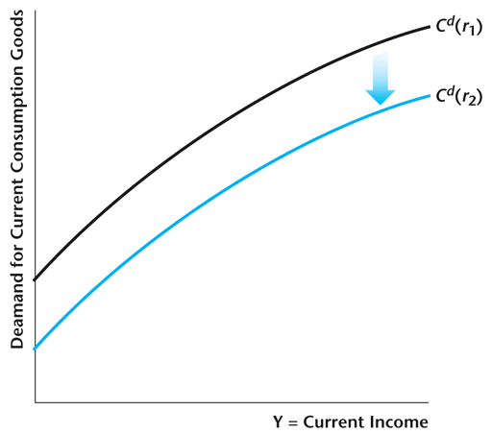
Figure 10.5
An Increase in the Real Interest Rate from to Shifts the Demand for Consumption Goods Down
10-<number>

Slide 24
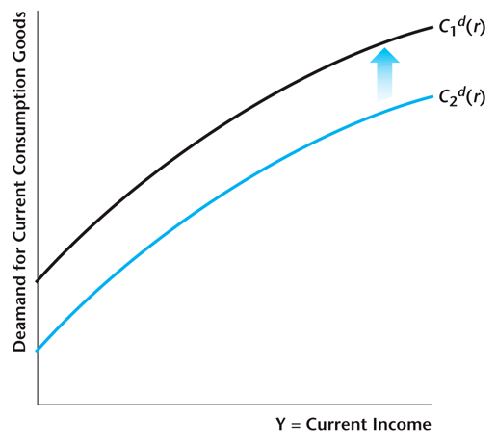
Figure 10.6
An Increase in Lifetime Wealth Shifts the Demand for Consumption Goods Up
10-<number>

Slide 25
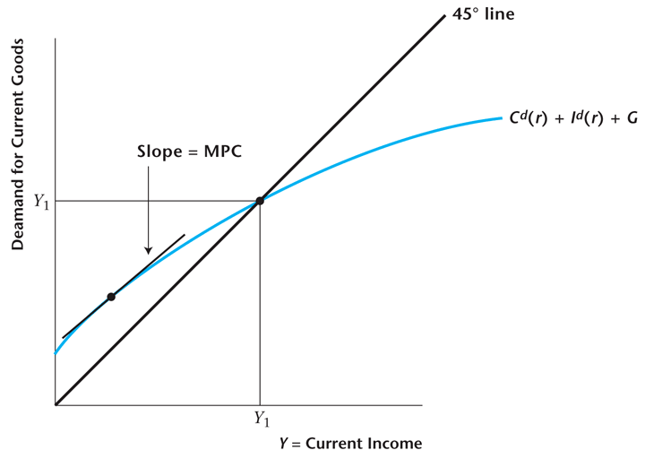
Figure 10.18
The Demand for Current Goods
10-<number>

Slide 26
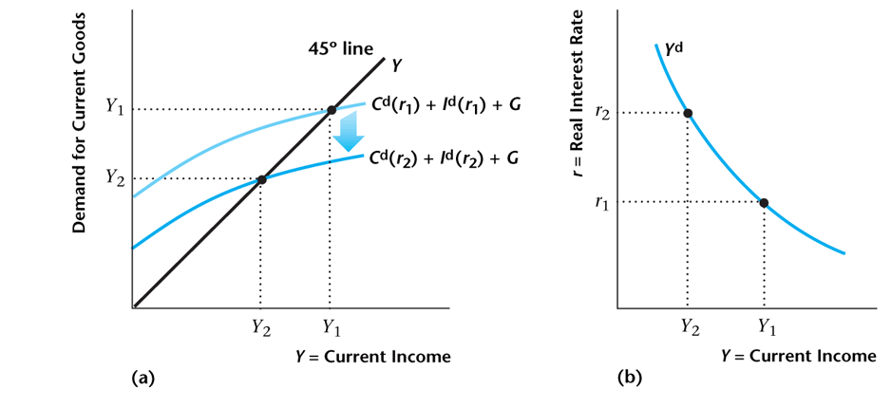
Figure 10.19
Construction of the Output Demand Curve
10-<number>

Slide 27
What Shifts the Output Demand Curve to the Right?
A decrease in the present value of taxes.
An increase in future income.
An increase in future total factor productivity.
A decrease in the current capital stock.
3-<number>

Slide 28
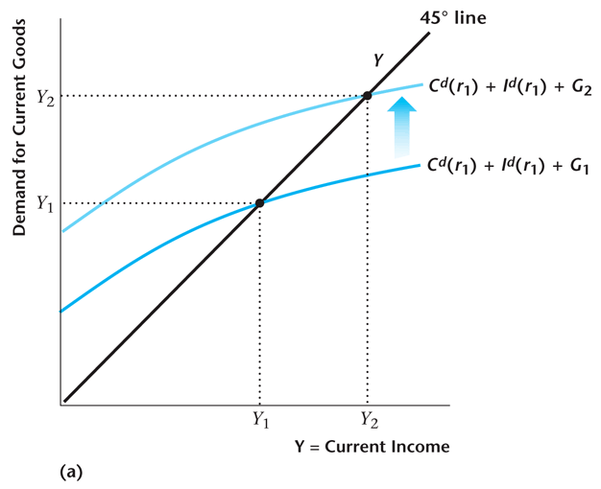
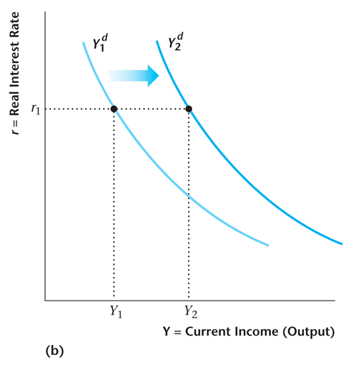
Figure 10.20
The Output Demand Curve Shifts to the Right if Current Government Spending Increases
10-<number>

Slide 29
The Representative Firm’s Investment Decision
The firm invests to the point where the marginal benefit from investment equals the marginal cost.
3-<number>

Slide 30
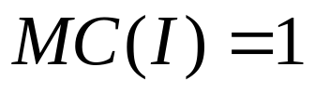
Marginal Cost of Investment
The marginal cost of investment is 1, as the firm gives up one unit of current profits for each unit it invests, so:
3-<number>

Slide 31
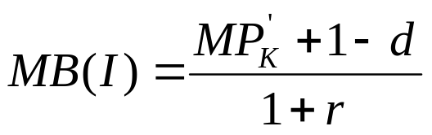
Marginal Benefit of Investment
The marginal benefit of investment is the marginal product of future capital plus the quantity of capital that will be left in the future after depreciation, all discounted back to the present:
3-<number>

Slide 32
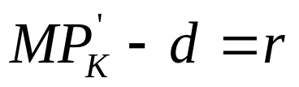
Optimal Investment Rule for the Firm
The firm’s optimal investment rule, obtained by equating the marginal benefit and marginal cost of investment:
3-<number>

Slide 33
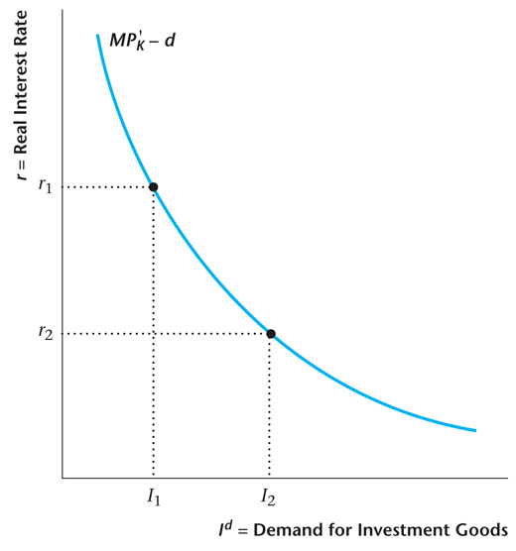
Figure 10.9
Optimal Investment Schedule for the Representative Firm
10-<number>

Slide 34
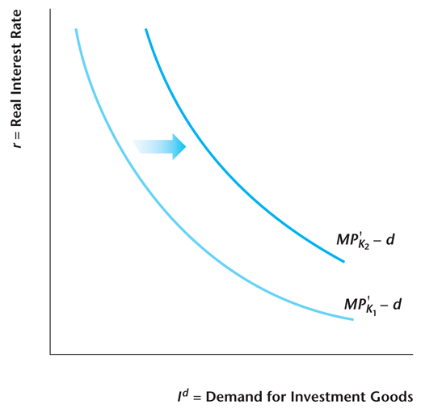
Figure 10.10
The Optimal Investment Schedule Shifts to the Right if K Decreases or Future TFP Is Expected to Increase
10-<number>

Slide 35
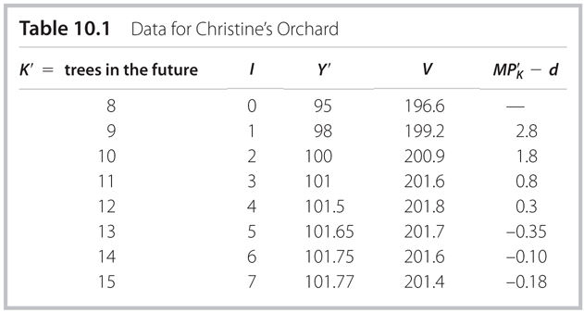
Table 10.1
Data for Christine’s Orchard
10-<number>

Slide 36
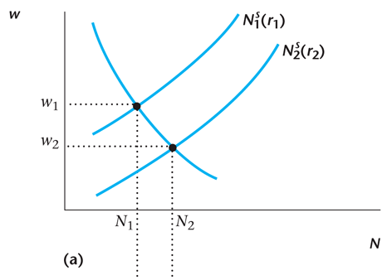
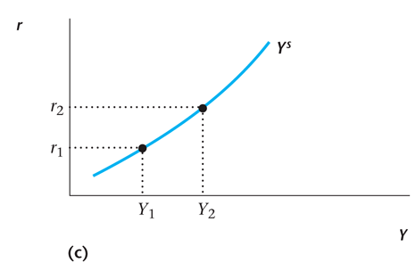
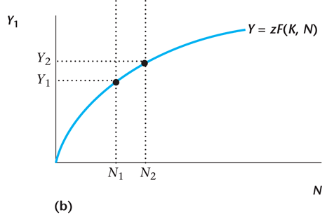
Figure 10.15
Construction of the Output Supply Curve
10-<number>

Slide 37
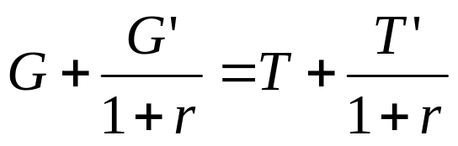
The Government’s Present-Value
Budget Constraint
3-<number>

Slide 38
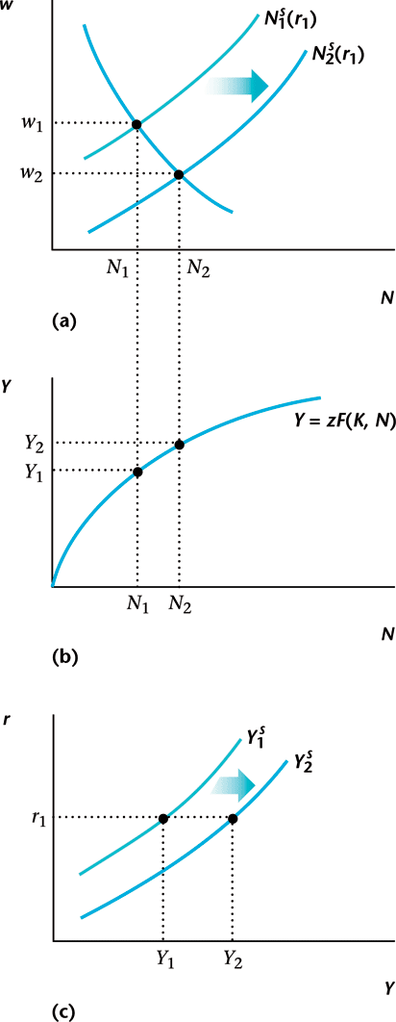
Figure 10.16
An Increase in Current or Future Government Spending Shifts the Y^{s} Curve
10-<number>

Slide 39
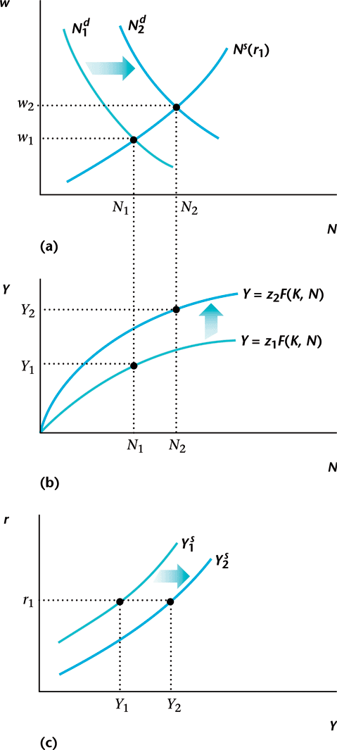
Figure 10.17
An Increase in Current TFP Shifts the Y^{s} Curve
10-<number>

Slide 40
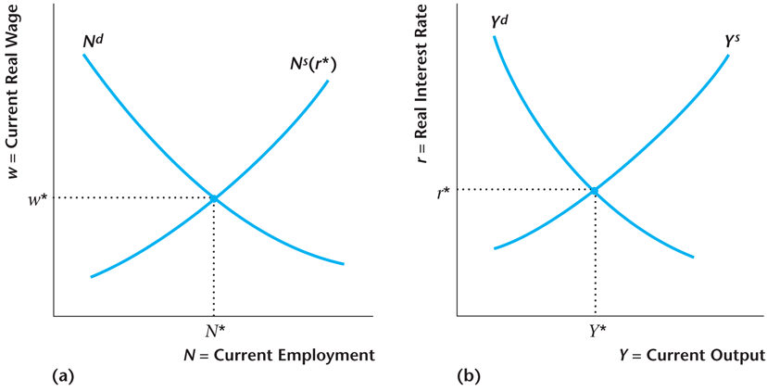
Figure 10.21
The Complete Real Intertemporal Model
10-<number>

