Slide 1
Chapter 11
A Real Intertemporal Model with Investment

Slide 2
Chapter 11 Topics
Construct a real intertemporal model.
Understand the investment decision of the firm.
Show how macroeconomic shocks affect the economy.
Focus on the implications of future expectations for current macroeconomic performance.
3-<number>

Slide 3
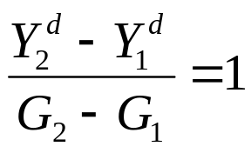
The Equilibrium Effects of a Temporary Increase in G
Question: What is the rightward shift in the output demand curve due to an increase in G?
Answer: The curve shifts to the right one-for-one with the increase in G.
The partial expenditure multiplier is one.
3-<number>

Slide 4
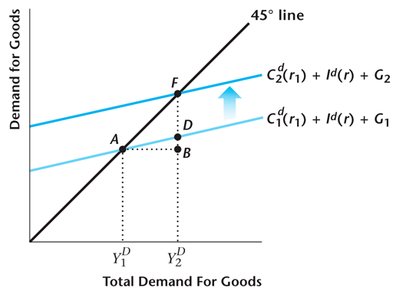
Figure 10.22
The Effect of an Increase in G on the
Total Demand for Goods
10-<number>

Slide 5
Equilibrium Effects
Output increases, real interest rate increases, real wage falls, consumption and investment decrease, employment rises.
Government spending crowds out both consumption and investment.
3-<number>

Slide 6
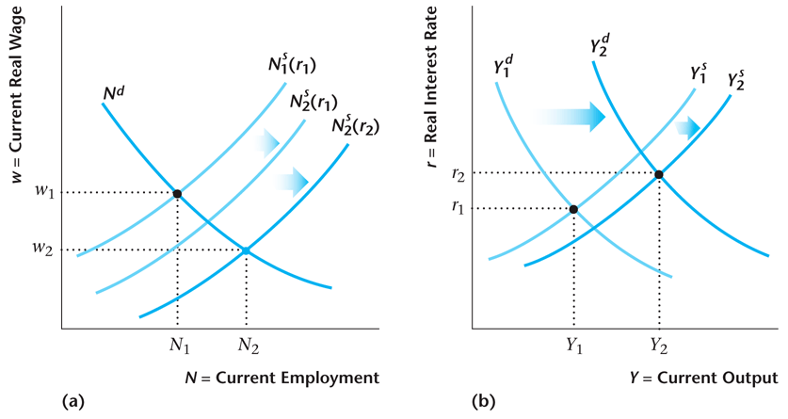
Figure 10.23
A Temporary Increase in Government Purchases
10-<number>

Slide 7
Important Points
The total multiplier – the ratio of the equilibrium increase in Y, to the increase in G – must be less than 1.
In rudimentary Keynesian analysis, the multiplier is greater than 1. Why? That type of analysis does not take account of: (i) how the extra output is to be produced; (ii) the effect of taxes (present and future) on consumption.
3-<number>

Slide 8
More Important Points
Extra government spending comes at a cost – crowds out private consumption and investment spending, and we all have to work harder.
In rudimentary Keynesian analysis, increases in G are costless – in fact Y and C increase as a result. The conclusion seems to be that G should be infinitely large – obviously silly.
3-<number>

Slide 9
A Decrease in the Current Capital Stock, K
This could arise due to a war or natural disaster.
Output may rise or fall, depending on how large the output demand effect is relative to the output supply effect.
The real interest rate rises, the real wage falls, employment may rise or fall.
3-<number>

Slide 10
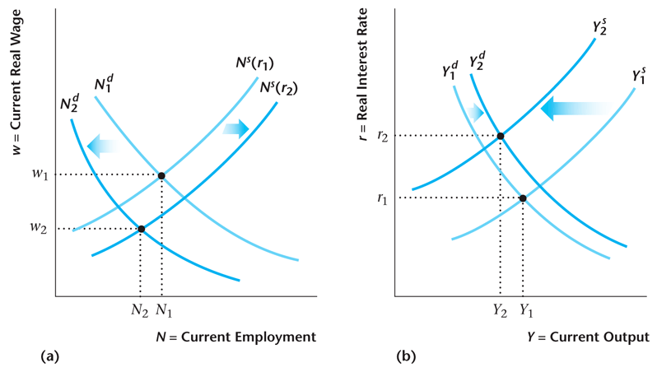
Figure 10.24
The Equilibrium Effects of a Decrease in the Current Capital Stock
10-<number>

Slide 11
Current Total Factor Productivity Increases
Real interest rate falls, consumption and investment rise, employment rises, real wage rises.
Productivity shocks are a potential explanation for business cycle.
3-<number>

Slide 12
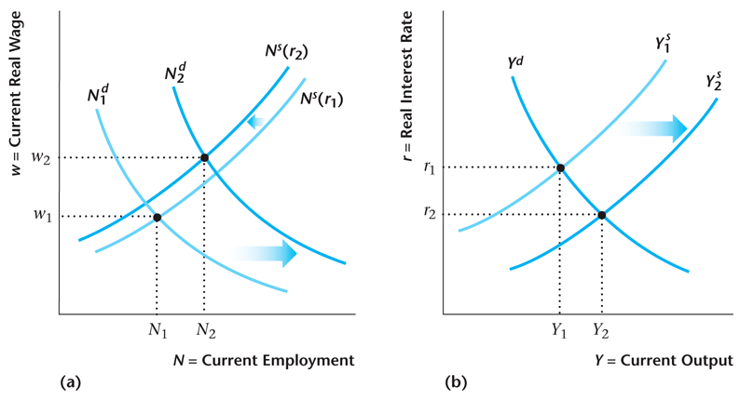
Figure 10.25
The Equilibrium Effects of an Increase in Current TFP
10-<number>

Slide 13
TFP Expected to Increase in Future – A News Shock
Output demand curve shifts right.
Real interest rate rises, investment increases, consumption may rise or fall, employment rises, real wage falls, output rises.
Important in explaining investment boom in the 1990s in the United States.
3-<number>

Slide 14
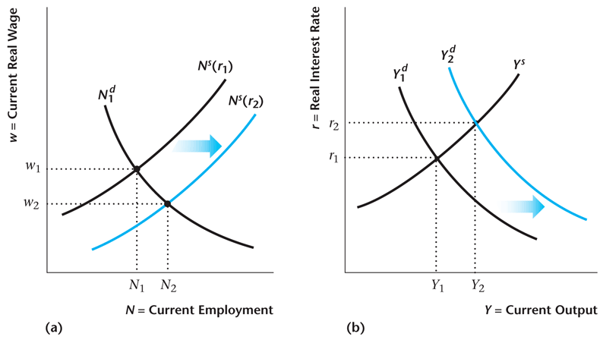
Figure 10.26
The Equilibrium Effects of an Increase in Future TFP
10-<number>

Slide 15
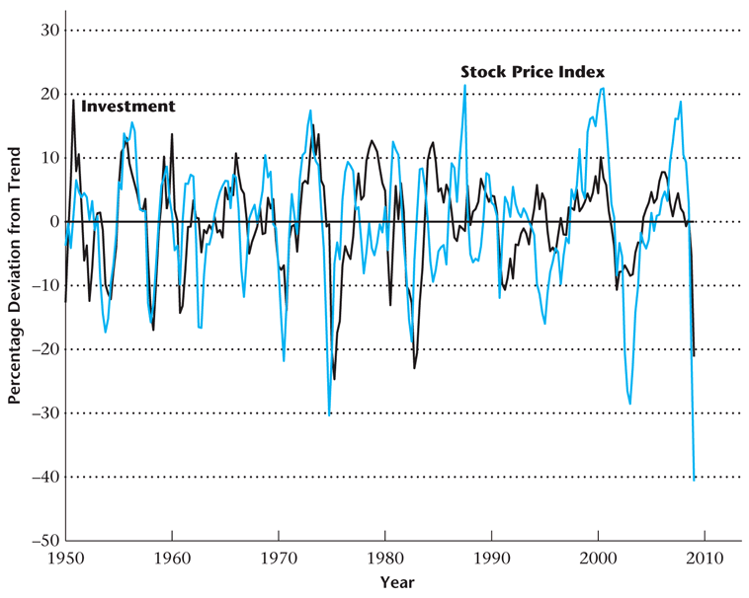
Figure 10.27
% Deviations from Trend in Investment and a Stock Price Index, 1950–2009
10-<number>

Slide 16
An Increase in Credit Market Uncertainty
Important for the financial crisis.
Increase in credit market uncertainty affects both consumers and firms – consumers who borrow to finance consumption and firms borrowing to finance investment.
Increase in interest rate spreads – default premia.
3-<number>

Slide 17
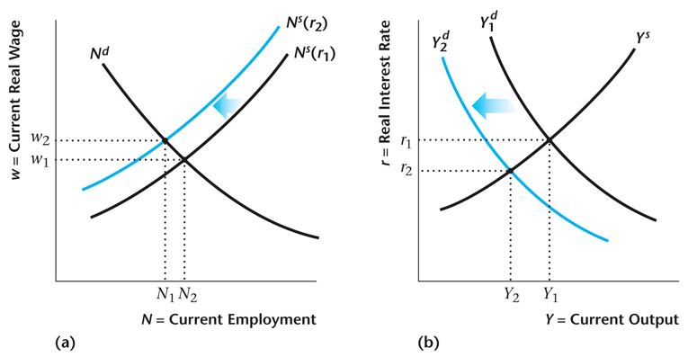
Figure 10.28
The Effect of an Increase in Credit Market Risk
10-<number>

Slide 18
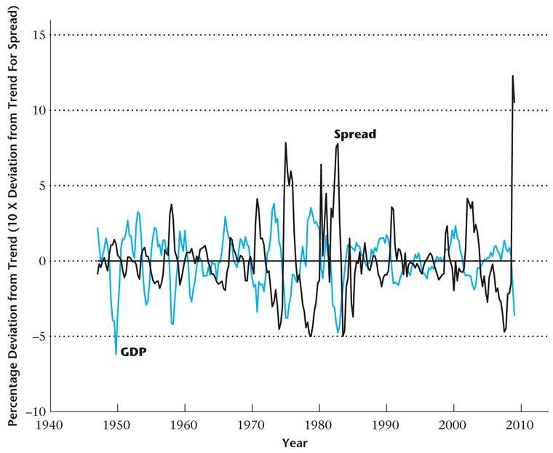
Figure 10.29
Real GDP and the Interest Rate Spread
10-<number>

