Slide 1
Chapter 12
Money, Banking, Prices, and Monetary Policy

Slide 2
Learning Objectives
12.1 Explain the functions of money, and how money is measured.
12.2 Construct the monetary intertemporal model.
12.3 Derive the Fisher relation.
12.4 Construct a competitive equilibrium in the monetary intertemporal model and carry out equilibrium experiments using the model.
12.5 Demonstrate that money is neutral in the monetary intertemporal model.
12.6 List the factors that can shift money demand and show how a shift in money demand affects economic variables in the monetary intertemporal model.
12.7 Show how conventional monetary policy is ineffective in a liquidity trap and explain unconventional monetary policies.
Notes:
In this chapter, we build on the real intertemporal model by including monetary factors. The rest of the model works in the same way, but we add a money market. This allows us to determine the price level and to consider the effects of monetary policy.

Slide 3
What is Money?
Medium of exchange
Store of value
Unit of account
Notes:
A standard set of functions for money is that it is a medium of exchange, store of value, and unit of account. It is the medium of exchange property of money that were are most interested in.

Slide 4
Measures of Money
Monetary Base (outside money) = currency in circulation + bank reserves
M1 = currency in circulation + transactions deposits + travelers’ checks + demand deposits
M2 = M1 + savings deposits + retail money market funds
Notes:
There are alternative measures for money from narrow to broad. The narrowest measure of money includes only the liabilities of the central bank (the Fed), which are currency and bank reserves. A broader measure, M1, includes the liabilities of banks that serve a transactions role. M2 is an even broader measure that includes assets that are highly liquid but which are not actually transactions accounts.

Slide 5
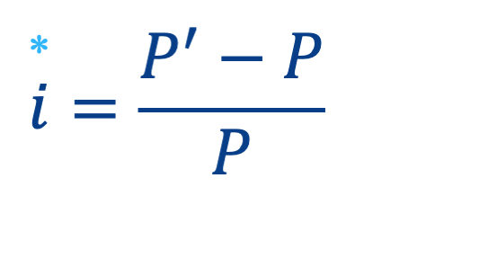
The Inflation Rate
Notes:
The inflation rate is the rate of change in the price level over time. P’ is the future price level, and P is the current price level.

Slide 6
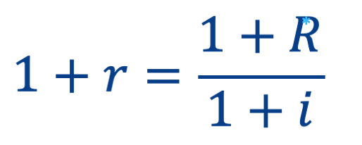
The Fisher Relation
Notes:
The real interest rate is r, the nominal interest rate is R, and the equation defines the relationship among the real interest rate, the nominal interest rate, and the inflation rate.

Slide 7

The Approximate Fisher Relation
Notes:
The way the Fisher relation is usually written is an approximation – the real interest rate is the nominal interest rate minus the inflation rate.

Slide 8
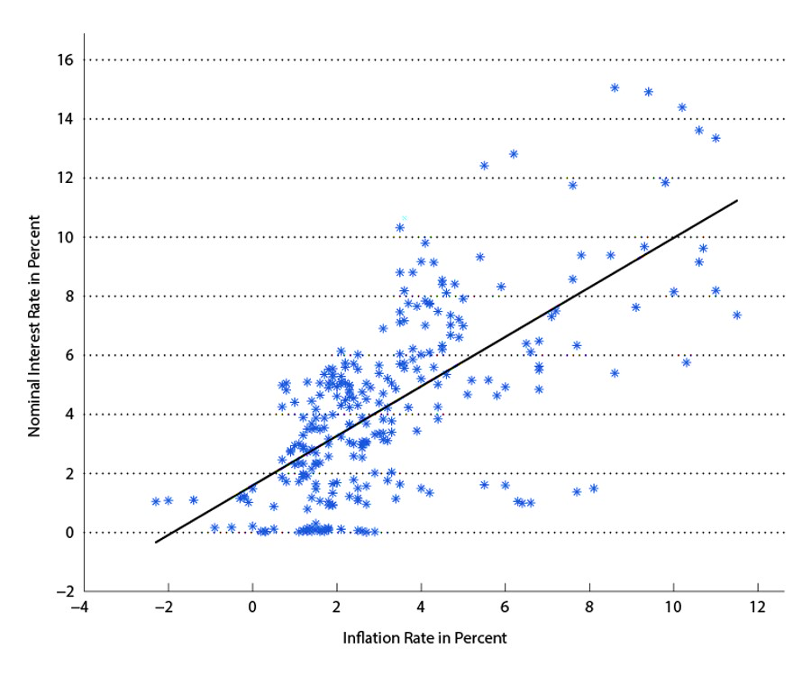
Figure 12.1 The Nominal Interest Rate vs. Inflation
Notes:
The Fisher effect is observable in this chart. This is the positive relationship observed between the nominal interest rate and inflation.

Slide 9
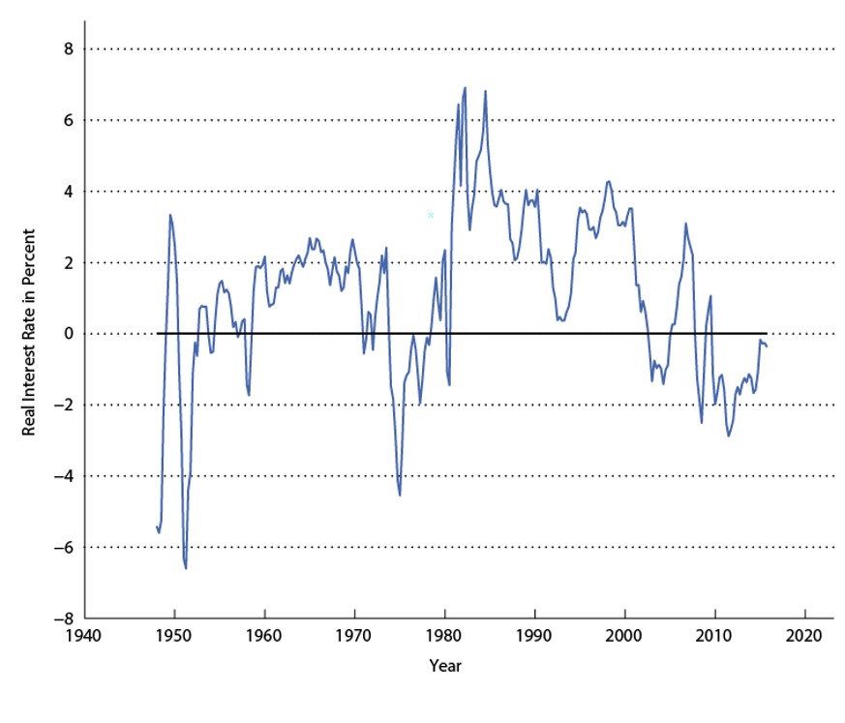
Figure 12.2 The Measured Real Interest Rate
Notes:
The real interest rate we observe is quite variable. Note in particular that the real interest rate has declined since about 1980, and is currently quite low – an issue for monetary policy. This is a worldwide phenomenon.

Slide 10
Banks and Alternative Means of Payment (1 of 2)
Assume all goods must be purchased with currency or credit cards.
“Credit cards” can be assumed to stand in, more broadly, for debt cards and checks, for example – all alternative means of payment supplied by the financial system.
Goods purchased at price P, no matter what means of payment is used.
Notes:
Our monetary model will include means of payment other than money – which we will think of as currency. Goods can be purchased with credit cards and currency, where “credit cards” is a stand-in for all other means of payment, including debit cards and ACH transfers.

Slide 11
Banks and Alternative Means of Payment (2 of 2)
Using a credit card costs q per unit of goods purchased.
Credit supply (by banks) is given by X^{s}(q), which is increasing in q.
Supplying credit card services is costly for banks.
Notes:
We will assume that supplying credit card services is costly for banks, and we specify a credit supply function which depends on q, the price of credit card services.

Slide 12
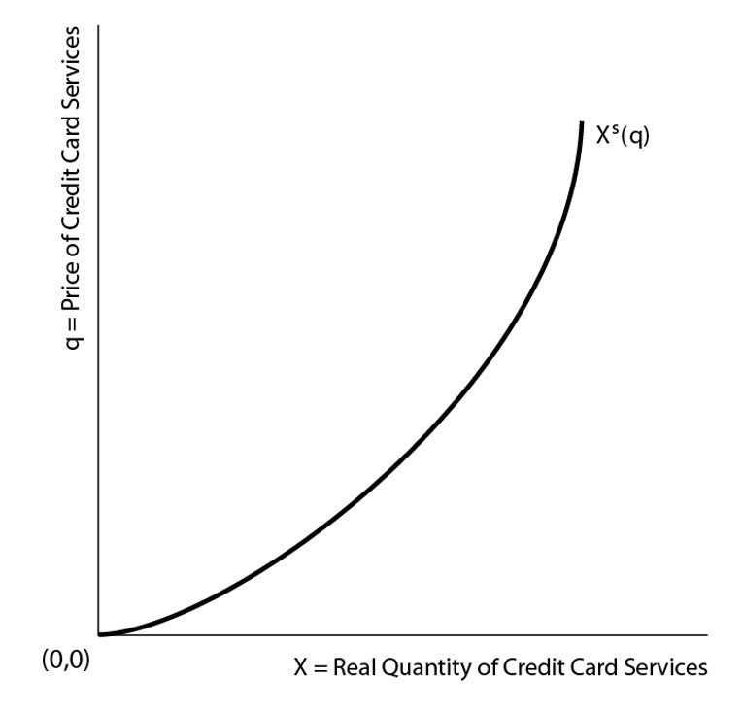
Figure 12.3 The Supply Curve for Credit Card Services
Notes:
The figure depicts the supply curve for credit card services, with the price of these services, q, on the vertical axis.

Slide 13
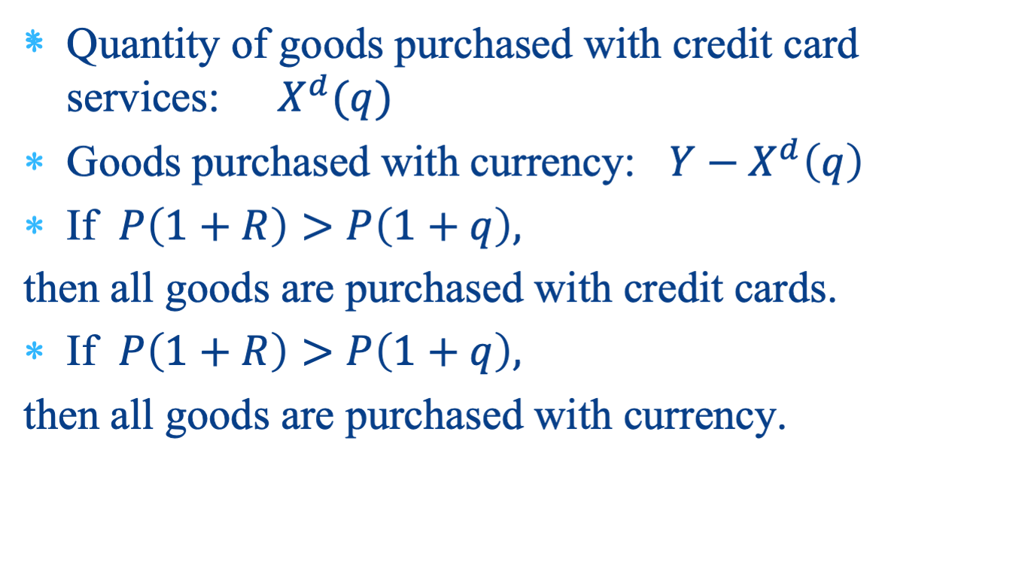

Demand for Credit Card Services
<
Notes:
Consumers will use whatever means of payment is cheaper. This decision depends on the nominal interest rate and the price of credit card services.

Slide 14
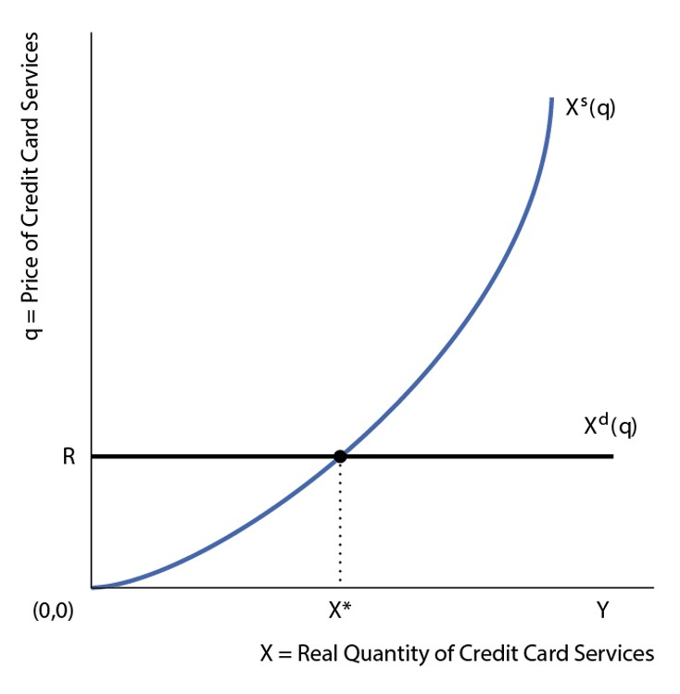
Figure 12.4 Equilibrium in the Market for
Credit Card Services
Notes:
Demand for credit card services is perfectly elastic at the price q = R, and the supply curve is upward sloping. Therefore, q = R in equilibrium, and the quantity of credit card services is X*.

Slide 15
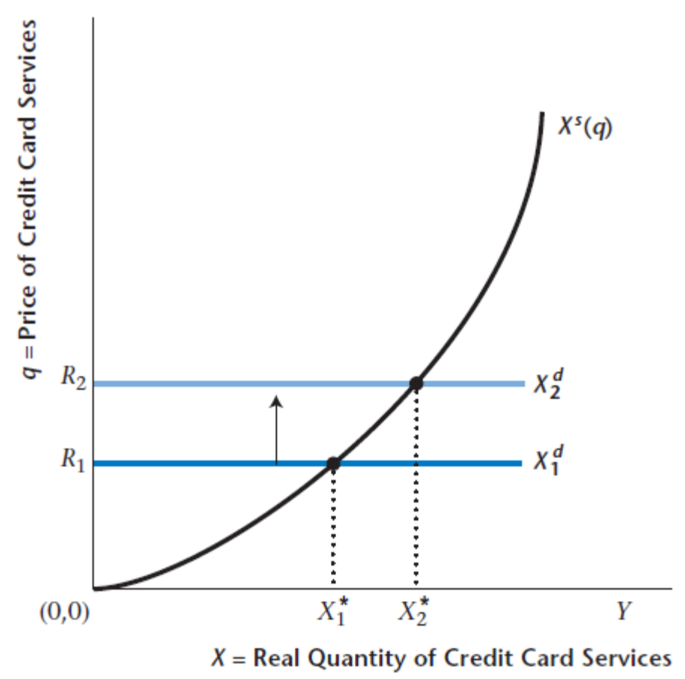
Figure 12.5 Increase in the Nominal Interest Rate and the Market for Credit Card Services
Notes:
If the nominal interest rate goes up, consumers will substitute credit card services for currency.

Slide 16
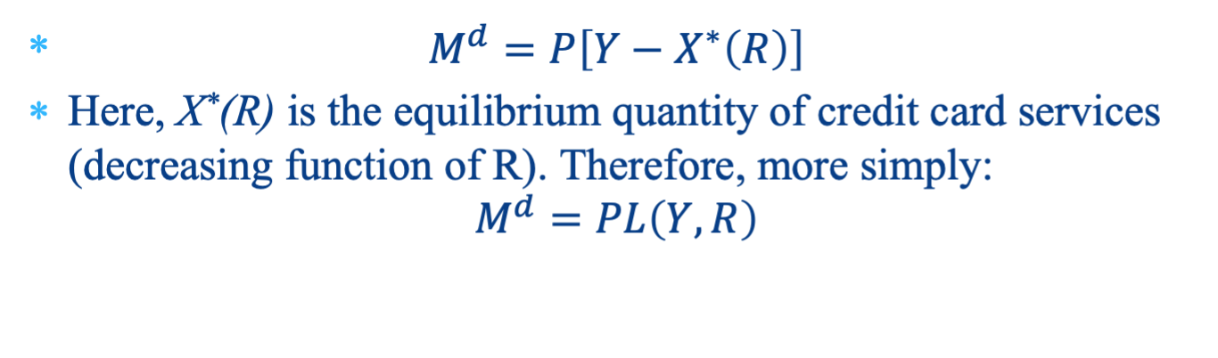
Demand for Money (1 of 2)
Notes:
From the demand for credit card services, we can derive the demand for money (currency), which is increasing in Y, because more income implies higher demand for all means of payment. The demand for money is decreasing in R, as an increase in R causes the consumer to use credit cards more and currency less.

Slide 17
Demand for Money (2 of 2)
Increasing in real income – more currency required as volume of transactions increases.
Decreasing in the nominal interest rate. The nominal interest rate is the opportunity cost of using currency in transactions – higher R implies greater use of credit in transactions, and less use of currency.

Slide 18
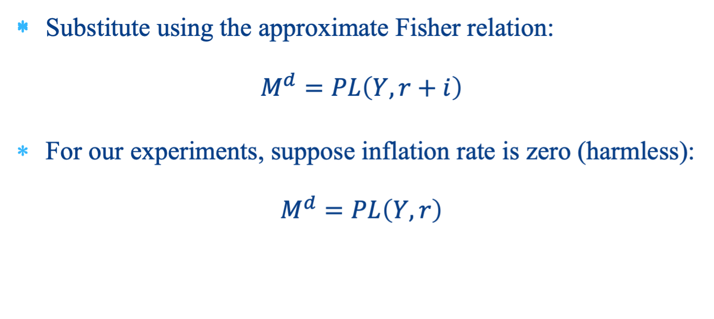
Nominal Money Demand
Notes:
To integrate money demand into the real intertemporal model in a simple way, suppose for now that inflation is zero (no harm done), so the nominal interest rate is equal to the real interest rate.

Slide 19
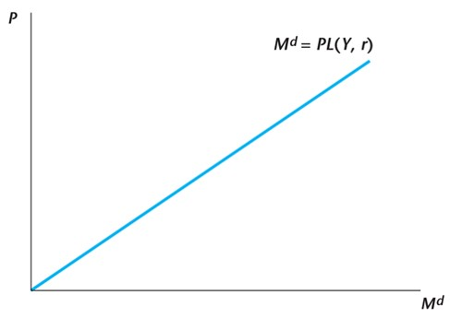
Figure 12.6 The Nominal Money Demand Curve in the Monetary Intertemporal Model
Notes:
Here, we draw money demand, with the quantity of money demanded on the horizontal axis and the price level on the vertical axis. The money demand function is then a straight line with coefficient L(Y,r).

Slide 20
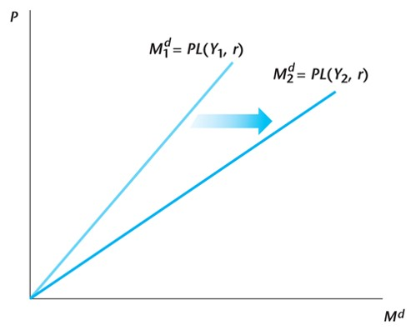
Figure 12.7 Increase in Current Real Income and the Nominal Money Demand Curve
Notes:
An increase in real income shifts the money demand function to the right.

Slide 21
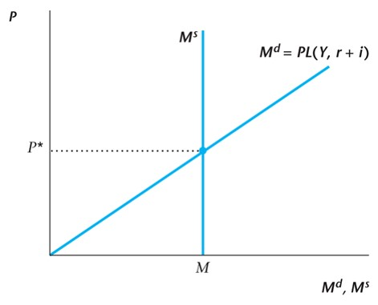
Figure 12.8 The Current Money Market in the Monetary Intertemporal Model
Notes:
This figure depicts the complete money market. Money supply, determined by the central bank, is a vertical line, as money supply is inelastic. Money demand and money supply then determine the price level.

Slide 22
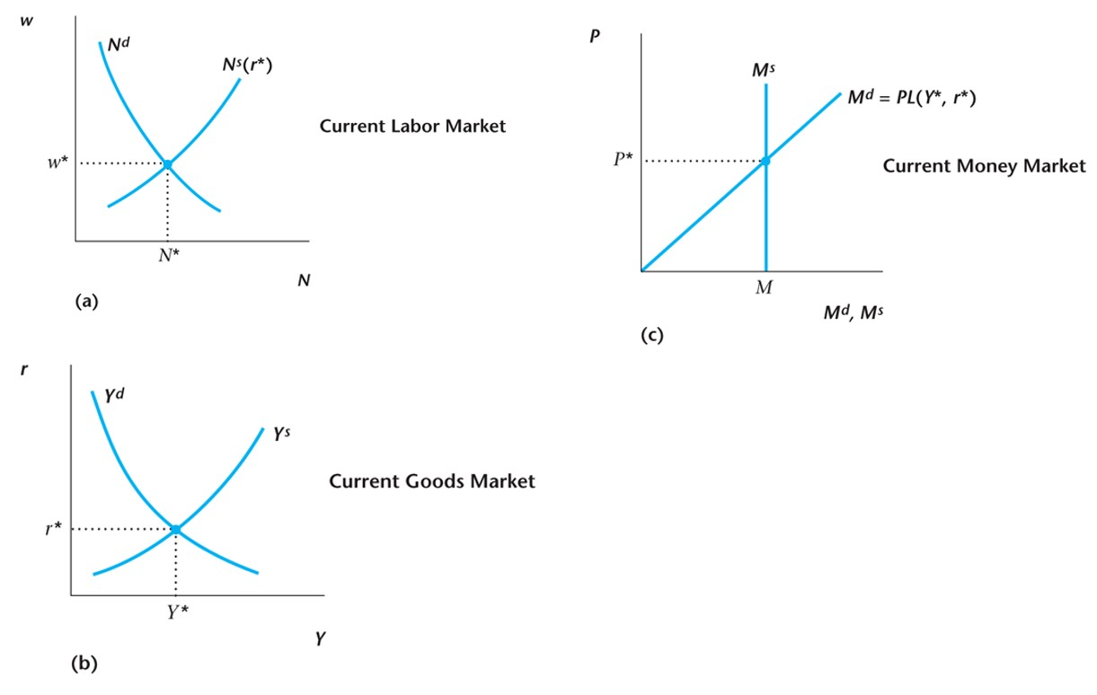
Figure 12.9 The Complete Monetary Intertemporal Model
Notes:
The figure denotes the complete money demand model. Output and the real interest rate are determined in the left two panels. This then determines money demand, which determines the price level in the right panel.

Slide 23
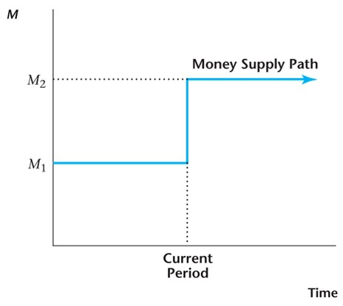
Figure 12.10 A Level Increase in the Money Supply in the Current Period
Notes:
Now, consider an experiment. The money supply increases once and for all, in a level fashion, in the current period. Suppose this is unanticipated.

Slide 24
The Neutrality of Money
In the monetary intertemporal model, a level increase in the money supply increases the price level and the nominal wage in proportion to the money supply increase, but has no effect on any real macroeconomic variable.
Notes:
Money is neutral in this version of the model, in that increasing its quantity has no real consequences. All nominal variables (in particular the price level) increase in proportion to the money supply increase.

Slide 25
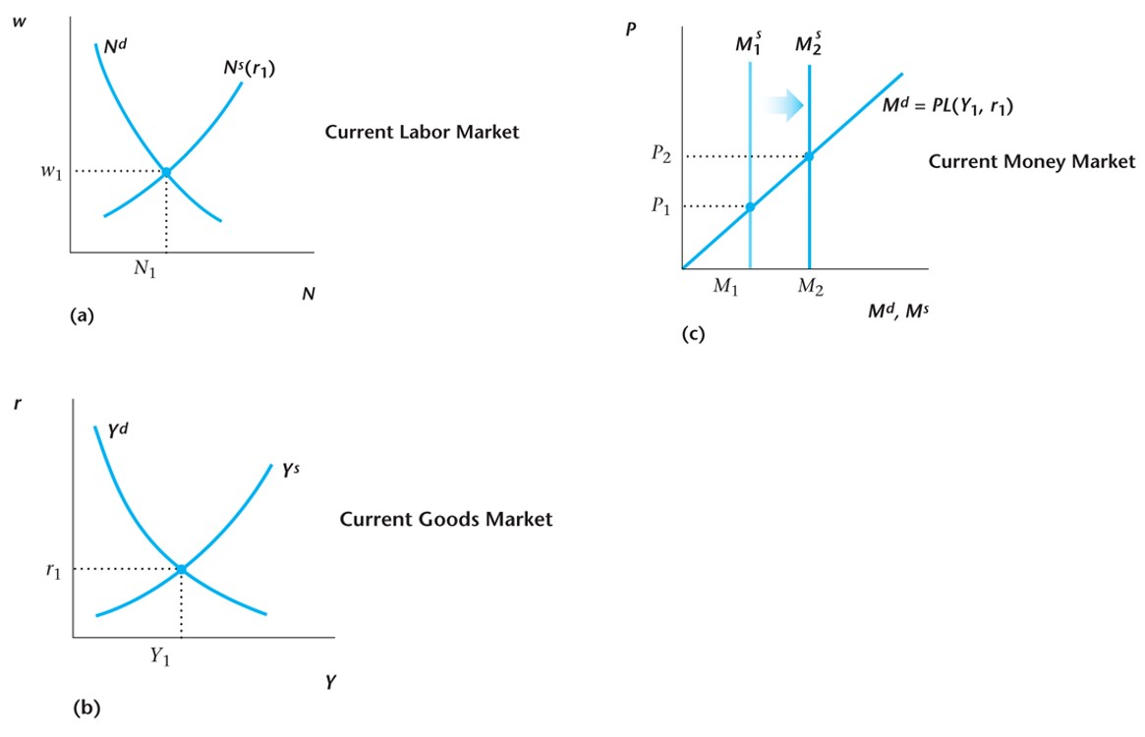
Figure 12.11 The Effects of a Level Increase in M—The Neutrality of Money
Notes:
The figure illustrates the neutrality of money. There is a classical dichotomy – the real variables are determined in the left-hand panels, and the price level in the money market.

Slide 26
Shifts in Money Demand
These shifts are important for how monetary policy should be conducted.
Shifts in the demand for money that occur within a day, week or month (the very short run) are a critical for the central bank.
Notes:
Shifts in money demand are important. They occur on a daily, weekly, monthly, and yearly basis. Some shifts are predictable, others are not.

Slide 27
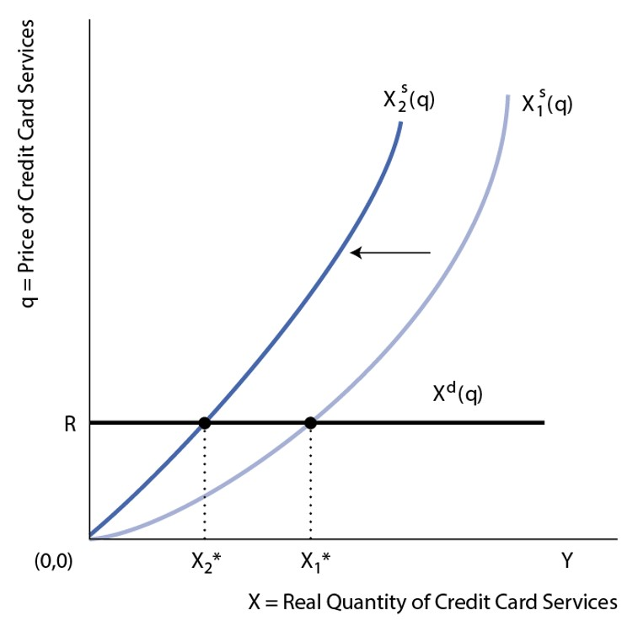
Figure 12.12 A Shift in the Supply of Credit Card Services
Notes:
In our model, a shift in the demand for money can occur because of a shift in the supply of credit card services. In this case, supply credit card services becomes more costly, which increases the demand for money.

Slide 28
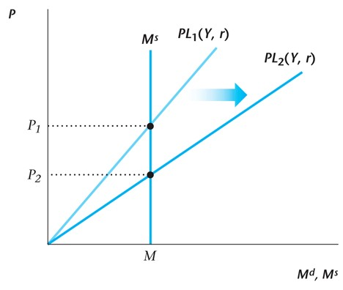
Figure 12.13 A Shift in the Demand for Money
Notes:
The shift in the supply of credit card services causes people to substitute currency for credit cards as a means of payment. The money demand function shifts to the right, and the price level goes down.

Slide 29
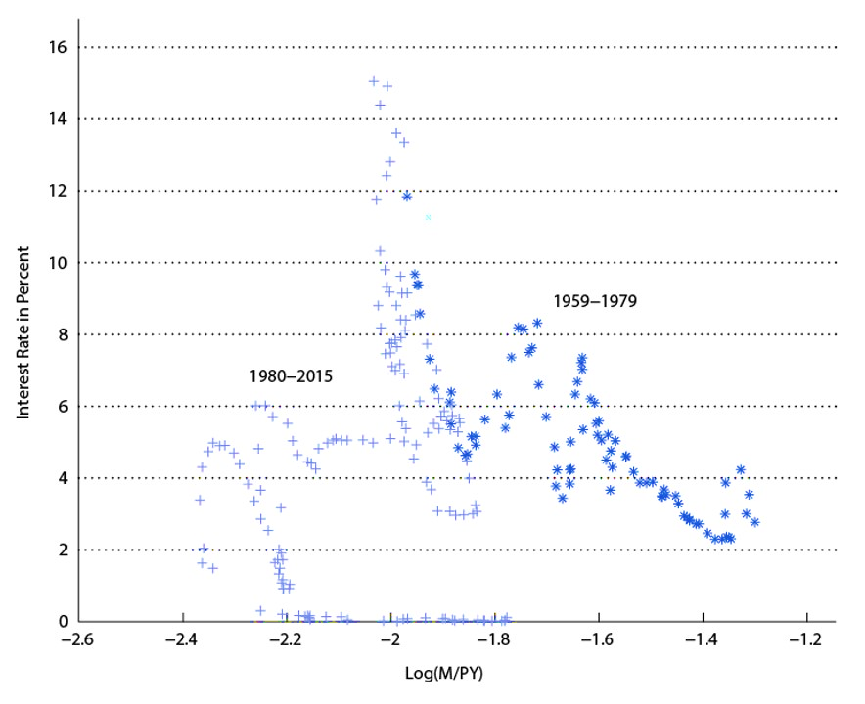
Figure 12.14 Instability in Money Demand
Notes:
Instability in money demand can be seen in the picture. If money demand were stable, there would be a tight fit to a negatively sloped line in the figure. For the period 1959-1979, the fit is not bad, as one can see a negative correlation in the data. But for 1980-2015, money demand is highly unstable, with no clear negative correlation.

Slide 30
Sources of Shifts in the Demand for Money
New information technologies.
Changes in government regulations.
Changes in the perceived riskiness of banks.
Changes in hour-to-hour, day-to-day, week-to-week circumstances in the banking system.
Notes:
There can be many reasons for instability in money demand. As new information technologies are introduced, for example more ATM machines, this can change the demand for money. Government regulations regarding banking are an important source of changes in money demand, for example those governing the payment of interest on deposit accounts. During the Great Depression, there was a dramatic increase in the demand for currency because of distrust of banks. Finally, shocks in the higher levels of the financial system that occur more or less frequently can lead to shifts in money demand.

Slide 31
The Liquidity Trap
Typically thought that the nominal interest rate cannot go below zero (though in practice, not quite correct).
There is a zero lower bound on the nominal interest rate.
At the zero lower bound, money M and B become perfect substitutes.
Liquidity trap: Open market purchases of B by the central bank will not matter.
Notes:
Zero was typically thought of as the lower bound on the nominal interest rate. Basically, this is still the case in the United States, though this could change, as it has in other countries where central banks pay negative interest on reserve accounts. But suppose the lower bound on the nominal interest rate is zero. Then, at zero there is a liquidity trap in which standard open market operations will not longer work.

Slide 32
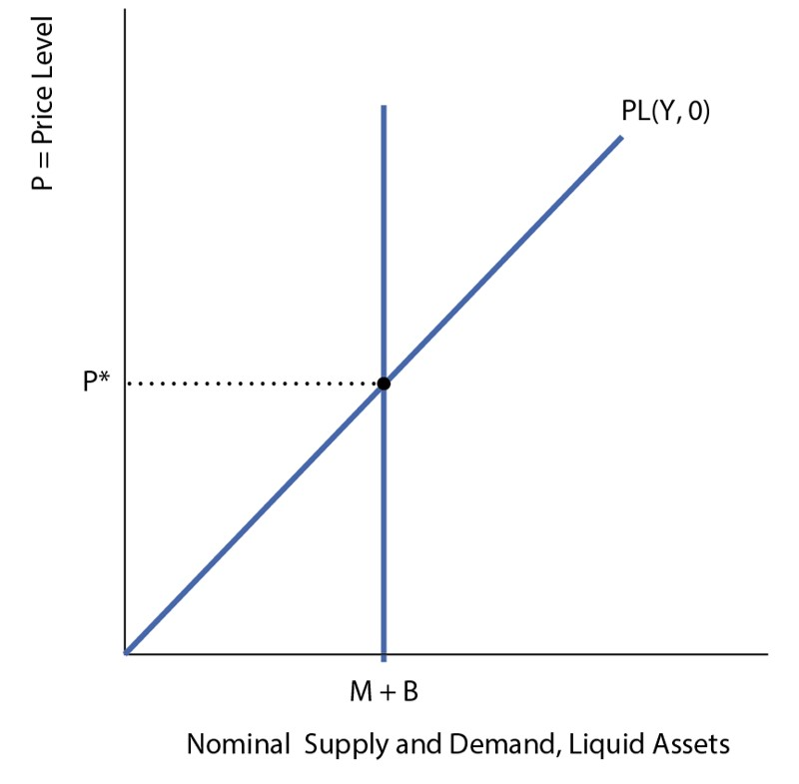
Figure 12.15 A Liquidity Trap
Notes:
The figure illustrates the liquidity trap. When the nominal interest rate is zero, money and bonds are essentially identical, so if the central bank swaps one for the other, this has no effect.

Slide 33
Unconventional Monetary Policy
Since conventional monetary policy – open market operations – does not work in a liquidity trap, central bank can resort to (among other policies):
  Quantitative easing – purchases of long-maturity government debt and private assets.
  Negative nominal interest rates – going below zero to the effective lower bound, by charging banks fees on reserve accounts with the central bank.
Notes:
In a liquidity trap, central banks can resort to unconventional monetary policies. Two such policies are quantitative easing, and negative nominal interest rates. The Fed resorted to extensive quantitative easing after the financial crisis, but has never paid negative interest on bank reserves. Countries with negative interest rates currently (late 2016) include Switzerland, Japan, Sweden, Denmark, and the Euro area.

