Slide 1
Chapter 13
Business Cycle Models with Flexible Prices and Wages

Slide 2
Learning Objectives
13.1 Construct the real business cycle model, explain how it matches the key business cycle facts, and use the model to analyze other problems.
13.2 Show how the real business cycle could be consistent with the observed comovements of money and output.
13.3 Discuss criticisms of the real business cycle model.
13.4 Construct the Keynesian coordination failure model, explain how it matches key business cycle facts, and use the model to analyze other problems.
13.5 Discuss criticisms of the Keynesian coordination failure model.
13.6 Explain how the business cycle models in this chapter are, or are not, consistent with the observed behavior of U.S. time series during the 2008–2009 recession.
Notes:
This is an important chapter, which starts our study of business cycles. This deals with business cycle models with flexible wages and prices – a sticky price New Keynesian model is covered in Chapter 14. Here, we want to address how these models fit the data, and what implications they have for government policy.

Slide 3
Key Questions in this Chapter
How does each model fit the data?
What is the role for government policy in each model?
Notes:
We will see that both of the models in this chapter do a good job of fitting the key business cycle facts we discussed in Chapter 3. But the policy implications of the two models are quite different.

Slide 4
Real Business Cycle Model
Business cycles are caused by fluctuations in total factor productivity.
There is no role for the government in smoothing business cycles – cycles are just optimal responses to the technology shocks.
Model fits the data well.
Notes:
The real business cycle model was developed by Finn Kydland and Edward Prescott, among others, in the early 1980s. The model is very simple. Business cycles are driven by exogenous persistent shocks to total factor productivity.

Slide 5
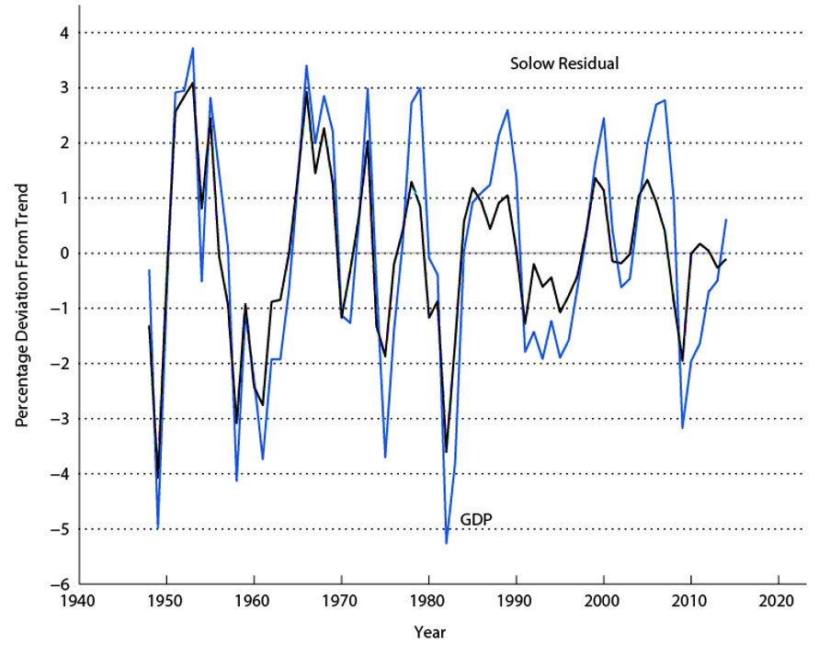
Figure 13.1 Solow Residuals and GDP
Notes:
This figure is suggestive of what the motivation for the model is. Fluctuations in the Solow residual, a measure of total factor productivity, track fluctuations in real GDP very closely.

Slide 6
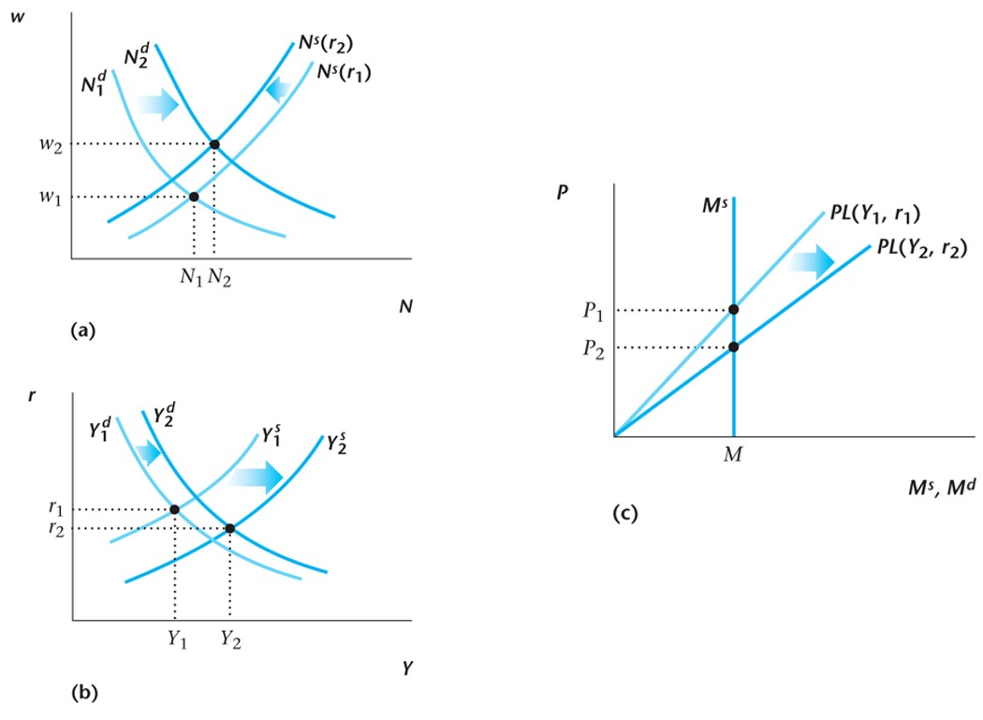
Figure 13.2 Persistent Increase in Total Factor Productivity in the Real Business Cycle Model
Notes:
Here is how the real business cycle model works. This is a persistent technology shock – from Chapter 11, a combination of a current TFP shock and a shock to future TFP as well. Output, consumption, investment, employment, and the real wage go up, and the price level goes down.

Slide 7
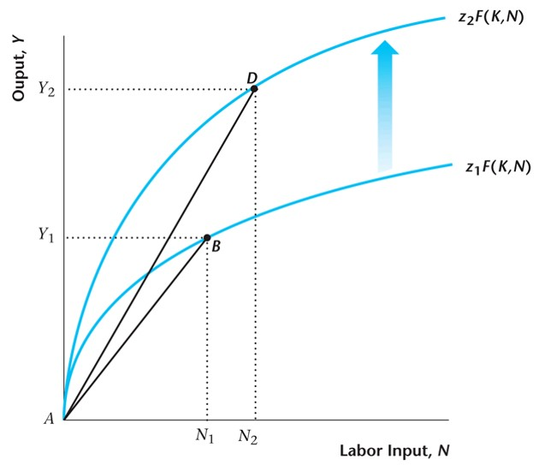
Figure 13.3 Average Labor Productivity with Total Factor Productivity Shocks
Notes:
One of our key business cycle facts is that average labor productivity is procyclical. The figure illustrates how the real business cycle model is consistent with this observation.

Slide 8
Table 13.1 Data Versus Predictions of the Real Business Cycle Model with Productivity Shocks
Variable | Data | Model
Consumption | Procyclical | Procyclical
Investment | Procyclical | Procyclical
Employment | Procyclical | Procyclical
Real Wage | Procyclical | Procyclical
Average Labor Productivity | Procyclical | Procyclical
Notes:
The chart shows how the real business cycle model matches the key business cycle facts from Chapter 3. In the full-blown model, simulated on the computer, the real business cycle also fits well the relative variabilities of these key variables.

Slide 9
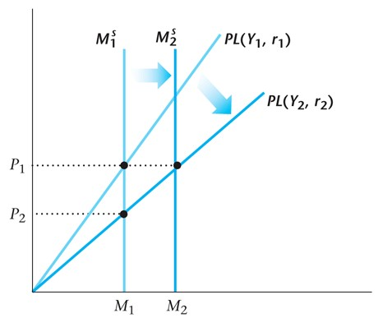
Figure 13.4 Procyclical Money Supply in the Real Business Cycle Model with Endogenous Money
Notes:
Though the comovements of the money supply with real economic activity have become irregular, particularly since 1980, in the past the money/output correlation had been important, particularly in the work of Friedman and Schwartz. So we want to explain why money/output correlations may or may not arise in the data, and also say something about the cyclical properties of the price level. In the model, if the central bank is attempting to target the price level, this will induce a positive correlation between money and output. That is, when TFP goes up, money demand increases. So, to keep the price level constant, the central bank increases M.

Slide 10
Keynesian Coordination Failure Model
Strategic complementarities imply that the aggregate production function has increasing returns to scale, and the labor demand function can be upward sloping.
There can be multiple equilibria.
In an example, the model fits the data as well as the real business cycle model.
GDP fluctuates in the model because of self-fulfilling waves of optimism and pessimism.
Notes:
The Keynesian coordination failure model is a flexible price/wage model with Keynesian properties. The model can produce more than one equilibrium – the idea is that a recession can be a self-fulfilling outcome arising from general pessimism.

Slide 11
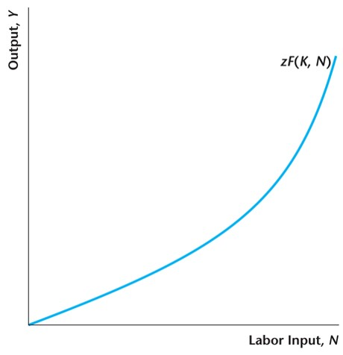
Figure 13.5 A Production Function with Increasing Returns to Scale
Notes:
In the model there are increasing returns to scale at the aggregate level, which we can capture in the form of a convex production function.

Slide 12
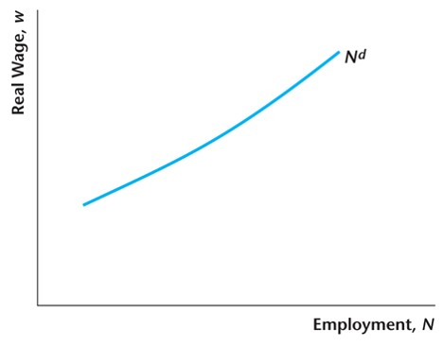
Figure 13.6 Aggregate Labor Demand with Sufficient Increasing Returns to Scale
Notes:
Then, since labor’s marginal product is increasing, the demand for labor is an increasing function of the wage.

Slide 13
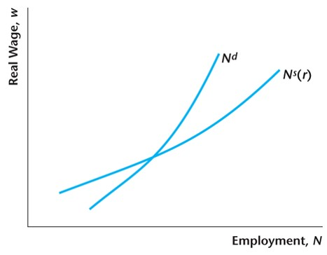
Figure 13.7 The Labor Market in the Coordination Failure Model
Notes:
To make the model work, the demand for labor must be steeper than the supply of labor. That is, there must be sufficient increasing returns to scale in aggregate production.

Slide 14
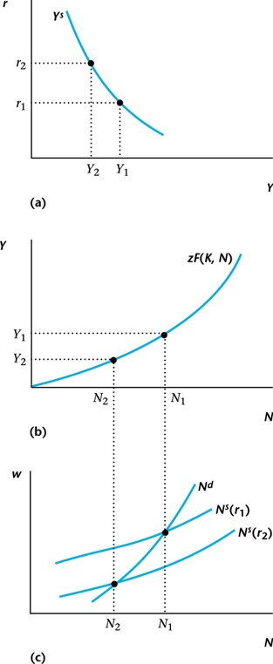
Figure 13.8 The Output Supply Curve in the Coordination Failure Model
Notes:
We need to reconstruct the output supply curve in this version of our basic model. The output supply curve is downward-sloping rather than upward-sloping, which will give us the possibility of more than one equilibrium – more than one intersection between the output demand and supply curves.

Slide 15
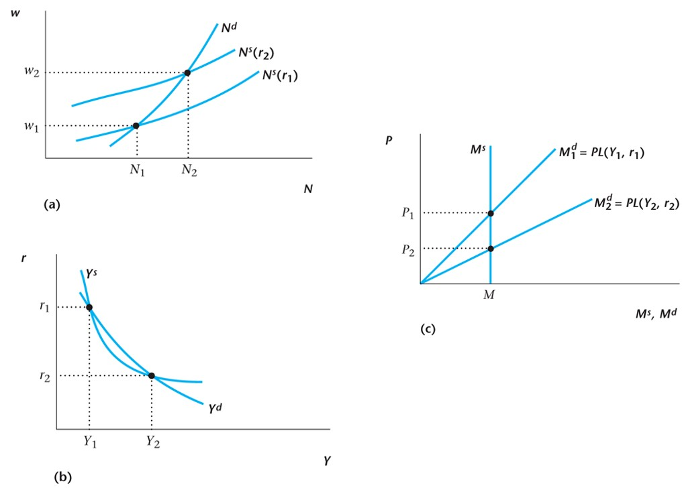
Figure 13.9 Multiple Equilibria in the Coordination Failure Model
Notes:
This figure shows an example in which there are two equilibria. In one, output, employment and the real wage are low, and the real interest rate and price level are high, and in the other, output employment and the real wage are high and the real interest rate and price level are low. We will get the low-output equilibrium if everyone is pessimistic, and the high-output equilibrium is everyone is optimistic.

Slide 16
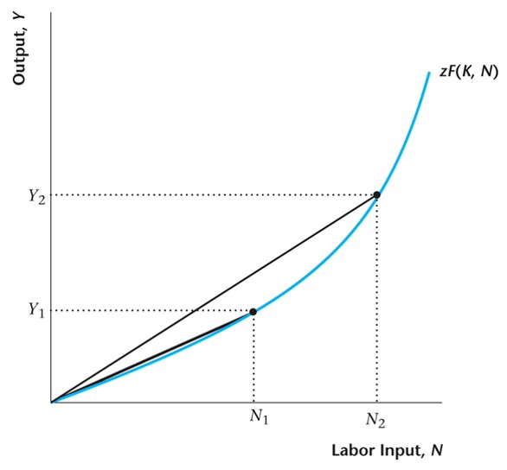
Figure 13.10 Average Labor Productivity in the Keynesian Coordination Failure Model
Notes:
This model, like the real business cycle model, can replicate the procyclicality in average labor product that we observe in the data.

Slide 17
Table 13.2 Data Versus Predictions of the Coordination Failure Model
Variable | Data | Model
Consumption | Procyclical | Procyclical
Investment | Procyclical | Procyclical
Employment | Procyclical | Procyclical
Real Wage | Procyclical | Procyclical
Average Labor Productivity | Procyclical | Procyclical
Notes:
The table shows how the Keynesian Coordination Failure Model fits the key business cycle facts from Chapter 3. Basically, the model behaves in much the same way as the real business cycle model, but with very different implications for policy. The RBC model says that there is no role for economic policy. This model says there’s a role for policy, though that role is complicated relative to what we’ll see in the Chapter 14 New Keynesian model.

Slide 18
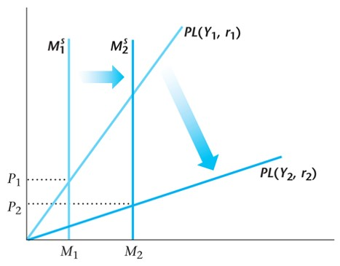
Figure 13.11 Procyclical Money Supply in the Coordination Failure Model
Notes:
In this model, we can observe procyclical money supply if economic agents coordinate on the money supply – they’re optimistic when money is high, and pessimistic when money is low.

Slide 19
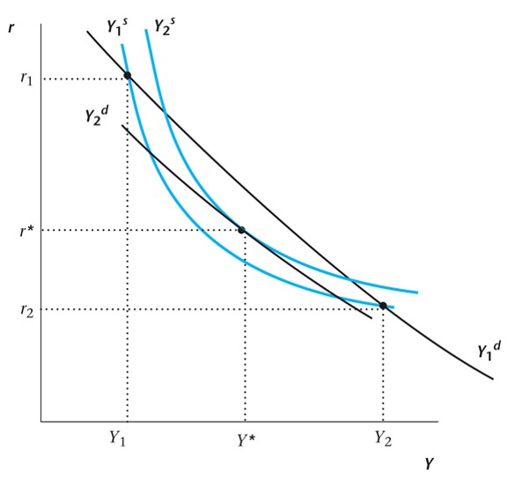
Figure 13.12 Stabilizing Fiscal Policy in the Coordination Failure Model
Notes:
This figure shows an example in which government spending can eliminate fluctuations. It makes output lower in the high-output state, and higher in the low-output state.

Slide 20
Business Cycle Theories and the 2008-2009 Recession
Real Business Cycle Model and Coordination Failure Model fit average business cycle behavior well.
But the fit to the 2008-2009 recession is not so good.
  Small drop in Solow residual.
  Price level procyclical.
  Obvious importance of financial factors, which play no role in either model.
Notes:
Macroeconomists received a lot of criticism during and after the financial crisis. Some, including Paul Krugman, thought that modern macro models were not useful in understanding what was going on at the time. For the two models in this chapter, we can ask how they fit the data for this period.

Slide 21
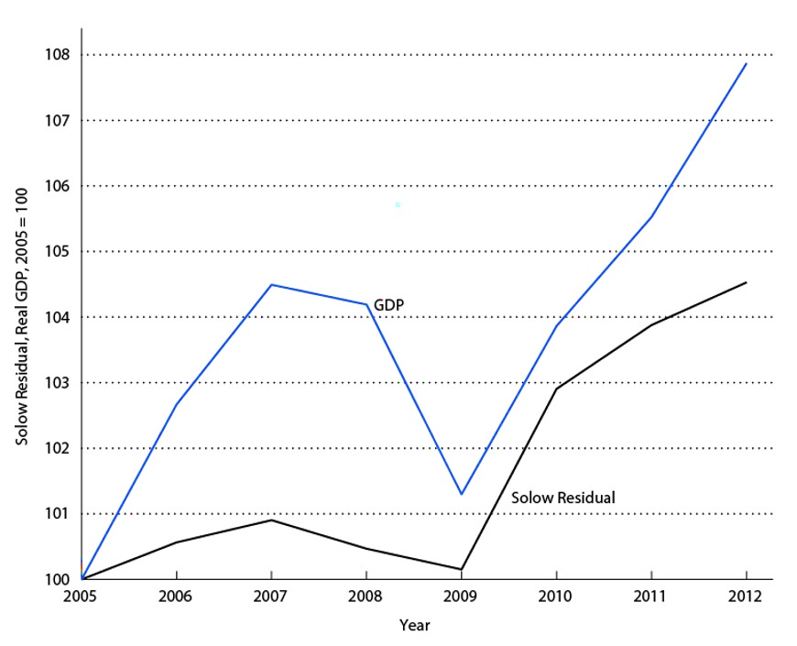
Solow Residual and Real GDP
Notes:
In the figure, there is drop in measured TFP during the 2008-2009 recession, and then TFP recovers after the recession. Thus, there are some hallmarks of a real business cycle type recession, but the drop in TFP does not appear to be consistent with what the RBC model tells us, if we think this recession was due to a TFP shock.

Slide 22
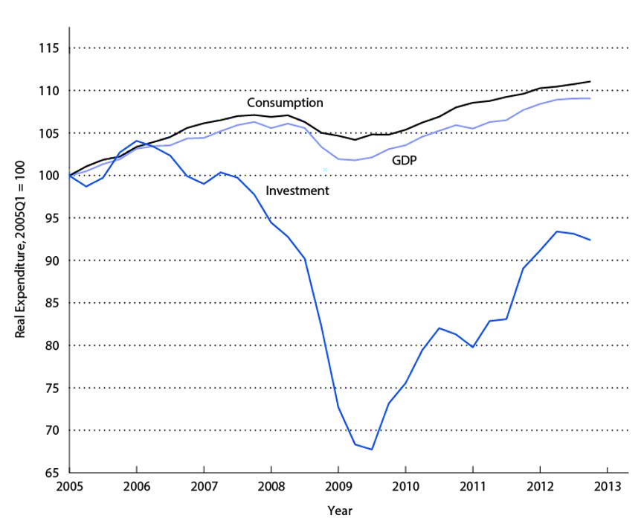
Consumption, Investment, and Real GDP
Notes:
Relative to the average business cycle, the behavior of consumption, investment, and real GDP looks standard. Consumption is smoother than output, which is much smoother than investment, and all three time series drop during the recession. So, given that our two models fit average behavior, they also fit this data.

Slide 23
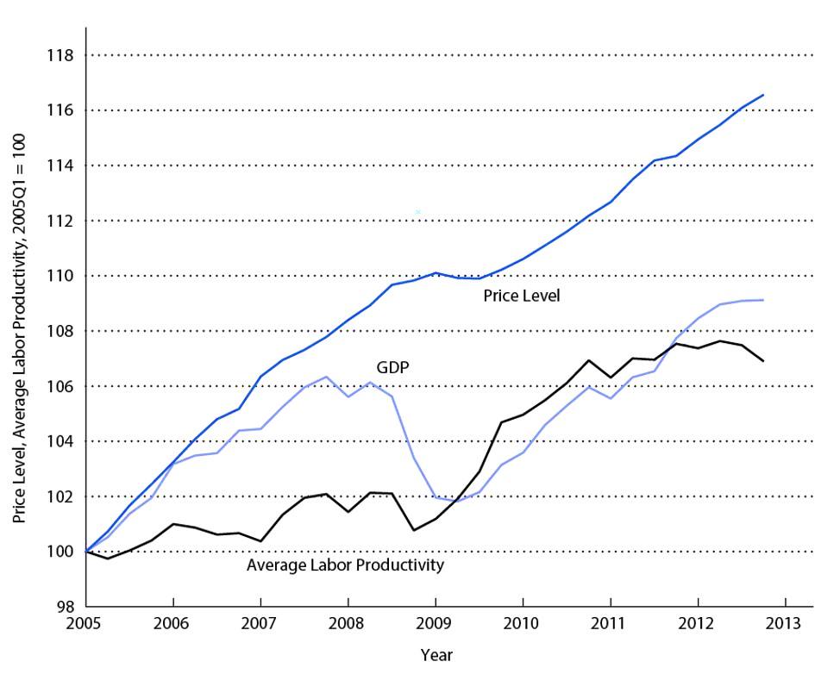
The Price Level, Average Labor Productivity, and Real GDP
Notes:
Here, the behavior of average labor productivity is not standard. It does not fall significantly during the recession. Unusually, the drop in employment during the recession was very large relative to the drop in real GDP. Also, the price level is above trend leading into the recession, which is not consistent with either model. The most glaring defects of our two models in explaining the 2008-2009 recession is the absence of financial factors in these models, which were obviously important over this period.

