Slide 1
Chapter 17
Unemployment: Search and Efficiency Wages

Slide 2
Chapter 17 Topics
Behavior of the unemployment rate, participation rate, employment/population ratio.
Search model of unemployment.
Efficiency wage model.
17-<number>

Slide 3
Key Determinants of the Unemployment Rate
Aggregate economic activity
Demographics
Government intervention
Sectoral shifts
17-<number>

Slide 4
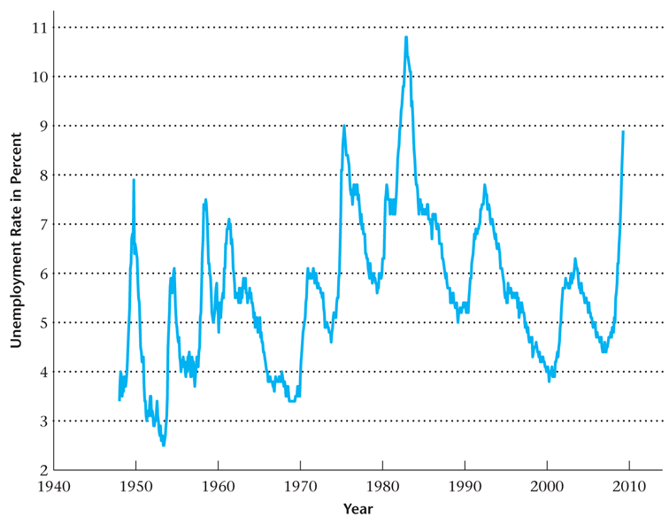
Figure 17.1
The U.S. Unemployment Rate, 1948–2009
17-<number>

Slide 5
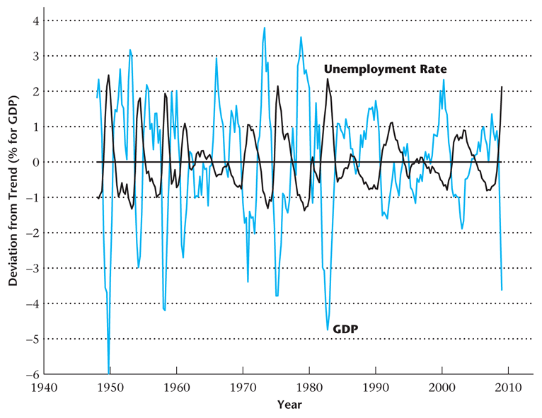
Figure 17.2
Deviations from Trend in the Unemployment Rate and Percentage Deviations from Trend in Real GDP
17-<number>

Slide 6
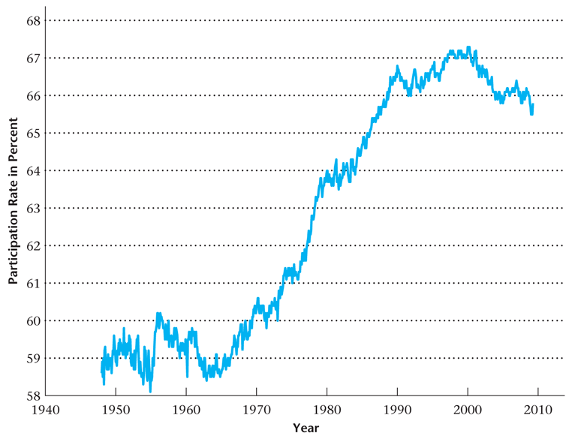
Figure 17.3
The U.S. Participation Rate
17-<number>

Slide 7
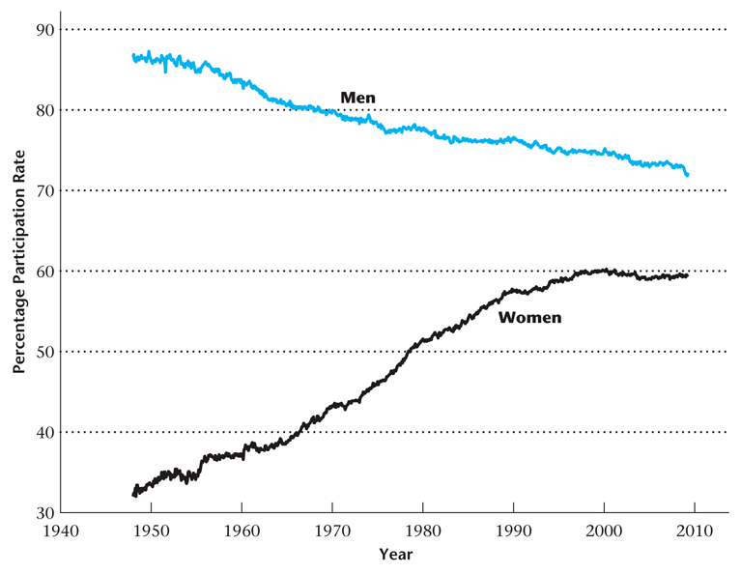
Figure 17.4
Labor Force Participation of Men and Women
17-<number>

Slide 8
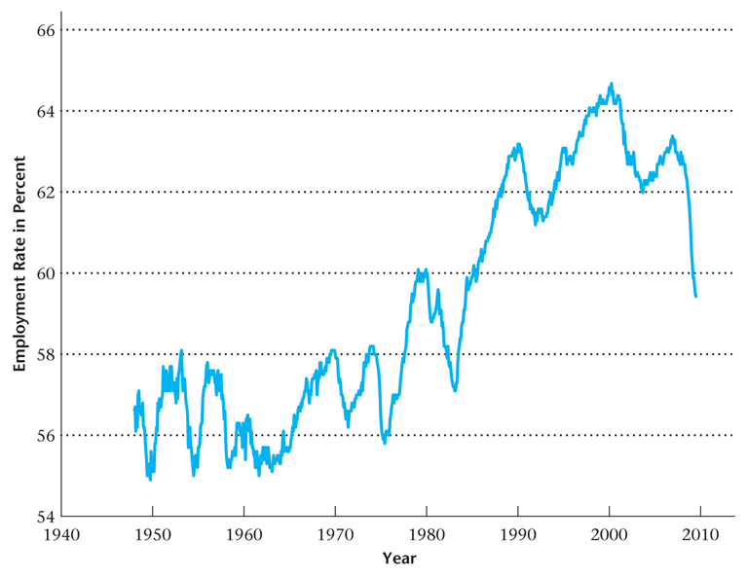
Figure 17.5
The Employment/Population Ratio for the
United States
17-<number>

Slide 9
Search Model of Unemployment
Unemployed workers receive job offers to work at a particular wage.
When an unemployed worker receives a job offer, he she has to decide whether to accept it or to reject it and continue searching for work.
Assume that workers are separated from their jobs at a constant rate.
Want to analyze the determinants of the reservation wage – the lowest wage offer that an unemployed worker is willing to accept.
17-<number>

Slide 10
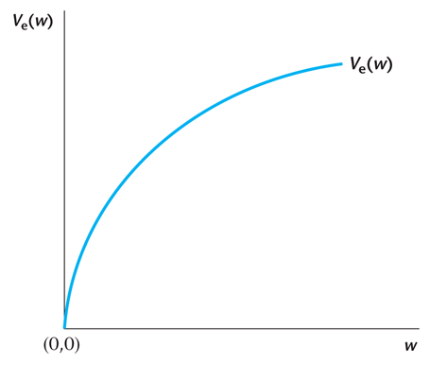
Figure 17.6
The Welfare of an Employed Worker
17-<number>

Slide 11
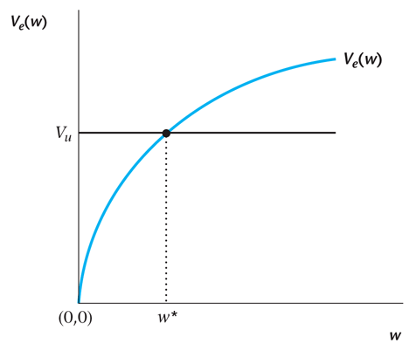
Figure 17.7
The Reservation Wage
17-<number>

Slide 12
The Reservation Wage
Increases when the unemployment insurance benefit b increases.
Increases if wage income is taxed at a higher rate.
17-<number>

Slide 13
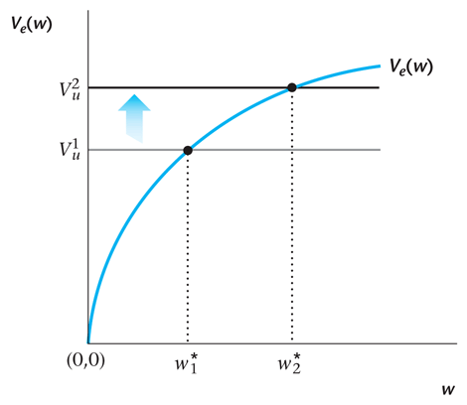
Figure 17.8
An Increase in the Unemployment Insurance Benefit b
17-<number>

Slide 14
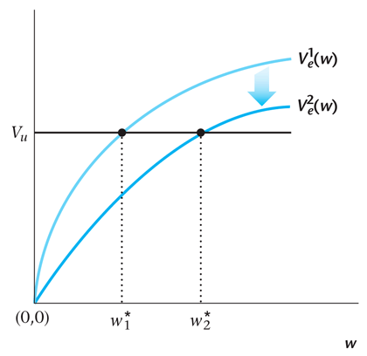
Figure 17.9
An Increase in the Taxes on the Wage Income of the Employed
17-<number>

Slide 15
Determining the Long-Run Unemployment Rate
The unemployment rate increases when the reservation wage increases, the separation rate increases, or the rate at which unemployed workers receive job offers falls.
17-<number>

Slide 16

Long-Run Unemployment Rate
Equation determining the long-run unemployment rate:
17-<number>

Slide 17
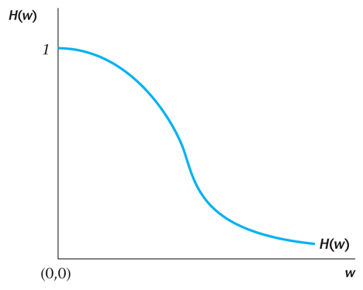
Figure 17.10
The Fraction of Unemployed Workers Receiving a Wage Offer Greater than w
17-<number>

Slide 18
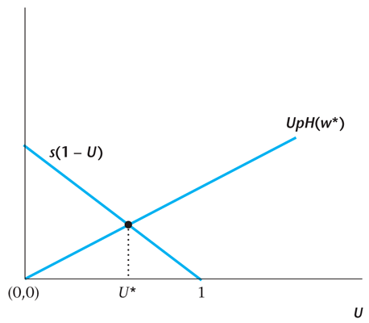
Figure 17.11
The Determination of the Unemployment Rate U* in the Search Model
17-<number>

Slide 19
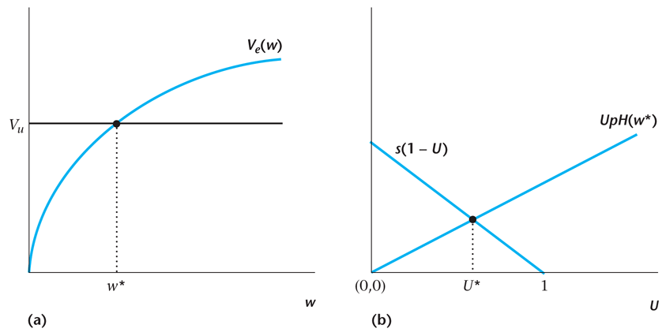
Figure 17.12
The Determination of the Reservation Wage and the Unemployment Rate in the Search Model
17-<number>

Slide 20
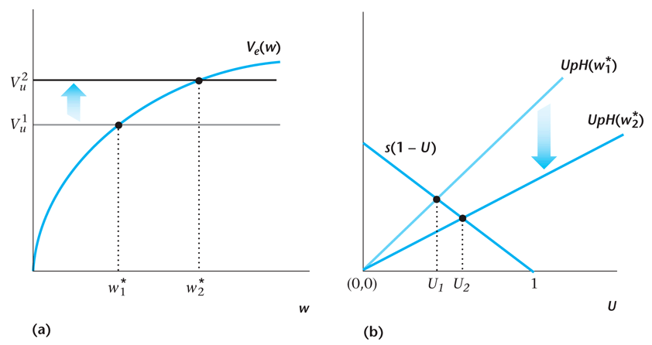
Figure 17.13
An Increase in the Unemployment Insurance
Benefit b
17-<number>

Slide 21
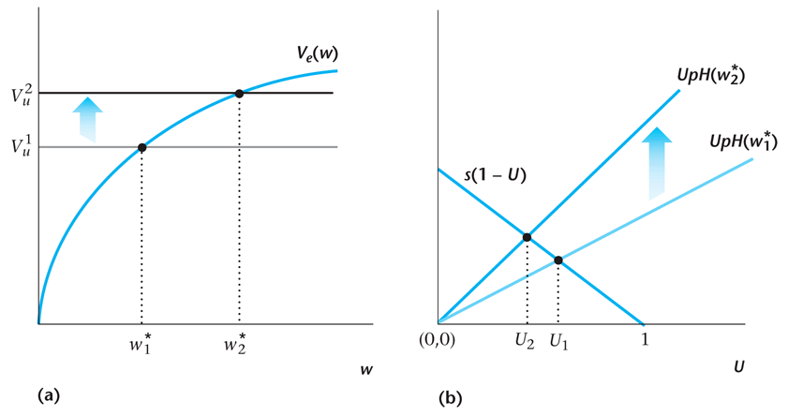
Figure 17.14
An Increase in the Job Offer Rate p
17-<number>

Slide 22
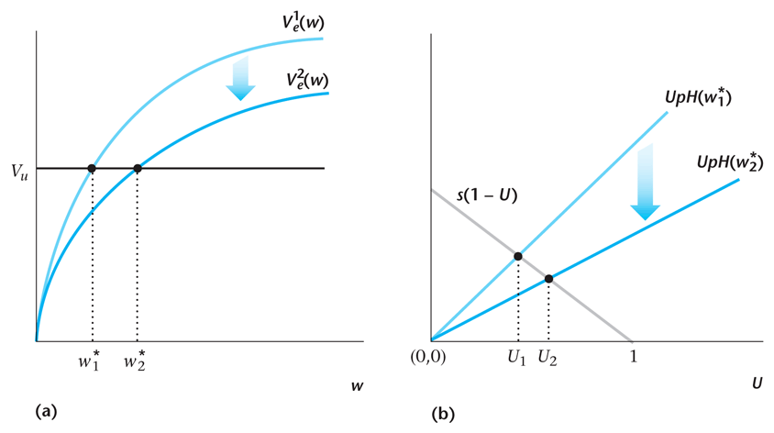
Figure 17.15
An Increase in Taxes on Labor Income
17-<number>

Slide 23
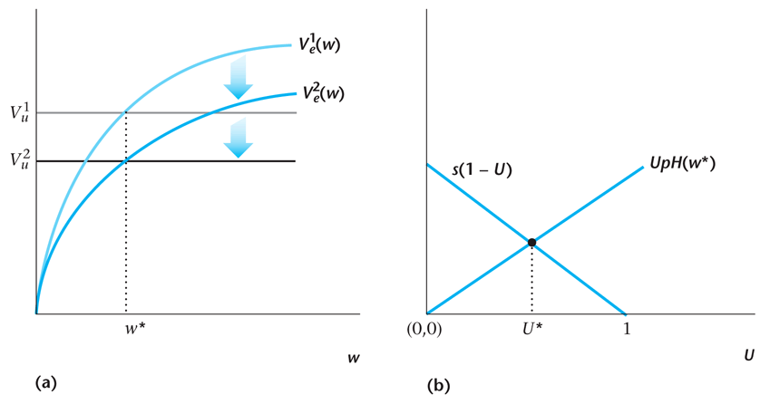
Figure 17.16
Taxes on Labor Income and Unemployment
17-<number>

Slide 24
The Efficiency Wage Model
Worker effort tends to increase with the real wage rate that they worker receives.
This occurs because of adverse selection and moral hazard.
This can produce a kind of stickiness in the real wage.
17-<number>

Slide 25
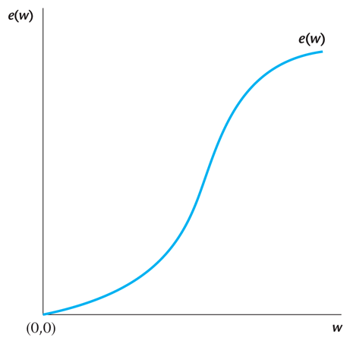
Figure 17.17
Effort of the Worker as a Function of His or Her Wage
17-<number>

Slide 26

Optimization by the Firm
When the firm optimizes,
17-<number>

Slide 27
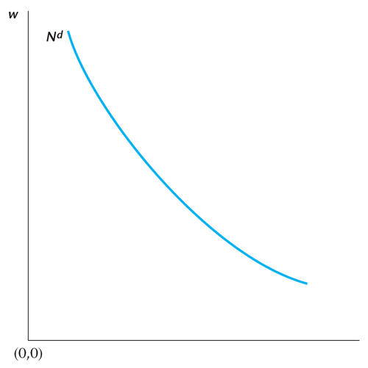
Figure 17.18
The Demand for Labor in the Efficiency Wage Model
17-<number>

Slide 28
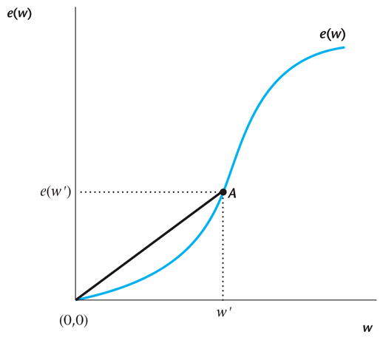
Figure 17.19
The Ratio of Effort to the Real Wage
17-<number>

Slide 29
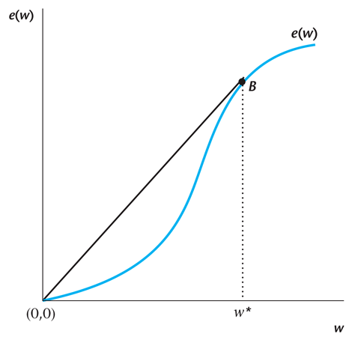
Figure 17.20
Determination of the Efficiency Wage
17-<number>

Slide 30
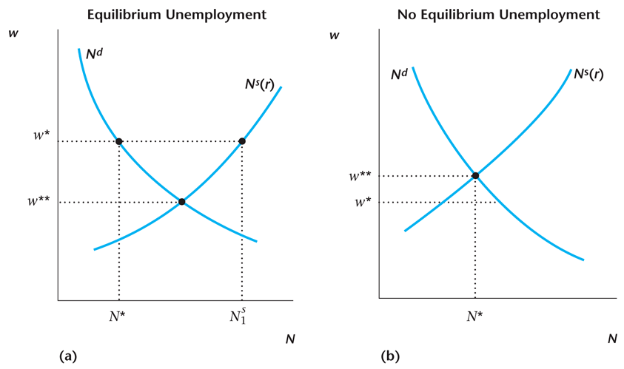
Figure 17.21
Unemployment in the Efficiency Wage Model
17-<number>

Slide 31
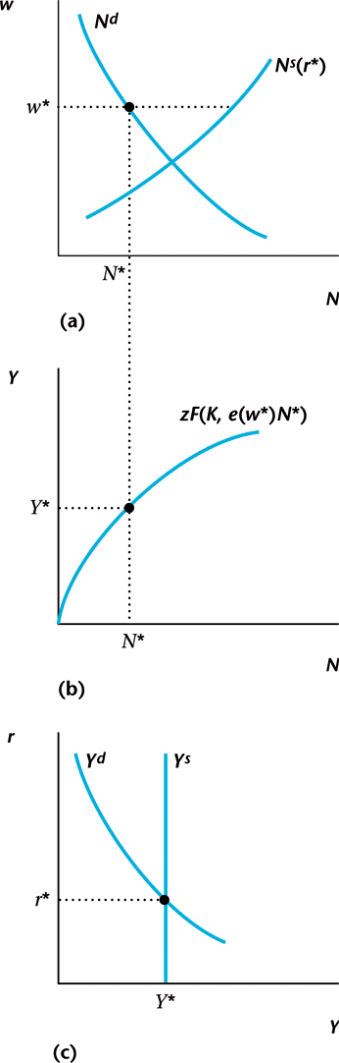
Figure 17.22
The Output Supply Curve in the Efficiency Wage Model
17-<number>

Slide 32
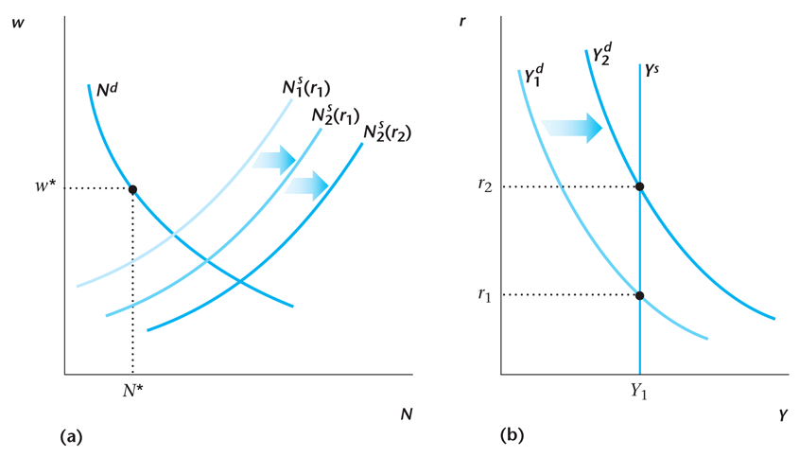
Figure 17.23
An Increase in G in the Efficiency Wage Model
17-<number>

Slide 33
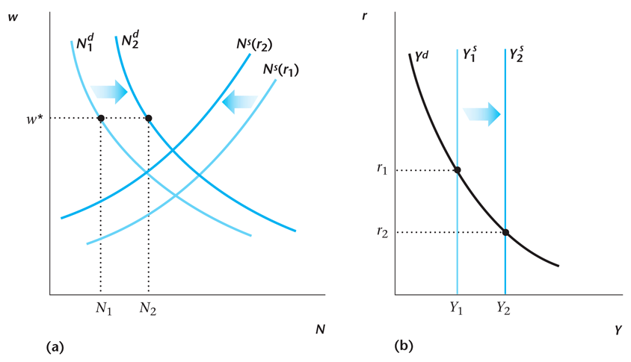
Figure 17.24
An Increase in Total Factor Productivity in the Efficiency Wage Model
17-<number>

Slide 34
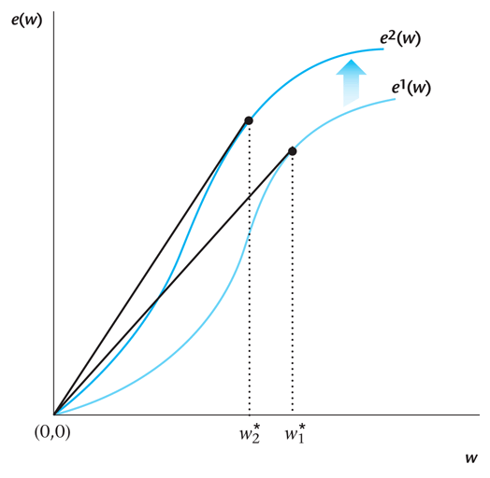
Figure 17.25
An Increase in the Effectiveness of
Monitoring by the Firm
17-<number>

