Slide 1
Chapter 18
Stabilization Policy

Slide 2
In this chapter, you will learn…
…about two policy debates:
1. Should policy be active or passive?
2. Should policy be by rule or discretion?

Slide 3
Question 1:
Should policy be active or passive?
?

Slide 4
Growth rate of real GDP, 1970-2006
Percent change from 4 quarters earlier
10
8
6
Average growth rate
4
2
0
-2
-4
1970
1975
1980
1985
1990
1995
2000
2005

Slide 5
Increase in unemployment during recessions
peak | trough | increase in no. of unemployed persons (millions)
July 1953 | May 1954 | 2.11
Aug 1957 | April 1958 | 2.27
April 1960 | February 1961 | 1.21
December 1969 | November 1970 | 2.01
November 1973 | March 1975 | 3.58
January 1980 | July 1980 | 1.68
July 1981 | November 1982 | 4.08
July 1990 | March 1991 | 1.67
March 2001 | November 2001 | 1.50

Slide 6
Arguments for active policy
Recessions cause economic hardship for millions of people.
The Employment Act of 1946:
“It is the continuing policy and responsibility of the Federal Government to…promote full employment and production.”
The model of aggregate demand and supply (Chaps. 9-13) shows how fiscal and monetary policy can respond to shocks and stabilize the economy.

Slide 7
Arguments against active policy
Policies act with long & variable lags, including:
  inside lag:
  the time between the shock and the policy response.
    takes time to recognize shock
    takes time to implement policy,
    especially fiscal policy
  outside lag:
  the time it takes for policy to affect economy.
If conditions change before policy’s impact is felt,
the policy may destabilize the economy.

Slide 8
Automatic stabilizers
definition:
policies that stimulate or depress the economy when necessary without any deliberate policy change.
Designed to reduce the lags associated with stabilization policy.
Examples:
  income tax
  unemployment insurance
  welfare

Slide 9
Forecasting the macroeconomy
Because policies act with lags, policymakers must predict future conditions.
Two ways economists generate forecasts:
  Leading economic indicators
  data series that fluctuate in advance of the economy
  Macroeconometric models
  Large-scale models with estimated parameters that can be used to forecast the response of endogenous variables to shocks and policies

Slide 10
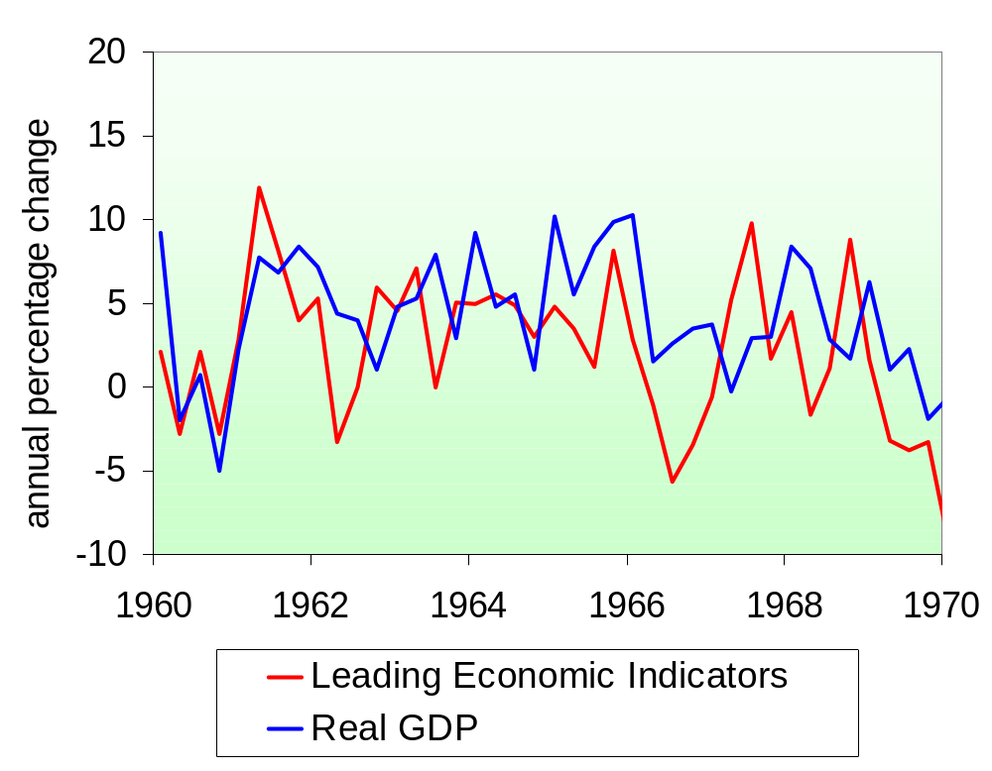
The LEI index and real GDP, 1960s
The Index of Leading Economic Indicators includes 10 data series
(see p.258 ).
source of LEI data:
The Conference Board

Slide 11
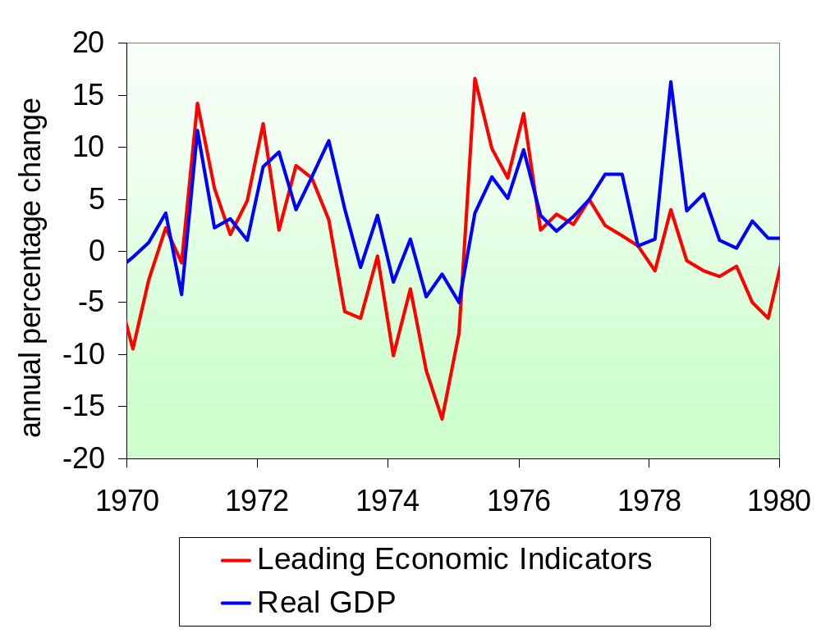
The LEI index and real GDP, 1970s
source of LEI data:
The Conference Board

Slide 12
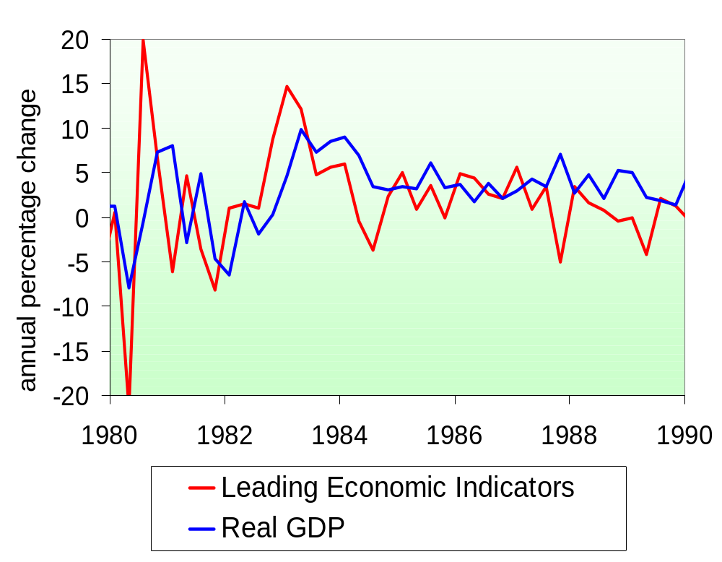
The LEI index and real GDP, 1980s
source of LEI data:
The Conference Board

Slide 13
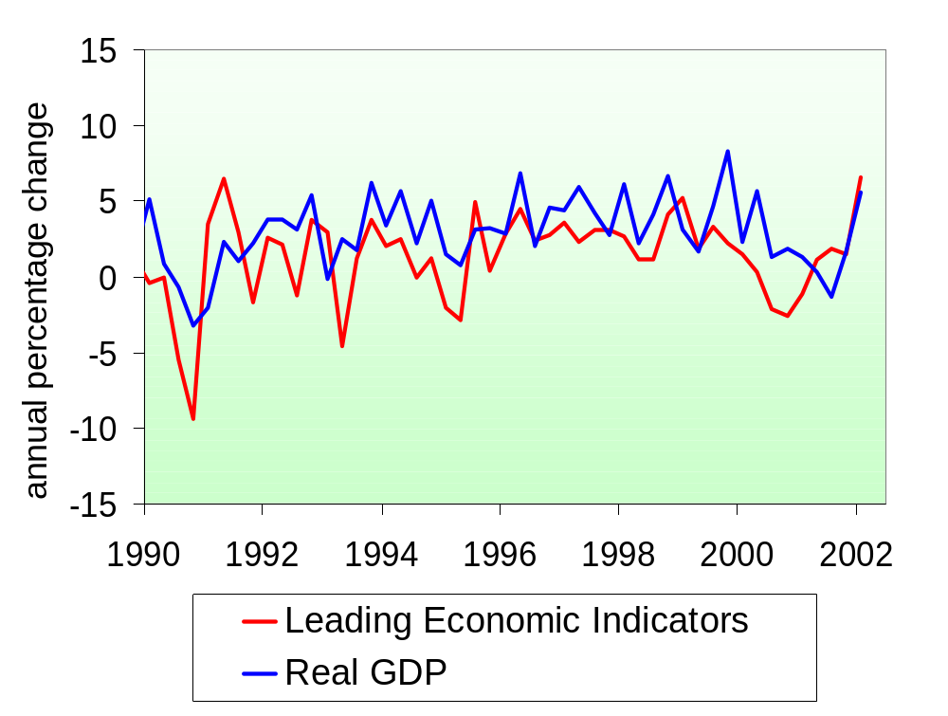
The LEI index and real GDP, 1990s
source of LEI data:
The Conference Board

Slide 14
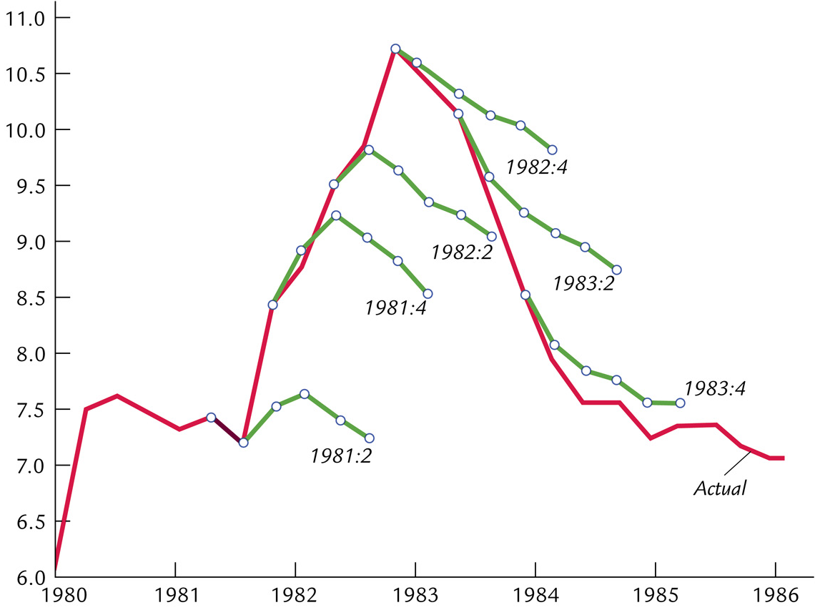
Mistakes forecasting the 1982 recession
Unemployment rate

Slide 15
Forecasting the macroeconomy
Because policies act with lags, policymakers must predict future conditions.
The preceding slides show that the forecasts are often wrong.
This is one reason why some
economists oppose policy activism.

Slide 16
The Lucas critique
Due to Robert Lucas
who won Nobel Prize in 1995 for rational expectations.
Forecasting the effects of policy changes has often been done using models estimated with historical data.
Lucas pointed out that such predictions would not be valid if the policy change alters expectations in a way that changes the fundamental relationships between variables.

Slide 17
An example of the Lucas critique
Prediction (based on past experience):
An increase in the money growth rate will reduce unemployment.
The Lucas critique points out that increasing the money growth rate may raise expected inflation, in which case unemployment would not necessarily fall.

Slide 18
The Jury’s out…
Looking at recent history does not clearly answer Question 1:
  It’s hard to identify shocks in the data.
  It’s hard to tell how things would have been different had actual policies not been used.
Most economists agree, though, that the
U.S. economy has become much more stable since the late 1980s…

Slide 19
The stability of the modern economy
4.0
Volatility
of GDP
3.5
Standard deviation
3.0
2.5
2.0
1.5
1.0
Volatility of Inflation
0.5
0.0
1960
1965
1970
1975
1980
1985
1990
1995
2000
2005

Slide 20
Question 2:
Should policy be conducted by rule or discretion?
?

Slide 21
Rules and discretion:
Basic concepts
Policy conducted by rule:
Policymakers announce in advance how
policy will respond in various situations,
and commit themselves to following through.
Policy conducted by discretion:
As events occur and circumstances change, policymakers use their judgment and apply whatever policies seem appropriate at the time.

Slide 22
Arguments for rules
1. Distrust of policymakers and the political process
  misinformed politicians
  politicians’ interests sometimes not the same as the interests of society

Slide 23
Arguments for rules
2. The time inconsistency of discretionary policy
  def: A scenario in which policymakers
  have an incentive to renege on a
  previously announced policy once others have acted on that announcement.
  Destroys policymakers’ credibility, thereby reducing effectiveness of their policies.

Slide 24
Examples of time inconsistency
1. To encourage investment,
govt announces it will not tax income from capital.
But once the factories are built,
govt reneges in order to raise more tax revenue.

Slide 25
Examples of time inconsistency
2. To reduce expected inflation,
the central bank announces it will tighten monetary policy.
But faced with high unemployment,
the central bank may be tempted to cut interest rates.

Slide 26
Examples of time inconsistency
3. Aid is given to poor countries contingent on fiscal reforms.
The reforms do not occur, but aid is given anyway, because the donor countries do not want the poor countries’ citizens to starve.

Slide 27
Monetary policy rules
a. Constant money supply growth rate
  Advocated by monetarists.
  Stabilizes aggregate demand only if velocity is stable.

Slide 28
Monetary policy rules
a. Constant money supply growth rate
b. Target growth rate of nominal GDP
  Automatically increase money growth whenever nominal GDP grows slower than targeted; decrease money growth when nominal GDP growth exceeds target.

Slide 29
Monetary policy rules
a. Constant money supply growth rate
b. Target growth rate of nominal GDP
c. Target the inflation rate
  Automatically reduce money growth whenever inflation rises above the target rate.
  Many countries’ central banks now practice inflation targeting, but allow themselves a little discretion.

Slide 30
Monetary policy rules
a. Constant money supply growth rate
b. Target growth rate of nominal GDP
c. Target the inflation rate
d. The Taylor rule:
Target the federal funds rate based on
  inflation rate
  gap between actual & full-employment GDP

Slide 31
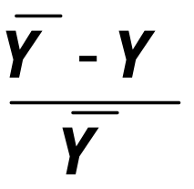
The Taylor Rule
i_{ff} = π + 2 + 0.5 (π – 2) – 0.5 (GDP gap)
where
i_{ff} = nominal federal funds rate target
GDP gap = 100 x
    = percent by which real GDP
    is below its natural rate

Slide 32
The Taylor Rule
i_{ff} = π + 2 + 0.5 (π – 2) – 0.5 (GDP gap)
If π = 2 and output is at its natural rate,
then fed funds rate targeted at 4 percent.
For each one-point increase in π,
mon. policy is automatically tightened
to raise fed funds rate by 1.5.
For each one percentage point that GDP falls below its natural rate, mon. policy automatically eases to reduce the fed funds rate by 0.5.

Slide 33
The federal funds rate:
Actual and suggested
12
Percent
Actual
10
8
6
4
2
Taylor’s Rule
0
1987
1990
1993
1996
1999
2002
2005

Slide 34
Taylor Rule – Carlstrom and Fuerst
Notice that in recent years, the interest rate has been much below the interest rate suggested by Taylor’s rule.
Were there exceptional circumstances? (Fall in stock prices, for example.)
Should the Fed deviate from the rule in special circumstances?
How do we tell the difference between “special circumstances” and discretionary policy?

Slide 35
Central bank independence
A policy rule announced by central bank will work only if the announcement is credible.
Credibility depends in part on degree of independence of central bank.

Slide 36
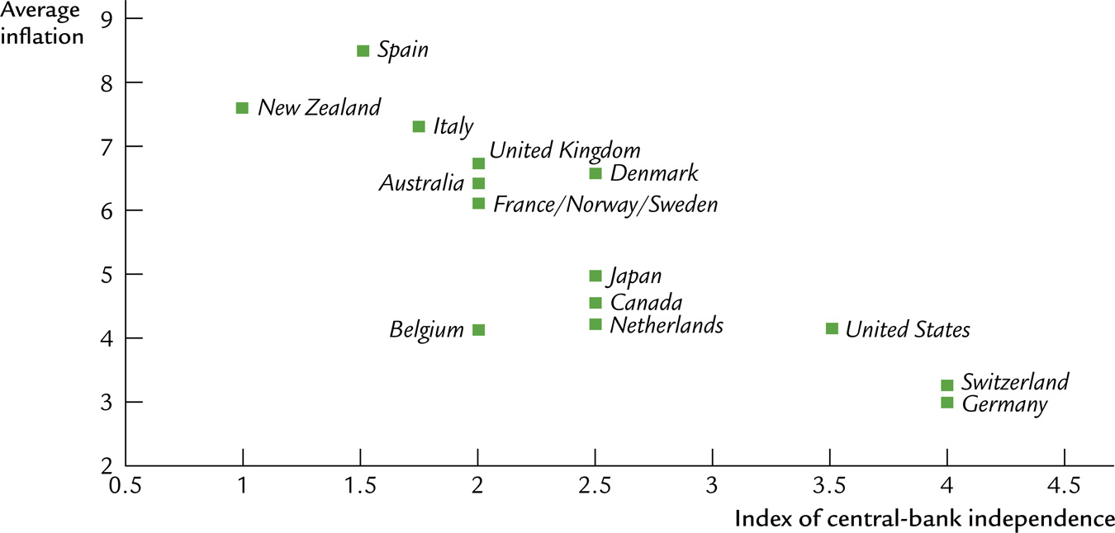
Inflation and central bank independence
average inflation
index of central bank independence

Slide 37

Chapter Summary
1. Advocates of active policy believe:
  frequent shocks lead to unnecessary fluctuations in output and employment
  fiscal and monetary policy can stabilize the economy
2. Advocates of passive policy believe:
  the long & variable lags associated with monetary and fiscal policy render them ineffective and possibly destabilizing
  inept policy increases volatility in output, employment

Slide 38
Chapter Summary
3. Advocates of discretionary policy believe:
  discretion gives more flexibility to policymakers in responding to the unexpected
4. Advocates of policy rules believe:
  the political process cannot be trusted: Politicians make policy mistakes or use policy for their own interests
  commitment to a fixed policy is necessary to avoid time inconsistency and maintain credibility

