Slide 1
Topics of today’s class
Last class:
  Chapter 1
    Introduction to Macroeconomics
    Recent and Current macroeconomic Events
Today’s class:
  Chapter 2
    Measuring GDP using three approaches
    Problem in measuring GDP
1-<number>

Slide 2
Chapter 2
Measurement

Slide 3
Why Study Measurement?
“Data, data, data, I cannot make bricks without clay” – Sherlock Holmes.
Macroeconomics produces hypothesis about aggregate policy.
Without a credible measurement of these quantities, it is impossible to test the validity of these theories.
Economic data are crucial for understanding the state of the economy.
2-<number>

Slide 4
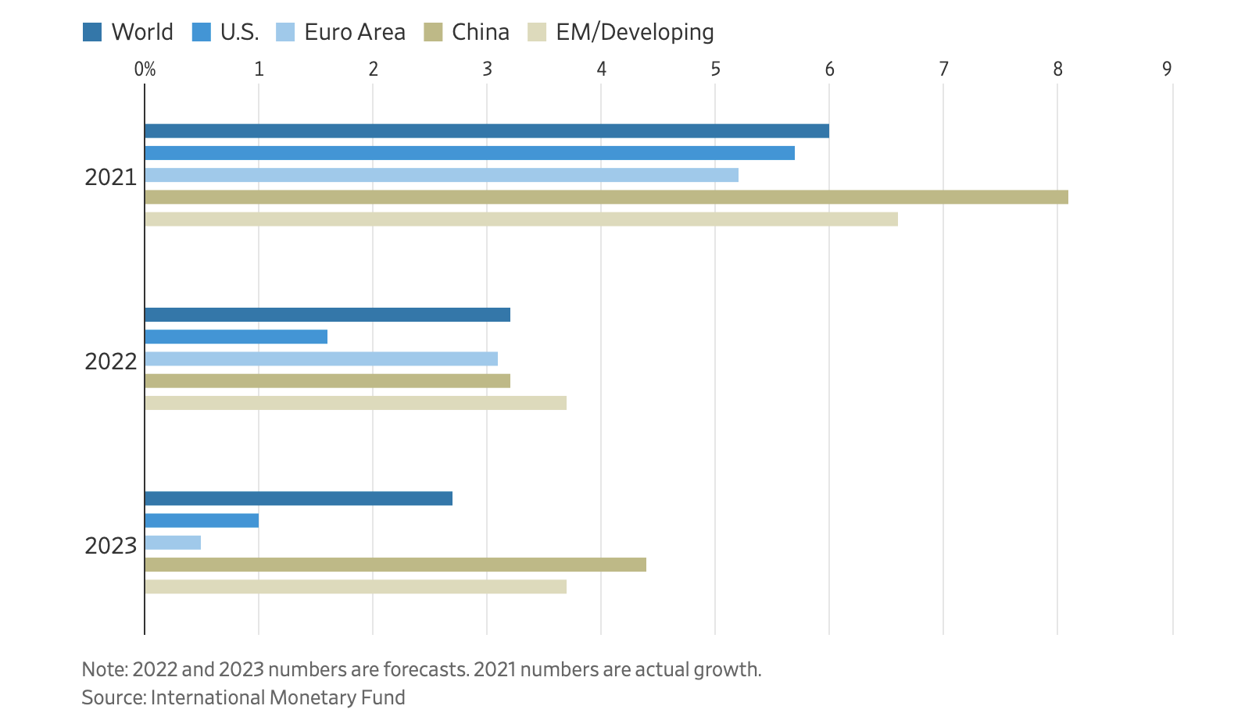
Measuring GDP: The National Income and Product Accounts (NIPA)
2-<number>

Slide 5
Measuring GDP: The National Income and Product Accounts (NIPA)
Nominal GDP is the dollar value of final output produced during a given period of time within the borders of the U.S.
GDP intended to summarize how much economic activity is going during a specific period.
The NIPA accounts are a conceptual framework for organizing data on the production of goods and services and on the incomes received by factors of production.
  published by the U.S. Department of Commerce
2-<number>

Slide 6
Why should we care about GDP?
“Yet the gross national product does not allow for the health of our children, the quality of their education, or the joy of their play. It does not include the beauty of our poetry or the strength of our marriages; the intelligence of our public debate or the integrity of our public officials. It measures neither our wit nor our courage; neither our wisdom nor our learning; neither our compassion nor our devotion to our country; it measures everything, in short, except that which makes life worthwhile. And it tells us everything about America except why we are proud that we are Americans.”
Robert F. Kennedy
Speech at the University of Kansas
March 18, 1968
2-<number>

Slide 7
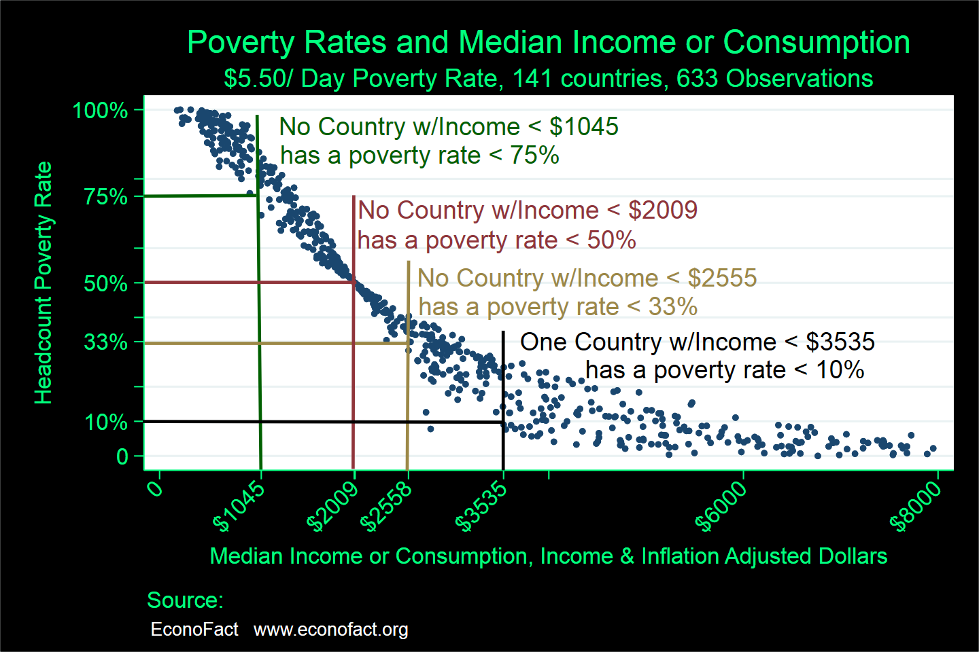
GDP and absolute poverty
2-<number>

Slide 8
NIPA
Three equivalent ways to think of GDP:
  The product approach: total production of everyone in the economy
  The expenditure approach: total expenditure of everyone in the economy
  The income approach: total income of everyone in the economy
They must all give the same results. (excluding measurement errors)
2-<number>

Slide 9
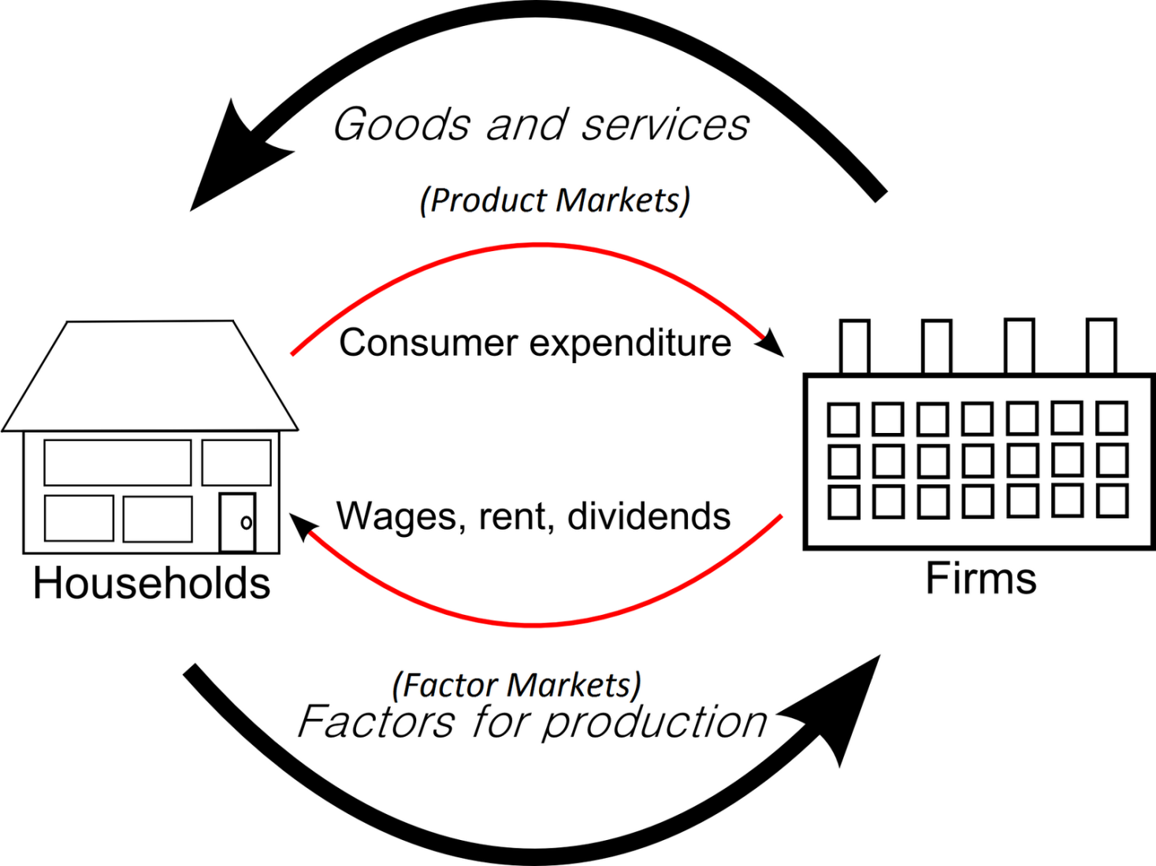
The Simple Circular Flow Diagram
2-<number>

Slide 10
National Income Accounting Example
Fictional Island Economy: a coconut producer, a restaurant, consumers, and a government.
Coconut Producer: owns all the coconut trees, harvests the coconuts that grow on the trees.
Restaurant: buys coconuts from the coconut producer and serves “coconut soup” to its client.
Consumers: buy coconuts or drinks and work.
Government: provides national defense.
2-<number>

Slide 11
National Income Accounting Example
Coconut producer: produces 10 million coconut, each sold at $2. 6 million coconuts go to the restaurant, remaining 4 million go to the consumers.
Restaurant: sells $30 million meals.
Government: provides protection from attacks from other islands. It collects taxes ($4.5 million from firms, 1 million from consumers).
Consumers: work for the business and government, receive interest, pay taxes.
2-<number>

Slide 12
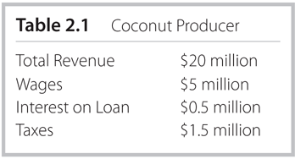
Table 2.1
Coconut Producer
2-<number>

Slide 13
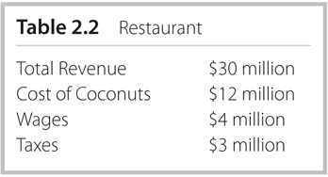
Table 2.2
Restaurant
2-<number>

Slide 14
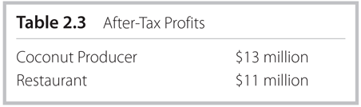
Table 2.3
After-Tax Profits
2-<number>

Slide 15
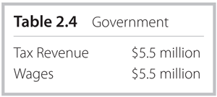
Table 2.4
Government
2-<number>

Slide 16
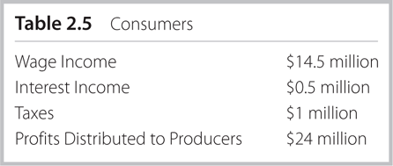
Table 2.5
Consumers
2-<number>

Slide 17
Product Approach
Also called the Value-added approach.
GDP = sum of value-added to goods and services across all productive units in the economy
  Value Added is the increase in the value of goods as a result of the production process
  Value-added = value of production – value of intermediate goods
  an intermediate good is a good that is produced and then used as an input to another production process
  Which good is an intermediate good in this economy?
2-<number>

Slide 18
Product Approach
Government production is not sold at market prices
What is the Value added of the government?
= cost of the inputs to production (standard practice)
2-<number>

Slide 19
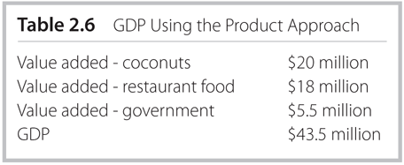
Table 2.6
GDP Using the Product Approach
2-<number>

Slide 20
Expenditure Approach
Measure the amount that people spend.
Y = C + I + G + NX
  Y: Nominal GDP
  C: Consumption Expenditures: durable goods, non-durables, and services.
  I: Investment Expenditures
  G: Government Expenditures: Sum of federal, state, and local purchases of goods and services, and government investment.
  NX = X – M: net exports: total export of US goods and services minus total imports into the US.
2-<number>

Slide 21
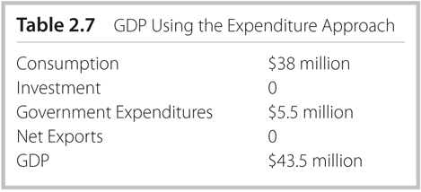
Table 2.7
GDP Using the Expenditure Approach
2-<number>

Slide 22
Income Approach
Measure income that people received.
GDP = Wage Income
+ After-Tax Profits
+ Interest Income
+ Taxes
2-<number>

Slide 23
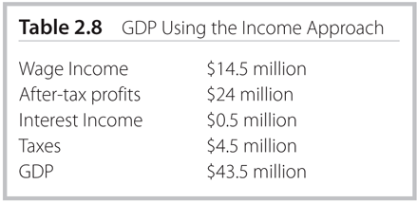
Table 2.8
GDP Using the Income Approach
2-<number>

Slide 24
Magic?
Why do they all give the same result?
  total output, or value-added, is ultimately sold thus shows up as an expenditure
  what is spend on all output produced is income for someone in the economy.
2-<number>

Slide 25
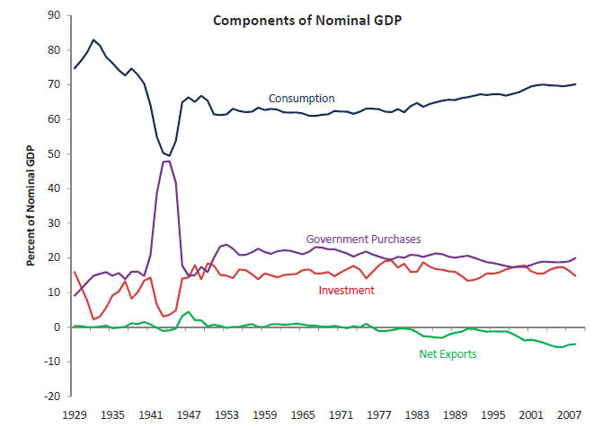
Table 2.9
Components of Nominal GDP
2-<number>

Slide 26
Table 2.9
GDP of the United States for 1961 & 2011
 | 1961 | % of GDP | 2011 | % of GDP
Gross domestic product | 544.8 | 100 | 15075.7 | 100
Personal consumption expenditures | 342.2 | 62.81 | 10729 | 71.17
Goods | 178.8 | 32.82 | 3624.8 | 24.04
Durable goods | 44.2 | 8.113 | 1146.4 | 7.604
Nondurable goods | 134.6 | 24.71 | 2478.4 | 16.44
Services | 163.4 | 29.99 | 7104.2 | 47.12
Gross private domestic investment | 78.2 | 14.35 | 1854.9 | 12.3
Fixed investment | 75.2 | 13.8 | 1818.3 | 12.06
Nonresidential | 48.8 | 8.957 | 1479.6 | 9.814
Residential | 26.4 | 4.846 | 338.7 | 2.247
Change in private inventories | 3 | 0.551 | 36.6 | 0.243
Net exports of goods and services | 4.9 | 0.899 | -568.1 | -3.768
Exports | 27.6 | 5.066 | 2094.2 | 13.89
Imports | 22.7 | 4.167 | 2662.3 | 17.66
Government consumption expenditures and gross investment | 119.5 | 21.93 | 3059.8 | 20.3
Federal | 67.9 | 12.46 | 1222.1 | 8.106
National defense | 56.5 | 10.37 | 820.8 | 5.445
Nondefense | 11.4 | 2.093 | 401.3 | 2.662
State and local | 51.6 | 9.471 | 1837.7 | 12.19
2-<number>

Slide 27
Add in Inventory Investment
Suppose now the coconut producer produces 13 million instead 10 million, but only sell out 10 million. What is GDP now?
Answer: $43.5+3*$2 = $49.5 million.
2-<number>

Slide 28
Add in International Trade
Suppose now the restaurant imports additional 2 million coconuts from other islands at $2 each. What is GDP now?
Answer: $43.5-2*$2 = $39.5 million.
2-<number>

Slide 29
Problems in Measuring GDP
GDP per capita partly captures welfare. BUT:
Domestic Production
  Hiring a professional cleaner (in GDP) VS cleaning your apartment yourself (not in GDP).
  increase in female labor force participation since WWII: may over-estimate GDP growth.
Underground economy
  paying a babysitter in cash.
  illegal drugs, criminality activity.
Government production is difficult to measure as the output is typically not sold in the market.
Inequality.
2-<number>

Slide 30





Problems in Measuring GDP
2-<number>

Slide 31
What is GNP?
GNP = GDP + NFP
NFP: Net Factor Payments
= Factor payments to US citizens
- Factor payments to foreigners
GNP: output produced by domestically owned factors
  unlike GDP, GNP is not geographic concept -> GDP is based on geographic borders of a country.
  GNP adds together income paid to nationally owned factors of production regardless of where in the world they are located
Difference between GDP and GNP for US is small (0.2%), larger for countries with many citizens working abroad
2-<number>

Slide 32
What is GNP?
Example:
if a Volvo Cars plant in Ohio has Chinese Owners but American workers:
  its profits are in the GDP but not in the GNP of the U.S.
  its wage bill is in the GDP and in the GNP of the U.S.
if a Google office in China is owned by US residents but Chinese engineers operate the branch:
  its profits are in the GNP but not in the GDP of the U.S.
  its wage bill is not in the GDP nor in the GNP of the U.S.
My income is paid by the State of Nebraska. But I am a Chinese citizen. It is counted in the US GDP but not in the US GNP, in China GNP but not in China GDP.
2-<number>

Slide 33
Question
Assume an economy with a coal producer, a steel producer, and some consumers (there is no government).
In a given year, the coal producer produced 15 million tons of coal and sells it for $5 per ton. The coal producer pays $50 million in wages to consumers.
The steel producer uses 25 million tons of coal as an input into steel production, all purchased at $5 per ton. Of this, 15 million tons of coal comes from the domestic coal producer and 10 million tons of coal is imported. The steel producer produces 10 million tons of steel and sells it for $20 per ton.
Domestic consumers buy 8 million tons of steel, and 2 million tons are exported. The steel producer pays consumers $40 million in wages. All profits made by domestic producers are distributed to domestic consumers.
(a) Determine GDP using three approaches.
(b) Determine GNP in the case where the coal producer is owned by foreigners.
2-<number>

Slide 34
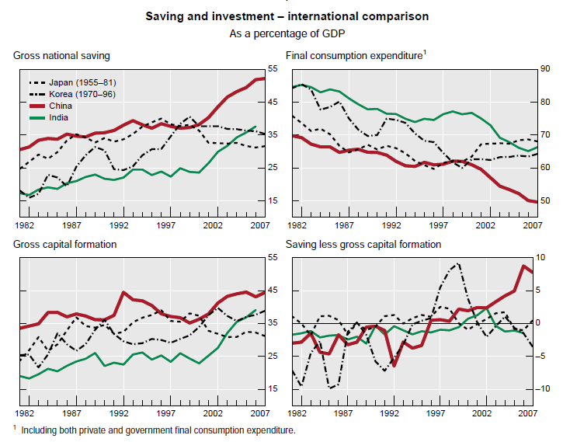
Case study: gender ratio and saving rate
Source: Ma and Yi (2010), Bank for International Settlements
2-<number>

Slide 35
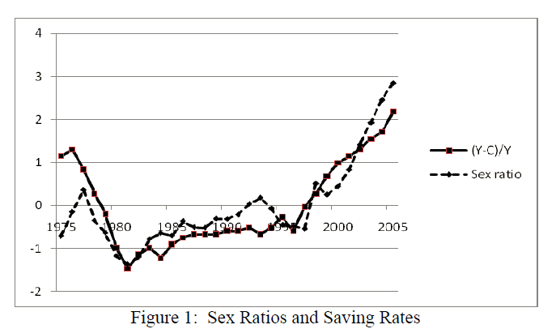
Case study: gender ratio and saving rate
Source: Wei and Zhang (2011), Journal of Political Economy
2-<number>

