Slide 1
Topics of today’s class
Last class:
  Chapter 2
    Measuring GDP using three approaches
    Problems in measuring GDP
Today’s class:
  Chapter 2
    Nominal and Real GDP and Price Indices
    Savings, wealth and capital
    Labor market measurement
1-<number>

Slide 2
Chapter 2
Measurement

Slide 3
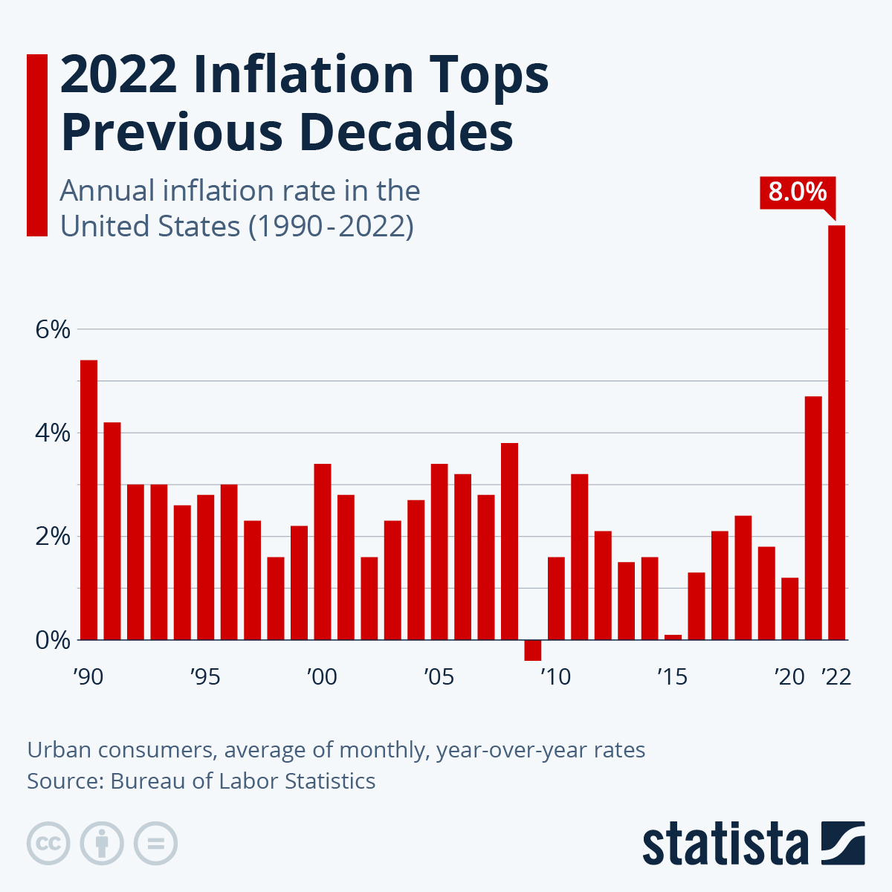
2-<number>

Slide 4
Nominal, Real GDP and Price Indices
Nominal GDP changes between year t and year t + 1 because:
  different amounts of goods and services are produced between the two years.
  such goods and services are sold at different prices in the two years.
However, standards of living are determined by the quantities of goods and services produced and consumed by households, not by the nominal value they have in the market. If we are interested in quantities, why don’t we just sum quantities and forget about prices altogether?
  You cannot sum 2 apples, 1 car and 3 plane tickets: what’s the result? We need prices to convert all goods and services in $ and aggregate them together
2-<number>

Slide 5
Nominal, Real GDP and Price Indices
Price Index: Weighted average of a set of observed prices that gives a measure of the price level.
Price indices allow us to measure the inflation rate – the rate of change in the price level.
A measure of the inflation rate allows us to determine how much of an increase in GDP is nominal and how much is real.
2-<number>

Slide 6
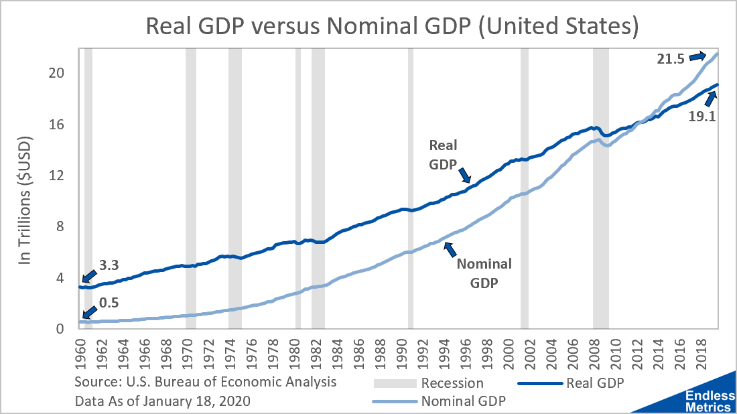
Figure 2.1
Nominal GDP and Chain-Weighted Real GDP for the Period 1947–2009.
2-<number>

Slide 7
Measures of the Price Level: CPI
There are two commonly used measures of the price level:
Consumer Price Index (CPI)
  only include goods and services that are purchased by consumers: “measure of standard of livings”.
  fixed basket index: define the typical quantities of goods and services that are purchased by consumers
  compute the average price of this basket of goods each year.
  Current year CPI =
  Cost of base year quantities at current year prices/
  Cost of base year quantities at base year prices x 100
2-<number>

Slide 8
Measures of the Price Level: GDP Deflator
Implicit GDP Price Deflator
  time-varying basket index
  Implicit GDP Price Deflator
  = Nominal GDP / Real GDP x 100
  = Cost of current year quantities at current year prices
    / Cost of current year quantities at base year prices x 100.
The key difference between CPI and GDP Deflator is that in one the weights do not change but in the other the weights change over time.
2-<number>

Slide 9
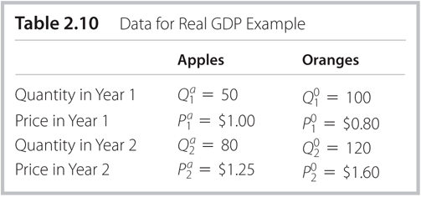
Table 2.10
Data for Real GDP Example
GDP Deflator:
Year 1: (50*1+100*0.8) / (50*1+100*0.8) * 100 = 100
Year 2: (80*1.25+120*1.6) / (80*1+120*0.8) * 100 = 165.9
2-<number>

Slide 10
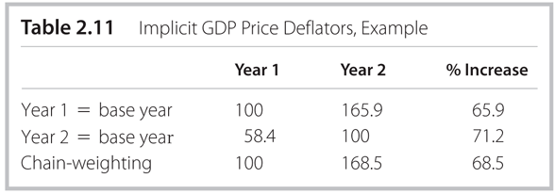
Table 2.11
Implicit GDP Price Deflators, Example
2-<number>

Slide 11
Table 2.10
Data for Real GDP Example
CPI Deflator:
Year 1: (50*1+100*0.8) / (50*1+100*0.8) * 100 = 100
Year 2: (50*1.25+100*1.6) / (50*1+100*0.8) * 100 = 171.2
2-<number>

Slide 12
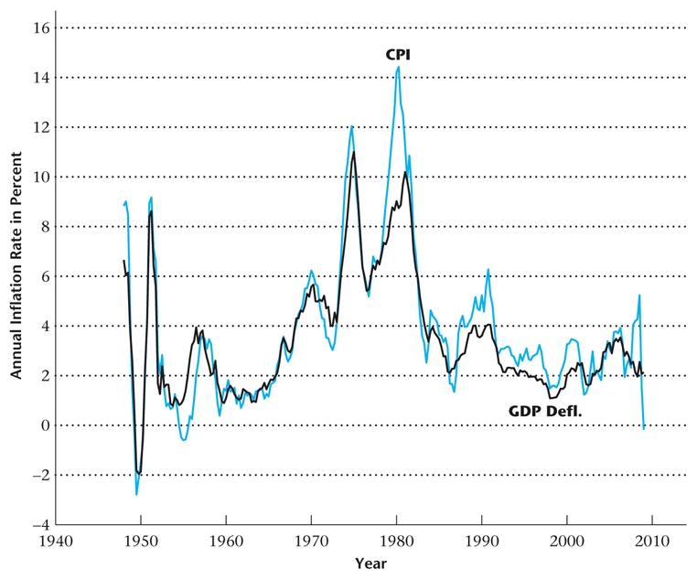
Figure 2.2
Inflation Rate Calculated from the CPI and from the Implicit GDP Price Deflator
2-<number>

Slide 13
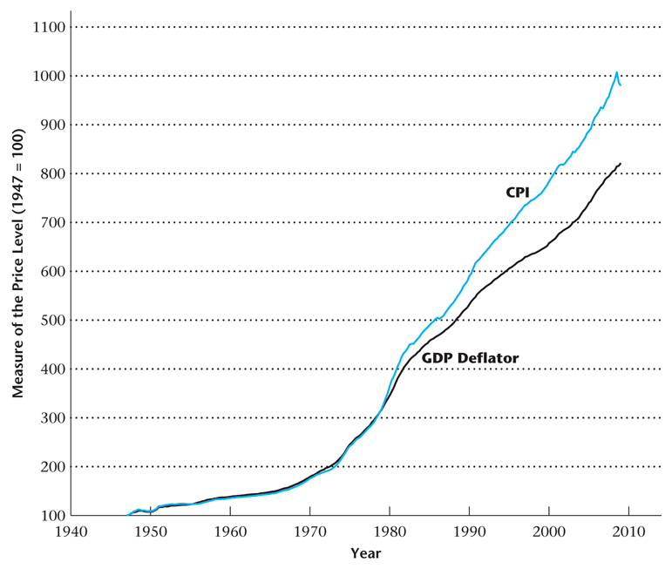
Figure 2.3
The Price Level as Measured by the CPI and the Implicit GDP Price Deflator, 1947–2009
2-<number>

Slide 14
CPI v.s. GDP Deflator
CPI is more volatile.
CPI is upward biased: substitution bias.
  oil price shock: price of oil skyrocketed in 1974-75.
  households reduce the demand for gasoline and cars and increase their demand for public transportation.
  the basket of goods includes much less gasoline in 1976.
  then the CPI using the 1974 quantities will overstate inflation.
BUT:
CPI is better measures of the cost of living in the US.
GDP price deflator based on all goods produced in the economy, even investment goods (such as trucks, planes, oil pipes) which are not of interest to households.
2-<number>

Slide 15
Problems in Measuring Real GDP and the Price Level
The relative prices of goods change over time – a problem for CPI measurement.
The quality of goods and services changes over time.
New goods and services are introduced, and some goods and services become obsolete.
2-<number>

Slide 16
House Prices and GDP Measurement
As a result of incentive problems in the mortgage market, the relative price of houses may have exceeded its true economic value prior to 2006.
The relative price of housing fell dramatically beginning in 2006.
This overvaluation of new houses may have exaggerated the value added in GDP accounted for by housing construction – an upward bias of perhaps 1.2%.
2-<number>

Slide 17
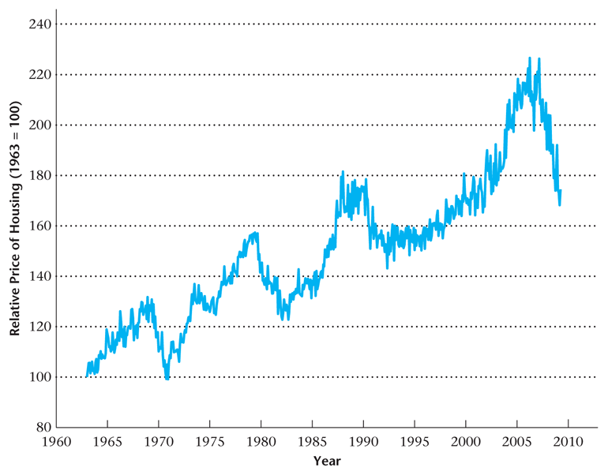
Figure 2.4
The Relative Price of Housing in the United States
2-<number>

Slide 18
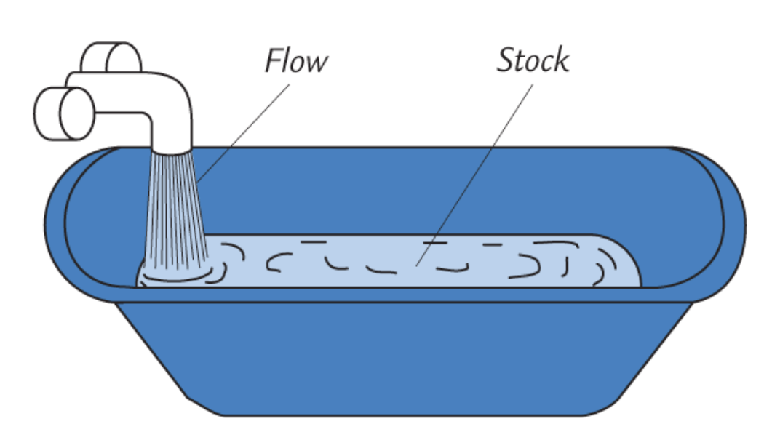
Savings and Investment
A stock is a quantity measured at a point in time.
E.g., “The U.S. capital stock was $10 trillion on January 1, 2012.”
A flow is a quantity measured per unit of time.
E.g., “U.S. investment was $2 trillion during 2012.”
2-<number>

Slide 19
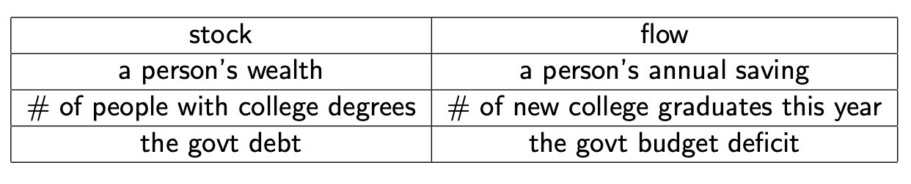
Savings and Investment
2-<number>

Slide 20
Savings and Investment
the balance on your credit card statement
Stock
Population of the U.S.
Stock
the size of your compact disc collection
Stock
the number of workers who lost their jobs last week
Flow
2-<number>

Slide 21
Savings and Investment
Y^{d}: private disposable income.
Y : GDP=all income received by agents contributing to production.
T: Taxes
It holds:
Y^{d} = Y − T.
2-<number>

Slide 22
Savings and Investment
S^{p}: private sector saving
S^{p} = Y^{d} − C
= Y − T − C
2-<number>

Slide 23
Savings and Investment
S^{g}: government saving
G: government expenditures
D: government deficit
It holds:
S^{g} = T − G
D = − S^{g} = G − T
2-<number>

Slide 24
Savings and Investment
S: national saving
S = S^{p} + S^{g}
= (Y − T − C) + (T − G)
= Y − C − G
2-<number>

Slide 25
Savings and Investment
GDP=total spending on all final goods and services production in the economy
Y = C + I + G + NX
Combined with expression on national saving:
S = Y − C − G
= C + I + G + NX − C − G
= I + NX
2-<number>

Slide 26
Savings and Investment
Re-writing:
S^{p} = I + D + NX
Private sector saving is used to finance:
private sector investment
government deficit
current account deficit
2-<number>

Slide 27
Savings and Investment
S^{p} = I + D + NX
Be careful this is just an accounting equality: an increase in D does not necessarily imply a decrease in I
D Y S^{p}
2-<number>

Slide 28
Labor Market Measurement
Adult population / potential workers: Everyone in the general population except:
  Children under 16 years
  Active military personnel
  Institutionalized persons
2-<number>

Slide 29
Labor Market Measurement
BLS Categories
  Employed
  Unemployed: unemployed during the past week but actively searched for work during the last four weeks
  Not in the Labor Force
2-<number>

Slide 30
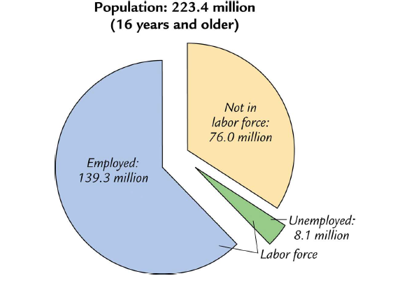
Labor Market Measurement
2-<number>

Slide 31
Labor Market Measurement
employed: working as paid employee, working in their own business, or working as unpaid workers in a family member’s business. Also include those who are absent due to pregnancy, illness, vacation, etc.
unemployed: not employed but looking for a job in the previous 4 weeks. Also include those waiting to be recalled to a job from which they had been laid off.
labor force: the amount of labor available for producing goods and services; all employed plus unemployed persons
not in the labor force: Neither employed, nor looking for work. Too old, full-time student, disabled, too rich
2-<number>

Slide 32
Examples
A college student working part-time. employed
A female employee on maternity leave. employed
John is a university teacher, and in 2011 he won the powerball lottery of 146 million dollars. Then he quit his job, bought a beachfront villa in Hawaii and has been living there ever since. not in the labor force: too rich to work
Mr Badluck lost his job last year. He is hunting for a new job now. unemployed
Ms Badluck lost her job last year. She has been looking for a new job in the last 6 months, but could not find one. She gave up and decided to live with her parents for one year. not in the labor force: discouraged worker
2-<number>

Slide 33
Labor Market Measurement
Labor Force = Employed + Unemployed
The Unemployment Rate =
Number unemployed / Labor force
Participation Rate =
Labor force / Total working age population
2-<number>

Slide 34
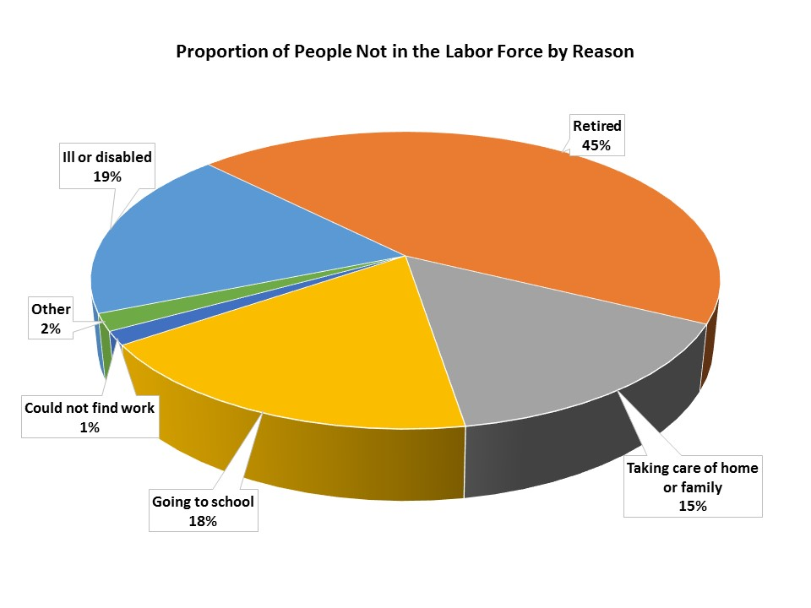
Labor Market Measurement
2-<number>

Slide 35
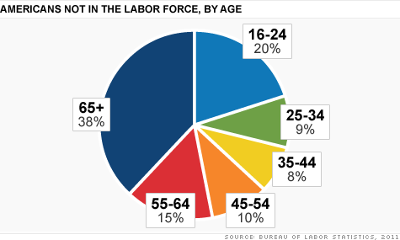
Labor Market Measurement
2-<number>

Slide 36
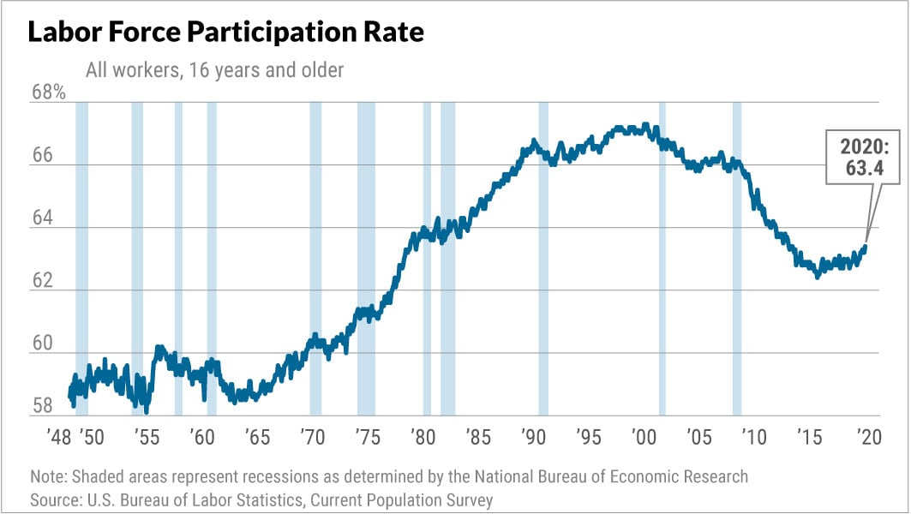
Trends in labor force participation
2-<number>

Slide 37
NOW YOU TRY
U.S. adult population by group, May 2009
  Number employed = 140.57 million
  Number unemployed = 14.51 million
  Adult population = 235.45 million
Use the above data to calculate
  the labor force
  the number of people not in the labor force
  the labor force participation rate
  the unemployment rate
2-<number>

Slide 38
Answers
Data: E = 140.57, U = 14.51, POP = 235.45
labor force:
L = E +U = 140.57 + 14.51 = 155.08
not in labor force:
NILF = POP – L = 235.45 – 155.08 = 80.37
unemployment rate
U/L × 100% = 14.51/155.08 × 100% = 9.4%
labor force participation rate
L/ POP × 100% = 155.08/ 235.45 × 100% = 65.9%
2-<number>

Slide 39
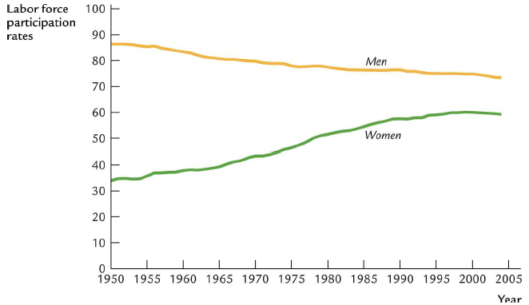
Case study: gender wage gap, labor force participation and Obesity
2-<number>

Slide 40
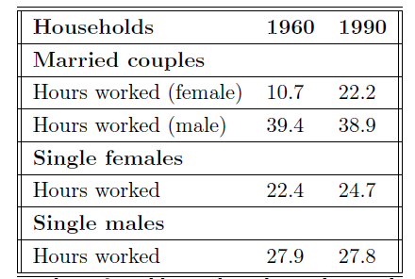
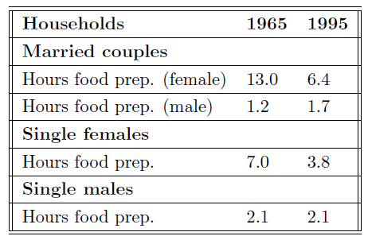
Case study: gender wage gap, labor force participation and Obesity
2-<number>

