Slide 1
Chapter 3
Business Cycle

Slide 2
Economic Fluctuations
U.S. economy fluctuates over time.
State the key regularities in GDP fluctuations.
Explain the importance of comovement among economic time series.
State the key properties of comovements among the components of GDP.
3-<number>

Slide 3
Economic Fluctuations
Discuss why comovements between the price level and real GDP and between the inflation rate and real GDP are important to our understanding of business cycles.
State the key comovements among labor market variables and real GDP.
Explain the importance of seasonal adjustment.
State the key business cycle facts.
3-<number>

Slide 4
Business Cycle Definitions and Regularities
Recession: Period of declining GDP (relative to trend).
Boom: Period of increasing GDP (relative to trend).
Peak: End of boom, beginning of recession.
Trough: End of recession, beginning of boom.
No regular amplitude or frequency of fluctuations.
But there are some regularities or “business cycle facts”:
  Correlations (comovements)
  Relative variabilities
  Phase: leading/coincident/lagging
3-<number>

Slide 5
Business Cycles in US
US experience: more volatile business cycles pre-war, moderation in fluctuations post-war and especially post 1984.
Of obvious recent relevance. On July 19, 2021 NBER determined US entered a recession in Feb. 2020, which ended in Apr. 2020.
Issue of stabilization policy for business cycles: Should Fed cut rates? Should govt. cut taxes? Should government increase spending?
3-<number>

Slide 6
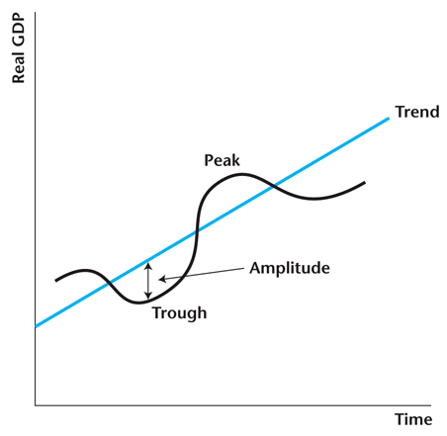
Figure 3.1
Idealized Business Cycles
3-<number>

Slide 7
Deviations From Trend in Real GDP are Irregular
The fluctuations in GDP about trend are quite choppy.
There is no regularity in the amplitude of fluctuations in real GDP about trend.
There is no regularity in the frequency of fluctuations in real GDP about trend.
3-<number>

Slide 8
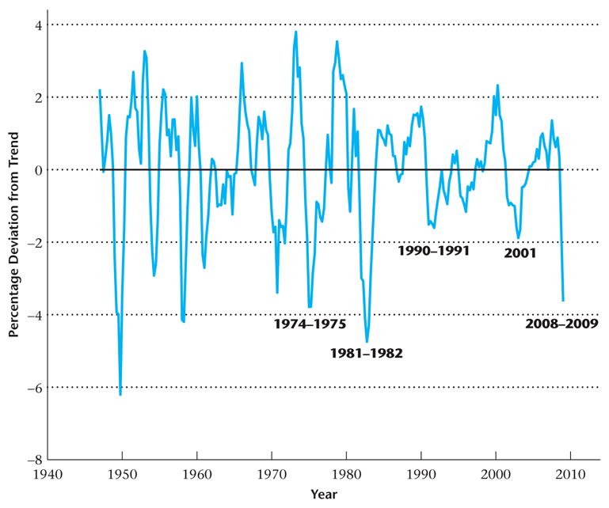
Figure 3.2
Percentage Deviations from Trend in
Real GDP from 1947–2009
3-<number>

Slide 9
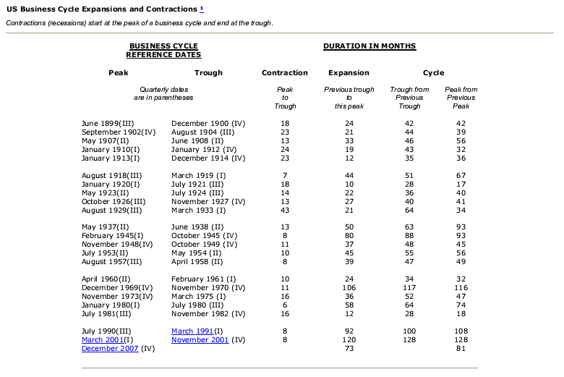
NBER Business Cycle Dates
3-<number>

Slide 10
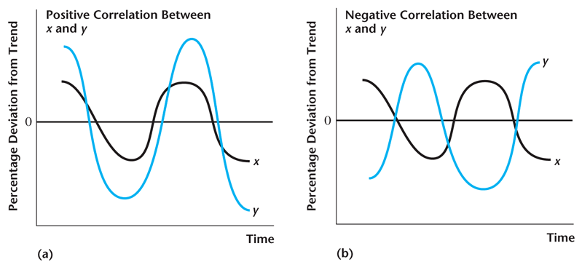
Figure 3.3
Time Series Plots of x and y
3-<number>

Slide 11
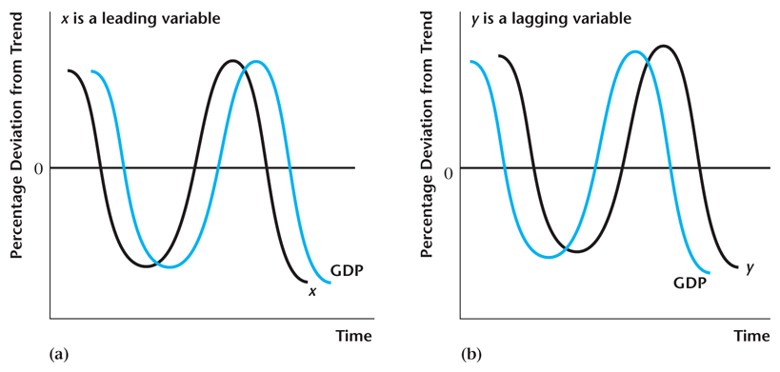
Figure 3.7
Leading and Lagging Variables
3-<number>

Slide 12
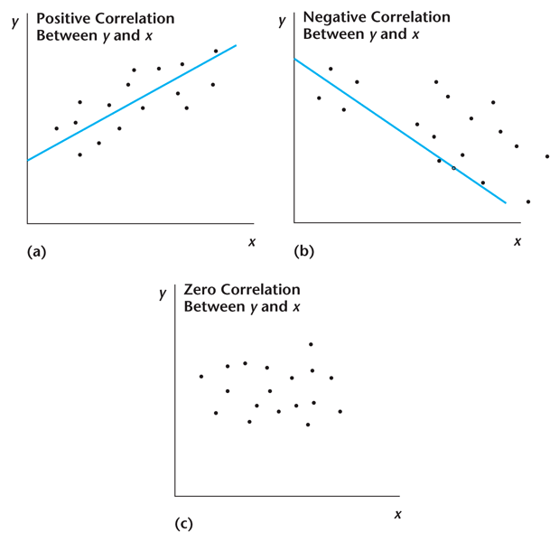
Figure 3.4
Correlations Between Variables y and x
3-<number>

Slide 13
Correlation with Real GDP
If the deviations from trend in a macroeconomic variable are positively (negatively) correlated with the deviations from trend in real GDP, then that variable is procyclical (countercyclical).
If a macroeconomic variable is neither procyclical nor countercyclical, it is acyclical.
3-<number>

Slide 14
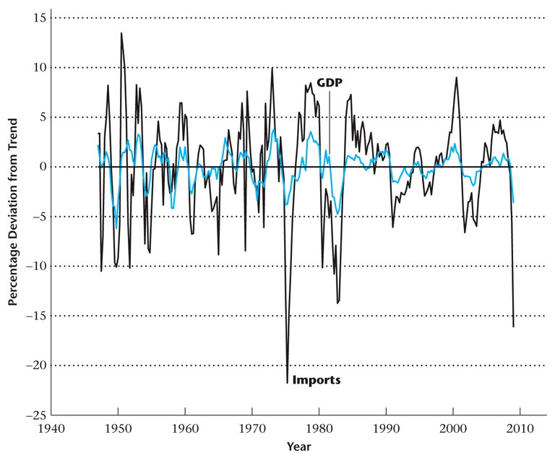
Figure 3.5
Imports and GDP
3-<number>

Slide 15
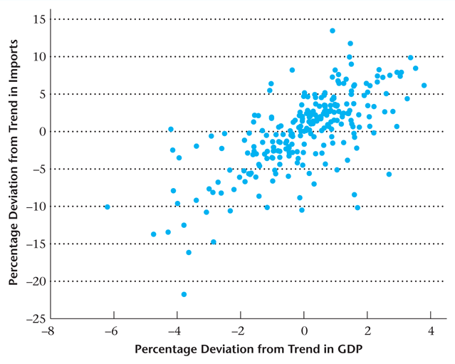
Figure 3.6
Scatter Plot of Imports and GDP
3-<number>

Slide 16
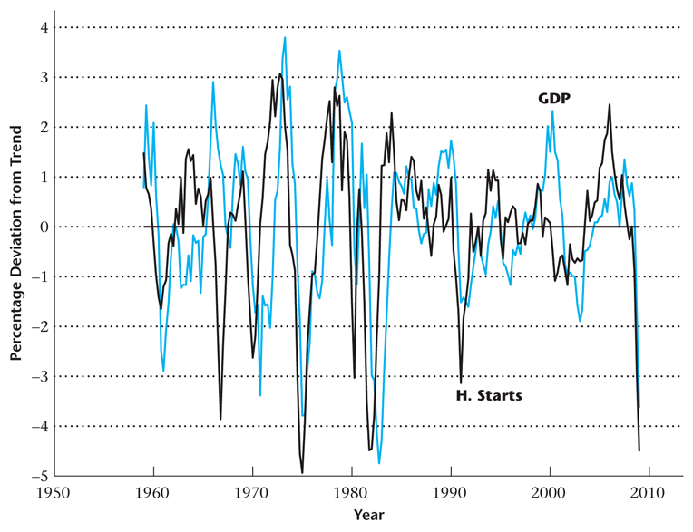
Figure 3.8
Percentage Deviations in Real GDP and Housing Starts, for 1959–2009
3-<number>

Slide 17
Behavior of Key Macroeconomic Variables
Components of GDP: consumption and investment.
Nominal variables: price level and money supply.
Labor market variables: employment, real wage, average labor productivity.
3-<number>

Slide 18
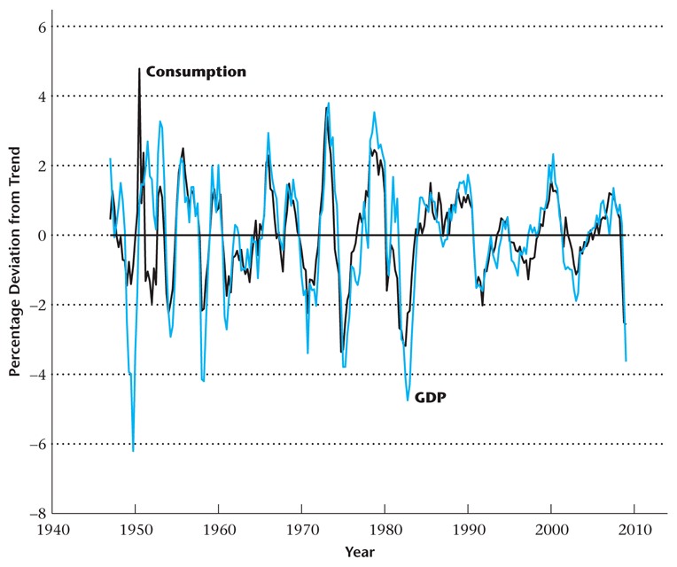
Figure 3.9
Percentage Deviations from Trend in
Real Consumption and Real GDP 1947–2009
3-<number>

Slide 19
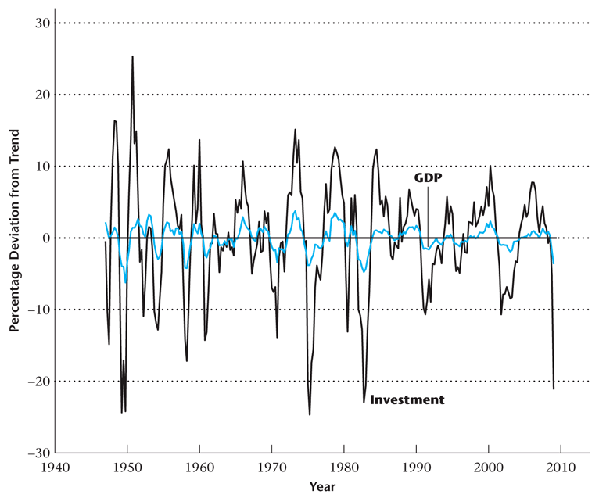
Figure 3.10
Percentage Deviations from Trend in Real Investment and Real GDP
3-<number>

Slide 20
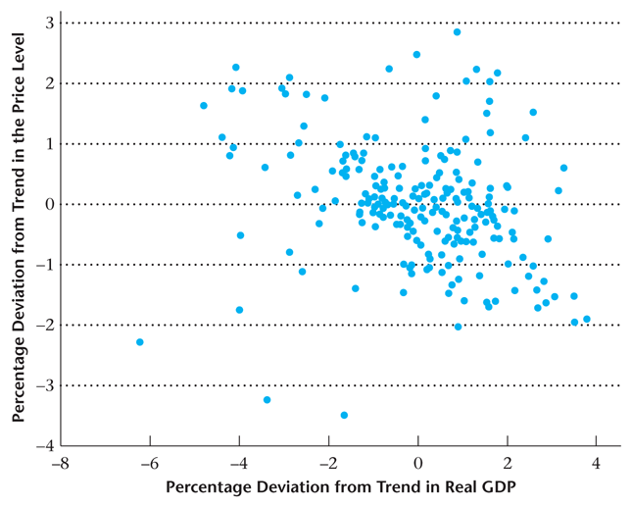
Figure 3.11
Scatter Plot for the Percentage Deviations from Trend in the Price Level and Real GDP
3-<number>

Slide 21
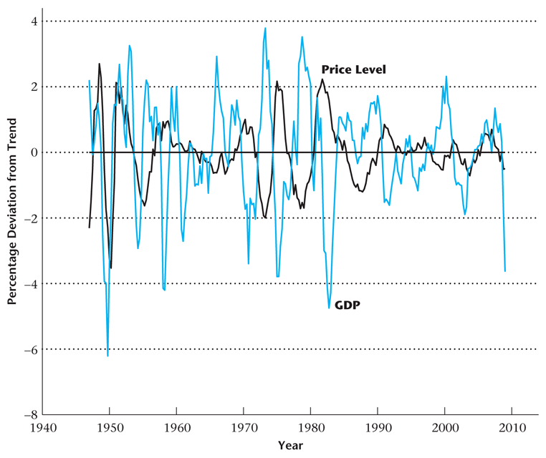
Figure 3.12
Price Level and GDP
3-<number>

Slide 22
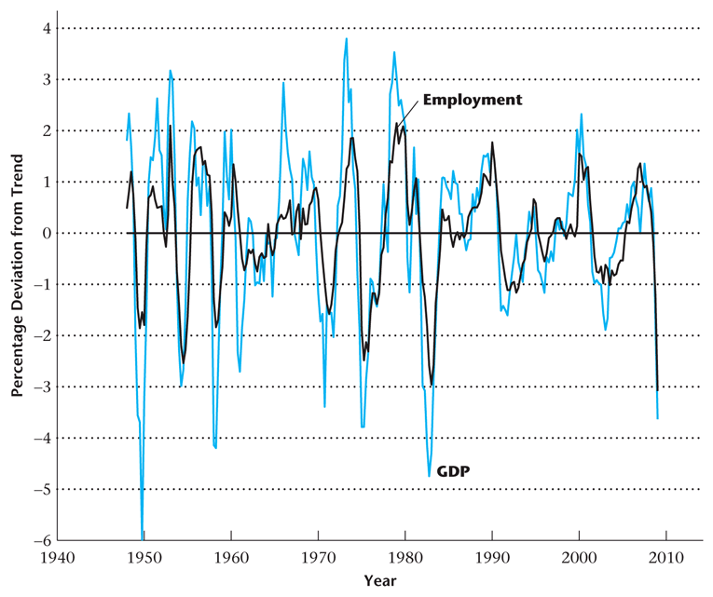
Figure 3.14
Percentage Deviations from Trend in Employment and Real GDP
3-<number>

Slide 23
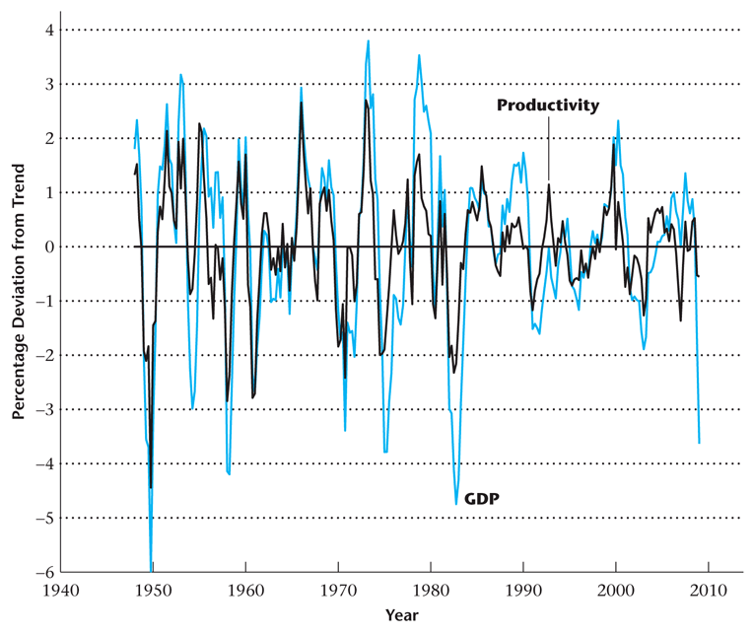
Figure 3.15
Percentage Deviations from Trend in Average Labor Productivity and Real GDP for 1948–2009
3-<number>

Slide 24
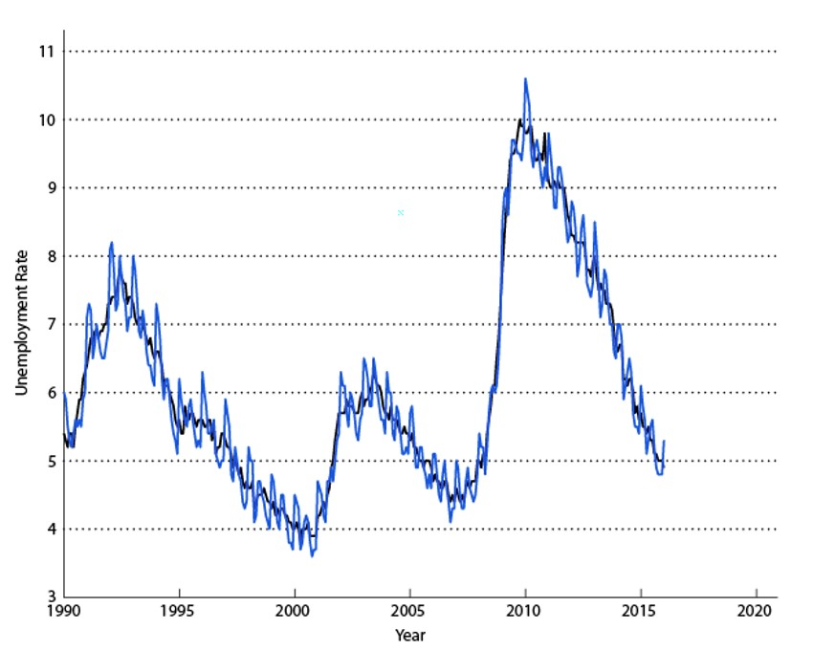
Figure 3.16
Seasonally Adjusted and Unadjusted Unemployment Rate, 1990-2015
3-<number>

Slide 25
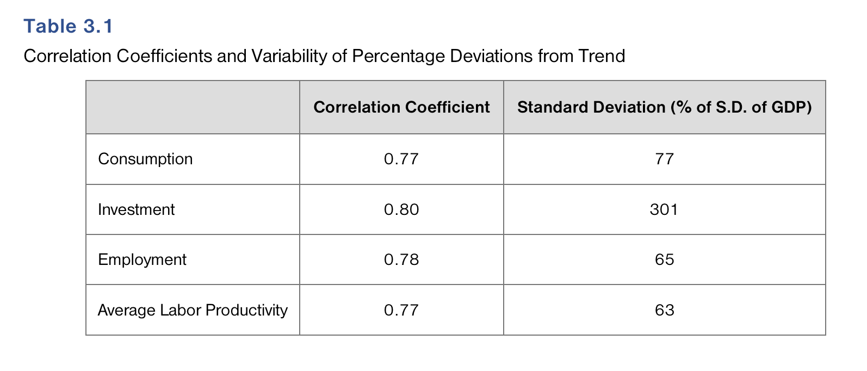
Table 3.1
Correlation Coefficients and Variability of Percentage Deviations from Trend
3-<number>

Slide 26
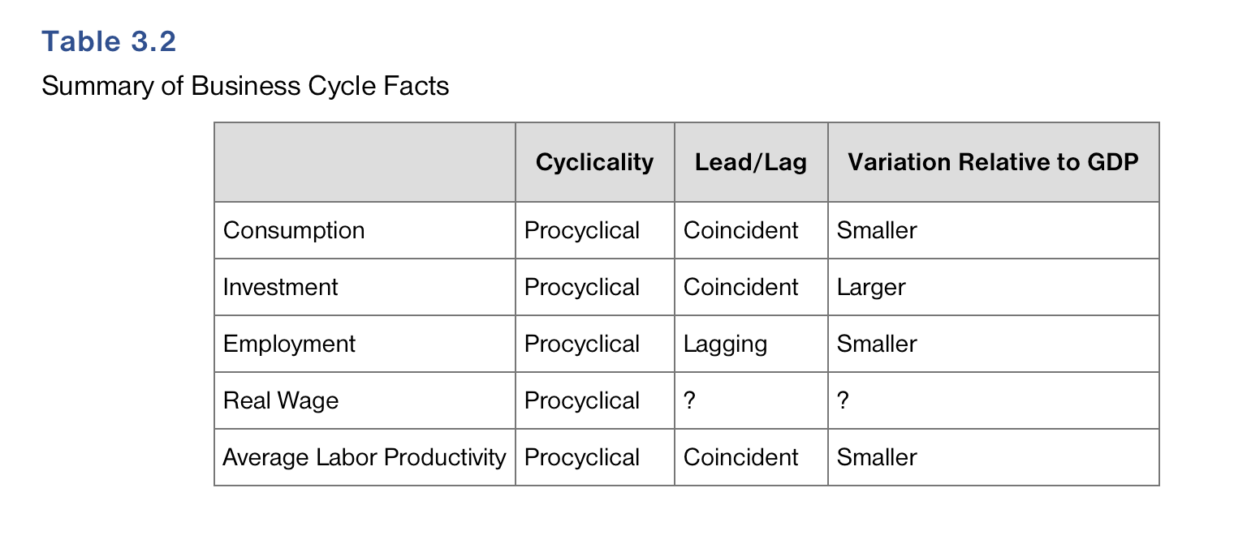
Table 3.2
Summary of Business Cycle Facts
3-<number>

