Slide 1
Topics of today’s class
Last class:
  Chapter 2
    Nominal and Real GDP and Price Indices
    Savings, wealth and capital
    Labor market measurement
Today’s class:
  Chapter 4
    Behavior of the representative consumer
1-<number>

Slide 2
Chapter 4
Consumer and Firm Behavior: The Work-Leisure Decision and Profit Maximization

Slide 3
John Keynes’ Prediction in 1930
In 1930, British economist John Keynes wrote an essay called "Economic Possibilities for Our Grandchildren." In the essay, he made the now-famous assertion that his grandchildren's generation (meaning people in the workforce today) would only work 15 hours a week.
Gallup reports that the average full-time American put in nearly 47 hours a week in 2014.
Why Keynes was so far off-base?
4-<number>

Slide 4
Representative Consumer
Consumer’s preferences.
Consumer’s budget constraint.
Consumer’s optimization problem.
How does the consumer respond to:
  (i) an increase in non-wage income;
  (ii) an increase in the market real wage rate?
4-<number>

Slide 5
Preference – an example
Ben is a tennis coach
  He earns $35 per hour by giving lesson.
  But his real passion is skydiving.
Ben’s decision is: how many hours to work each year?
  cost of working an extra hour: loss of an hour of skydiving.
  benefit of working an extra hour: $35 in income
4-<number>

Slide 6
Preference
2 goods:
  consumption c
  leisure l: economists use the term leisure for all off-the-job activities
Utility Function
U(c, l)
4-<number>

Slide 7
Preference
We say that (c₁, l₁) is strictly preferred by the consumer to (c₂, l₂) if
U(c₁, l₁) > U(c₂, l₂)
and the consumer is indifferent between the two consumption bundles if
U(c₁, l₁) = U(c₂, l₂)
4-<number>

Slide 8
Indifference curves
An indifference curve connects a set of points, with these points representing consumption bundles among which the consumer is indifferent.
  More is always preferred to less;
  The consumer likes diversity in consumption bundle;
  Consumption and leisure are normal goods.
4-<number>

Slide 9
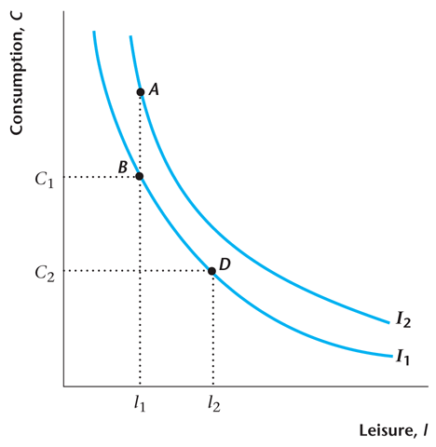
Figure 4.1
Indifference Curves
4-<number>

Slide 10
Indifference Curves
An indifference curve slopes downward (more is preferred to less).
An indifference curve is convex (the consumer prefers diversity in his or her consumption bundle).
4-<number>

Slide 11
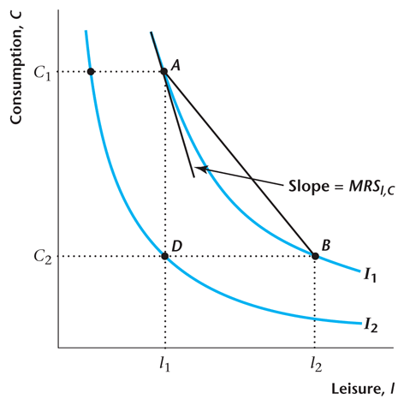
Figure 4.2
Properties of Indifference Curves
4-<number>

Slide 12
Marginal rate of substitution
The marginal rate of substitution of leisure for consumption is the rate at which the consumer is just willing to substitute leisure for consumption goods.
MRS_{l,c} = -[the slope of indifference curve passing through the bundle (c, l)]
4-<number>

Slide 13

The Consumer’s Time Constraint
l: leisure
N^{s} : labor supply or time spent working
h: hours of time available.
4-<number>

Slide 14

The Consumer’s Budget Constraint
Consumption is equal to total wage income, plus dividend income, minus taxes.
4-<number>

Slide 15
The Consumer’s Budget Constraint,
Accounting for the Time Constraint
4-<number>

Slide 16
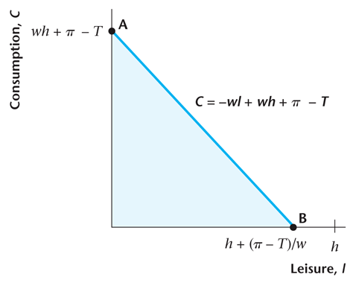
Figure 4.3
Representative Consumer’s Budget Constraint when T > π
4-<number>

Slide 17
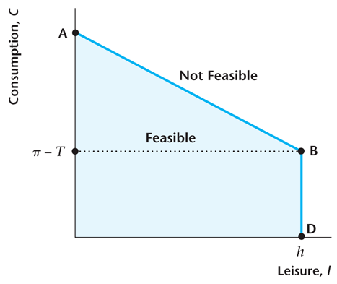
Figure 4.4
Representative Consumer’s Budget Constraint when T < π
4-<number>

Slide 18
Consumer Optimization
The consumer chooses the consumption bundle that is on his or her highest indifference curve, while satisfying his / her budget constraint.
4-<number>

Slide 19
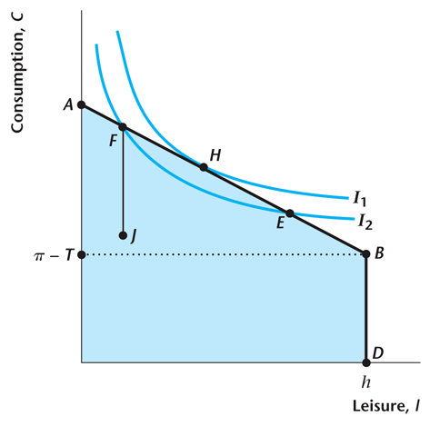
Figure 4.5
Consumer Optimization
4-<number>

Slide 20
Optimization Implies:
The marginal rate of substitution of leisure for consumption equals the real wage.
4-<number>

Slide 21
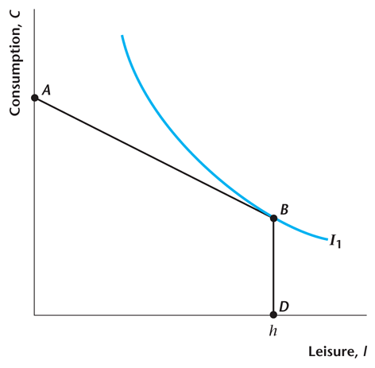
Figure 4.6
The Representative Consumer Chooses
Not to Work
4-<number>

Slide 22
Thought experiments
Impact of a tax decrease.
Impact of a wage increase.
4-<number>

Slide 23
Income and substitution effect
Decomposition of the effect of policy into:
  Income Effect: what is the impact on the budget constraint of the consumer?
  Substitution Effect: what is the impact on the cost/benefit of working an additional hour?
4-<number>

Slide 24
Income and substitution effect - example
Pure Income Effect:
Randy bought 1,000 shares of Apple at $90.2 in early 2009.
“Pure” Substitution Effect:
a one-day rise in the real wage
  Randy works for $35 an hour. Mark wants to take a private lesson and is willing to pay $350 per hour.
4-<number>

Slide 25
Real Dividends or Taxes Change for the Consumer
Assume that consumption and leisure are both normal goods.
An increase in dividends or a decrease in taxes will then cause the consumer to increase consumption and reduce the quantity of labor supplied (increase leisure).
Pure income effect.
4-<number>

Slide 26
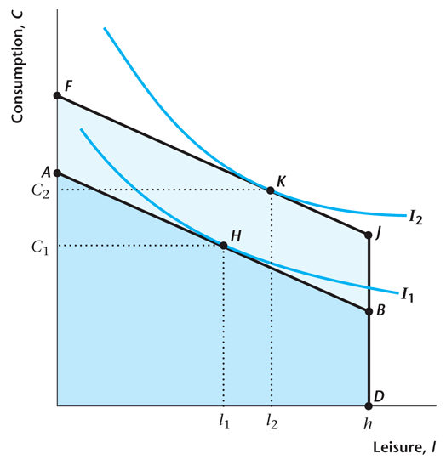
Figure 4.7
An Increase in π - T for the Consumer
4-<number>

Slide 27
An Increase in the Market Real Wage Rate
Ben works for $35 at his current tennis club. Another tennis club offers him $50 per hour. Will Ben increase his number of hours worked?
  the reward to working is greater: Ben is tempted work more.
  But: if Ben was working 10 hours a week before, he was earning $350. Now he can earn the same income by working just 7 hours.
4-<number>

Slide 28
An Increase in the Market Real Wage Rate
This has income and substitution effects.
Substitution effect: the price of leisure rises, so the consumer substitutes from leisure to consumption.
Income effect: the consumer is effectively wealthier and, since both goods are normal, consumption increases and leisure increases.
Conclusion: Consumption must rise, but leisure may rise or fall.
4-<number>

Slide 29
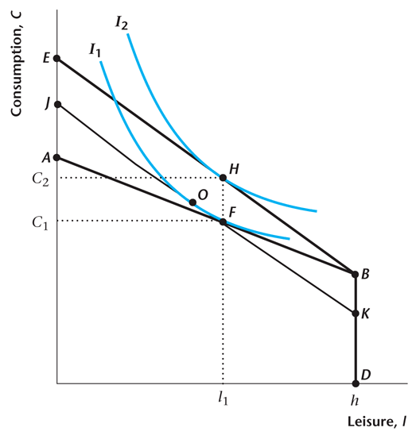
Figure 4.8
Increase in the Real Wage Rate–Income and Substitution Effects
4-<number>

Slide 30
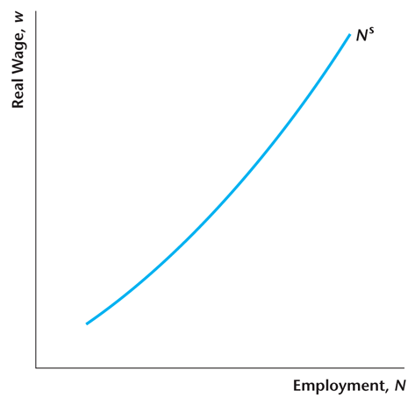
Figure 4.9
Labor Supply Curve
4-<number>

Slide 31
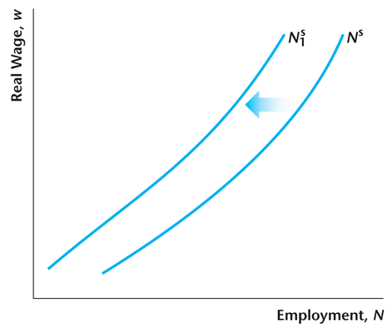
Figure 4.10
Effect of an Increase in Dividend Income or a Decrease in Taxes
4-<number>

Slide 32
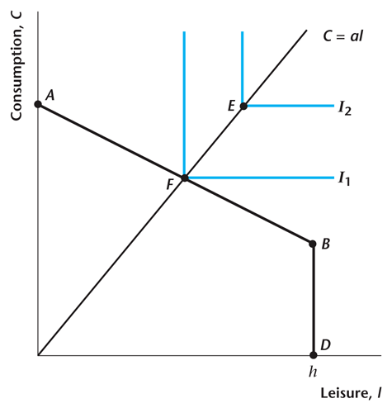
Figure 4.11
Perfect Complements
4-<number>

Slide 33
Practice question
Suppose that Chris works part time as a cashier and can earn a higher wage rate for working overtime. He receives a real wage of w₁ for the first q hours of his normal work, and for hours worked more than q, he receives w₂, where w₂ > w₁.
Assume that there is no tax or non-labor income, and he is free to choose hours of work. His preference over c and l are given by u(c,l) = min(c,2l).
Illustrate your answers on a diagram. Draw the student's budget constraint and show his or her possible optimal choice of consumption and leisure.
4-<number>

Slide 34
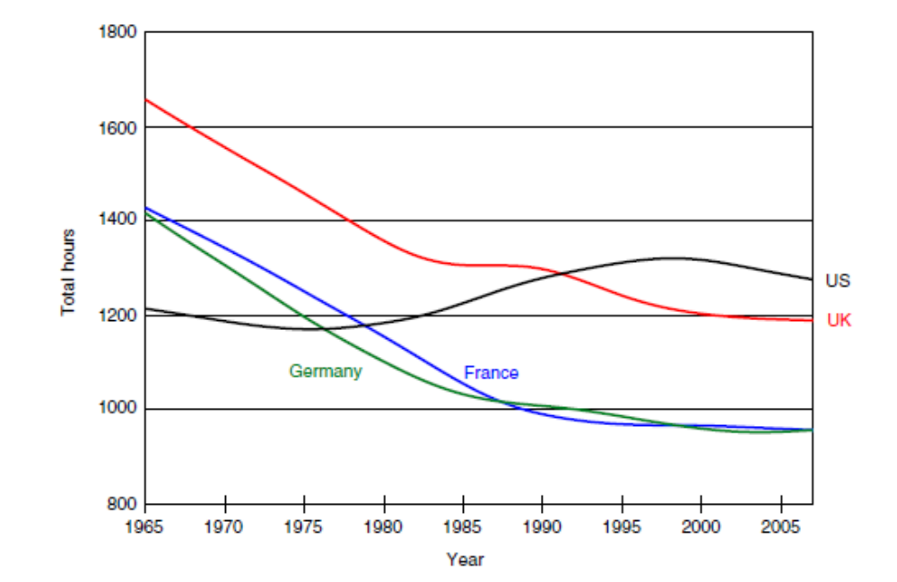
Case study: Why Americans work more than Europeans?
4-<number>

Slide 35
Case study: Why Americans work more than Europeans?
Today, hours worked in Europe are almost 30 percent lower than in the U.S.
Cross-country variation in tax systems is one of the most popular proposed explanations for the observed discrepancy in work hours between the US and Europe. [Prescott (2004)]
Holter, Chakraborty, and Stepanchuk (2015) believe that divorce rates also play a role, particularly for women's labor supply.
4-<number>

