Slide 1
Topics of today’s class
Last class:
  Chapter 4
    Behavior of the representative consumer
Today’s class:
  Chapter 4
    Behavior of the representative firm
1-<number>

Slide 2
The Representative Firm
The production function.
Profit maximization and labor demand.
4-<number>

Slide 3

How much does the economy produce?
What determines the quantity of goods and services produced? 2 Keys Factors of Production:
  K: Capital (factories and machines)
  N^{d}: Labor
Quality matters too:
  z is the level of technology or total factor productivity (TFP)
  Example: changes in the organization of production, personal computer, weather (especially in agriculture), government regulations, price of energy
4-<number>

Slide 4
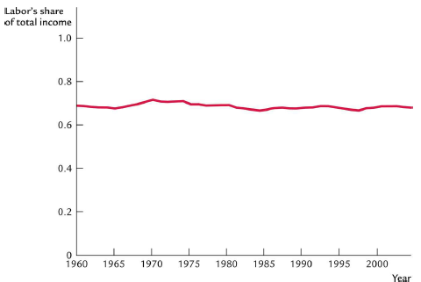
US aggregate production function
4-<number>

Slide 5
US aggregate production function
Empirical Studies show that a reasonable description of the U.S Economy production is:
Y = zK^{0.36}N^{0.64}
Y, K and N are observed. We can recover z (the Solow residual):
z = Y / (K^{0.36}N^{0.64})
4-<number>

Slide 6
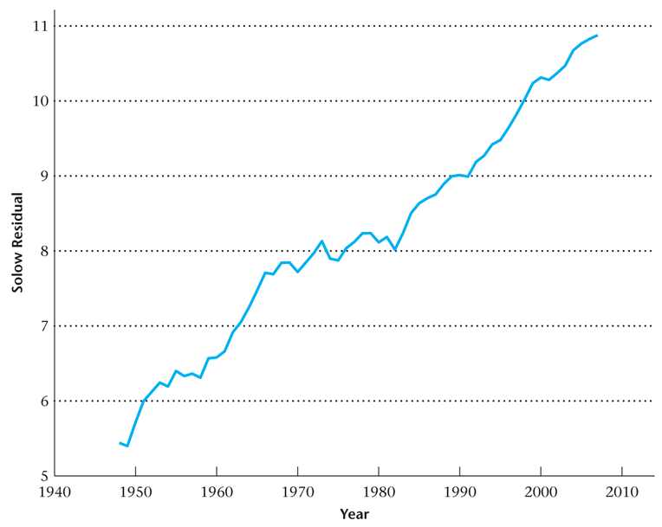
Figure 4.18
The Solow Residual for the United States
4-<number>

Slide 7
The shape of the production function
In 2004:
N = 139.3 million workers
z = 20.68
The Production function becomes:
Y = zK^{0.3}N^{0.7}
= 20.68K^{0.3}139.3^{0.7}
= 655.11K^{0.3}
4-<number>

Slide 8
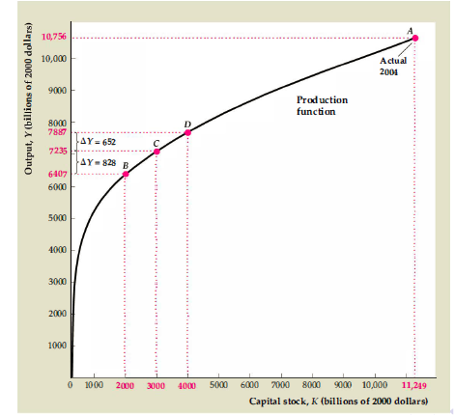
The shape of the production function
4-<number>

Slide 9
Production function: output and capital
Two properties:
  output is increasing in capital
  the slope of the production function becomes flatter as capital increases
4-<number>

Slide 10
The marginal product of capital
Definition: the marginal product of capital is the additional output that can be produced with one additional unit of capital, holding labor constant
  It is the slope of the production function in the previous figure: output as a function of capital when labor is fixed
4-<number>

Slide 11
The marginal product of capital
Two properties of the production function can be expressed as:
  MPK > 0.
  MPK is declines as the capital stock is increased: diminishing marginal productivity of capital.
4-<number>

Slide 12
Production function: output and labor
In 2004:
K = 11.249 billion
z = 20.68
The Production function becomes:
Y = zK^{0.3}N^{0.7}
= 20.68 (11.249^{0.3}) N^{0.7}
= 339.54N^{0.3}
4-<number>

Slide 13
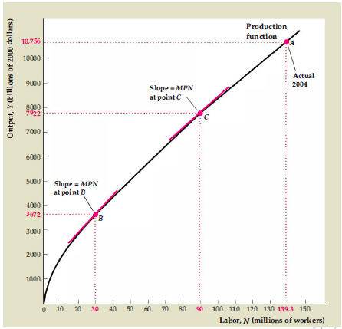
The marginal product of labor
4-<number>

Slide 14
The marginal product of labor
Definition: the marginal product of labor is the additional output that can be produced with one additional unit of labor, holding capital constant
  It is the slope of the production function in the previous figure: output as a function of labor when capital is fixed.
Two properties
  MPL > 0
  MPL is declines as the labor is increased: diminishing marginal productivity of labor.
4-<number>

Slide 15
Profit maximization problem
Firm rents capital at rate r.
Firm hires labor at wage w.
  wages of the workers they hired is determined in a competitive labor market and not set by the firms themselves
Profits: Output minus Costs
  a firm’s goal is to earn the highest possible level of profit
π = zF (K,N) − rK − wN
Assume that K is fixed: static economy
4-<number>

Slide 16
Profit maximization: example
The Clip Joint is a small business that groom dogs:
  capital: clippers, tubs, brushes
  labor: workers that groomed dogs
  output: number of groomed dogs
4-<number>

Slide 17
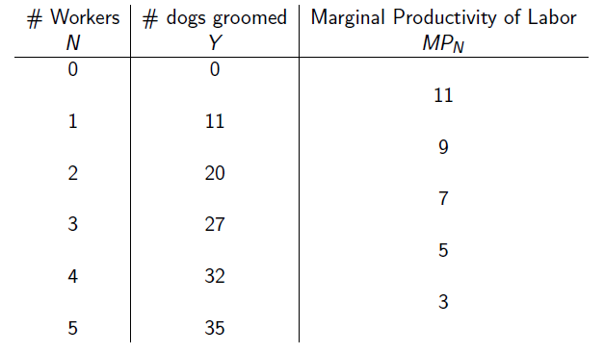
Profit maximization: example
4-<number>

Slide 18
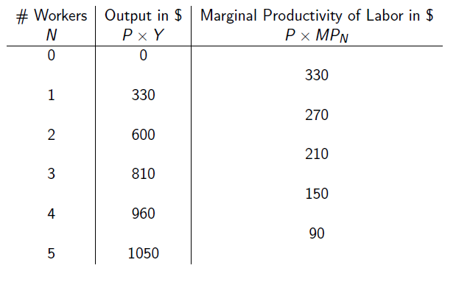
Profit maximization: example
4-<number>

Slide 19
Profit maximization: example
P = $30
nominal wage: w = $240
real wage: w / p = 240 / 30 = 8 grooming per day
N^{d} = 2
4-<number>

Slide 20
Profit maximization: example
Impact of a decrease in the nominal wage w = $180?
N^{d} = 3.
a decrease in the real wage rate raises labor demanded.
4-<number>

Slide 21
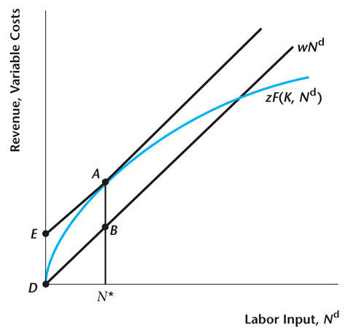
Figure 4.19
Revenue, Variable Costs, and Profit Maximization
4-<number>

Slide 22
Profit Maximization
When the firm maximizes profits, the marginal product of labor equals the real wage.
MPL = W
4-<number>

Slide 23
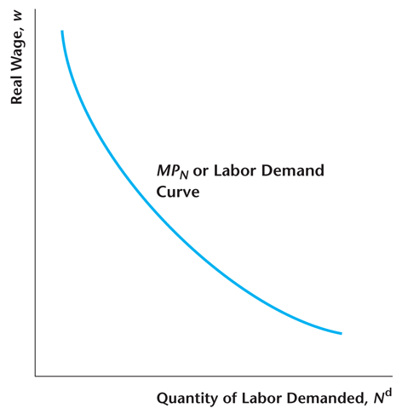
Figure 4.20
The Marginal Product of Labor Curve Is the Labor Demand Curve of the Profit-Maximizing Firm.
4-<number>

Slide 24
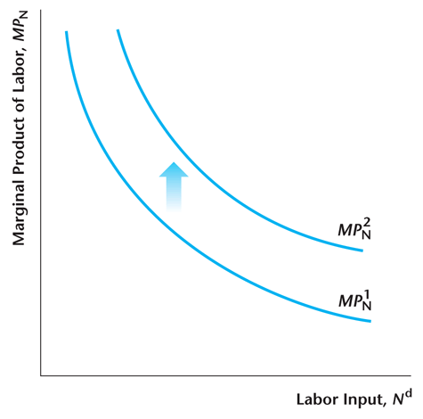
Figure 4.15
Adding Capital Increases the Marginal Product of Labor
4-<number>

Slide 25
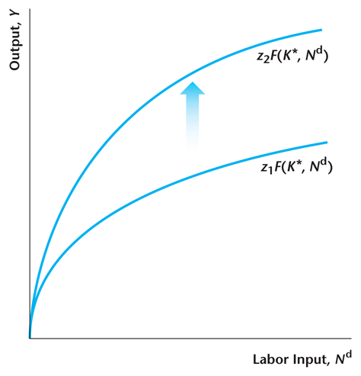
Figure 4.16
Total Factor Productivity Increases
4-<number>

Slide 26
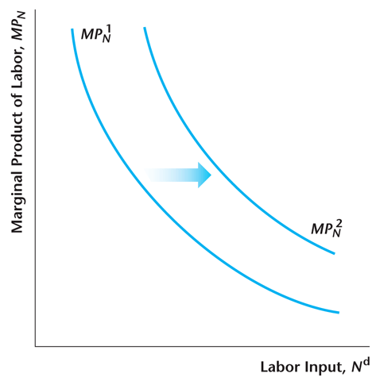
Figure 4.17
Effect of an Increase in Total Factor Productivity on the Marginal Product of Labor
4-<number>

Slide 27
Case study: The Black Death and Factor Prices
Black Death: peaking in Europe between 1348 and 1350. It killed 30–60 percent of Europe's population.
L falls, but K stays the same.
  Fewer workers means that each remaining worker is more productive: MPL rises.
Each machine becomes less productive: MPK falls.
4-<number>

Slide 28
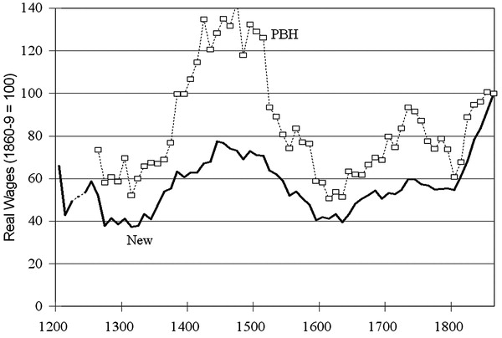
Case study: The Black Death and Factor Prices
Source: Clark (2005), Journal of Political Economy. Phelps Brown and Hopkins vs. new series. In both series, 1860–69 has been set to 100.
4-<number>

Slide 29
Productivity in the 2008-09 Recession
Problem: Timely measures of total factor productivity are not available, as we measure the capital stock with a lag.
Can get timely measures of average labor productivity – closely related to total factor productivity, but not the same thing.
4-<number>

Slide 30
Puzzle
In the 2008-09 recession, average labor productivity has declined much less than in typical recessions of the same severity.
Why? Potential reasons are:
  The causes of the 2008-09 recession are different – housing sector problems and problems in the financial system.
  Long term shifts in employment across sectors – from construction and manufacturing to services.
4-<number>

Slide 31
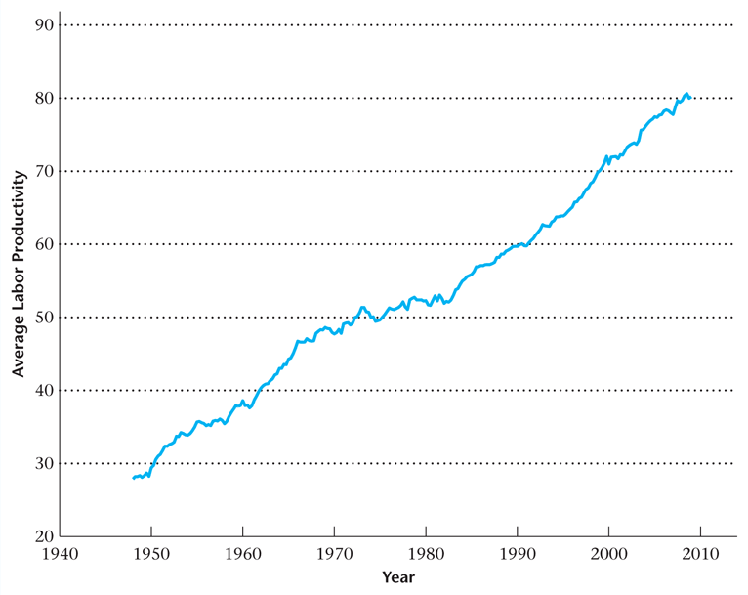
Figure 4.21
Average Labor Productivity
4-<number>

Slide 32
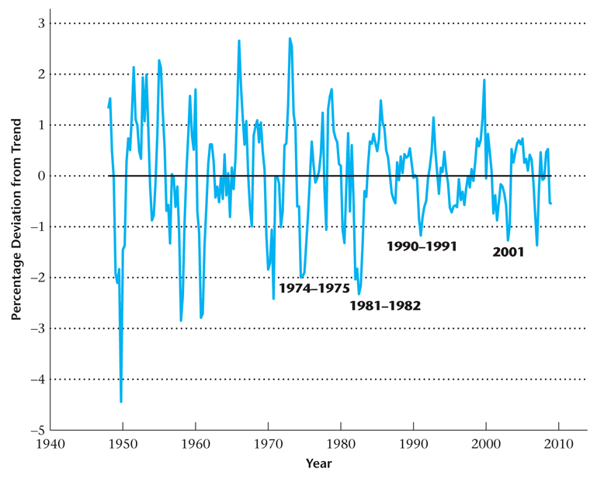
Figure 4.22
Percentage Deviations from Trend in
Average Labor Productivity
4-<number>

Slide 33
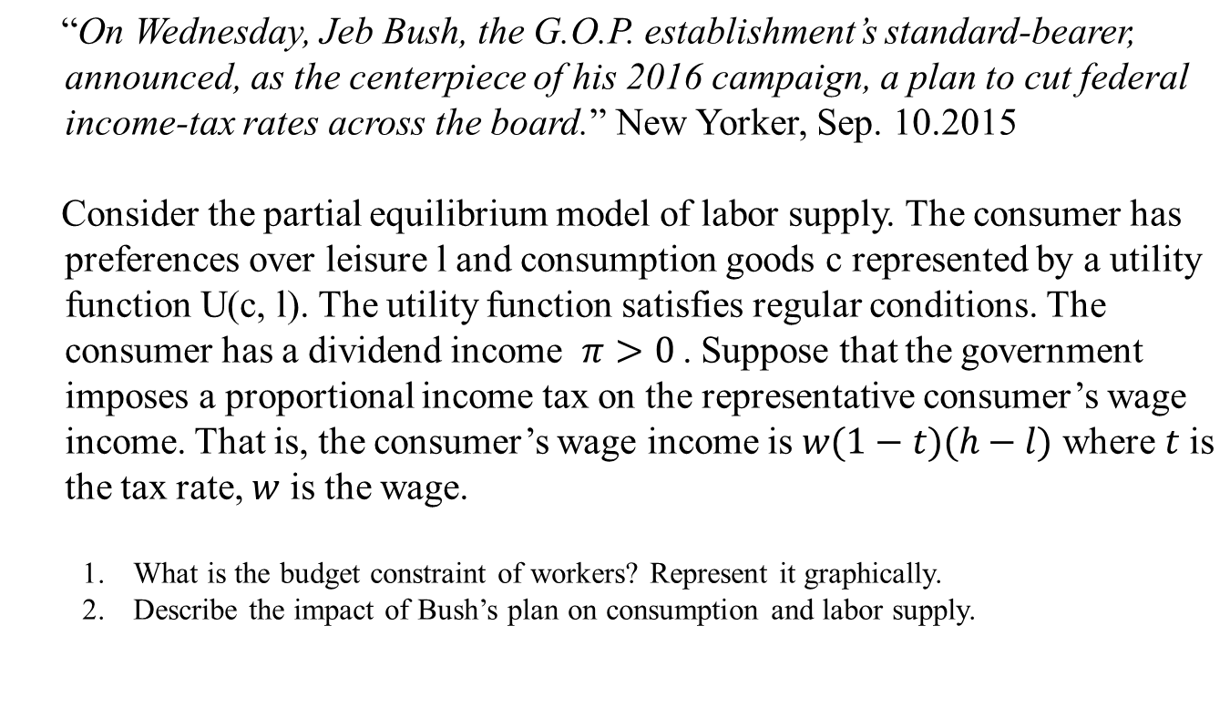
Practice Question
4-<number>

Slide 34
Practice Question
Consider the model of labor supply of Chapter 4. Suppose that the representative consumer’s dividend income increases, and his or her wage rate falls at the same time.
Determine the effects on consumption and labor supply and explain your results in terms of income and substitution effects. (Assume the dividend income is always greater than the amount of Tax)
4-<number>

Slide 35
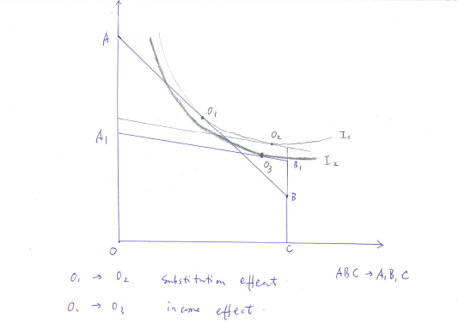
Practice Question
4-<number>

Slide 36
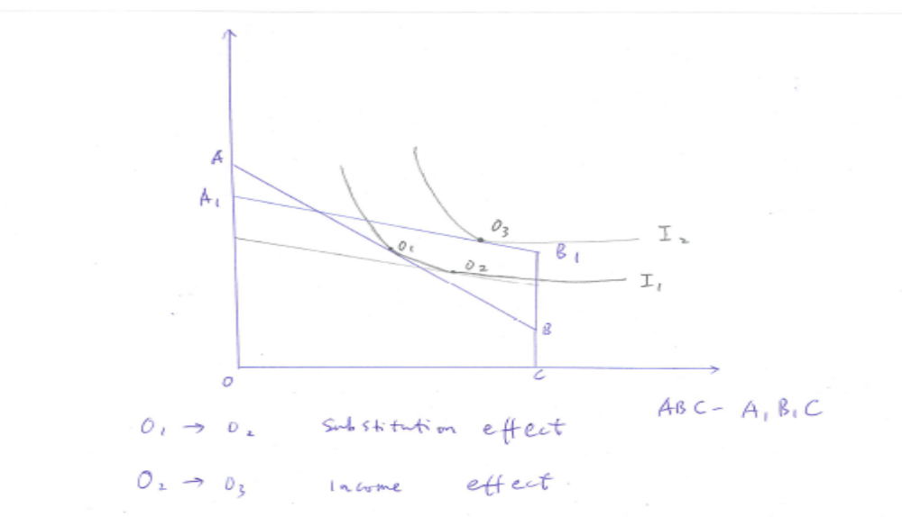
Practice Question
4-<number>

