Slide 1
Topics of today’s class
Last class:
  Chapter 4
    Consumer and Firm Behavior
    The Work-Leisure Decision and Profit Maximization
Today’s class:
  Chapter 5
    Introduce the government.
    Construct closed-economy one-period macroeconomic model.
    Economic efficiency and Pareto optimality
1-<number>

Slide 2
Chapter 5
A Closed Economy
One-Period Macroeconomic Model

Slide 3
Chapter 5 Topics
Introduce the government.
Construct closed-economy one-period macroeconomic model.
Economic efficiency and Pareto optimality.
Experiments:
  Increases in government spending and total factor productivity.
  Consider a distortionary tax on wage income and study the Laffer curve.
5-<number>

Slide 4
Closed-Economy One-Period Macro Model
Representative Consumer
  decides how much to work and how much to consume: (c, N_{s} ) taking as given the wage rate w and the interest rate r.
Representative Firm
  decides how much to produce Y and how much labor to hire N_{d} taking as given the wage rate w and the interest rate r.
Government
  raises taxes T and spends G.
Static world: K is constant.
5-<number>

Slide 5
Why?
We will now put these together. Why?
Consistency: we are sure that everyone is doing things that are compatible.
To derive positive predictions from the model.
5-<number>

Slide 6

Exogenous Variables and Endogenous Variables
Exogenous Variables: K, G, z.
Endogenous Variables: w, r, N, c, T, Y, π, l.
5-<number>

Slide 7
Competitive Equilibrium
A Competitive Equilibrium is
  an allocation {Y, N, K, c};
  a price system {w, r};
  a government policy {T, G}.
such that
  Representative consumer optimizes given market prices.
  Representative firm optimizes given market prices.
  The government budget constraint is satisfied, or G = T.
  Markets clear: goods market, labor market and capital market.
5-<number>

Slide 8
Income-Expenditure Identity
In a competitive equilibrium, the income-expenditure identity is satisfied, so
Y = C + G
why?
5-<number>

Slide 9
Income-Expenditure Identity
Consumer’s Budget constraint:
C = wN_{s} + rK + π − T
Profits:
π = Y − wN_{d} − rK
Government Budget Constraint:
T = G
5-<number>

Slide 10
Income-Expenditure Identity
Consumer’s Budget constraint:
C = wN_{s} + Y − wN_{d} − G
and Equilibrium on the Labor Market
N_{s} = N_{d}
done!
5-<number>

Slide 11
Solving for an equilibrium
Graphical Approach
Key here: to find w (wage) that clears labor market.
5-<number>

Slide 12
The Production Function
Production Function
Y = zF(K,N)
Time Constraint
N = h − l
So
Y = zF(K, h − l)
5-<number>

Slide 13
Production Possibilities Frontier
In Equilibrium
C = Y − G
combined with
Y = zF (K, h − l)
finally:
C = zF (K, h − l) − G
Definition: The Production Possibilities Frontier describes what the technological possibilities are, for the economy as the whole, in terms of the production of consumption goods and leisure.
5-<number>

Slide 14
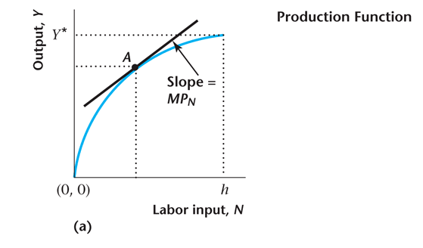
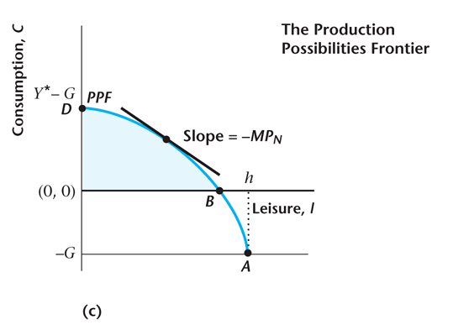
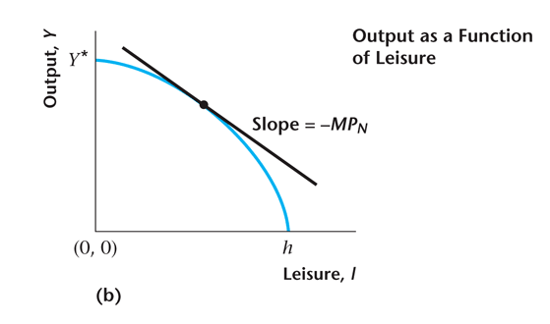
Figure 5.2
The Production Function and the Production Possibilities Frontier
5-<number>

Slide 15
Marginal Rate of Transformation
The marginal rate of transformation (MRT) is the rate at which one good can be converted technologically into another.
In our case, the MRT is the rate at which leisure can be converted in the economy into consumption goods through work.
MRT_{l,c} = MPN = -(the slope of the PPF).
5-<number>

Slide 16
Key Properties of a Competitive Equilibrium
From consumer utility maximization:
MRS_{l,C} = w
From firm profit maximization:
MPN = w
Imposing labor market clearing:
MRS_{l,C} = MPN
5-<number>

Slide 17
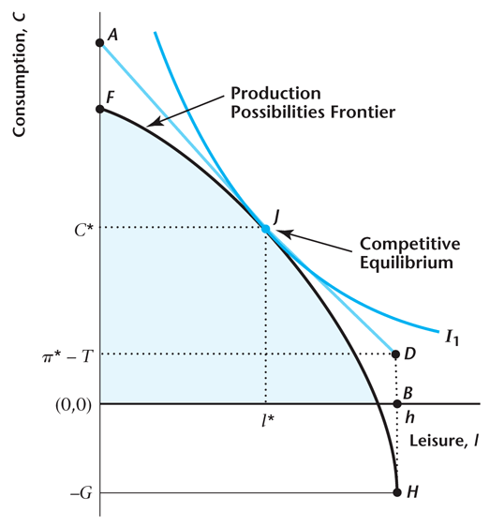
Figure 5.3
Competitive Equilibrium
5-<number>

Slide 18
Pareto Optimality
A competitive equilibrium is Pareto Optimal if there is no way to rearrange production or to reallocate goods so that someone is made better off without making someone else worse off.
5-<number>

Slide 19
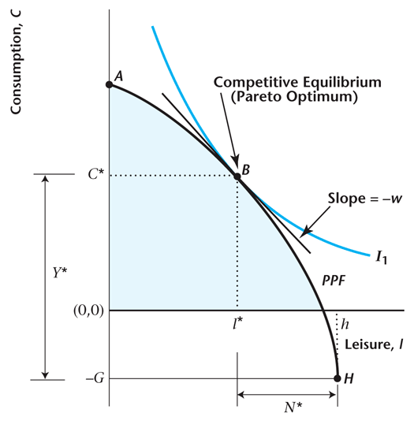
Figure 5.4
Pareto Optimality
5-<number>

Slide 20
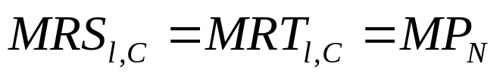
Key Properties of a Pareto Optimum
In this model, the competitive equilibrium and the Pareto optimum are identical.
We know this as, at the Pareto optimum,
5-<number>

Slide 21
First and Second Welfare Theorems
These theorems apply to any macroeconomic model.
First Welfare Theorem: Under certain conditions, a competitive equilibrium is Pareto optimal.
Second Welfare Theorem: Under certain conditions, a Pareto optimum is a competitive equilibrium.
5-<number>

Slide 22
Figure 5.5
Using the Second Welfare Theorem to
Determine a Competitive Equilibrium
5-<number>

Slide 23
Thought Experiments
Increase in Governments Expenditures
  Government Expenditures during World War II
Increases in total factor productivity
Impact of a tax proportional to wages
5-<number>

Slide 24
WWII and increase in G
During WWII government spending to finance the war effort increased to levels unseen previously in the US.
What are the predictions of the model for this increase in spending?
The assumption that government spending is a pure loss of output arguably makes sense here.
  Military expenditure protect us.
  But means less consumption goods and services.
5-<number>

Slide 25
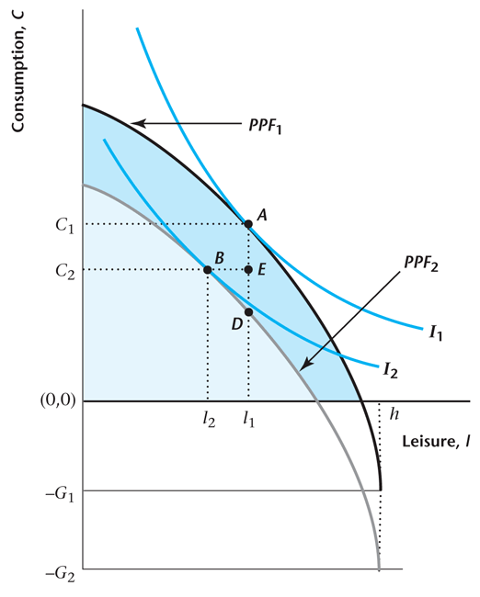
Figure 5.6
Equilibrium Effects of an Increase in
Government Spending
5-<number>

Slide 26
World War II Increase in G
Essentially: Negative Income Effects
  increase in (Y, N),
  decrease in (c, w).
Private consumption spending is “crowded out” by increased government spending.
Loss of welfare as both c, l fall.
  Crucial Assumption: G is not in the Utility Function
These predictions match U.S. experience of WWII.
5-<number>

Slide 27
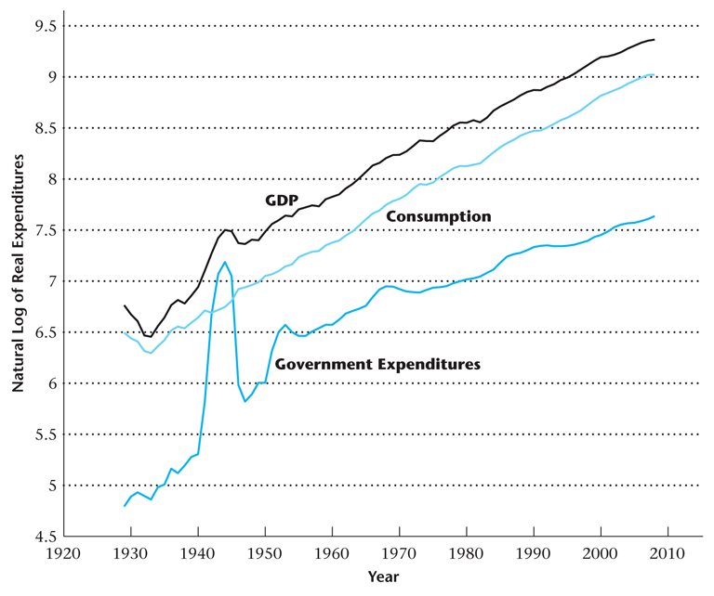
Figure 5.7. GDP, Consumption, and
Government Expenditures
5-<number>

Slide 28
WWII
Large Increase in Government Expenditures.
Y increases.
C decreases by a small amount.
5-<number>

Slide 29
What does this analysis miss?
Government debt. A large fraction of the wartime spending was financed by government debt.
  Deficit/GDP ratio hit 24% by 1944.
  So Taxes increased less which is maybe why consumption only decreased by a small amount
Increased productivity. Wartime mobilization of production increased labor productivity dramatically.
  Increase in Output is larger than our model suggests
5-<number>

Slide 30
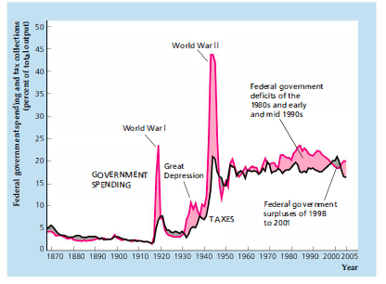
Deficit
5-<number>

Slide 31
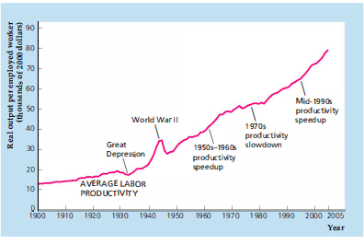
Labor Productivity
5-<number>

