Slide 1
Topics of today’s class
Last class:
  Chapter 5
    Introduce the government.
    Construct closed-economy one-period macroeconomic model.
    Economic efficiency and Pareto optimality.
Today’s class:
  Chapter 5
    Increases in government spending and total factor productivity.
    Consider a distortionary tax on wage income and study the Laffer curve.
1-<number>

Slide 2
Chapter 5
A Closed Economy
One-Period Macroeconomic Model

Slide 3
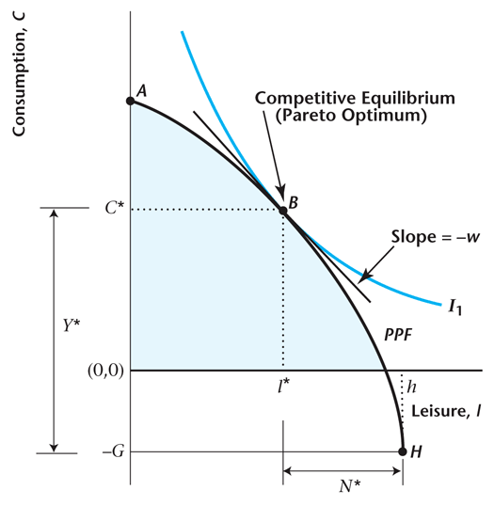
Figure 5.4
Pareto Optimality
5-<number>

Slide 4
American Recovery and
Reinvestment Act of 2009
$787 billion in changes in the federal government’s budget (5.5% of 2008 GDP).
$290 billion in changes in G (2.0% of 2008 GDP).
Our model says: effect on GDP will be less than $290 billion, because of crowding out.
Keynesians say: economy is operating inside the PPF, and the increase in GDP will be more than $290 billion.
5-<number>

Slide 5
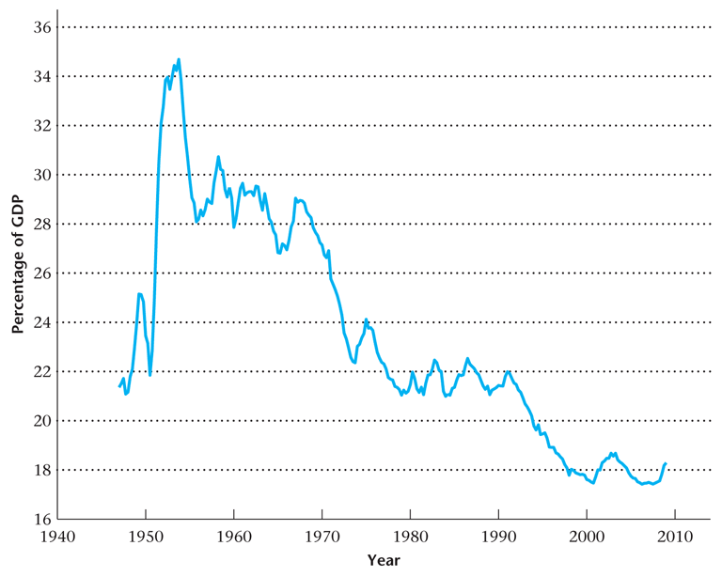
Figure 5.13
Government Expenditures as a Percentage of GDP
5-<number>

Slide 6
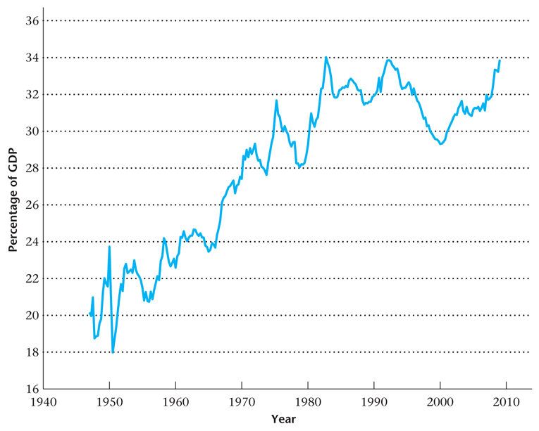
Figure 5.14
Total Government Outlays as a Percentage of GDP
5-<number>

Slide 7
American Recovery and Reinvestment Act of 2009
In the discussions of fiscal stimulus, the size of the multiplier is a source of some controversy.
  Obama administration suggests ≈ 1.5
  Barro suggests ≈ 0
Our model says: effect on GDP < 1 because of crowding out.
This isn’t the best framework for current issues, as there’s no unemployment or idle resources. These are the main rationale for the fiscal stimulus.
5-<number>

Slide 8
Increase in TFP
An increase in TFP
  Example: technological innovation
2 directs effects:
  Can produce more with the same amount of labor.
  Production Possibility Frontier is steeper.
5-<number>

Slide 9
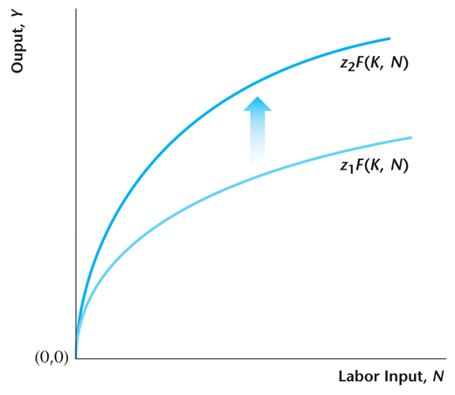
Figure 5.8
Increase in Total Factor Productivity
5-<number>

Slide 10
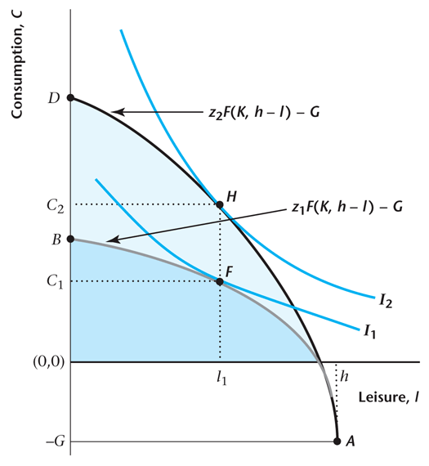
Figure 5.9
Competitive Equilibrium Effects of an Increase in Total Factor Productivity
5-<number>

Slide 11
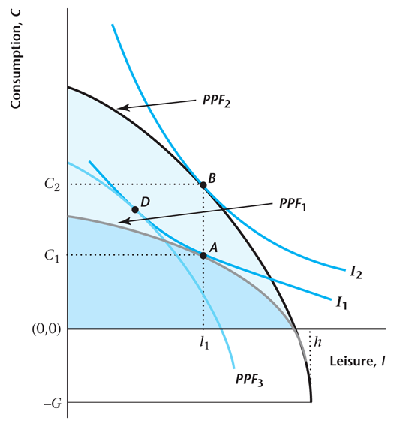
Figure 5.10
Income and Substitution Effects of an Increase in Total Factor Productivity
5-<number>

Slide 12
The effect of an increase in TFP
C increase unambiguously
Effect on N will depend on income and substitution effects
w increases
Y increases
5-<number>

Slide 13
The effect of an increase in TFP
Remember that z is technological progress.
The model predicts that technological progress leads to more consumption, more output, higher wages and ambiguous effect on number of hours worked.
We know that z has been increasing over time in the data. Let’s see whether we observe the predicted trend in endogenous variables in the data.
5-<number>

Slide 14
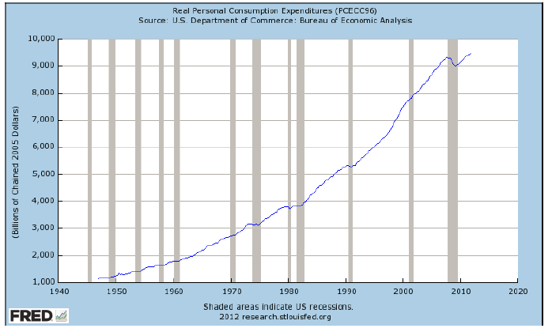
Consumption
5-<number>

Slide 15
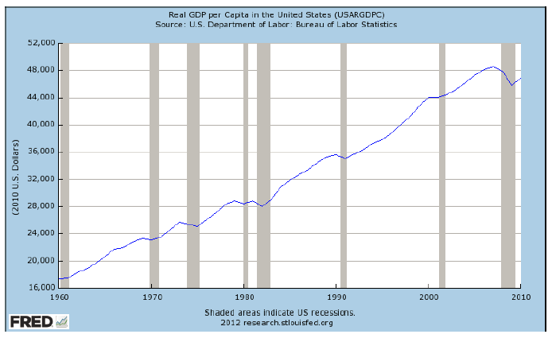
Output
5-<number>

Slide 16
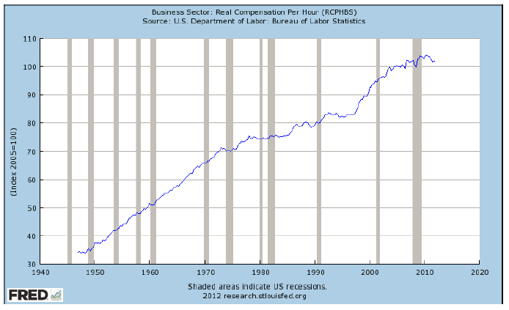
Compensation per hours
5-<number>

Slide 17
TFP
So data seems consistent with this VERY simple model
Really?
Let’s Examine Changes in Hours Worked in the US since 1950.
Hours worked per person have been roughly constant since WWII
  overall:+7% from 1950 to 2000
But: hours worked for men have fallen and market hours for women have increased
5-<number>

Slide 18
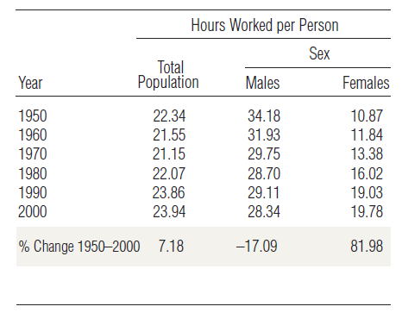
Hours worked per person
5-<number>

Slide 19
TFP
Hours per person = Total Hours worked / Population
= Total Hours worked / Labor Force ×
Labor Force / Population
= Hours per worker × Participation Rate
Intensive Margin: Hours per worker
Extensive Margin: Participation Rate
5-<number>

Slide 20
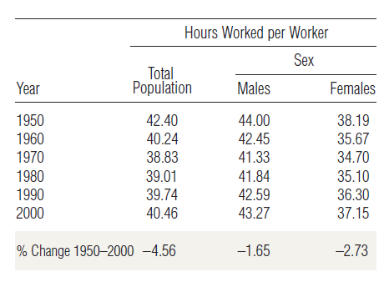
Hours worked per worker
5-<number>

Slide 21
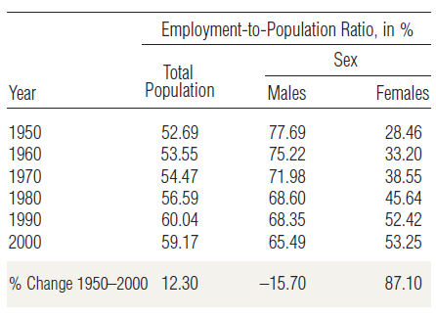
Employment-to-population ratio
5-<number>

Slide 22
Changes in Hours worked
Hours worked per person have been roughly constant since WWII
  overall:+7% from 1950 to 2000
Hours per worker: -4.5% total population
Large reallocation of working hours from males to females
  Participation Rate of Men: -15%
  Participation Rate of Women: +87%
Improved technology in home sector (appliances, home delivery, the Internet, e-shopping).
5-<number>

Slide 23
Distortionary Tax
Economist Arthur Laffer.
Ronald Reagan’s Economic advisor during 1980 U.S. election.
Advice:
  decreasing income tax rates,
  will increase the quantity of labor supplied,
  and increase tax revenues.
5-<number>

Slide 24
Distortionary Tax
George H.W. Bush (Reagan’s opponent in the Republican primaries):
  This is “voodoo economics”
2001: tax cut proposals during George W. Bush’s campaign for President
  using more or less the same argument,
  supposed to expire at the end of 2010,
  two-year extension by Obama.
5-<number>

Slide 25

Production Function Without Capital
Labor is the only input, but there is still constant returns to scale (linear production function).
5-<number>

Slide 26

Production Possibilities Frontier
5-<number>

Slide 27
Consumer’s Budget Constraint
5-<number>

Slide 28
Profits for the Firm
5-<number>

Slide 29

The Consumer’s Budget Constraint in Equilibrium
5-<number>

Slide 30
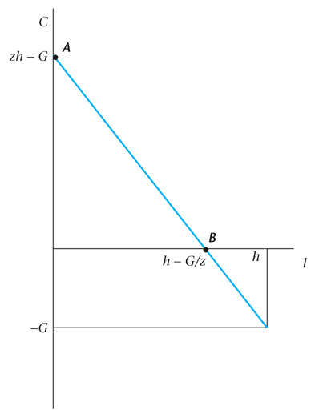
Figure 5.15
The Production Possibilities Frontier in the Simplified Model
5-<number>

Slide 31
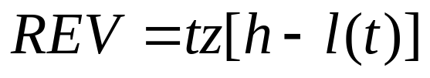
Revenue for the Government Given the Tax Rate t
5-<number>

Slide 32
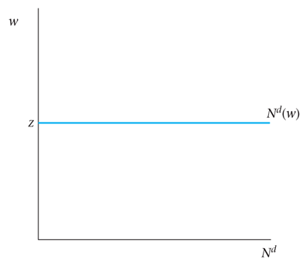
Figure 5.16
The Labor Demand Curve in the Simplified Model
5-<number>

Slide 33
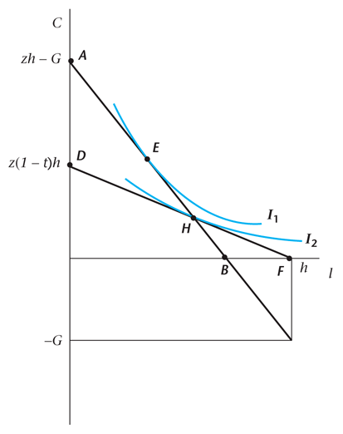
Figure 5.17
Competitive Equilibrium in the Simplified Model with a Proportional Tax on Labor Income
5-<number>

Slide 34
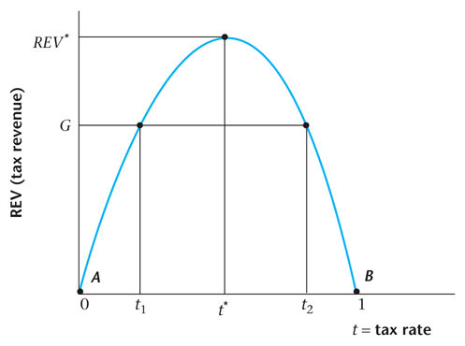
Figure 5.18
A Laffer Curve
5-<number>

Slide 35
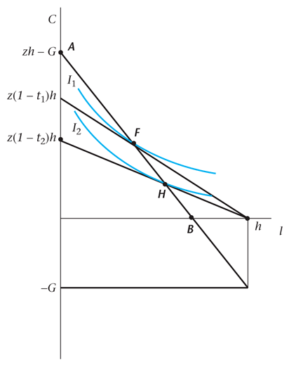
Figure 5.19
There Can Be Two Competitive Equilibria
5-<number>

Slide 36
Is the U.S. Economy on the Bad Side of the Laffer Curve?
Reagan administration: cuts in marginal tax rates in 1981.
Bush administration: cuts in marginal tax rates in 2001.
Results: decrease in tax revenue in both cases.
Implication: We are on the good side of the Laffer curve.
5-<number>

Slide 37
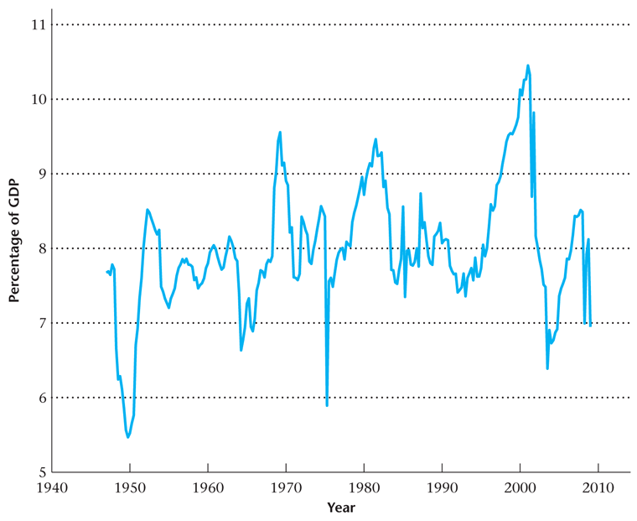
Figure 5.20
Federal Personal Taxes as a Percentage of GDP
5-<number>

