Slide 1
Chapter 6
Unemployment: Search and Efficiency Wages

Slide 2
Learning Objectives, Part I
6.1 List the key labor market facts concerning the unemployment rate, the participation rate, and the employment/population ratio.
6.2 Describe the Beveridge curve, and explain its importance.
6.3 In the one-sided search model, explain how the reservation wage is determined.
Notes:
This chapter is devoted to understanding the workings of the labor market, particularly the determinants of the unemployment rate. Unemployment is fundamentally search activity, so we understand it by using search theory, in two models – a one-sided search model, and a two-sided search model.

Slide 3
Learning Objectives, Part II
6.4 Show how the one-sided search model determines the unemployment rate.
6.5 Use the one-sided search model to determine the effects of changes in the labor market on the efficiency wage and the unemployment rate.

Slide 4
Learning Objectives, Part III
6.6 Construct an equilibrium in the two-sided search model.
6.7 Use the two-sided search model to explain how shocks to the labor market change labor force participation, unemployment, vacancies, aggregate output, and labor market tightness.

Slide 5
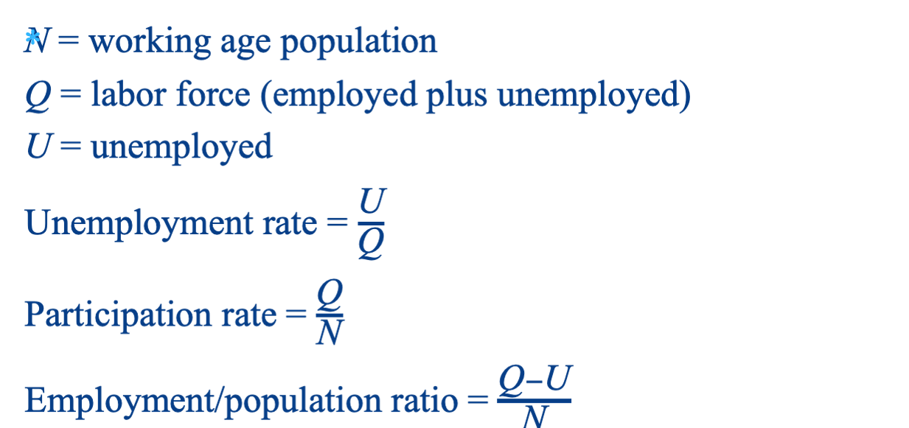
Key Labor Market Variables
Notes:
First, we will review basic labor market variables and examine some key labor market data for the United States. Three key labor market measures are the unemployment rate, the participation rate, and the employment/population ratio.

Slide 6
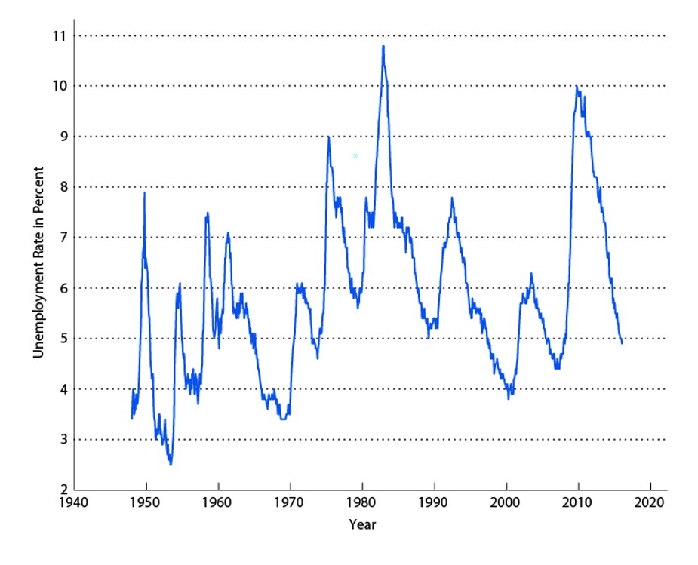
Figure 6.1 The Unemployment Rate
Notes:
The chart shows the unemployment rate for the United States. The unemployment rate is countercyclical, and there important trends in the data, with the unemployment rate increasing on trend until about 1980, and then decreasing on trend.

Slide 7
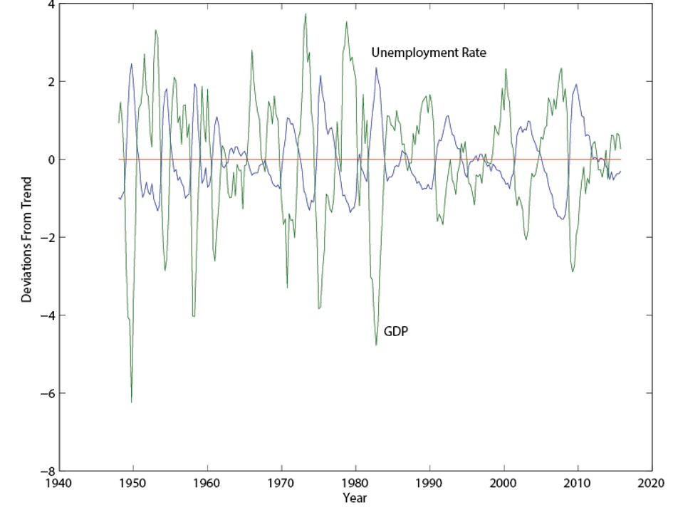
Figure 6.2 Deviations From Trend in the Unemployment Rate and Real GDP
Notes:
The chart shows the countercyclical nature of the unemployment rate. Unemployment is typically high (low) when real GDP is low (high).

Slide 8
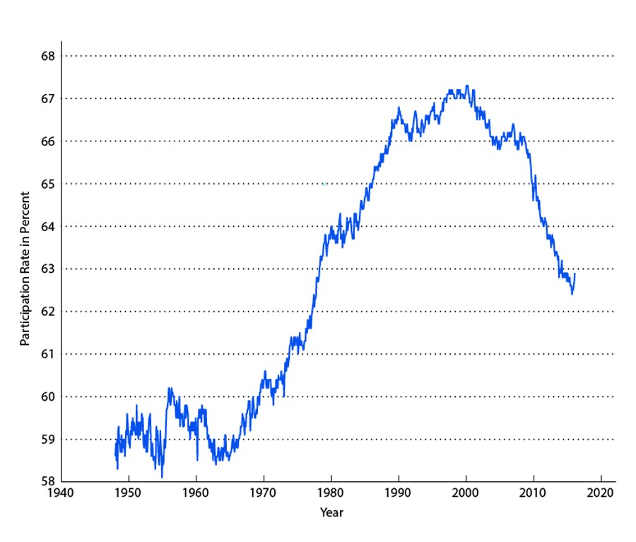
Figure 6.3 Labor Force Participation Rate
Notes:
Labor force participation increased from 1948 until about 2000, and has declined since then. This recent decline in the participation rate is important, as it is not observed to the same extent in other countries, such as Canada and the UK, which have similar demographic structure.

Slide 9
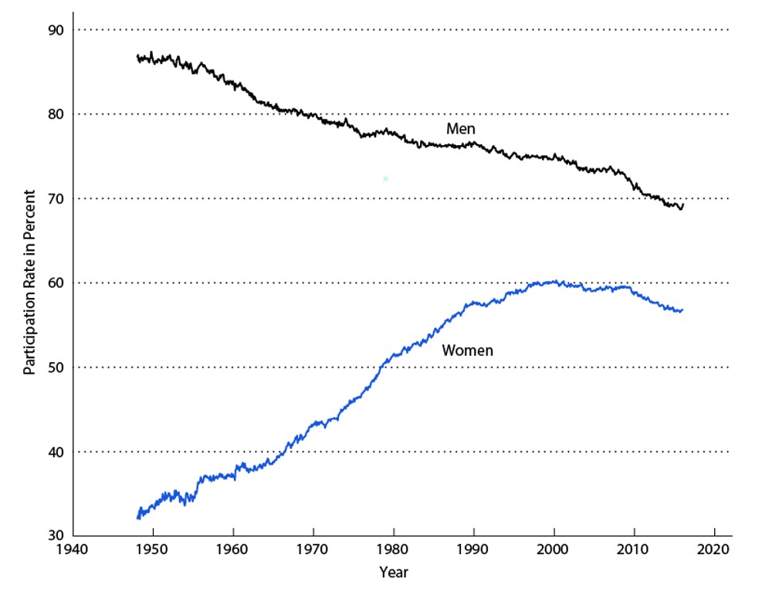
Figure 6.4 Labor Force Participation Rates of Men and Women
Notes:
This chart shows that the increase in the aggregate labor force participation rate in the previous chart was entirely due to increased participation of women. The recent decline in labor force participation is due to reduced participation by both men and women.

Slide 10
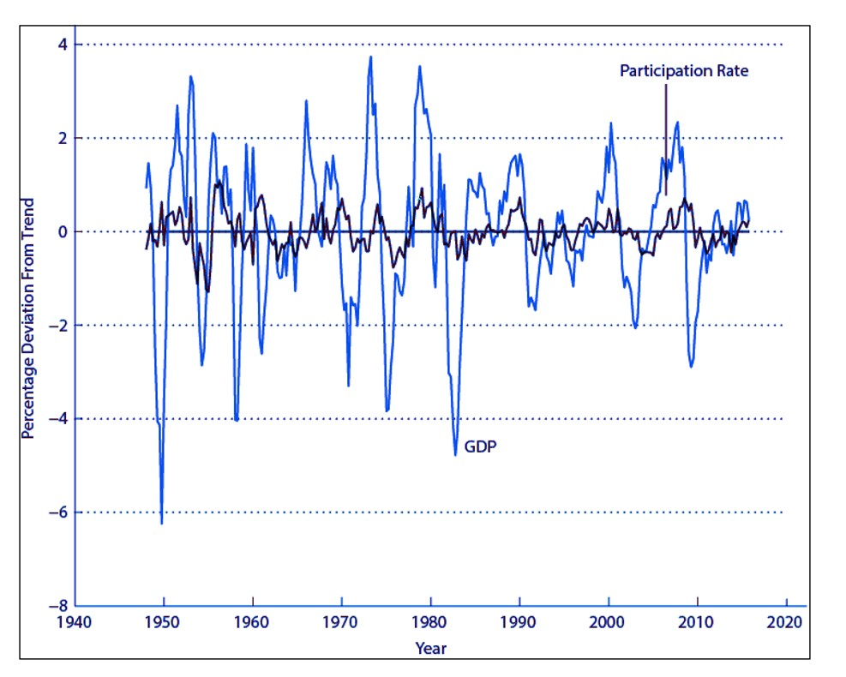
Figure 6.5 Percentage Deviations From Trend: Labor Force Participation Rate and Real GDP
Notes:
The labor force participation rate is mildly procyclical. If the past is a good guide, the recent decline in labor force participation is not due to the recent recession, but a long run phenomenon.

Slide 11
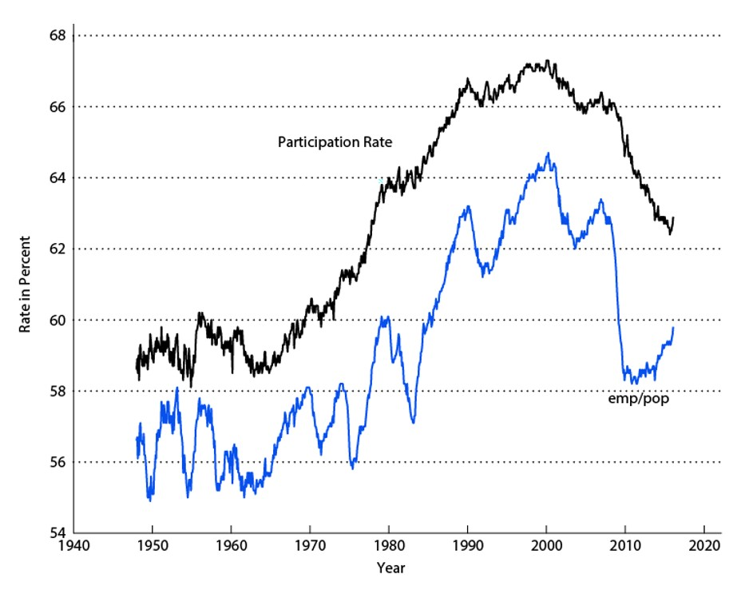
Figure 6.6 Labor Force Participation Rate and Employment/Population Ratio
Notes:
The employment population ratio exhibits much more cyclical variation than the participation rate. But note the recent large decline in the employment population ratio. This variable fell during the recent recession, and has not retained its previous level as in earlier recessions.

Slide 12
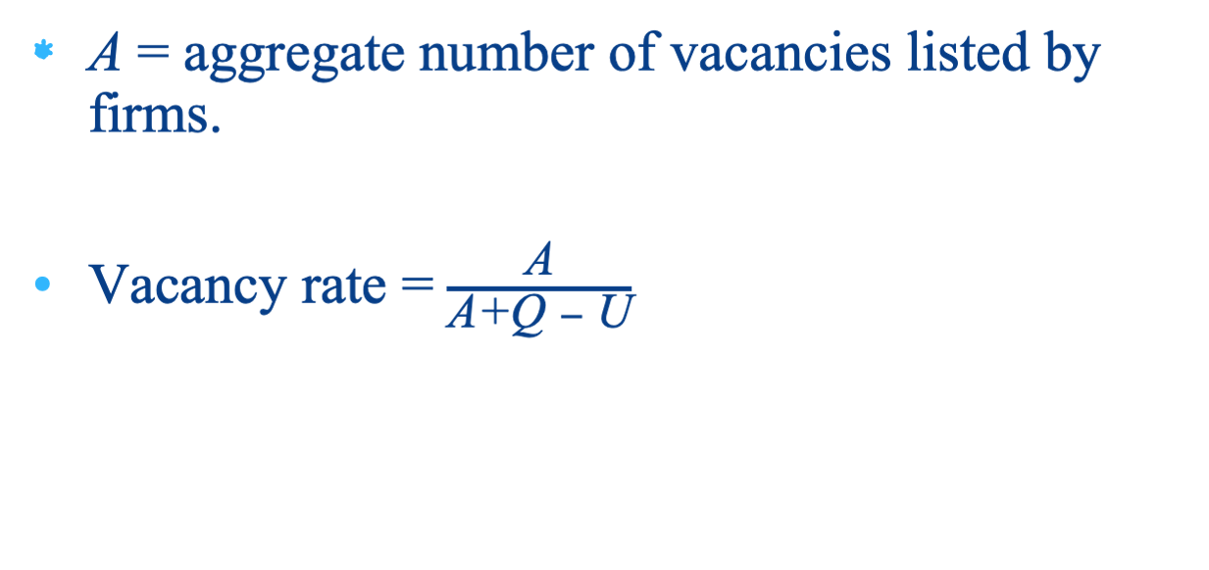
Vacancies and Unemployment
Notes:
The vacancy rate is a useful measure of available job openings in the economy.

Slide 13
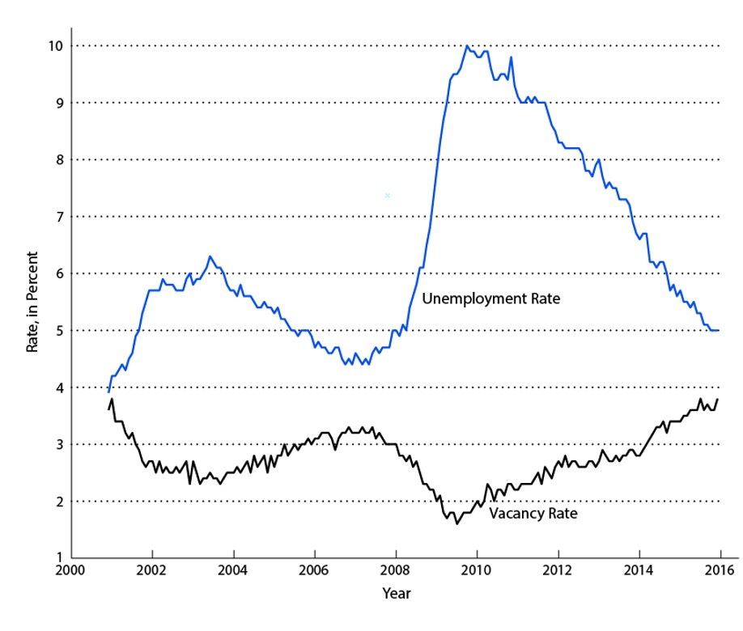
Figure 6.7 The Vacancy Rate and Unemployment Rate
Notes:
In our two-sided search model, vacancies and unemployment will play an important role. Note that the unemployment rate and the vacancy rate tend to be negatively correlated in the data.

Slide 14
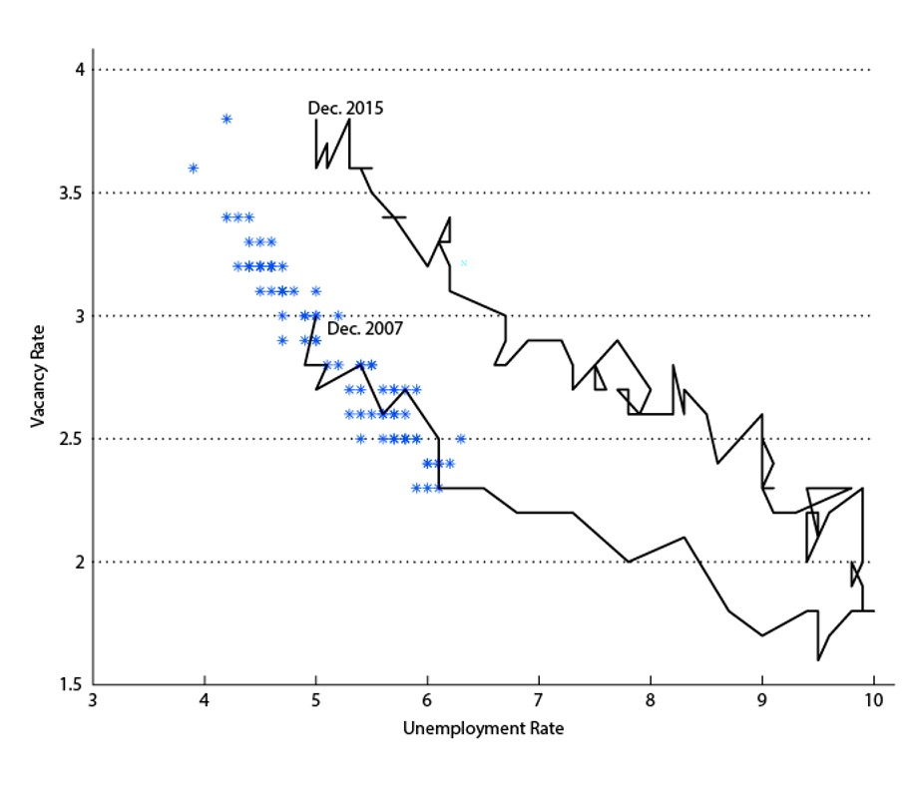
Figure 6.8 Beveridge Curve
Notes:
A key regularity in the data is the Beveridge curve – the negative relationship between the vacancy rate and the unemployment rate. The Beveridge curve has shifted out significantly since the beginning of the 2008-2009 recession.

Slide 15
Key Labor Market Observations
The unemployment rate is countercyclical.
The unemployment rate and the vacancy rate are negatively correlated (the Beveridge curve).
The Beveridge curve shifted out during the last recession.
Notes:
This slide is a summary of the key labor market observations from the previous slides.

Slide 16
The One-Sided Search Model
Focuses on the behavior of an unemployed worker.
Unemployed worker receives wage offer with probability p.
Wage offer w either accepted, or unemployed worker turns down the offer and continues to search.
All workers are either employed or unemployed. Not-in-the-labor-force not modeled.
Notes:
The one-sided search model is what we would call a “partial equilibrium” model, that treats the demand side of the labor market as exogenous, and focuses only on the behavior of the unemployed. An unemployed worker receives wage offers and must decide what offers to turn down, and what offers to accept. Turning down an offer implies the worker will continue to search for work.

Slide 17
Welfare of the Employed and Unemployed
Welfare of an employed worker V_{e}(w) :
  decreases with the separation rate s.
  Welfare of an unemployed worker V_{u}:
  – increases with the UI benefit, b.
  – increases with p, the frequency with which the unemployed worker receives job offers.
Notes:
In analyzing the unemployed worker’s decisions, we need to analyze the welfare from employment, which depends on the wage earned and the separation rate from the job. As well the welfare from unemployment depends on the unemployment benefit and the chances of receiving a job offer.

Slide 18
Reservation Wage (1 of 2)
Reservation Wage: the wage w* at which the unemployed worker is just indifferent between accepting and declining a job offer.
  The unemployed worker turns down jobs with w < w*, and accepts jobs with w < w*.
Notes:
The reservation wage is an important concept. The unemployed worker will accept any offer above the reservation wage, and decline any offer below that. Once we know the determinants of the reservation wage, that will allow us to say a lot about the consequences for the unemployment rate.

Slide 19
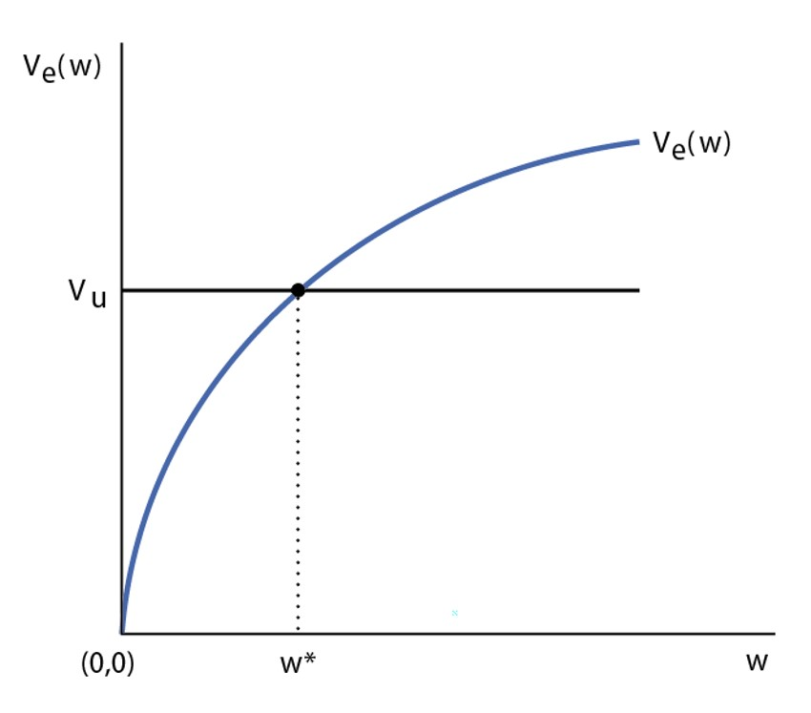
Reservation Wage
Notes:
The figure shows how the reservation wage is determined by the intersection of the welfare from employment function and the welfare from unemployment function.

Slide 20
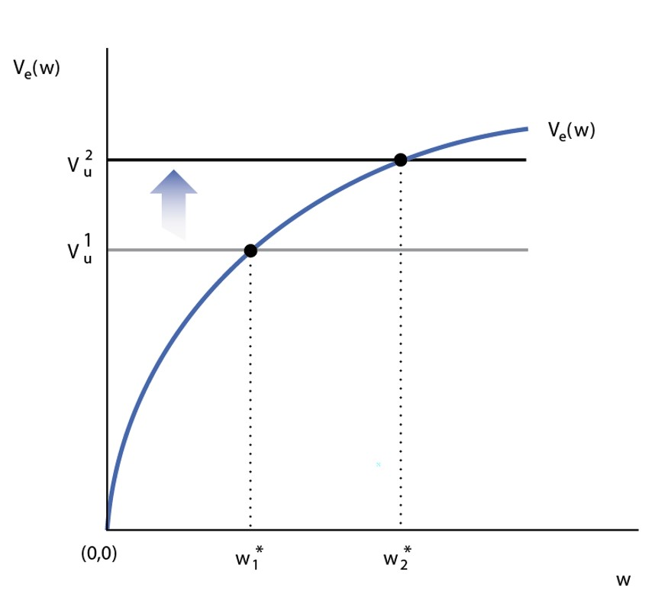
An Increase in the Unemployment
Insurance Benefit
Notes:
If the unemployment insurance benefit increases, this makes the reservation wage go up. Unemployment is then less painful, so the worker becomes more picky about which job offers to accept.

Slide 21
Determining the Unemployment Rate in the One-Sided Search Model
H(w) = Fraction of workers receiving a wage offer greater than w.
U = unemployment rate.
Long-run equilibrium: flow of workers from employment to unemployment equals the flow in reverse direction:
      s(1− U) = UpH (w*)
Notes:
Our next step is to determine the long-run unemployment rate given the reservation wage. In a long run equilibrium, the flow of workers from employment to unemployment is equal to the flow in the opposite direction. The flow of workers from employment to unemployment is determined by separations, while the flow in the other direction is determined by the number of unemployed workers who receive job offers above the reservation wage.

Slide 22
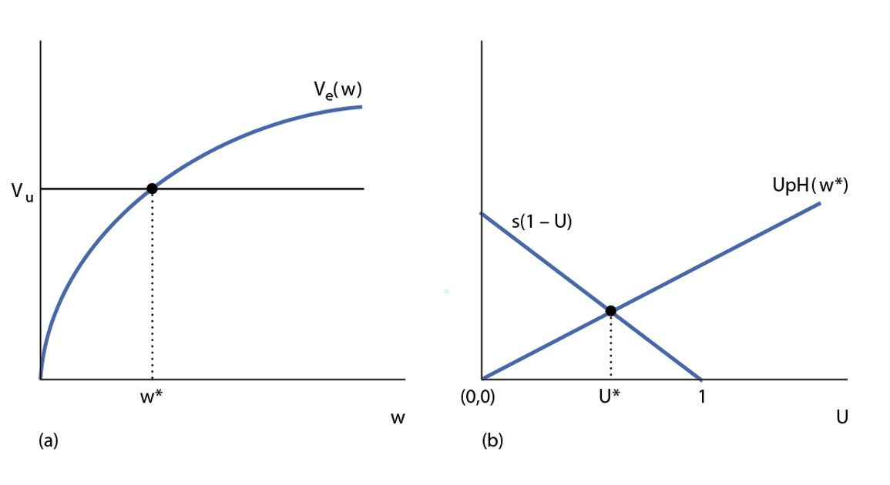
Determining the Reservation Wage and Unemployment Rate
Notes:
The figure shows the determination of the reservation wage and the unemployment rate. This is just a depiction of what is on the previous slide.

Slide 23
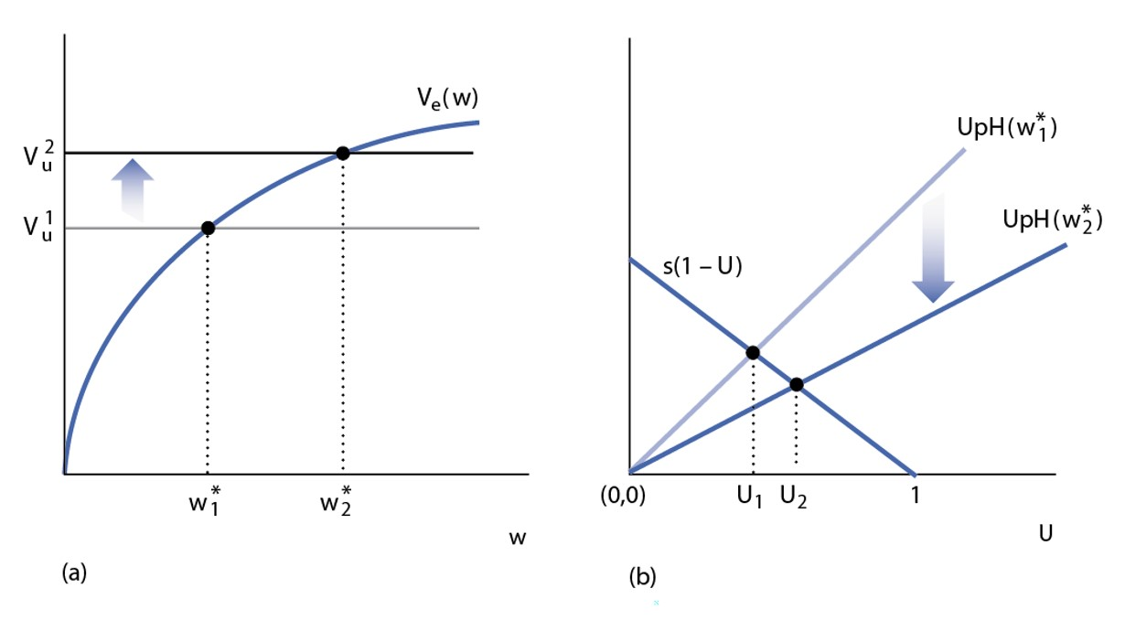
An Increase in the UI Benefit
Notes:
An increase in the UI benefit increases the reservation wage, which reduces the flow of workers from unemployment to employment. In the long run, the unemployment rate rises. This illustrates a disincentive effect of unemployment insurance.

Slide 24
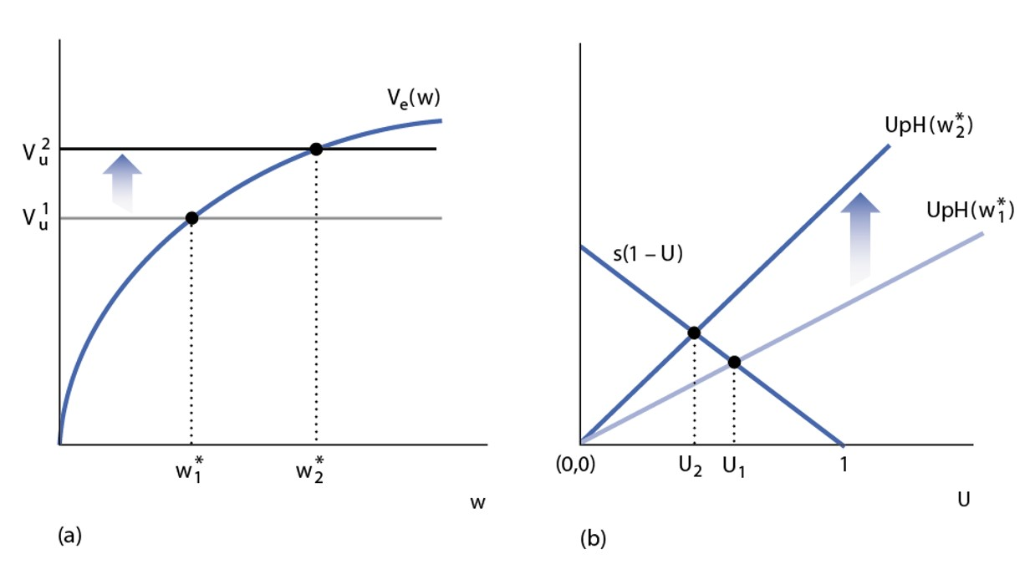
An Increase in the Job Offer Rate
Notes:
An increase in the job offer rate, for example because of better matching in the labor market, acts to increase the value of unemployment and increase the reservation wage. The increase in the reservation wage acts to reduce the flow of workers from unemployment to employment, but the increase in p acts to increase the flow. On net, it is not clear which way the net effect goes – the unemployment rate could rise or fall. In the figure the unemployment rate is shown to fall.

Slide 25
A Two-Sided Search Model of Unemployment
One-period model.
N consumers who can all potentially work, so N is the working age population.
Number of firms is endogenous.
Notes:
In the two-sided search model, we take account of both sides of the labor market, and include labor force participation. This follows work by Mortensen, Pissarides and Diamond (2010 Nobel prize). There are N consumers in the working age population, but the number of firms will be determined in the model.

Slide 26
Consumers in the Two-Sided Search Model
Each of the N consumers chooses whether to work outside the market (homework), or to search for work in the market.
Q = number of consumers who search for work
N-Q = not in the labor force
P(Q) = expected payoff to searching for work that would induce Q workers to search. P(Q) is essentially the supply curve for searching workers.
Notes:
An important part of the model is determining labor force participation. Each consumer has an alternative – work outside the market. Some Q is the number of consumers who choose to search for work, and P(Q) is the expected payoff of searching for work for the marginal person.

Slide 27
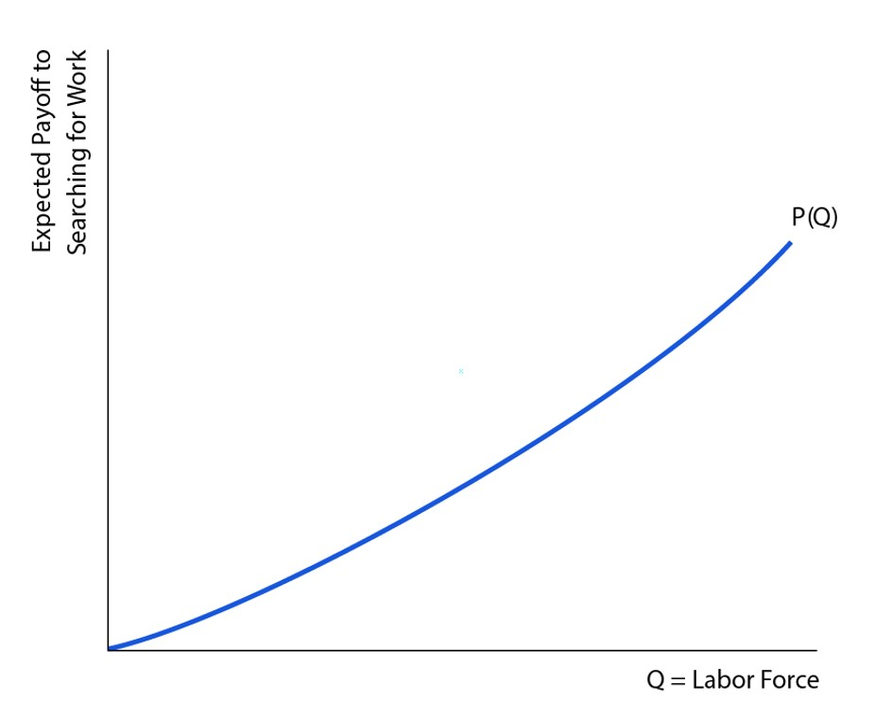
Figure 6.17 The Supply Curve of Consumers Searching for Work
Notes:
The figure shows the supply curve of consumers searching for work. Given Q, the number of people searching for work, the schedule tells us the expected payoff to working for the consumer who is just indifferent between homework and searching for work in the market.

Slide 28
Firms
A firm must post a vacancy in order to have a chance of matching with a worker.
k = cost of posting a vacancy, in units of consumption goods
A = number of active firms (firms posting vacancies)
Notes:
For firms, there is a cost posting a vacancy, and we will determine the number of active firms – the number posting job vacancies.

Slide 29
Matching
A successful match in the model is between one worker and one firm.
M = aggregate number of matches
e = matching efficiency
Matching function:
M = em(Q,A)
Notes:
Searching would-be workers are matched with firms posting vacancies. The matching function tells us how many successful matches there are, given the number of economic agents searching on each side of the labor market.

Slide 30
Properties of the Matching Function
The matching function has properties like a production function.
The “inputs,” Q and A, produce the “output” M, and e plays the same role as total factor productivity in the production function.
The matching function has constant returns to scale, positive marginal products, and diminishing marginal products.
Notes:
We need to assume particular properties for the matching function, to make the model work. Basically, the matching function has properties like a production function – it takes the inputs of searching would-be workers and searching firms, and produces output – successful matches.

Slide 31
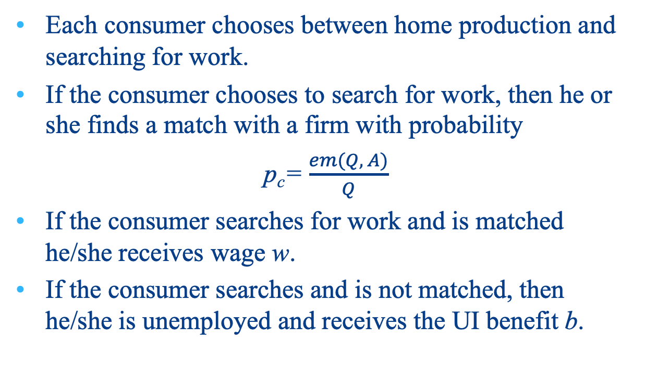
Supply Side of the Labor Market:
Optimization by Consumers
Notes:
On the supply side of the labor market, a key variable is the probability of a successful match for a would-be worker, which is the number of successful matches divided by the number of people searching for work. If the consumer is matched with a firm, he or she earns the market wage w. Otherwise, he or she gets the unemployment insurance benefit.

Slide 32
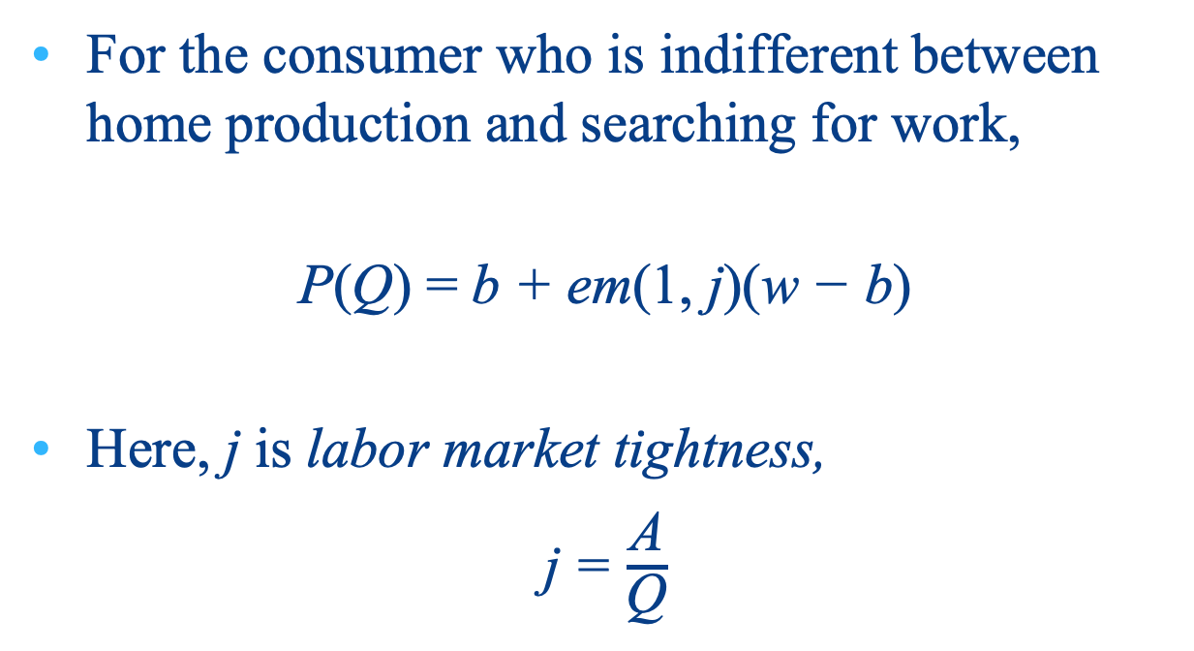
Marginal Consumer
Notes:
For the marginal consumer who is just indifferent between searching for work and staying at home, the payoff from staying at home is equal to the expected payoff from search.

Slide 33
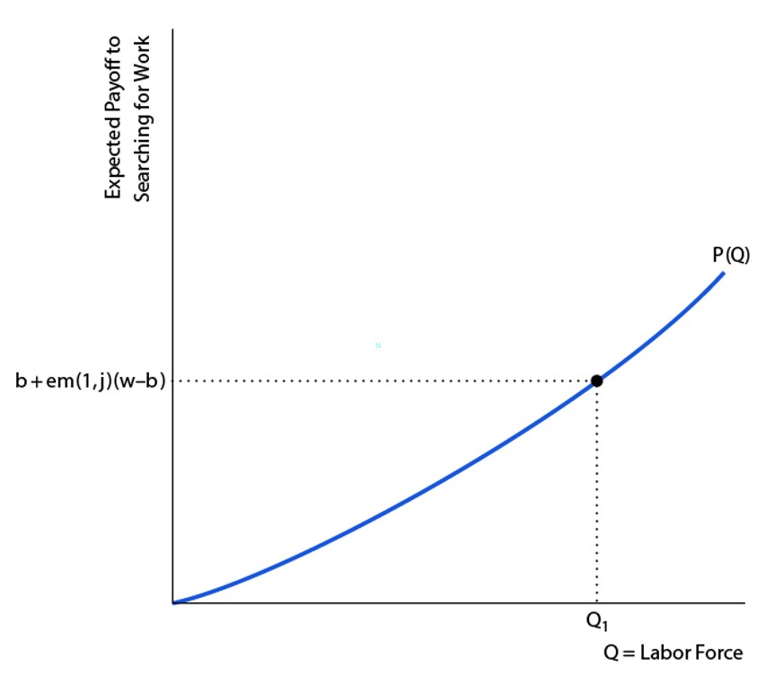
Figure 6.18 The Supply Side of the Labor Market
Notes:
This figure illustrates what was on the previous slide. The expected payoff from searching for work determines the number of people searching, Q.

Slide 34
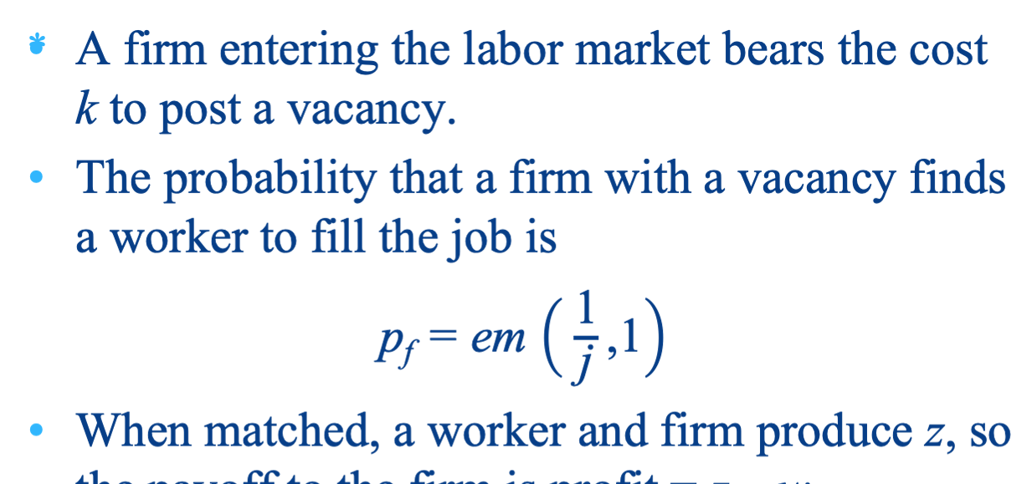
Demand Side of the Labor Market
Notes:
On the demand side of the labor market, would-be firms are also concerned with the expected payoff from searching. If a firm posts a job vacancy, at cost k, then there is some probability of matching with a worker, which is determined by labor market tightness, j = A/Q. The payoff for the firm in a match is profit, z – w, i.e. what is produced in the match minus the wage.

Slide 35
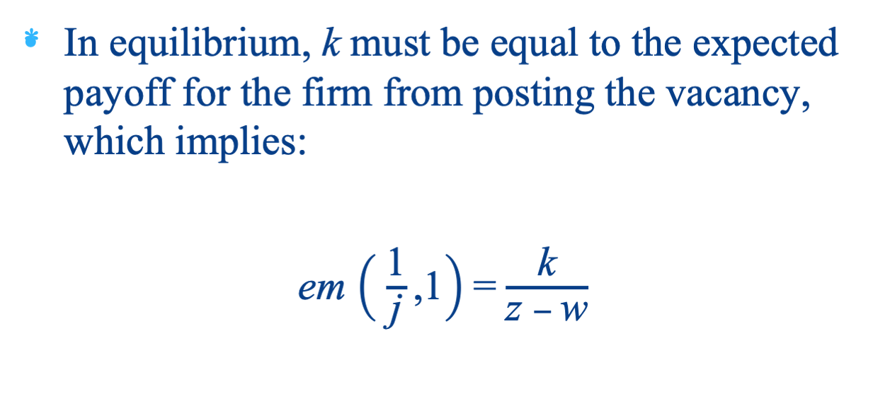
Expected Net Payoff for a Firm Posting a Vacancy is Zero in Equilibrium
Notes:
In equilibrium, each firm will be just indifferent to posting a vacancy – the expected payoff is zero. This implies the equation on the slide.

Slide 36
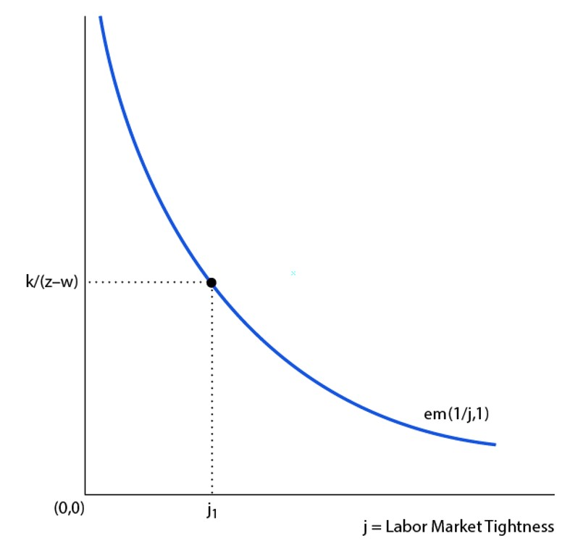
Figure 6.19 Demand Side of the Labor Market
Notes:
We can depict the firm’s decision on the slide. Given the ratio of the cost of posting a vacancy to a firm’s profit, we determine labor market tightness.

Slide 37
Nash Bargaining
Use Nash bargaining theory to determine how a matched firm and worker split the total revenue from production.
Worker’s surplus = w – b (wage minus UI benefit)
Firm’s surplus = z – w (profit)
Total surplus = z – b
a = worker’s share of total surplus (“bargaining power”)
w = az + (1 – a)b
Notes:
The last detail in the model is how the wage is determined, i.e. how the surplus from exchange is split between the worker and the firm. The worker and firm have to bargain, and a simple bargaining rule is the Nash bargaining rule. Assuming the worker’s share of the total surplus is a constant, the formula on the slide determines the wage, which depends on output produced in the match and the UI benefit.

Slide 38
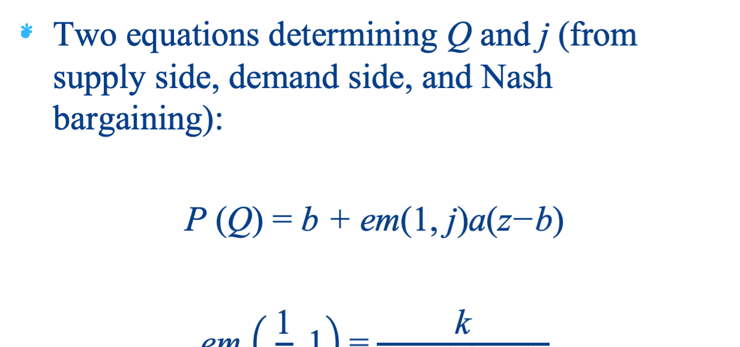
Equilibrium
Notes:
Then, using the Nash bargaining solution, we can obtain 2 equations that solve for Q and j. All of the experiments we do will involve determining how Q and j change with given changes in exogenous variables.

Slide 39
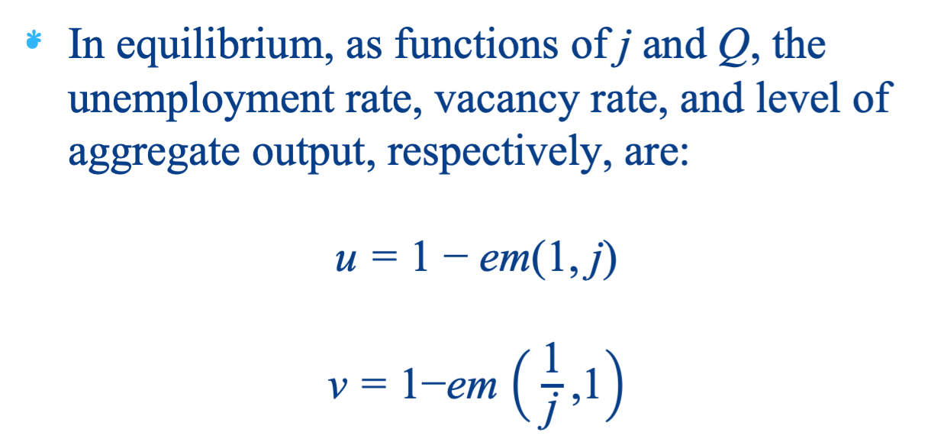
Equilibrium Unemployment Rate, Vacancy Rate, and Aggregate Output
Notes:
Once we know Q and j, we can work backward to solve for the unemployment rate, vacancy rate, and output.

Slide 40
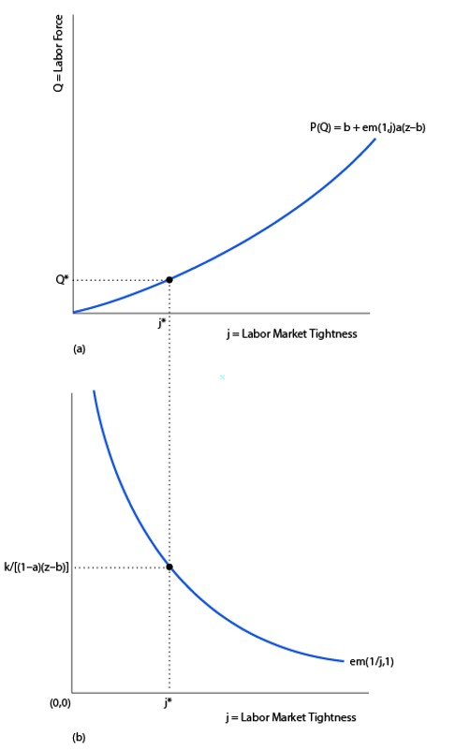
Figure 6.20 Equilibrium in the Two-Side Search Model
Notes:
This diagram will be what we use to analyze the model. The model solves by determining j in the bottom panel first, then determining Q given j in the top panel.

Slide 41
Working with the Two-Sided Search Model: 3 Experiments
Increase in the UI benefit b.
Increase in productivity z.
Decrease in matching efficiency e.
Notes:
We will look at three experiments. These are useful because: (i) looking at the effects of the UI benefit gives us more information, in addition to what we know from the one-sided model; (ii) productivity shocks will tie in our analysis with Chapters 5, 11, and 13; (iii) a change in matching efficiency is informative about what was going on in the 2008-2009 recession.

Slide 42
Increase in the UI Benefit, b
Reduces total surplus from a match, z – b.
Increases the wage, w, as the alternative to working becomes more tempting for a searching consumer.
Posting vacancies becomes less attractive for firms, so labor market tightness, j, falls.
For consumers, searching for work becomes more attractive, as the wage is higher. But searching for work is also less attractive, as the chances of finding a job are lower (j is lower).
Q may rise or fall given these two opposing effects.
u rises and v falls.

Slide 43
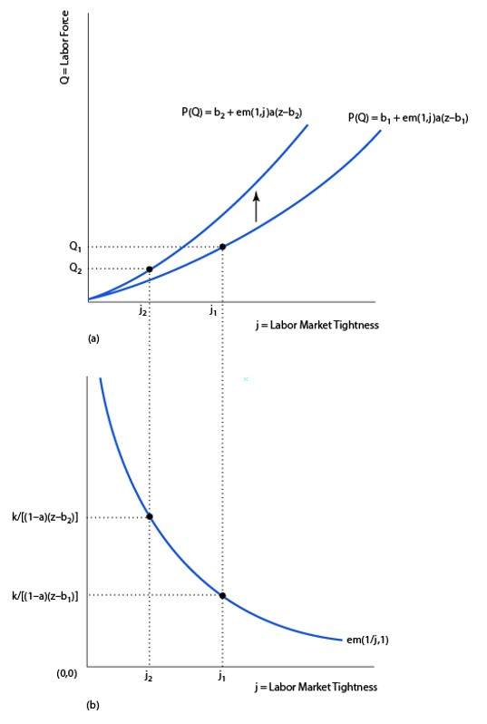
Figure 6.21 An Increase in the UI Benefit (b)
Notes:
The increase in the UI benefit acts to increase the payoff to searching for work for a consumer. However, it also raises the market wage, because firms have to pay workers more, as the workers have a better outside option. The higher wage causes fewer firms to post vacancies, and labor market tightness falls. Thus, searching is more attractive for consumers because wages and UI benefits are higher, but the chances of getting a job a lower, so Q could rise or fall. The unemployment rate rises, and the vacancy rate falls. Thus, we get the same result as in the one-sided model, that the unemployment rate rises with UI benefits, but for a different reason.

Slide 44
An Increase in Productivity
Increases the total surplus from a match, z – b.
Increases the wage, w, as the worker gets the same share of a larger pie.
As profit is higher, posting vacancies becomes more attractive for firms, so labor market tightness, j, rises.
For consumers, searching for work becomes more attractive, as the wage is higher, and the chances of finding work are better.
Q rises, u falls, v rises, Y rises.

Slide 45
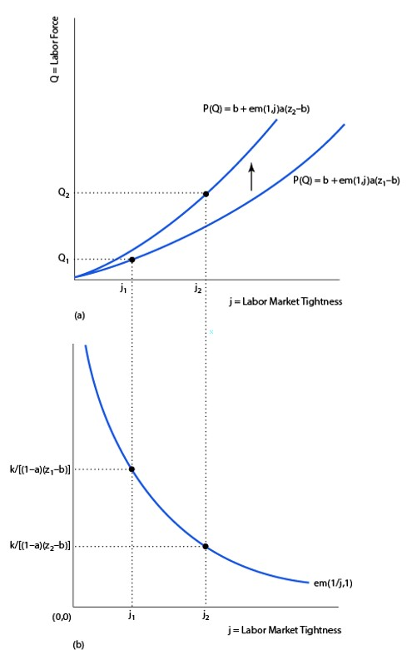
Figure 6.22 An Increase in Productivity
Notes:
Higher productivity increases the payoff to posting vacancies for firms, and this tends to increase labor market tightness. More consumers are induced to search for work, because wages and labor market tightness are higher. The unemployment rate falls, the vacancy rate rises, and output rises.

Slide 46
A Decrease in Matching Efficiency (1 of 2)
No change in total surplus, or in the wage.
Chances of finding a worker are lower, so fewer firms post vacancies and j falls.
For consumers searching is less attractive – the wage is the same, but the chances of finding a job are lower, so Q falls.
u rises, but vacancy rate stays the same, and Y falls.
Potential explanation for the shifting Beveridge curve.

Slide 47
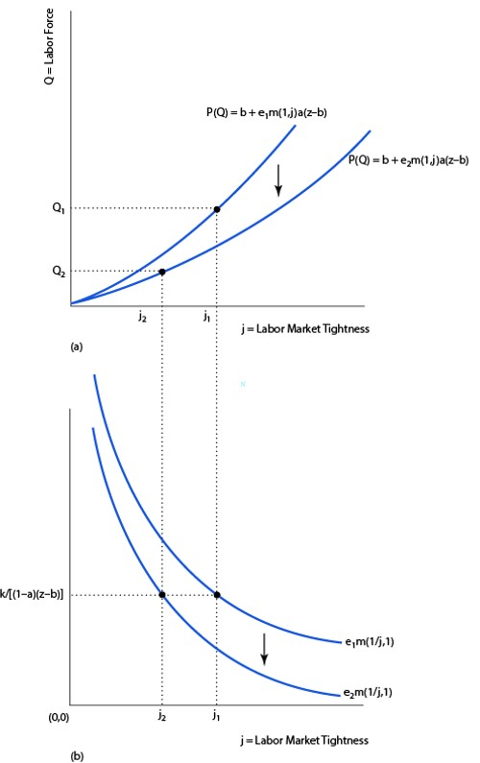
A Decrease in Matching Efficiency (2 of 2)
Notes:
This experiment provides a potential explanation for the recent rightward shift in the Beveridge curve. With lower matching efficiency, labor market tightness falls. Lowering matching efficiency along with lower labor market tightness reduces the chances of finding work for consumers. This reduces labor force participation and increases the unemployment rate, but the vacancy rate does not change.

